Slide 1

Course Orientation on the California Health
Care Delivery System
Assembly Bill 1045 of
the State of California

Slide 2
Authors
Clinica de Salud del Valle de Salinas
Natividad Medical Center, and National Autonomous University of Mexico (UNAM)
California State University Monterey Bay (CSUMB)
California State University Long Beach (CSULB)
NCLR/CSULB Center for Latino Community Health
University of California, Davis

Slide 3
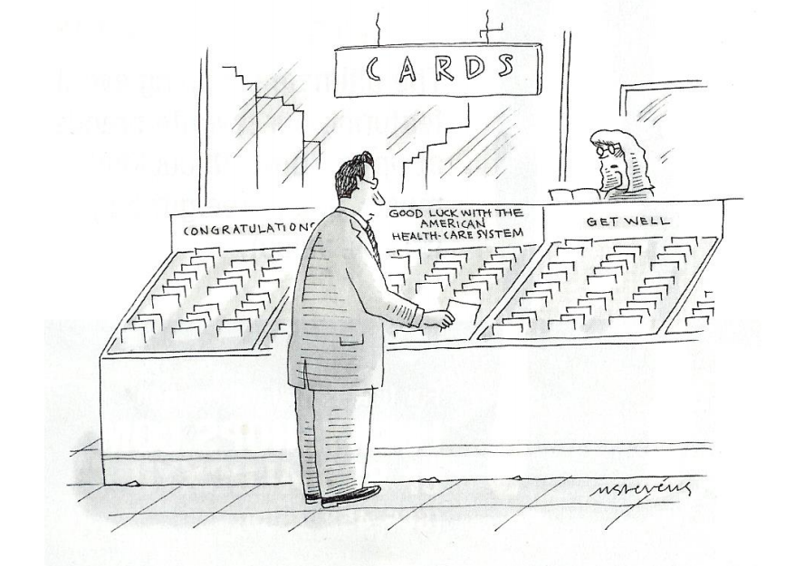
GOOD LUCK WITH
THE AMERICAN
HEALTH-CARE
SYSTEM

Slide 4
INTRODUCTION
This Orientation Course of the California Health Care Delivery System was generated in response to the requirements set forth in AB 1045 of the State of California and approved by Governor Gray Davis on September 30th, 2002.
AB 1045 allows 30 physicians from Mexico to participate as part of a pilot project, in the care of patients served by community health centers in the State of California for a period of three years.

Slide 5
INTRODUCTION continued
This course includes aspects about the administration and operation of clinics and hospitals, the processes of the California medical delivery system, health maintenance organizations and managed care practices, the differences in the pharmacological management as compared to those in Mexico, as well as medical protocols, community clinic history and operations, professionalism and medical ethics.

Slide 6
INTRODUCTION continued
The curriculum will provide a practical understanding of the areas defined by this law and lead to the proper insertion of capable physicians into the Health Care Delivery System of California.

Slide 7
OBJECTIVE
To provide the necessary administrative, ethical, legal and medical knowledge foundation so that you will be able to apply, analyze, and synthesize that information to work in the Community Health Clinics in the State of California by meeting the requirements of the California Law AB 1045.

Slide 8
PROGRAM LEARNING OUTCOMES
#1: Demonstrate an ability to describe, compile, and implement, analyze, and synthesize medical protocols and quality assurance practices that meet California law and medical standards.

Slide 9
PROGRAM LEARNING OUTCOMES
#2: Demonstrate knowledge of the California medical delivery system with an emphasis on applying, analyzing, and synthesizing that foundational knowledge to community health centers.

Slide 10
PROGRAM LEARNING OUTCOMES
#3: Demonstrate an awareness of the ability to apply, analyze, and synthesize the responsiveness to the health care needs of California’s diverse patient population.

Slide 11
PROGRAM LEARNING OUTCOMES
#4: Demonstrate knowledge of ethical practice and legal and regulatory requirements as a foundation to apply, analyze, synthesize those issues relating to ethical practice in California.

Slide 12
PROGRAM LEARNING OUTCOMES
#5: Demonstrate an understanding of differences in pharmacology and prescribing practices in the United States in comparison to Mexico then to use that as a foundation to apply, analyze, and synthesize that information for patient care in California.

Slide 13

Table of contents
INSTRUCTIONAL MODULES
HEALTH PROFILE OF CALIFORNIA’S POPULATION
OVERVIEW OF HEALTH SYSTEMS IN CALIFORNIA
MEDICAL ADMINISTRATION AND SERVICE DELIVERY STRUCTURES IN COMMUNITY HEALTH SETTINGS
MEDICAL PROTOCOLS AND QUALITY ASSURANCE
PROFESSIONALISM, ETHICS, AND BIOETHICS
PHARMACOLOGY
MEDICAL REVIEW (CASE STUDIES AND RESOURCES)

Slide 14
Module one
HEALTH PROFILE OF CALIFORNIA’S POPULATION
Socio-demographic Profile of the Population
Epidemiological Profile of the Population
Burden of Disease
Opioid Crisis as an American Problem in California

Slide 15
MODULE TWO
Overview of health systems in California
California Health System
California Medical Management
Health Laws and Regulations
Managed Care and Health Maintenance Organizations
California Public Health System

Slide 16
MODULE THREE
MEDICAL ADMINISTRATION AND SERVICE DELIVERY STRUCTURES IN COMMUNITY HEALTH SETTINGS
History of Community Health Centers in California
Federally Qualified Health Centers (FQHCs)
Governance and Organizational Structure of Community Health Centers
Health Clinic Policies and Procedures
Patient Centered Medical Home (PCMH) and Integrated Care Teams and Communication
Process of Care in Health Clinics
Referral System and Patient Transfer
Risk Management, Federal Torts Claims Act, and Professional Liability

Slide 17
MODULE FOUR
MEDICAL PROTOCOLS AND QUALITY ASSURANCE
Levels of Care
Diagnostic and Treatment Protocols
Electronic Medical Records (EMRs)
Quality Care Structures and Peer Review
System Certification and Accreditation, Quality of Medical Units and Staff, Joint Commission and National Committee for Quality Assurance (NCQA)
Clinical Pathways, Evidence Based Medicine, Population Health, and Pay for Performance
Patient Satisfaction
Mandatory Reporting including HEDIS Measures

Slide 18
MODULE FIVE
PROFESSIONALISM, ETHICS, AND BIOETHICS
Physician Professionalism and Responsibilities
Introduction of Ethics and Bioethics
Human Rights
Ethical Decision-Making
Conflict of Interest
Patient Rights and Responsibilities

Slide 19
MODULE SIX
PHARMACOLOGY
US Food and Drug Administration (FDA)
Medication: FDA- and not FDA-approved
Pharmacologic Protocols for Common Diseases
Prescriptions in Clinical Practice: The Role of the Physician and the Pharmacologist
Alternative Medication Practices

Slide 20
MODULE SEVEN
MEDICAL REVIEW (CASE STUDIES AND RESOURCES)
Abbreviations Commonly Used in Medicine
Clinical Case Studies
Tools and Resources

