Slide 1

MODULE ONE:
HEALTH PROFILE OF CALIFORNIA’S
POPULATION

Slide 2
MODULE ONE:
SECTION one:
SOCIO-DEMOGRAPHIC
OF THE POPULATION

Slide 3
Unit Objective
To increase knowledge of the geographical distribution of the population in the state of California and to apply, analyze, and synthesize that information to better care for your patients.

Slide 4
SOCIO-DEMOGRAPHIC
PROFILE OF POPULATION
Population pyramid
Distribution by ethnic groups (minorities)
Socioeconomic status
Languages spoken
Specific patient profile in community health clinics

Slide 5
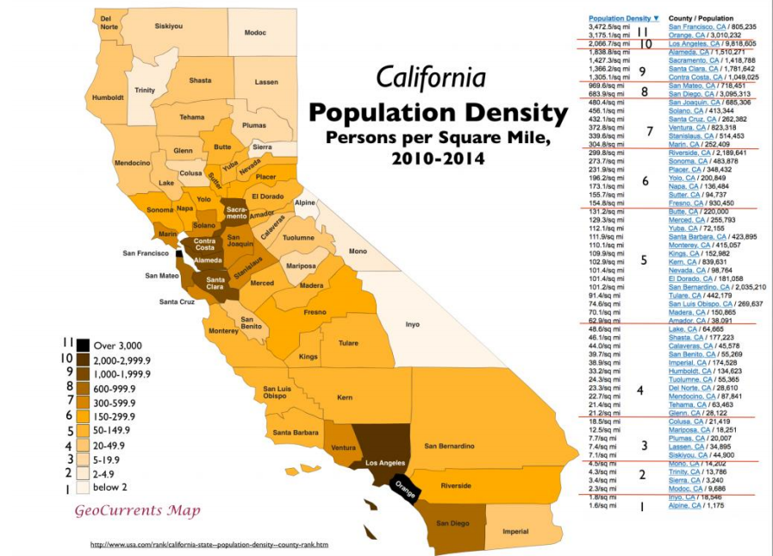
THE HIGHEST POPULATION
DENSITY IS IN THE
BAY AREA AND
LOS ANGELES AREA
QUESTION TO FOLLOW

Slide 6
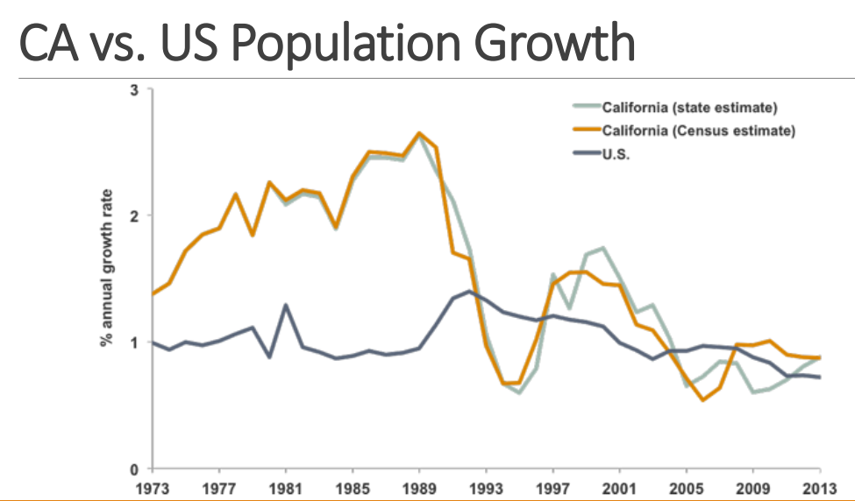
Source: Public Policy Institute of California
THE POPULATION
GROWTH FOR
CALIFORNIA IS
HIGHER THAN THE
US AVERAGE

Slide 7
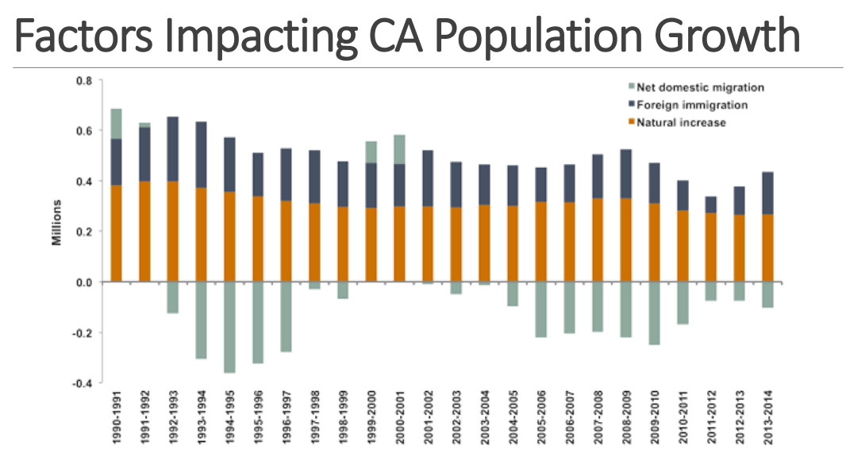
SOCIO-DEMOGRAPHIC PROFILE OF POPULATION
FOREIGN
IMMIGRATION
PLAYS A LARGE
ROLE IN
POPULATION
GROWTH
QUESTION TO FOLLOW

Slide 8
1. Which factor has contributed most to the recent decrease in California’s population?
  Net domestic migration
  Foreign immigration
  Natural increase
  Foreign naturalism

Slide 9
1. Which factor has contributed most to the recent decrease in California’s population?
  a) Net domestic migration
  Foreign immigration
  Natural increase
  Foreign naturalism

Slide 10
CA Population by Age and Gender
California has a younger population than the total US population
Although the majority of the CA population is under the age of 18 years (23.3%), the fastest growing age group is 65-74 year-olds
CA’s median age is 36.2 years
CA’s population is equally distributed by gender
Female (50.3%); Male (49.7%)
Source: 2015 American Community Survey 1-Year Estimates
QUESTION TO FOLLOW

Slide 11
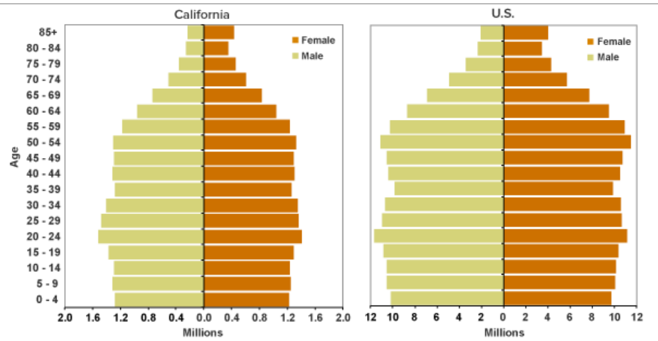
California vs. US Population by Age and Gender, 2013
Source: Public Policy Institute of California
CALIFORNIA HAS
A YOUNGER
POPULATION THAN
THE US OVERALL

Slide 12
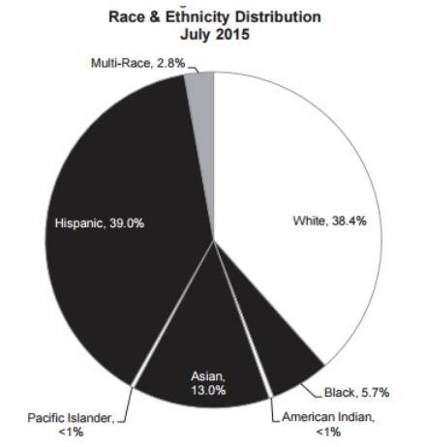
California Population by Race/Ethnicity, 2015
Majority Minority state
The majority of the CA population is Hispanic (39%)
Asians are the 3rd largest group in CA (13%)
QUESTION TO FOLLOW

Slide 13
2. What is the state of California known as when referring to race/ethnicity?
“Majority” State
“Minority” State
“Hispanic” State
“Majority Minority” State

Slide 14
2. What is the state of California known as when referring to race/ethnicity?
“Majority” State
“Minority” State
“Hispanic” State
“Majority Minority” State

Slide 15
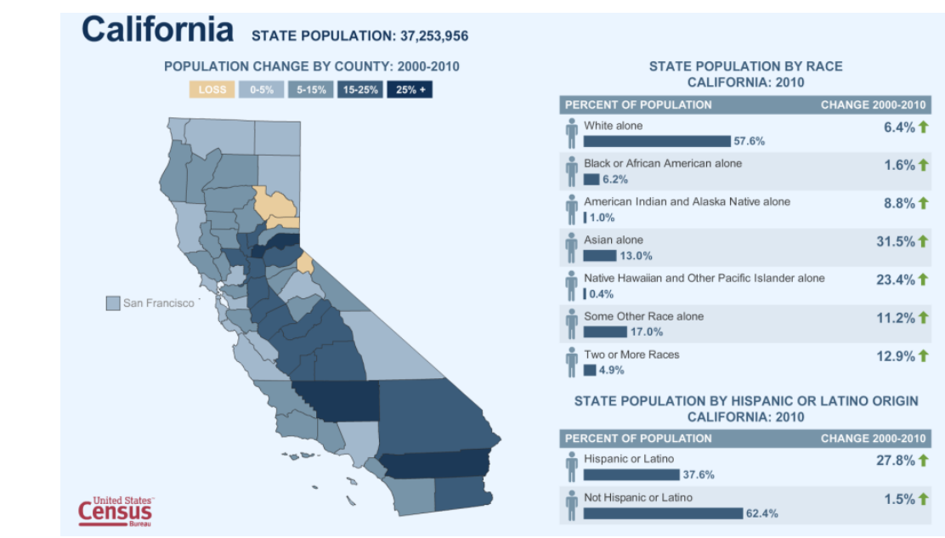
SOCIO-DEMOGRAPHIC PROFILE OF POPULATION
THE HISPANIC AND
ASIAN POPULATION
ARE GROWING AT
THE HIGHEST RATE

Slide 16
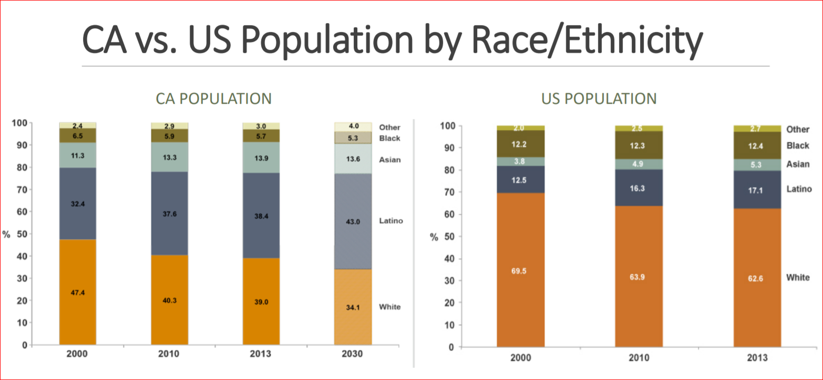
Source: public policy institute of california
SOCIO-DEMOGRAPHIC PROFILE OF POPULATION
QUESTION TO FOLLOW

Slide 17
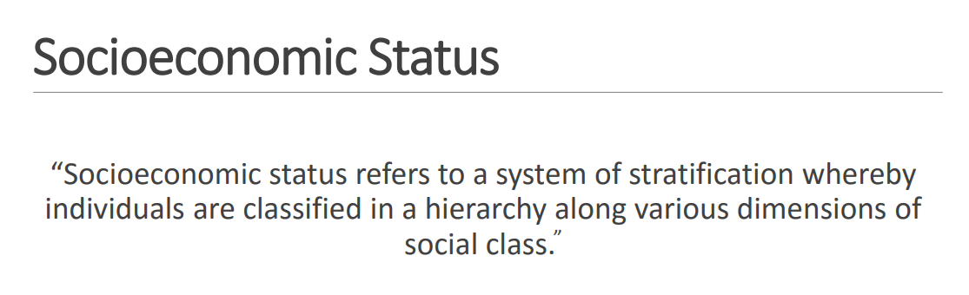
SOCIO-DEMOGRAPHIC
PROFILE OF POPULATION
LaVeist, 2009
QUESTION TO FOLLOW

Slide 18
Measures of Socioeconomic Status
Income: personal, family, and household
Poverty level
Education
Occupation
Occupational Status
Wealth
QUESTION TO FOLLOW

Slide 19

Measures of Socioeconomic Status
INCOME
Median annual household income: $61,818
Mean annual household income: $87,877
The majority of the CA population has an annual household income between $50,000 - $74,999 (16.7%)
Source: 2011-2015 American Community Survey 5-Year Estimates
QUESTION TO FOLLOW

Slide 20
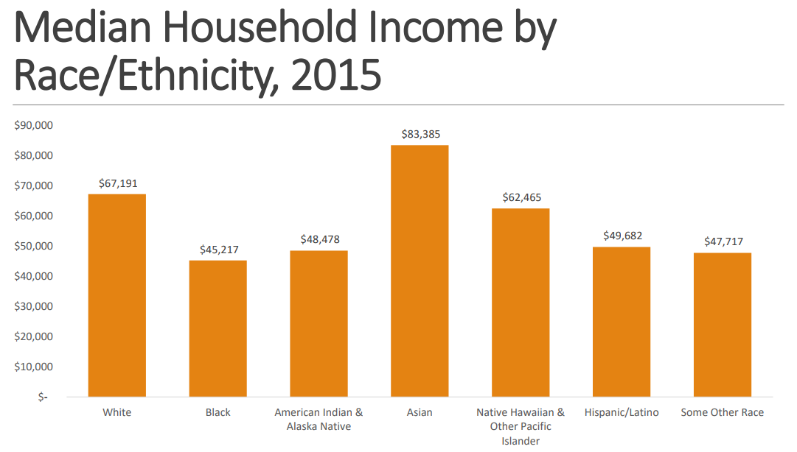
Measures of Socioeconomic Status Source: 2015 American Community Survey 1-Year Estimates
QUESTION TO FOLLOW

Slide 21
Measures of Socioeconomic Status
Poverty Level
Overall about 4 out of 10 Californians are living in or near poverty
Minorities and less educated Californians have higher poverty rates
Children under the age of 18 years are at highest risk for living in or near poverty

Slide 22
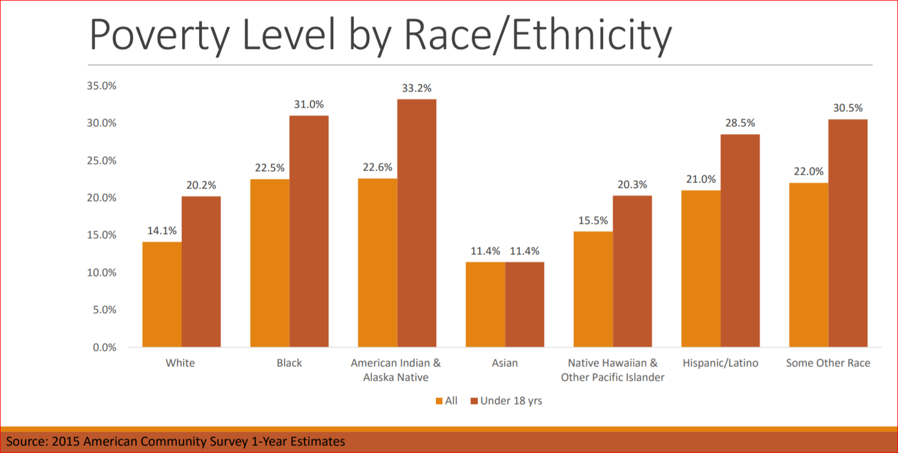
Measures of Socioeconomic Status

Slide 23
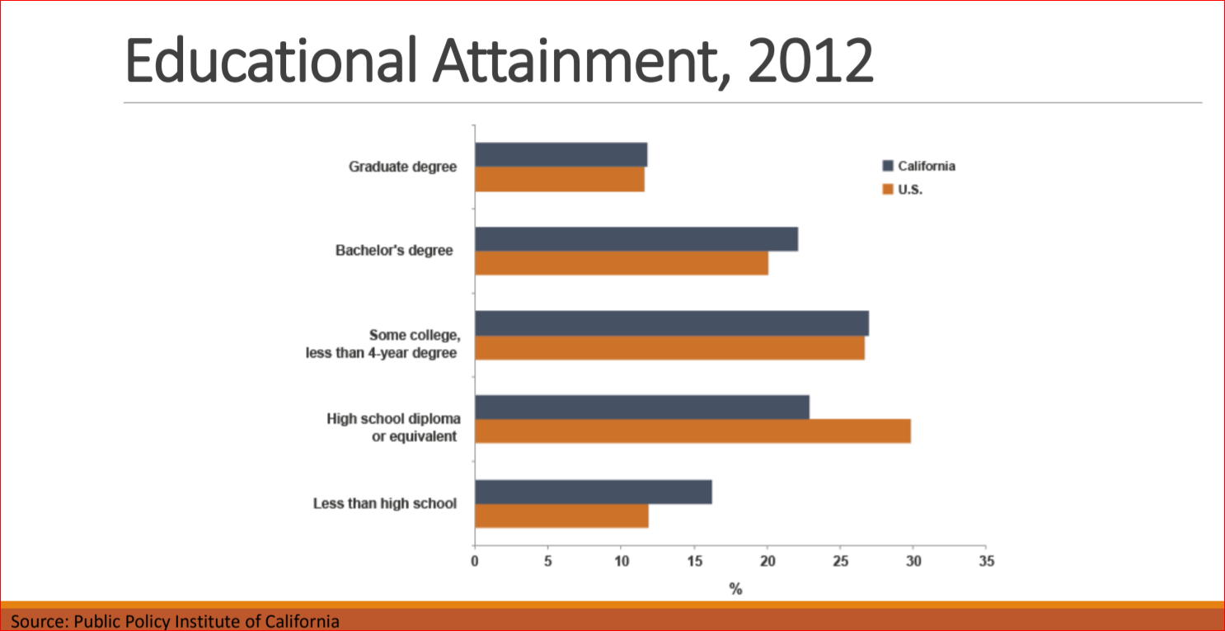
Measures of Socioeconomic Status

Slide 24
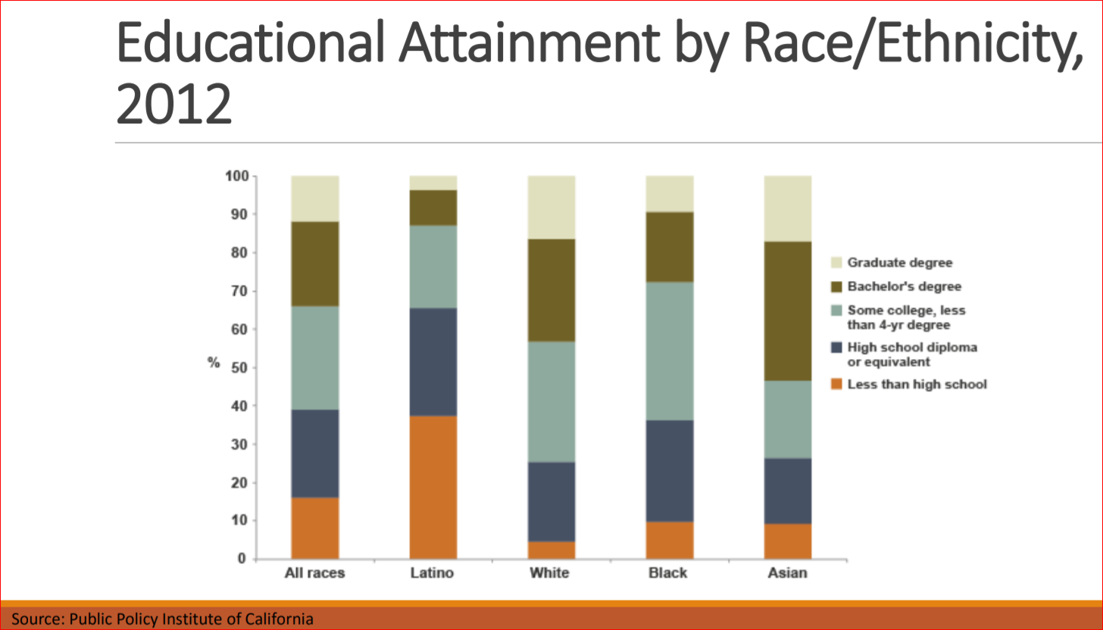
SOCIO-DEMOGRAPHIC PROFILE OF POPULATION

Slide 25
Source: 2011-2015 American Community Survey 5-Year Estimates
Educational Attainment
Measures of Socioeconomic Status
Over 80% of the CA population has a high school degree or higher
31.4% has a bachelor’s degree or higher
Hispanics have the lowest rates of attaining a high school degree or higher
QUESTION TO FOLLOW

Slide 26
3. Which racial/ethnic group has the lowest rates of educational attainment for California?
a) White
b) Hispanic/Latino
c) Black
d) Asian
e) Some other race

Slide 27
3. Which racial/ethnic group has the lowest rates of educational attainment for California?
a) White
b) Hispanic/Latino
c) Black
d) Asian
e) Some other race

Slide 28
Source: 2011-2015 American Community Survey 5-Year Estimates
Employment
SOCIO-DEMOGRAPHIC
PROFILE OF POPULATION
Population 16 years and older in the labor force: 63.6%
CA unemployment rate: 9.9%
The majority of the CA population is employed in management, business, science, and arts occupations (37.3%)
QUESTION TO FOLLOW

Slide 29
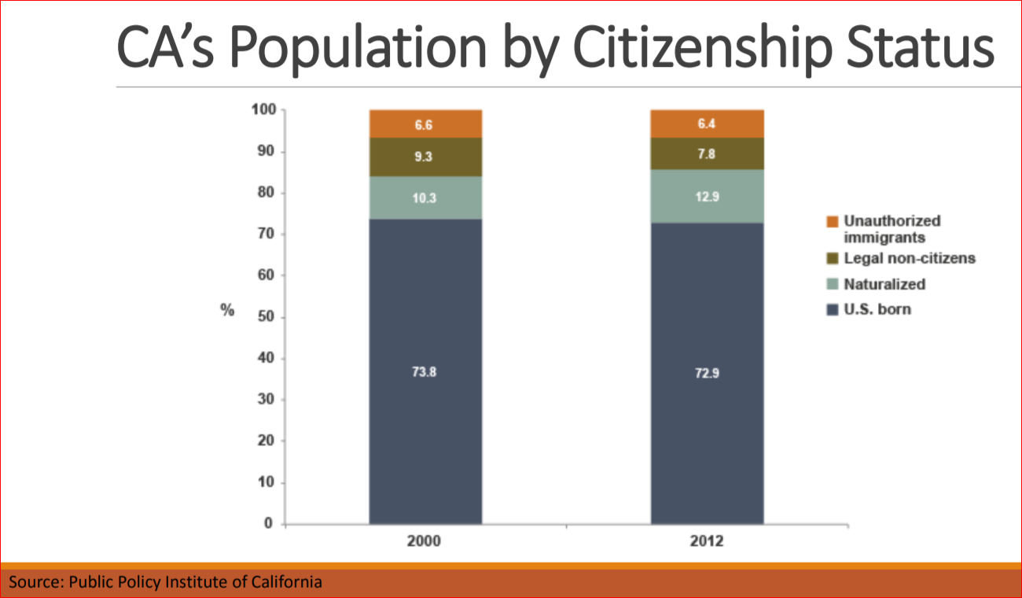
SOCIO-DEMOGRAPHIC PROFILE OF POPULATION

Slide 30
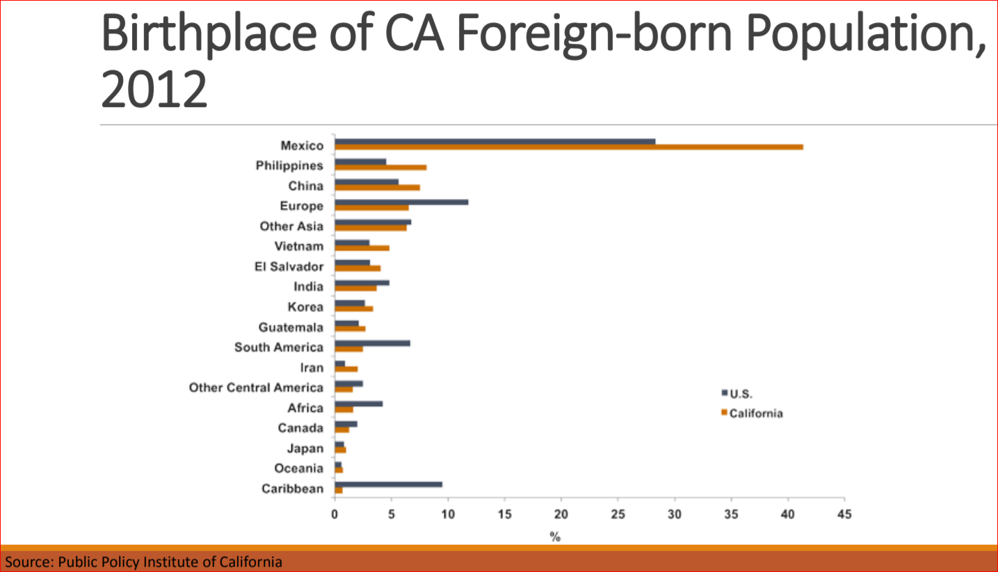
SOCIO-DEMOGRAPHIC PROFILE OF POPULATION
QUESTION TO FOLLOW

Slide 31
4. According to the Public Policy Institute of California these three countries have the highest percentile of foreign-born Californian’s in 2012:
a) Mexico, Central America, Other Asia
China, Mexico, Central America
South America, China, El Salvador
Mexico, Philippines, China

Slide 32
4. According to the Public Policy Institute of California these three countries have the highest percentile of foreign-born Californian’s in 2012:
a) Mexico, Central America, Other Asia
China, Mexico, Central America
South America, China, El Salvador
Mexico, Philippines, China

Slide 33
Source: 2011-2015 American Community Survey 5-Year Estimates
Languages Spoken
SOCIO-DEMOGRAPHIC PROFILE OF POPULATION
Percent limited English-speaking households: 9.5%
Households speaking…
Spanish: 25.3%
Other Indo-European Languages: 5.8%
Asian and Pacific Island Languages: 10.5%
Primarily Chinese, Vietnamese, Korean, and Tagalog
Other Languages: 1.1%
QUESTION TO FOLLOW

Slide 34
5. Primary language other than English spoken in California is:
a) Spanish
b) Chinese
c) Vietnamese
d) Tagalog

Slide 35
5. Primary language other than English spoken in California is:
a) Spanish
b) Chinese
c) Vietnamese
d) Tagalog

Slide 36
CONCEPTUAL HIGHER LEARNING
How will you be able to use your increased knowledge of the geographical distribution of the population in the state of California and to apply, analyze, and synthesize that information to better care for your patients? Please select all that apply.
Sense of fulfillment by understanding that there the patients being served by yourself do not have the same level of opportunity for health care services if it were not for like minded individuals like your self that have chosen to engage in their health care services.
Sense of commitment to use Spanish speaking language skills to serve a population that will be predominately Spanish speaking.
Knowledge to understand that my services as a physician will be overall well received and valuable to the population served.

Slide 37
CONCEPTUAL LEARNING OPPORTUNITY
How will you be able to use your increased knowledge of the geographical distribution of the population in the state of California and to apply, analyze, and synthesize that information to better care for your patients? Please select all that apply.
Sense of fulfillment by understanding that there the patients being served by yourself do not have the same level of opportunity for health care services if it were not for like minded individuals like your self that have chosen to engage in their health care services.
Sense of commitment to use Spanish speaking language skills to serve a population that will be predominately Spanish speaking.
Knowledge to understand that my services as a physician will be overall well received and valuable to the population served.

