Slide 1

MODULE ONE:
HEALTH PROFILE OF CALIFORNIA’S
POPULATION

Slide 2
MODULE ONE:
SECTION two:
Epidemiological
Profile of the
populati0n

Slide 3
Unit Objective
To understand the main risks to the health of California’s population by regions and ethnic groups then to use that information to apply, analyze, and synthesize that information to better care for patients.

Slide 4
epidemiological
PROFILE OF the POPULATION
Morbidity
Mortality
Social determinants of health
Most common causes for seeking consultations in health clinics
Common diseases in vulnerable populations
Urban/Rural setting differences

Slide 5
HIV/AIDS Epidemic
In 2015, an estimated 39,393 people in the United States were diagnosed with HIV, the virus that causes AIDS. About 1 in 7 people with HIV in the United States do not know that they are infected.
In 2015, an estimated 4,720 adults and adolescents were diagnosed with HIV in California. California ranked 2nd among the 50 states in the number of HIV diagnoses in 2015.
QUESTION TO FOLLOW

Slide 6
How many people were diagnosed with HIV infection in California in the year 2015 according to the CDC?
In 2015, an estimated 4,720 adults and adolescents were diagnosed with HIV in California.
HIV/AIDS Epidemic

Slide 7
HIV/AIDS Epidemic
According to the 2015 data, how does California rank in HIV infection rate compared to the other states?
Answer: Second in the US

Slide 8
HIV/AIDS Epidemic
Estimated adults and adolescents diagnosed with HIV, by transmission category, CA 2015
*MSM, men who have sex with men;
IDU, injection drug users;
MSM/IDU, men who have sex with men
who also inject drugs;
HET, heterosexuals
**Other: <0.64%
CDC

Slide 9
HIV/AIDS Epidemic
What group of HIV positive category represents greater than 80% of those affected by HIV infection in the state of california?
Answer: Men having sex with men

Slide 10
HIV/AIDS Epidemic
What group is affected less than 20% of those affected by HIV infection in the state of california?
Answer: Heterosexual transmission of HIV

Slide 11
Estimated adults and adolescents diagnosed with HIV, by race/ethnicity, CA 2015
*AI/AN; American Indian/Alaska Native;
Black; Black/African American;
Hisp/Lat; Hispanic/Latino;
MultRace; Multiple Races;
Native Hawaiian/Other Pacific Islander;
Unk; Unknown
**AI/AN; <0.61%
CDC

Slide 12
HIV/AIDS Epidemic
What is the largest ethnic group affected by HIV infection in the state of california at over 40%?
Answer: Hispanic/Latino

Slide 13
Adolescent and School Health
Many young people engage in sexual risk behaviors that can result in unintended health outcomes. Sexual risk behaviors place adolescents at risk for HIV infection, other sexually transmitted diseases, and unintended pregnancy.
However, there has been a nationwide decrease in the percentage of adolescents who have ever had sex; in 2015 among high school students in California:
14.9% of 9th graders had ever had sexual intercourse.
26% of 10th graders had ever had sexual intercourse.

Slide 14
HIV/AIDS EPIDEMIC
What risk factors does this place adolescents at risk for by having sexual relations?
Answer: HIV infection, other sexually transmitted diseases and unintended pregnancy

Slide 15
HIV/AIDS EPIDEMIC
How frequently do adolescents have sexual relations?
Answer: 14.9% of 9th graders . and 26 % of 10th graders have ever had sexual intercourse

Slide 16
Sexually Transmitted Diseases (STDs)
Syphilis
Chlamydia
Gonorrhea

Slide 17
Syphilis
Primary and secondary (P&S) syphilis (the stages in which syphilis is most infectious) remains a health problem, primarily among men who have sex with men, but congenital transmission of syphilis from infected mothers to their unborn children persists in many areas of the country.

Slide 18
Syphilis
In California, the rate of primary and secondary syphilis was 6.5 per 100,000 in 2011 and 12.6 per 100,000 in 2015. California now ranks 3rd in rates of P&S syphilis among 50 states.
There were 376 cases of congenital syphilis from 2011 through 2015.

Slide 19
Sexually Transmitted Diseases (STDs)
In california did the rate of syphilis rise or lower from 2011 to 2015?
Answer: The rate of syphilis increases from 2011 to 2015

Slide 20
Sexually Transmitted Diseases (STDs)
How does california rank in terms of primary or secondary syphilis?
ANSWER: Third among the 50 states

Slide 21
Chlamydia and Gonorrhea
Untreated STDs are a common cause of pelvic inflammatory disease, infertility and chronic pelvic pain.
In addition, they can increase the spread of HIV, and cause cancer.
Pregnant women and newborns are particularly vulnerable.

Slide 22
Chlamydia and Gonorrhea
In 2015, California:
Ranked 17th among 50 states in chlamydial infections (487.5 per 100,000 persons) and ranked 14th among 50 states in gonorrheal infections (139.5 per 100,000 persons).

Slide 23
Chlamydia and Gonorrhea
Reported rates of chlamydia among women (621.4 cases per 100,000) that were 1.8 times greater than those among men (350.2 cases per 100,000).

Slide 24
Cases
CDC

Slide 25
What age group is the most common to acquire chlamydia or gonorrhea?
Answer: the 20-24 age group

Slide 26
Answer: Chlamydia
What sexually transmitted disease is more common gonorrhea or chlamydia?

Slide 27
Tuberculosis (TB)
Although the overall rate of TB in the United States has declined substantially since 1992, the rate of decrease among foreign-born persons has been much smaller than that for U.S.-born persons. In 2015, California:
Ranked 3rd among the 50 states in TB rates (5.4 per 100,000 persons).
80.54% of TB cases occurred in foreign-born persons.

Slide 28
CDC

Slide 29
Was the incidence of TB more common in native born residents or in foreign born residents in california?
Answer: Foreign born residents

Slide 30
In what ethnicity was the highest incidence of TB present?
Answer: Asian

Slide 31
Hepatitis A, B, and C Virus (HAV, HBV, HCV)
While acute hepatitis A virus and acute hepatitis B virus (HBV) infections have generally been declining in incidence since 1990 mainly due to effective vaccination strategies, the number of cases increased in 2015 compared to 2014.
Reported cases of acute hepatitis C virus (HCV) infection also continued to increase in 2015, more than 2.9-fold from 2011–2015.
Approximately 4.4 million people are living with HBV and HCV infection; most do not know they are infected.

Slide 32
Hepatitis A, B, and C Virus (HAV, HBV, HCV)
Lifelong infections with HBV and HCV are shown to be major risk factors for liver cancer.
In California, between 2011 and 2015:
Reported rates of acute hepatitis A did not increase.
Reported rates of acute hepatitis B did not increase.
Reported rates of acute hepatitis C increased by 100%.

Slide 33
How much in percentage points did reported cases of acute hepatitis C increase from 2011 to 2015 in California?
Answer: 100%

Slide 34
Answer: Liver Cancer
What is the major risk factor for patients that have long term hepatitis B and C infections?

Slide 35
Program Initiatives Supported by CDC
CDC Funding to California, 2016
HIV/AIDS | $72,626,071
STDs | $12,861,715
TB | $19,982,743
Viral Hepatitis | $1,070,389
Includes direct assistance

Slide 36
What level of funding did the CDC provide to California for treatment and or management of HIV infection in 2016?
Answer: $72,626,071

Slide 37
Answer: HIV, STDS, TB, Viral Hepatitis
What were the four top conditions funded in California by the CDC in 2016?

Slide 38
HIV/AIDS
CDC funds the California State health department, as well as two local health departments, to implement cost-effective and scalable programs and policies that will have the greatest impact on HIV prevention in the state’s most affected communities and regions.
Funding supports science-based disease monitoring, service delivery, staff development, routine program evaluation, and research on preventing HIV. CDC also supports 24 community-based organizations, 8 capacity building assistance providers.
CDC funds the California State education department and four local education agencies for HIV prevention activities, to assess adolescent health-risk behaviors, and to increase access to youth-friendly health services and effective education programs to delay sexual initiation and prevent HIV infection and other STDs.

Slide 39
What types of programs does CDC funding pay for in California?
Answer:
In California, CDC funds the State and three city health departments for TB prevention and control activities.
These funds also support the identification and evaluation of persons exposed to TB, as well as laboratory services.
CDC also supports a regional medical consultation and training center for complex TB cases, and funds the State and a university for TB research.

Slide 40
Does the CDC fund preventive care projects or only treatment based projects in california?
Answer:
In California, CDC supports projects to improve the delivery of primary and secondary viral hepatitis prevention services in health-care settings and public health programs that serve at-risk adults and adolescents.
CDC supports community-based projects to improve the identification and care for chronic hepatitis B infection among people in the U.S. who were born in countries with intermediate to high prevalence.
Additionally, CDC supports enhanced, active surveillance projects to monitor the burden of acute and chronic viral hepatitis.

Slide 41
STD
In California, CDC funds the state and two local health departments to reduce STDs through science-based prevention and control services that are high impact, scalable, cost effective, and sustainable.
California is home to a participant in the National Network of STD/HIV Prevention Training Centers, which trains clinicians to effectively serve at-risk patients, and a network of STD programs that collect additional information to better and more quickly shed light on STD trends

Slide 42
TB
In California, CDC funds the State and three city health departments for TB prevention and control activities.
These funds also support the identification and evaluation of persons exposed to TB, as well as laboratory services.
CDC also supports a regional medical consultation and training center for complex TB cases, and funds the State and a university for TB research.

Slide 43
Does the CDC funding for TB involve any efforts directed at research?
Answer: Yes, CDC funds the State and a university for TB research.

Slide 44
Answer: CDC supports a regional medical consultation and training center for complex TB cases
Does the CDC funding support the evaluation and treatment for complex TB cases or is that left to other funding sources?

Slide 45
Viral Hepatitis
In California, CDC supports projects to improve the delivery of primary and secondary viral hepatitis prevention services in health-care settings and public health programs that serve at-risk adults and adolescents.
CDC supports community-based projects to improve the identification and care for chronic hepatitis B infection among people in the U.S. who were born in countries with intermediate to high prevalence.
Additionally, CDC supports enhanced, active surveillance projects to monitor the burden of acute and chronic viral hepatitis.

Slide 46
Does the CDC funding in California support prevention in high risk groups?
Answer, yes the CDC supports projects to improve the delivery of primary and secondary viral hepatitis prevention services in health-care settings and public health programs that serve at-risk adults and adolescents.

Slide 47



Slide 48
Let’s Talk Cannabis
What's Legal for Adult Use?
Under California law, adults 21 or older can use, carry, and grow cannabis (marijuana, weed, pot).
Buying cannabis (without a current physician’s recommendation or a county-issued medical marijuana identification card) has become legal for adults 21 or older as of January 1, 2018.
Use of medicinal cannabis is legal if you have a current physician’s recommendation or a valid county-issued medical marijuana identification card.

Slide 49
Let’s Talk Cannabis
What's Legal for Adult Use?
To buy medicinal cannabis, you must be 18 or older and have either have current physician’s recommendation, a valid county-issued medical marijuana identification card, or be a Primary Caregiver as defined in Health and Safety Code Section 11362.7(d).
You can consume cannabis on private property but you cannot consume, smoke, eat, or vape cannabis in public places. Property owners and landlords may ban the use and possession of cannabis on their properties.
Even though it is legal under California law, you cannot consume or possess cannabis on federal lands like national parks, even if the park is in California.
It is illegal to take your cannabis across state lines, even if you are traveling to another state where cannabis is legal.

Slide 50
What are some basic restrictions on the use of cannabis by a patient in California?
Answer:
A patient in California can use cannabis on private property, but restrictions apply to consuming, smoking, eating, or vaping cannabis in public places on federal lands like national parks. Property owners and landlords may ban the use and possession of cannabis on their properties.

Slide 51

Can secondhand cannabis smoke affect nonsmokers and children?

Slide 52
Can secondhand cannabis smoke affect nonsmokers and children?
Yes. Secondhand cannabis smoke contains THC and many of the same toxins and chemicals found in tobacco smoke. These toxins can be harmful to those around you, especially babies and children.

Slide 53
Risks for Pregnant and Breastfeeding Women
Consuming cannabis (marijuana, weed, pot) can affect the health of your baby and is not recommended for women who are pregnant or breastfeeding, or who plan to become pregnant soon.
Research shows that if you use cannabis while you are pregnant or breastfeeding, your baby may be born with a lower birth weight, which means the baby is more likely to have health problems, especially in the first year of life.
No matter how you consume cannabis (smoking, vaping, eating, or drinking), the active ingredient in cannabis, THC (tetrahydrocannabinol), will reach your baby through your bloodstream and into the placenta, through your breast milk, and through secondhand smoke that enters the baby's lungs.
​​Because the health of your baby is important to you, check out the resources below and learn more about how cannabis use during pregnancy or while breastfeeding affects your baby.

Slide 54
Risks for Pregnant and Breastfeeding Women
If I am pregnant, can I use cannabis to relieve nausea?
No. Using any form of cannabis is not recommended for women who are pregnant or who plan to be pregnant soon. If you already use cannabis for medicinal purposes, ask your doctor for an alternative treatment shown to be safe during pregnancy.

Slide 55
What should you tell patients who are pregnant or are planning to become pregnant with regard to cannabis usage?
Answer: Advise against cannabis usage and encourage other safer therapeutic options.

Slide 56
Valley Fever Cases increased in 2016 in CAL
Most commonly reported in the Southern Central Valley and the Central Coast of California
In the year 2016, over 5,000 new cases of “Valley Fever” (Coccidioidomycosis) were reported to the California Public Health Department
People get infected by breathing in spores present in dust that gets into the air when it is windy or when soil is disturbed, especially if the individuals work outdoors.
The incidence of Valley Fever depends on a variety of environmental factors and types of human activities in areas where the fungus is present.
While most infected people will not show signs of illness—some may develop more severe complications of Valley Fever which may include pneumonia, or infection of the brain, joints, bone, skin, or other organs.
QUESTION TO FOLLOW

Slide 57
How many new cases of valley fever were reported in 2016?
Answer: In the year 2016, over 5,000 new cases of “Valley Fever” (Coccidioidomycosis) were reported to the California Public Health Department

Slide 58
Answer: People get infected by breathing in spores present in dust that gets into the air when it is windy or when soil is disturbed, especially if the individuals work outdoors.
How is valley fever transmitted to the patient?

Slide 59
Answer: While most infected people will not show signs of illness—some may develop more severe complications of valley fever which may include pneumonia, or infection of the brain, joints, bone, skin, or other organs.
What kind of medical complications can result from valley fever?

Slide 60
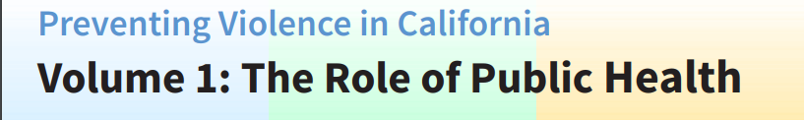


Slide 61
Why is Violence a Public Health Issue?
Violence is a leading cause of injury, physical and mental disability and death. Adverse experiences, including exposure to violence, can negatively impact an individual’s ability to adopt healthy behaviors and manage stress, increasing their risk of chronic diseases and other serious health issues. Exposure to violence and chronic stress prenatally, in early childhood or adolescence has been linked to changes in the developing brain that effect mental health and the ability to learn.
The consequences of violence, for both victims and perpetrators, are costly and influence nearly all health and mental health outcomes throughout life. And just as individuals are traumatized by violence, so are communities. When violence is prevalent, entire communities can experience trauma, weakened social ties and lack of economic investment.
By joining together in the interest of statewide public health, we can maximize violence prevention efforts for greater impact and do more to recognize and address the connections among the forms of violence. Primary prevention of both violence perpetration and victimization is important. Working collectively allows greater use of resources, knowledge and expertise in ways that can protect individuals and communities from violence.

Slide 62
What can I as a physician do to help when one of my patients is the victim of domestic violence?
Answer: By joining together in the interest of statewide public health, you can maximize violence prevention efforts for greater impact and do more to recognize and address the connections among the forms of violence. Primary prevention of both violence perpetration and victimization is important. Working collectively allows you to have greater use of resources, knowledge and expertise in ways that can protect individuals and communities from violence.

Slide 63
Answer: The consequences of violence, for both victims and perpetrators, are costly and influence nearly all health and mental health outcomes throughout life. And just as individuals are traumatized by violence, so are communities. When violence is prevalent, entire communities can experience trauma, weakened social ties and lack of economic investment.
Why is violence a public health issue?

Slide 64
CDPH's Leadership Role with regard to violence
Although many effective public policy, community-based and programmatic solutions have been developed and are in place throughout California, the full range of societal resources must be engaged and mobilized to address multiple forms of violence. The California Department of Public Health (CDPH) is taking the lead in highlighting and framing the role of governmental public health in addressing interpersonal and community violence.
Since January 2016, CDPH staff across programs shared data and information about current program efforts, identified opportunities and challenges, and confirmed the role of CDPH in preventing violence.
CDPH adopted the Safe States Alliance’s recommended roles to direct the state public health department in preventing violence.
These include:
Collect, analyze and disseminate data and information
Develop a statewide public health agenda
Help build local capacity
Translate research into practice
Maximize existing resources and identify potential new funding streams
Contribute to national efforts
Develop and implement policy approaches to violence prevention.

Slide 65
Implementation Approach with regard to violence
Current efforts are underway to build the CDPH Violence Prevention Initiative. These include:
Develop a statewide violence data report and expanding California’s Violent Death Reporting System;
Develop a common language and framework for understanding violence as a public health issue;
Create a plan for moving on key priorities and establishing infrastructure

Slide 66
What is the CDPH (california department of public health) doing about the problem of violence in the state of california?
Answer:
Develop a statewide violence data report and expanding California’s Violent Death Reporting System;
Develop a common language and framework for understanding violence as a public health issue;
Create a plan for moving on key priorities and establishing infrastructure

Slide 67
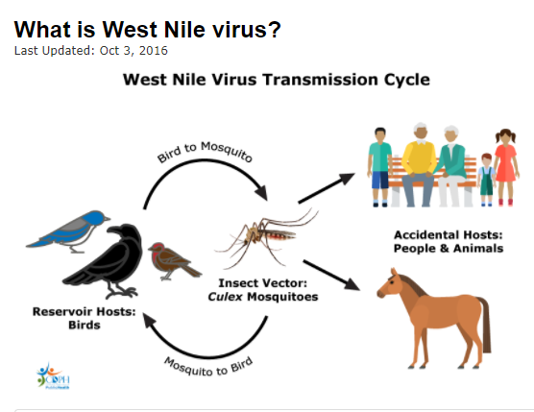

Slide 68

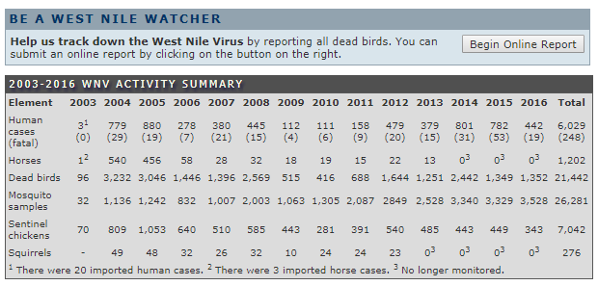

Slide 69
CDPH Confirms First Human West Nile Virus Deaths of 2017
SACRAMENTO – The California Department of Public Health (CDPH) announced three confirmed deaths in California due to West Nile virus (WNV). "West Nile virus can cause a deadly infection in humans, and the elderly are particularly susceptible," said CDPH Director and State Health Officer Dr. Karen Smith. "August and September are peak periods of West Nile virus transmission in the state so we urge everyone to take every possible precaution to protect themselves against mosquito bites."
West Nile virus is influenced by many factors, including climate, the number and types of birds and mosquitoes in an area, and the level of WNV immunity in birds. West Nile virus is transmitted to humans and animals by the bite of an infected mosquito. The risk of serious illness to most people is low. However, some individuals – less than one percent – can develop serious neurologic illnesses such as encephalitis or meningitis.
People 50 years of age and older and individuals with diabetes or hypertension have a higher chance of getting sick, and are more likely to develop complications.

Slide 70
CDPH recommends that individuals protect against mosquito bites and WNV by practicing the "Three Ds":
DEET – Apply insect repellent containing DEET, picaridin, oil of lemon eucalyptus or IR3535 according to label instructions. Repellents keep the mosquitoes from biting you. Insect repellents should not be used on children under two months of age.
DAWN AND DUSK – Mosquitoes that transmit West Nile Virus usually bite in the early morning and evening so it is important to wear proper clothing and repellent if outside during these times. Make sure your doors and windows have tight-fitting screens to keep out mosquitoes. Repair or replace screens that have tears or holes.
DRAIN – Mosquitoes lay their eggs on standing water. Eliminate all sources of standing water on your property by emptying flower pots, old car tires, buckets, and other containers. If you know of a swimming pool that is not being properly maintained, please contact your local mosquito and vector control agency.

Slide 71
What is the transmission cycle for the West Nile Virus?
Answer: West Nile Virus is transmitted to humans and animals by the bite of an infected mosquito.

Slide 72
Answer: The West Nile Virus is transmitted by the mosquito insect vector to the reservoir host “birds” as well as accidental hosts including humans and livestock.
What is the vectors involved and how do humans get infected by the virus?

Slide 73
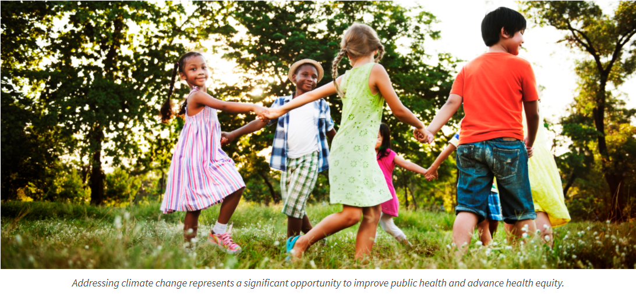

Slide 74
Climate Change & Health Equity
The Climate Change and Health Equity Program (CCHEP) embeds health and equity in California climate change planning, and embeds climate change and equity in public health planning.
CCHEP works with local, state, and national partners to assure that climate change mitigation and adaptation activities have beneficial effects on health while not exacerbating already existing unfair and preventable differences in health status of some groups (health inequities).
CCHEP implements California’s climate change laws and executive orders, contributing health equity considerations.

Slide 75
Climate Action and Advancing Health Equity
Climate change and health inequities share similar root causes: the inequitable distribution of social, political, and economic power. These power imbalances result in systems (economic, transportation, land use, etc.) and conditions that drive both health inequities and greenhouse gas (GHG) emissions. As a result, we see communities with inequitable living conditions, such as low-income communities of color living in more polluted areas, facing climate change impacts that compound and exacerbate existing vulnerabilities.
Fair and healthy climate action requires addressing the inequities that create and intensify community vulnerabilities, through strategically directing extra investments in improving living conditions for and with people facing disadvantage. The CCHEP provides health equity input into California’s plans for transportation, housing, land use planning, and other systems that affect both health outcomes and vulnerability to climate change impacts.
The good news is that addressing climate change represents a significant opportunity to improve public health and advance health equity. Many actions that limit climate change also improve the health of families and communities and reduce health inequities.

Slide 76
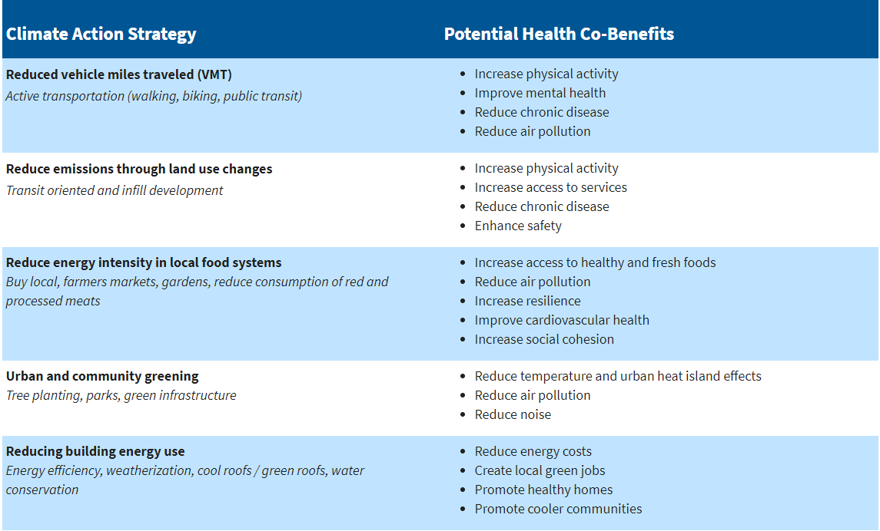
Climate Change & Health Equity

Slide 77
What does climate change have to do with me as a physician?
Answer: As a physician addressing climate change this represents a significant opportunity to improve public health and advance health equity. Many actions that limit climate change also improve the health of families and communities and reduce health inequities.
Climate Action and Advancing Health Equity

Slide 78


What are the characteristics of the immigrants who might seek health care in the United States?
How easy is it for even documented immigrants and naturalized U.S. citizens to access quality health care?
Are undocumented immigrants a burden on the health care system? The Center’s Health Disparities Program is a leading source of quantitative analysis on the consequences of providing health care to this controversial population.
In recent years, the Health Disparities Program has contributed to a number of omnibus reports essential to understanding the broad health concerns of Health Disparities, including the annual Migration and Health report series in partnership with UC Berkeley's Health Initiative of the Americas and others.

Slide 79
Unique Data on Immigrant Health
The Center conducts the California Health Interview Survey (CHIS)​, the nation's largest state health survey and the only health survey to ask questions in five Asian languages (Mandarin, Cantonese, Vietnamese, Korean, Tagalog) in addition to English and Spanish.
The survey also asks about immigration status, history, parents place of birth, language proficiency and other relevant characteristics essential to understanding immigrant health.

Slide 80
Use of Health Services
The Program is particularly known for its examinations of immigrant use of U.S. health services and systems. Using a wide variety of data sources, Program researchers have conducted numerous investigations into the supposed burden immigrants place upon hospitals, medical clinics and emergency rooms.
In reports, policy briefs and journal articles, Program staff have demonstrated the opposite is true: Immigrants, particularly the undocumented, are less likely to impose a burden on U.S. health care systems than citizens.
The reasons range from immigrant’s fear of authority and lack of health insurance to the relative youth and health of some immigrant populations.
For immigrants, the consequences of such aversion can be dire: By avoiding or delaying preventative care, immigrants put themselves at risk of more severe and costly long-term illnesses.

Slide 81

Access to Care
Immigrant access to quality health care is often impeded by a variety of linguistic, socio-economic and even environmental obstacles.
Program staff conduct in-depth analysis and suggest policy solutions for problems ranging from the challenges of enrolling immigrants in health care reform to the language barriers that exist between immigrants and medical professionals.

Slide 82

How are you by being a physician working at a community health center serving a largely low income Mexican immigrant population be able to reduce health care disparities among that group? (Hint-this is the easiest question you will ever be asked. Thank you in advance for your service.)
Answer: By working in a community health center as a physician and improving access to quality care and thus lessening the health care disparities in that group.

Slide 83
Answer: immigrants from Mexico place a lesser burden on the U.S. Health care system than does citizens with regard to utilization of hospitals, medical clinics and emergency rooms according to the UCLA center for health policy research
  Do immigrants from Mexico place a greater burden or a lesser burden on the U. S. Health care systems than citizens with regard to utilization of hospitals, medical clinics and emergency rooms?

Slide 84

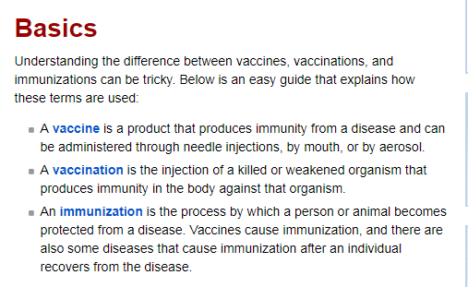

Slide 85

Prevention/wellness
Learn more about the benefits and risks of immunization including how vaccines are monitored for safety, answers to common questions, what is in vaccines, and who should be vaccinated.
Review the clinic guidelines, policies and procedures.

Slide 86

Prevention/wellness
Vaccines help prevent many serious diseases. Learn more about how vaccines work and the extensive testing process they undergo to ensure they are effective and safe.

Slide 87

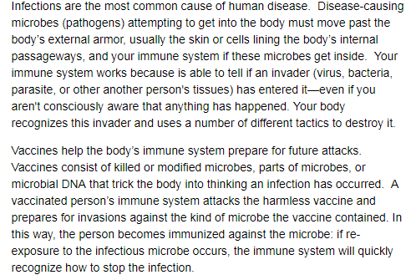

Slide 88
vaccines.gov
Please define vaccine,
vaccination and
immunization.

Slide 89
vaccines.gov
Question:
Are the following terms below properly matched according to the definition?
Vaccine – is the process by which a person or animal becomes protected from a disease. Vaccines cause immunization, and there are also some diseases that cause immunization after an individual recovers from the disease.
Vaccination – is a product that produces immunity from a disease and can be administered through needle injections, by mouth, or by aerosol.
Immunization – is the injection of a killed or weakened organism that produces immunity in the body against that organism.
If not matched properly what is the correct matching of definitions to appropriate words in bold.

Slide 90
vaccines.gov
Are the following terms below in bold matched according to the proper definition? Now they are correctly matched!
Vaccine – is a product that produces immunity from a disease and can be administered through needle injections, by mouth, or by aerosol.
Vaccination – is the injection of a killed or weakened organism that produces immunity in the body against that organism.
Immunization – is the process by which a person or animal becomes protected from a disease. Vaccines cause immunization, and there are also some diseases that cause immunization after an individual recovers from the disease.

Slide 91
Please provide strategies to increase the vaccination rate in the patient population you will serve.
Answer:
This will be an ongoing challenge for you to determine as a physician working with your new health care team.
vaccines.gov
vaccines.gov

Slide 92
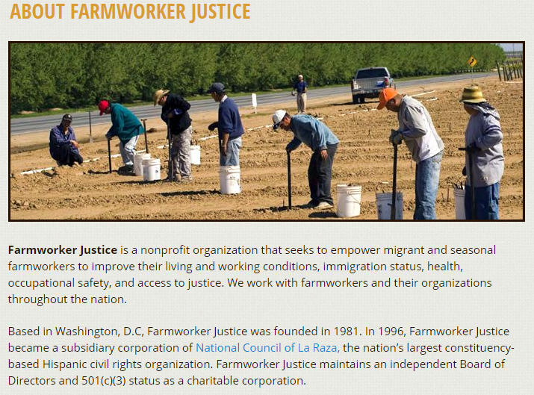

Slide 93
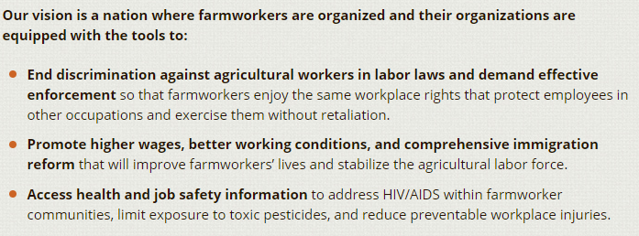


Slide 94
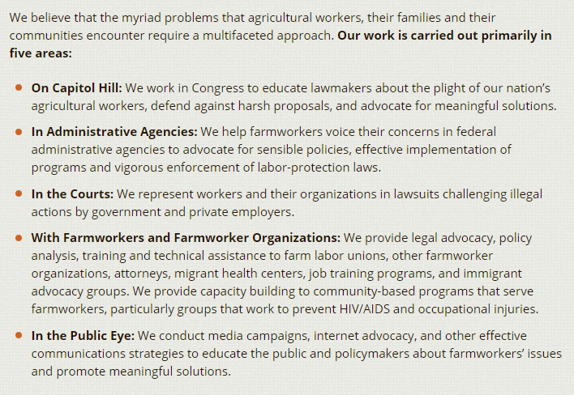

Slide 95
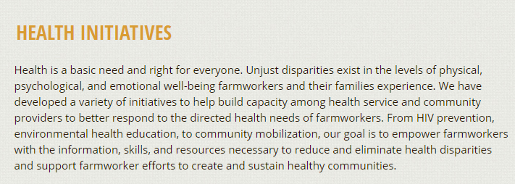

Slide 96
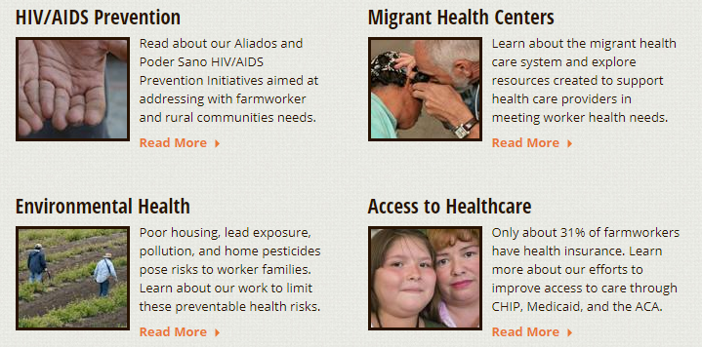

Slide 97
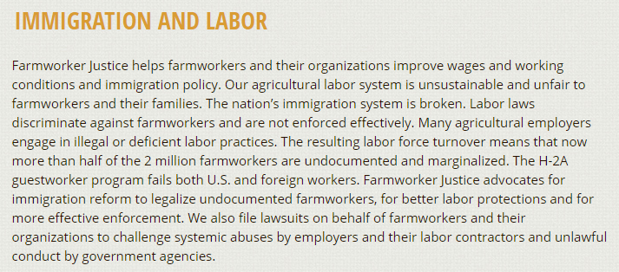

Slide 98

QUESTION TO FOLLOW

Slide 99
Answer: End discrimination against agricultural workers in labor laws and demand effective enforcement
Promote higher wages, better working conditions, and comprehensive immigration reform
Improve health care and job safety
What are some of the goals of the farmworker justice program?
ABOUT FARMWORKER JUSTICE

Slide 100
Answer: improve access to quality health care thus reducing the health care disparity that this group currently faces
What will you be able to do as a physician working in a community health center to help assist in one of the goals of the farmworker justice program?

Slide 101

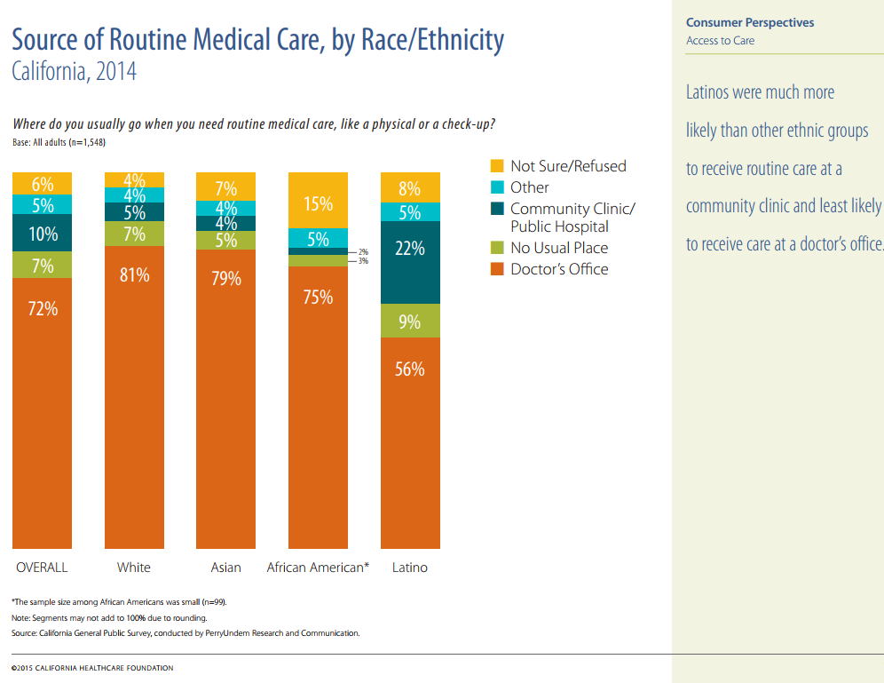
Answer: Latinos as an ethnic group are more likely to receive care at a community health center
What significance does this bar graph have?

Slide 102
What significance does
this bar graph have?
Latinos as an ethnic group are
more likely to receive care at
a community health center

Slide 103
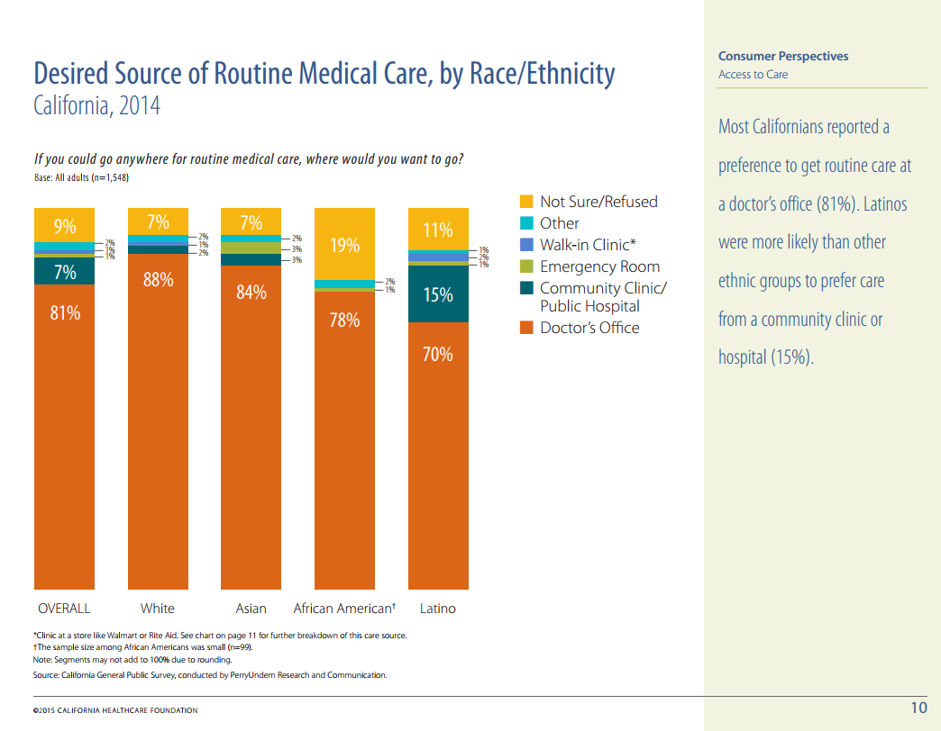
What significance does this have?

Slide 104
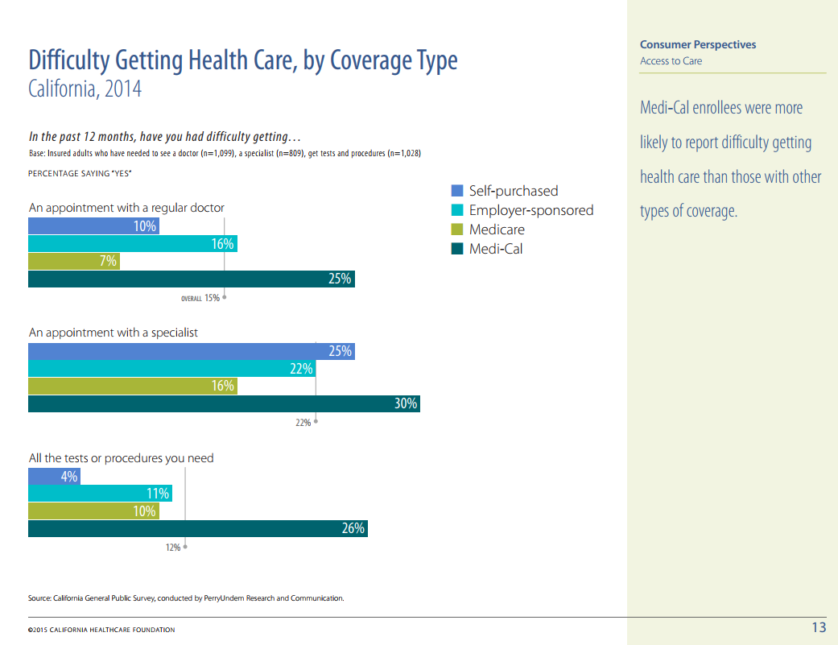
What significance does this graph have?

Slide 105
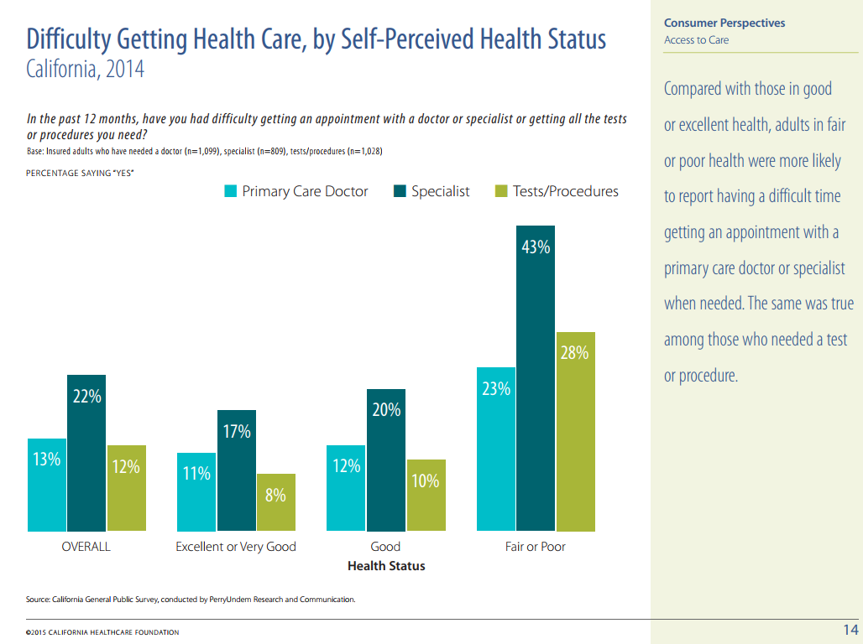
The poorer the
the health the more
difficulty in obtaining
health care

Slide 106
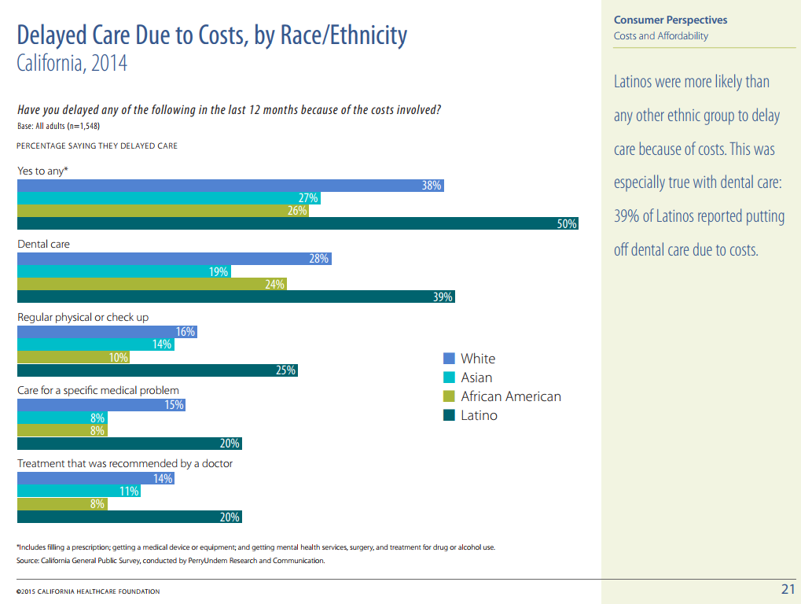
Latinos are more likely
to delay health care
due to costs

Slide 107
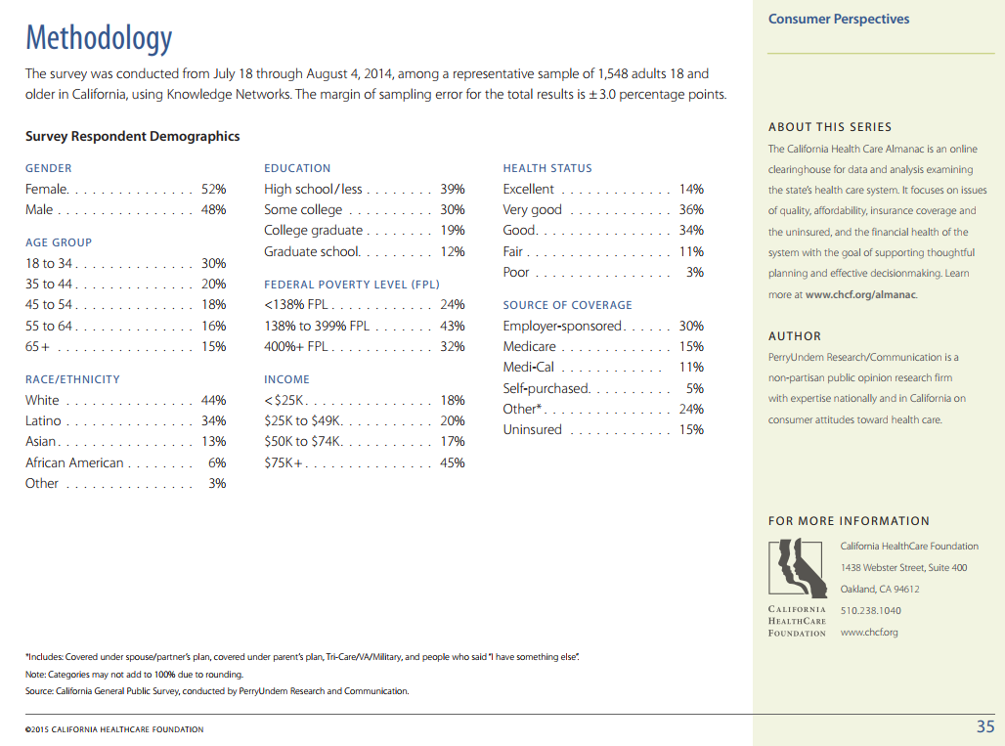
DEMOGRAPHICS
OF RESPONDENTS

Slide 108
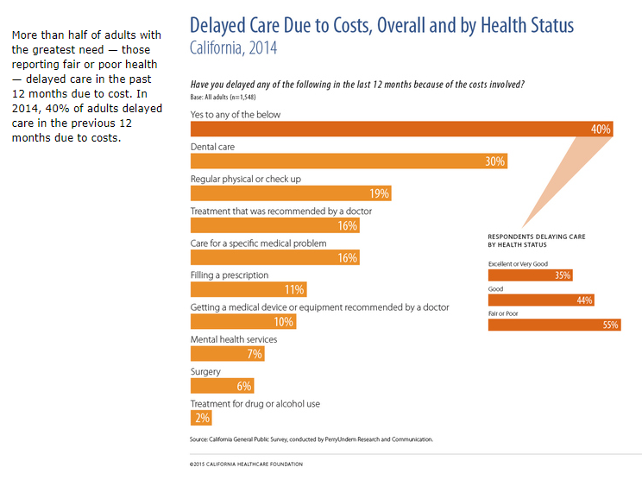
DELAY OF
HEALTH CARE
DUE TO COSTS

Slide 109
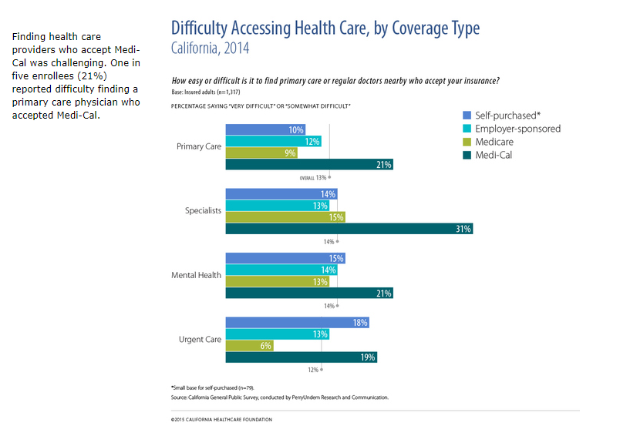
DIFFICULTY IN ACCESS TO HEALTH CARE
GREATEST IF
PATIENT HAS MEDI-CAL

Slide 110
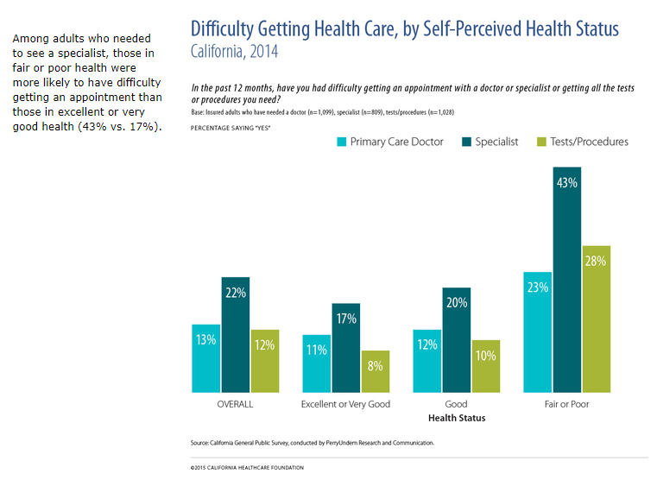
POOREST HEALTH
HAVE GREATEST
DIFFICULTY GETTING
HEALTH CARE

Slide 111
What trends were you able to identify in the previous graphs and or charts?
Answer: Patients who are underserved have the greatest difficulty in obtaining health care including patients with poor health, low income, Latino ethnicity, self pay, medi-cal recipient status.

Slide 112
Answer: By improving access to care for those patients who are currently in underserved groups
How will you as a physician be able to have an impact in altering some of these health care disparities in the future?

Slide 113
1. In the United States in the year 2015 over 39,000 people were diagnosed with HIV virus that causes AIDS. How many people in the state of California were diagnosed with the HIV virus?
a) 100 to1,000
b) 1,001 to 2,000
c) 2,001 to 3,000
d) Over 4,000

Slide 114
In the United States in the year 2015 over 39,000 people were diagnosed with HIV virus that causes AIDS. How many people in the state of California were diagnosed with the HIV virus?
a) 100 to1,000
b) 1,001 to 2,000
c) 2,001 to 3,000
d) Over 4,000

Slide 115
Please choose the best answer regarding adolescents in the state of California for which 26% of tenth graders had sexual relations in 2015.
a) Sexual risk behaviors place adolescents at risk for HIV infection
b) Sexual risk behaviors place adolescents at risk for unintended pregnancy
c) Sexual risk behaviors place adolescents at risk for other sexually transmitted diseases
d) All of the above

Slide 116
2. Please choose the best answer regarding adolescents in the state of California for which 26% of tenth graders had sexual relations in 2015.
a) Sexual risk behaviors place adolescents at risk for HIV infection
b) Sexual risk behaviors place adolescents at risk for unintended pregnancy
c) Sexual risk behaviors place adolescents at risk for other sexually transmitted diseases
d) All of the above

Slide 117
3. In the year 2016, over 5,000 new cases of “Valley Fever” (Coccidiodomycosis) were reported to the California Public Health Department which is a large increase compared to the previous year. This condition is most commonly reported in the Southern Central Valley and the Central Coast. Which of the following answers is the best response?
a) People get infected by breathing in spores present in dust that gets into the air when it is windy or when soil is disturbed, especially if they work outdoors.
b) The incidence of Valley Fever depends on a variety of environmental factors and types of human activity in areas where the fungus is present.
c) While most infected people will not show signs of illness—some may develop more severe complications of Valley Fever which may include pneumonia, or infection of the brain, joints, bone, skin, or other organs.
d) All of the above.

Slide 118
3. In the year 2016, over 5,000 new cases of “Valley Fever” (Coccidiodomycosis) were reported to the California Public Health Department which is a large increase compared to the previous year. This condition is most commonly reported in the Southern Central Valley and the Central Coast. Which of the following answers is the best response?
a) People get infected by breathing in spores present in dust that gets into the air when it is windy or when soil is disturbed, especially if they work outdoors.
b) The incidence of Valley Fever depends on a variety of environmental factors and types of human activity in areas where the fungus is present.
c) While most infected people will not show signs of illness—some may develop more severe complications of Valley Fever which may include pneumonia, or infection of the brain, joints, bone, skin, or other organs.
d) All of the above.

Slide 119
4. “West Nile Virus” (WNV) can cause a deadly infection in humans and in 2017 caused multiple deaths as a result of complications such as encephalitis or meningitis in California --- although the risk to most people of a serious illness is low. Which of the following responses is the best answer?
West Nile virus is influenced by many factors, including climate, the number
and types of birds and mosquitoes in an area, and the level of WNV immunity in birds.
b) West Nile virus is transmitted to humans and animals by the bite of an
infected mosquito.
c) People 50 years of age and older and individuals with diabetes or
hypertension have a higher chance of getting sick, and are more likely to
develop complications.
d) All of the above

Slide 120
4. “West Nile Virus” (WNV) can cause a deadly infection in humans and in 2017 caused multiple deaths as a result of complications such as encephalitis or meningitis in California --- although the risk to most people of a serious illness is low. Which of the following responses is the best answer?
West Nile virus is influenced by many factors, including climate, the number
and types of birds and mosquitoes in an area, and the level of WNV immunity in birds.
b) West Nile virus is transmitted to humans and animals by the bite of an
infected mosquito.
c) People 50 years of age and older and individuals with diabetes or
hypertension have a higher chance of getting sick, and are more likely to
develop complications.
d) All of the above

Slide 121
5. The UCLA Center for Health Policy Research through health disparity research has generated the following information. Which of the following answers is false according to the UCLA Center for Health Policy Research?
a) Immigrants, particularly the undocumented place a much greater burden on the U. S. health care systems than citizens with regard to utilization of hospitals, medical clinics and emergency rooms
b) Immigrant access to quality health care is often impeded by a variety of linguistic, socio-economic and even environmental obstacles
c) The UCLA Center conducts the California Health Interview Survey (CHIS), the nation’s largest state health survey and the only health survey to ask questions in five Asian languages, as well as, English and Spanish
d) The Center’s Health Disparities Program is a leading source of quantitative analysis on the consequences of providing health care to this controversial population

Slide 122
5. The UCLA Center for Health Policy Research through health disparity research has generated the following information. Which of the following answers is false according to the UCLA Center for Health Policy Research?
a) Immigrants, particularly the undocumented place a much greater burden on the U. S. health care systems than citizens with regard to utilization of hospitals, medical clinics and emergency rooms
b) Immigrant access to quality health care is often impeded by a variety of linguistic, socio-economic and even environmental obstacles
c) The UCLA Center conducts the California Health Interview Survey (CHIS), the nation’s largest state health survey and the only health survey to ask questions in five Asian languages, as well as, English and Spanish
d) The Center’s Health Disparities Program is a leading source of quantitative analysis on the consequences of providing health care to this controversial population

Slide 123
Conceptual HIGHER learning
How will you be able to understand the main risks to the health of California’s population by regions and ethnic groups then to use that information to apply, analyze, and synthesize that information to better care for patients? Please select all answers that apply.
By having an appropriately higher level of clinical awareness so as to analyze, and synthesize the disease relationship concerns based of many different demographics including sexual preference and risk of having HIV infection for example, then applying those concepts into my clinical practice.
By understanding the many different relationships between the demographics of vulnerable populations with regard to many other disease processes such as tuberculosis, Hepatitis A, B, C, Valley Fever, West Nile to improve clinical skills of detection and appropriate treatment resources.
By developing conceptual thought patterns that incorporates the role of public health, population medicine, to address the tremendous health care challenges while at the same time optimally utilizing the scarce resources to stretch the health care dollar.
Comparing the conceptual thought processes and resources to identify and address such insidious problems such as domestic violence and how it may be viewed differently in the US as compared to Mexico.
Conceptual understanding of the health related institutional opinions regarding such substances as cannabis and how to apply those conceptual ideas to advise my patients accordingly.

Slide 124
Conceptual HIGHER learning
How will you be able to understand the main risks to the health of California’s population by regions and ethnic groups then to use that information to apply, analyze, and synthesize that information to better care for patients? Please select all answers that apply.
By having an appropriately higher level of clinical awareness so as to analyze, and synthesize the disease relationship concerns based of many different demographics including sexual preference and risk of having HIV infection for example, then applying those concepts into my clinical practice.
By understanding the many different relationships between the demographics of vulnerable populations with regard to many other disease processes such as tuberculosis, Hepatitis A, B, C, Valley Fever, West Nile to improve clinical skills of detection and appropriate treatment resources.
By developing conceptual thought patterns that incorporates the role of public health, population medicine, to address the tremendous health care challenges while at the same time optimally utilizing the scarce resources to stretch the health care dollar.
Comparing the conceptual thought processes and resources to identify and address such insidious problems such as domestic violence and how it may be viewed differently in the US as compared to Mexico.
Conceptual understanding of the health related institutional opinions regarding such substances as cannabis and how to apply those conceptual ideas to advise my patients accordingly.

