Slide 1

MODULE ONE:
HEALTH PROFILE OF CALIFORNIA’S POPULATION

Slide 2
MODULE ONE:
SECTION three:
burden of disease

Slide 3

UNIT OBJECTIVE
To know the health care outcomes and risk factors, and identify prominent chronic diseases affecting California’s populations then to use that information to apply, analyze, and synthesize to provide better care to your patients.

Slide 4
burden of disease
Health profile
Chronic diseases (e.g. diabetes, hypertension, obesity, etc.)
Personal, behavioral, and socio-environmental risk factors

Slide 5
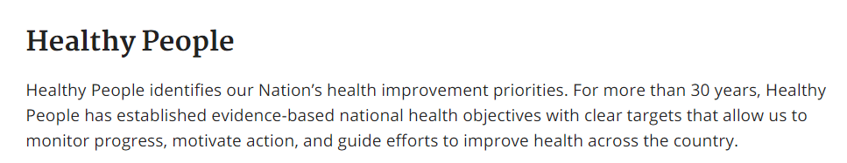
Healthy people 2010 served in the past as clinical health care quality measures
REVIEW OF PRIOR DATA COLLECTION

Slide 6
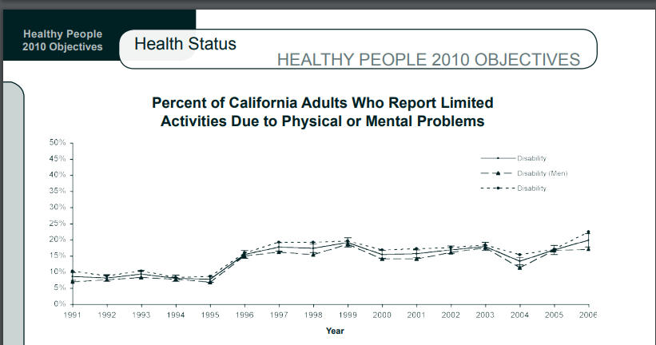

Slide 7
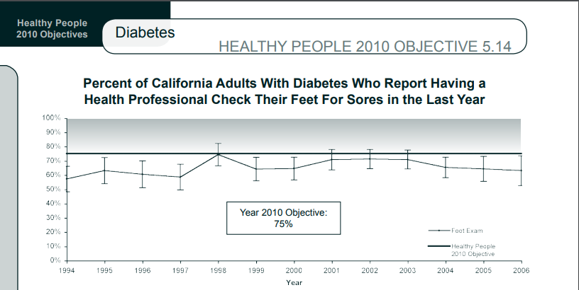

Slide 8


Slide 9


Slide 10
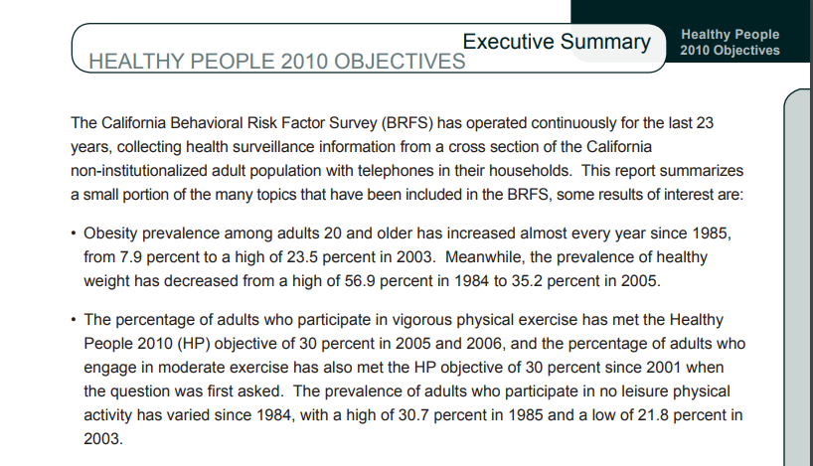

Slide 11
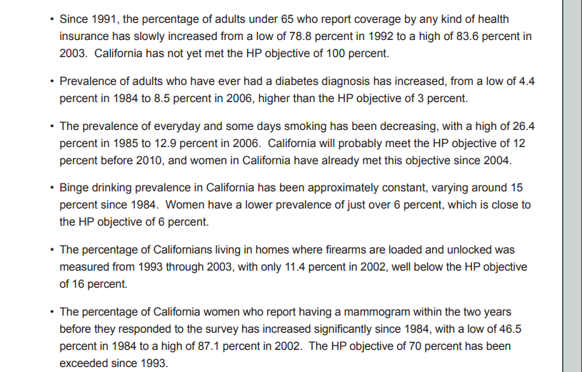

Slide 12
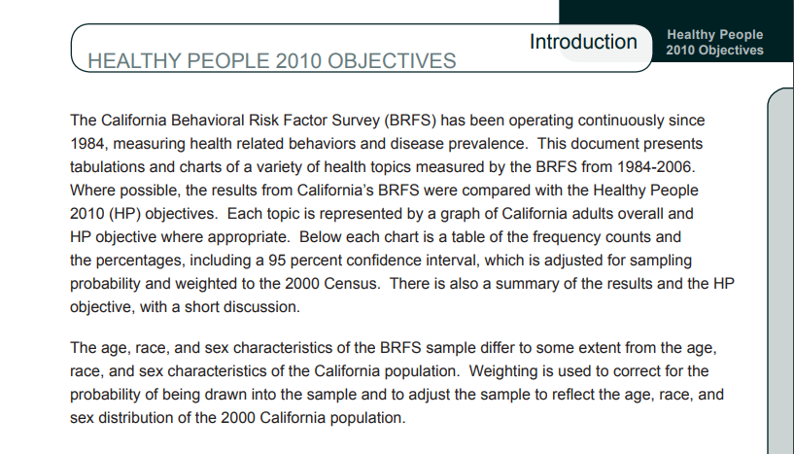

Slide 13
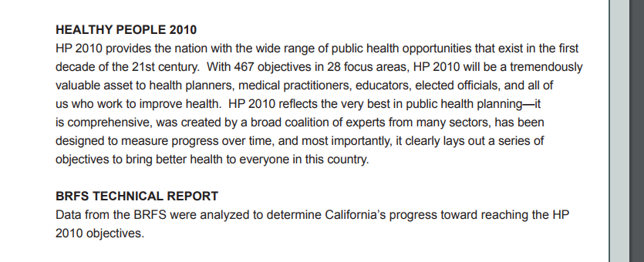

Slide 14

hrsa Bureaus & Offices
The Health Resources and Services Administration (HRSA), an agency of the U.S. Department of Health and Human Services (HHS), provides health care to people who are geographically isolated, and/or economically or medically vulnerable. This includes people living with HIV/AIDS, pregnant women, mothers and their families, and those otherwise unable to access high quality health care. HRSA also supports the training of health professionals, the distribution of providers to areas where they are needed most, and improvements in health care delivery. In addition, HRSA oversees organ, bone marrow, and cord blood donation. It compensates individuals harmed by vaccination, and maintains databases that flag providers with a record of health care malpractice, waste, fraud, and abuse for Federal, state and local use.
Nearly 90 percent of HRSA’s budget is awarded through grants and cooperative agreements to approximately 3,000 awardees, including community-based organizations, colleges and universities, hospitals, private entities, and state, local, and tribal governments. HRSA’s management and oversight of programs is organized through five bureaus and eleven offices.

Slide 15

Bureaus
Bureau of Health Workforce
The Bureau of Health Workforce administers programs that are designed to strengthen the health workforce and connect skilled professionals to rural, urban, and tribal underserved communities nationwide.
Bureau of Primary Health Care
The Bureau of Primary Health Care oversees the Health Center Program, a national network of health centers that provide comprehensive primary health care services to more than 24 million people nationwide, regardless of a patients' ability to pay, charging for services on a sliding fee scale.
Healthcare Systems Bureau
The Healthcare Systems Bureau encompasses a diverse set of programs focused on protecting the public health and improving the health of individuals, including: solid organ, bone marrow, and cord blood transplantation; poison control center services; countermeasure and vaccine injury compensation; Hansen’s Disease direct patient care, provider education, and research; the Medical Claims Review Panel; and the 340B Drug Pricing Program.
HIV/AIDS Bureau
The HIV/AIDS Bureau administers the Ryan White HIV/AIDS Program, which provides a comprehensive system of care for people living with HIV. The Program works with cities, states, and local community-based organizations to provide HIV care and treatment services to more than half a million people each year.
Maternal and Child Health Bureau
The Maternal and Child Health Bureau’s programs serve more than 50 million women, children and families each year, including half of all pregnant women and one-third of all infants and children in the United States.

Slide 16

multiple Offices
Federal Office of Rural Health Policy
The Federal Office of Rural Health Policy provides policy support to the Office of Secretary and supports a number of rural health programs, including rural health networks, black lung clinics, telehealth, and veterans rural health access programs.
Office of Communications
The Office of Communications oversees communications to and from the public, including media, social media, speeches, presentations, and Web content; and also handles clearances of agency publications and reports.
Office of Civil Rights, Diversity, and Inclusion
The Office of Civil Rights, Diversity, and Inclusion protects and serves the rights of all HRSA employees, applicants and beneficiaries of federal funds by enforcing federal laws, policies and practices prohibiting discrimination.
Office of Federal Assistance Management
The Office of Federal Assistance Management provides assurance of the financial integrity of HRSA's grant programs, and oversees HRSA grant activities to ensure they are managed in an efficient and effective manner.
Office of Global Health
The Office of Global Health is HRSA's point of contact with the HHS Office of Global Affairs to improve the health of Americans through global action.
Office of Health Equity
The Office of Health Equity works across the agency to reduce health disparities and improve health equity through HRSA programs and policies.
Office of Legislation
The Office of Legislation serves as the Administrator's primary staff and principal source of advice on legislative affairs, which includes preparation of testimony to Congressional Committees, developing legislative proposals, and facilitating communication between the Administrator and HHS leadership on legislative matters.
Office of Operations
The Office of Operations provides an array of essential agency-wide centralized financial, acquisitions, IT, budget, management, human resource, and administrative services to HRSA's bureaus and offices.
Office of Planning, Analysis, and Evaluation
The Office of Planning, Analysis and Evaluation serves as an agency source for policy analysis, performance data, organizational planning, external agency engagements, research, and evaluation.
Office of Regional Operations
The Office of Regional Operations provides regional, state and community training and technical assistance through HRSA's ten regional offices.
Office of Women's Health
The Office of Women's Health works within and outside of HHS to improve the health, we

Slide 17


Slide 18


Slide 19

About the Federal Tort Claims Act (FTCA)

Slide 20

About the Federal Tort Claims Act (FTCA)

Slide 21

About the Federal Tort Claims Act (FTCA)

Slide 22


Slide 23


Slide 24



Slide 25

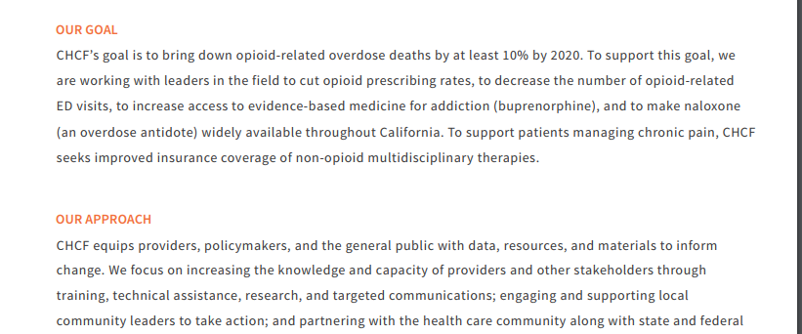

Slide 26


Slide 27
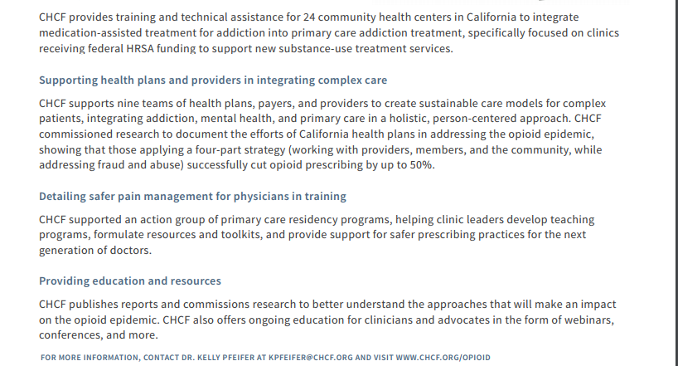
Treating addiction in community health centers

Slide 28
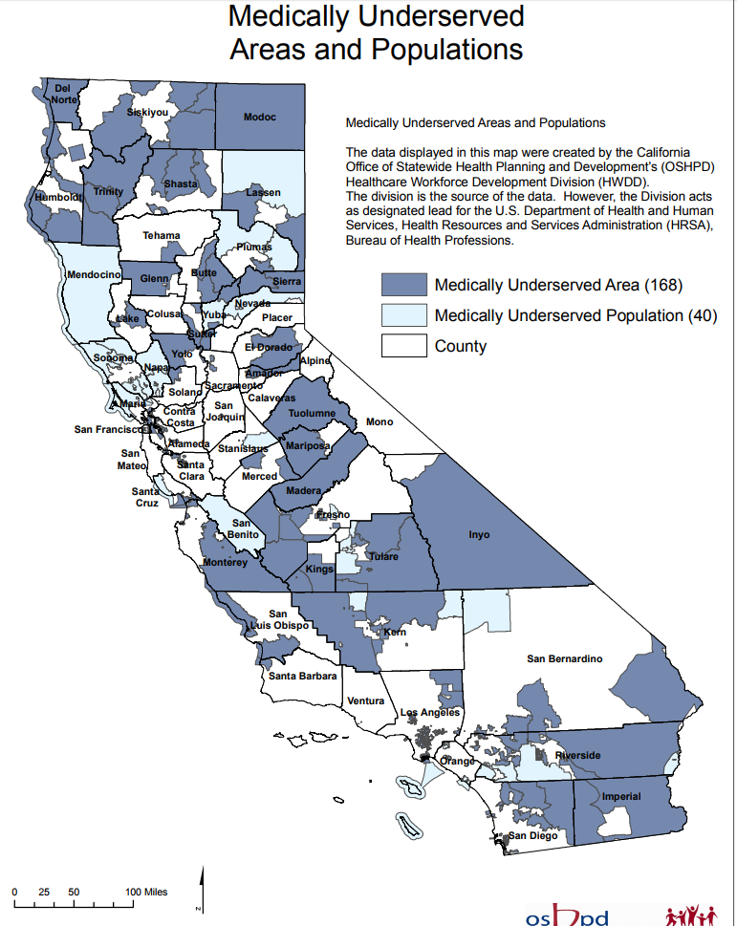
As physicians
you will be
serving a
Medically Underserved
Area and
Patient
Population

Slide 29
Overview of medical care in adults with diabetes mellitus
INTRODUCTION — The estimated overall prevalence of diabetes among adults in the United States ranges from 5.8 to 12.9 percent (median 8.4 percent). However, because of the associated microvascular and macrovascular disease, diabetes accounts for almost 14 percent of United States health care expenditures, at least one-half of which are related to complications such as myocardial infarction (MI), stroke, end-stage renal disease, retinopathy, and foot ulcers.
Numerous factors, in addition to directly related medical complications, contribute to the impact of diabetes on quality of life and economics. Diabetes is associated with a high prevalence of depression and adversely impacts employment, absenteeism, and work productivity.
This review will provide an overview of the medical care for patients with diabetes. The management approach is consistent with guidelines from the American Diabetes Association (ADA) for health maintenance in patients with diabetes, which are published yearly. Consensus recommendations for the management of glycemia in type 2 diabetes were published in 2006 and are updated regularly.

Slide 30
Overview of medical care in adults with diabetes mellitus
EVALUATION
Initial — Patients with newly diagnosed diabetes require a history and physical examination to assess the characteristics of onset of diabetes (asymptomatic laboratory finding or symptomatic polyuria and polydipsia), nutrition and weight history, physical activity, cardiovascular risk factors, history of diabetes-related complications, hypoglycemic episodes, diabetic ketoacidosis (DKA) frequency (type 1 diabetes only), and current management.
●If not measured in the past two to three months, we measure glycated hemoglobin (A1C)
●If not measured in the past one year, we measure:
•Fasting lipid profile
•Liver function tests
•Urine albumin excretion (spot urine)
•Serum creatinine
•Serum thyroid-stimulating hormone (TSH, in type 1 diabetes only)
Type 2 diabetes accounts for over 90 percent of cases of diabetes in the United States, Canada, and Europe; type 1 diabetes accounts for another 5 to 10 percent, with the remainder due to other causes. The etiologic classification of diabetes, including distinguishing type 2 from type 1 diabetes, and monogenic forms of diabetes (formerly referred to as maturity onset diabetes of the young [MODY]) from type 1 and type 2 diabetes, is reviewed elsewhere.

Slide 31
Routine foot examination — The feet should be visually inspected at each routine visit to identify problems with nail care, poorly fitting footwear resulting in barotrauma, fungal infections, and callus formation that may jeopardize acceptable foot care. A comprehensive foot examination should be performed annually on patients with diabetes to identify risk factors predictive of ulcers and amputation. Foot problems due to vascular and neurologic disease are a common and important source of morbidity in diabetic patients. Systematic screening examinations for neuropathic and vascular involvement of the lower extremities, and careful inspection of feet may substantially reduce morbidity from foot problems.
The comprehensive foot examination can be accomplished in the primary care setting and should include inspection, assessment of foot pulses, and testing for loss of protective sensation, as follows:
●The skin should be assessed for integrity, especially between the toes and under the metatarsal heads. The presence of erythema, warmth, or callus formation may indicate areas of tissue damage. Bony deformities, joint mobility, and gait and balance should also be assessed.
●Screen for peripheral artery disease by asking about a history of claudication and assessing the pedal pulses. Patients with clinical evidence of peripheral artery disease should have ankle brachial index testing. The presence of peripheral artery disease also suggests a high likelihood of cardiovascular disease (CVD).
●Test for loss of protective sensation using a Semmes-Weinstein 5.07 (10 g) monofilament at specific sites to detect loss of sensation in the foot, plus any one of the following: vibration using a 128-Hz tuning fork, pinprick sensation, ankle reflexes, or vibration perception threshold with a biothesiometer.
●Advice for prophylactic foot care should be given to all patients
•Avoid going barefoot, even in the home.
•Test water temperature before stepping into a bath.
•Trim toenails to shape of the toe; remove sharp edges with a nail file. Do not cut cuticles.
•Wash and check feet daily.
•Shoes should be snug but not tight and customized if feet are misshapen or have ulcers.
•Socks should fit and be changed daily.
Patients who may have neuropathy (based on abnormal results from a microfilament and one other test) or who have calluses or other foot deformities should be referred to clinicians with expertise in diabetic foot care (podiatrist, nurse, diabetes foot clinic, or other, depending on available local resources).
Overview of medical care in adults with diabetes mellitus

Slide 32
Screening for coronary heart disease — We do not routinely perform exercise stress testing in asymptomatic patients with diabetes. Instead, we perform an annual assessment of risk criteria (blood pressure, fasting lipid profile, smoking history) to identify patients at high risk for coronary heart disease (CHD) who might benefit from interventions such as aspirin, ACE inhibitors, and statin therapy. We no longer recommend that these criteria be used to identify patients for stress testing.
For sedentary adults (age >50 years) with diabetes who are beginning an exercise program, we typically perform a physical examination and a resting electrocardiogram (ECG). In addition, all CVD risk factors should be treated. There are no randomized trial data to support the routine performance of exercise stress testing in asymptomatic patients with diabetes who are planning to begin an exercise program. The decision to perform stress testing prior to beginning an exercise program should be individualized.
We do not typically perform exercise stress testing in asymptomatic patients as long as they are beginning a gentle exercise program with gradual progression as tolerated. However, the increased risk for asymptomatic coronary artery disease in those with diabetes and other risk factors suggests that an exercise tolerance test be considered prior to changing exercise levels in patients with diabetes who also have peripheral or carotid or coronary artery disease.
Patients with diabetes have an increased risk for atherosclerosis due both to diabetes and to the frequent presence of other risk factors. Furthermore, diabetic patients with CHD are more likely to be asymptomatic or have atypical symptoms than nondiabetic patients with CHD. Despite the frequency of silent ischemia, however, it has not been proven that identifying asymptomatic disease or providing early intervention will improve outcomes in this population. In addition, CHD risk factors (dyslipidemia, hypertension, smoking, positive family history of early coronary disease, and presence of increased urinary albumin excretion) do not predict the likelihood of having ischemic findings on stress testing or coronary angiography.
The evaluation and treatment of diabetic patients with known CHD is reviewed in detail elsewhere.
Overview of medical care in adults with diabetes mellitus

Slide 33
Comorbid conditions — Adults with type 2 diabetes are at risk for comorbidities other than obesity, hypertension, and dyslipidemia. These disorders, which may be present at diagnosis or may develop over time, include hearing impairment, sleep apnea, fatty liver disease, periodontal disease, cognitive impairment, depression, anxiety, and fractures. For patients with signs or symptoms of these conditions, additional assessment is warranted. Annual examination by a dentist is recommended in both dentate and nondentate diabetic patients.
Some studies suggest an increased risk of certain cancers (liver, pancreas, endometrium, colon/rectum, breast, bladder) in patients with type 2 diabetes, possibly related to the coincident obesity. Adults with type 2 diabetes also have an increased risk of cancer mortality. In a systematic review of individual patient data from 97 prospective studies (820,900 patients), adults with diabetes compared with those without had an increased risk of death from cancer (hazard ratio [HR] 1.25, 95% CI 1.19-1.31). The increased risk of death was associated specifically with cancers of the liver, pancreas, ovary, colorectum, lung, bladder, and breast. In addition, the relative risk was substantially reduced when A1C levels were considered in multivariate analyses, consistent with a direct effect of hyperglycemia on cancer risk.
Patients with diabetes should undergo recommended age- and gender-specific cancer screening.
Overview of medical care in adults with diabetes mellitus

Slide 34
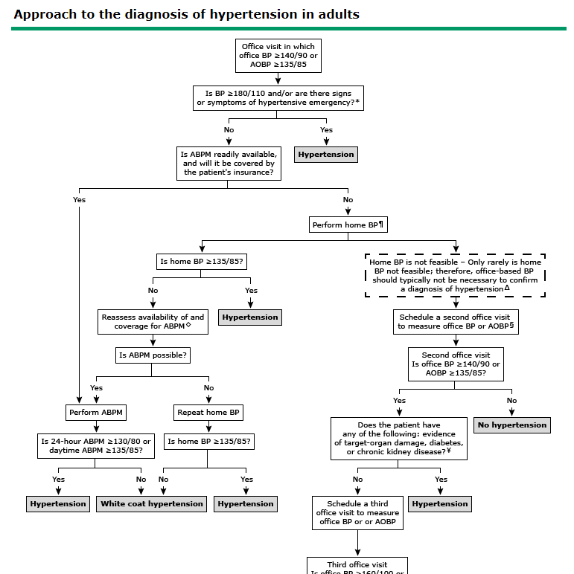
This is an example of the “Up to Date” treatment guideline
Overview of medical care in adults with hypertension

Slide 35
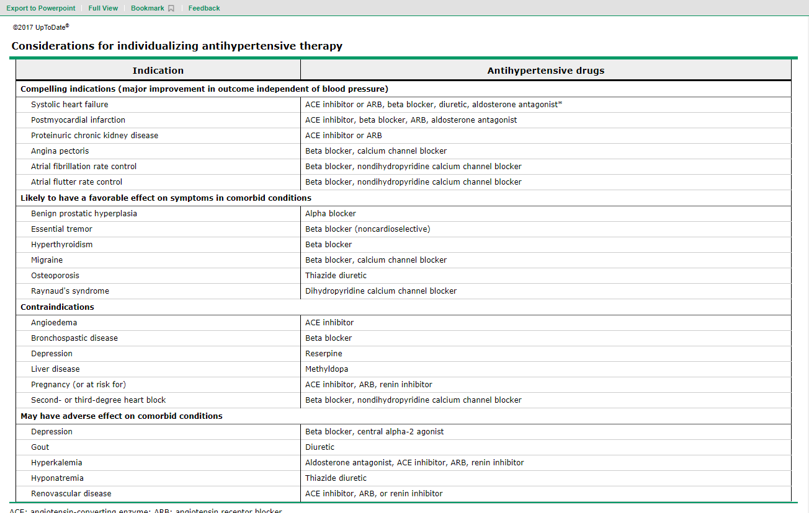
Overview of medical care in adults with hypertension

Slide 36
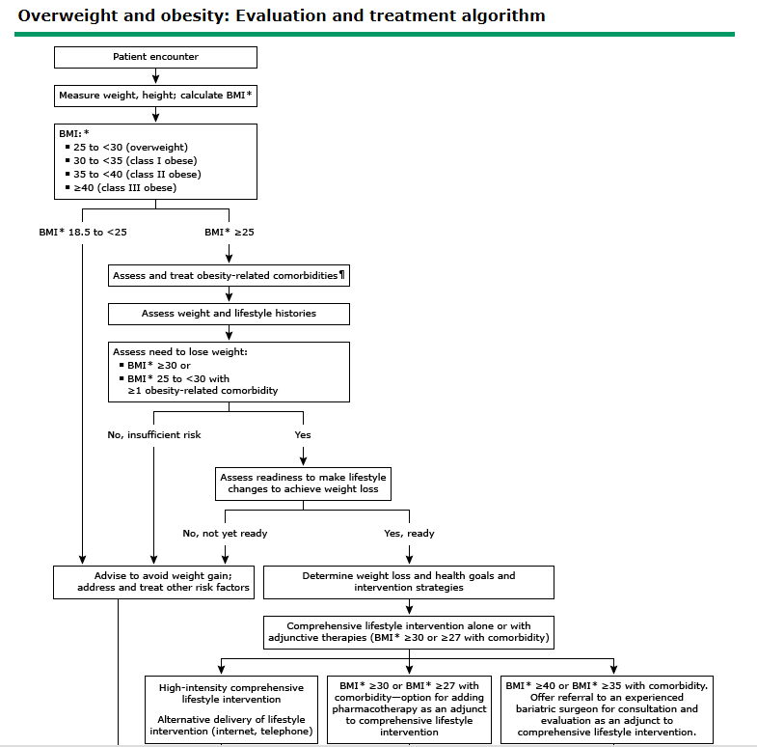
This is an example of the “Up to Date” treatment guideline or algorithm.
Overview of medical care in adults with obesity

Slide 37
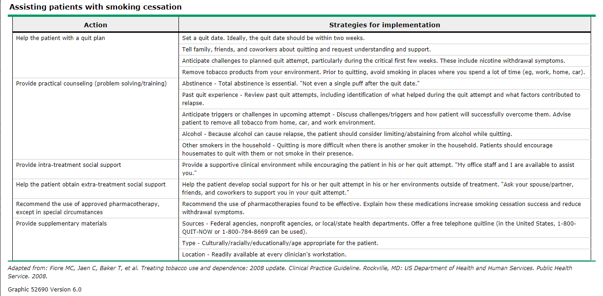
Overview of medical care in adults for smoking cessation

Slide 38
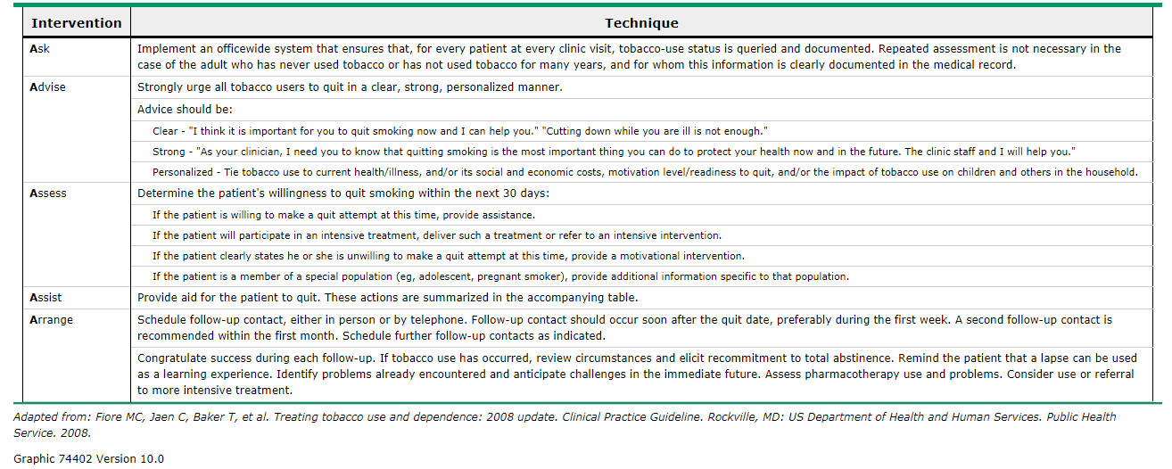
Five "A's" for assessing for tobacco use and addressing smoking cessation

Slide 39

Chapter One: Health and
Well-Being
What important information did we learn about common adolescent health characteristics, and about U.S. Adolescents specifically, that we didn’t already know?
What relevant U.S. Or international research addresses the factors underlying the
highlighted health
issues?
Chapter Two: Fitness
Chapter Three: Family
and Peer Relationships
Chapter Four: School
Environment
Chapter Five: Smoking
and Alcohol Use
Chapter Six: Violence

Slide 40
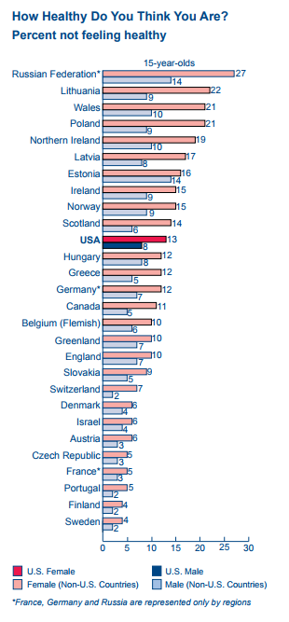
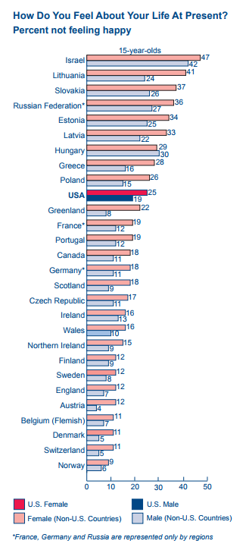
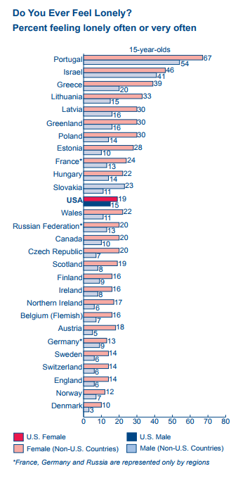

Slide 41
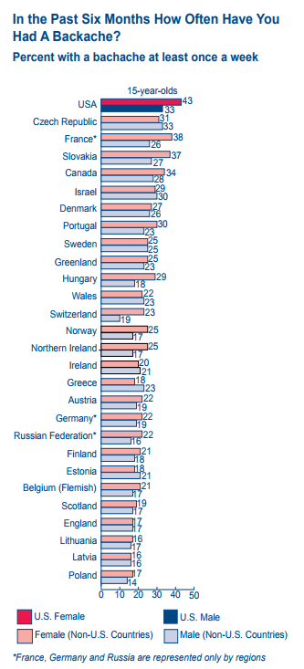
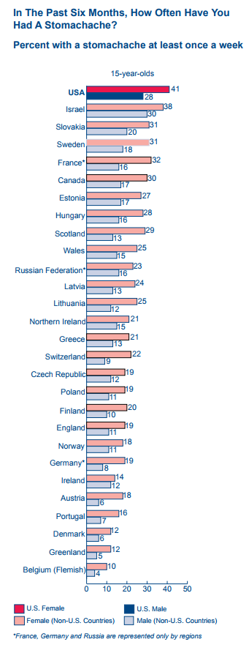
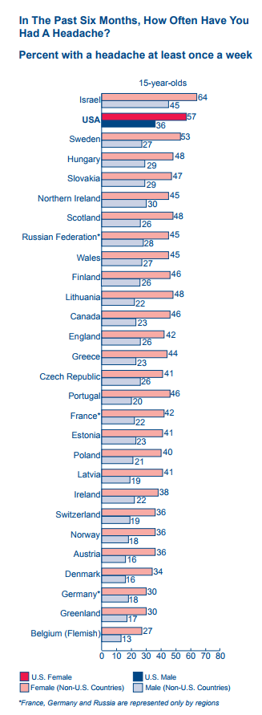

Slide 42
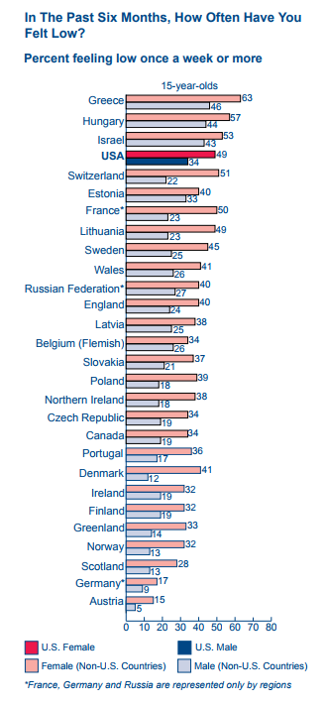
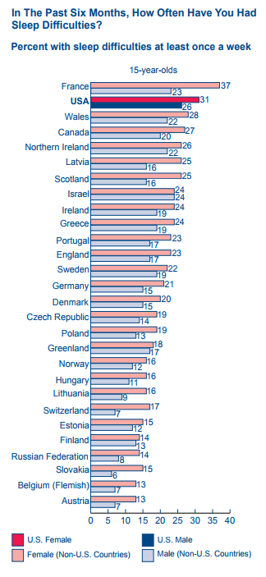
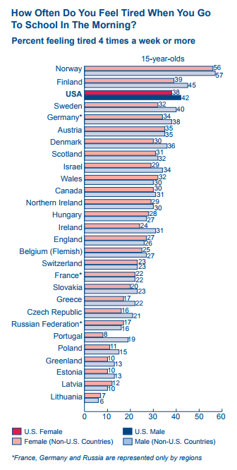

Slide 43
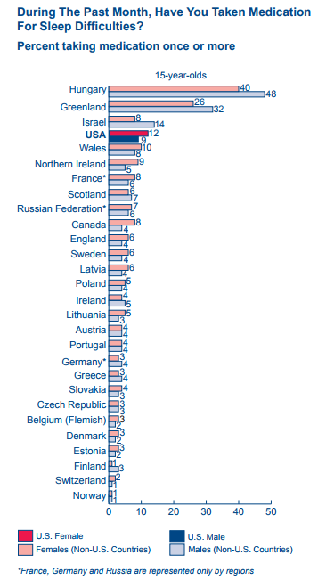
What didn't we know?
Students in the U.S. rank highest or among the top four countries in prevalence of stomachache, backache, headache, difficulty sleeping, feeling tired, and feeling low. Report of medication use for headache, stomachache, and difficulty sleeping is equally high, supporting high estimates of student reports for these symptoms. U.S. students are no more likely to feel lonely, but they are more likely to report feeling low at least once a week. Girls report higher levels of all these symptoms than boys, except for feeling tired.

Slide 44
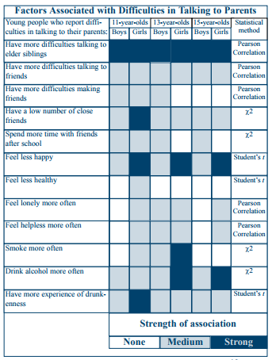
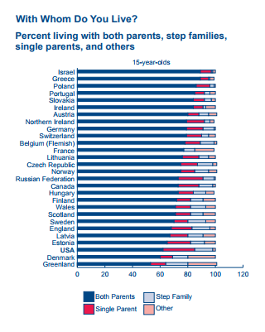
YOUTH LIVING CIRCUMSTANCES AND COMMUNICATION ISSUES

Slide 45
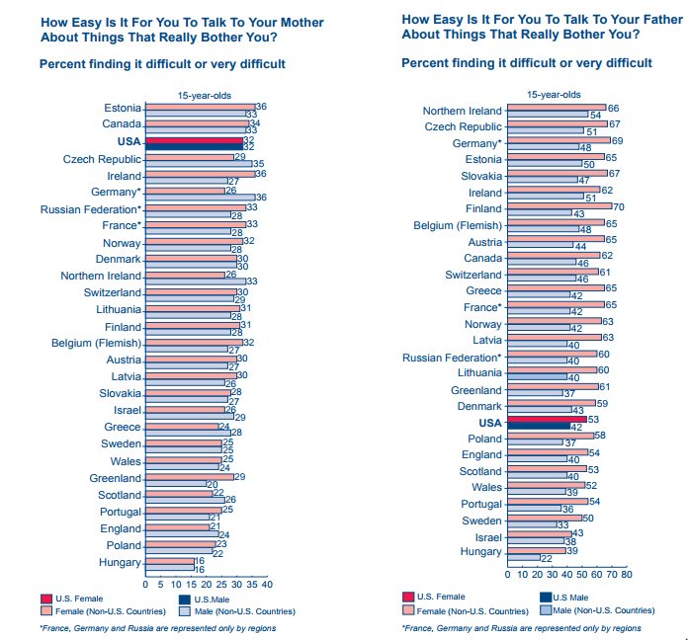
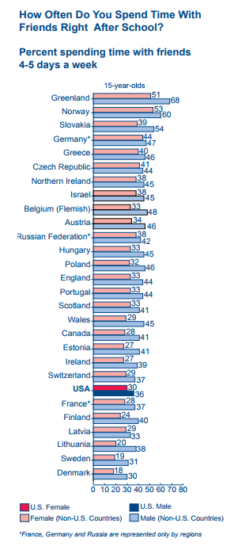
What didn't we know?

Slide 46
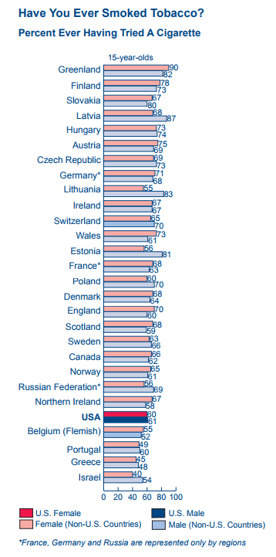
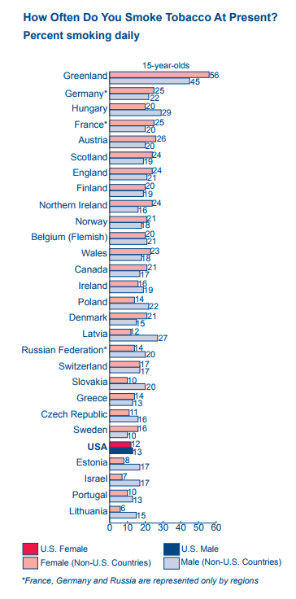
Promotion of youth development is a national movement that encourages programs to be based on a developmental framework that supports young people’s acquisition of personal and social skills. Acquisition of personal and social skills help youth to mature into healthy, economically self-sufficient, and happy adults who practice good citizenship and to thrive during adolescence. Both the Life Skills Training Program and the Midwest Prevention Project are examples of programs that promote youth development. This strategy, as evaluation results continue to grow across multiple programs, is poised to become the cornerstone of youth programming.

Slide 47
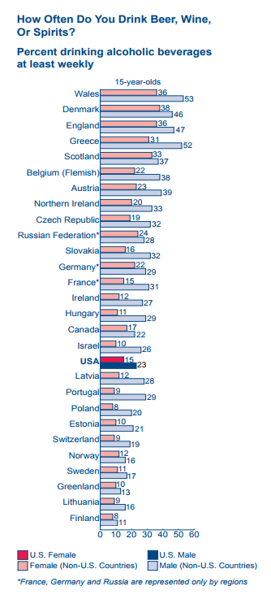
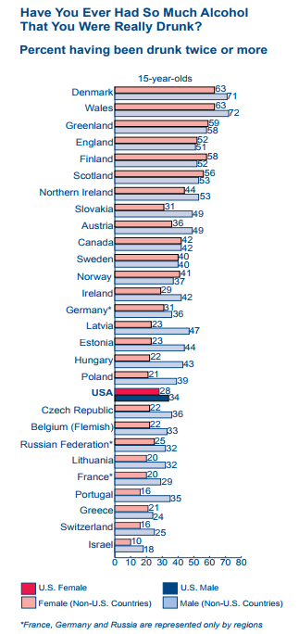
Multiple approaches are necessary to control tobacco and alcohol use; no single step appears effective by itself. Community-based interventions directed at preventing tobacco and alcohol use by youth have had variable success. Policy level interventions aimed at restricting substance use by youth, such as clean air laws, price increases through taxation, counter-advertising, and enforcement of existing laws restricting minors’ purchase of tobacco and alcohol products, need to be combined for maximum effectiveness.

Slide 48
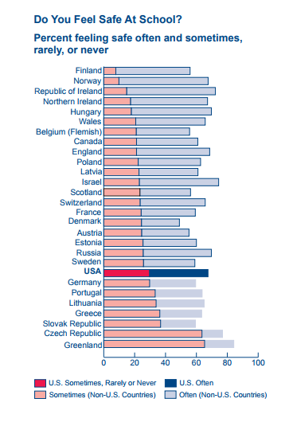

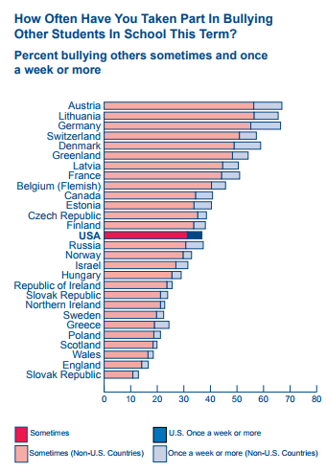
FEELING SAFE AT SCHOOL

Slide 49
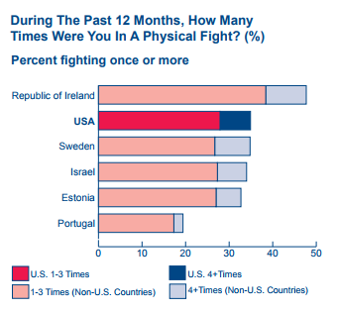
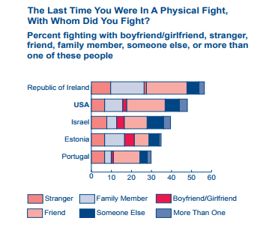
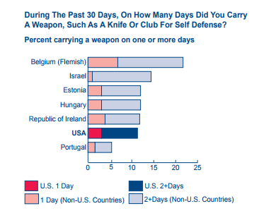
Reported violence

Slide 50
Violence
Since U.S. youth homicide rates are the highest among industrialized countries and suicide rates are among the highest, our concern for violent behavior is strong. U.S. homicides and suicides are most likely to involve firearms, accounting for more than 80 percent of all firearm fatalities to children and youth under age 15 in a study combining manner of death in 26 industrialized countries. Shootings at school have heightened our awareness of school safety.

Slide 51
What didn't we know?
As the National Academy of Sciences Report on the interplay of biological, behavioral, and societal influences emphasized, family and peer relationships are complex. Without longitudinal and genetic studies, the causal effects from family and peer relations remain difficult to trace. The limited family and peer relations factors measured by the Health Behavior in School-aged Children are only indicators of complex societal, family, and individual interactions. Part of the family context are the intergenerational and genetic influences working within the larger social and physical environment. Each student both influences and is influenced by the social network in which he or she lives.

Slide 52
Which of the following population groups is most likely to develop diabetes in their lifetime?
a. Black
b. White
c. Hispanic
d. Asian

Slide 53
Which of the following population
groups is most likely to develop diabetes in their lifetime?
a. Black
b. White
c. Hispanic
d. Asian

Slide 54
2. Which of the following population groups is most likely to seek healthcare in a delayed fashion due to cost related issues?
a. Black
b. White
c. Hispanic
d. Asian

Slide 55
2. Which of the following population groups is most likely to seek healthcare in a delayed fashion due to cost related issues?
a. Black
b. White
c. Hispanic
d. Asian

Slide 56
3. Do the goals of Healthy People 2010 Objectives with regard to obesity reduction seem to be on track to meet or exceed the objectives?
a. Yes
b. No

Slide 57
3. Do the goals of Healthy People 2010 Objectives with regard to obesity reduction seem to be on track to meet or exceed the objectives?
a. Yes
b. No

Slide 58
4. The goal of Healthy People 2010 Objectives is to reflect the very best in public health planning---it is comprehensive, was created by a broad coalition of experts from many sectors, has been designed to measure progress over time, and most importantly, it clearly lays out a series of objectives to bring better health to everyone in this country. Please indicate below whether the above statement is true or false.
a. True
b. False

Slide 59
4. The goal of Healthy People 2010 Objectives is to reflect the very best in public health planning---it is comprehensive, was created by a broad coalition of experts from many sectors, has been designed to measure progress over time, and most importantly, it clearly lays out a series of objectives to bring better health to everyone in this country. Please indicate below whether the above statement is true or false.
a. True
b. False

Slide 60
5. The Health Resources and Services Administration (HRSA), an agency of the U.S. Department of Health and Human Services (HHS), provides health care to people who are geographically isolated, and/or economically or medically vulnerable. HRSA also supports the training of health professionals, the distribution of providers to areas where they are needed most, and improvements in health care delivery. Please indicate below whether the above statements are true or false.
a. True
b. False

Slide 61
5. The Health Resources and Services Administration (HRSA), an agency of the U.S. Department of Health and Human Services (HHS), provides health care to people who are geographically isolated, and/or economically or medically vulnerable. HRSA also supports the training of health professionals, the distribution of providers to areas where they are needed most, and improvements in health care delivery. Please indicate below whether the above statements are true or false.
a. True
b. False

Slide 62
Conceptual higher learning
How will you be able to incorporate the health care outcomes and risk factors, and identify prominent chronic diseases affecting California’s populations then use that information to apply, analyze, and synthesize to provide better care to your patients? Please select all appropriate answers.
By realizing the importance with regard to finance and oversight provided by Health Resources and Services Administration (HRSA), an agency of the U.S. Department of Health and Human Services (HHS) and our partner, to assist me in caring for people who are geographically isolated, and/or economically or medically vulnerable.
By utilizing the power of past population data regarding the burden of disease to understand areas where care emphasis should be prioritized such as opioid crisis, gun and other violence, depression and suicide especially in school age children, diabetes, hypertension, and obesity to improve health care outcomes in the future.
By realizing the importance of being a partner with HRSA and of collecting data on an ongoing basis for development of goals involving population health which will yield valuable information to better take care of our patients in the more distant future.

Slide 63
Conceptual higher learning
How will you be able to incorporate the health care outcomes and risk factors, and identify prominent chronic diseases affecting California’s populations then use that information to apply, analyze, and synthesize to provide better care to your patients? Please select all appropriate answers.
By realizing the importance with regard to finance and oversight provided by Health Resources and Services Administration (HRSA), an agency of the U.S. Department of Health and Human Services (HHS) and our partner, to assist me in caring for people who are geographically isolated, and/or economically or medically vulnerable.
By utilizing the power of past population data regarding the burden of disease to understand areas where care emphasis should be prioritized such as opioid crisis, gun and other violence, depression and suicide especially in school age children, diabetes, hypertension, and obesity to improve health care outcomes in the future.
By realizing the importance of being a partner with HRSA and of collecting data on an ongoing basis for development of goals involving population health which will yield valuable information to better take care of our patients in the more distant future.

