Slide 1

MODULE two: overview of health systems in California

Slide 2
MODULE two:
SECTION three:
Heath law and
regulations

Slide 3

UNIT OBJECTIVE
To learn the laws and regulations related to the practice of medicine in the state of California to use as a foundation to apply, analyze, and synthesize those issues to optimize patient care.

Slide 4
Heath law and regulations
Laws concerning the provision of health services
Incorporation policy of the United States of America
Power of attorney
Do not resuscitate
The Health Insurance Portability and Accountability Act of 1996 (HIPAA)
Guidance Regarding Methods for De-identification of Protected Health Information in Accordance with HIPAA
Laws related to malpractice
CA differences
Federal Torts Claims Act
National Committee for Quality Assurance (NCQA)
Emergency Medical Treatment and Labor Act (EMTALA)

Slide 5


Slide 6
Federal Healthcare Laws & Regulations
Healthcare is a rewarding career field, but it can also be intimidating. Not only do you need to know important medical information inside and out, healthcare workers are also responsible for keeping up with complicated laws and regulations.
Federal healthcare laws are constantly changing. With everything else you have on your plate, it can feel like keeping up with federal healthcare regulations isn’t worth it. But all healthcare professionals should stay up-to-date on healthcare laws — even if you aren’t in the workforce yet.
“Becoming familiar with healthcare laws before you’re faced with a real-world challenge that requires that knowledge will go a long way,” says Michael Z. Stahl, Sr. VP of Health Markets. “It also lowers your chances of inadvertently violating the law once you do join the workforce.”
Federal healthcare laws can be confusing, but it’s essential for every healthcare professional to be familiar with them. We’re demystifying six healthcare regulations you need to know. Thanks to this breakdown from our experts, you’ll be prepared to act within the law in the healthcare field.

Slide 7
Federal Healthcare
Laws & Regulations
You may have joined the healthcare field because you want to make a difference in patient’s lives, but federal healthcare laws can also be a big part of your daily work.
“Healthcare compliance is a major concern, and you should be aware and prepared for the challenges that you will face when you enter the workforce,” says, health information management program coordinator.
Enter this healthcare career with all the knowledge you need about these six important federal healthcare laws.

Slide 8
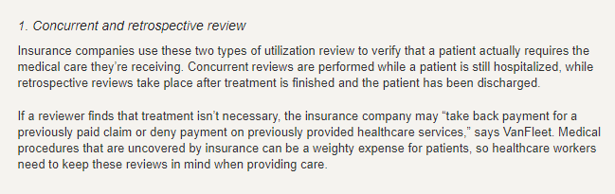
Federal Healthcare Laws & Regulations

Slide 9
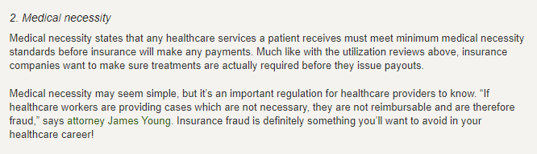
Federal Healthcare Laws & Regulations

Slide 10
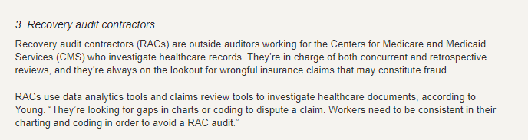
Federal Healthcare Laws & Regulations

Slide 11
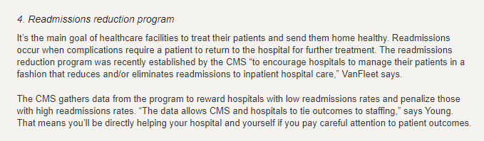
Federal Healthcare Laws & Regulations

Slide 12
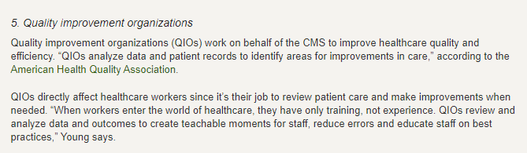
Federal Healthcare Laws & Regulations

Slide 13
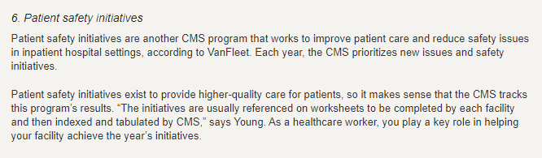
Federal Healthcare Laws & Regulations

Slide 14
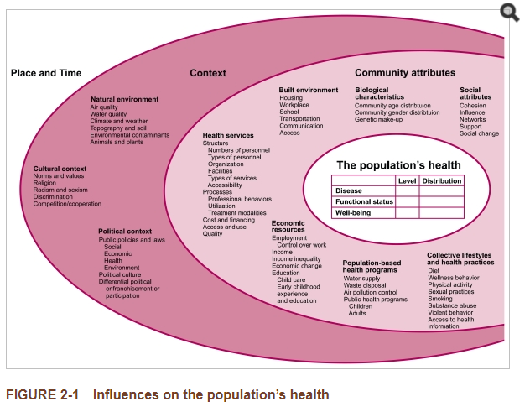

Slide 15
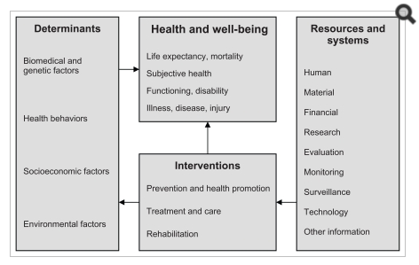

Slide 16
Incorporation policy of the
United States of America
United States corporate law regulates the governance, finance and power of corporations in US law. Every state and territory has its own basic corporate code, while federal law creates minimum standards for trade in company shares and governance rights, found mostly in the Securities Act of 1933 and the Securities and Exchange Act of 1934, as amended by laws like the Sarbanes-Oxley Act of 2002 and the Dodd-Frank Act of 2010. The US Constitution was interpreted by the US Supreme Court to allow corporations to incorporate in the state of their choice, regardless of where their headquarters are. Over the 20th century, most major corporations incorporated under the Delaware General Corporation Law, which offered lower corporate taxes, fewer shareholder rights against directors, and developed a specialized court and legal profession. Nevada has done the same. Twenty-four states follow the Model Business Corporation Act, while New York and California are important due to their size.

Slide 17

Power of Attorney

Slide 18
Do-not-resuscitate order
A do-not-resuscitate order, or DNR order, is a medical order written by a doctor. It instructs health care providers not to do cardiopulmonary resuscitation (CPR) if a patient's breathing stops or if the patient's heart stops beating.
A DNR order is created, or set up, before an emergency occurs. A DNR order allows you to choose whether or not you want CPR in an emergency. It is specific about CPR. It does not have instructions for other treatments, such as pain medicine, other medicines, or nutrition.
The doctor writes the order only after talking about it with the patient (if possible), the proxy, or the patient's family.

Slide 19
What is Resuscitation with regard to DNR?
CPR is the treatment you receive when your blood flow or breathing stops. It may involve:
Simple efforts such as mouth-to-mouth breathing and chest compressions
Electric shock to restart the heart
Breathing tubes (endotracheal) to open the airway
Medicines

Slide 20
Making the Decision---
Patient persective
If you are near the end of your life or you have an illness that will not improve, you can choose whether you want CPR to be done.
If you do want to receive CPR, you do not have to do anything.
If you do not want CPR, talk with your doctor about a DNR order.
These can be hard choices for you and those who are close to you. There is no hard and fast rule about what you may choose.
Think about the issue while you are still able to decide for yourself.
Learn more about your medical condition and what to expect in the future.
Talk to your doctor about the pros and cons of CPR.
A DNR order may be a part of a hospice care plan. The focus of this care is not to prolong life, but to treat symptoms of pain or shortness of breath, and to maintain comfort.
If you have a DNR order, you always have the right to change your mind and request CPR.

Slide 21
How is a DNR Order Created?
If you decide you want a DNR order, tell your doctor and health care team what you want. Your doctor must follow your wishes, or:
Your doctor may transfer your care to a doctor who will carry out your wishes.
If you are a patient in a hospital or nursing home, your doctor must agree to settle any disputes within 72 hours so that your wishes are followed.
The doctor can fill out the form for the DNR order.
The doctor writes the DNR order on your medical chart if you are in the hospital.
Your doctor can tell you how to get a wallet card, bracelet, or other DNR documents to have at home or in non-hospital settings.
Standard forms may be available from your state's Department of Health.
Make sure to:
Include your wishes in a living will or health care power of attorney.
Inform your health care agent and family of your decision.
If you do change your mind, talk with your doctor or health care team right away. Also tell your family and caregivers about your decision. Destroy any documents you have that include the DNR order.

Slide 22
When You are Unable to Make the Decision
Due to illness or injury, you may not be able to state your wishes about CPR. In this case:
If your doctor has already written a DNR order at your request, your family may not override it.
You may have named someone to speak for you, such as a health care agent. If so, this person or a legal guardian can agree to a DNR order for you.
If you have not named someone to speak for you, a family member or friend can agree to a DNR order for you, but only when you are not able to make your own medical decisions.

Slide 23

Alternative Names
No code; End-of-life; Do not resuscitate; Do not resuscitate order; DNR; DNR order; Advance care directive - DNR; Health care agent - DNR; Health care proxy - DNR; End-of-life - DNR; Living will – DNR

Slide 24


Slide 25


Slide 26


Slide 27
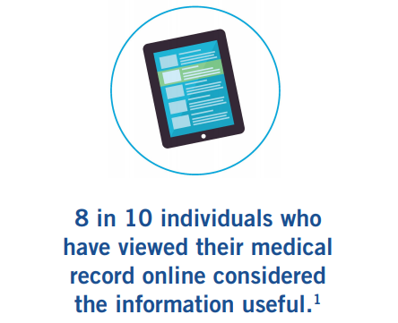

Slide 28
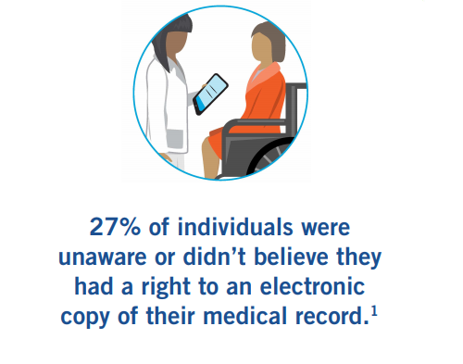

Slide 29
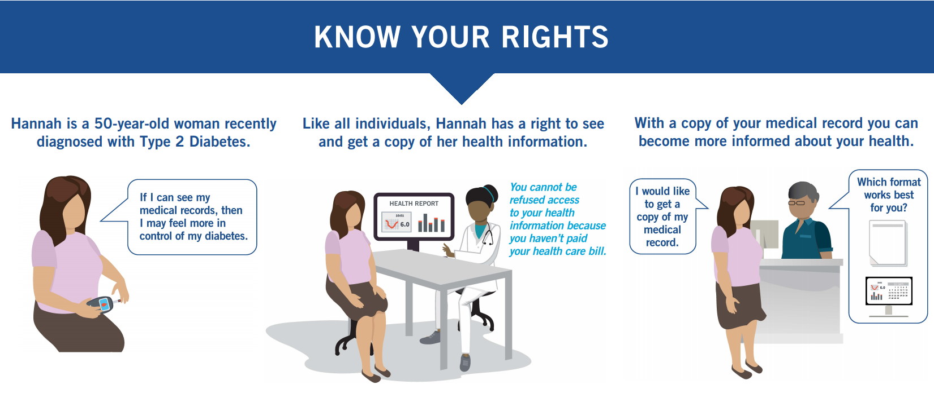
RIGHTS TO MEDICAL RECORD ACCESS

Slide 30

THE PATIENT HOLDS THE KEY
TO THEIR MEDICAL INFORMATION

Slide 31
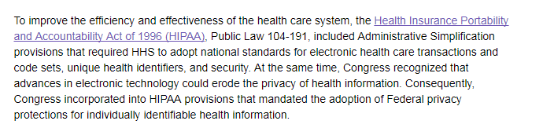
HIPAA for Professionals

Slide 32
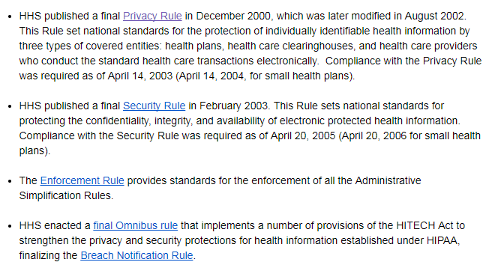
HIPAA for Professionals

Slide 33
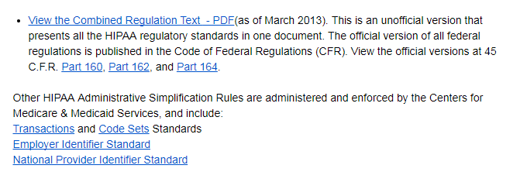
HIPAA for Professionals

Slide 34
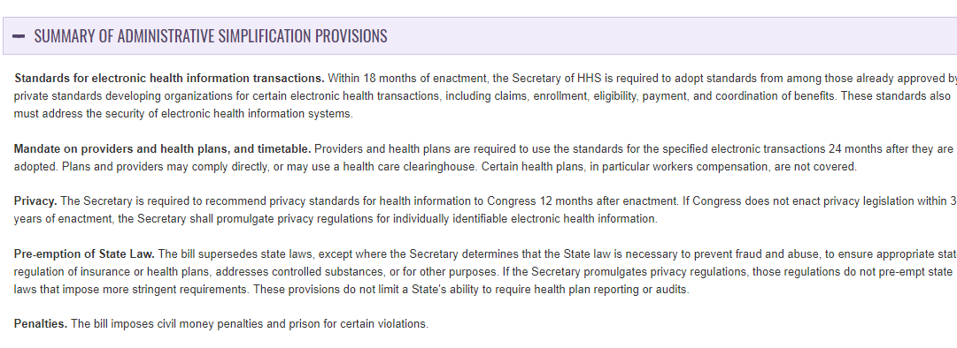
HIPAA for Professionals

Slide 35
Summary of the HIPAA Privacy Rule
The Standards for Privacy of Individually Identifiable Health Information (“Privacy Rule”) establishes, for the first time, a set of national standards for the protection of certain health information.
The U.S. Department of Health and Human Services (“HHS”) issued the Privacy Rule to implement the requirement of the Health Insurance Portability and Accountability Act of 1996 (“HIPAA”).
The Privacy Rule standards address the use and disclosure of individuals’ health information—called “protected health information” by organizations subject to the Privacy Rule — called “covered entities,” as well as standards for individuals' privacy rights to understand and control how their health information is used.
Within HHS, the Office for Civil Rights (“OCR”) has responsibility for implementing and enforcing the Privacy Rule with respect to voluntary compliance activities and civil money penalties.
A major goal of the Privacy Rule is to assure that individuals’ health information is properly protected while allowing the flow of health information needed to provide and promote high quality health care and to protect the public's health and well being.
The Rule strikes a balance that permits important uses of information, while protecting the privacy of people who seek care and healing.
Given that the health care marketplace is diverse, the Rule is designed to be flexible and comprehensive to cover the variety of uses and disclosures that need to be addressed.

Slide 36
Statutory & Regulatory Background
The Health Insurance Portability and Accountability Act of 1996 (HIPAA), Public Law 104-191, was enacted on August 21, 1996. Sections 261 through 264 of HIPAA require the Secretary of HHS to publicize standards for the electronic exchange, privacy and security of health information. Collectively these are known as the Administrative Simplification provisions.
HIPAA required the Secretary to issue privacy regulations governing individually identifiable health information, if Congress did not enact privacy legislation within three years of the passage of HIPAA.
Because Congress did not enact privacy legislation, HHS developed a proposed rule and released it for public comment on November 3, 1999. The Department received over 52,000 public comments.
The final regulation, the Privacy Rule, was published December 28, 2000.2 In March 2002, the Department proposed and released for public comment modifications to the Privacy Rule. The Department received over 11,000 comments.
The final modifications were published in final form on August 14, 2002.3 A text combining the final regulation and the modifications can be found at 45 CFR Part 160 and Part 164, Subparts A and E on the OCR website: http://www.hhs.gov/ocr/hipaa.

Slide 37
Who is Covered by the Privacy Rule
The Privacy Rule, as well as all the Administrative Simplification rules, apply to health plans, health care clearinghouses, and to any health care provider who transmits health information in electronic form in connection with transactions for which the Secretary of HHS has adopted standards under HIPAA (the “covered entities”).
For help in determining whether you are covered, use the decision tool at: http://www.cms.hhs.gov/hipaa/hipaa2/support/tools/decisionsupport/default.asp.

Slide 38
Who is Covered by the Privacy Rule
Health Plans
Individual and group plans that provide or pay the cost of medical care are covered entities.
Health plans include health, dental, vision, and prescription drug insurers, health maintenance organizations (“HMOs”), Medicare, Medicaid, Medicare + Choice and Medicare supplement insurers, and long-term care insurers (excluding nursing home fixed-indemnity policies).
Health plans also include employer-sponsored group health plans, government and church-sponsored health plans, and multi-employer health plans.
There are exceptions—a group health plan with less than 50 participants that is administered solely by the employer that established and maintains the plan is not a covered entity.
Two types of government funded programs are not health plans: (1) those whose principal purpose is not providing or paying the cost of health care, such as the food stamps program; and (2) those programs whose principal activity is directly providing health care, such as a community health center, or the making of grants to fund the direct provision of health care.
Certain types of insurance entities are also not health plans, including entities providing only workers’ compensation, automobile insurance, and property and casualty insurance.

Slide 39
Who is Covered by the Privacy Rule
Health Care Providers
Every health care provider, regardless of size, who electronically transmits health information in connection with certain transactions, is a covered entity. These transactions include claims, benefit eligibility inquiries, referral authorization requests, or other transactions for which HHS has established standards under the HIPAA Transactions Rule.
Using electronic technology, such as email, does not mean a health care provider is a covered entity; the transmission must be in connection with a standard transaction. The Privacy Rule covers a health care provider whether it electronically transmits these transactions directly or uses a billing service or other third party to do so on its behalf. Health care providers include all “providers of services” (e.g., institutional providers such as hospitals) and “providers of medical or health services” (e.g., non-institutional providers such as physicians, dentists and other practitioners) as defined by Medicare, and any other person or organization that furnishes, bills, or is paid for health care.

Slide 40
Who is Covered by the Privacy Rule
Health Care Clearinghouses
Health care clearinghouses are entities that process nonstandard information they receive from another entity into a standard (i.e., standard format or data content), or vice versa.
In most instances, health care clearinghouses will receive individually identifiable health information only when they are providing these processing services to a health plan or health care provider as a business associate.
In such instances, only certain provisions of the Privacy Rule are applicable to the health care clearinghouse’s uses and disclosures of protected health information.
Health care clearinghouses include billing services, repricing companies, community health management information systems, and value-added networks and switches if these entities perform clearinghouse functions.

Slide 41
What Information is Protected
Protected Health Information
The Privacy Rule protects all "individually identifiable health information" held or transmitted by a covered entity or its business associate, in any form or media, whether electronic, paper, or oral.
The Privacy Rule calls this information "protected health information (PHI)."

Slide 42
Business Associates
Business Associate Defined
In general, a business associate is a person or organization, other than a member of a covered entity's workforce, that performs certain functions or activities on behalf of, or provides certain services to, a covered entity that involve the use or disclosure of individually identifiable health information.
Business associate functions or activities on behalf of a covered entity include claims processing, data analysis, utilization review, and billing. Business associate services to a covered entity are limited to legal, actuarial, accounting, consulting, data aggregation, management, administrative, accreditation, or financial services.
However, persons or organizations are not considered business associates if their functions or services do not involve the use or disclosure of protected health information, and where any access to protected health information by such persons would be incidental, if at all.
A covered entity can be the business associate of another covered entity.

Slide 43
Business Associates
Business Associate Contract
When a covered entity uses a contractor or other non-workforce member to perform "business associate" services or activities, the Rule requires that the covered entity include certain protections for the information in a business associate agreement (in certain circumstances governmental entities may use alternative means to achieve the same protections).
In the business associate contract, a covered entity must impose specified written safeguards on the individually identifiable health information used or disclosed by its business associates.
Moreover, a covered entity may not contractually authorize its business associate to make any use or disclosure of protected health information that would violate the Rule.
Covered entities that have an existing written contract or agreement with business associates prior to October 15, 2002, which is not renewed or modified prior to April 14, 2003, are permitted to continue to operate under that contract until they renew the contract or April 14, 2004, whichever is first.
Sample business associate contract language is available on the OCR website at: http://www.hhs.gov/ocr/hipaa/contractprov.html.
Also see OCR “Business Associate” Guidance.

Slide 44
De-Identified Health Information
There are no restrictions on the use or disclosure of de-identified health information.
De-identified health information neither identifies nor provides a reasonable basis to identify an individual.
There are two ways to de-identify information; either:
1) a formal determination by a qualified statistician.
2) the removal of specified identifiers of the individual and of the individual’s relatives, household members, and employers is required, and is adequate only if the covered entity has no actual knowledge that the remaining information could be used to identify the individual.

Slide 45
General Principle for Uses and Disclosures
Basic Principle. A major purpose of the Privacy Rule is to define and limit the circumstances in which an individual’s protected heath information may be used or disclosed by covered entities. A covered entity may not use or disclose protected health information, except either: (1) as the Privacy Rule permits or requires; or (2) as the individual who is the subject of the information (or the individual’s personal representative) authorizes in writing.
Required Disclosures. A covered entity must disclose protected health information in only two situations: (a) to individuals (or their personal representatives) specifically when they request access to, or an accounting of disclosures of, their protected health information; and (b) to HHS when it is undertaking a compliance investigation or review or enforcement action. See OCR “Government Access” Guidance.

Slide 46
Permitted Uses and Disclosures
Permitted Uses and Disclosures
A covered entity is permitted, but not required, to use and disclose protected health information, without an individual’s authorization, for the following purposes or situations: (1) To the Individual (unless required for access or accounting of disclosures); (2) Treatment, Payment, and Health Care Operations; (3) Opportunity to Agree or Object; (4) Incident to an otherwise permitted use and disclosure; (5) Public Interest and Benefit Activities; and (6) Limited Data Set for the purposes of research, public health or health care operations. Covered entities may rely on professional ethics and best judgments in deciding which of these permissive uses and disclosures to make.

Slide 47
Medical Malpractice in the United States
Medical malpractice law in the United States is derived from English common law, and was developed by rulings in various state courts.
Medical malpractice lawsuits are a relatively common occurrence in the United States.
The legal system is designed to encourage extensive discovery and negotiations between adversarial parties with the goal of resolving the dispute without going to jury trial.
The injured patient must show that the physician acted negligently in rendering care, and that such negligence resulted in injury.
To do so, four legal elements must be proven: (1) a professional duty owed to the patient; (2) breach of such duty; (3) injury caused by the breach; and (4) resulting damages.
Money damages, if awarded, typically take into account both actual economic
loss and noneconomic loss, such as pain and suffering.

Slide 48
California Medical Malpractice Laws
Statutes of Limitations, which are statutory laws restricting the potential claimant to a period following an incident of medical malpractice in which a lawsuit in California must be filed.
Comparative negligence laws, which in California and other state jurisdictions, may prevent a claimant from filing a medical malpractice lawsuit in the event of proportional liability, negligence on behalf of the claimant, or other instances of shared responsibility for fault in a medical malpractice incident, which may bar claimants in certain instances from filing lawsuits
Tort feasor liability, which is also known as the joint and several liabilities and falls broadly under comparative negligence laws in California medical malpractice law, Includes instances whereby defendants are held jointly responsible for the injury and damages. There is a rather extensive set of exemptions, exceptions, and other case-specific elements to consider including non-economic damages and several liabilities under California medical malpractice law.
Expert testimony requirements, which include medical expert affidavit filings in certain states as a prerequisite to filing a viable medical malpractice lawsuit, are required in California, and in short, serve as proof or grounds for filing a viable malpractice claim against a specific medical healthcare provider with an expert’s opinion that this given provider was, in fact, negligent in conduct
Statutory Caps, which include restrictions or limits on the amount of money recoverable in a medical malpractice lawsuit in many states, can greatly influence the economic calculus influencing any proposed medical malpractice lawsuit’s value

Slide 49
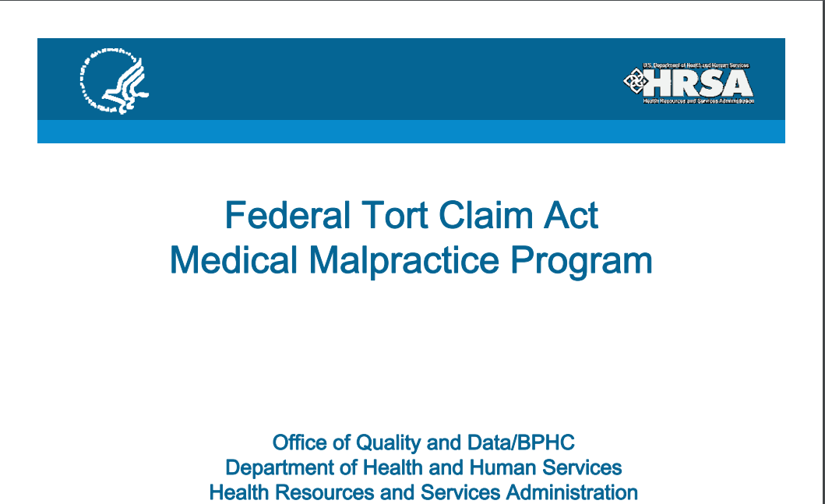

Slide 50
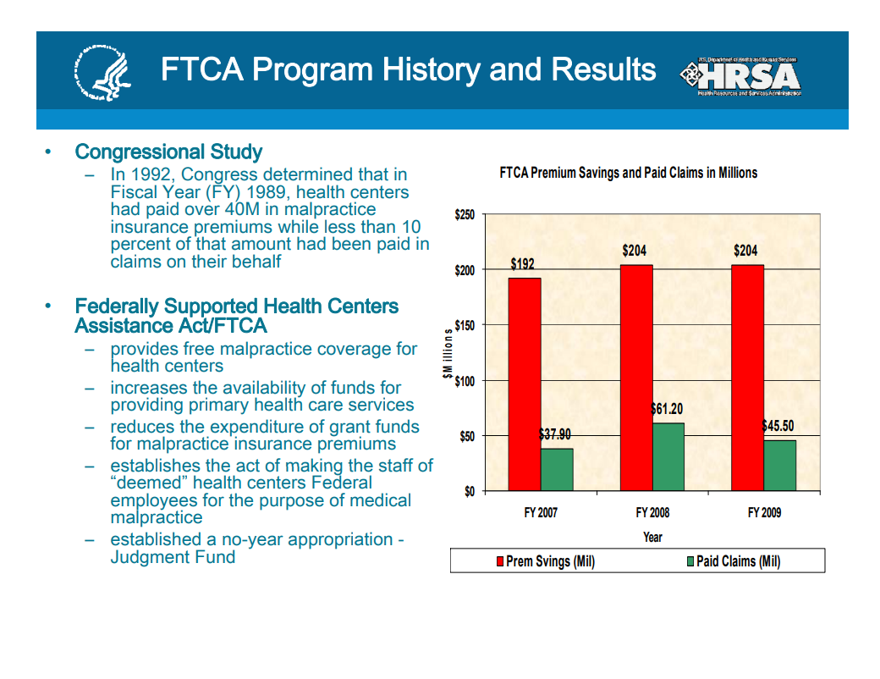

Slide 51
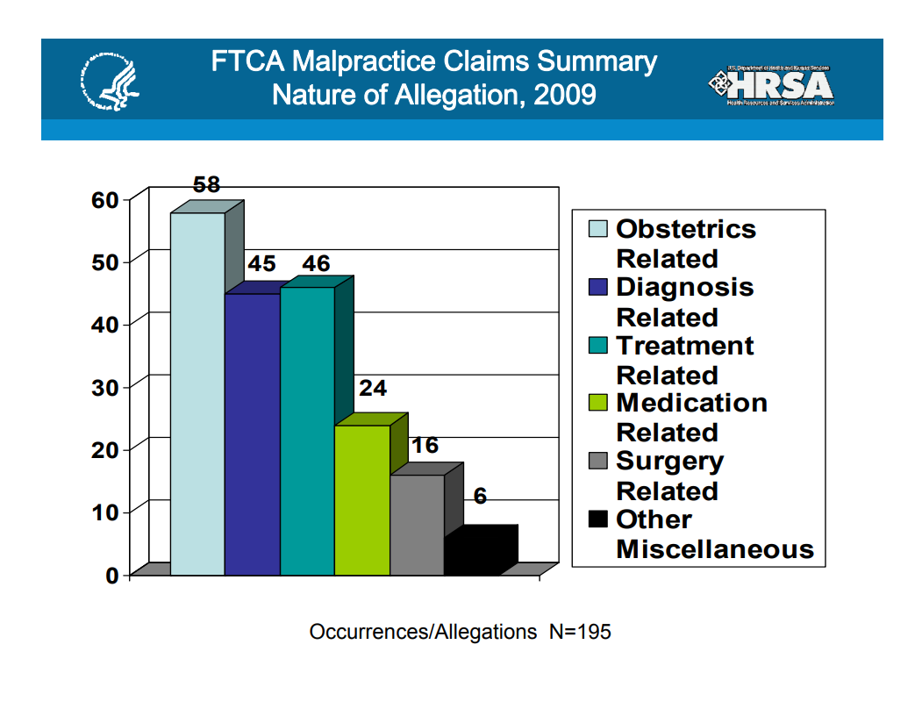

Slide 52
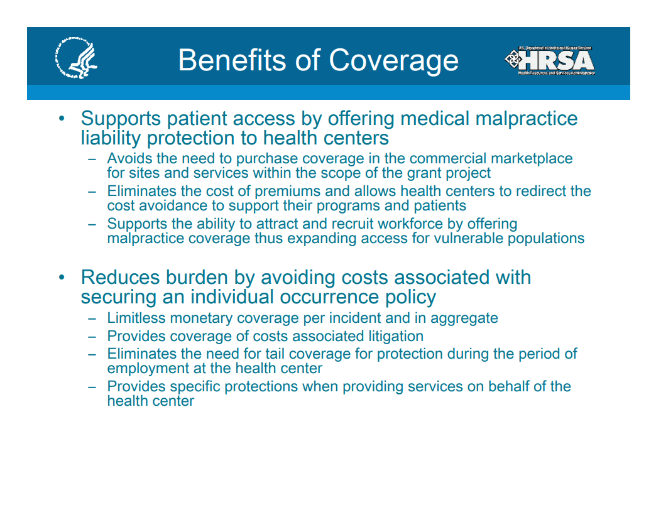

Slide 53
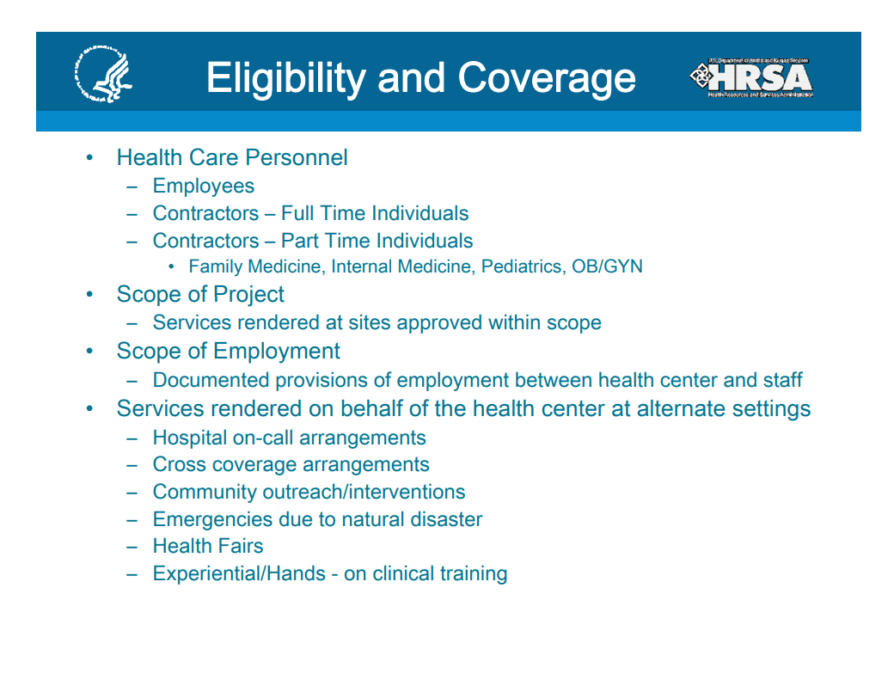

Slide 54
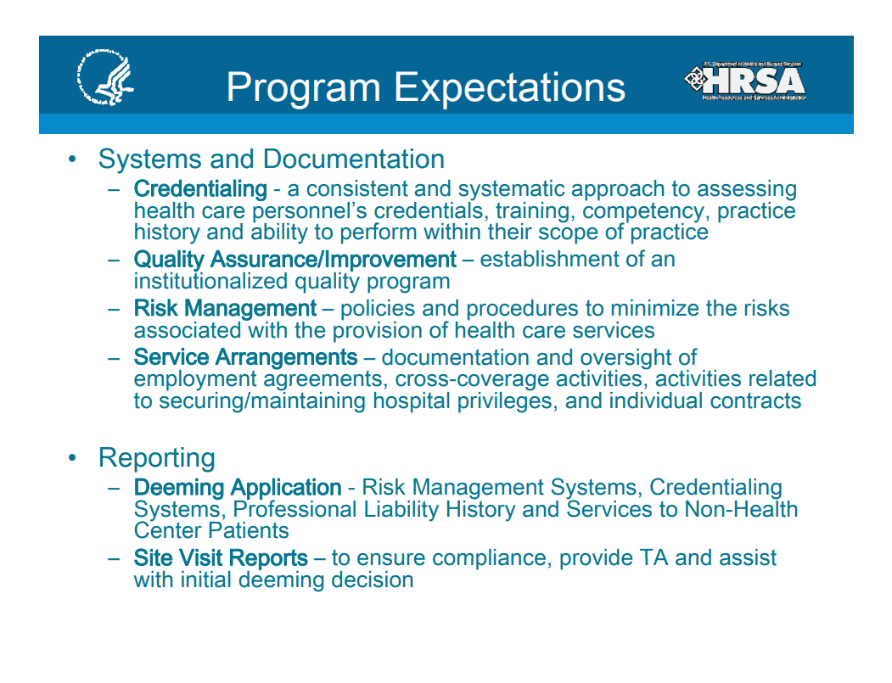

Slide 55
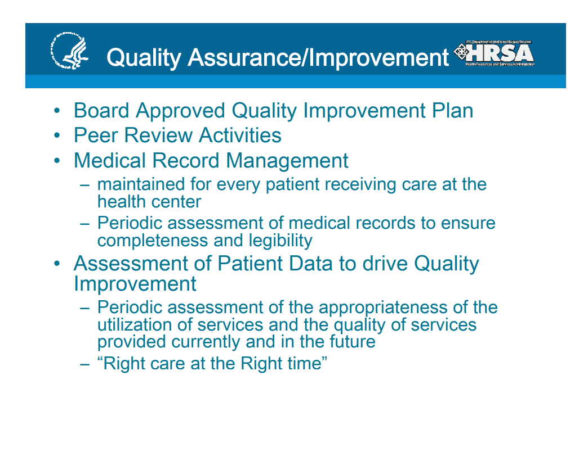

Slide 56
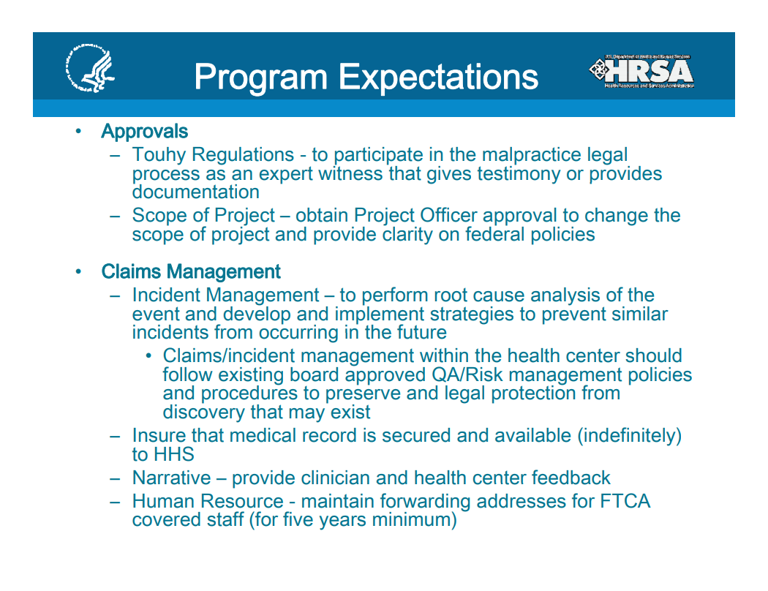

Slide 57
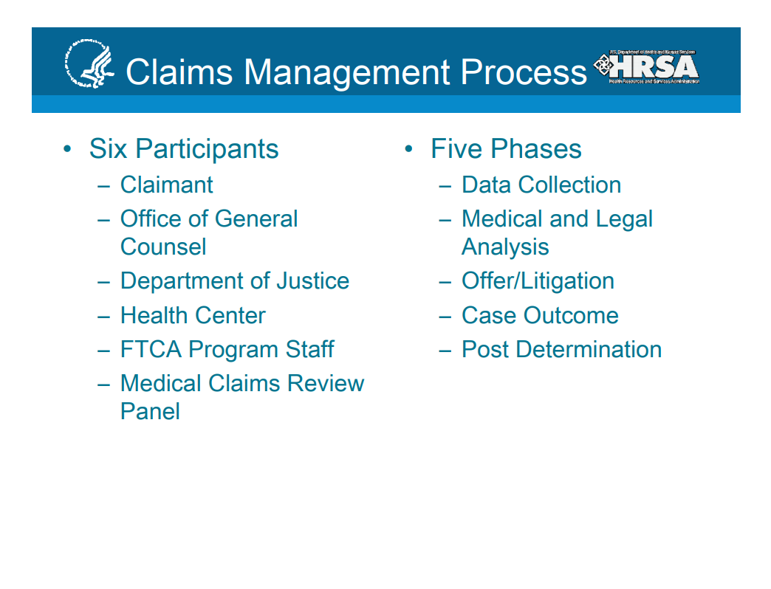

Slide 58
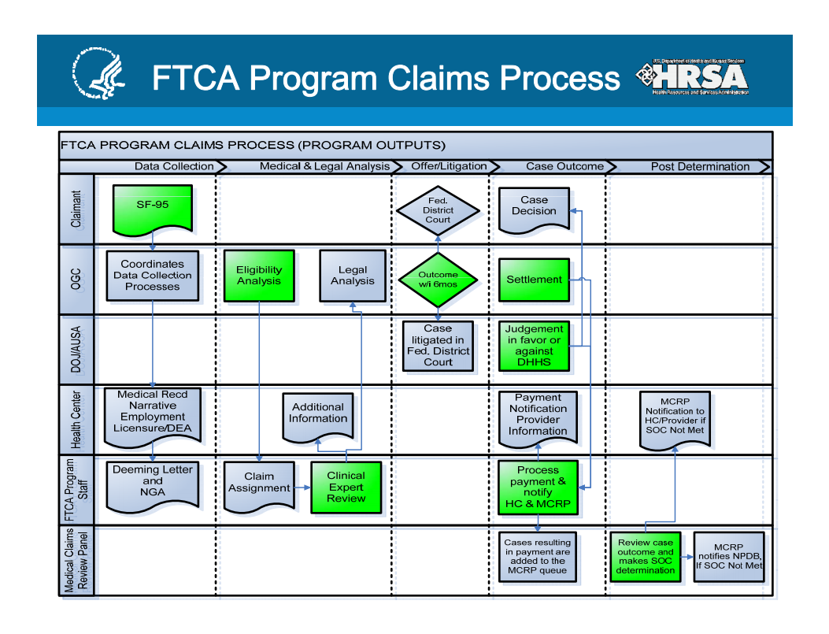

Slide 59
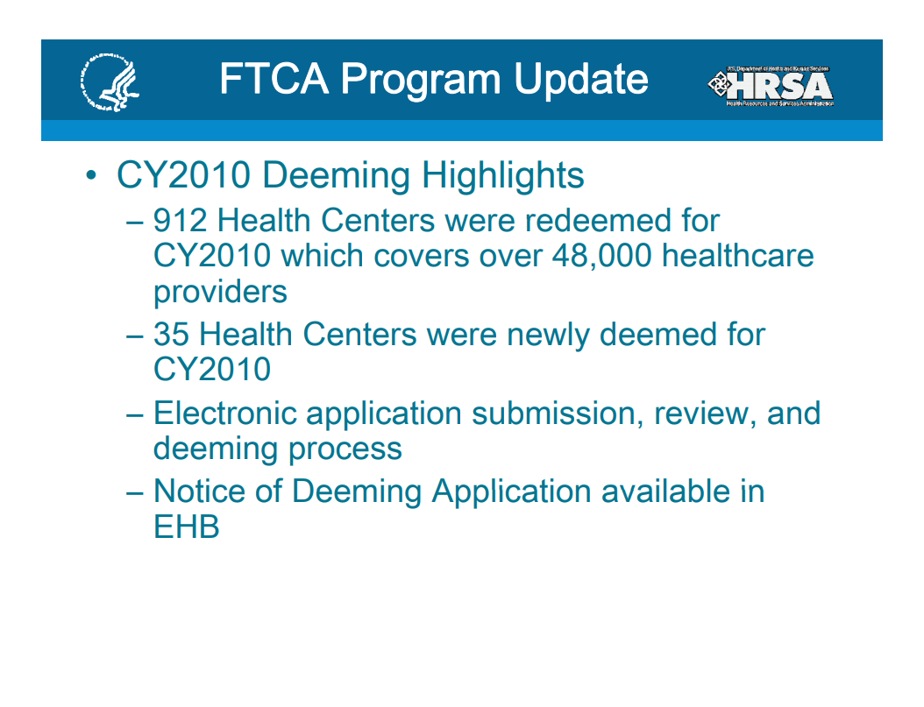

Slide 60
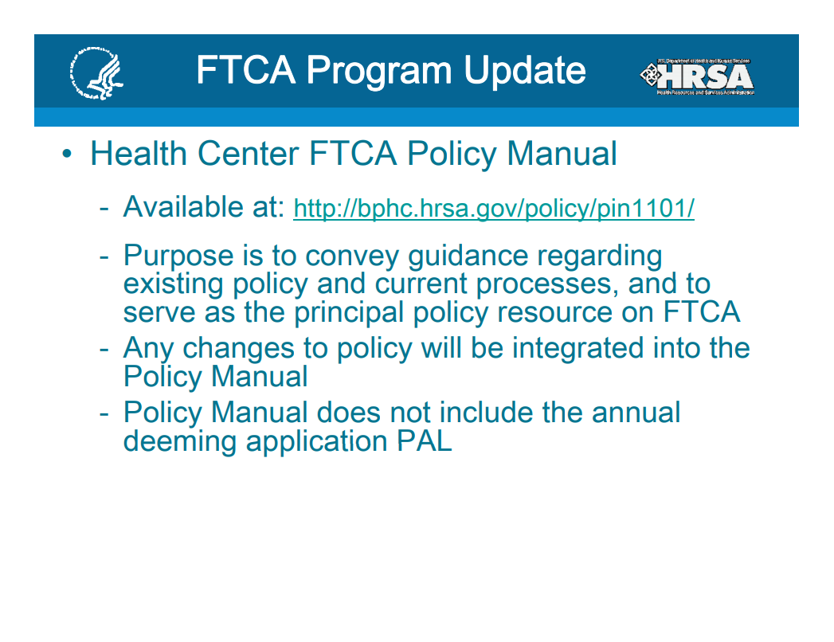

Slide 61
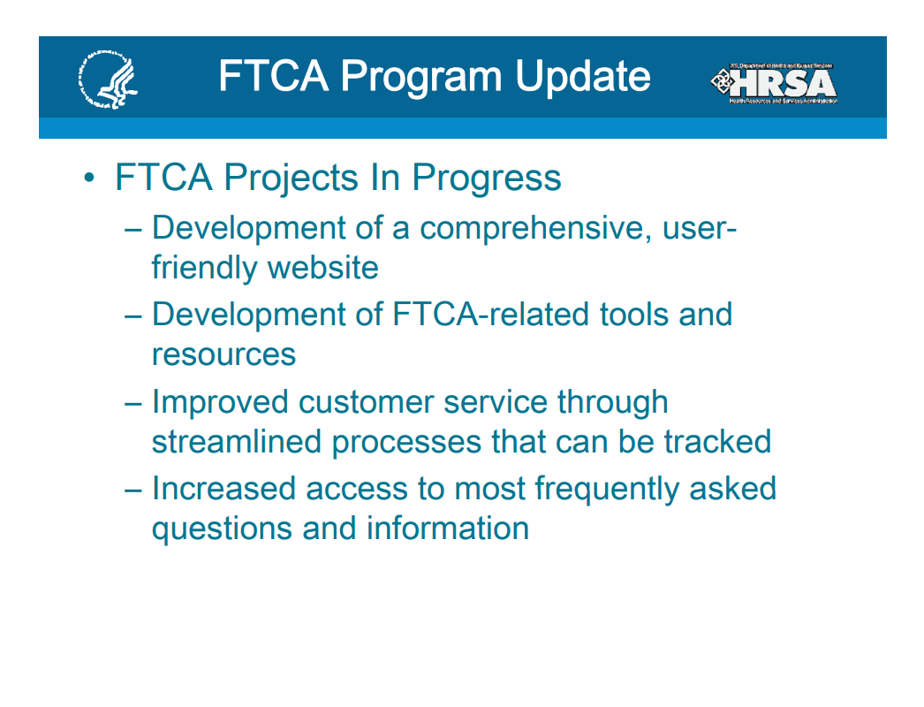

Slide 62
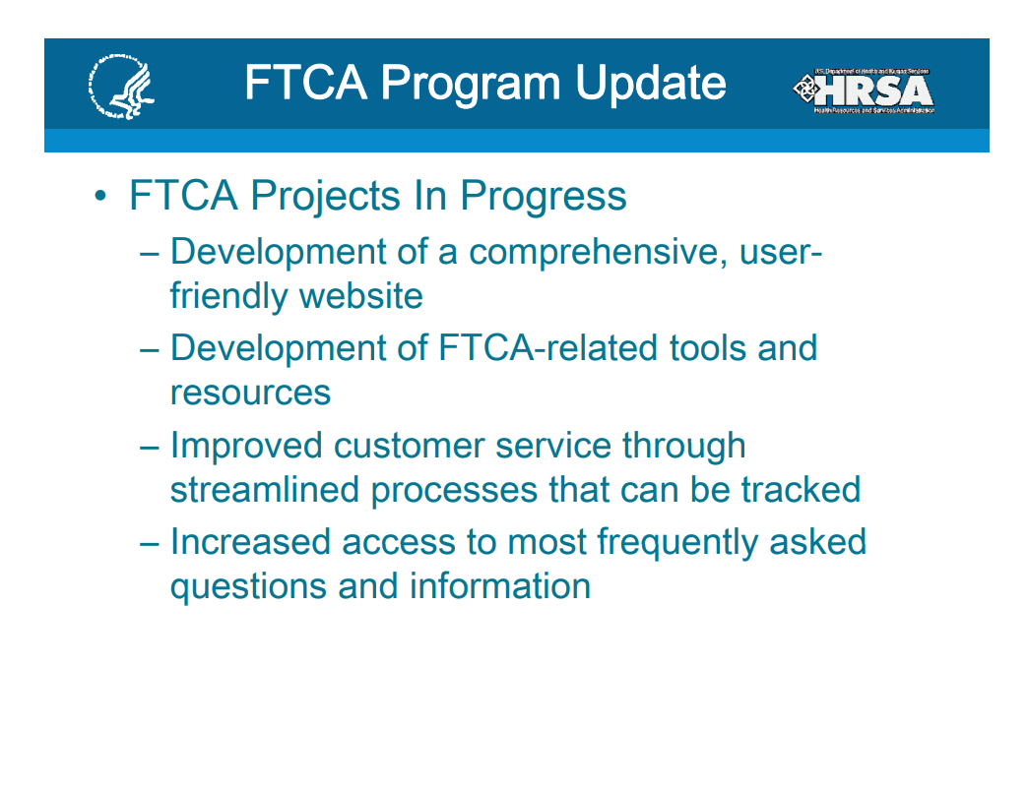

Slide 63
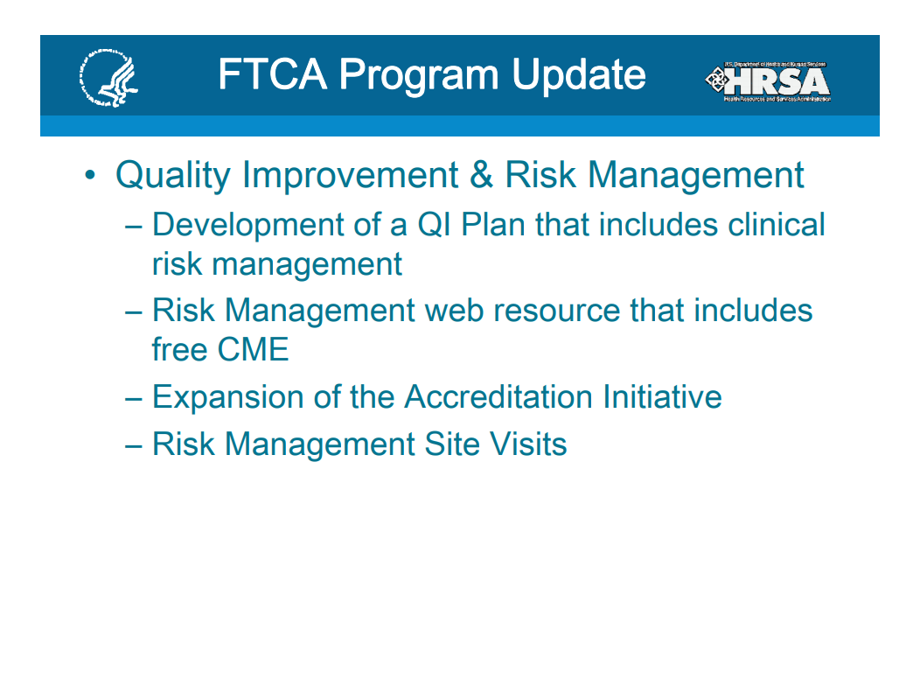

Slide 64
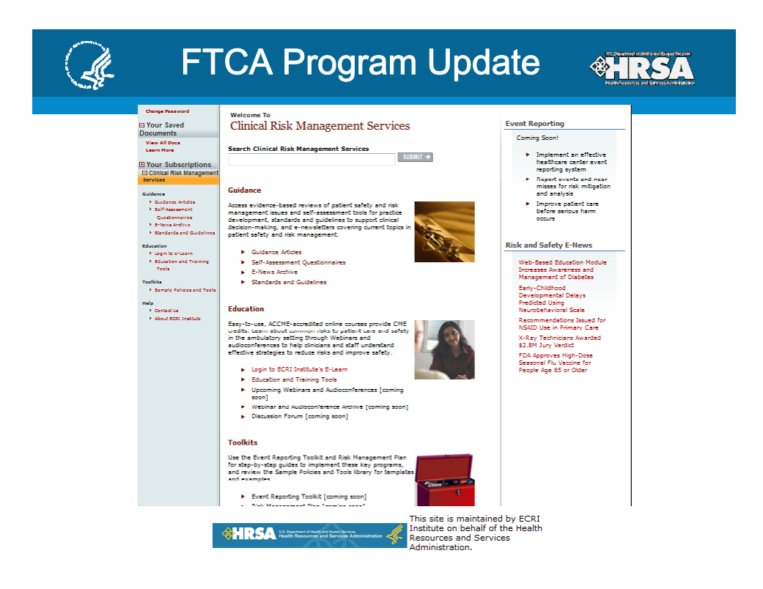
Clinical Risk Management Services

Slide 65
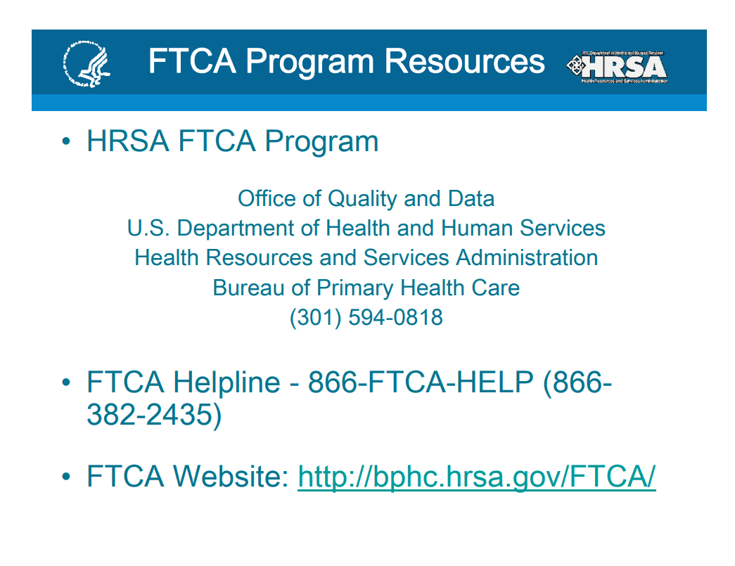

Slide 66
FTCA applies if:
The entity is “deemed eligible” – application required
Actions are within the scope of employment
Within the requirements of the job description
Within the approved scope of assigned project under employment

Slide 67
FTCA does not apply to:
Activities occurring before being deemed eligible
Directors and officers claims (not medical malpractice)
Activities outside the scope of employment such as sexual misconduct

Slide 68

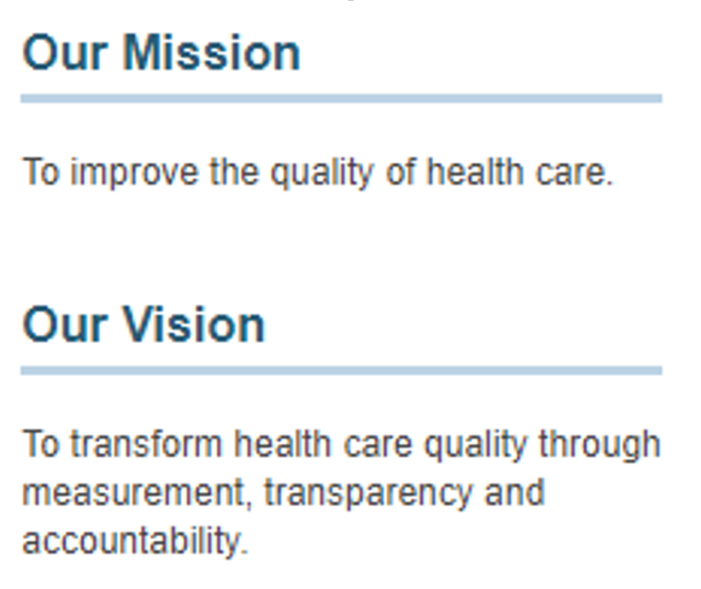


NATIONAL COMMISSION
OF QUALITY ASSURANCE

Slide 69
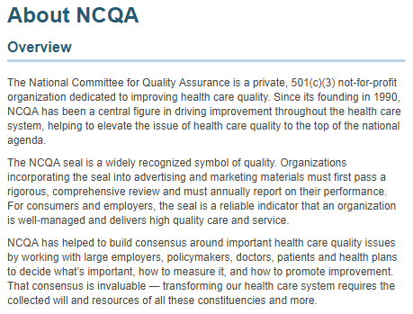


Slide 70
1. What is EMTALA?
The Emergency Medical Treatment and Active Labor Act is a statute which governs when and how a patient may be (1) refused treatment or (2) transferred from one hospital to another when he is in an unstable medical
condition.
EMTALA was passed as part of the Consolidated Omnibus Budget Reconciliation Act of 1986, and it is sometimes referred to as "the COBRA law". In fact, a number of different laws come under that general name. Another very familiar provision, also referred to under the COBRA name, is the statute governing continuation of medical insurance benefits after termination of employment.
Reportedly, a 1989 amendment to the statute removed the word "active" from the official name of the statute. The amendment, however, cannot be found in the report of the official public law.
EMTALA is Section 1867(a) of the Social Security Act, within the section of the U.S. Code which governs Medicare.

Slide 71
1. What is EMTALA?
EMTALA applies only to "participating hospitals" -- i.e., to hospitals which have entered into "provider agreements" under which they will accept payment from the Department of Health and Human Services, Centers for
Medicare and Medicaid Services (CMS) under the Medicare program for services provided to beneficiaries of that program. In practical terms, this means that it applies to virtually all hospitals in the U.S., with the exception of the Shriners' Hospital for Crippled Children and many military hospitals. Its provisions apply to all patients, and not just to Medicare patients. (See Section 15 below.)

Slide 72
1. What is EMTALA?
The avowed purpose of the statute is to prevent hospitals from rejecting patients, refusing to treat them, or transferring them to "charity hospitals" or "county hospitals" because they are unable to pay or are covered under
the Medicare or Medicaid programs. This purpose, however, does not limit the coverage of its provisions -- see Sections 15 and 16 below.

Slide 73
1. What is EMTALA?
EMTALA is primarily but not exclusively a non-discrimination statute. One would cover most of its purpose and effect by characterizing it as providing that no patient who presents with an emergency medical condition and
who is unable to pay may be treated differently than patients who are covered by health insurance. That is not the entire scope of EMTALA, however; it imposes affirmative obligations which go beyond non-discrimination.
See Section 16 below.

Slide 74
TERMINOLOGY USED
EMTALA - The Emergency Medical Treatment and Active Labor Act
COBRA - The Consolidated Omnibus Budget Reconciliation Act of 1986
HCFA - The Health Care Financing Administration - previous name for CMS
CMS - Centers for Medicare and Medicaid Services, a division of the Department of Health and Human Services. Responsible for the Medicare program and the development and enforcement of regulations on EMTALA.
Transferring hospital - A facility at which a patient is seen initially and whose personnel determine that transfer to another facility is warranted
Receiving hospital - A facility to which a patient is transferred; it may or may not constitute a "regional referral center" as that term is used elsewhere in the Medicare statute and (at one point) in EMTALA.

Slide 75
2. What are the provisions of EMTALA?
The essential provisions of the statute are as follows:
Any patient who "comes to the emergency department" requesting "examination or treatment for a medical condition" must be provided with "an appropriate medical screening examination" to determine
if he is suffering from an "emergency medical condition". If he is, then the hospital is obligated to either provide him with treatment until he is stable or to transfer him to another hospital in conformance with
the statute's directives.

Slide 76
2. What are the provisions of EMTALA?
If the patient does not have an "emergency medical condition", the statute imposes no further obligation on the hospital.
A pregnant woman who presents in active labor must, for all practical purposes, be admitted and treated until delivery is completed, unless a transfer under the statute is appropriate.
The statute explicitly provides that this must include delivery of the placenta.
In essence, then, the statute: imposes restrictions on transfers of persons who exhibit an "emergency medical condition" or are in active labor, which restrictions may or may not be limited to transfers made for economic reasons;
imposes an affirmative duty to institute treatment if an "emergency medical condition" does exist

Slide 77
3. What is an "emergency medical condition"?
An attempt is made by the statute to provide a definition, but as usually happens, the legal definition leaves much to be desired. The determination is ultimately a medical one rather than a legal one.
That is not to say that it is sheltered from review. As is the case with any medical decision, it must often be made quickly, with such information as is available, and is subject to critical retrospective review by physicians testifying as expert witnesses in the alien setting of the courtroom, in the event of litigation.

Slide 78
3. What is an "emergency medical condition"?
The definition provided under the statute is:
"A medical condition manifesting itself by acute symptoms of sufficient severity (including severe pain) such
that the absence of immediate medical attention could reasonably be expected to result in –
placing the health of the individual (or, with respect to a pregnant woman, the health of the woman or her
unborn child) in serious jeopardy, serious impairment to bodily functions, or serious dysfunction of any bodily
organ or part, or "With respect to a pregnant woman who is having contractions -- that there is inadequate
time to effect a safe transfer to another hospital before delivery, or that the transfer may pose a threat to the
health or safety of the woman or her unborn child."

Slide 79
4. What are the provisions for pregnant women in active labor?
Note that the determination of whether a woman in labor falls under the definition of "emergency medical condition" is determined by consideration of time factors -- whether there is adequate time to effect a "safe transfer" to another hospital before delivery. (If the woman is not in labor, that is, is not having contractions, then she does not fall under the terms of the statute unless her condition fits the general definition of "emergency medical condition" under the first paragraph for some other medical reason.)
Do all patients in active labor need to be admitted? It is common for patients to present with "false labor" or in the very early stages of true active labor, and certainly it is not necessary to admit all such patients. EMTALA clearly requires an examination ("medical screening examination") to determine the stage of labor, in order to make the determination of whether the patient has reached the level at which a safe transfer cannot be effectuated. If the patient is at the stage at which a safe transfer could be arranged, she can be discharged without a violation of EMTALA.
This can be one of the most problematic areas of application of the language of EMTALA. Since a seemingly safe and normal course of labor can suddenly take a turn for the worse, it can often be very difficult to determine precisely where the line for "safe transfer" is crossed. As with the application of the other key language of the statute, the determination of where the line is located is ultimately a medical decision.

Slide 80
5. When can a patient be transferred to another facility?
Under EMTALA, unless the patient requests transfer [see Section 13 below], this depends on whether the patient has become stable -- i.e., whether his emergency medical condition has resolved. See Sections 10 and 11 below.
A transfer to another facility before the patient has become stable can only take place if it is an "appropriate transfer" under the statute.
A transfer after the patient has become stable is permitted and is not restricted by the statute in any way. The statute's restrictions apply only to transfers before the patient has become stable, either on his own or as a result of medical treatment. Of course, the question of whether the patient has become stable is sure to generate factual and medical issues when litigation ensues, so the prudent hospital is cautioned to tread carefully here.
A transfer of a patient who is not experiencing an "emergency medical condition" is permitted and is not restricted by the statute in any way. In other words, and speaking a bit loosely, a patient may be freely transferred either before the emergency condition arises or after it has been resolved, and may only be transferred under a defined set of circumstances while the condition exists.

Slide 81
6. What is meant by "stabilized"?
As is the case with the term "emergency medical condition", the statute offers a definition, but this determination is ultimately a matter of clinical judgment on the part of the medical professional assessing the patient. By contrast, the definition for a pregnant woman is clear and has little need for interpretation.
The definition is:
(for emergency medical conditions) that no material deterioration of the patient's condition is likely to result from the transfer or is likely to occur during the transfer;
(for patients in active labor) the infant and the placenta have been delivered.

Slide 82
7. What is an appropriate transfer?
An "appropriate transfer" (a transfer before stabilization which is legal under EMTALA) is one in which all of the following occur:
The patient has been treated at the transferring hospital, and stabilized as far as possible within the limits of its capabilities.
The patient needs treatment at the receiving facility, and the medical risks of transferring him are outweighed by the medical benefits of the transfer; the weighing process as described above is certified in writing by a physician; the receiving hospital has been contacted and agrees to accept the transfer, and has the facilities to provide the necessary treatment to him; the patient is accompanied by copies of his medical records from the transferring hospital; the transfer is effected with the use of qualified personnel and transportation equipment, as required by the circumstances, including the use of necessary and medically appropriate life support measures during the transfer.
The statute provides that, if a physician is not physically present in the emergency room, the written certification in support of transfer may be signed by a "qualified medical person" in consultation with the physician, provided that the physician agrees with the certification and subsequently countersigns it.

Slide 83
8. What if the patient refuses examination and/or treatment?
Section 1395dd(b)(2) provides that a hospital has met the requirement of a medical screening if it
offers the patient the further medical examination and treatment required under Section 1395dd(a);
informs the patient or another on his behalf "of the risks and benefits of the offered examination and treatment";
and the patient or another acting on his behalf refuses to consent to the examination and treatment.
Additional regulatory provisions The regulations additionally provide that:
the medical record must contain a description of the examination and/or treatment which was refused;
the hospital must take all reasonable steps to secure the refusal in writing;
the document to be signed by the patient should include a recitation of the fact that the patient or other acting on his behalf has been informed "of the risks and benefits of examination or treatment". 42 CFR 489.24(d)(3)
A court would undoubtedly conclude that the requirement of a discussion of the risks and benefits "of the examination and treatment", in both quoted sections above, includes a discussion of the risks of refusing the examination and treatment.

Slide 84
9. What if the patient requests transfer?
A patient may request a transfer to another institution, and it appears from the wording of the statute that this request takes the place of the physician's certification mentioned in section 11 above. The transfer must still be an "appropriate transfer", however.
Additional regulatory provisions
The regulations require that the request for the transfer must be made in writing, after being advised of the hospital's EMTALA obligations and of the risk of transfer, and the written request must include a statement of the risks and benefits of transfer, and the reasons for the requested transfer. 42 CFR 489.24(e)(1)(ii)(A)

Slide 85
10. Who is covered?
Most of the provisions of EMTALA apply by their terms to hospitals only. There are numerous court cases which have held that its principal provisions do not give rise to a claim against a physician. There are some situations in which physicians may be subject to liability, as noted below.
Hospitals, of course, are not persons. A hospital is an institution which can operate only through the people who work within its walls. A hospital is typically a corporation, and a corporation is a legally-recognized entity which can be sued and which can have its Medicare provider agreement revoked by CMS. In truth, then, the requirements of EMTALA are imposed on the people who work within and on behalf of the hospital, but the hospital is the entity which must bear the loss if it is found that they have violated the statute. A hospital may seek to assert a claim for reimbursement (indemnity or contribution) in the event that a decision by one of its employees or staff physicians makes a decision for which it becomes legally liable; these claims have been recognized by some courts.
The person who will usually have to make the sometimes difficult decisions which are governed by EMTALA is the emergency physician.

Slide 86
11. What obligations apply to physicians?
There are a few provisions which do, by their terms, apply to physicians:
Section 1395dd(d)(1)(C) imposes a penalty on a physician who fails to respond to an emergency situation when he is assigned as the on-call physician. (See also item 1 under "Special Questions" below.)
A physician who signs a certification in support of an appropriate transfer, as detailed in Section 11 below, is liable if he knew or should have known that the certification was false.
The Balanced Budget Act of 1997 amended section 1395dd(d)(1)(B) to provide directly for liability of physicians working at specialty hospitals (not just assigned on-call physicians) which violate the special obligations imposed on those hospitals. Presumably this section applies only to the physician involved in the violation.
The penalty imposed on physicians adds exclusion from the Medicare program in repeated cases or in a "gross and flagrant" violation.

Slide 87
12. What if an emergency medical condition is not properly diagnosed at the transferring hospital?
If the patient is erroneously diagnosed, and the physician mistakenly believes that he does not have an "emergency medical condition", when in fact he does, several courts have held that the statute does not apply to that case. Urban v. King, 834 F Supp 1328 (1993). There could, of course, be a claim for professional negligence for failure to make a diagnosis under State malpractice law in this situation.
The court in Jones v. Wake County Hospital System, Inc., 786 F.Supp. 538 (E.D.N.C. 1991) stated that EMTALA requires only that a medical screening procedure be established and that it be followed in every case, without regard to ability to pay, and that EMTALA is not violated even if the screening procedure is insufficient under state malpractice law.
Some of the cases have suggested otherwise, however. There was a brief mention in Deberry v. Sherman Hospital Association, 741 F. Supp. 1302 (N.D. Ill.1990), to the effect that a hospital could be found to be in violation of EMTALA for failure to diagnose an emergency medical condition through an inadequate screening procedure. This principle is at least implicitly recognized in other cases as well. See, for example, Power v. Arlington Hospital, 42 F3d 851 (4th Cir 1994) (failure to order CBC, leading to missed diagnosis of sepsis).

Slide 88
12. What if an emergency medical condition is not properly diagnosed at the transferring hospital?
The most prominent case on this point is Summers v. Baptist Medical Center of Arkadelphia, 69 F.3d 902 (8th Cir. 1995). In that case, an examination of a patient who had fallen from a tree stand while hunting was allegedly incomplete because a chest x-ray had not been included when a set of spinal x-rays was ordered. The physician did not believe that the patient had any fractures, and discharged him home, with instructions. There was no transfer to another facility involved. The patient presented at another hospital two days later, and he was diagnosed with an acute comminuted vertebral fracture, a sternal fracture, and bilateral hemopneumothoraces secondary to untreated rib fractures.
The original decision of the three-judge Court of Appeals was that the Complaint did state a claim on which relief may be granted, and that the failure of a doctor to follow what he admitted was a standard screening diagnostic protocol supported a claim for a violation of EMTALA. When the case was decided on rehearing by the full Eighth Circuit, sitting en banc, this decision was reversed and it was held that providing a screening examination, even if it is negligent under state-created malpractice law, is sufficient to provide full compliance with EMTALA, and that only disparate treatment in the screening process would support a claim. Further information on this case is found at the EMTALA.COM site, http://www./summers.htm.

Slide 89
13. Can the hospital inquire about the patient's ability to pay?
Yes, but timing is everything. The statute does not prohibit an inquiry into availability of medical insurance; it does provide that neither examination nor treatment may be delayed to make the inquiry.
Prior to 2003, some knowledgeable commentators had suggested that no discussion of any payment issues should take place before the medical screening examination and any needed stabilizing treatment are provided. CMS has even recommended that hospital personnel not answer any questions initiated by the patient, apparently on the theory that some patients may be dissuaded from staying if they learn that they will be financially responsible for the treatment, even if they are assured that they will be seen without consideration of payment issues. Such recommendations, however, do not arise to the level of a definitive statement of what is required.
It should go without saying, but it unfortunately doesn't, that there should be no sign on the wall declaring any policy regarding prepayment of fees or payment of co-pays and deductibles.
The regulations were amended in 2003 to specifically permit reasonable registration procedures, including inquiries about insurance, before the medical screening examination is done, again as long as those inquiries do not delay the examination. A request for payment, however, may not be made at that time.
A pre-authorization requirement imposed by a managed care organization or a health insurer may not be allowed to prevent or delay the performance of a medical screening evaluation or the institution of necessary stabilizing treatment once it is determined that an emergency medical condition exists. The requirements of EMTALA are mandatory and are unaffected by payment considerations. A hospital may not permit a denial of payment or uncertainty about payment to interfere with its obligations under EMTALA. The issue of payment or authorization for payment must not be allowed to influence the physician's decision as to whether an emergency medical condition exists or (2) the nature or timing of the treatment needed.
In February 1996, the Medical Services Administration changed its policies to provide for payment to providers for EMTALA-mandated medical screening examinations for patients receiving services through its MCOs. A prohibition against pre-authorization in Medicare and Medicaid managed care plans was then enacted into law by Congress in 1997 with the Balanced Budget Act.
In 1999, CMS issued a Special Advisory Bulletin (PDF) to underscore its position on this issue, in view of the fact that this is one of the most common sources of noncompliance. Its recommendations should be carefully reviewed. They offer some comments on common situations, including dual staffing arrangements, when calls to the MCO or carrier may be made, and how to respond when the patient inquires about payment issues.

Slide 90
14. Does EMTALA apply only to E.R. patients?
At locations on the hospital campus and within the 250-yard sphere (see paragraph 2 above and the special note) but not at a Dedicated Emergency Department, the obligation under EMTALA arises only if (1) a request for emergency services is made, or if (2) a reasonably prudent layperson would conclude, based on the person's appearance or behavior, that he is in need of emergency treatment. This will include new conditions which arise for visitors or employees.
Once the patient is admitted and stabilized, the EMTALA obligations end, under the 2003 regulations and as clarified in the 2008 amendments. A new emergency medical condition which arises thereafter, or a decision to transfer the patient, does not invoke EMTALA. 42 CFR 489.24(d)(2). Note, however, that one case, arising from a 2002 incident, declined to follow this language, asserting that CMS's construction of the language was contrary to "clear legislative intent". Moses v. Providence Hospital, ___ F.3d ___ (6th Cir. 2009)

Slide 91
15. Does EMTALA apply only to people without insurance?
No. Despite the fact that the purpose of the statute is to prevent "patient dumping", several Courts have held that there is no requirement that the patient in fact be unable to pay his bills or that there be an economic motivation behind the decision to transfer the patient. Cooper v. Gulf Breeze Hospital, 839 F. Supp. 1538 (1993).
The statute expressly provides that the Act's provisions apply to all patients "whether or not eligible for Medicare benefits". [42 USC 1395dd(a)]
Some courts have held that there must be disparate treatment of patients who cannot pay for treatment, for liability to be imposed under EMTALA. Holcomb v. Monahan, 30 F.3d 116 (11th Cir. 1994); Gatewood v. Washington Healthcare Corp., 933 F.2d 1037 (D.C.Cir. 1991) Others have held that that is not an essential requirement. Deberry v. Sherman Hospital Association, 741 F. Supp. 1302 (N.D. Ill.1990).

Slide 92
16. What obligations are imposed on receiving hospitals?
Most of the obligations under EMTALA are imposed on the transferring hospital. There are a couple of significant obligations imposed on the receiving hospital as well.
The statute and the regulations provide that any participating hospital which has "specialized capabilities or facilities" such as burn units, shock-trauma units, or neonatal intensive care units, or which is a "regional referral center" in a rural area, may not refuse to accept a patient in transfer, if it has the capacity to treat the individual. [42 USC 1395dd(g); 42 CFR 489.24(f)] The receiving hospital will be obligated to accept the transfer in most cases, so long as it has the ability to treat the patient and its capabilities exceed those of the referring hospital, even if only because of overcrowding or temporary unavailability of personnel. The receiving hospital will be obligated to accept the transfer in most cases, so long as it has the ability to treat the patient and its capabilities exceed those of the referring hospital, even if only because of overcrowding or temporary unavailability of personnel.
We earlier suggested that it could be argued that the fact that the statute provides specific examples of "specialized capabilities or facilities" would suggest that the obligation exists only where the specified services or similarly-recognized specialty services are involved. The St. Anthony Hospital case, decided in August 2002, found otherwise. See the write-up under "EMTALA news" and on the Cases page.
One court has held that the receiving hospital has no obligation to conduct another medical screening examination. Baber v. Hospital Corporation of America, 977 F.2d 872 (D.W.Va. 1992). Whether that decision will be accepted by other courts is questionable.
We do not believe, incidentally, that a receiving hospital which meets the standard may refuse to accept a transfer simply because another hospital also has the specialized capabilities, even if the other hospital is geographically closer or has better facilities.
Additional regulatory provisions - the "snitch rule"
The regulations do include a provision which imposes a very significant obligation on receiving hospitals. The regulation, at 42 CFR 489.20(m), obligates a participating hospital "to report to [CMS] or the State survey agency any time it has reason to believe it may have received an individual who has been transferred in an unstable emergency medical condition from another hospital in violation of the requirements of Section 489.24(d)." This regulation became effective on September 29, 1995. Note that it requires reporting only when a patient has been improperly transferred; it does not require reporting other known or suspected violations.

Slide 93
17. What obligations are imposed on ambulance services?
The statute imposes no requirements on ambulance services per se. The responsibilities of the ambulance service and its employees are solely a matter of State-created law. See item 19 below, however, for special information relating to hospital-owned ambulances.

Slide 94
18. What about the transferring hospital's responsibility regarding ambulance services?
EMTALA places the responsibility on the transferring hospital to ensure that the statute's requirements are met. The statute requires that the patient be accompanied by "qualified personnel and transportation equipment" [Section 1395dd(c)(2)(D)] In some cases, this may be construed to mean that it must send its own personnel with the patient.
There is already a case on the books which found that it was necessary that a physician accompany a pregnant patient on a transfer to a hospital 170 miles away. Burditt v. U.S. Department of Health and Human Services, 934 F2d 1362 (5th Cir 1991). The court in that case decided that sending an OB nurse with the patient during the transfer did not comply with the "qualified personnel" requirement. The Court noted that the nurse was capable of doing an emergency vaginal delivery but not of doing an emergency C-section, although how a physician could in fact carry out an emergency C-section in an ambulance was not explained by the Court.

Slide 95
19. What rules apply to patients who are being transported to a hospital via ambulance?
EMTALA itself does not address the question of whether a patient being transported via ambulance is considered to have "presented" to the hospital. The regulations, however, provide some help.
The regulations specify that a patient in a non-hospital-owned ambulance in transit is not considered to have "come to the emergency department" even if the ambulance is in contact with the hospital by telephone or by radio telemetry. Further, the regulations provide that the hospital may deny access to the patient in transit if it is in "diversionary status" -- that is, if it does not have the staff or facilities to accept additional patients.
Under previous regulations, an ambulance owned by a hospital was obligated to transport the patient to that hospital, even if another or even a more suitable facility was closer. The 2003 regulations have now removed the obligation for hospital-owned ambulances if they are "integrated" with EMS services. The net effect is that these ambulances will now be free to transport patients to a suitable hospital facility and will not be required to automatically transport the patients to the hospitals which own them.

Slide 96
20. What penalties are imposed for violations?
The essential provisions are:
A hospital which negligently violates the statute may be subject to a civil money penalty (i.e., a fine, but without criminal implications) of up to $50,000 per violation. If the hospital has fewer than 100 beds, the maximum penalty is $25,000 per violation.
A physician who is responsible for providing an examination or treatment, including but not limited to an on-call physician, may be liable for a civil money penalty for signing the medical certificate if he knew or should have known that the benefits of transfer did not in fact outweigh the risks of transfer, or if he misrepresents the patient's condition or the hospital's obligations under the statute.
A physician who is on call and who fails or refuses to appear after being called by an E.R. physician (or other physician) may be subject to a penalty under the statute, or may subject his hospital to a penalty. The wording of this section [1395dd(d)(1)(C)] is so garbled as to be virtually indecipherable.
Additional regulatory provisions
The regulations also provide that a hospital found to be in violation may have its provider agreement revoked. This, of course, is likely to be a much more significant potential sanction, and this "Medicare death penalty" provides the biggest incentive to hospitals to accept the positions adopted by CMS in its enforcement activities.

Slide 97
21. Does civil liability attach for claims under EMTALA?
Yes. The following provisions apply:
A hospital may be held liable to an injured person in a civil action for damages under the statute, with no maximum on the liability. Unlike a number of other Federal statutes enabling a civil remedy, there is no provision for an award of attorneys' fees to a successful plaintiff.
A hospital may also be held liable to another hospital in a civil action for any financial loss suffered by the second hospital, to the extent available under State law.
Precisely what that means is uncertain. It is not clear what, if any, remedies were available under common law to a hospital which received a patient in transfer from another facility. Presumably, the receiving hospital could recoup from the transferring hospital any expenses and liabilities which were not reimbursed by Medicaid, Medicare, or third-party medical insurance. Depending on State law and/or the applicable contractual language, a third-party payor, such as a medical insurer, may become subrogated to the claim, meaning that it would be entitled to recover from the transferring hospital the amounts that it paid on behalf of the patient. It would not require much of a stretch for a court to conclude further that the statute would entitle CMS to recover the benefits paid under Medicare or a State to recover benefits paid under Medicaid if a violation is found, even if there is no specific provision for such a recovery elsewhere in the Medicare statute.

Slide 98
22. How does this statute affect malpractice claims?
As noted above, claims for medical malpractice arise under State law, and vary from State to State. EMTALA does not take the place of or limit any malpractice claim under State law. Instead, it offers another way for a plaintiff to make a claim for damages, another avenue in addition to claims under State law, and a way to get his claim heard in Federal court if he wishes to do so. It may also avoid the effect of limitations on damages or other substantive or procedural barriers under State law. The courts have had varying rulings on whether procedural aspects of a State's tort law (caps on damages, presuit notice, etc.) will apply to claims under EMTALA.

Slide 99
23. Doesn't EMTALA simply restate in a different way the general obligation to provide appropriate treatment when it is needed?
No. To some extent, of course, the obligations of EMTALA and of a State's substantive tort law are coextensive. EMTALA does impose an affirmative obligation to conduct an assessment and to provide treatment, even when State law may not have so required.
It would be overly simplistic to assume that compliance with the standard of care will automatically entail compliance with EMTALA. The statute imposes certain limits on a transfer and certain requirements as to treatment which go beyond the ordinary standard of care requirements.
One Court has held that the obligations under EMTALA are absolute, and that the patient must be treated even when that treatment would not be necessary under State law and even when treatment, in fact, may be ethically inappropriate and/or a violation of the standard of care. In In re Baby K, 16 F.3d 590 (4th Cir 1994), the Court found that EMTALA imposed an obligation to intubate an infant and to provide mechanical ventilation, in the case of an anencephalic infant who had no hope for conscious awareness or for any form of what most people would think of as human existence. Even though all parties agreed and the Court found that, under the common law of the Commonwealth of Virginia, under generally-accepted principles of medical ethics, and under the standard of care, intervention could and should be withheld, the Court ruled that EMTALA imposes an affirmative (and ongoing) obligation on the hospital to provide such intervention and care to the infant.

Slide 100
24. What other resources are available on this subject?
The American College of Emergency Physicians puts out a newsletter, published quarterly, called Patient Transfer News. Its stated purpose is to "provide accurate information with regard to patient transfers". Subscriptions are $89 per year for members of ACEP, and $107 for non-members. Contact ACEP Sales and Services, P.O. Box 619911, Dallas, Texas 75261-9911; (800) 798-1822.
ACEP has published a book entitled "Patient Transfers: How to Comply with the Law". The author is Stephen A. Frew, J.D. The book is available for $54.00 from ACEP at the number provided above.
Dr. Robert Bitterman has written "Providing Emergency Care Under Federal Law: EMTALA", also offered through ACEP.
In addition, there are a number of law review articles which have been written on EMTALA and the issues it raises. Several have been listed at this site.

Slide 101
25. What are the requirements of EMTALA for ER staffing and call lists?
A quick and roughly accurate answer is that there are no official requirements imposed by EMTALA.
Rather, the affirmative obligation to maintain a call schedule is imposed on hospitals by another section of the Medicare statute, although it refers back to the EMTALA obligations.

Slide 102
26. What if the patient leaves the E.R. before he undergoes an assessment?
This could be a significant problem. The obligation to do the medical screening examination to determine whether the patient exhibits an emergency medical condition is couched in absolute terms.
Triage is the process by which a quick determination is made as to how quickly and how extensively the emergency department's resources should be used to provide treatment to a patient. By its nature, it needs to be done early. A hospital which regularly keeps its patients waiting for the triage examination or for the medical screening examination runs the risk that the patient will become impatient, leave, and then raise a claim that the initial assessment was not done.
It is important to remember this crucial point: Triage is not the same as a medical screening examination. Triage is a process which determines when a patient is seen by a physician, not whether he is seen.

Slide 103
27. Does the medical screening examination need to be done by a physician?
The short answer is that any assessment which is done by any person other than a physician has a much higher risk of being found insufficient under EMTALA. As noted in sections 4 and 12 above, the regulations provide that the hospital must make a designation of who is considered to be a qualified medical person for purposes of (1) performing the medical screening examination and (2) the certifying signature in support of transfer in the event that a physician is not available. It is doubtful, however, that CMS or the courts would give hospitals unfettered discretion to specify who can be regarded as a "qualified medical person" as provided in the regulations. It is very unlikely, for example, that an attempt to simply designate all nurses as "qualified medical persons" would be found to comply. On the other hand, tailoring the provisions to particular areas of nursing specialty, such as permitting OB nurses to examine patients who may be in labor, would probably be found reasonable.
Designating appropriate "physician substitutes" such as physicians' assistants or nurse-midwives is often reasonable, but it is recommended that the bylaws provide for phone consultation with the supervising physician and also identify the situations in which the supervising physician must come in to see the patient personally.

Slide 104
28. What about specialty care hospitals such as pediatric hospitals and the like?
What happens if an adult patient comes to a specialty pediatric hospital or a similar specialty care facility and demonstrates an obvious emergency medical condition?
It is likely that a court would find that the obligation to provide treatment until a patient is stable is the same, despite the hospital's special status, although a physician may be more willing to provide a written certification that care can and should be provided within a general hospital environment.
A physician's determination in this regard may be given some degree of deference by a reviewing court.

Slide 105
29. Does EMTALA require that patients be seen for follow-up visits without consideration of ability to pay?
After the patient is seen in the ER, treated, and sent home, does EMTALA require that the hospital provide follow-up care? If the patient had been seen by a specialist in the emergency room, does the specialist have an obligation to see the patient for follow-up care regardless of ability to pay?
For a specialist who responds while on call, the answer is probably yes. Proper stabilization of many presentations requires follow-up as an essential part of the treatment. A patient who undergoes abdominal surgery must be seen for suture removal and wound care. A patient whose fracture has been reduced needs examination of the cast and follow-up x-rays to ensure that the fracture is properly aligned. The patient is not truly stabilized until those follow-ups have been done, with satisfactory results.
For the hospital, the issue does not have an easy answer. We take the position that a hospital which provides for a medical screening evaluation and provides, with the help of a consulting specialist, medical treatment necessary to stabilize a patient to the point where he can be discharged without violating EMTALA has at that point fully discharged its obligation to the patient, and that the specialist's office follow-up of the patient thereafter does not implicate the hospital's EMTALA responsibilities in any way.
It is hard to imagine an emergency medical condition which can be satisfactorily treated by an emergency physician without the aid of a specialty consult, but which would be regarded as still not stabilized by the time the patient is released.
If such a case arises, however, a return visit for follow-up, without consideration of ability to pay, should be provided.

Slide 106
After a patient has decided to request a “Do-not-resuscitate order” and it has already been written as an order by the physician---which of the following is not correct?
The family is able to override this request
DNR is also referred to as NO CODE ORDER
DNR is also called Health Care Proxy
DNR is also called Advance Care Directive

Slide 107
After a patient has decided to request a “Do-not-resuscitate order” and it has already been written as an order by the physician---which of the following is not correct?
The family is able to override this request
DNR is also referred to as NO CODE ORDER
DNR is also called Health Care Proxy
DNR is also called Advance Care Directive

Slide 108
2. Under HIPPA required disclosures include the following except:
The individual patient
The legal representative of the patient
Health and human services as a part of a compliance investigation or review or enforcement action.
The ex-spouse of the patient

Slide 109
2. Under HIPPA required disclosures include the following except:
The individual patient
The legal representative of the patient
Health and human services as a part of a compliance investigation or review or enforcement action.
The ex-spouse of the patient

Slide 110
3. Federal Tort Claim Act medical malpractice coverage was developed for what purpose? Please select the best answer.
Reduction of expenditure of grant funds for malpractice insurance premiums.
Due to a history of community health centers malpractice claims being 10% of what was paid in premiums.
Increases the availability of funds for providing primary health care services.
All of the above.

Slide 111
3. Federal Tort Claim Act medical malpractice coverage was developed for what purpose? Please select the best answer.
Reduction of expenditure of grant funds for malpractice insurance premiums
Due to a history of community health centers malpractice claims being 10% of what was paid in premiums
Increases the availability of funds for providing primary health care services
All of the above

Slide 112
4. Please which activity would not be covered by Federal Tort Claim Act medical malpractice coverage?
Community health center outreach/ interventions
Health fairs related to the community health center
Coverage for a private doctor in their office on weekends without obtaining permission from the supervisor at the community health center
Contractual long standing cross-coverage agreements with a private physician

Slide 113
4. Please which activity would not be covered by Federal Tort Claim Act medical malpractice coverage?
Community health center outreach/ interventions
Health fairs related to the community health center
Coverage for a private doctor in their office on weekends without obtaining permission from the supervisor at the community health center
Contractual long standing cross-coverage agreements with a private physician

Slide 114
5. What does EMTALA stand for?
Express Medical Treatment Addressing Legislative Action
Emergency Medical Treatment and Active Labor Act
Enlighted Medical Therapy and Action Law Alternatives

Slide 115
5. What does EMTALA stand for?
Express Medical Treatment Addressing Legislative Action
Emergency Medical Treatment and Active Labor Act
Enlighted Medical Therapy and Action Law Alternatives

Slide 116
Conceptual higher learning
How will you be able to demonstrate a conceptual understanding of the laws and regulations relevant to the practice of medicine in the state of California to use as a foundation to apply, analyze, and synthesize those issues to optimize patient care? Select all appropriate responses.
By appreciating the many unique benefits afforded by the Federally Qualified Health Centers with regard to the most solid backing for malpractice coverage under the Federal Torts Claims Act possible for an FQHC physician as long as they are practicing or acting with a high professional and ethical standard following the tenants of “best practice” evidence-based medicine to optimize patient care.
By acting as an FQHC physician that has an understanding and is compliant with the concepts or rights afforded to patients under laws including the Power of Attorney (POA), Do Not Resuscitate (DNR), The Health Insurance Portability and Accountability Act of 1996 (HIPAA), Guidance Regarding Methods for De-identification of Protected Health Information in Accordance with HIPAA, Emergency Medical Treatment and Labor Act (EMTALA), as well as cooperating with oversight entities such as the National Committee for Quality Assurance (NCQA) all in an effort to optimize patient care while following rules and regulations.
By working in a partnership in a patient centered medical home as an FQHC physician following all the detailed directives of administration so as to best serve the “patient” with high quality and safety which is your number one priority.

Slide 117
Conceptual higher learning
How will you be able to demonstrate a conceptual understanding of the laws and regulations relevant to the practice of medicine in the state of California to use as a foundation to apply, analyze, and synthesize those issues to optimize patient care? Select all appropriate responses.
By appreciating the many unique benefits afforded by the Federally Qualified Health Centers with regard to the most solid backing for malpractice coverage under the Federal Torts Claims Act possible for an FQHC physician as long as they are practicing or acting with a high professional and ethical standard following the tenants of “best practice” evidence-based medicine to optimize patient care.
By acting as an FQHC physician that has an understanding and is compliant with the concepts or rights afforded to patients under laws including the Power of Attorney (POA), Do Not Resuscitate (DNR), The Health Insurance Portability and Accountability Act of 1996 (HIPAA), Guidance Regarding Methods for De-identification of Protected Health Information in Accordance with HIPAA, Emergency Medical Treatment and Labor Act (EMTALA), as well as cooperating with oversight entities such as the National Committee for Quality Assurance (NCQA) all in an effort to optimize patient care while following rules and regulations.
By working in a partnership in a patient centered medical home as an FQHC physician following all the detailed directives of administration so as to best serve the “patient” with high quality and safety which is your number one priority.

