Slide 1

MODULE two: overview of health systems in California

Slide 2

MODULE two:
SECTION two:
California medical
management

Slide 3
UNIT OBJECTIVE
To review the system of financing health services in California, as well as administrative and fiscal responsibilities of physicians in practice

Slide 4
California medical management
Financing health clinics
Distribution of health spending
Coverage of health services
Administrative responsibility in health clinics
System tax and professional obligation

Slide 5

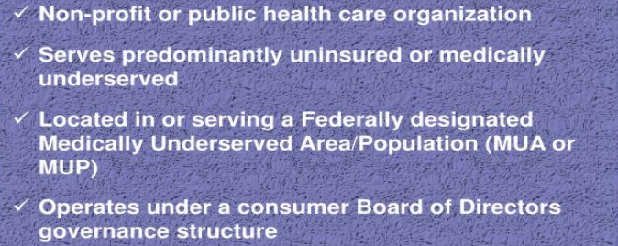

Slide 6
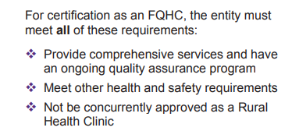
FQHC CERTIFICATION

Slide 7
Federally Qualified Health Center
CHARGES AND PAYMENT
FQHCs set their own charges for the services they provide and determine which services to include in the bundle of services associated with each FQHC G code. Charges must be uniform for all patients.
To find the specific FQHC payment codes to use when submitting claims under the PPS and a list of billable visits, visit the FQHC webpage.
Payment is for professional services only. Laboratory tests (excluding venipuncture) and the technical component of billable visits are paid separately. Procedures are included in the payment of an otherwise qualified visit and are not separately billable. If a procedure is associated with a qualified visit, include the charges for the procedure on the claim with the visit.

Slide 8
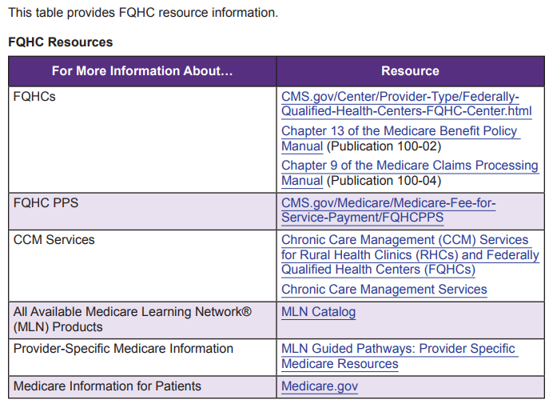

Slide 9
FQHC VISITS
A FQHC visit is a medically-necessary face-to-face medical or mental health visit or a qualified preventive health visit between the patient and a physician, NP, PA, CNM, CP, or CSW during which time one or more qualified FQHC services are furnished.
Transitional Care Management and Advance Care Planning can also be a FQHC visit.
In certain limited situations, a FQHC visit may also include a visit by a registered professional nurse or a licensed practical nurse to a homebound patient.

Slide 10
Federally Qualified Health Center
FQHCs are safety net providers that primarily provide services typically furnished in an outpatient clinic.
FQHCs include community health centers, migrant health centers, health care for the homeless health centers, public housing primary care centers, and health center program “lookalikes.”
They also include outpatient health programs or facilities operated by a tribe.

Slide 11
Federally Qualified Health Center
FQHC Medicaid services and reimbursement
In 1989, Congress established5 in the Social Security Act a new provider type – “Federally-qualified health center” or “FQHC.”
FQHCs are public or tax-exempt entities which receive a direct grant from the United States under Section 330 of the Public Health Service Act, or are determined by HHS to meet the requirements for receiving such grants.
Certain outpatient clinics that target Native American populations also quality as FQHCs.
This statute defined the services to be provided by FQHCs for Medicaid purposes and included special payment provisions to ensure that they would be reimbursed for 100 percent of their reasonable costs associated with furnishing these services.
As indicated in the Congressional Record, one of the express legislative purposes in doing so was to “ensure that Federal [Public Health Service] Act grant funds are not used to subsidize health center or program services to Medicaid beneficiaries.”

Slide 12
FQHC Medicaid services and reimbursement
State Medicaid agencies must make “wraparound” payments to FQHCs to cover the difference, if any, between what an FQHC has been paid by the Managed Care Organizations (MCOs) and the center’s PPS or APM per-visit rate.
States are required to make the wraparound payments at least every four months.
In Section 4712 of the BBA of 1997, Congress did two things. First, it relieved the MCO of the responsibility to pay the FQHCs their cost-based rate and instead required the MCOs to pay FQHCs “not less” than they would pay non-FQHC providers for the same medical services.34 Second, it ensured that FQHCs were reimbursed the amounts required by federal law by requiring States to make a direct “supplemental payment *to FQHCs+ equal to the amount . . . by which” an FQHC’s reasonable costs “exceeded+ the amount of payments” FQHCs received from MCOs.
In doing so, “Congress intended to encourage contracting between [FQHCs] and MCOs and to remove financial barriers to this contracting.”

Slide 13

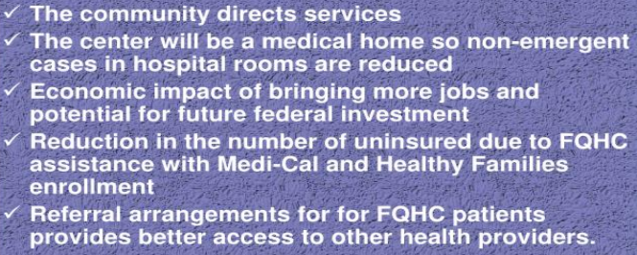

Slide 14


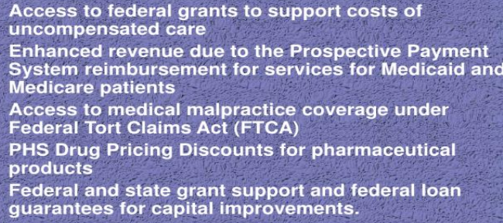

Slide 15
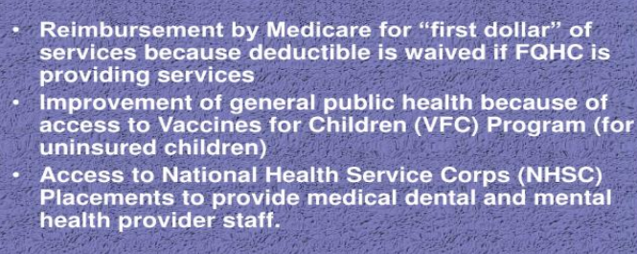
FQHC
Community Health Center
Benefits

Slide 16
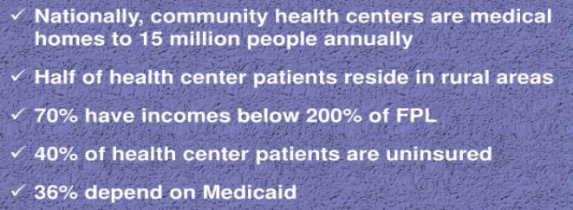
Who do Federally
Qualified Health
Centers serve?

Slide 17
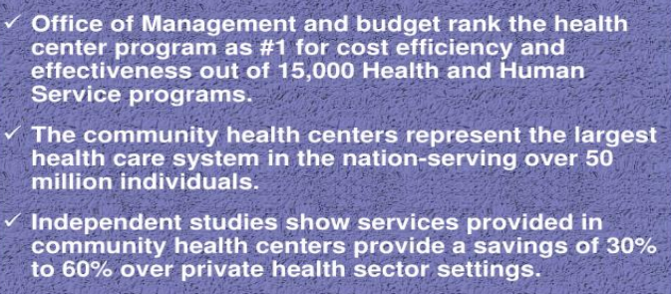
Our Nation’s
Health Centers

Slide 18
1. Office of Management and budget rank the health center program as #1 for cost efficiency and effectiveness out of 15,000 Health and Human Service Programs
True
False

Slide 19
Office of Management and Budget rank the health center program as #1 for cost efficiency and effectiveness out of 15,000 Health and Human Service Programs
True
False

Slide 20
2. FQHC Community Health Center Benefits include reimbursement by Medicare for “first dollar” of services because deductible is waived if FQHC is providing services
True
False

Slide 21
2. FQHC Community Health Center Benefits include reimbursement by Medicare for “first dollar” of services because deductible is waived if FQHC is providing services
True
False

Slide 22
3. FQHCs are safety net providers that primarily provide services typically furnished in an outpatient clinic
True
False

Slide 23
3. FQHCs are safety net providers that primarily provide services typically furnished in an outpatient clinic
True
False

Slide 24
4. A FQHC visit is a medically-necessary face-to-face medical or mental health visit or a qualified preventive health visit between the patient and a physician, NP, PA, CNM, CP, or CSW during which time one or more qualified FQHC services are furnished
True
False

Slide 25
4. A FQHC visit is a medically-necessary face-to-face medical or mental health visit or a qualified preventive health visit between the patient and a physician, NP, PA, CNM, CP, or CSW during which time one or more qualified FQHC services are furnished.
True
False

Slide 26
5. For certification as an FQHC, the entity must meet all of these requirements except for the following?
Provide comprehensive services and have an ongoing quality assurance program
Meet other health and safety requirements
Not be concurrently approved as a Rural Health Clinic
Must own all buildings for clinic facilities

Slide 27
5. For certification as an FQHC, the entity must meet all of these requirements except for the following?
Provide comprehensive services and have an ongoing quality assurance program
Meet other health and safety requirements
Not be concurrently approved as a Rural Health Clinic
Must own all buildings for clinic facilities

