Slide 1

MODULE two:
Overview of health systems in California

Slide 2

MODULE two:
SECTION one:
California
health system

Slide 3

UNIT OBJECTIVE
To learn the organization and functioning of the health system in the State of California

Slide 4
California health system
Affordable Care Act (Obama Care)
Covered California insurance marketplace
Types of insurance
Public insurance (Medi-Cal, Medicare)
Private insurance
Non-insured
Undocumented immigrant users
Health4All Kids
Other special populations (adults with disabilities)

Slide 5
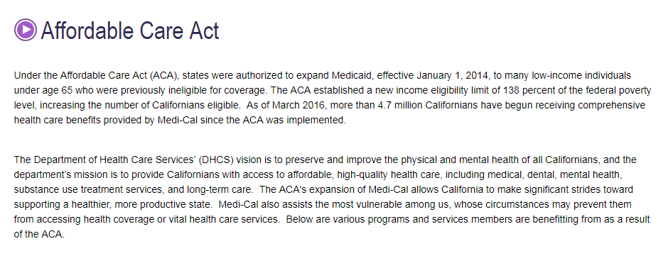


Slide 6
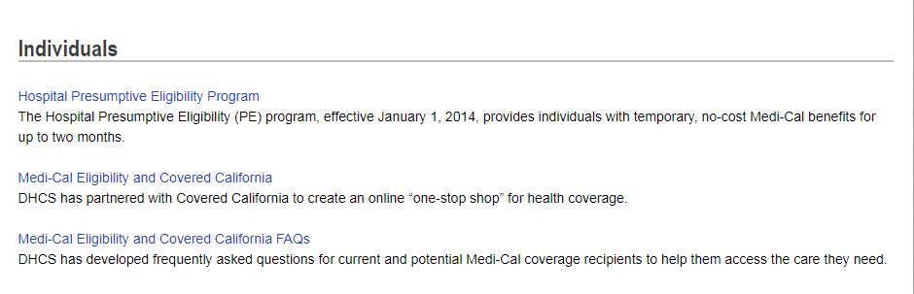
MEDI-CAL

Slide 7
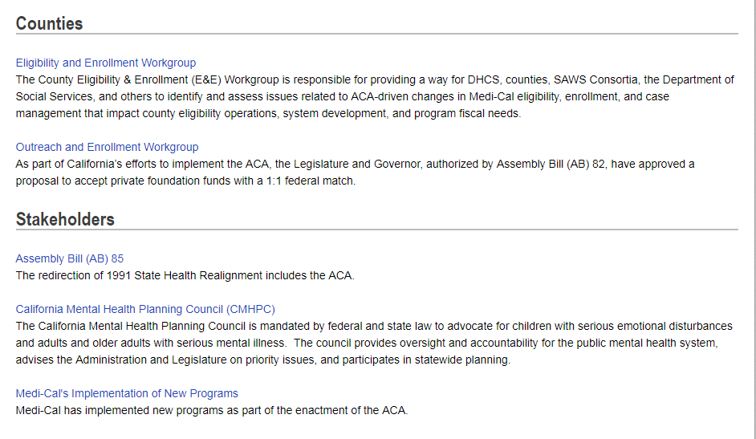

Slide 8

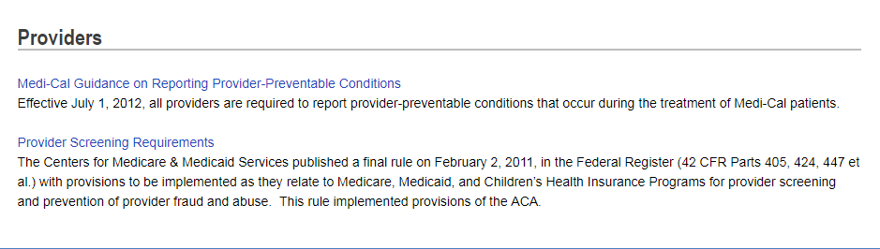

Slide 9
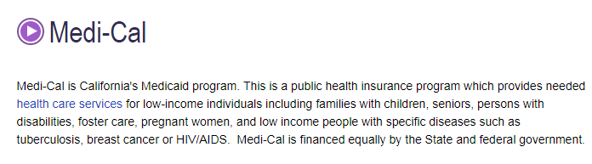
MEDI-CAL

Slide 10
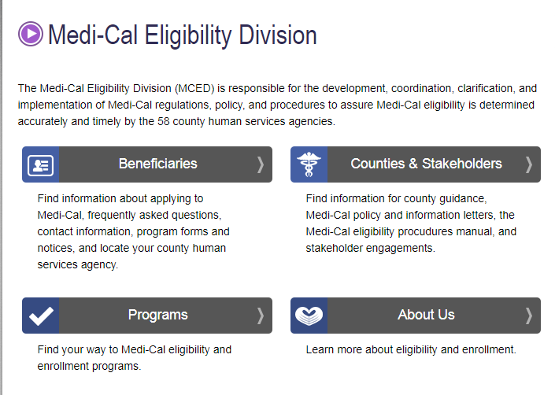

Slide 11
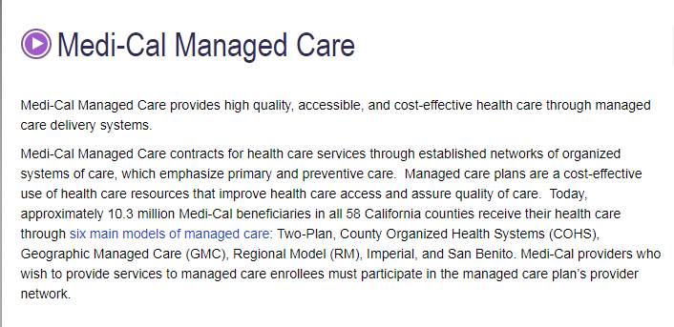

Slide 12
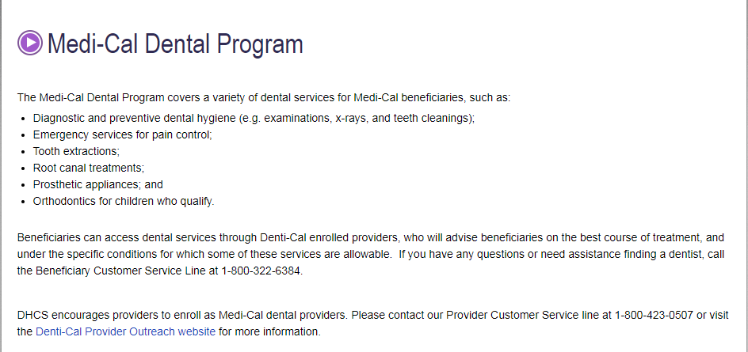

Slide 13
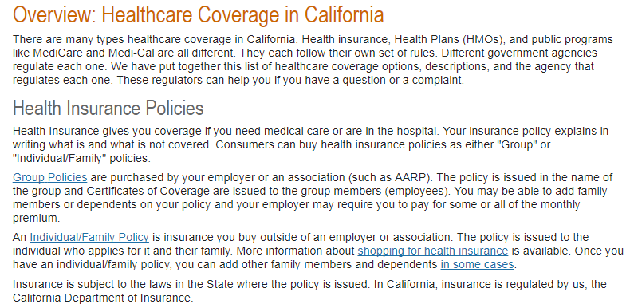

Slide 14
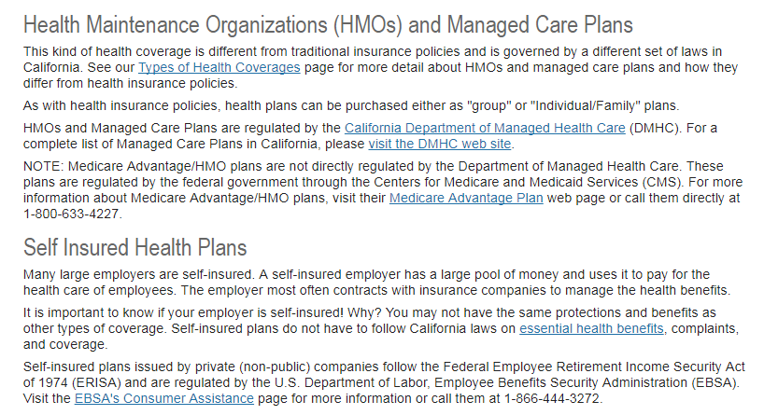

Slide 15
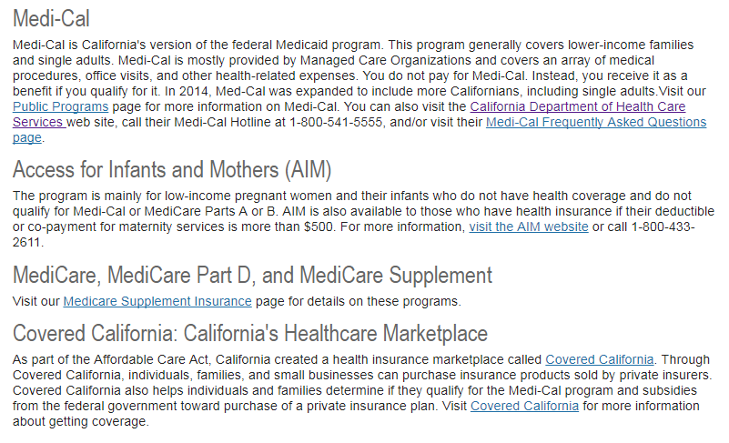

Slide 16
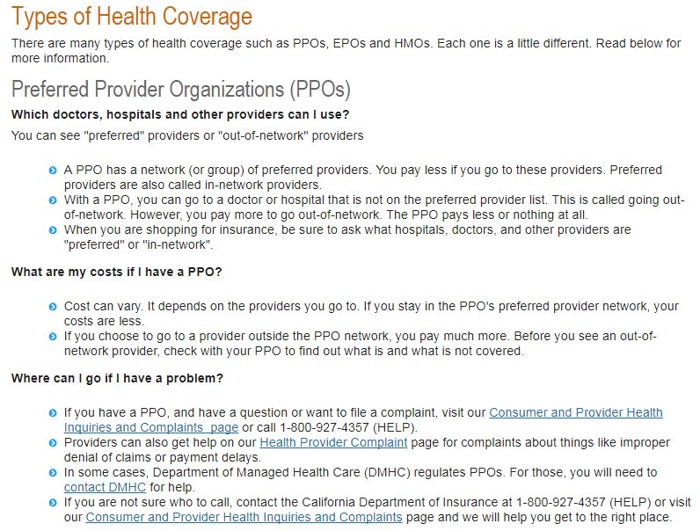

Slide 17
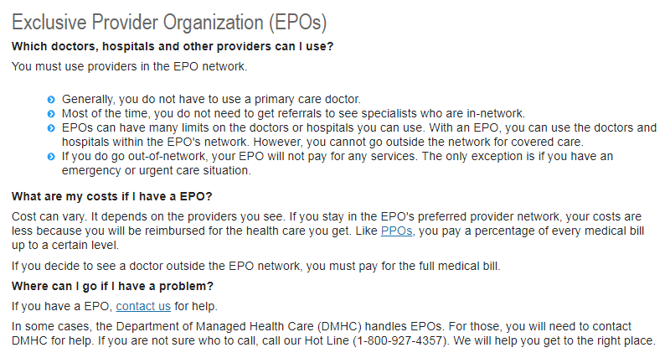

Slide 18
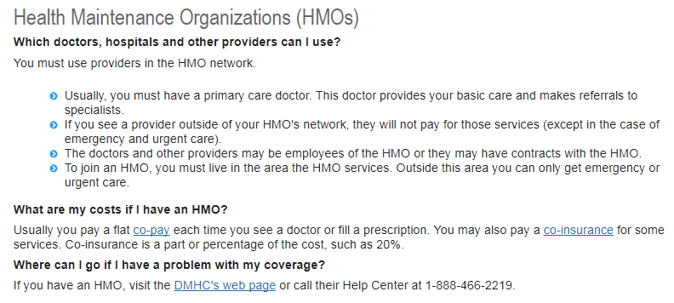

Slide 19
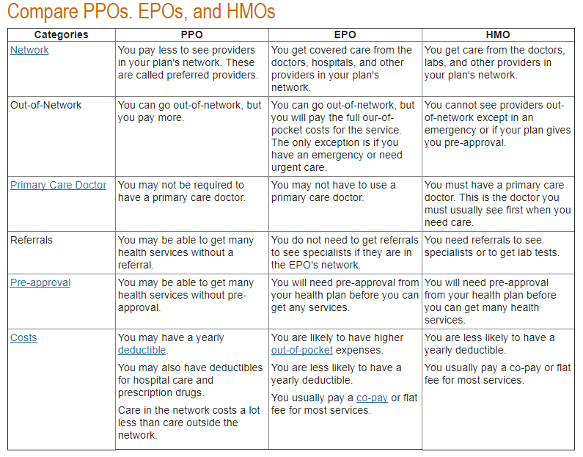

Slide 20
The State Legislature
The Legislative Branch of the California State Government is composed of the State Assembly, the State Senate, and several other departments.
This branch holds the principle lawmaking powers of the state. On average, the Legislature will propose, analyze, and debate over 6,000 bills in a single two-year session.

Slide 21

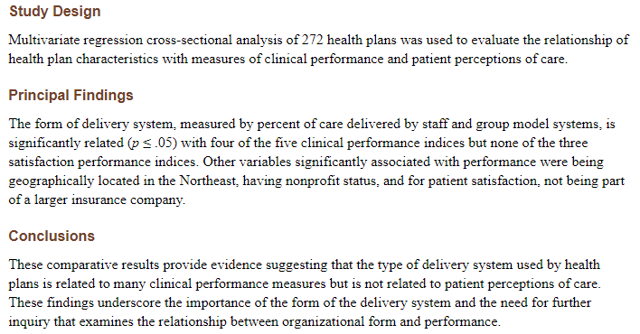

Slide 22

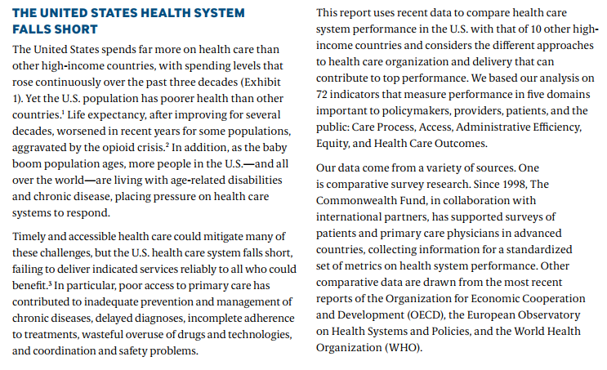

Slide 23
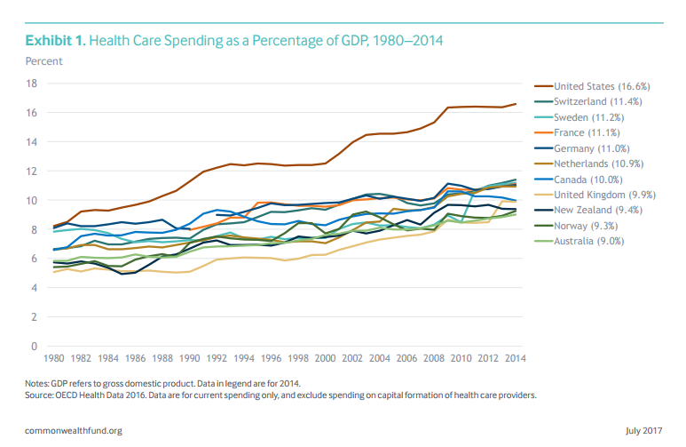

Slide 24
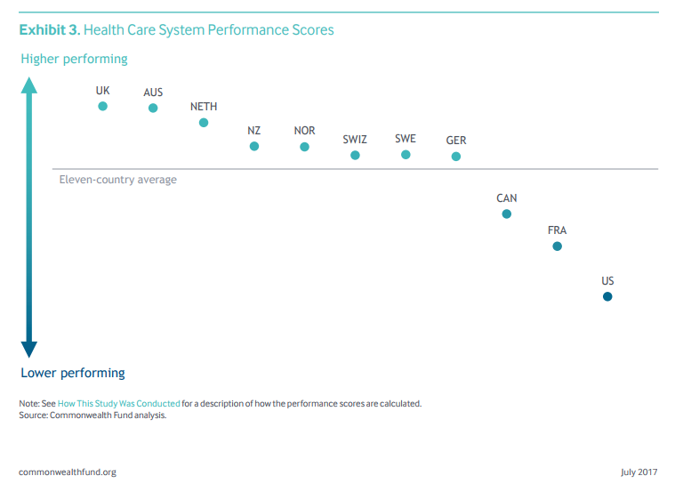

Slide 25
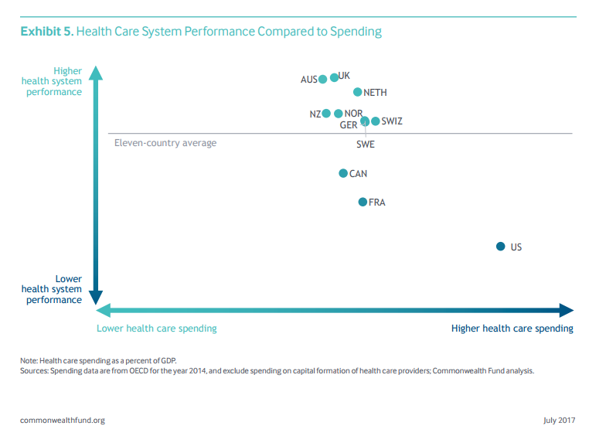

Slide 26
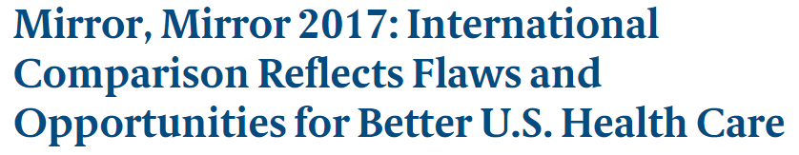
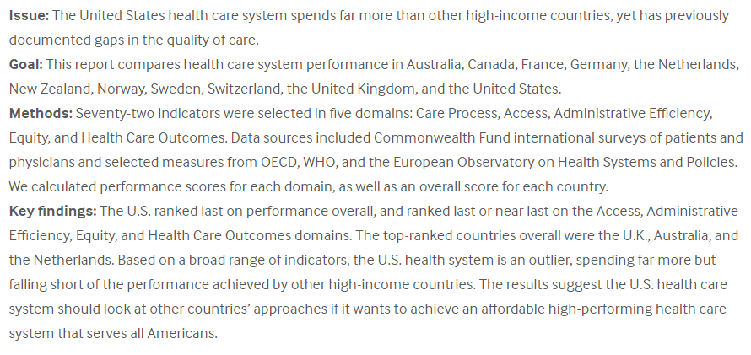

Slide 27
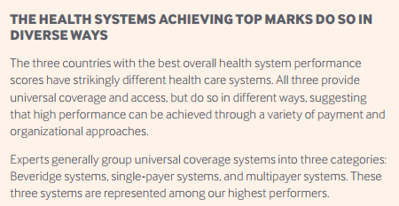

Slide 28

https://bphc.hrsa.gov/datareporting/reporting/ranking.html

Slide 29
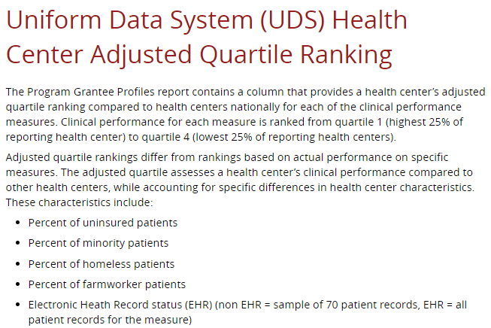
https://bphc.hrsa.gov/datareporting/reporting/ranking.html

Slide 30
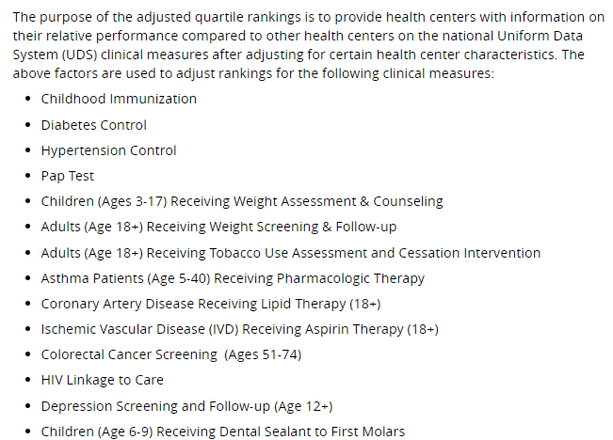
https://bphc.hrsa.gov/datareporting/reporting/ranking.html

Slide 31
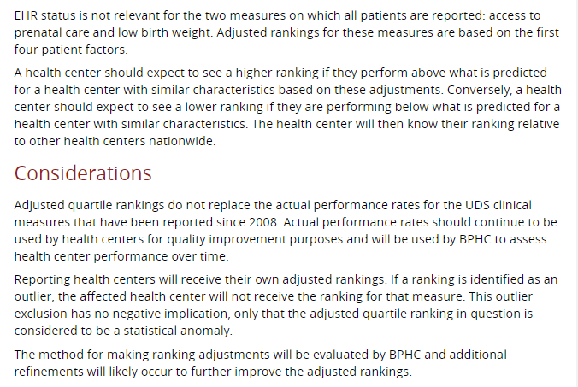
https://bphc.hrsa.gov/datareporting/reporting/ranking.html

Slide 32

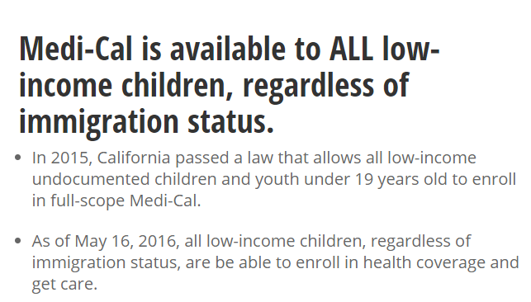

Slide 33
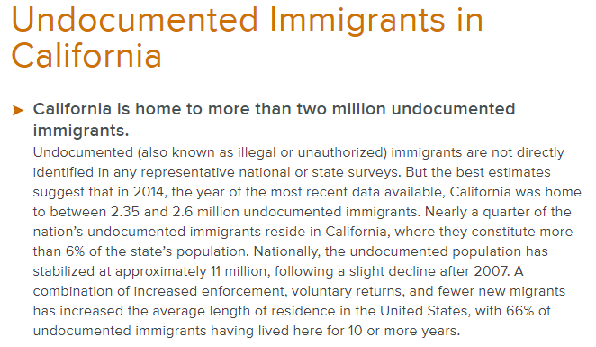


Slide 34
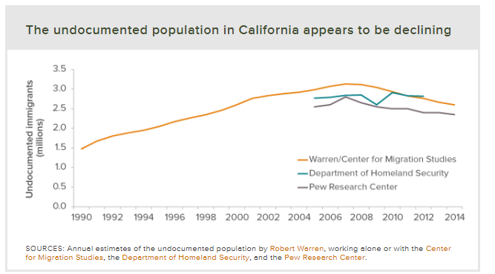

Slide 35
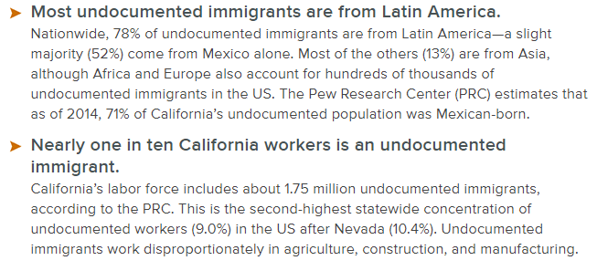

Slide 36
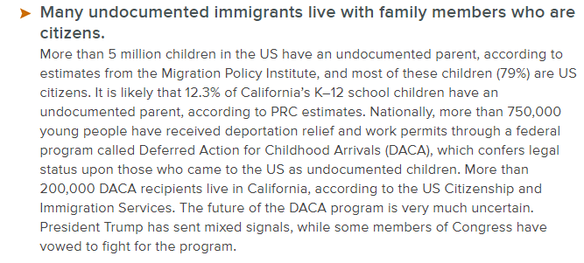

Slide 37


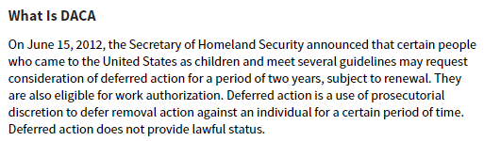

CNN

Slide 38
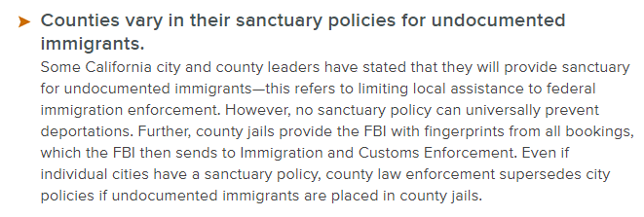

Slide 39
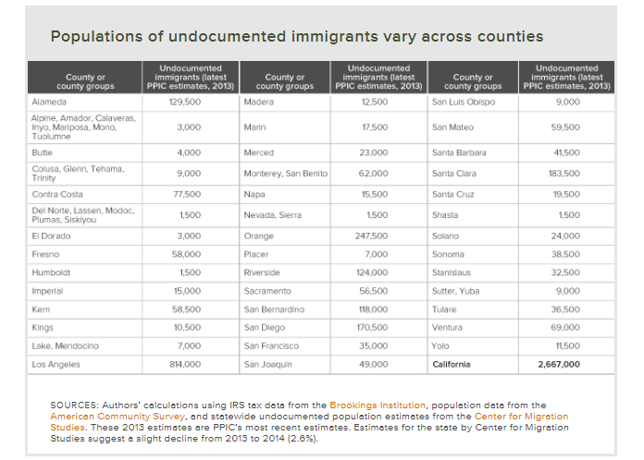

Slide 40

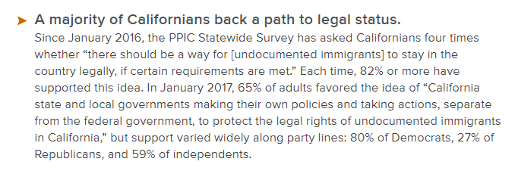

Slide 41

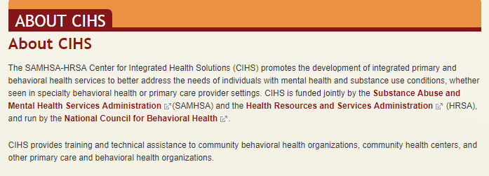

Slide 42
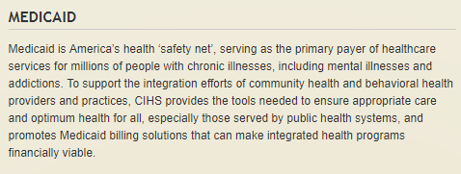

Slide 43

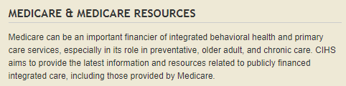

Slide 44

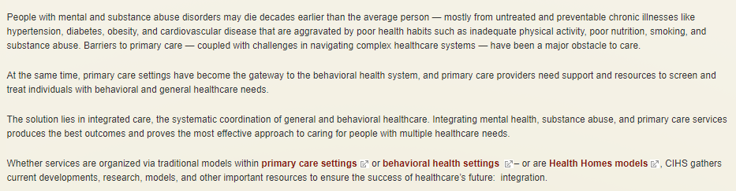

Slide 45
1. Under the Affordable Care Ac (ACA), states were authorized to expand Medicaid, effective January 1, 2014, to many low-income individuals under age 65 who were previously ineligible for coverage. The ACA established a new income eligibility limit of 138 percent of the federal poverty level, increasing the number of Californians eligible. As of March 2016, more than 4.7 million Californians have begun receiving comprehensive health care benefits provided by Medi-Cal since the ACA was implemented.
True
False

Slide 46
1. Under the Affordable Care Act (ACA), states were authorized to expand Medicaid, effective January 1, 2014, to many low-income individuals under age 65 who were previously ineligible for coverage. The ACA established a new income eligibility limit of 138 percent of the federal poverty level, increasing the number of Californians eligible. As of March 2016, more than 4.7 million Californians have begun receiving comprehensive health care benefits provided by Medi-Cal since the ACA was implemented.
True
False

Slide 47
2. How much will Medi-Cal cost a patient that is at a level below 138 percent of the federal poverty level?
Less than $20/month
More than $20/month

Slide 48
2. How much will Medi-Cal cost a patient that is at a level below 138 percent of the federal poverty level?
Less than $20/month
More than $20/month

Slide 49
3. Both lawfully present and not lawfully present individuals can apply through Covered California to see if they are eligible for health plan options through Covered California or Medi-Cal. Immigrants who are not lawfully present are not eligible to purchase a health plan through Covered California; however, they may be eligible for coverage through Medi-Cal.
True
False

Slide 50
3. Both lawfully present and not lawfully present individuals can apply through Covered California to see if they are eligible for health plan options through Covered California or Medi-Cal. Immigrants who are not lawfully present are not eligible to purchase a health plan through Covered California; however, they may be eligible for coverage through Medi-Cal.
True
False

Slide 51
4. Immigrants who are not lawfully present can apply through Covered California to see if they are eligible for health plan options through Medi-Cal, although the benefits may be limited. Immigrants who are not lawfully present can also buy private health insurance coverage on their own outside of Covered California. Additionally, some counties offer other health care options for which immigrants who are not lawfully present might qualify.
True
False

Slide 52
4. Immigrants who are not lawfully present can apply through Covered California to see if they are eligible for health plan options through Medi-Cal, although the benefits may be limited. Immigrants who are not lawfully present can also buy private health insurance coverage on their own outside of Covered California. Additionally, some counties offer other health care options for which immigrants who are not lawfully present might qualify.
True
False

Slide 53
5. Individuals who are under Deferred Action for Childhood Arrivals (DACA) are considered to have lawfully entered the USA.
True
False

Slide 54
5. Individuals who are under Deferred Action for Childhood Arrivals (DACA) are considered to have lawfully entered the USA.
True
False

