Slide 1

MODULE two: overview of health systems in California

Slide 2
MODULE two:
SECTION four:
Managed care
and health
maintenance
organizations

Slide 3

UNIT OBJECTIVE
Understand the functioning and interrelationship of organizations involved in the delivery of health services in California

Slide 4
Managed care and health maintenance organizations
Nutrition Support Institutions
Psychological support and mental health
Addiction prevention and maintenance

Slide 5
United States Innovations in Healthcare Delivery
RECOMMENDATIONS BY STEPHEN SHORTELL PHD, MP
Population aging, rapidly increasing costs of healthcare and the growing burden of chronic disease are challenges to health systems worldwide. To meet these challenges will require new approaches to healthcare delivery and comprehensive population health management. Within the context of healthcare reform initiatives, important innovations in delivery system organization in the United States are discussed. The innovations focused on are the Patient-Centered Medical Home (PCMH), the Accountable Care Organization (ACO) and the Population Health Management System (PHMS) combined with new payment arrangements that reward for health outcomes achieved rather than paying a fee for each service rendered. For each of these innovations, the evidence on its performance, the challenges involved, and the factors that might promote greater adoption and diffusion of successful models.

Slide 6
Managed care
The term managed care or managed healthcare is used in the United States to describe a group of activities ostensibly intended to reduce the cost of providing health care while improving the quality of that care ("managed care techniques"). It has become the essentially exclusive system of delivering and receiving American health care since its implementation in the early 1980s, and has been largely unaffected by the Affordable Care Act of 2010.

Slide 7
Managed health care
1. Managed care is intended to have the following health care consequences including all of the following except for which response?
To reduce the cost of providing health care
To improve the quality of health care
To allow greater access to health care to more patients due to cost savings
To allow greater freedom of all health care plan options

Slide 8
Managed health care
1. Managed care is intended to have the following health care consequences including all of the following except for which response?
To reduce the cost of providing health care
To improve the quality of health care
To allow greater access to health care to more patients due to cost savings
To allow greater freedom of all health care plan options

Slide 9


One of the most characteristic forms of managed care is the use of a panel or network of healthcare providers to provide care to enrollees. Such integrated delivery systems typically include one or more of the following:
A set of designated doctors and healthcare facilities, known as a provider network, which furnish an array of health care services to enrollees
Explicit standards for selecting providers
Formal utilization review and quality improvement programs
An emphasis on preventive care
Financial incentives to encourage enrollees to use care efficiently

Slide 10
Managed health care
2. Most forms of managed care organizations use a panel or network of health care providers to deliver health care services to enrollees with which of the following features? Select the best answer.
  Emphasis on preventive care
  Financial incentives to encourage enrollees to use care efficiently or in a cost effective manner
  Have a formal utilization review and quality improvement program
  All of the above

Slide 11
Managed health care
2. Most forms of managed care organizations use a panel or network of health care providers to deliver health care services to enrollees with which of the following features? Select the best answer.
  Emphasis on preventive care
  Financial incentives to encourage enrollees to use care efficiently or in a cost effective manner
  Have a formal utilization review and quality improvement program
  All of the above

Slide 12
Accountable Care Organizations Accountable for What, to Whom, and How
Interest in accountable care organizations (ACOs) has increased dramatically with the passage of the Affordable Care Act, which establishes ACOs as a new payment model under Medicare and fosters pilot programs to extend the model to private payers and Medicaid.
Proponents hope that ACOs will allow physicians, hospitals, and other clinicians and health care organizations to work more effectively together to both improve quality and slow spending growth.
Skeptics are concerned that ACOs will focus narrowly on their bottom line and either stint on needed care or use the leverage they achieve through local integration to demand unreasonable prices from payers.

Slide 13
Accountable Care Organizations Accountable for What, to Whom, and How
3. The Affordable Care Act, which establishes Accountable Care Organizations (ACOs) as a payment model under Medicare and fosters pilot programs to extend the model to private payers and Medicaid.
True
False

Slide 14
Accountable Care Organizations Accountable for What, to Whom, and How
3. The Affordable Care Act, which establishes Accountable Care Organizations (ACOs) as a new payment model under Medicare and fosters pilot programs to extend the model to private payers and Medicaid.
True
False

Slide 15
The Health Maintenance Organization (HMO): A Look at Managed Care
Health maintenance organizations (HMOs), a type of managed healthcare system, were created by the 1973 Health Maintenance Organization Act as a way to decrease costs for healthcare consumers. As the name implies, HMOs tend to place importance on preventative measures and are willing to spend money to keep their populations healthy (and to avoid higher costs later). Although this style of healthcare has had its issues in the past, some systems have made it work very well. One of the most successful examples is the Kaiser Permanente system.

Slide 16
How HMOs work
Geared towards bigger companies needing to offer health insurance to large numbers of people, HMOs include primary care physicians (PCP), specialists, and hospitals, clinics, and other facilities at which its members receive care. The primary care physician acts as a “gatekeeper” in that s/he refers patients to specialists. Additionally, patients who belong to an HMO are required to obtain health care at specific facilities and/or form specific providers who are under contract and have agreed to adhere to the HMO’s guideline and restrictions. The exception to this rule is emergency care, which can be obtained from any facility.
Financially, HMOs operate by receiving a fixed payment for its services per patient per period of time , generally a month. This type of payment is called capitation. This differs from the fee-for-service model, in which providers are compensated for each individual service. In this way , physicians are relieved of the temptation to prescribe unnecessary medical services in order to maintain a healthy revenue cycle. In fact, in the HMOs, providers are compared to their peers to verify that s/he is not prescribing significantly more or less services than everyone else.

Slide 17
Benefits of HMOs
Commercial HMOs that involve both Medicaid and privately insured patients can reduce healthcare costs due to the large number of people covered by the HMO. As mentioned, because patients need referrals by PCPs, only those services that are deemed medically necessary are approved, thus costs are contained. For the patient, HMOs may require a copay for prescriptions, hospital stays, or doctor’s visits, but these are generally kept to a minimal amount or are usually free with Medical. Many HMOs receive a flat fee for each person they cover, patients can have the comfort knowing that their monthly payments will remain the same regardless of their utilization of the healthcare system.

Slide 18
Limitations of HMOs
Patients are used to having a choice when selecting medical provider, so the in-network restriction of HMOs did not sit well with many patients at first. A study conducted in 2007 found that HMO enrollees were less satisfied with the quality of their care and with doctor-patient interactions. Additionally, the capitation model, which was mentioned as a benefit, an also lead to restrictive practices, since the organizations profit more by doing less ( the opposite of fee-for-service). Some less-than-ethical providers may withhold performing exams or prescribing expensive drugs or treatments in order to increase their bottom line.
Concluding, HMOs have been successful at achieving a cos-containing model that focuses on prevention. Although the y have had their issues, HMOs will likely thrive in the future, especially since systems like Kaiser Permanente have found such success. Like most models, these organizations depend on the thorough peer review to avoid detrimental practices like withholding care to achieve higher profits.

Slide 19
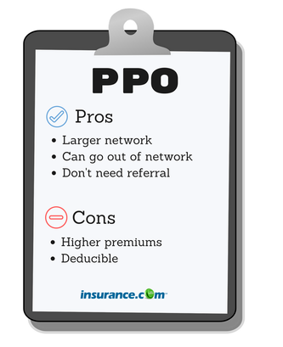
What is a PPO?
PPO stands for preferred provider organization. Premiums and deductibles are usually much higher for a PPO compared to an HMO, but that comes with greater flexibility.
About one-half of enrollees in employer –based health plans are in a PPO. Though it remains the most utilized type of plan, the popularity may change as some employers turn more to other options as a way to contain health care costs.
What kind of person should opt for a PPO: Someone who utilizes health care regularly and sees specialists or wants to have the option to see a specialist without getting a referral.
Though a PPO gives you more independence, this doesn’t mean that you have complete access to the health care system without any oversight. A health plan may still require the patient a physician to get approval for a costly service, such as an MRI.

Slide 20
4. A PPO stands for Preferred Provider Organization. Please indicate below which of the following represents the best answer regarding PPOs.
PPO allows for a smaller network
PPO always requires a referral
PPO has generally lower payments compared to other options
None of the above are correct

Slide 21
4. A PPO stands for Preferred Provider Organization. Please indicate below which of the following represents the best answer regarding PPOs.
PPO allows for a smaller network
PPO always requires a referral
PPO has generally lower payments compared to other options
None of the above are correct

Slide 22
5. Under Health Maintenance Organization the term “capitation” refers to which of the following statements?
Where benefits to the patient cease after a certain ‘”cap”
Providers not following protocols are capitated from the provider group
HMO’s operate by receiving a fixed payment for its services patient per month
Fee for service is “capped”

Slide 23
5. Under Health Maintenance Organization the term “capitation” refers to which of the following statements?
Where benefits to the patient cease after a certain ‘”cap”
Providers not following protocols are capitated from the provider group
HMO’s operate by receiving a fixed payment for its services patient per month
Fee for service is “capped”

Slide 24
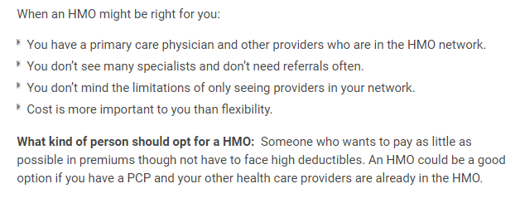
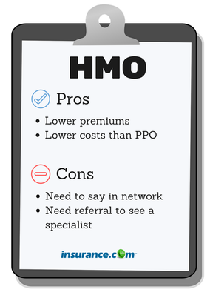
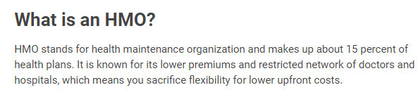

Slide 25

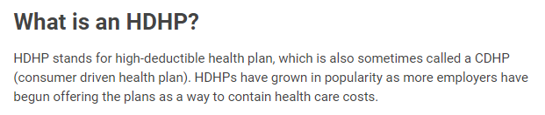
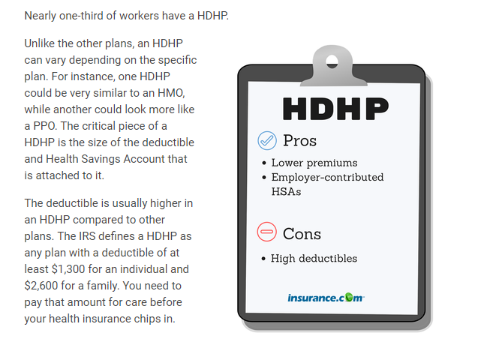
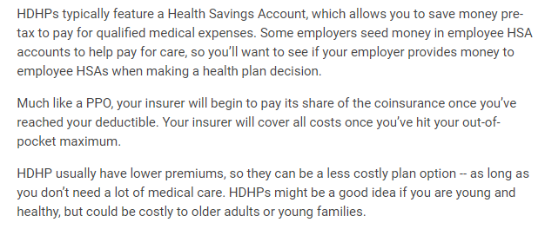
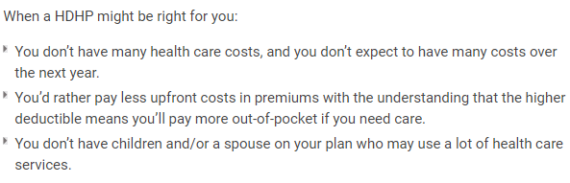

Slide 26
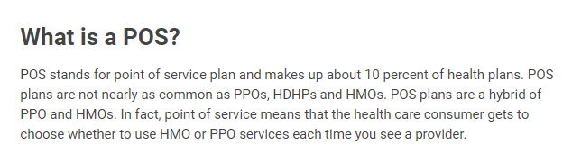
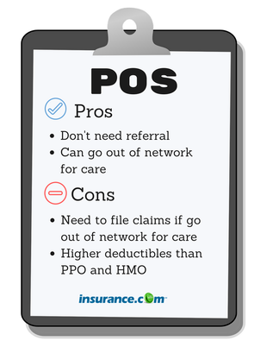
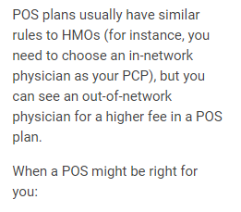
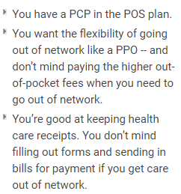

Slide 27
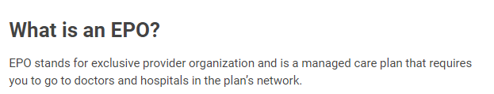
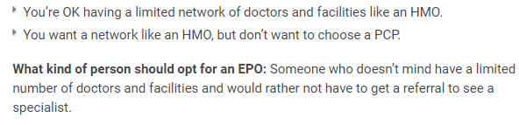
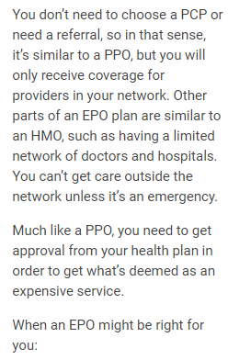
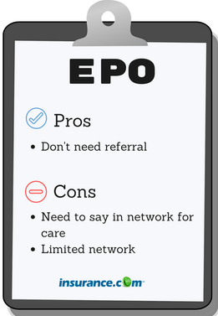


Slide 28
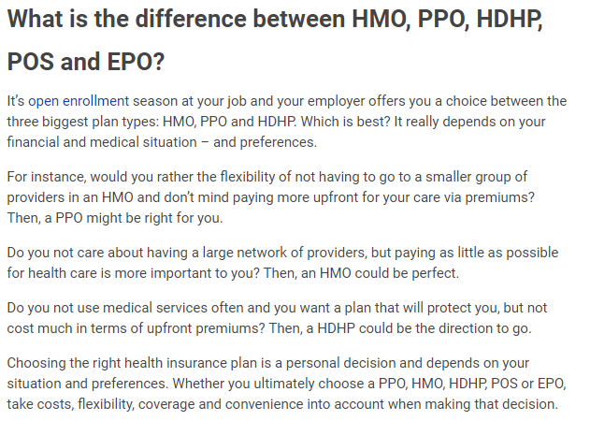

Slide 29

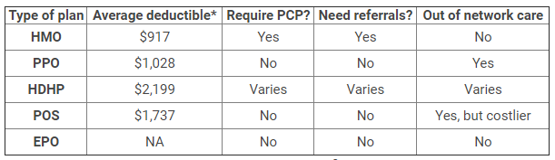

Slide 30
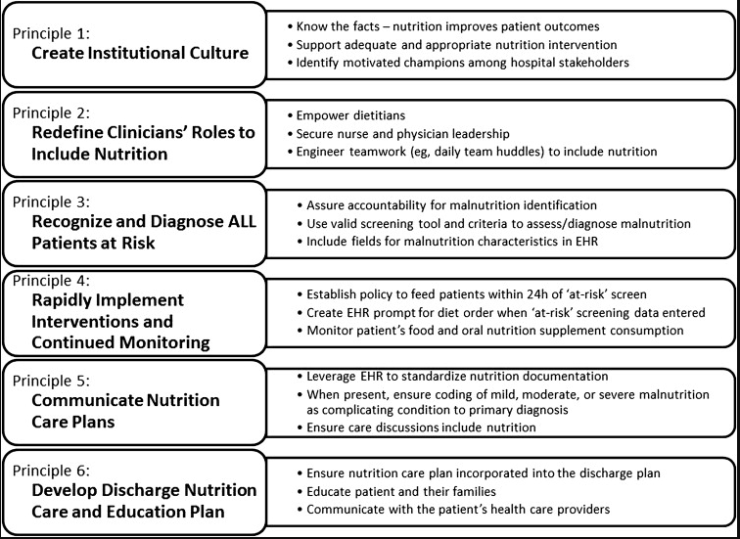
NUTRITION SERVICES
Quality primary care
includes nutritional
outpatient care as well
as hospital discharge
planning with outpatient
follow up

Slide 31

For dyslipidemia, hypertension, heart failure, diabetes, and renal disease, available evidence supports a role for nutrition therapy in the routine management of these conditions for the Medicare population. For this reason it is recommended that nutrition therapy be considered a covered benefit for Medicare beneficiaries in the ambulatory setting.
Nutrition education is also important in the primary prevention of chronic disease. However, a variety of health care professionals such as physicians, nurses, and pharmacists should and do provide nutrition education in the context of routine preventive health visits or patient encounters. These encounters, however, should not constitute a separate covered visit, but rather be considered incident to medical care or the nutrition therapy being provided.
In order to eliminate a barrier to access for nutrition therapy, nutrition professionals should be considered eligible as qualified providers who receive direct Medicare reimbursement or payment by one of the organizations noted previously.

Slide 32

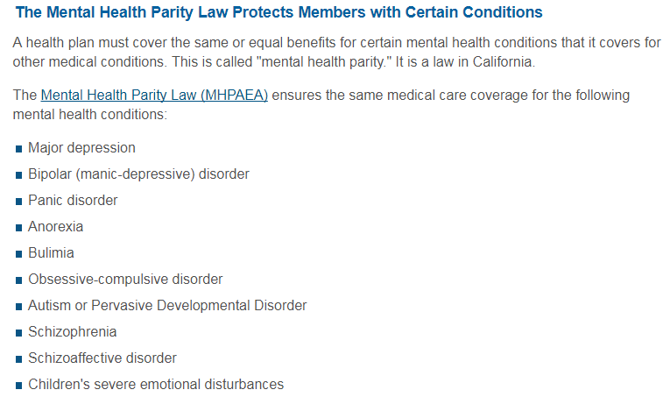
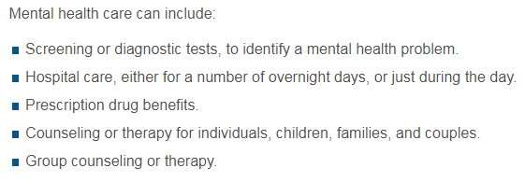

Psychological support and mental health

Slide 33
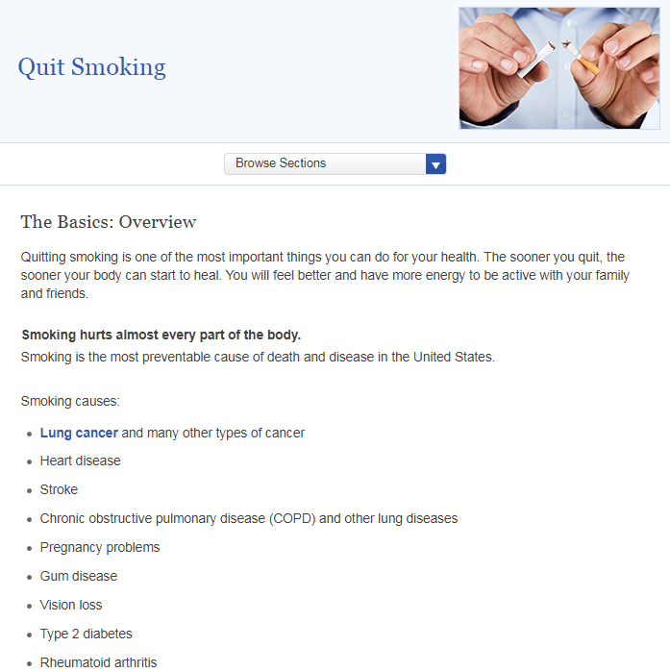
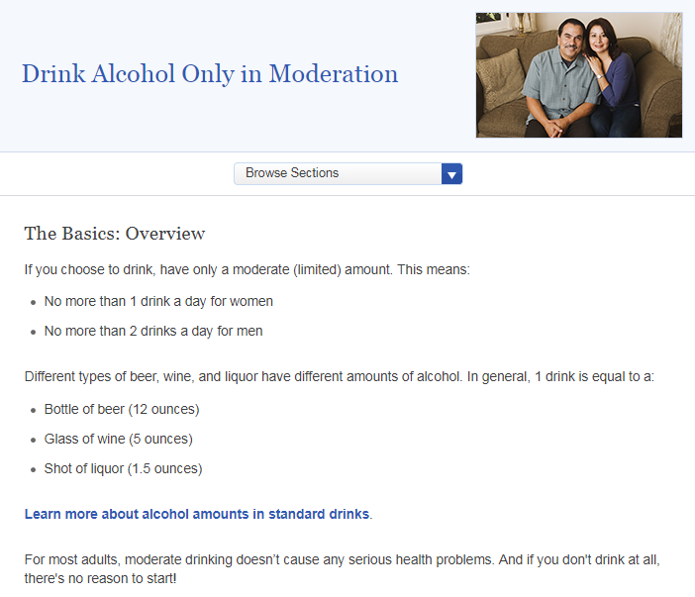

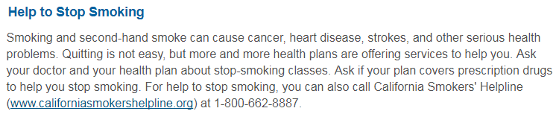
Free Preventive Services including addiction prevention and maintenance
Example of smoking cessation resource
Example of alcohol abuse screening resource

