Slide 1

MODULE two: overview of health systems in California

Slide 2
MODULE two:
SECTION five:
California
public
health system

Slide 3

UNIT OBJECTIVE
To understand the public health system in California and its impact on medical care systems

Slide 4
California public health system
Local, state, and federal public health agencies
Role of public health in medical care
Public health initiatives

Slide 5
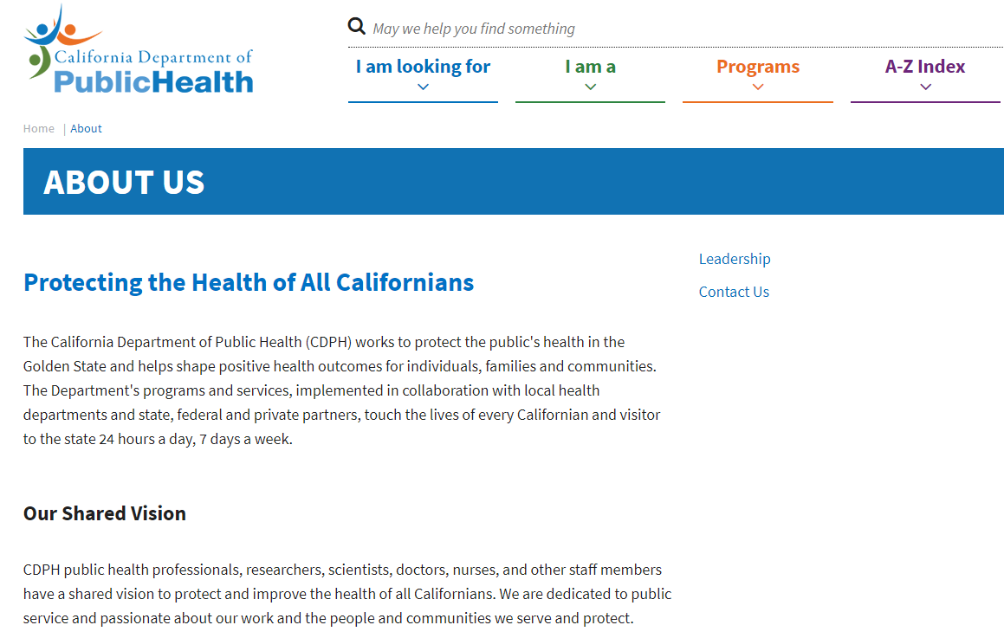
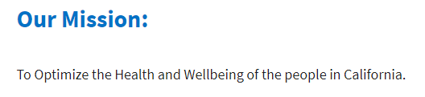
CALIFORNIA DEPARTMENT
OF PUBLIC HEALTH

Slide 6

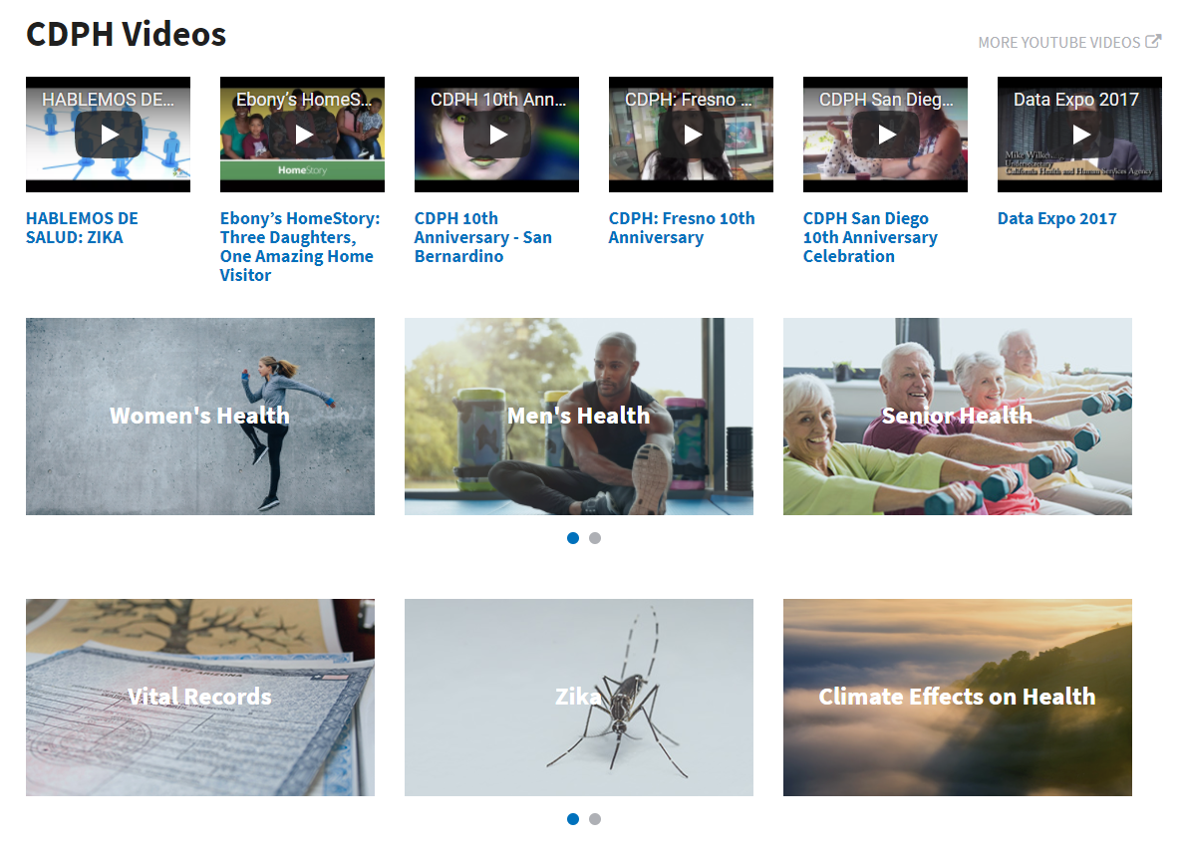
CDPH INFORMATION RESOURCE

Slide 7
Chronic conditions present a strong economic incentive for action
During the past century, a major shift occurred in the leading causes of death for all age groups, including older adults, from infectious diseases and acute illnesses to chronic diseases and degenerative illnesses.
More than a quarter of all Americans and two out of every three older Americans have multiple chronic conditions, and treatment for this population accounts for 66% of the country’s health care budget.
Question to follow

Slide 8
1. During the past century, a major shift occurred in the leading causes of death for all age groups, including older adults, from infectious diseases and acute illnesses to chronic diseases and degenerative illnesses. Please indicate below if this is a true statement or false.
True
False

Slide 9
1. During the past century, a major shift occurred in the leading causes of death for all age groups, including older adults, from infectious diseases and acute illnesses to chronic diseases and degenerative illnesses. Please indicate below if this is a true statement or false.
True
False

Slide 10
2. More than a quarter of all Americans and two out of every three older Americans have multiple chronic conditions, and treatment for this population accounts for 66% of the country’s health care budget. Please indicate below if this is a true statement or false.
True
False

Slide 11
2. More than a quarter of all Americans and two out of every three older Americans have multiple chronic conditions, and treatment for this population accounts for 66% of the country’s health care budget. Please indicate below if this is a true statement or false.
True
False

Slide 12
The United States has met six of the Healthy People 2020 targets in this report
No leisure time physical activity in past month (31.4% vs. goal of 32.6%).
Obesity (24.5% vs. goal of 30.6%).
Current smoking (8.4% vs. goal of 12%).
Taking medications for high blood pressure (94.1% vs. goal of 77.4%).
Mammograms within past 2 years (81.9% vs. goal of 70%).
Colorectal cancer screenings (72.2 % vs. goal of 70%).

Slide 13
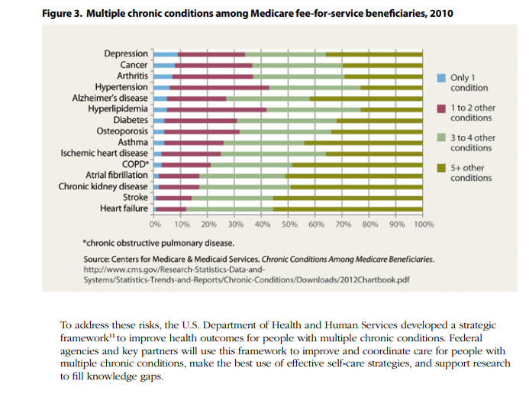
CHRONIC DISEASE MANAGEMENT INFORMATION

Slide 14
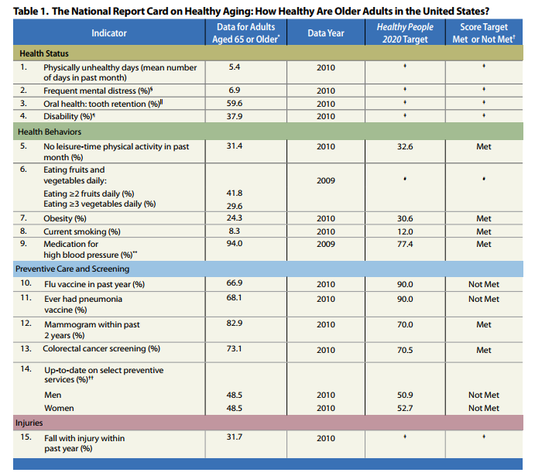
HEALTHY PEOPLE
2020 TARGETS
AND POSITIVE ACHIEVEMENTS AS
WELL AS GOALS
UNABLE TO BE MET

Slide 15
3. The United States has met the following Healthy People 2020 targets except for
which one of the statements listed below?
No leisure time physical activity in past month (31.4% vs. goal of 32.6%).
Obesity (24.5% vs. goal of 30.6%).
Current smoking (8.4% vs. goal of 12%).
Taking medications for high blood pressure (94.1% vs. goal of 77.4%).
Mammograms within past 2 years (81.9% vs. goal of 70%).
Colorectal cancer screenings (72.2 % vs. goal of 70%).
Pet ownership rates increased from (25% vs goal of 24%)

Slide 16
3. The United States has met following Healthy People 2020
targets except for which one
of the statements listed below?
No leisure time physical activity in past month (31.4% vs. goal of 32.6%).
Obesity (24.5% vs. goal of 30.6%).
Current smoking (8.4% vs. goal of 12%).
Taking medications for high blood pressure (94.1% vs. goal of 77.4%).
Mammograms within past 2 years (81.9% vs. goal of 70%).
Colorectal cancer screenings (72.2 % vs. goal of 70%).
Pet ownership rates increased from (25% vs goal of 24%)

Slide 17
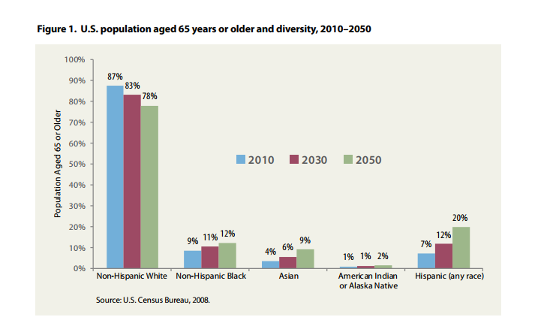
ETHNIC
MAKEUP
OF OLDER
PATIENTS

Slide 18
4. Which of the following ethnic groups makes up the largest percentage of population aged 65 or older?
Non-Hispanic White
Non-Hispanic Black
Asian
American Indian or Alaska Native
Hispanic any race

Slide 19
4. Which of the following ethnic groups makes up the largest percentage of population aged 65 or older?
Non-Hispanic White
Non-Hispanic Black
Asian
American Indian or Alaska Native
Hispanic any race

Slide 20
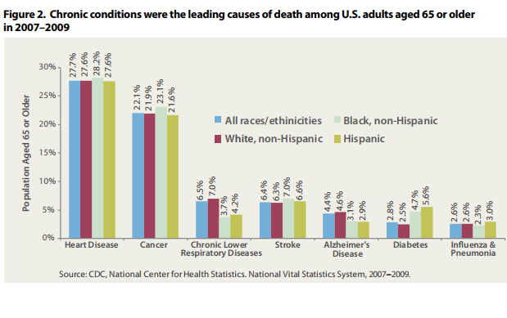
CAUSES
OF DEATH
IN OLDER
PATIENTS

Slide 21
5. What was the leading cause of death from 2007 through 2009 in the U.S. in adults aged 65 or older?
Chronic Respiratory Disease
Chronic Heart Disease
Cancer
Stroke

Slide 22
5. What was the leading cause of death from 2007 through 2009 in the U.S. in adults aged 65 or older?
Chronic Respiratory Disease
Chronic Heart Disease
Cancer
Stroke

Slide 23
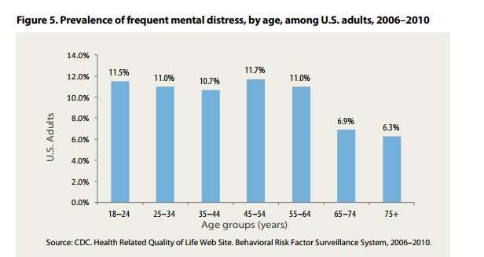

Slide 24
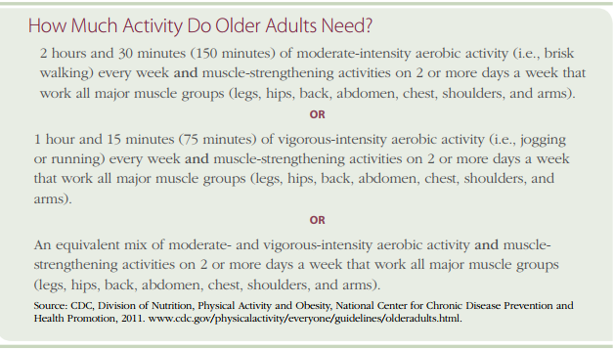

Slide 25
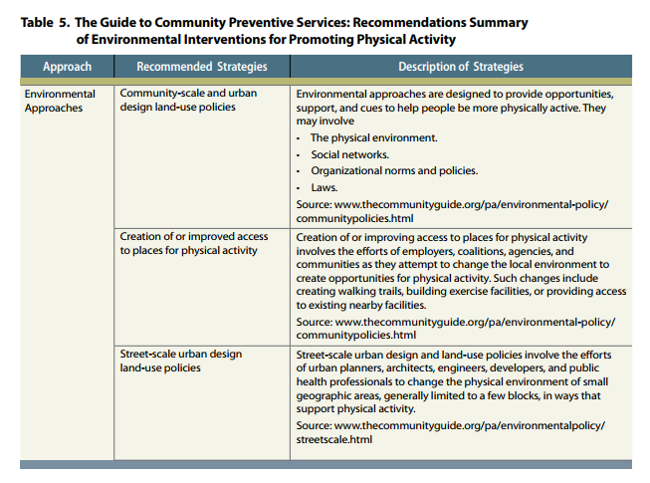
INTERVENTIONS
PROMOTNG
PHYSICAL
ACTIVITY
INTERVENTIONS
PROMOTING
PHYSICAL ACTIVITY

Slide 26
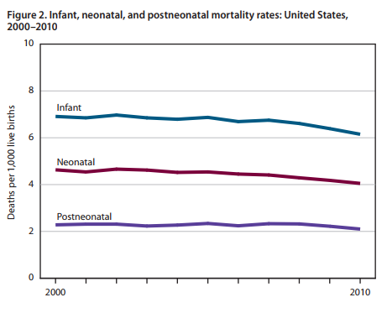
IMPROVING INFANT MORTALITY RATE OVER TIME

Slide 27
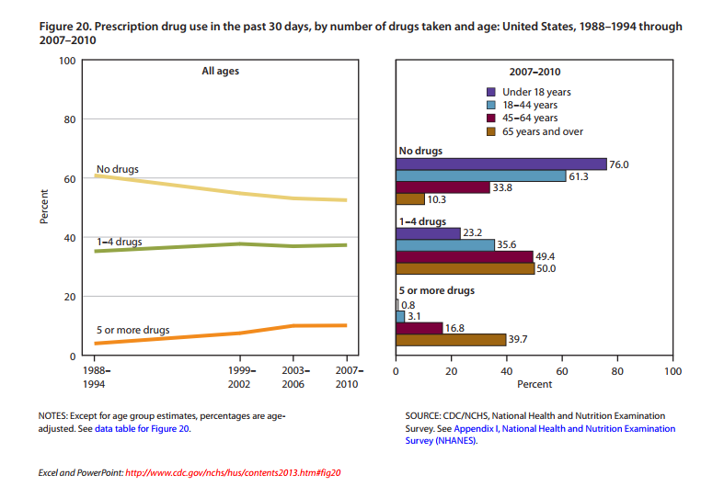
MEDICATION USAGE REVIEW

Slide 28
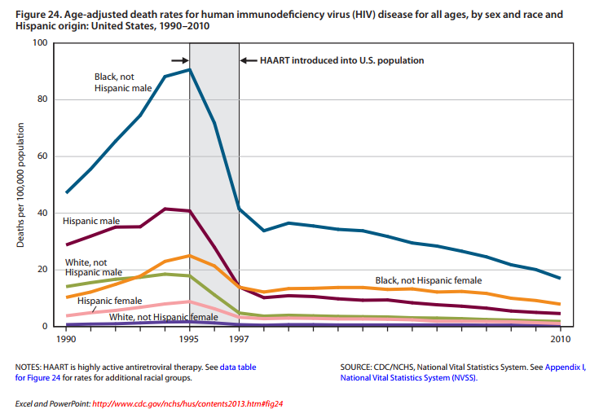
MARKED REDUCTION
IN DEATHS RELATED
TO HIV INFECTION
OVER TIME ESPECIALLY
IN BLACK AND HISPANIC MALES

Slide 29
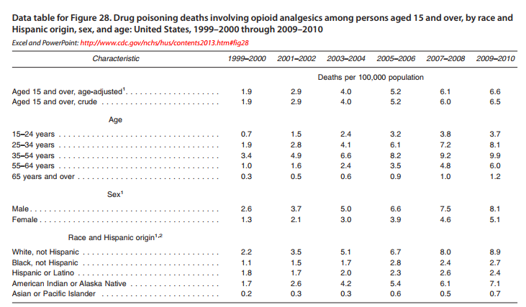

Slide 30
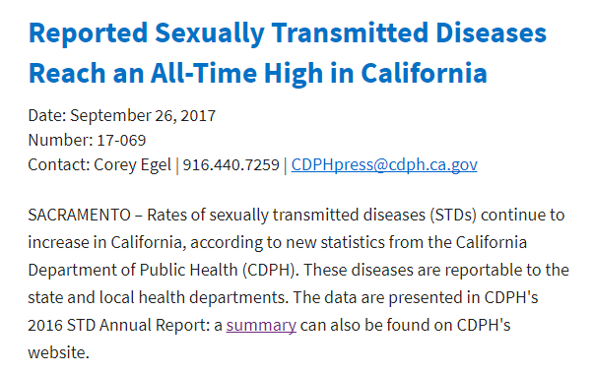

Slide 31

California STD Surveillance
2016 Data Graph Set

Slide 32
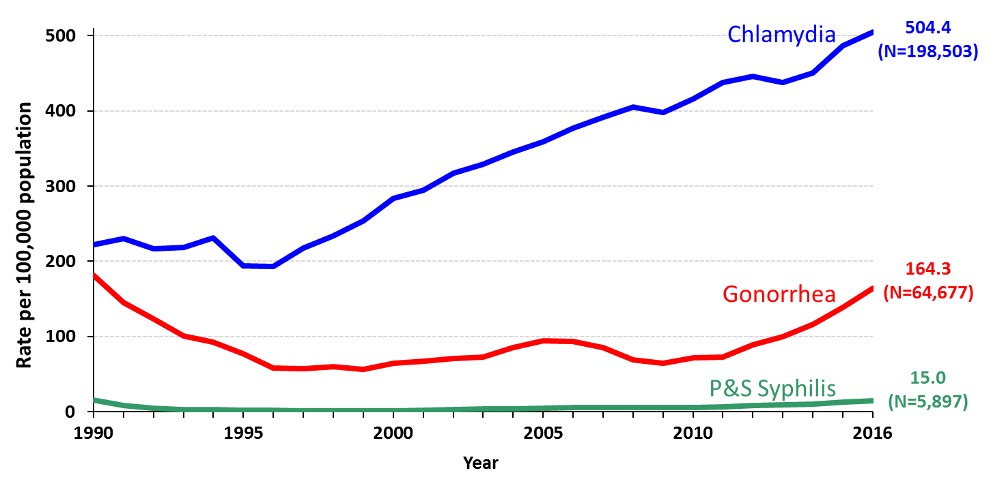
Chlamydia, Gonorrhea, and Primary & Secondary Syphilis
California Incidence Rates, 1990–2016
Rev. 6/2017

Slide 33
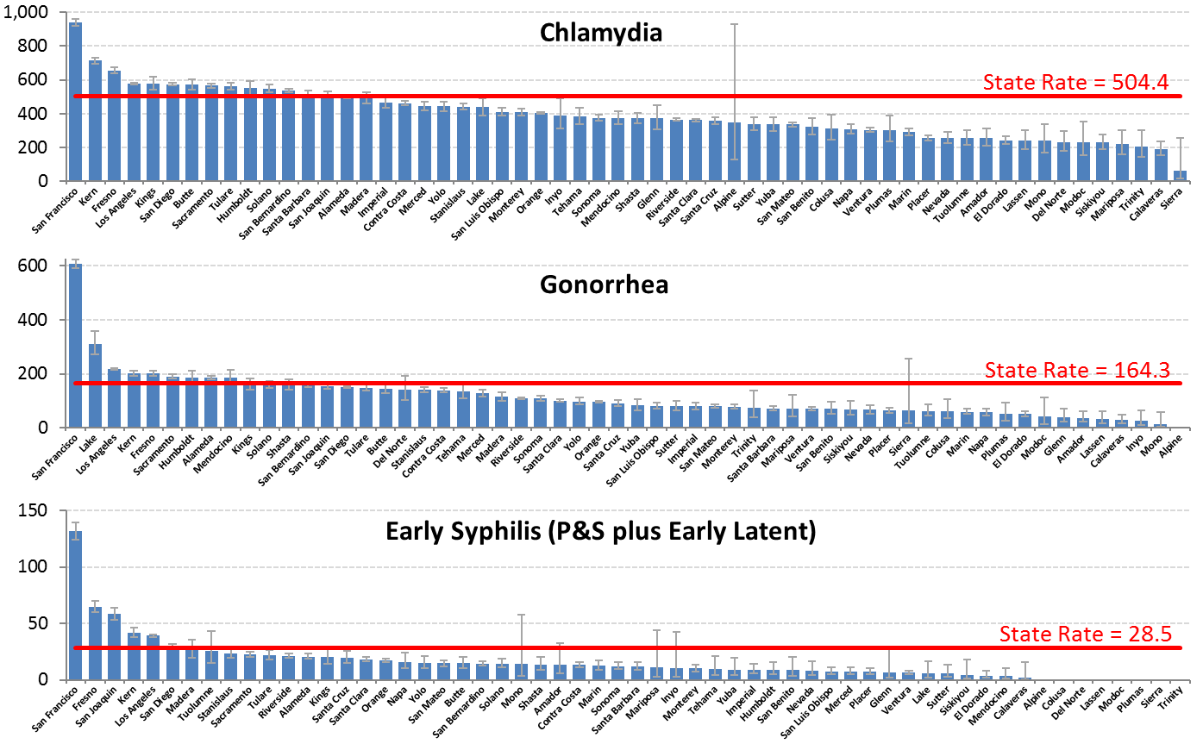
Chlamydia, Gonorrhea, and Early Syphilis
Ranking of County Incidence Rates, California, 2016
(with 95% Confidence Intervals*)
* Confidence intervals were calculated using Poisson exact method; not shown for counties with zero cases.
Note: Rates are per 100,000 population.
Source: California Department of Public Health, STD Control Branch
Rev. 6/2017
Notes:
* Confidence intervals were calculated using Poisson exact method; not shown for counties with zero cases.
Note: Rates are per 100,000 population.
Source: California Department of Public Health, STD Control Branch

Slide 34
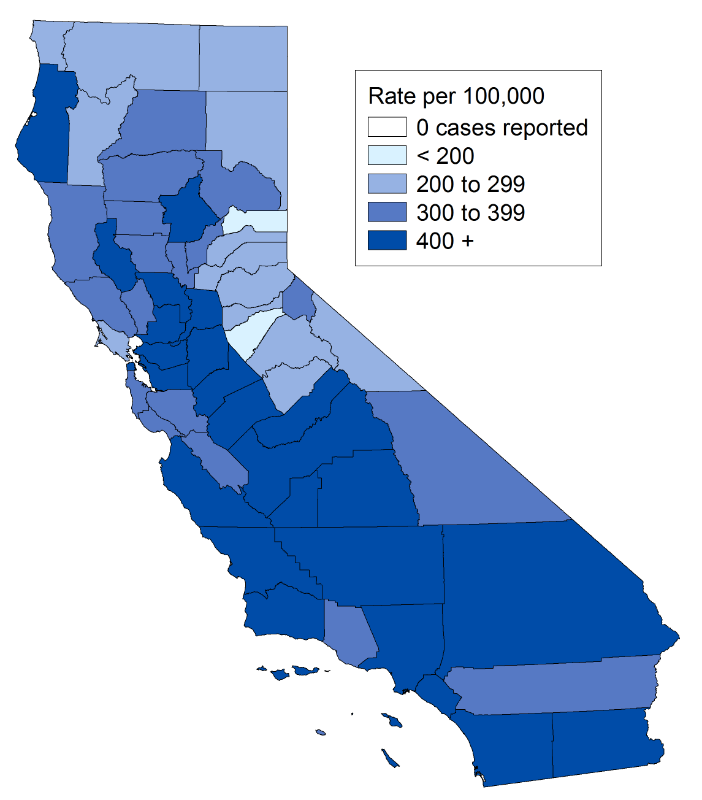
Chlamydia, Incidence Rates by County, California, 2016
Rev. 6/2017

Slide 35
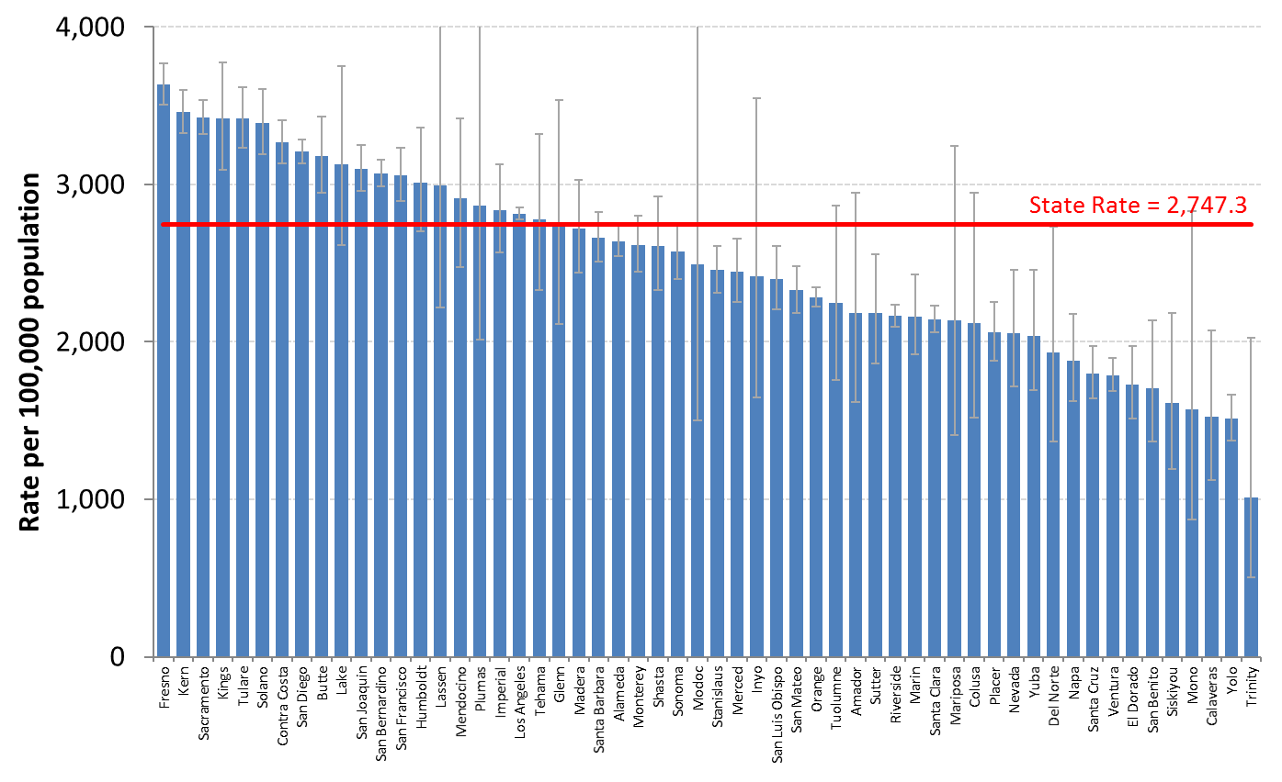
Ranking of County Chlamydia Rates among
Females Ages 15-24, California, 2016
(with 95% Confidence Intervals*)
* Confidence intervals were calculated using Poisson exact method; excludes counties with no cases or statistically unstable rates.
Note: Rates are per 100,000 population.
Source: California Department of Public Health, STD Control Branch
Rev. 6/2017
Notes:
* Confidence intervals were calculated using Poisson exact method; excludes counties with no cases or statistically unstable rates.
Note: Rates are per 100,000 population.
Source: California Department of Public Health, STD Control Branch

Slide 36
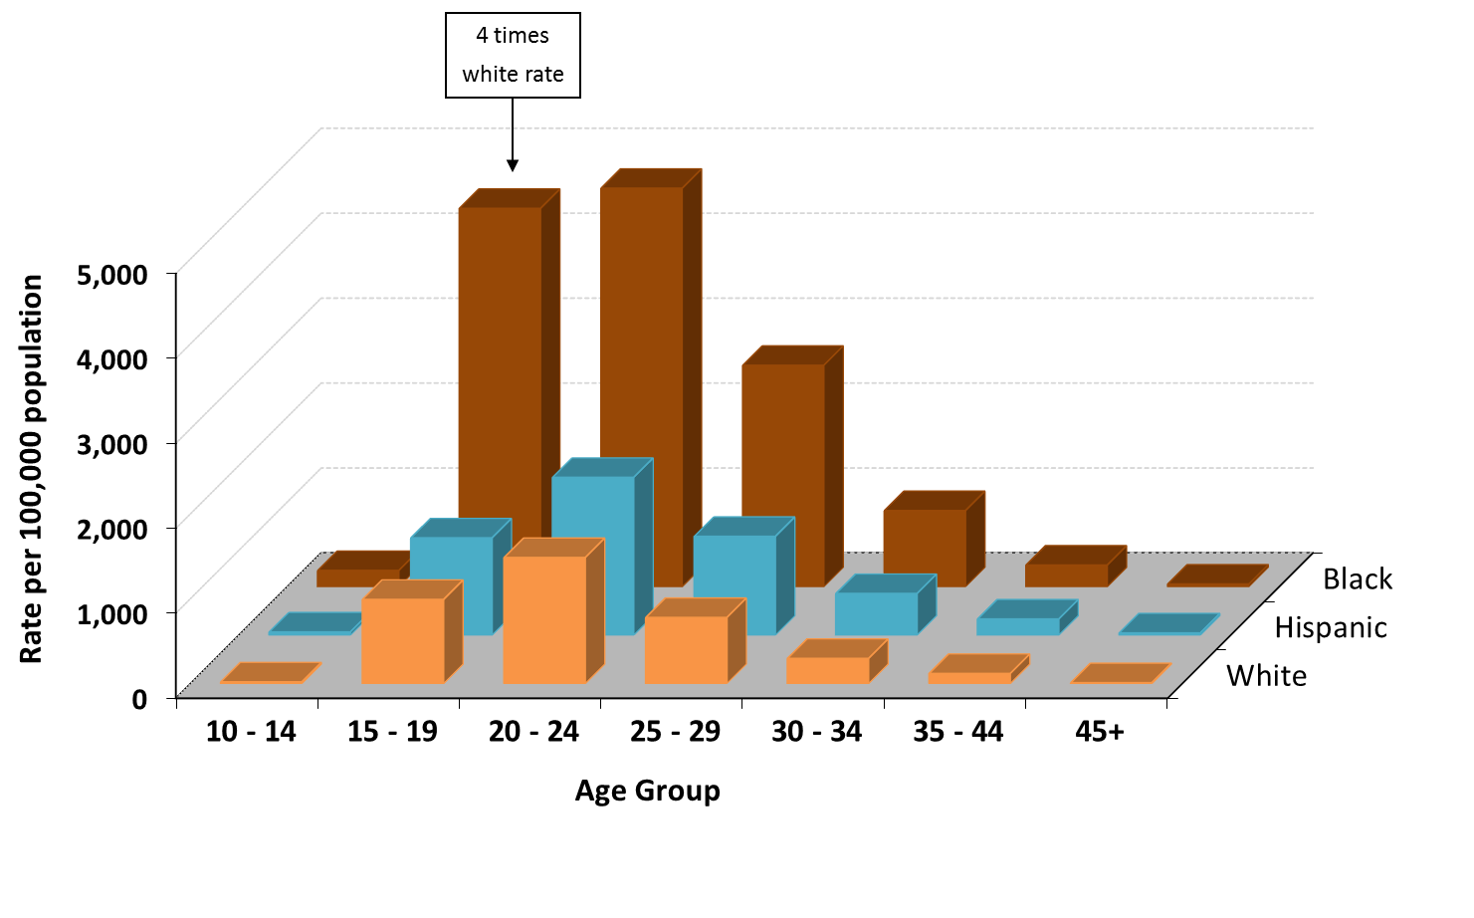
Chlamydia, Female Incidence Rates by Race/Ethnicity and Age Group (in years), California, 2016
Rev. 6/2017

Slide 37
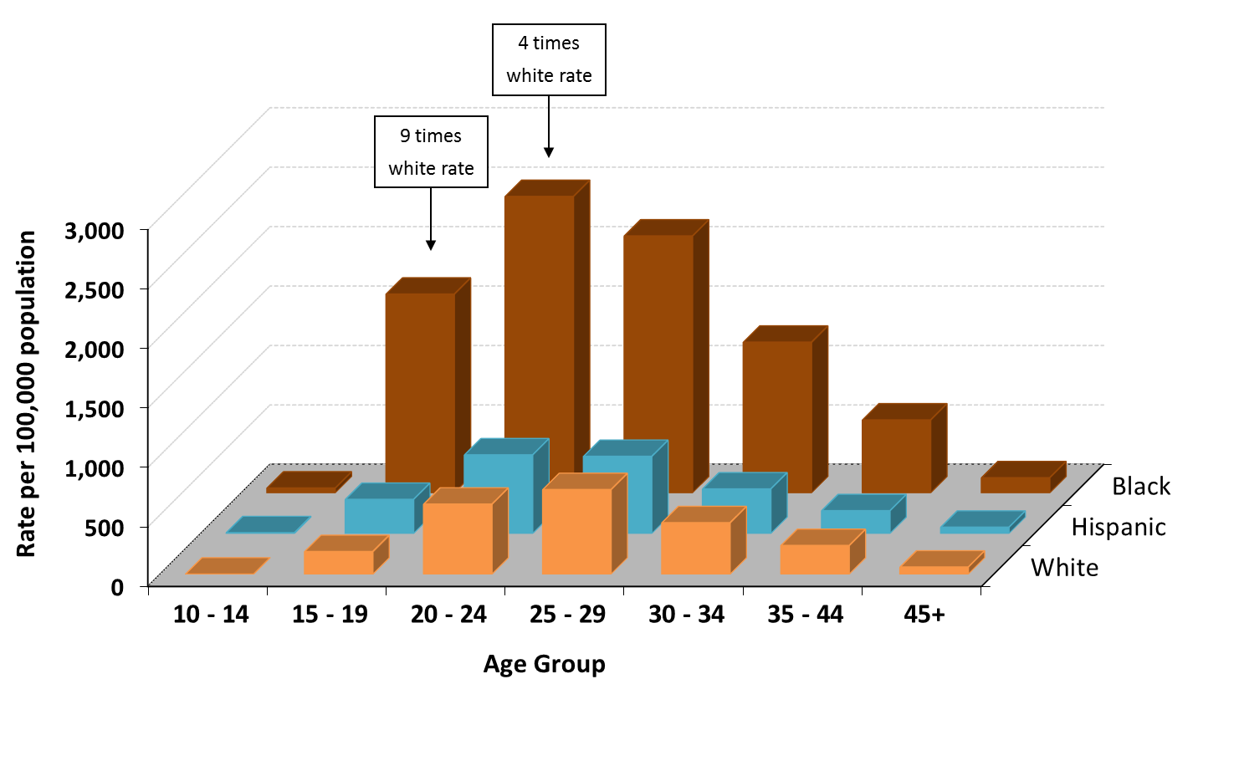
Chlamydia, Male Incidence Rates by Race/Ethnicity and Age Group (in years), California, 2016
Rev. 6/2017

Slide 38
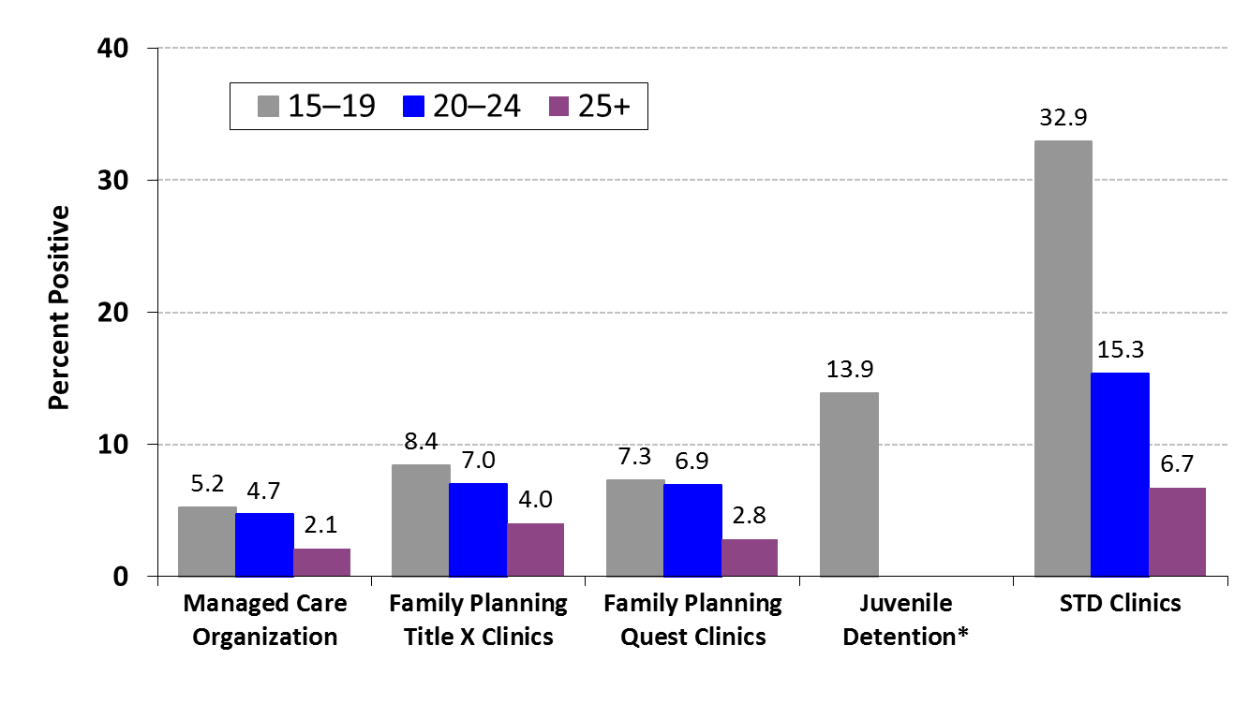
Chlamydia Prevalence Monitoring, Percent Positive for Females of Selected Age Groups, by Health Care Setting,
California, 2015–2016*
* This venue targets adolescents primarily; 2015 data for managed care, and 2016 data for family planning, juvenile detention, and STD clinics.
Source: California Department of Public Health, STD Control Branch
Rev. 7/2017
Notes:
* This venue targets adolescents primarily; 2015 data for managed care, and 2016 data for family planning, juvenile detention, and STD clinics.
Source: California Department of Public Health, STD Control Branch

Slide 39
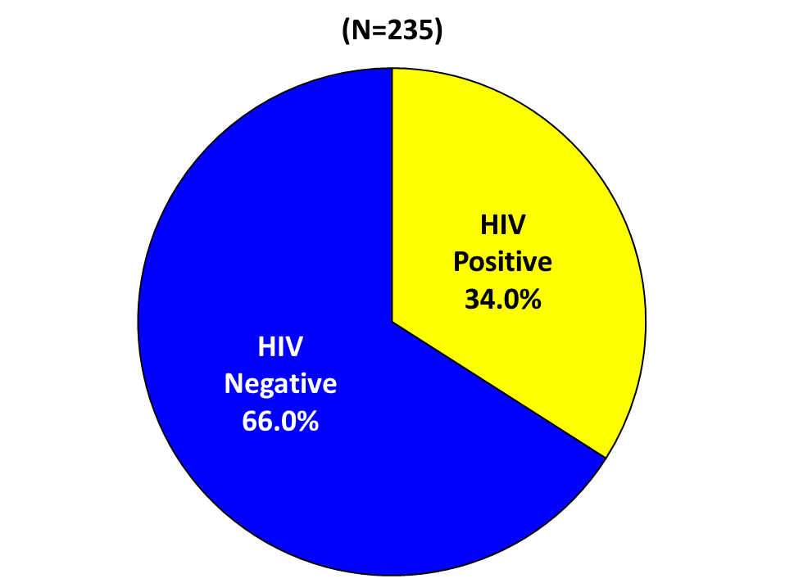
California Gonococcal Surveillance System (CGSS)
HIV Status among Sampled and Interviewed Cases
Men who Have Sex with Men, California, 2016
Note: N does not include HIV status unknown or refused to state: 16 cases in 2016.
Rev. 7/2017
Notes:
Note: N does not include HIV status unknown or refused to state: 16 cases in 2016.

Slide 40
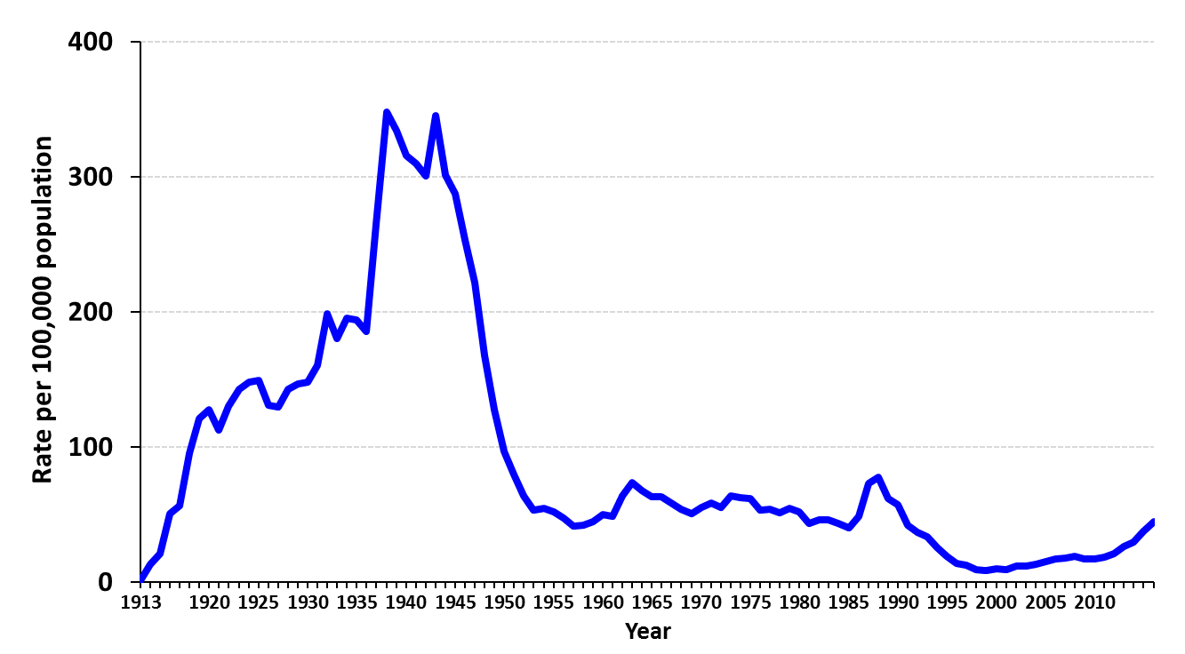
Total Syphilis (all stages)
California Incidence Rates, 1913–2016
Rev. 6/2017

Slide 41
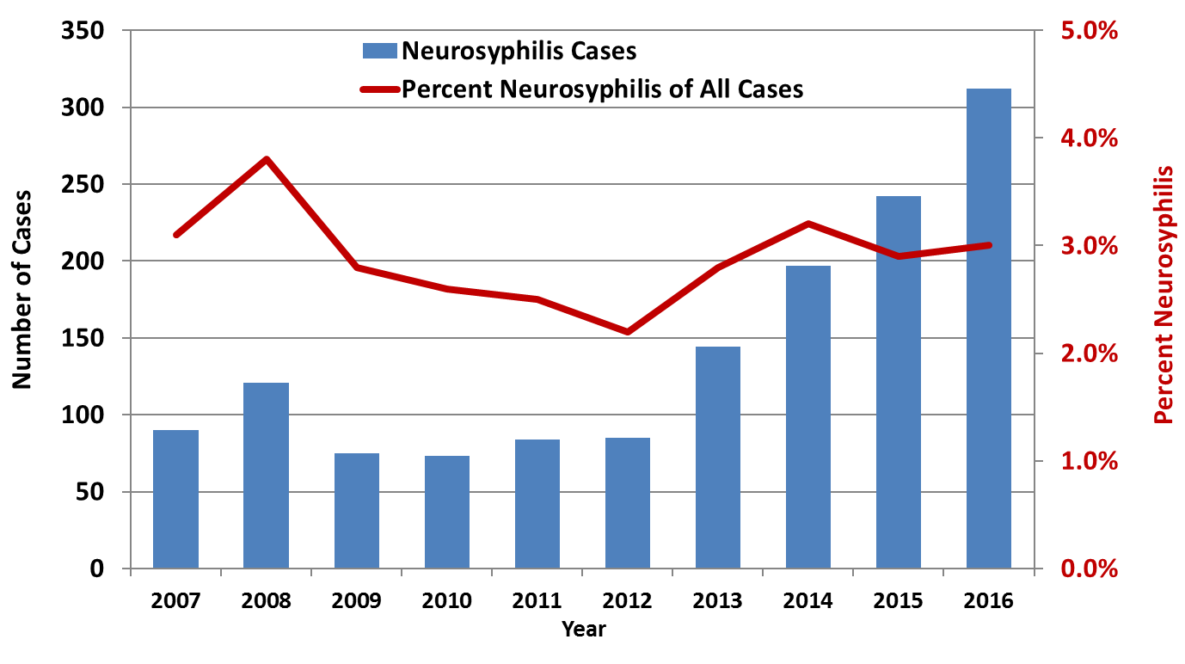
Neurosyphilis Case Count and Percent of All Syphilis Cases
California Project Area*, 2007-2016
* California Project Area (CPA) excludes Los Angeles and San Francisco.
Rev. 6/2017
Notes:
* California Project Area (CPA) excludes Los Angeles and San Francisco.

Slide 42
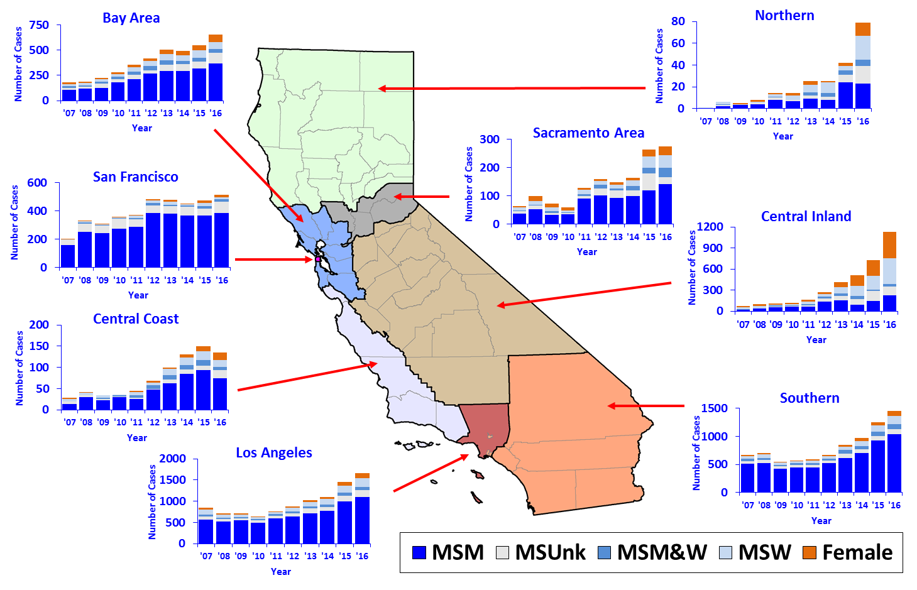
Number of Primary & Secondary Syphilis Cases by Region,
Sexual Orientation, and Year, California, 2007–2016
MSM=Men who have sex w/men, MSW=Men who have sex w/women, MSUnk=Men of unknown sexual orientation
Rev. 6/2017
Notes:
MSM=Men who have sex w/men, MSW=Men who have sex w/women, MSUnk=Men of unknown sexual orientation

Slide 43
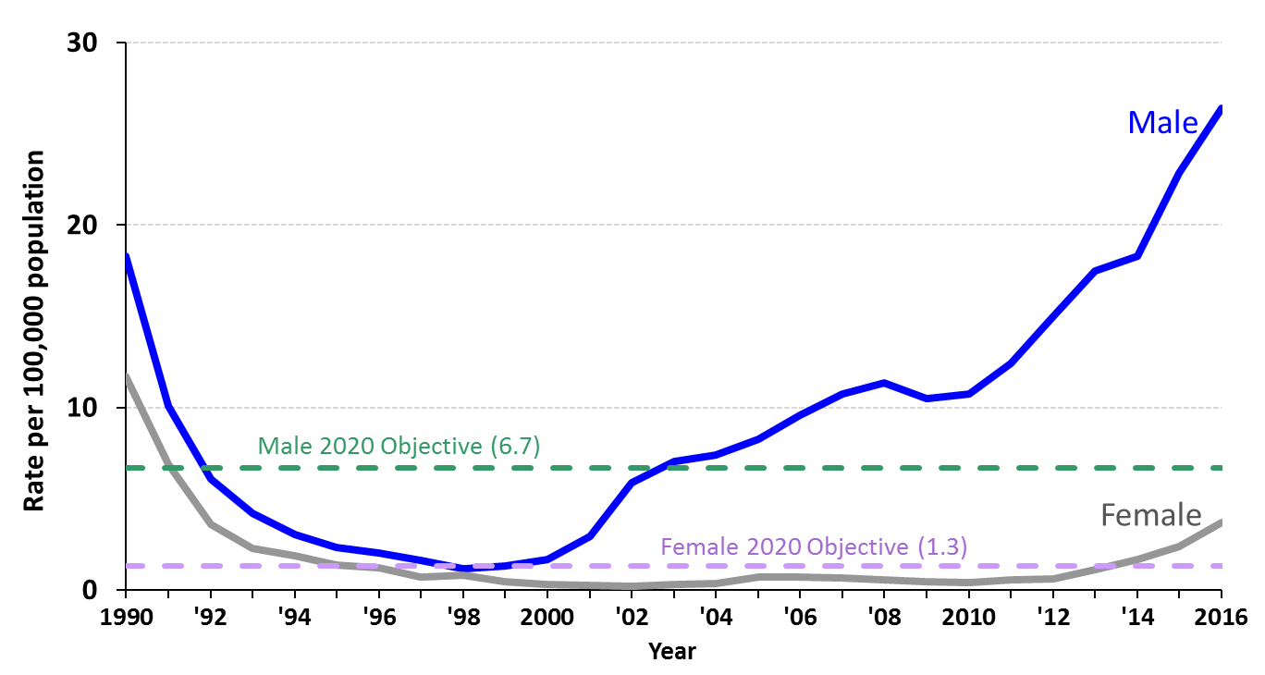
Primary & Secondary Syphilis, Incidence Rates by Gender
California, 1990–2016
Rev. 6/2017

Slide 44
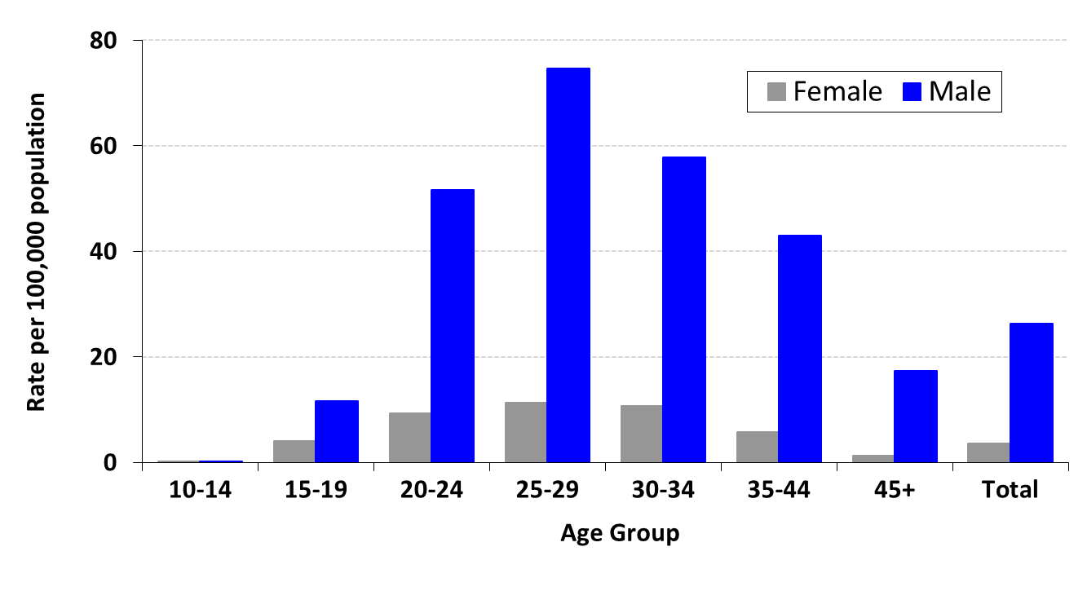
Primary & Secondary Syphilis
Incidence Rates by Gender and Age Group (in years)
California, 2016
Rev. 6/2017

Slide 45
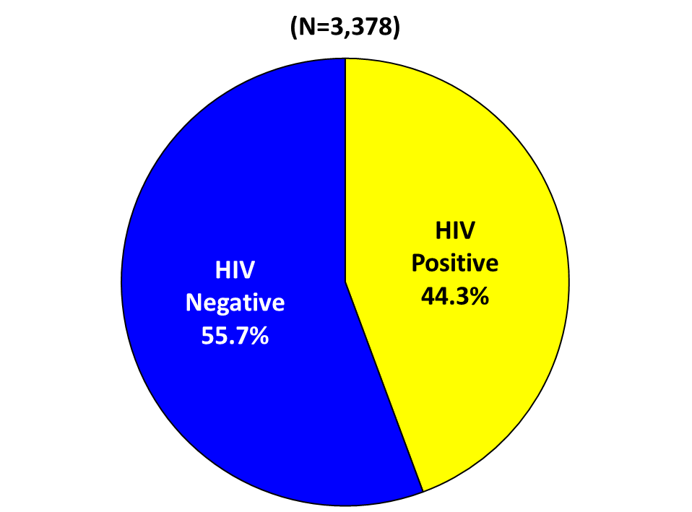
HIV Status among Primary & Secondary Syphilis Cases
Men who Have Sex with Men
California, 2016
Note: N does not include HIV status unknown or refused to state: 286 cases in 2016.
Rev. 6/2017
Notes:
Note: N does not include HIV status unknown or refused to state: 286 cases in 2016.

Slide 46
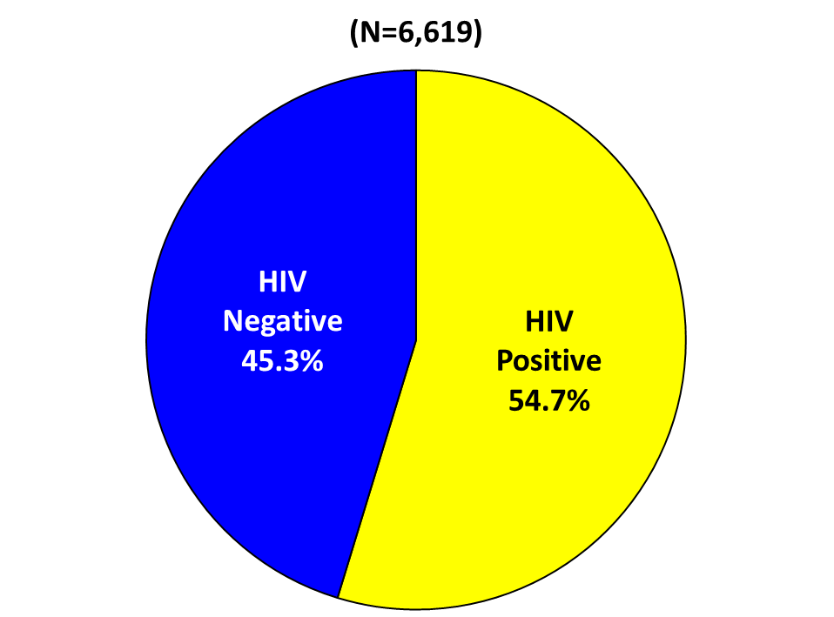
HIV Status among Early Syphilis* Cases
Men who Have Sex with Men
California, 2016
Note: N does not include HIV status unknown or refused to state: 476 cases in 2016.
* Includes primary, secondary, and early latent syphilis.
Rev. 6/2017
Notes:
Note: N does not include HIV status unknown or refused to state: 476 cases in 2016.
* Includes primary, secondary, and early latent syphilis.

Slide 47
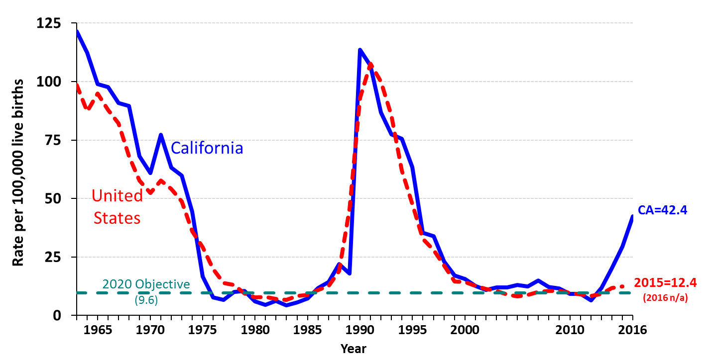
Congenital Syphilis, California versus United States Incidence Rates, 1963–2016
Note: The Modified Kaufman Criteria were used through 1989. The CDC Case
Definition (MMWR 1989; 48: 828) was used effective January 1, 1990.
California data prior to 1985 include all cases of congenital syphilis, regardless of age.
Rev. 6/2017
Notes:
Note: The Modified Kaufman Criteria were used through 1989. The CDC Case Definition (MMWR 1989; 48: 828) was used effective January 1, 1990. California data prior to 1985 include all cases of congenital syphilis, regardless of age.

Slide 48
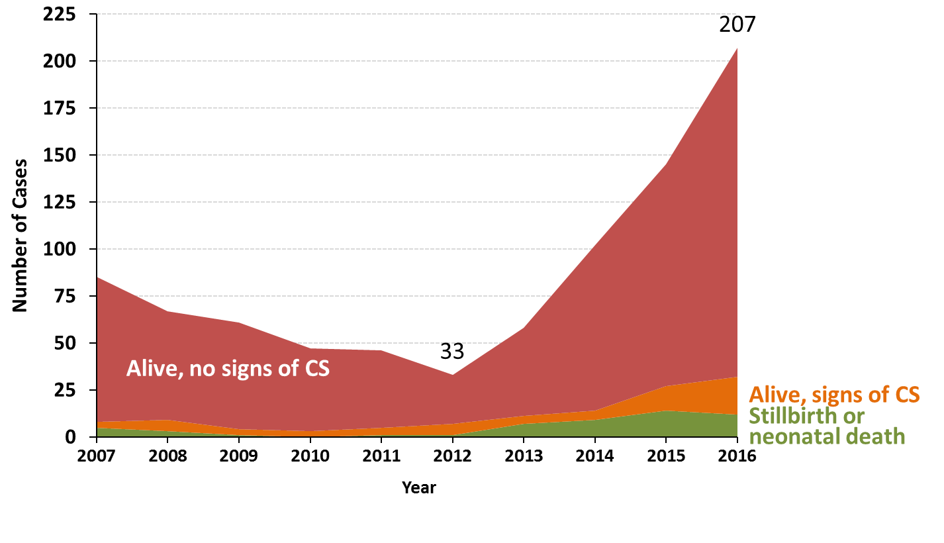
Congenital Syphilis
Cases by Vital Status and Presence of Signs/Symptoms
California, 2007–2016
Note: Alive, no signs/symptoms includes alive with missing documentation on signs/symptoms.
Of the 207 total cases, 175 alive with no signs, 20 alive with signs of CS, 12 stillbirth or neonatal death
Rev. 6/2017
Notes:
Alive, no signs/symptoms includes Alive with missing documentation on signs/symptoms. For 2016, that was 1/(174+1) = 0.6%
See column O on data tab for annual numbers.
Of the 207 total cases, 175 alive with no signs, 20 alive with signs of CS, 12 stillbirth or neonatal death

Slide 49
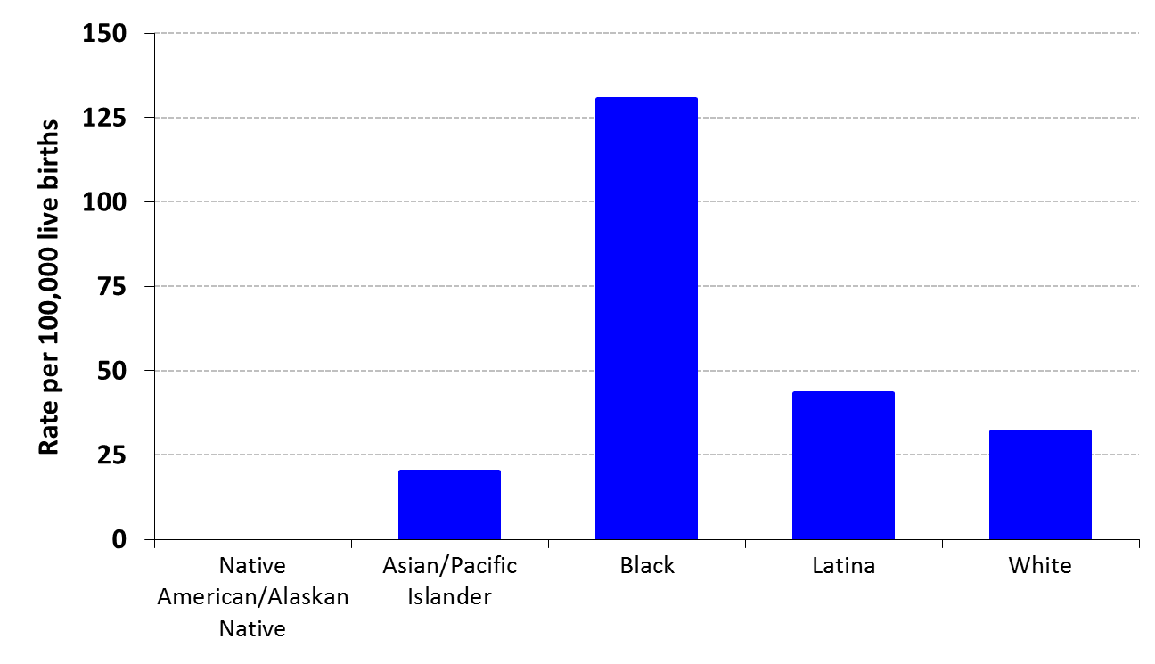
Congenital Syphilis
Incidence Rates by Race/Ethnicity of Mother
California, 2016
Rev. 6/2017

Slide 50
Prevent the Flu this Season by Getting a Flu Shot
The California Department of Public Health (CDPH) urges Californians to get the influenza (flu) vaccine in September or October ahead of the arrival of influenza season.
In California, flu usually begins to increase in late November or December. It takes a couple of weeks after vaccination for the body to respond fully, so now is the time to get vaccinated to have the best protection before the flu season begins.
"Getting vaccinated is the best protection against flu illness," said CDPH Director and State Health Officer Dr. Karen Smith. "You can prevent missing work or school, visits to the doctor or hospitalizations, and protecting others from coming down with the flu."
A person with flu may be contagious and infect others before they even feel sick.

Slide 51
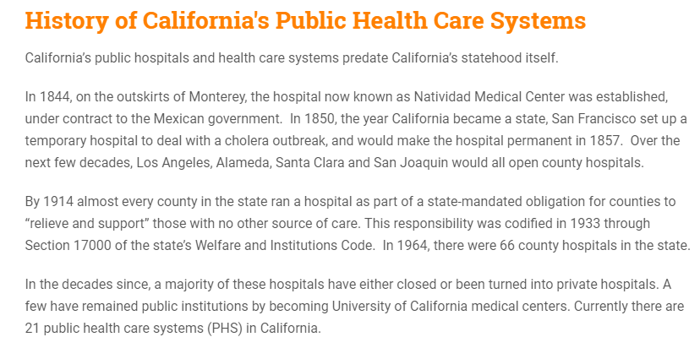

Slide 52
People of Color 38%
GREATER LATINO POPULATION IN CALIFORNIA COMPARED TO THE REST OF THE
UNITED STATES
Figure 1: Racial and Ethnic Distribution of Residents, 2013

Slide 53
GREATEST POVERTY
LEVELS SEEN IN THE BLACK AND LATINO
POPULATIONS IN
CALIFORNIA
Race/Ethnicity
Age (Years)

Slide 54
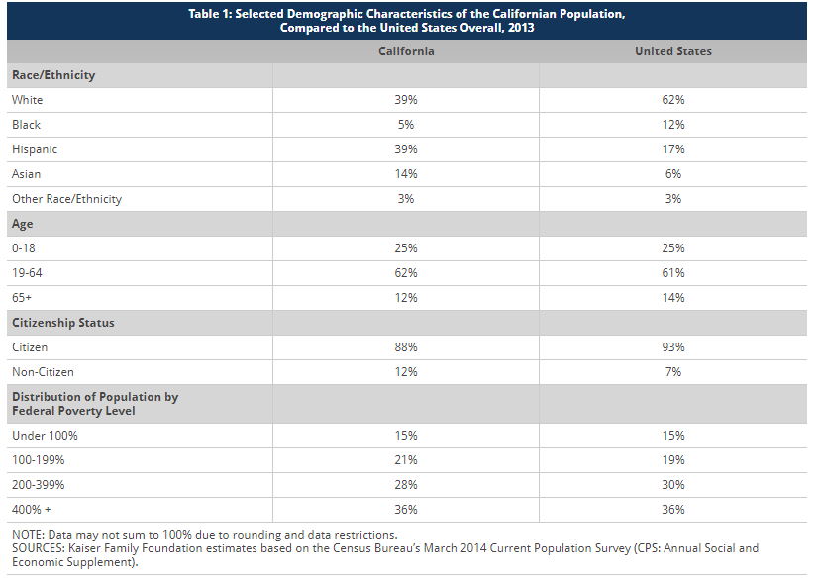
DEMOGRAPHIC
CHARACTERISTICS
OF CALIFONIA
IN THE YEAR 2013
COMPARED TO THE
THE U.S. OVERALL

Slide 55
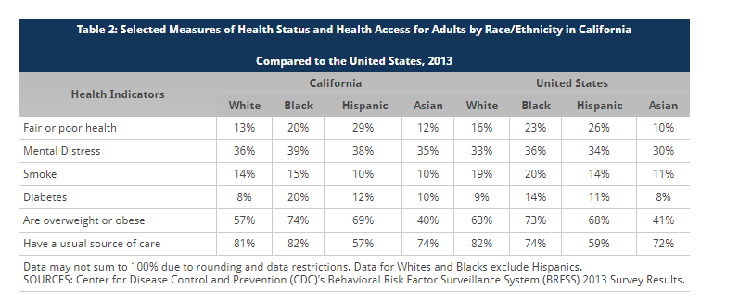
Population Health

Slide 56
IMPROVED MEDICAID/CHIP BENEFIT ELIGIBILITY AFTER AFFORDABLE CARE ACT IMPLEMENTATION ESPECIALLY IN CHILDLESS ADULTS

Slide 57
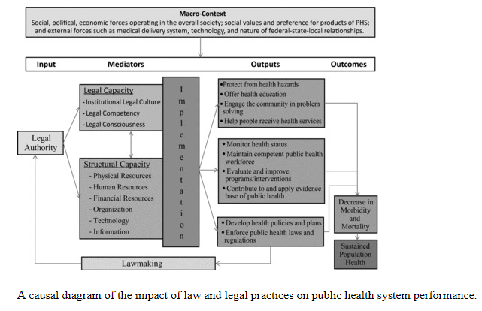
DIAGRAM OF THE LAW AND
POPULATION PUBLIC HEALTH

Slide 58
Moving from Intersection to Integration: Public Health Law Research and Public Health Systems and Services Research
Conclusions: The routine integration of law as a salient factor in broader PHSSR(Public Health Systems and Services Research) studies of public health system functioning and health outcomes will enhance the usefulness of research in supporting practice and the long-term improvement of system performance.

