Slide 1

MODULE three:
MEDICAL ADMINISTRATION AND SERVICE DELIVERY STRUCTURES IN COMMUNITY HEALTH SETTINGS

Slide 2
MODULE three :
SECTION one:
History of community
health centers
in California

Slide 3

UNIT OBJECTIVE
To be aware of the principles, values, and historical evolution of community health centers in California

Slide 4
History of community health centers in California
Creation and evolution of community health centers in California
Patient profiles
Geographic location differences
Physician leadership
Patient care and satisfaction

Slide 5
INTRODUCTION TO YOUR CLINIC SITES
The following clinics are where you will be working under the AB1045 Program.
All of the following clinics are Federally Qualified Health Centers.
All of the following clinics primarily serve Hispanic clients.
All of the following clinics follow best practice evidence- based medical practice.
All place the patient as the primary focus and attempt to prioritize HEDIS clinical measures and decrease health care disparity.

Slide 6


Slide 7
The mission of San Benito Health Foundation is to provide quality, affordable comprehensive health services to the community of San Benito County and surrounding areas in a manner that is accountable to the community while being respectful, empathetic, and culturally-sensitive to our clients.
Our vision is for a safe and healthy San Benito County where health disparities do not exist, people have access to care, and have the knowledge and skills to make healthy choices. The SBHF is a leader among alliances and partnerships that foster a climate of thoughtful change and create solutions for maintaining our community safe and healthy.

Slide 8
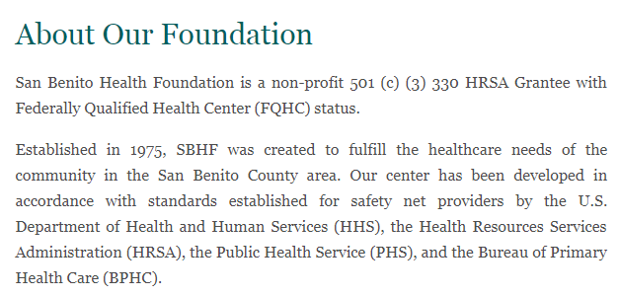

Slide 9


Slide 10
Welcome to Altura Centers for Health
Altura Centers for Health formerly (TCHC) has been providing medical and dental care to the community since 1995.
Historically the clinic was formerly owned and operated by Tulare Local Health Care District. It was purchased from Tulare District Hospital (TDH) in July 1998.
Altura first became a Federal Qualified Look A-Like Clinic in 1997 and in 2000 became a Federally Qualified Health Center (FQHC), and is an FTCA deemed facility. In addition, the clinic is a 501 (C) 3 Non-profit Organization.
Altura is governed by a committed Volunteer Community Board of Directors which meet once a month and serve on several committees.
The majority of the Board of Directors are patients of Altura. Hence, it is a clinic governed by its patients as well as community.
The majority of our providers are contracted with the clinic. This arrangement has enabled us to have many specialists available to our patients.
It has resulted in continuity of providers (majority are Board Certified) allowing the patient and provider to build a long lasting relationship.
Our Primary Care Physicians (PCPs), including Dentists are on-call 24 hours a day 7 days a week.

Slide 11

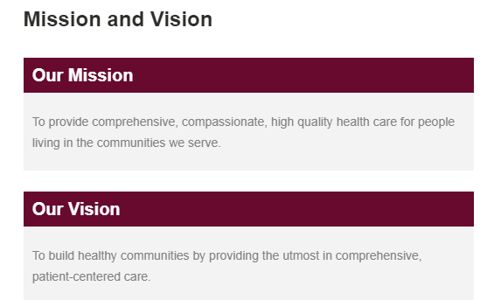

Slide 12
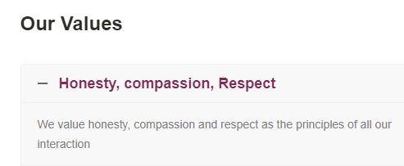


Slide 13



Slide 14


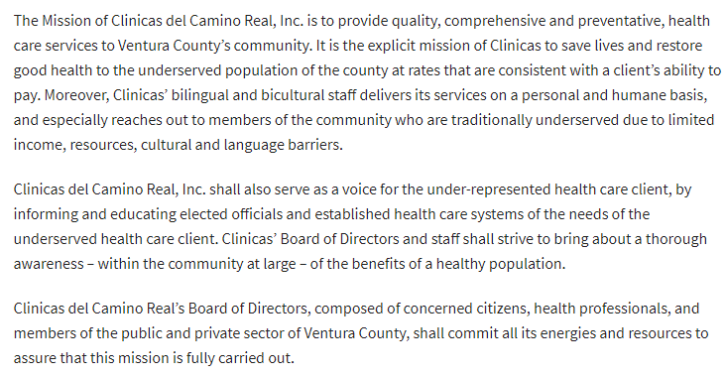

Slide 15



Slide 16

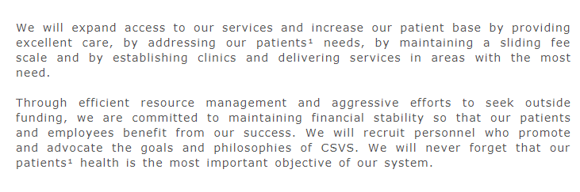

Slide 17


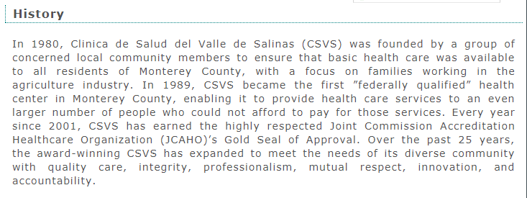

Slide 18
1. All of the community health centers you will be working for have all of the following
true similarities except for one false statement below. What is the false statement identified
Below?
All of the following clinics are Federally Qualified Health Centers.
All of the following clinics primarily serve Hispanic clients.
All of the following clinics follow best practice evidence- based medical practice.
All place the patient as the primary focus and attempt to prioritize HEDIS clinical measures and decrease health care disparity.
All clinic protocols are based on “well established” standard.

Slide 19
1. All of the community health centers you will be working for have all of the following
true similarities except for one false statement below. What is the false statement identified
Below?
All of the following clinics are Federally Qualified Health Centers.
All of the following clinics primarily serve Hispanic clients.
All of the following clinics follow best practice evidence- based medical practice.
All place the patient as the primary focus and attempt to prioritize HEDIS clinical measures and decrease health care disparity.
All clinic protocols are based on “well established” standard.

Slide 20
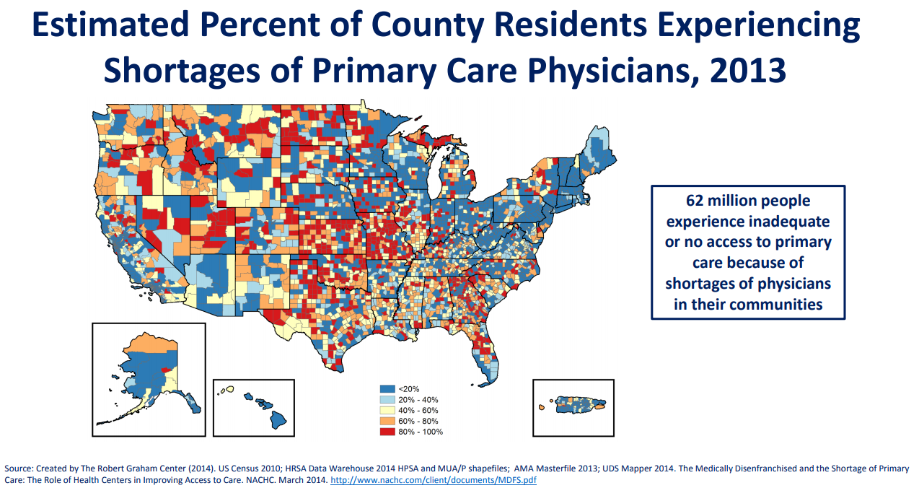

Slide 21
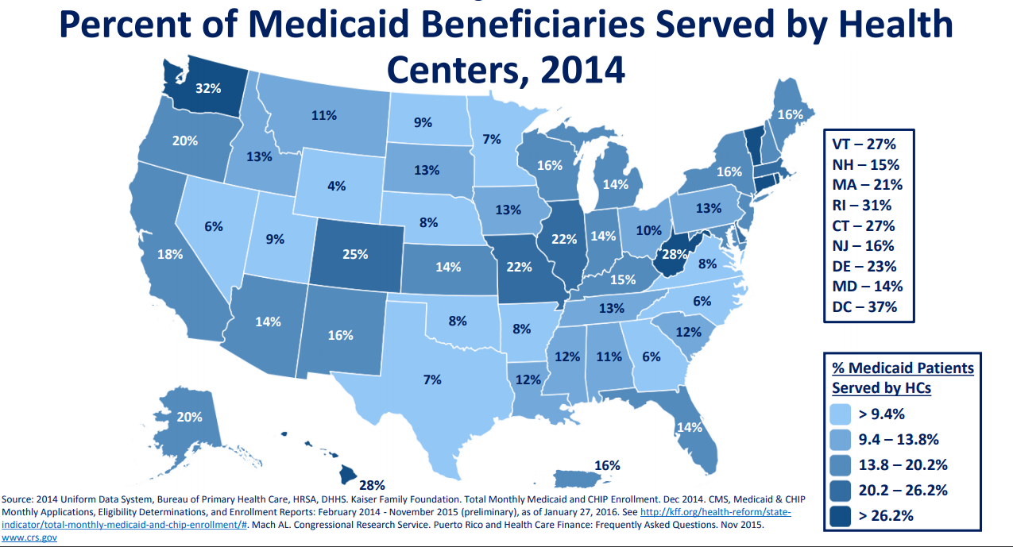
PATIENT MEDICAID PROFILE AND GEOGRAPHIC DIFFERENCES

Slide 22
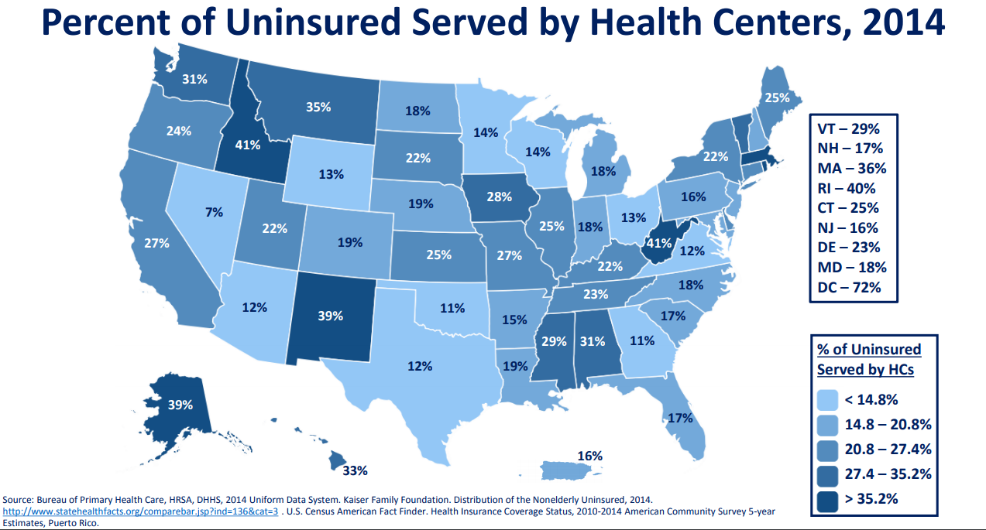
PATIENT UNINSURED PROFILE AND GEOGRAPHIC DIFFERENCES

Slide 23
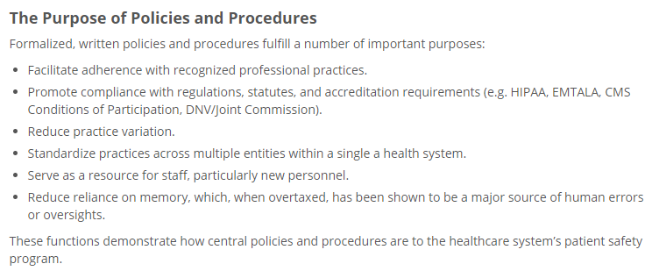


Slide 24



Slide 25

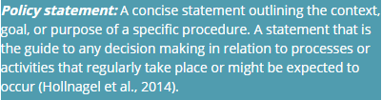


Slide 26

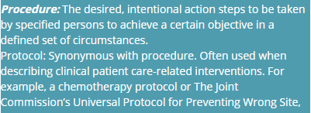

Slide 27

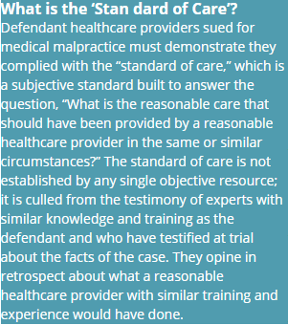


Slide 28
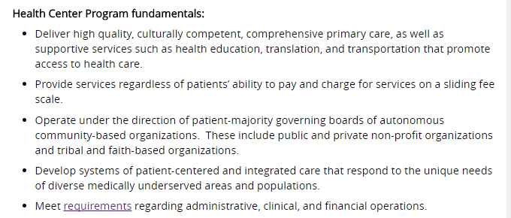
What is a Health Center?

Slide 29
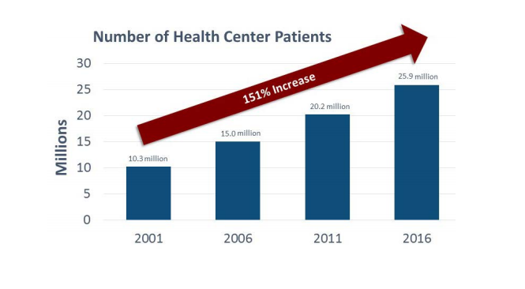

Slide 30
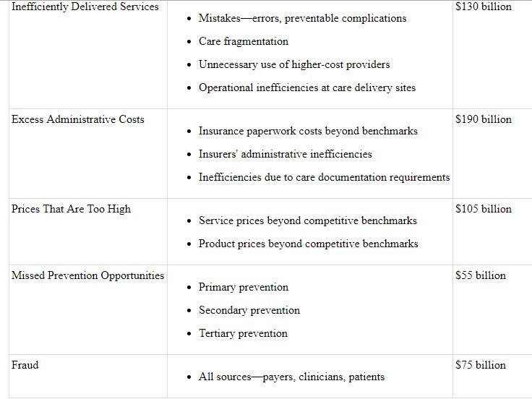

Slide 31
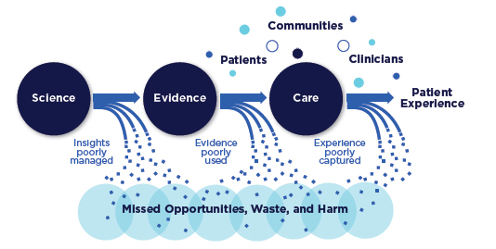

Slide 32
2. All of the following are thought to be missed opportunities to use data to improve the health care system in the USA and California except for the following?
Insights poorly managed
Evidence poorly used
Experience poorly captured
Performance should be rewarded by the funding system

Slide 33
2. All of the following are thought to be missed opportunities to use data to improve the health care system in the USA and California except for the following?
Insights poorly managed
Evidence poorly used
Experience poorly captured
Performance should be rewarded by the funding system

Slide 34
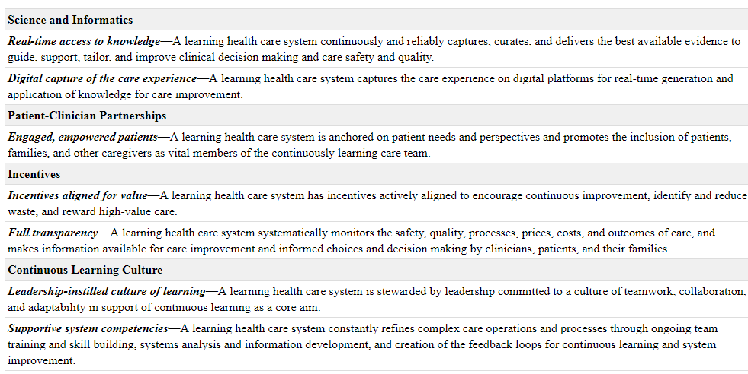

Slide 35
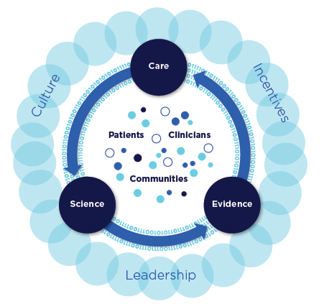
DYNAMIC INTERACTIONS
BETWEEN PATIENTS, CLINICIANS,
COMMUNITIES, CULTURE, INCENTIVES
AND LEADERSHIP

Slide 36
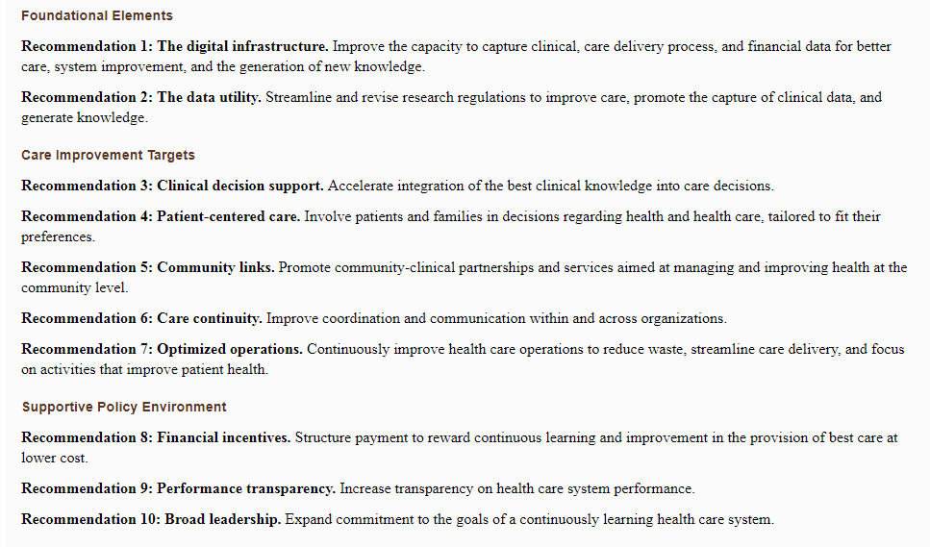

Slide 37
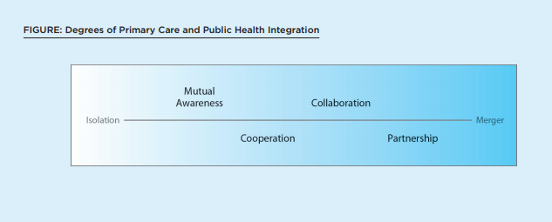
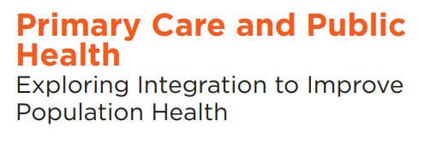
WORKING TOGETHER
IN A COMMON DIRECTION

Slide 38
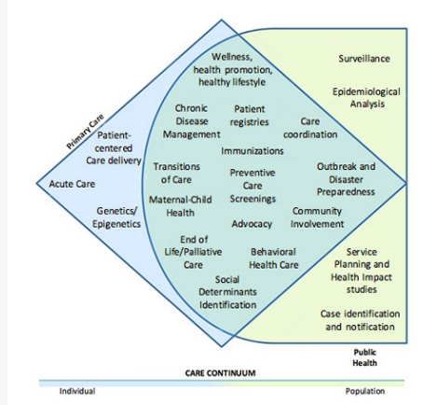
INDIVIDUAL
PATIENT
TO POPULATION

Slide 39
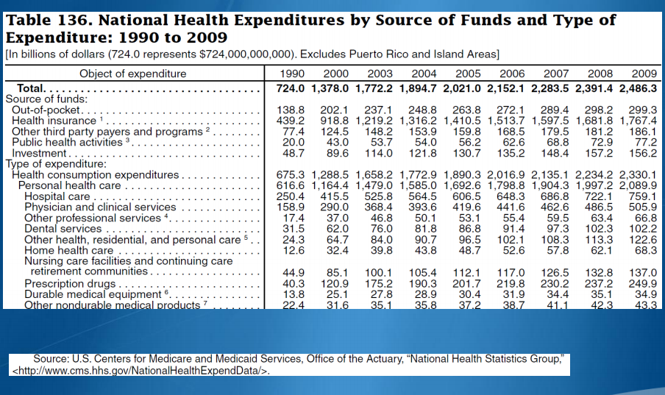
COSTS OF HEALTH CARE

Slide 40
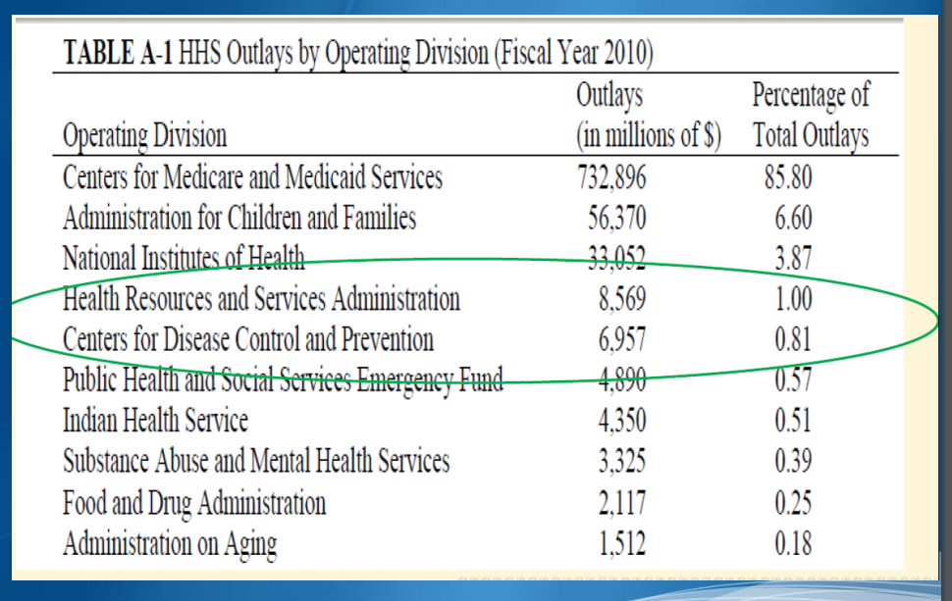
HEALTH CARE PROGRAM COST BREAKDOWN

Slide 41
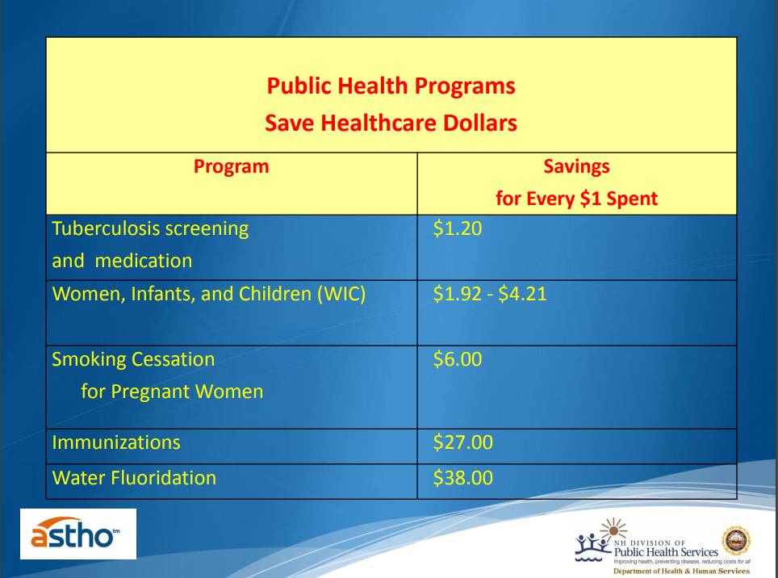
HEALTH CARE EXPENSES THAT SAVE MONEY FOR HEALTHCARE SYSTEM

Slide 42
3. Examples of Public Health Programs that actually save money include all of the following except for which response?
WIC (women, infants, and children)
Smoking cessation
Immunizations
Water fluoridation
Elimination of authorization requirements for MRI referals

Slide 43
3. Examples of Public Health Programs that actually save money include all of the following except for which response?
WIC (women, infants, and children)
Smoking cessation
Immunizations
Water fluoridation
Elimination of authorization requirements for MRI referals

Slide 44
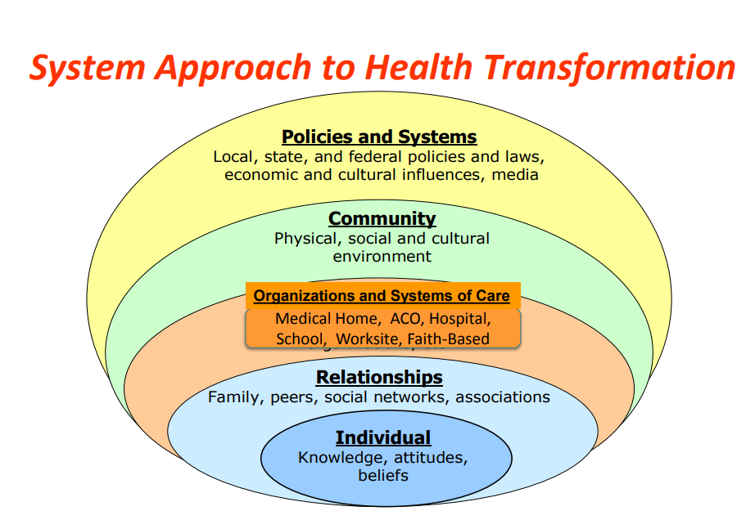
MULTIPLE LEVEL
ORGANIZATIONAL
DECISIONS THAT
TRANSLATE INTO
OVERALL IMPROVEMENT
“THE INDIVIDUAL”

Slide 45
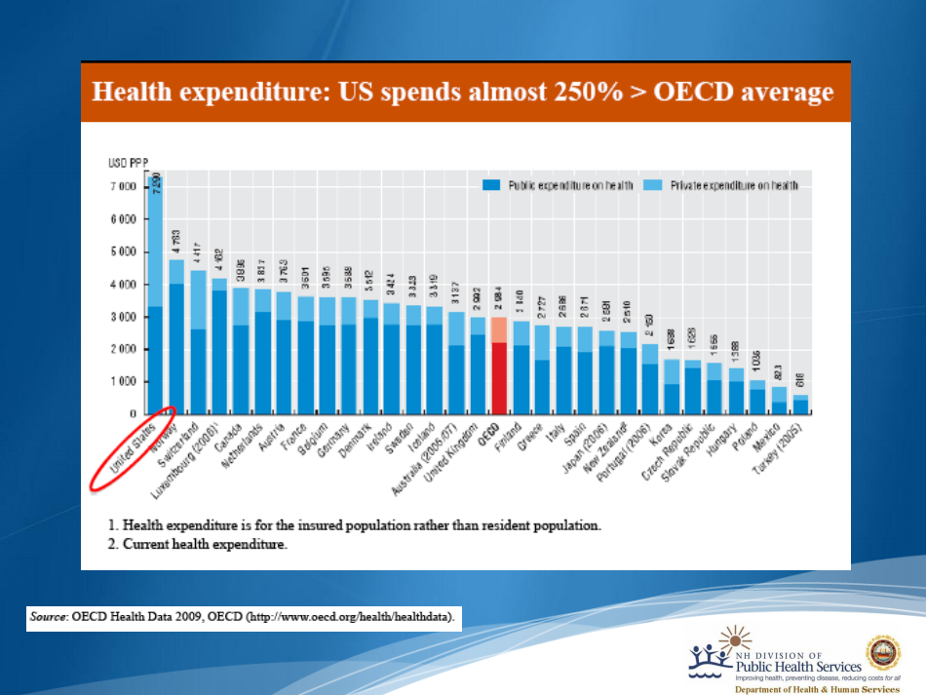
US SPENDS MORE THAN ANY OTHER COUNTRY ON HEALTH CARE
AS REPORTED IN 2009

Slide 46
4. The USA spends a lower total health care expenditure than all other countries that were compared. Is this a true or false statement?
True
False

Slide 47
4. The USA spends a lower total health care expenditure than all other countries that were compared. Is this a true or false statement?
True
False

Slide 48
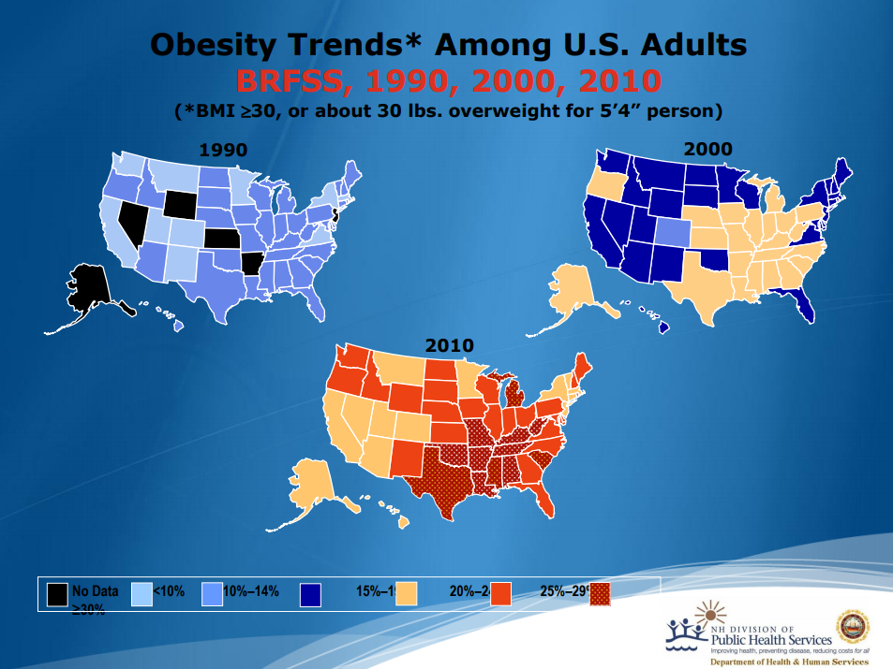
OBESITY TRENDS
ACROSS THE US
IN DIFFERENT STATES
OVER TIME

Slide 49
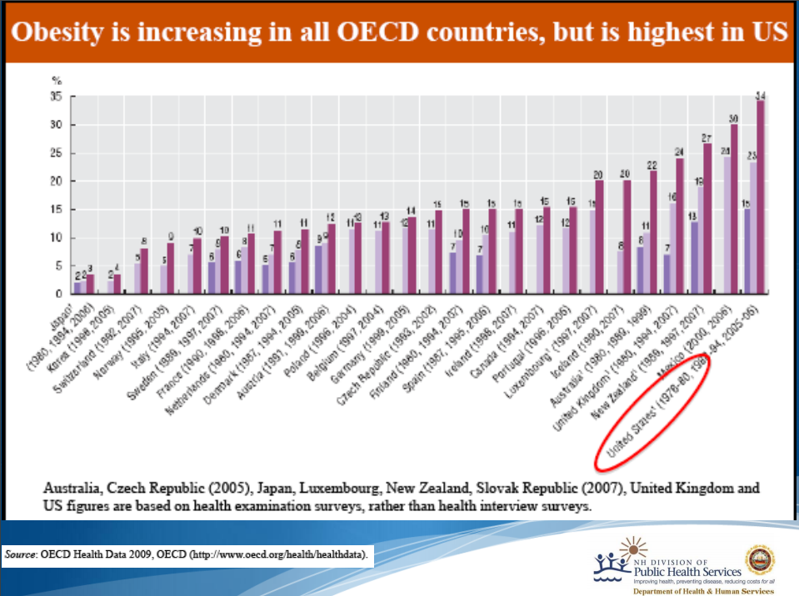
HIGHEST RATE OF
OBESITY IN
COMPARISON
TO OTHER
COUNTRIES
IN 2007

Slide 50
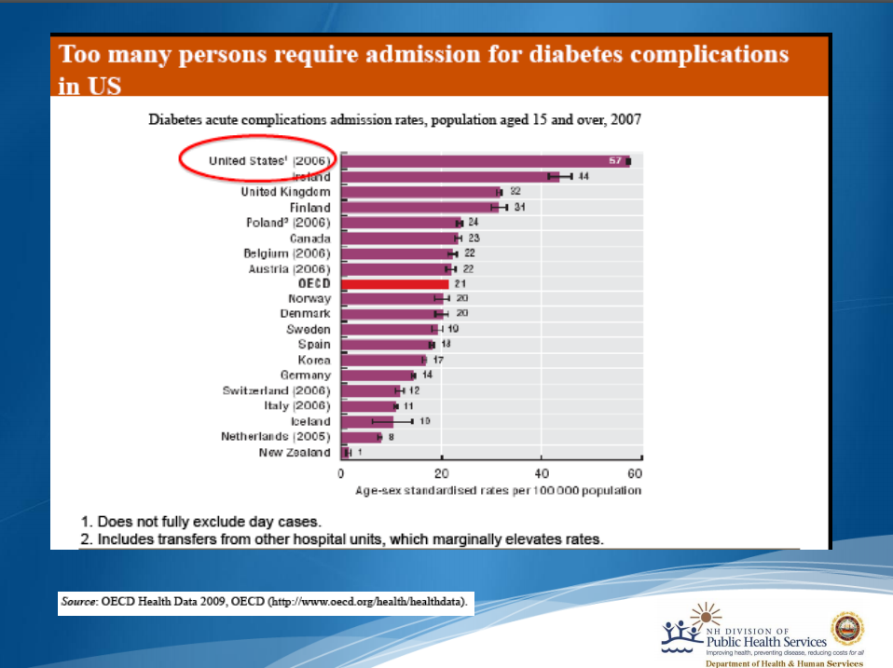
US HAS HIGHESTADMISSION RATE FOR DIABETES ASREPORTED IN 2009

Slide 51
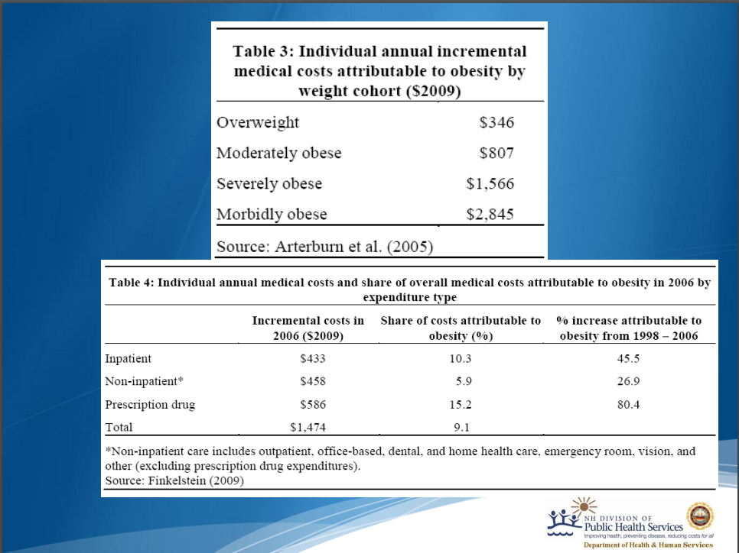
WORSENING OBESITY
STATUS SHOWS
CORRESPONDING
GREATER HEALTH
CARE EXPENSES

Slide 52
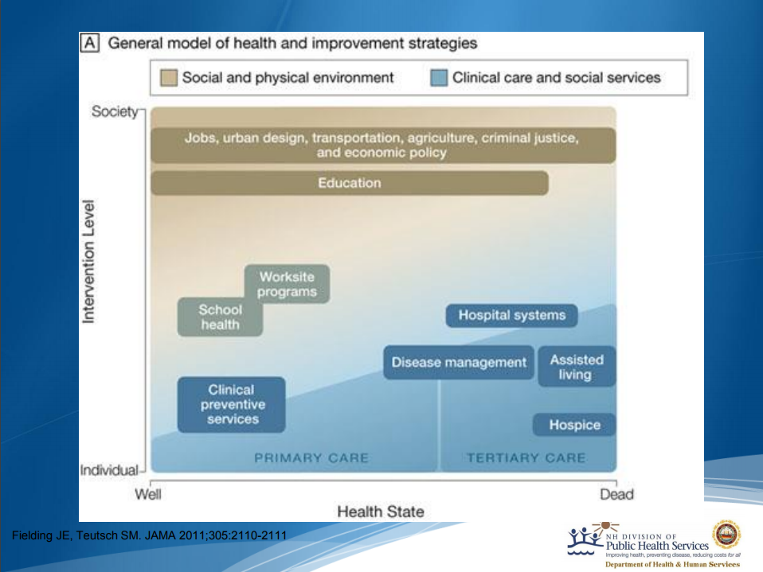
HEALTH IMPROVEMENT STATEGIES

Slide 53
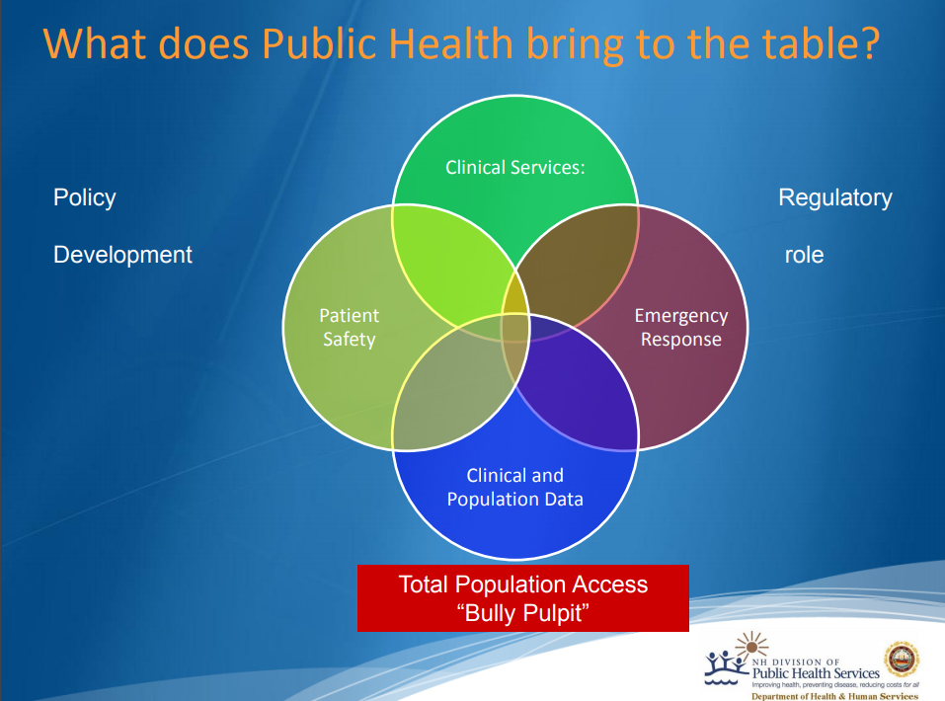
PUBLIC HEALTH
IS THE GLUE THAT
ASSISTS IN
INTEGRATING
DIFFERENT
SERVICES

Slide 54
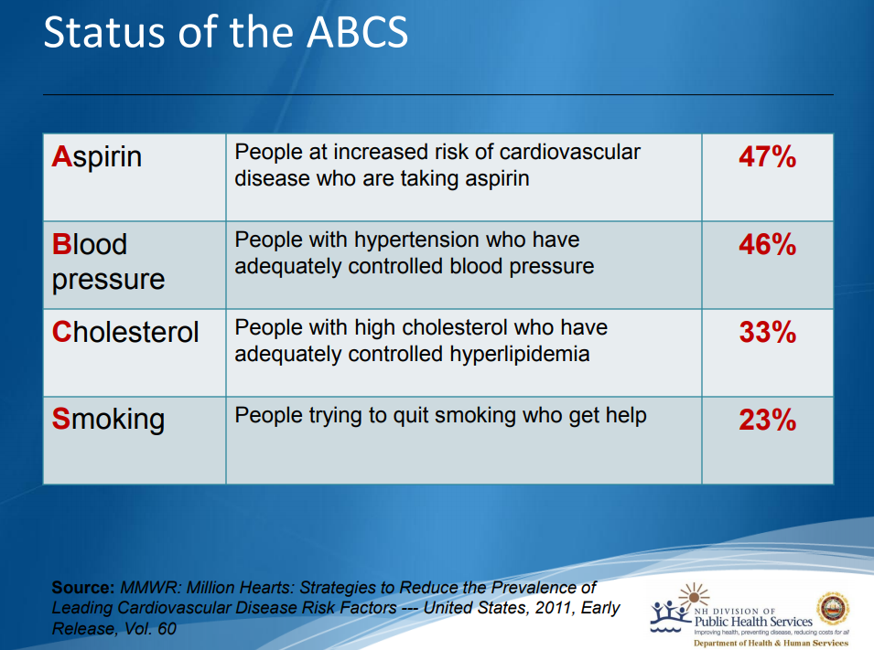
PREVENTATIVE STRATEGIES TO
SAVE LIVES AND REDUCE ADVERSE
EVENTS

Slide 55
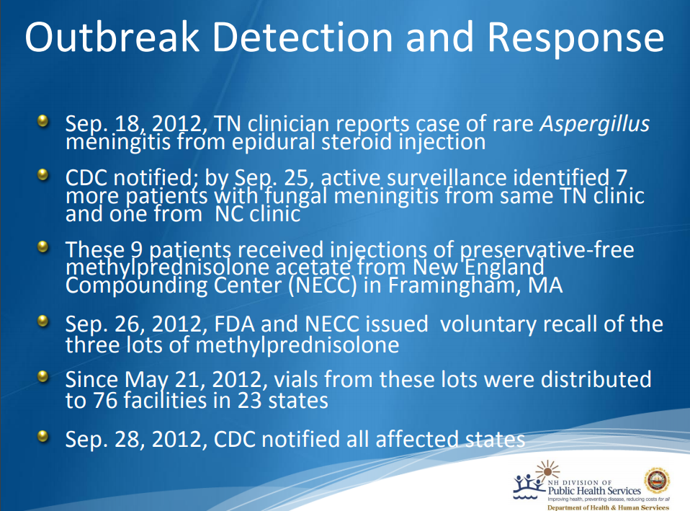
EARLY IDENTIFICATION AND INTERVENTION TO IDENTIFIY PROBLEMS,
SAVE LIVES, MONEY AND REDUCE ADVERSE EVENTS

Slide 56
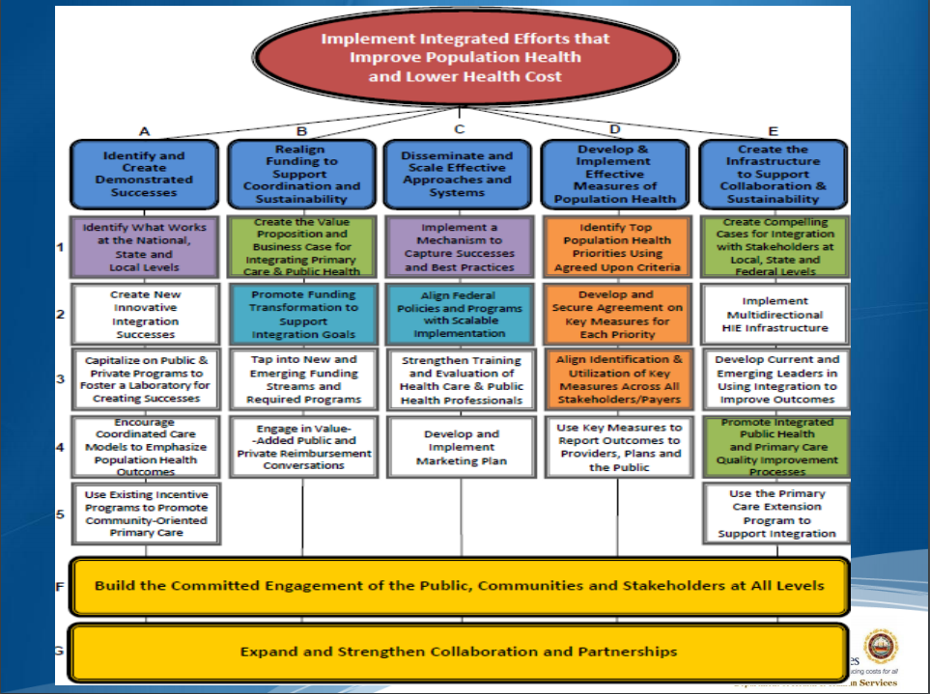
COLLECTIVE
EFFORTS
TO IMPROVE
POPULATION
HEALTH AND
LOWER HEALTH
CARE COSTS

Slide 57
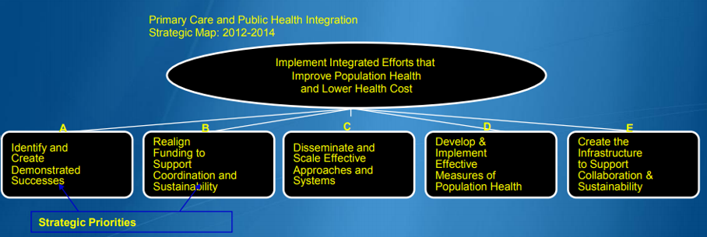
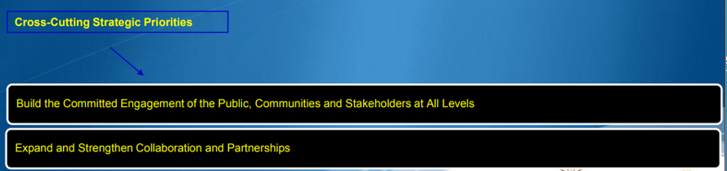
WORKING
TOGETHER
TO IMPROVE
BIG PICTURE

Slide 58
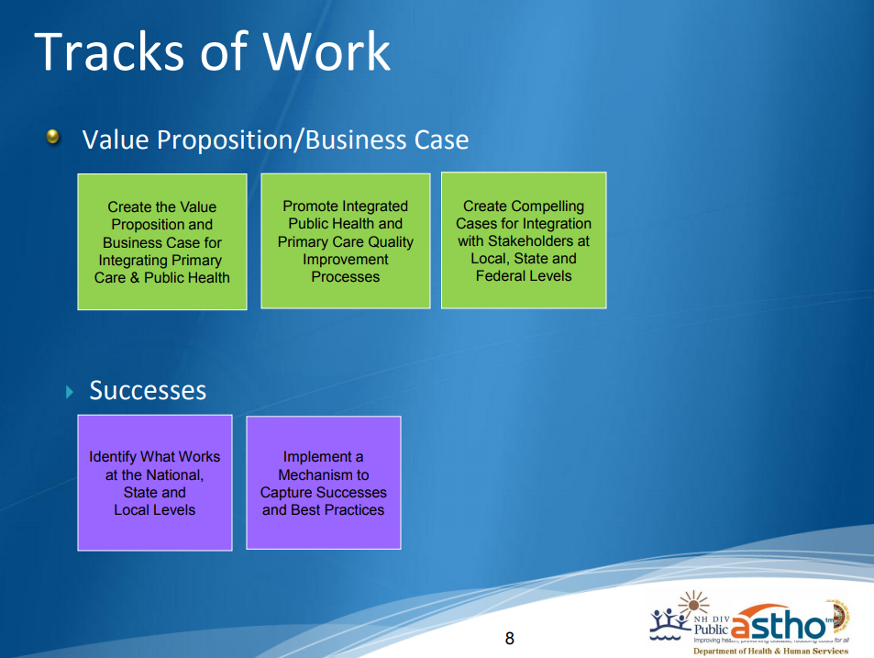
EVIDENCE-BASED
EFFECTIVE
BEST PRACTICE
IDENTIFICATION
DEVELOPMENT
AND IMPLEMENTATION

Slide 59
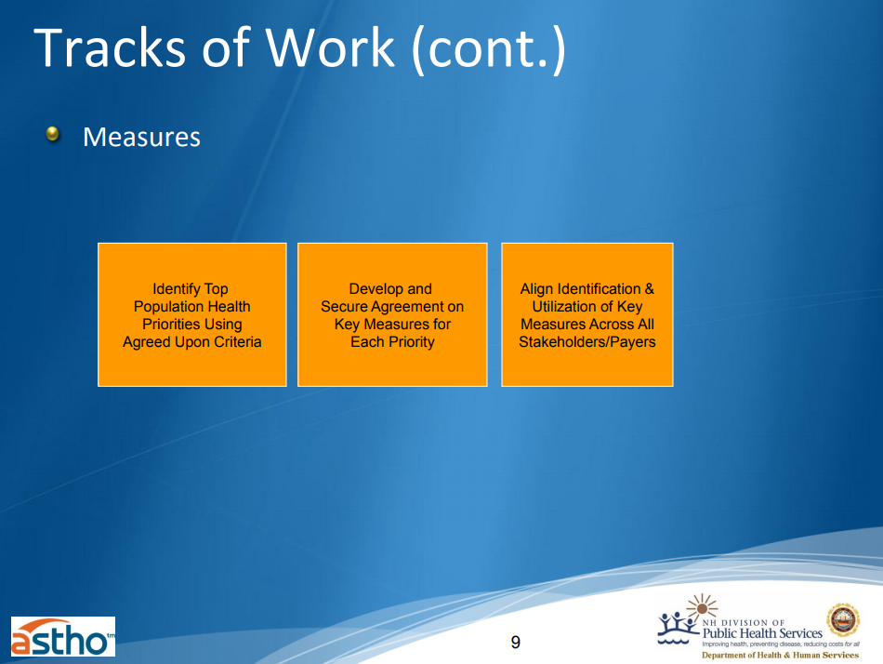
PERFORMANCE
IS REALITY

Slide 60
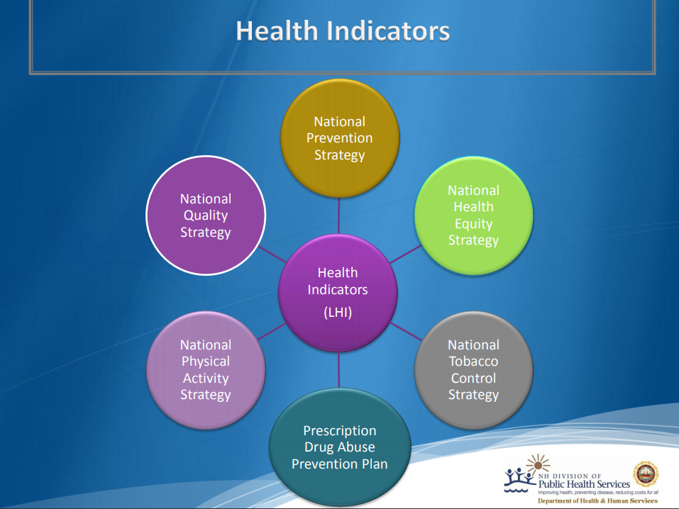
MEASUREMENT OF
HEALTH INDICATORS
IS ESSENTIAL TO
MEANINGFUL
IMPROVEMENT

Slide 61
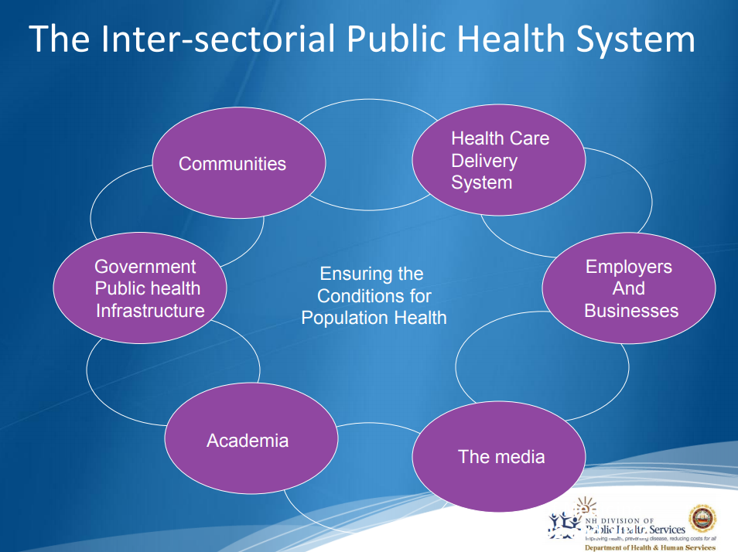
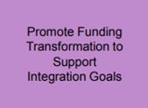
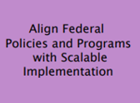
WORKING
TOGETHER
TO IMPROVE
BIG PICTURE

Slide 62
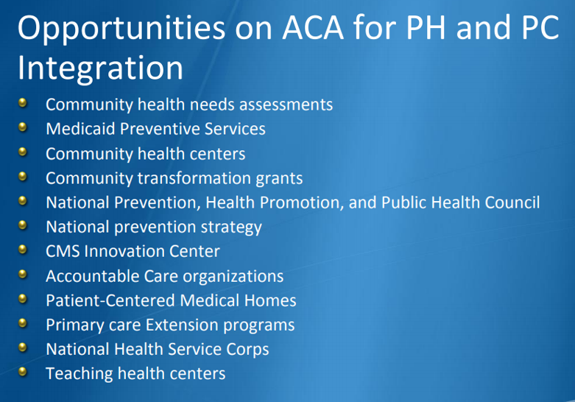
AFFORDABLE CARE ACT
PUBLIC
HEALTH
PRIMARY
CARE
PERFORMANCE
IS REALITY
AGENCIES
WORKING
TOGETHER
TO IMPROVE
INDIVIDUAL
HEALTH
THROUGH
POPULATION
HEALTH
STRATEGIES

Slide 63
5. Which of the following organizational types are not involved in integrative efforts to improve individual health through population health improvement strategies?
Accountable Care Organizations
Patient-Centered Medical Homes
Genetic Cleansing Organization of the USA
National Health Service Corps

Slide 64
5. Which of the following organizational types are not involved in integrative efforts to improve individual health through population health improvement strategies?
Accountable Care Organizations
Patient-Centered Medical Homes
Genetic Cleansing Organization of the USA
National Health Service Corps

Slide 65
Why Measure Patient Satisfaction or Patient Experience?
There has been much activity and energy devoted to improving the patient experience as well as determining a way to measure the satisfaction of the patient and their experience in a health care setting. When patient feedback is collected and acted upon in a meaningful way, the health center can achieve greater patient satisfaction. The American Medical Association (AMA) encourages health care providers to proactively measure and respond to patient satisfaction data, and reports that practices that act on patient satisfaction data can:
Inform quality improvement efforts
Make informed staffing decisions
Gain a competitive edge
Improve patients’ health, compliance, and confidence in treatment
Inform contract negotiations
Use information to contradict negative ratings/profiles
Give patients a constructive outlet to provide feedback on their experience
Reduce malpractice suits
Prepare for and improve performance on federal and private initiatives
Show patients that their physicians care about their input.
PATIENT CARE AND SATISFACTION

Slide 66
Patient care and satisfaction
Patient Satisfaction/Experience Surveys and Patient Activation/Engagement Resources
HRSA’s Health Center Program Grantees must measure and assess patient satisfaction. The information and resources below will provide health centers with goals and justifications for measuring patient satisfaction and/or patient experience, requirements for measuring patient satisfaction to become a recognized Patient-Centered Medical Home (PCMH), and examples of satisfaction surveys. There are also information and resources to help health centers understand how activated and/or engaged patients may be more satisfied and have better experiences and health outcomes.

