Slide 1

MODULE three:
MEDICAL ADMINISTRATION
AND SERVICE Delivery
STRUCTURES IN COMMUNITY
HEALTH SETTINGS

Slide 2
MODULE three:
SECTION two:
federally Qualified
Health Centers (FQHC)

Slide 3

UNIT OBJECTIVE
To be able to describe the services, populations, and financing structure of FQHCs and how they differ from other clinics..

Slide 4
federally Qualified
Health Centers (FQHC)
Requirements for status
FQHC prospective payment
System reimbursement for services to Medicare and Medicaid beneficiaries
HRSA’s role and regulation

Slide 5
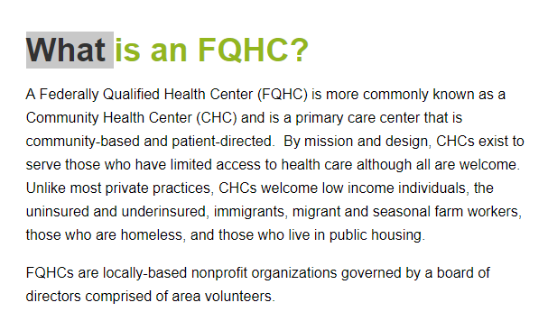

Slide 6
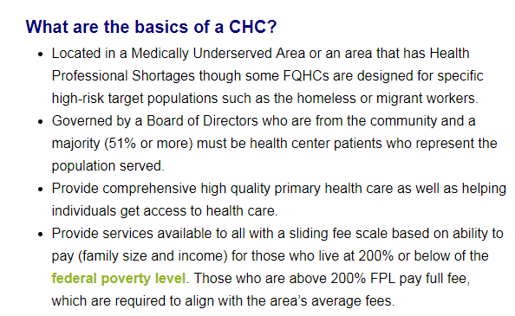

Slide 7
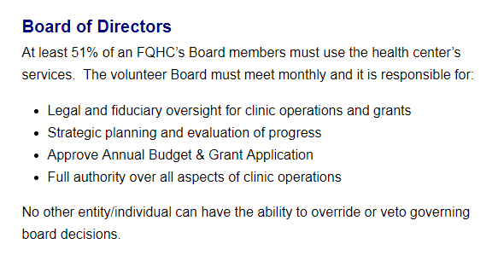

Slide 8

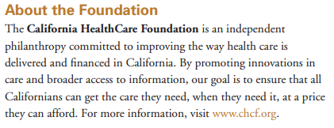
CALIFORNIA HEALTH CARE FOUNDATION

Slide 9
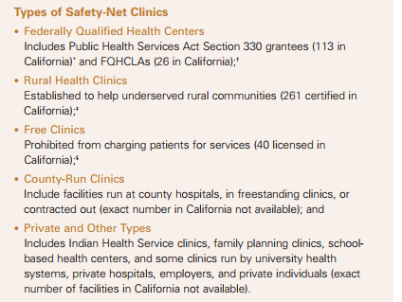

SAFETY-NET
CLINICS

Slide 10
FQHC Patients by Race/Ethnicity, 2009
Race
Ethnicity
HISPANICS COMPRISE
A LARGE SEGMENT OF FQHC USERS
Source: Bureau of Primary Health Care, HRSA, DHHS, 2009 Uniform Data System.

Slide 11
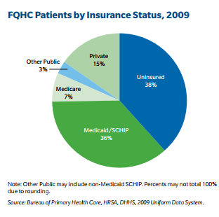
FQHC CLINCICS SERVE
PRIMARILY MEDICAID
AND THE UNINSURED

Slide 12
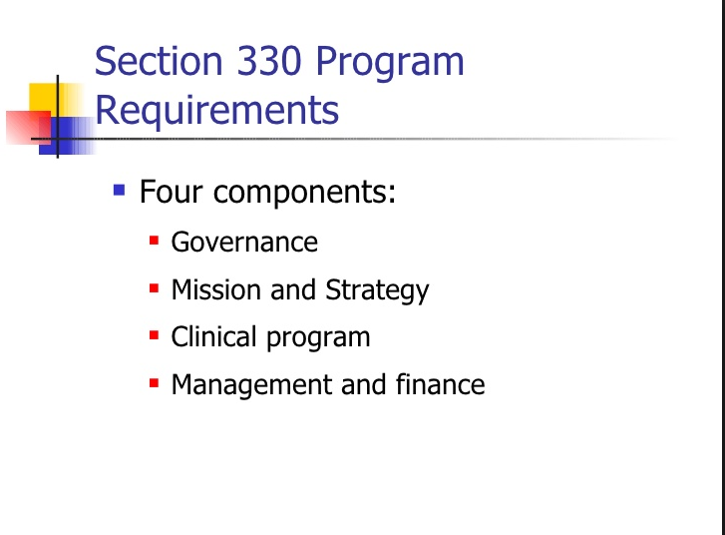
FQHC

Slide 13
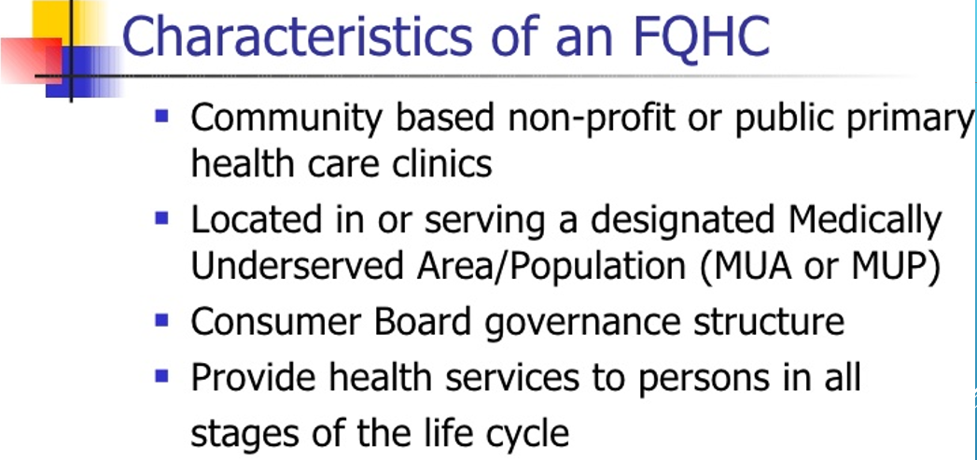
WORKS WITH LOCAL HEALTH DEPARTMENTS TO PROVIDE VALUABLE SERVICES

Slide 14
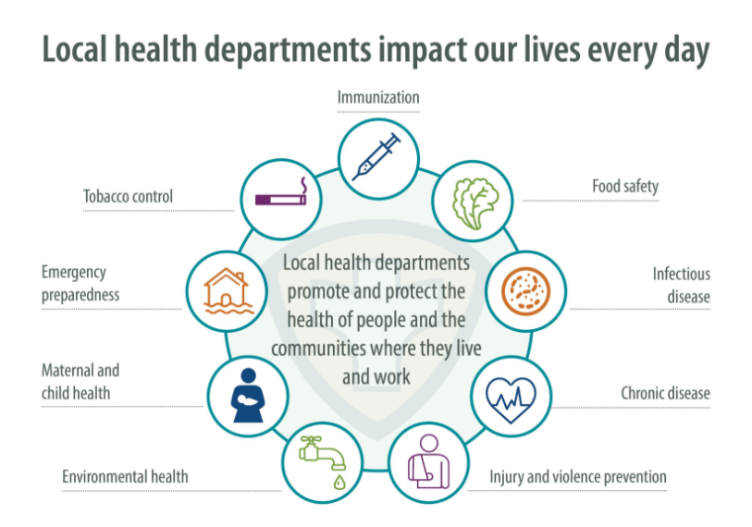
FQHC PARTNER
IN PROVIDING
VITAL PUBLIC
HEALTH
SERVICES

Slide 15
Percentage Distribution of Total Annual LHD
Revenues, By Revenue Source
LOCAL HEALTH
DEPARTMENT
FUNDING
DISTRIBUTION
Source: 2008 National Profile of Local Health Departments

Slide 16
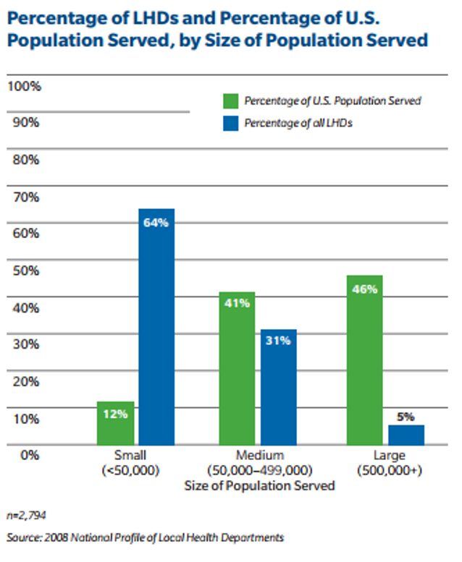
IN SMALLER COMMUNITIES THERE
IS A MUCH GREATER SEGMENT OF
THE OVERALL POPULATION SERVED
BY LOCAL HEALTH DEPARTMENTS

Slide 17
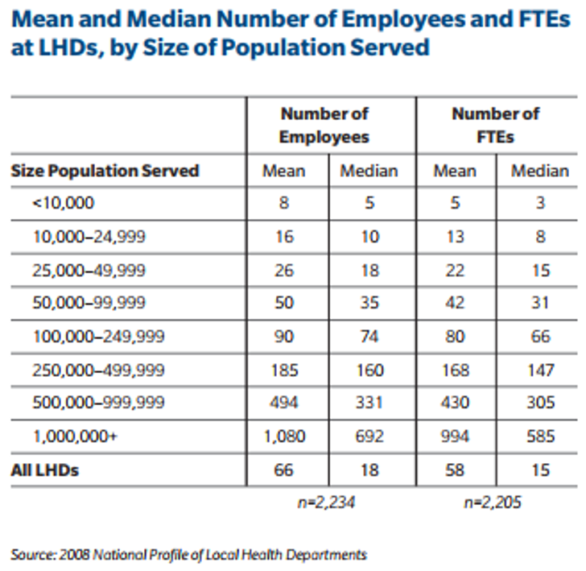
VARIATIONS IN SIZES
OF LOCAL HEALTH
DEPARTMENTS TO FIT
THE SIZE OF THE
COMMUNITY

Slide 18
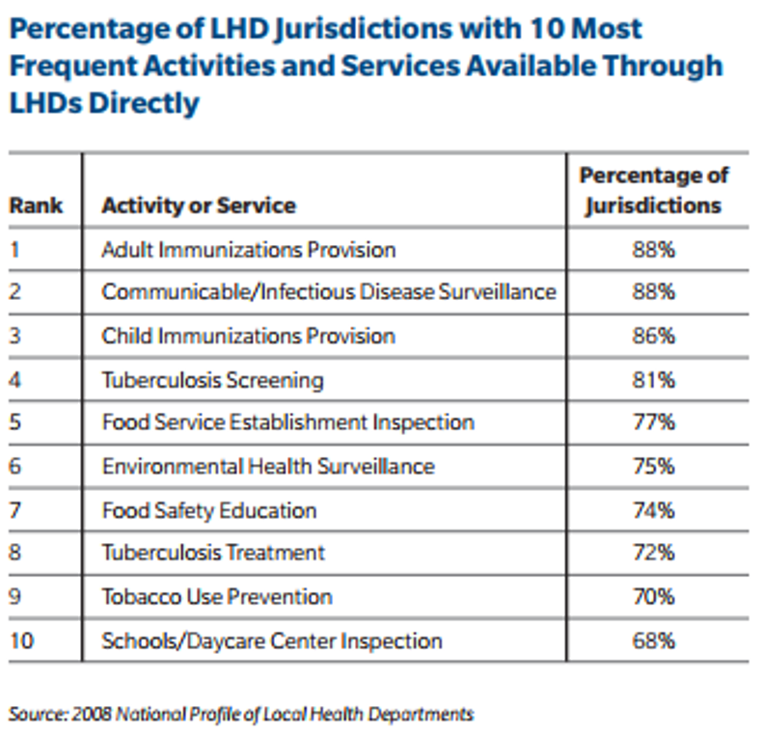
LEVEL OF INVOLVEMENT
OF THE LOCAL
HEALTH DEPARTMENTS
IN DIFFERENT
PUBLIC HEALTH
SERVICES

Slide 19
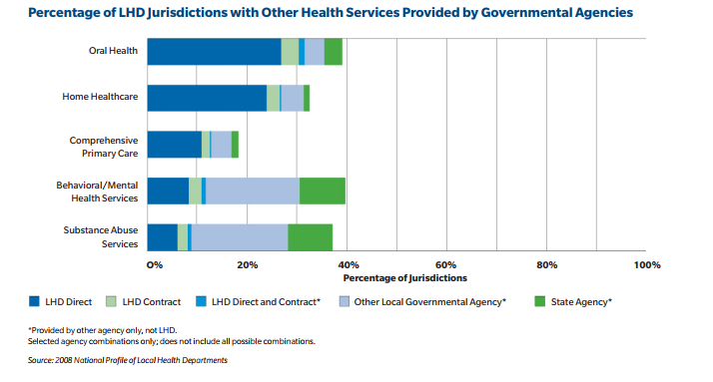
DIFFERENT TYPES OF SERVICES
ARE PERFORMED DIRECTELY
AND OTHERS ARE CONTRACTED
OUT TO OTHER GOVERNMENTAL
OR STATE AGENCIES

Slide 20
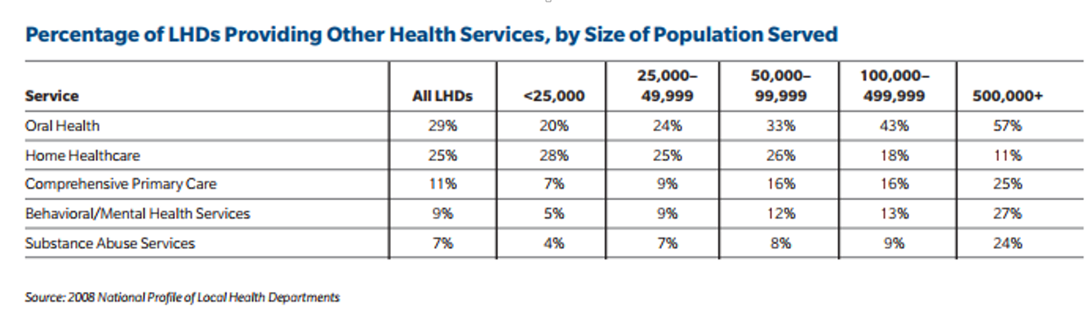
LARGER LOCAL HEALTH DEPARTMENTS
PLAY A GREATER ROLE IN THESE TYPES OF HEALTH SERVICES

Slide 21
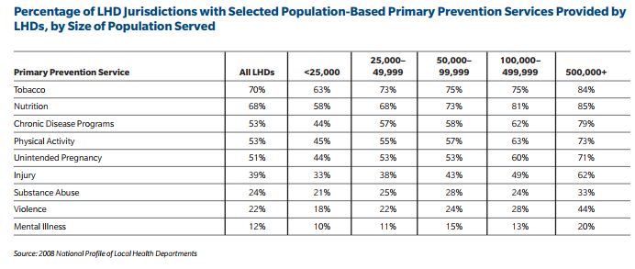
DISTRIBUTION OF PREVENTIVE SERVICES PERFORMED BY DIFFERENT SIZED
LOCAL HEALTH DEPARTMENTS

Slide 22
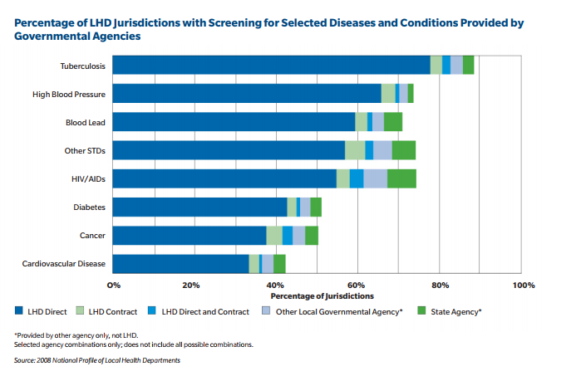
SERVICES
WHERE THE
LOCAL HEALTH
DEPARTMENT
PERFORMS THE
MAJORITY OF
THE SERVICES
DIRECTLY

Slide 23
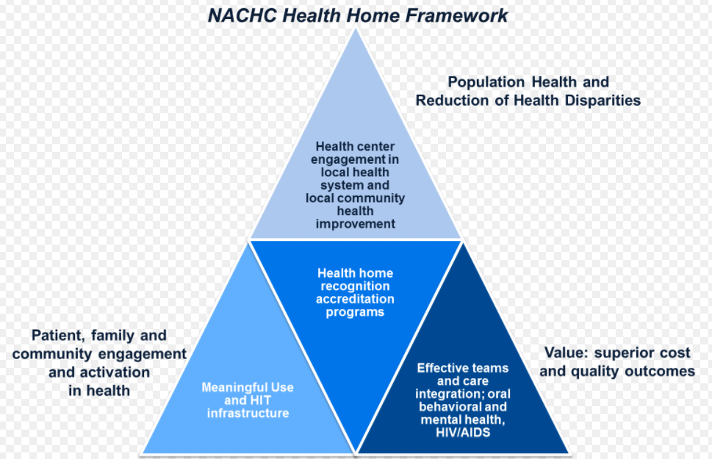
NACHC
National
Association
of
Community
Health
Centers

Slide 24
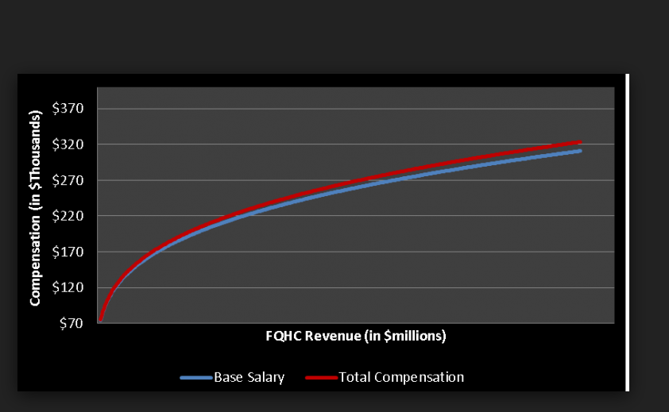
FQHC REVENUE HAS BEEN
STEADILY INCREASING

Slide 25
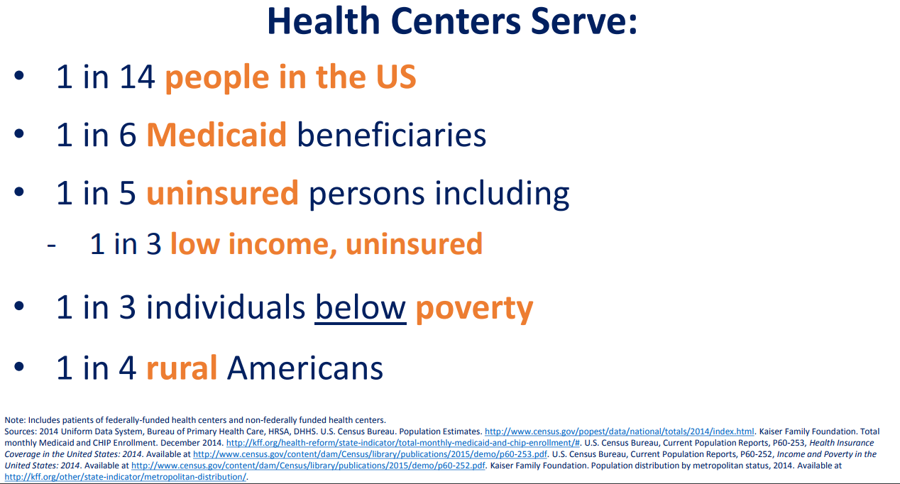

Slide 26
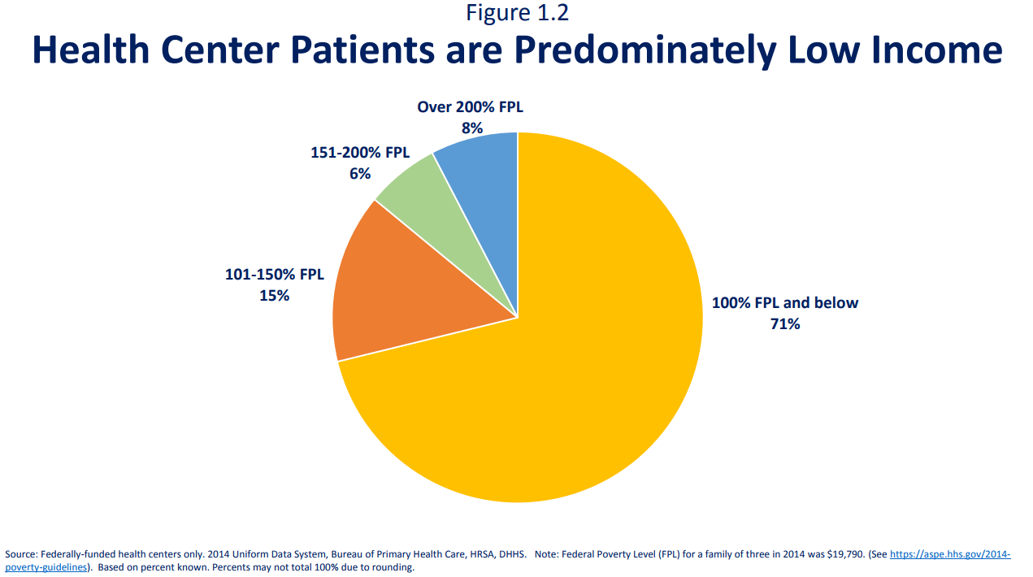

Slide 27
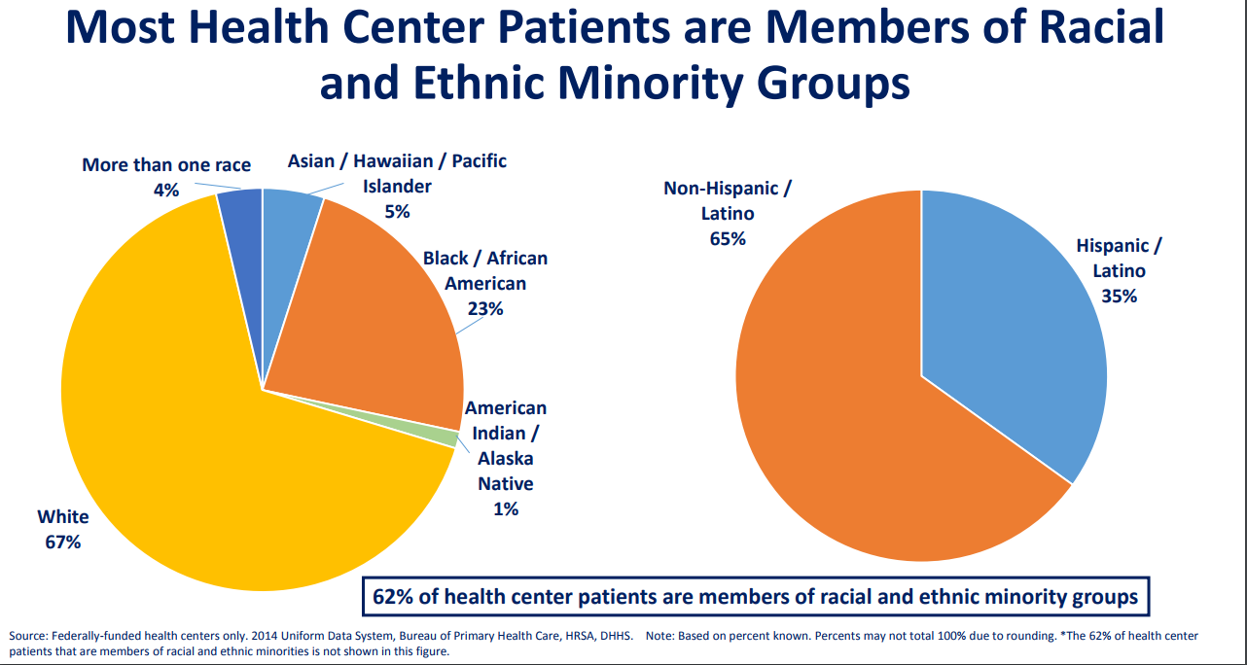

Slide 28
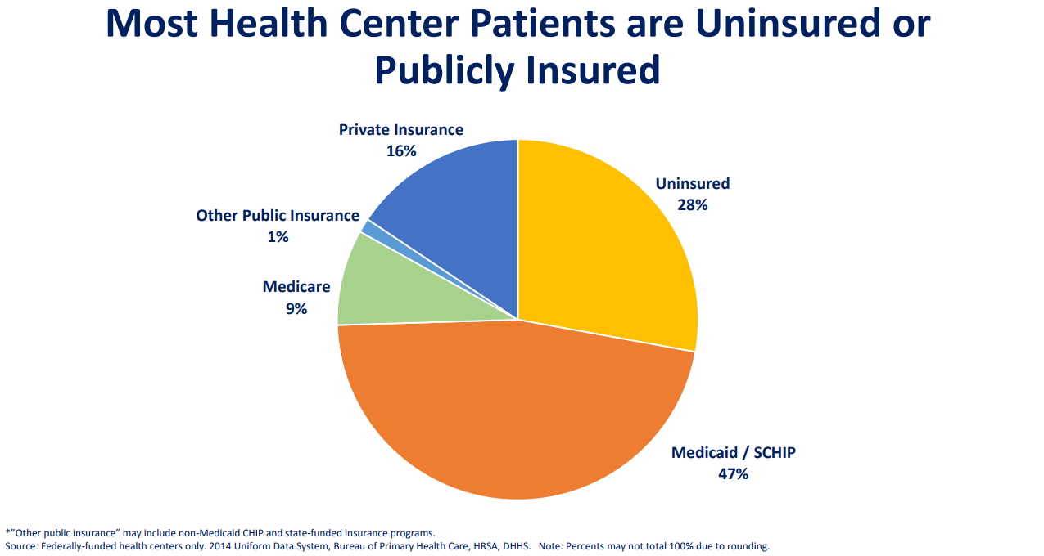

Slide 29
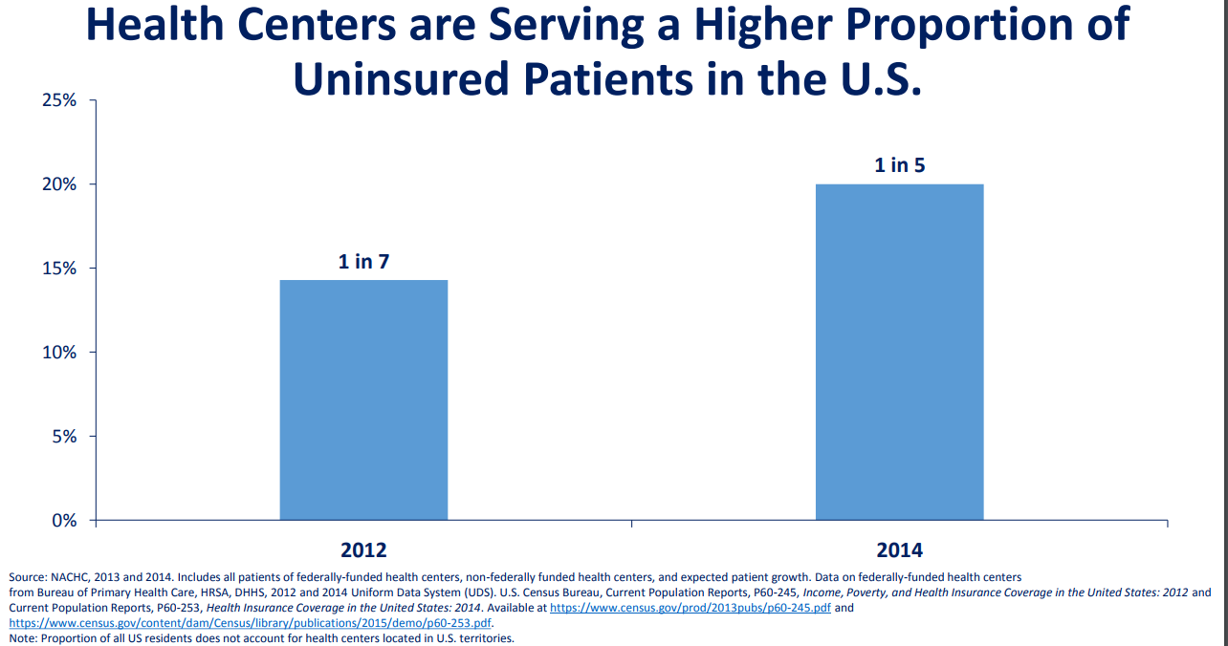

Slide 30
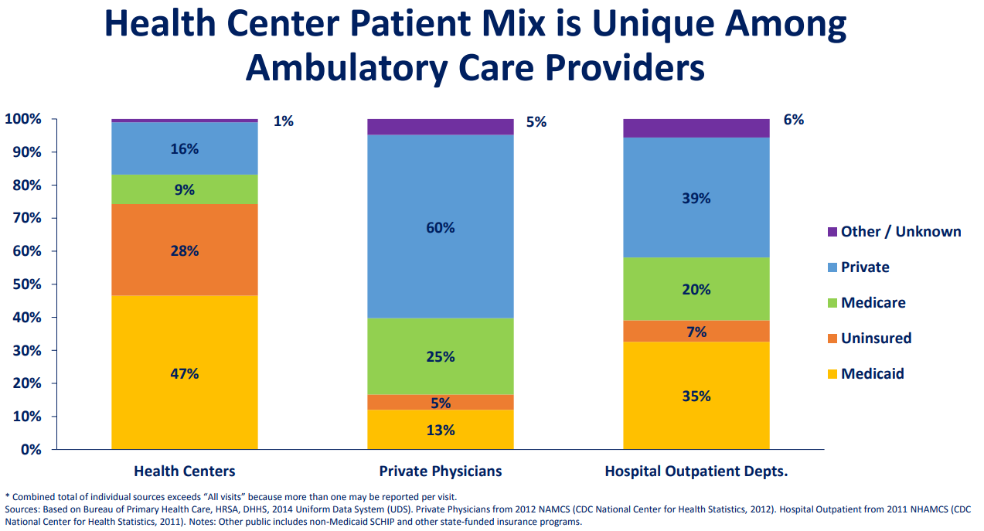

Slide 31
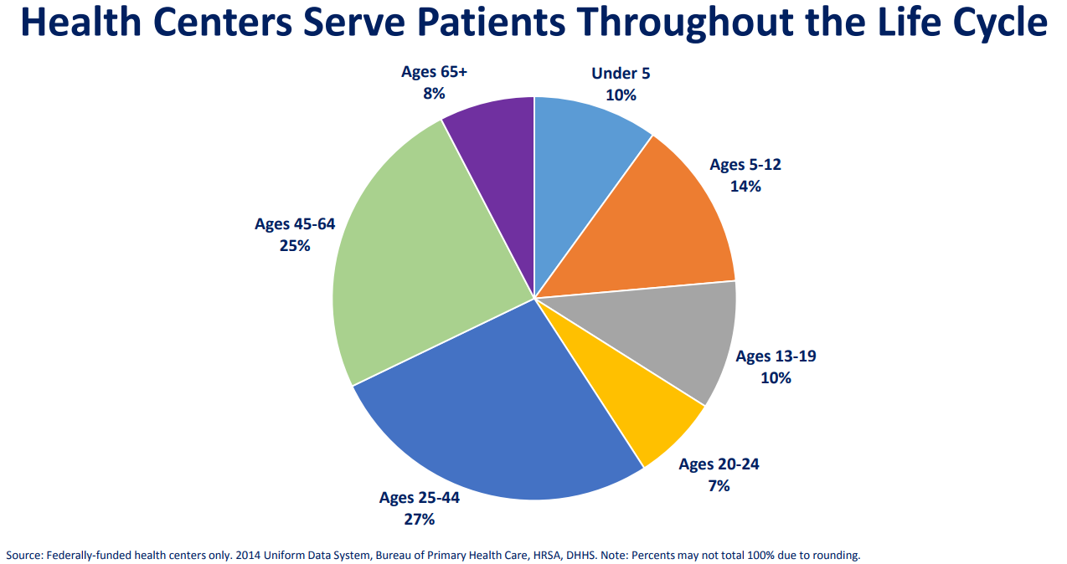

Slide 32
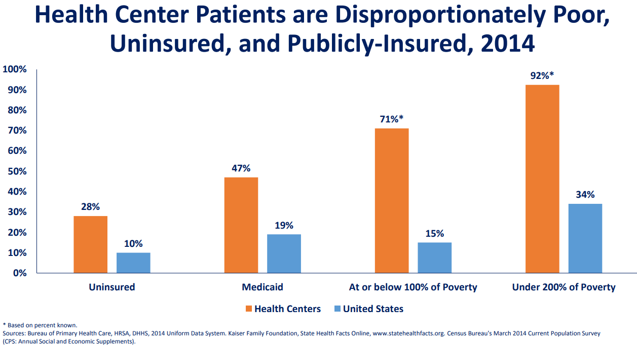

Slide 33
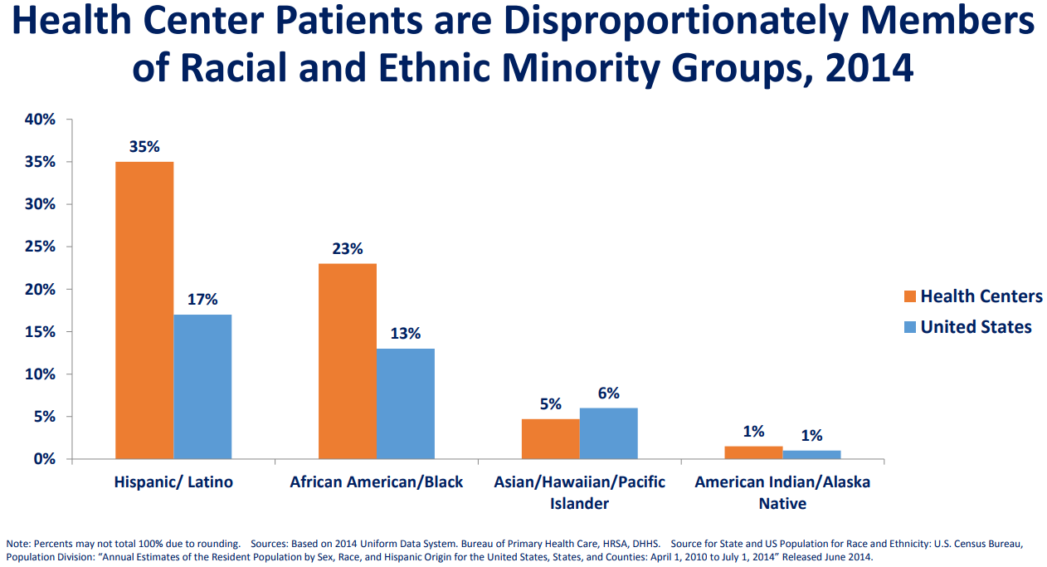

Slide 34
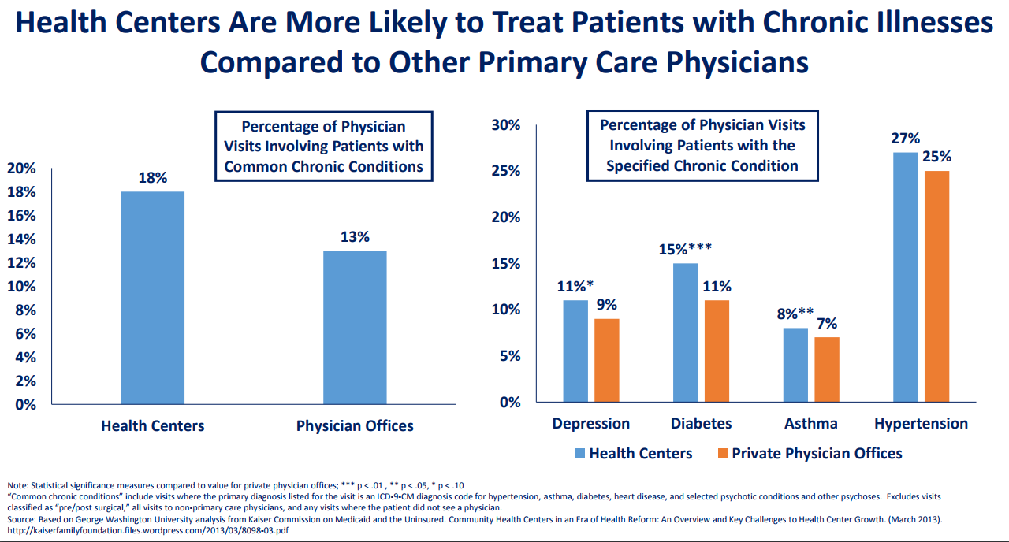

Slide 35
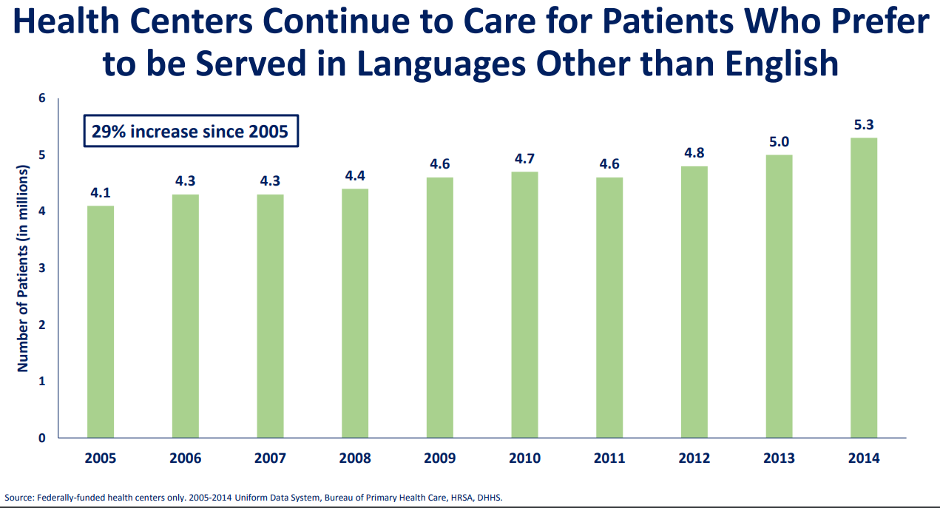

Slide 36
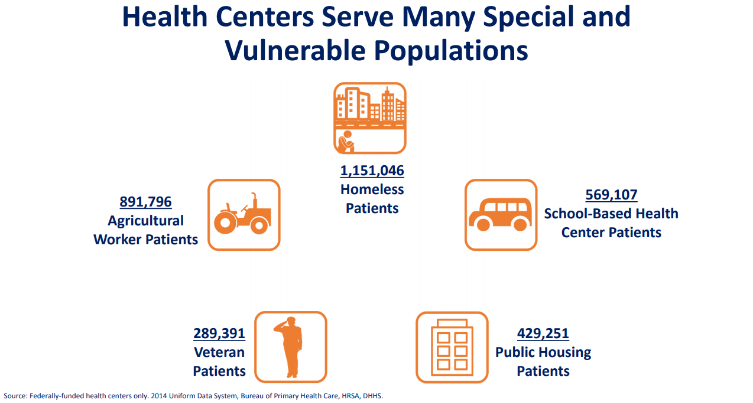

Slide 37
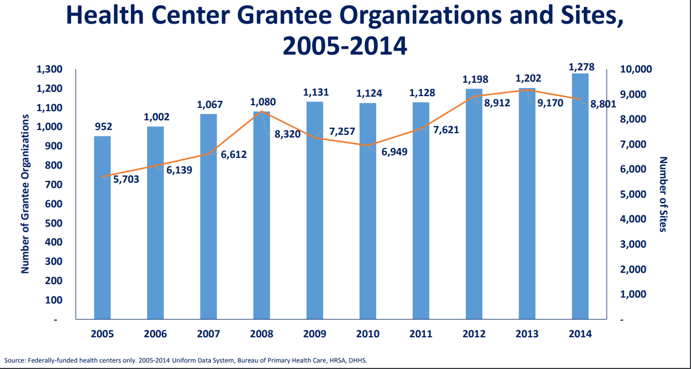

Slide 38
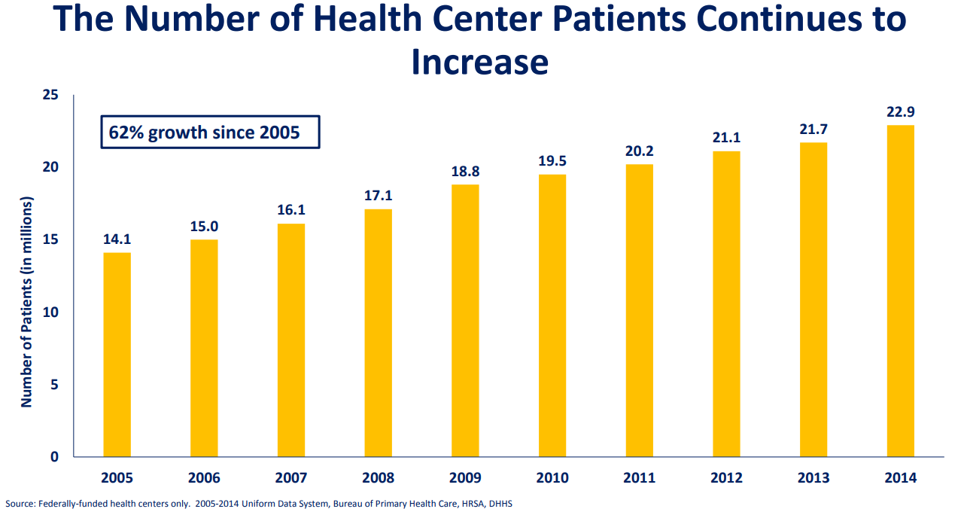

Slide 39
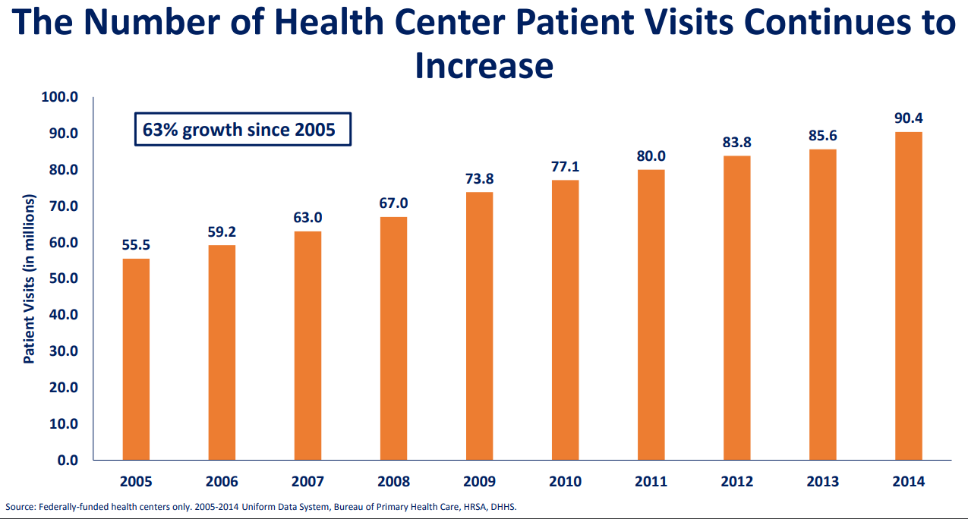

Slide 40
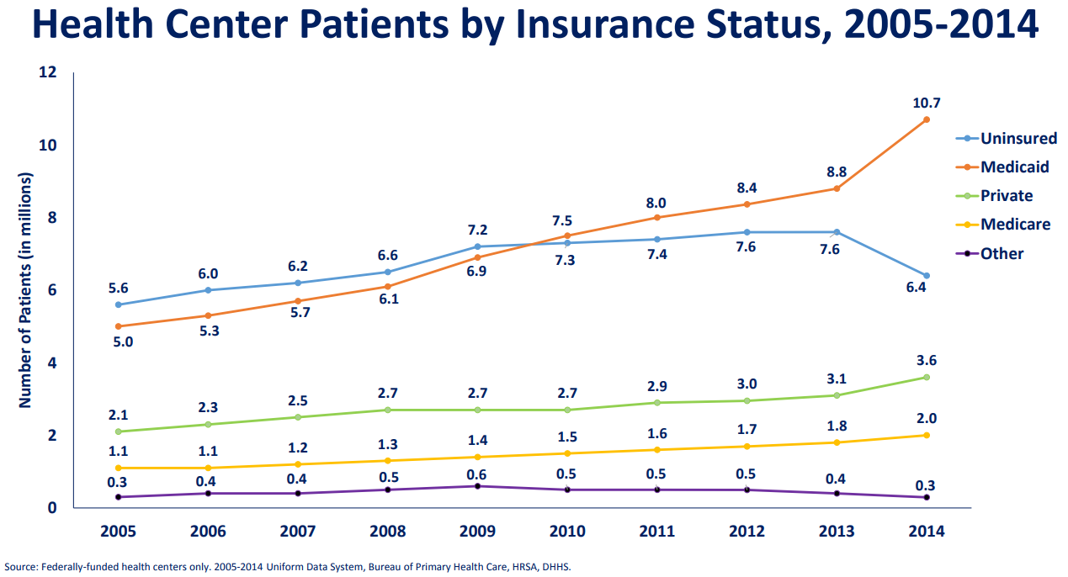

Slide 41
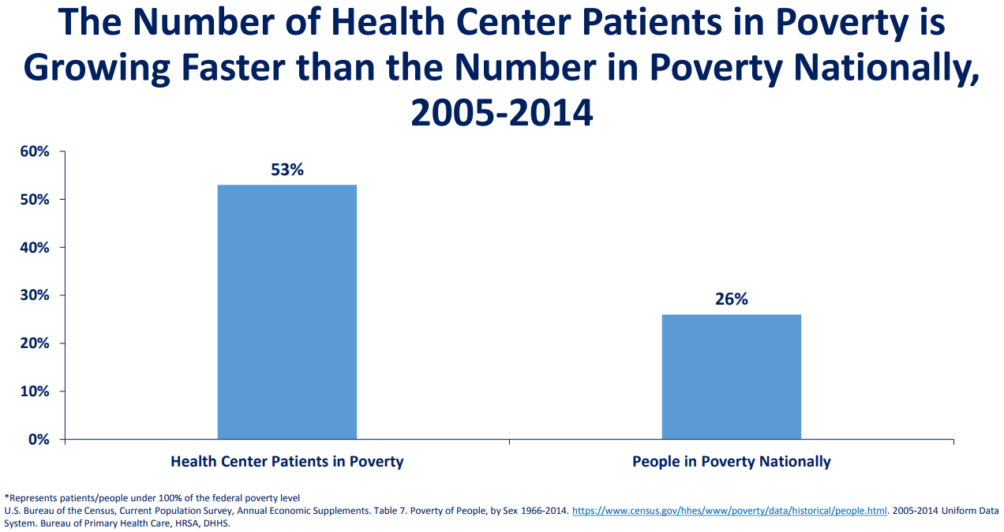

Slide 42
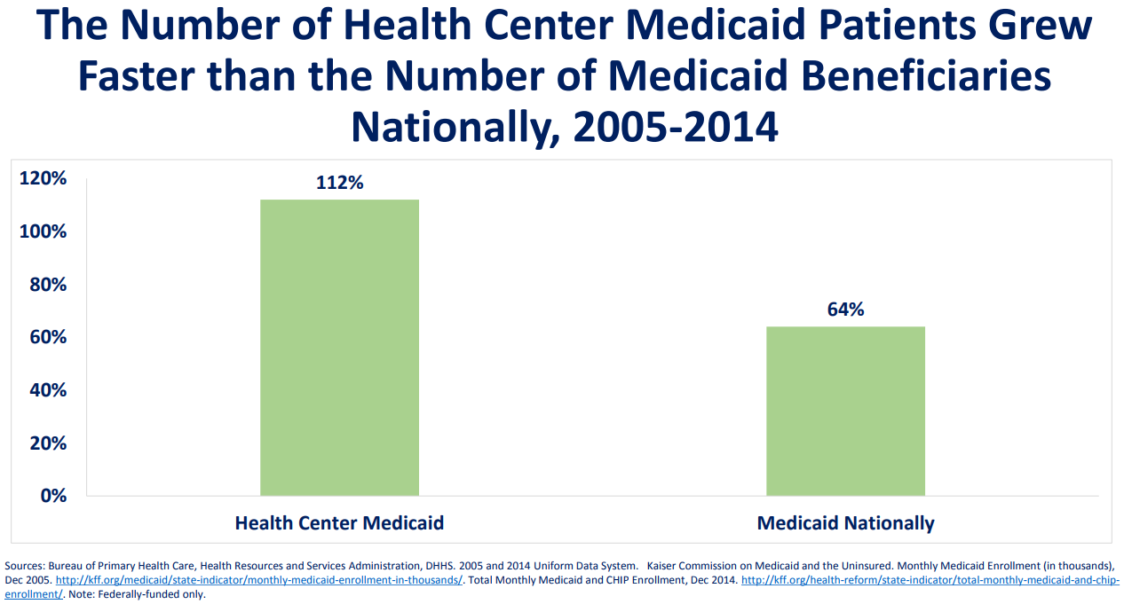

Slide 43
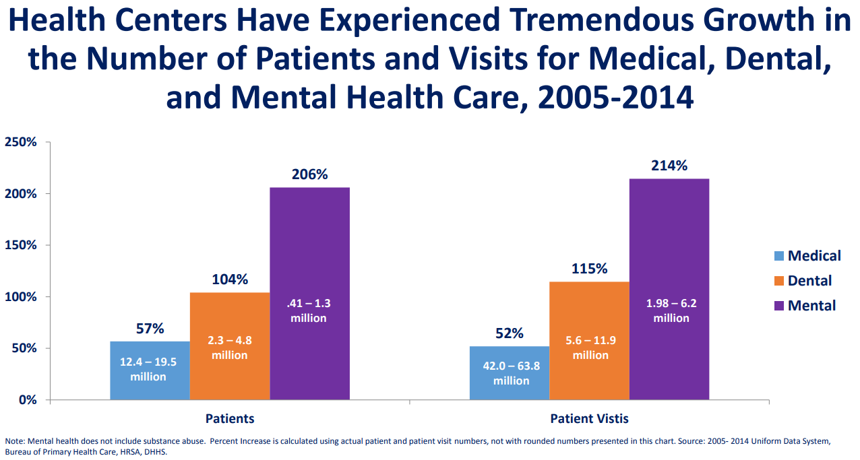

Slide 44
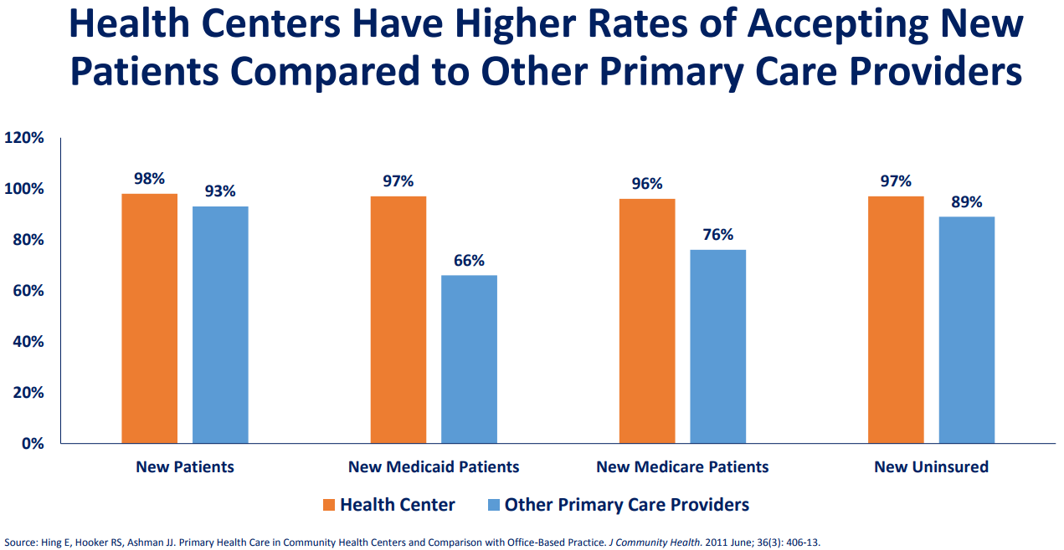

Slide 45
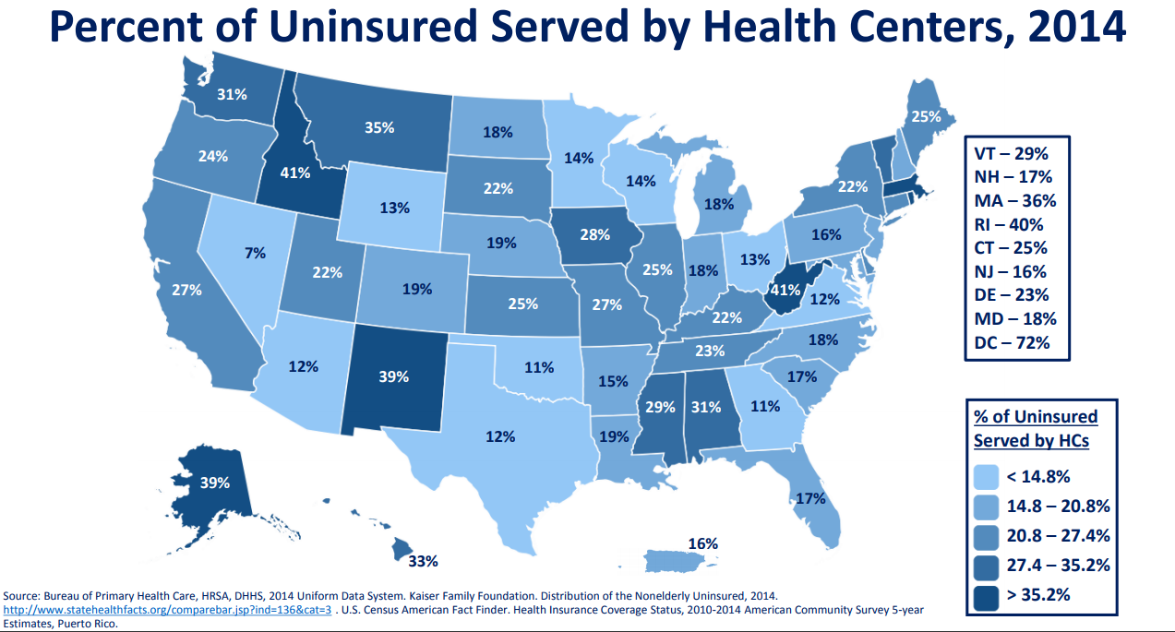

Slide 46
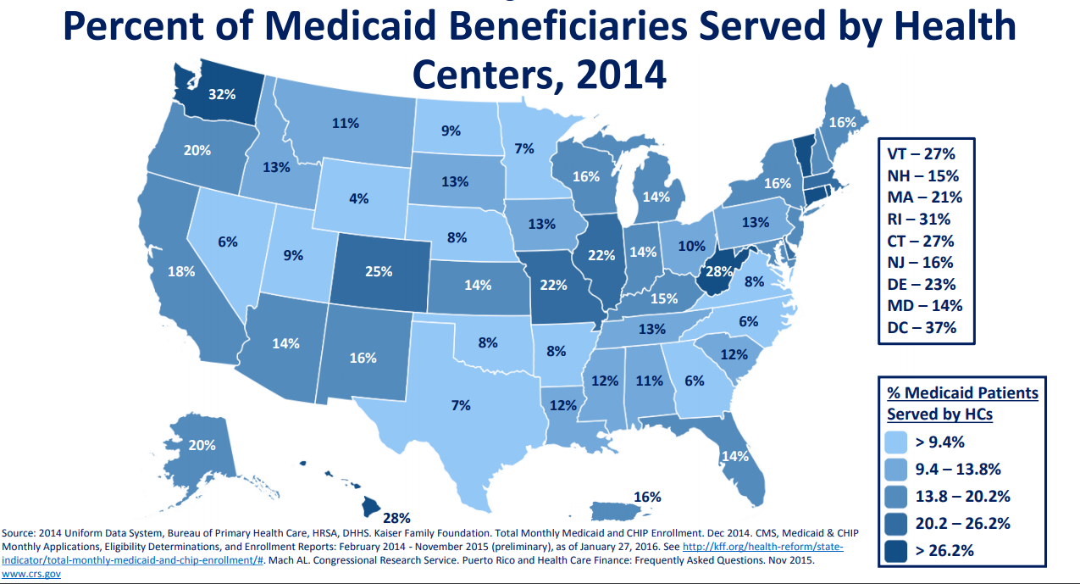

Slide 47
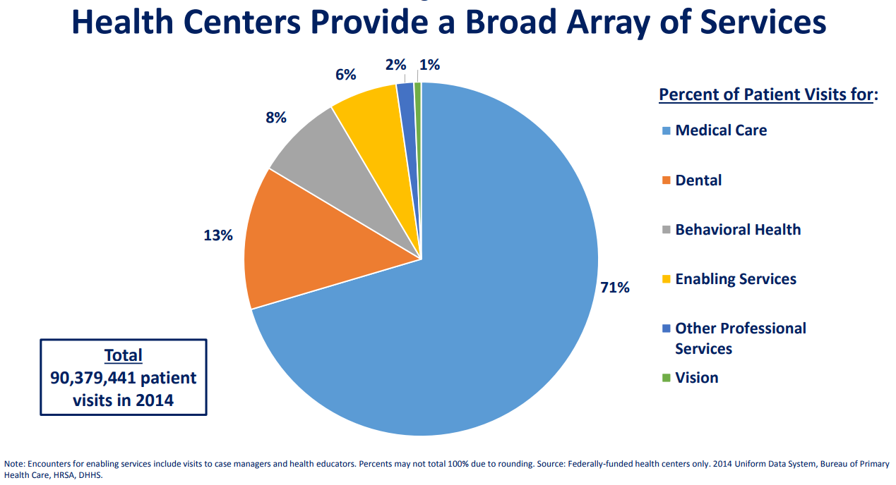

Slide 48
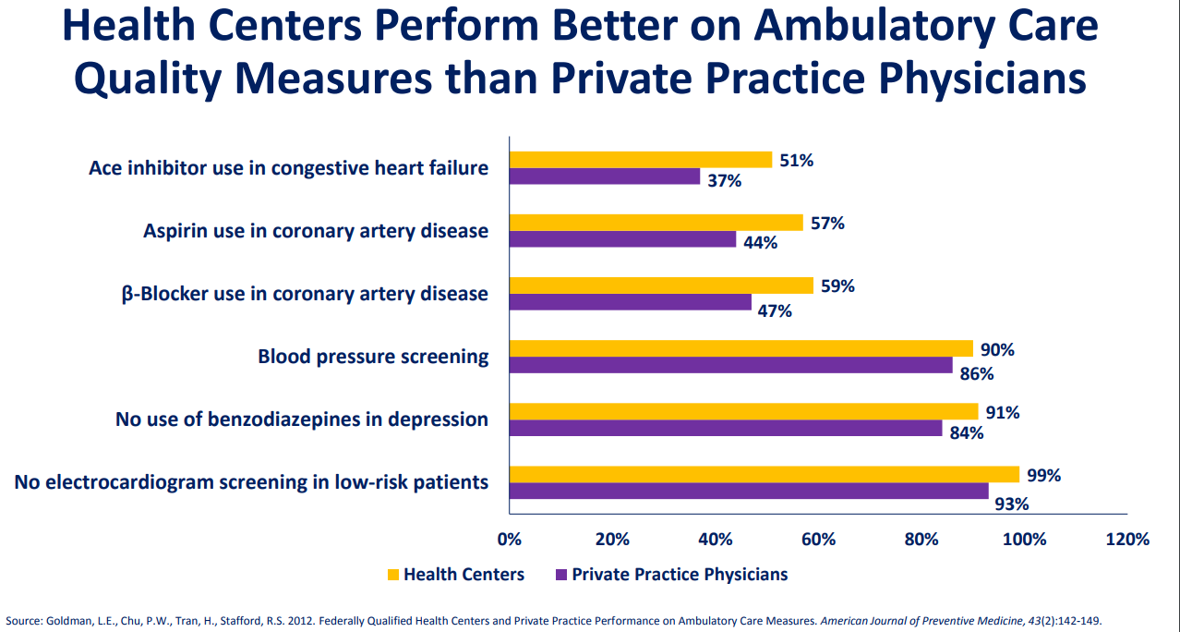

Slide 49
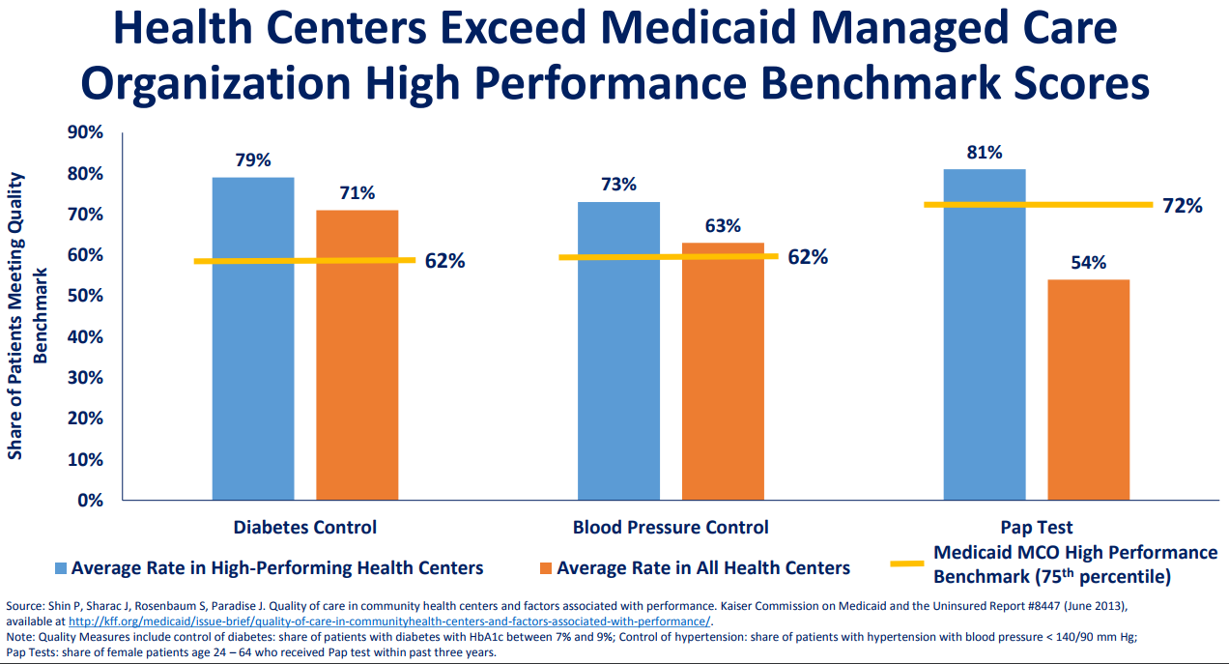

Slide 50
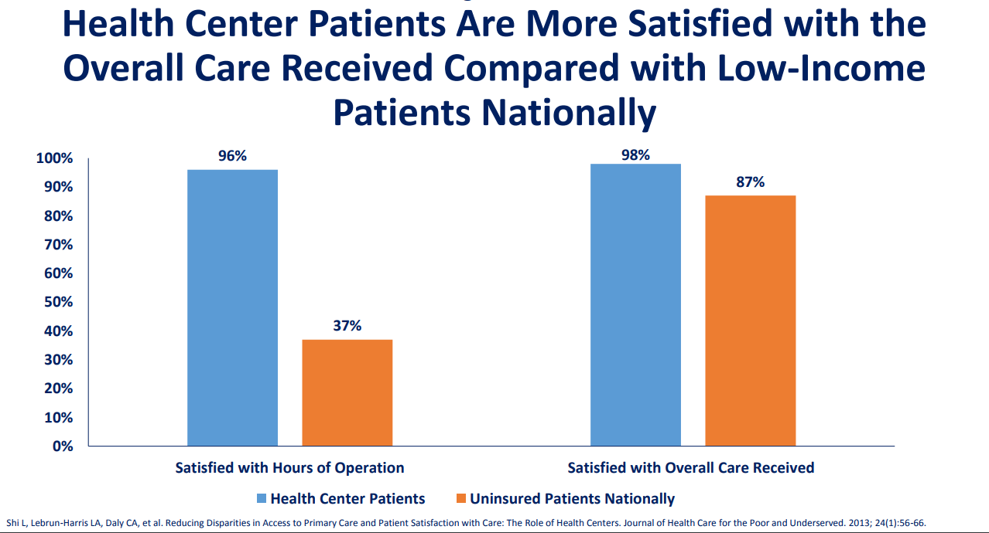

Slide 51
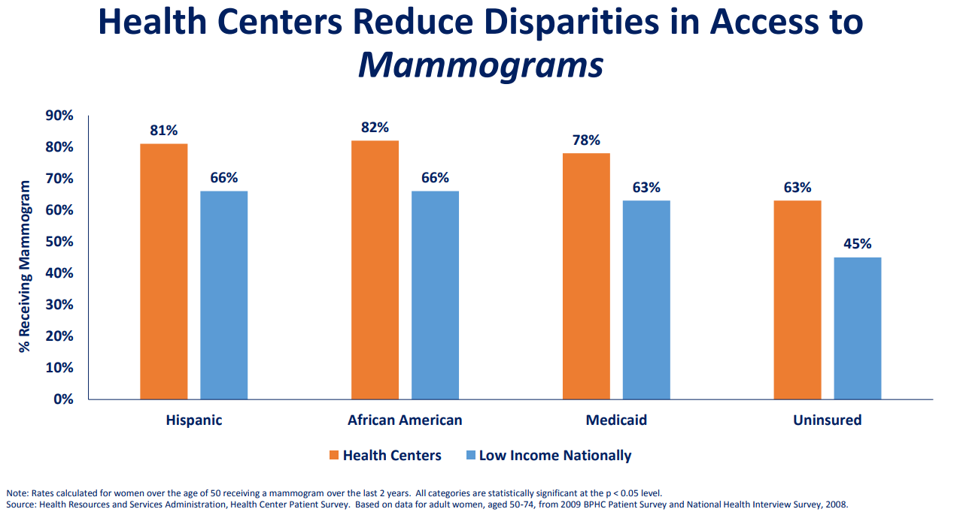

Slide 52
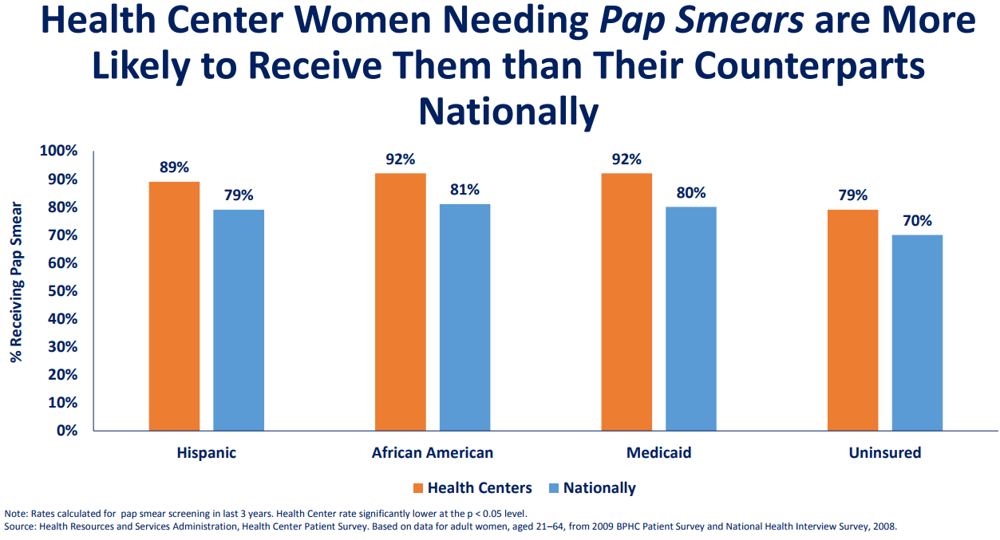

Slide 53
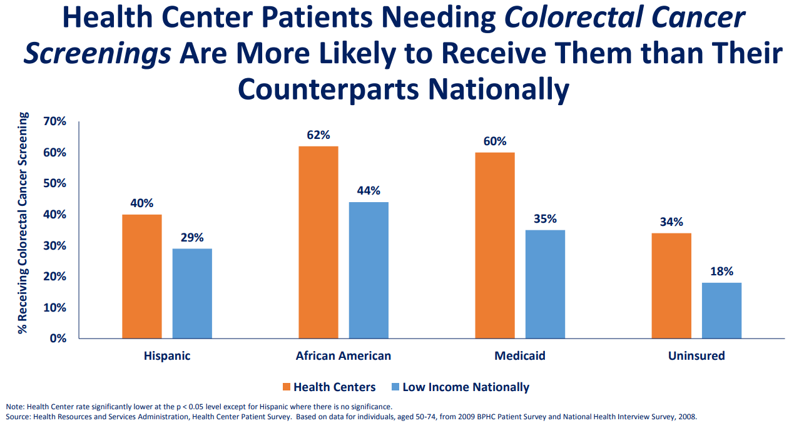

Slide 54
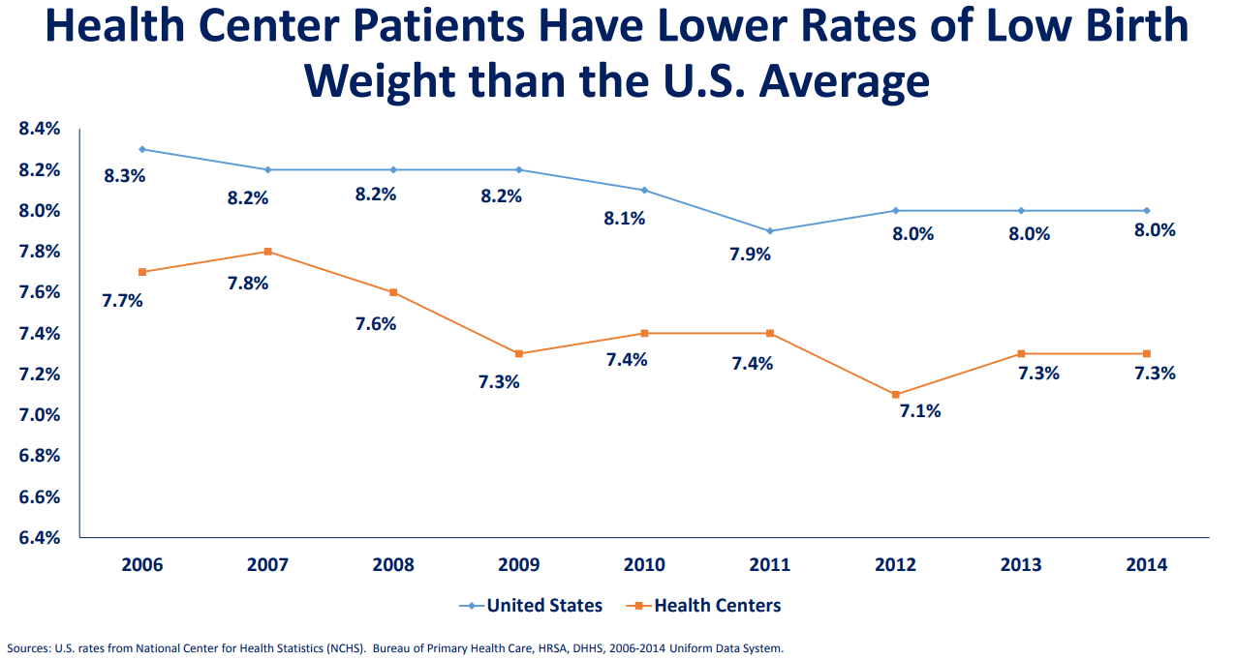

Slide 55
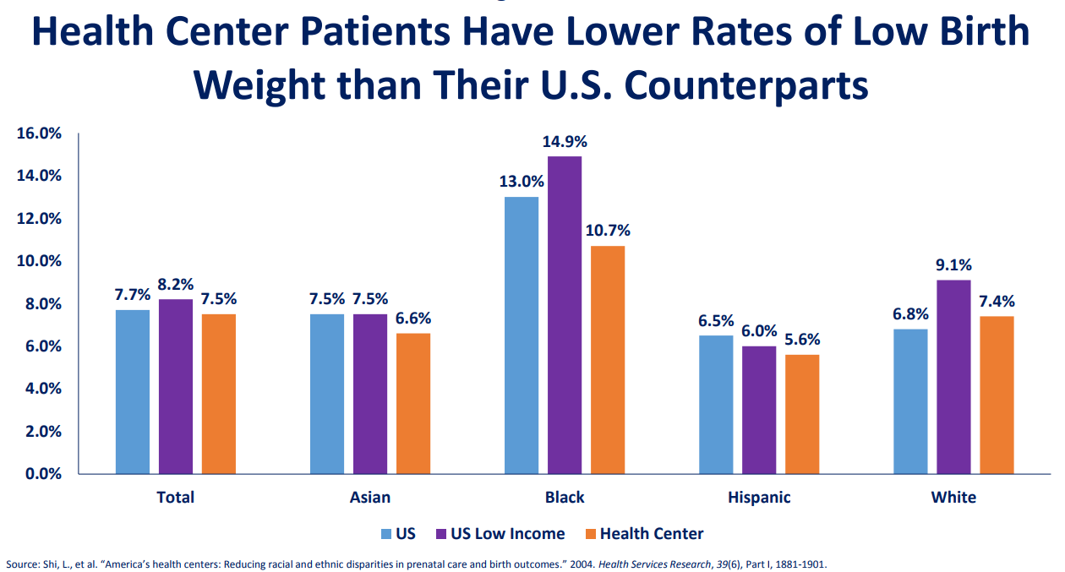

Slide 56
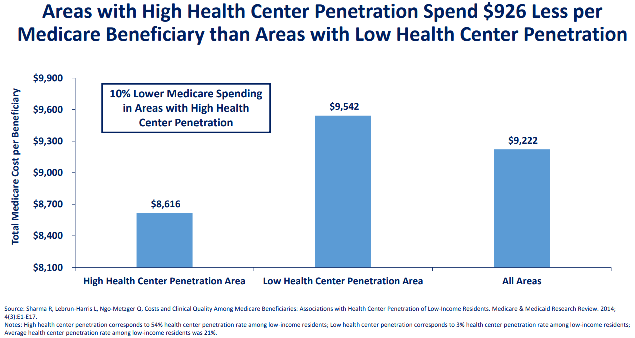

Slide 57


Slide 58


Slide 59


Slide 60


Slide 61


Slide 62


Slide 63


Slide 64


Slide 65


Slide 66


Slide 67


Slide 68


Slide 69


Slide 70


Slide 71


Slide 72


Slide 73


Slide 74


Slide 75


Slide 76


Slide 77


Slide 78


Slide 79


EXAMPLES OF PUBLIC HEALTH
AND OTHER PREVENTABLE
CONDITIONS THAT HEALTH
RESOURCES AND SERVICES
ADMINISTRATION PLANS TO
IMPACT OUTCOMES OVER
TIME INDIRECTLY THROUGH
COMMUNITY HEALTH CENTERS
HRSA

Slide 80

HRSA
Health
Resources
and
Services
Administration

Slide 81


Slide 82



Slide 83



Slide 84


Slide 85



Slide 86

HRSA

Slide 87

HRSA

Slide 88

HRSA

Slide 89

HRSA

Slide 90

HRSA

Slide 91

HRSA

Slide 92

HRSA

Slide 93

HRSA

Slide 94

HRSA

Slide 95

HRSA

Slide 96

HRSA

Slide 97

HRSA

Slide 98

HRSA

Slide 99

HRSA

Slide 100

HRSA

Slide 101

HRSA

Slide 102
Performance Measures
Achieving high performance in pursuing its mission is a major priority for HRSA. The measures presented below have been selected, from among the many measures used by HRSA to review performance, as points of focus for tracking and evaluating the status and progress in addressing Strategic Plan goals.
HRSA

Slide 103
Goal 1: Improve access to quality health care and services Performance Measures
Number of patients served by health centers
Percent of eligible persons diagnosed with HIV served by the Ryan White HIV/AIDS Program
Number of unique individuals receiving direct services through the Federal Office of Rural Health Policy Outreach grants
Number of participants served by the Maternal, Infant, and Early Childhood Home Visiting Program
Access

Slide 104
Goal 1: Improve access to quality health care and services
Performance Measures
Percent of patients served by the Ryan White Program, regardless of age, with a HIV viral load less than 200copies/mL at last HIV viral load test during the measurement year
Percent of health centers meeting or exceeding Healthy People 2020 goals on selected quality measures
Percent of Home Visiting participants who received appropriate screening for: (a) depression, (b) interpersonal violence, (c) developmental delay
Quality

Slide 105
Goal 1: Improve access to quality health care and services
Performance Measures
Number of assists provided by trained assisters working on behalf of health centers to support individuals with actual or potential enrollment/reenrollment in health insurance available through Marketplace-qualified health plans and/or through Medicaid or CHIP
Outreach and
Enrollment

Slide 106
Goal 2: Strengthen the Health Workforce Performance Measures
Field strength of the National Health Service Corps through scholarship and loan repayment agreements
Percentage of individuals supported by the Bureau of Health Workforce who completed a primary care training program and are currently employed in underserved areas
Percentage of trainees in Bureau of Health Workforce-supported health professions training programs who receive training in medically underserved communities
Percentage of trainees in Bureau of Health Workforce programs who are underrepresented minorities and/or from disadvantaged backgrounds
HRSA

Slide 107
Goal 3: Build Healthy Communities
Performance Measures
Number of pregnant women and children served by the Maternal and Child Health Block Grant
Percent of low birth weight births among Healthy Start program participants
Percent of health centers providing: (a) oral health, (b) behavioral health, and (c) specific preventive health services
Percent of donated kidneys used for transplantation
HRSA

Slide 108
Goal 4: Improve Health Equity Performance Measures
Percent of (a) health centers and (b) Ryan/White programs that have reduced disparities on specific clinical performance measures
Number of blood stem cell transplants facilitated for minority patients by the C.W. Bill Young Cell Transplantation Program
HRSA

Slide 109
Goal 5: Strengthen HRSA Program Management and Operations
Performance Measures
Percent of HRSA products and services (e.g., FOAs, correspondence, reports, audits, technical assistance) that meet established quality and timeliness benchmarks
Program customer satisfaction: Percent of HRSA awardees reporting positively on key indicators
Employee satisfaction: Percent of HRSA staff reporting positively on key indicators
HRSA

Slide 110
Overview of Principal Programs
      HRSA has an annual budget of approximately $10 billion. With that, HRSA operates more than 80 programs and awards more than 10,000 grants and supplements to approximately 3,000 partner organizations. Comprised of five bureaus and ten offices, HRSA provides leadership and support to health care providers
      , schools for health professionals, local health systems, states, and other entities throughout the United States and its territories.
HRSA

Slide 111
Health center program
Bureau of Primary Health Care
For over 50 years, health centers have provided high quality preventive and primary health care to patients regardless of their ability to pay. Approximately 1 in 13 people in the U.S. relies on a HRSA-funded health center for medical care.
Over 1,400 health centers operate approximately 9,800 service delivery sites in every U.S. state, D.C., Puerto Rico, the Virgin Islands and the Pacific Basin; these health centers employ more than 180,000 staff who provide care for over 24 million patients. For millions of Americans, including some of the most vulnerable individuals and families, health centers are the essential medical home where they find services that promote health, diagnose and treat disease and disability, and help them cope with environmental challenges that put them at risk.
HRSA

Slide 112
Overview of Principal Programs
Summary of all Principal Programs
Health Center Program
Ryan White HIV/AIDS Program
National Health Service Corps
Health Workforce Training Programs
Maternal and Child Health Block Grant Program
Rural Health Policy Program
(many others)
HRSA

Slide 113
1. HRSA has as its second goal to improve access to quality health care and services performance measures
True
False

Slide 114
1. HRSA has as its second goal to improve access to quality health care and services performance measures
True
False

Slide 115
2. Health Centers Perform Better on Ambulatory Care Quality Measures than Private Practice Physicians
True
False

Slide 116
2. Health Centers Perform Better on Ambulatory Care Quality Measures than Private Practice Physicians
True
False

Slide 117
3. Health Centers Have Higher Rates of Accepting New Patients Compared to Other Primary Care Providers
True
False

Slide 118
3. Health Centers Have Higher Rates of Accepting New Patients Compared to Other Primary Care Providers
True
False

Slide 119
4. Health Centers Are More Likely to Treat Patients with Chronic Illnesses Compared to Other Primary Care Physicians
True
False

Slide 120
4. Health Centers Are More Likely to Treat Patients with Chronic Illnesses Compared to Other Primary Care Physicians
True
False

Slide 121
5. Most Health Center Patients are Uninsured or Publicly Insured
True
False

Slide 122
5. Most Health Center Patients are Uninsured or Publicly Insured
True
False

