Slide 1

MODULE three:
MEDICAL ADMINISTRATION
AND SERVICE DELIVERY
STRUCTURES IN COMMUNITY
HEALTH SETTINGS

Slide 2
MODULE three :
SECTION three:
Governance anD
Organizational structure
of community health centers

Slide 3
objective
To understand the structural conformation of health clinics and hierarchical levels within the health care system.

Slide 4

Organizational structure of community health centers
Organizational chart
Job descriptions

Slide 5
ORGANIZATIONAL OUTLINE OF AUTHORITY
The following represents various organizational diagrams which delineate how funding and other administrative decisions are determined and by who at various levels of government.

Slide 6
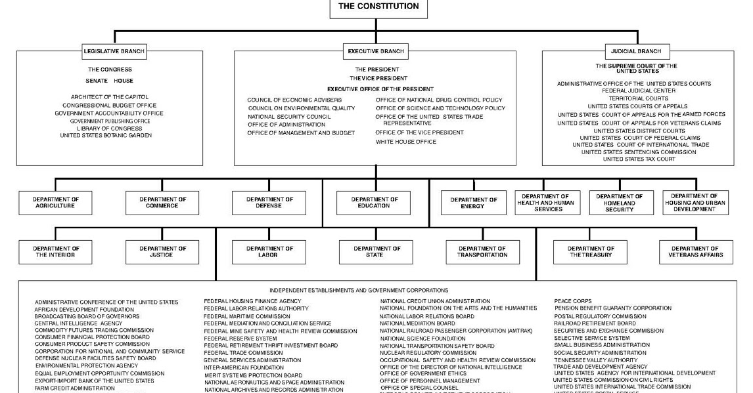
HRSA

Slide 7
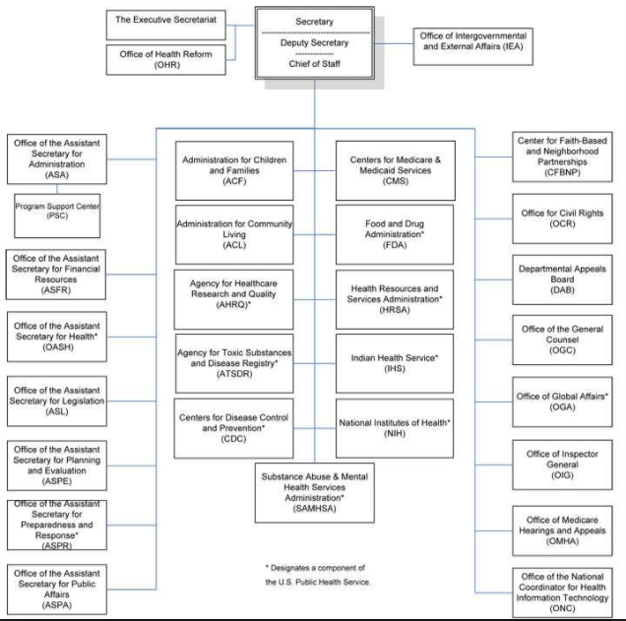
HRSA

Slide 8
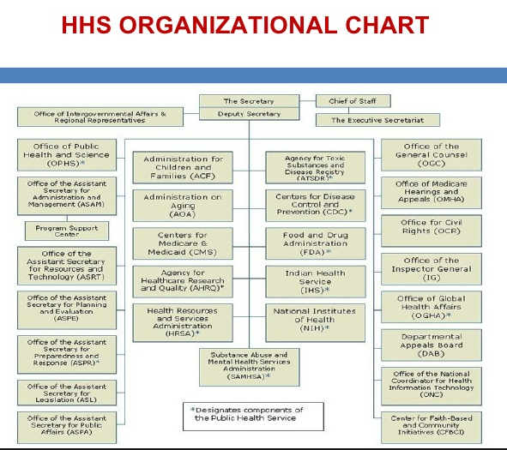
HRSA

Slide 9
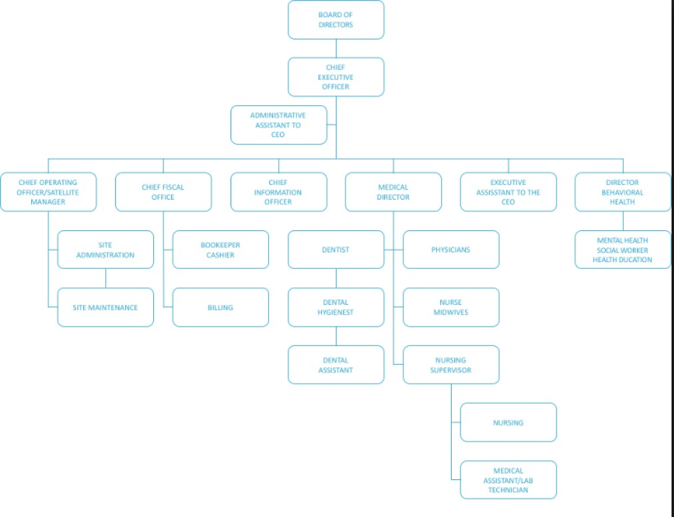
HRSA
COMMUNITY
HEALTH
CENTER
ORGANIZATIONAL
CHART examples

Slide 10
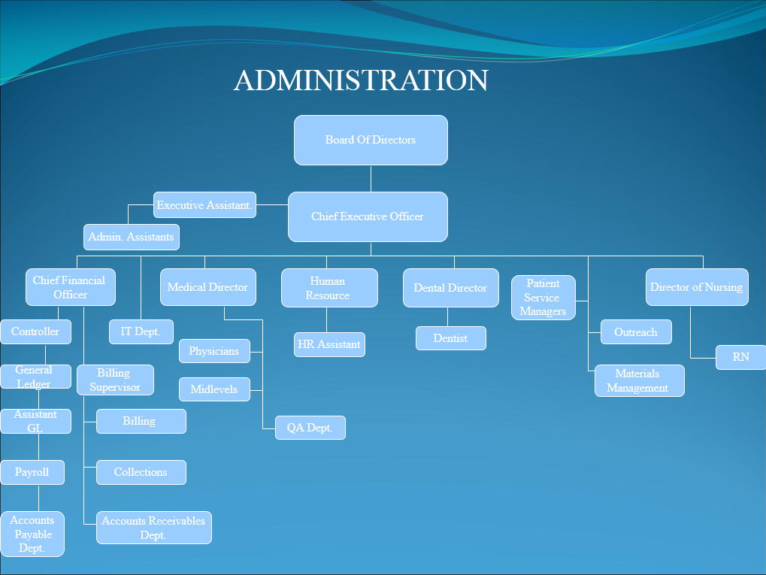
HRSA
Organizational
Chart at Clinica
de Salud del Valle
de Salinas

Slide 11
PHYSICIAN JOB DESCRIPTION
Job Summary: Performs direct patient care in the medical office setting under the supervision of the Medical Director.
Assures the adequacy and appropriateness of medical care provided to patients.
Note: All medical staff will be privileged and credentialed according to the rules and regulations of the COMMUNITY HEALTH CENTER.
The medical staff of each department or service is responsible for peer review activities to promote continuous improvement of the quality of patient care provided by the medical staff in all departments of the COMMUNITY HEALTH CENTER.
SEE NEXT PAGE FOR AREAS OF PERFORMANCE EVALUATION

Slide 12
PHYSICIAN PERFORMANCE EVALUATION
Demonstrates Competency in the Following Areas:
Directs and coordinates medical care at the medical office.
Serves as a clinical director and medical practitioner for the medical office.
Provides clinical supervision for medical office staff: physicians, nurses, physician assistants, etc.
Participates in administrative decision making, establishes policies, procedures and guidelines designed to ensure the provision of adequate, comprehensive care across all specialties.
Develops, revises and implements policies and procedures for patient care, infection prevention and control, quality management and patients' rights.
Understands and ensures compliance with the medical offices policies and procedures for safety, infection prevention and control, hazardous materials and waste, etc.
Communicates with the medical staff regarding policies, standards and specific patient problems.

Slide 13
PHYSICIAN PERFORMANCE EVALUATION
Demonstrates Competency in the Following Areas:
Communicates with the medical staff regarding policies, standards and specific patient problems.
Serves as a member of the organized medical staff, attends medical staff meetings and ensures adherence to the medical staff bylaws and rules and regulations.
Participates in the development and implementation of educational programs for staff and the community.
Provides recommendations to CEO regarding capital expenditures for equipment and the facility.
Able to evaluate medical services provided by the medical office and makes recommendations as appropriate.
Available for consultation for clinical staff.
Knowledgeable of social, regulatory, political and economic factors that relates to patient care services.
Performs all aspects of patient care in an environment that optimizes patient safety and reduces the likelihood of medical/health care errors.
Supports and maintains a culture of safety and quality.
Advises CEO concerning the adequacy and appropriateness of the medical office’s scope of services for patients, its professional and support staff and its medical equipment.

Slide 14
PHYSICIAN PERFORMANCE EVALUATION (continued)
Demonstrates Competency in the Following Areas:
Monitors and evaluates the quality and appropriateness of medical services as an integral part of the overall quality management program.
Provides medical leadership for research and development activities in patient care.
Articulates the medical practice’s mission to the community.
.
UTILIZATION REVIEW:
Develops, implements and monitors the Utilization Review Plan.
Develops practice guidelines for high volume diagnoses in conjunction with the appropriate specialists.
Educates staff about utilization practices to promote high quality, cost effective care.
Develops written policies for the resolution of utilization problems.
Plans and conducts interventions with outlier physicians.
Assists in the growth and development of the Case Management program.
Acts as a resource for the Utilization Review Coordinators.
Reviews frequent or unusual referral requests.
Interfaces with health plan Medical Directors as needed on utilization issues.

Slide 15
PHYSICIAN PERFORMANCE EVALUATION (continued)
Demonstrates Competency in the Following Areas:
Monitors and evaluates the quality and appropriateness of medical services as an integral part of the overall quality management program.
Provides medical leadership for research and development activities in patient care.
Articulates the medical practice’s mission to the community.
UTILIZATION REVIEW:
Develops, implements and monitors the Utilization Review Plan.
Develops practice guidelines for high volume diagnoses in conjunction with the appropriate specialists.
Educates staff about utilization practices to promote high quality, cost effective care.
Develops written policies for the resolution of utilization problems.
Plans and conducts interventions with outlier physicians.
Assists in the growth and development of the Case Management program.
Acts as a resource for the Utilization Review Coordinators.
Reviews frequent or unusual referral requests.
Interfaces with health plan Medical Directors as needed on utilization issues.

Slide 16
PHYSICIAN PERFORMANCE EVALUATION (continued)
PROVIDES DIRECT PATIENT MEDICAL CARE:
Performs histories and physicals.
Makes diagnoses.
Treat a variety of disease processes and acute injuries.
Orders appropriate diagnostic tests and treatments.
Prescribes drugs and regulated medical devices.
Provide preventive healthcare education to patients and the
community.
Refers patients to other healthcare professionals as appropriate.
Demonstrates Competency in the Following Areas:
Takes patient phone calls as needed.
Provides clinical training to nurses and other staff.

Slide 17
PHYSICIAN PERFORMANCE EVALUATION (continued)
Professional Requirements:
Meets dress code standards; appearance is neat and clean.
Maintains regulatory requirements, including all federal, state,
local regulations and accrediting organization standards.
Wears identification while on duty.
Represents the organization in a positive and professional manner.
Complies with all organizational policies regarding ethical
business practices.
Communicates the mission, ethics and goals of the clinic.

Slide 18
ANNUAL COMPETENCY CLINICAL SKILLS ASSESSMENT EVALUATION OF CLINICAL PERFORMANCE
PHYSICIAN – MEDICAL OFFICE
Functions as a member of the healthcare office team for the benefit of the patient.
Exercises excellent judgment for patients that require consultation, referral or evaluation.
Demonstrates the knowledge and skills to care for patients across the life span:
Physical exam
Obtaining medical histories
Order and interprets laboratory and diagnostic tests/procedures
Formulates a diagnosis and patient treatment plan
Provides patient and family education
Orders, prescribes, administers drugs
All documentation is per standards
All documentation is dated, authenticated and legible

Slide 19
ANNUAL COMPETENCY CLINICAL SKILLS ASSESSMENT EVALUATION OF CLINICAL PERFORMANCE PHYSICIAN – MEDICAL OFFICE (continued)
Demonstrates knowledge and ability to perform technical skills:
Assists and performs minor surgery
Performs medical and surgical asepsis at all times
Inserts and removes lines and monitoring devices
Inserts and removes drains
Applies and removes casts
Sutures lacerations
Removes sutures, skin staples Performs wound care and dressing changes
Other
List criteria for identification of abuse victims:
Infant/child
Adolescent
Elderly
Domestic abuse
Fiduciary
Neglect
Demonstrates competence in reporting victims of abuse according to established medical office standards and state and local laws.

Slide 20
ANNUAL COMPETENCY CLINICAL SKILLS ASSESSMENT EVALUATION OF CLINICAL PERFORMANCE PHYSICIAN – MEDICAL OFFICE (continued)
Waived Testing:
Evaluation includes written evaluation of theory; direct observation of test performance by a qualified proctor; direct observation of quality control methodologies (equipment calibration, outdating, troubleshooting, quality control and remedial actions, documentation of quality control measures), if applicable.
List waived testing performed:
Blood glucose monitoring
Fecal occult blood testing
Reagent strips for Urinalysis
Other
Demonstrates knowledge of the office’s electronic health record system.
Demonstrates knowledge of HIPAA regulations and patient privacy.
Uses appropriate reporting mechanisms as required by state law.
Seeks consultation of the physician for patients conditions outlined in agreement.
Demonstrates knowledge of current state, federal and local laws and regulation governing the delivery of care.

Slide 21
ANNUAL COMPETENCY CLINICAL SKILLS ASSESSMENT EVALUATION OF CLINICAL PERFORMANCE PHYSICIAN – MEDICAL OFFICE (continued)
Demonstrates competency in the knowledge of the delivery of patient care in an environment that optimizes patient safety and reduces the likelihood of medical/health care errors.
Demonstrates the knowledge of proper identification and reporting of medical/healthcare errors. Protects the patient in the event of a medical/health care error and, as appropriate, assists in the medical/health care error resolution.
Demonstrates knowledge of the office's scheduling system
Knowledgeable of various insurance plans, third party payers
Knowledgeable of community agencies, social service agencies etc.
Demonstrates a commitment to person growth and development.
Arranges referrals to other members of the health team as needed and to community resources as appropriate.
Demonstrates knowledge of and follows organization policies regarding the applicable National Patient Safety Goals. (See NPSGs and Universal Protocol Competency Form)

Slide 22
ANNUAL COMPETENCY CLINICAL SKILLS ASSESSMENT EVALUATION OF CLINICAL PERFORMANCE PHYSICIAN – MEDICAL OFFICE (continued)
Documentation:
Entries are clear and concise
All patient care documented
Record is timed and authenticated
All entries are legible
Office Environment - Able to locate and/or demonstrate knowledge of:
Office directory
Physician directory
Hospital directories
Telephone system
Beeper system
Computer system 1 2 3 NA
Charge system

Slide 23
ANNUAL COMPETENCY CLINICAL SKILLS ASSESSMENT EVALUATION OF CLINICAL PERFORMANCE PHYSICIAN – MEDICAL OFFICE (continued)
Fire Equipment:
Alarms
Extinguishers
Exit doors
Office Organization - Able to describe roles and functions of:
Office Medical Director
Office Physicians
Office Manager
Nursing Staff
Ancillary Staff
Other
Other

Slide 24
ANNUAL COMPETENCY CLINICAL SKILLS ASSESSMENT EVALUATION OF CLINICAL PERFORMANCE PHYSICIAN – MEDICAL OFFICE (continued)
Office Resources - Able to locate and demonstrate knowledge of:
Medical Office Policy and Procedure Manual
Fire/Safety Manual
Emergency Management Manual
Safety Data Sheets (SDS) Manual
Infection Prevention and Control Manual
PDR/Drug Reference Manual
Specific Reference Materials/Community Resources
Patient Teaching Materials/Aids
PI Documentation
Other

Slide 25
ANNUAL COMPETENCY CLINICAL SKILLS ASSESSMENT EVALUATION OF CLINICAL PERFORMANCE
PHYSICIAN – MEDICAL OFFICE (continued)
Office Routines - Able to describe, locate and/or demonstrate knowledge of:
Communication System:
Bulletin boards
Meeting minutes
Cultural Factors:
Religion
Food preferences
Family/community relationships
Healthcare attitudes/understanding
Trust/privacy needs
Socioeconomic environment

Slide 26
WHAT ARE THE JOB RELATED EXPECTATIONS WITH REGARD TO THE FOLLOWING AREAS?
Demonstrate ability to place the patient’s health in proper perspective
Demonstrate professional priorities
Demonstrate role as a leader and functional health care team member
Demonstrate health care delivery knowledge and documentation skills
Demonstrate abilities to perform technical skills
Demonstrate knowledge of reporting expectations
Demonstrate knowledge of rules and regulations
Demonstrate understanding of behavioral expectations
Demonstrate knowledge of resource management

Slide 27
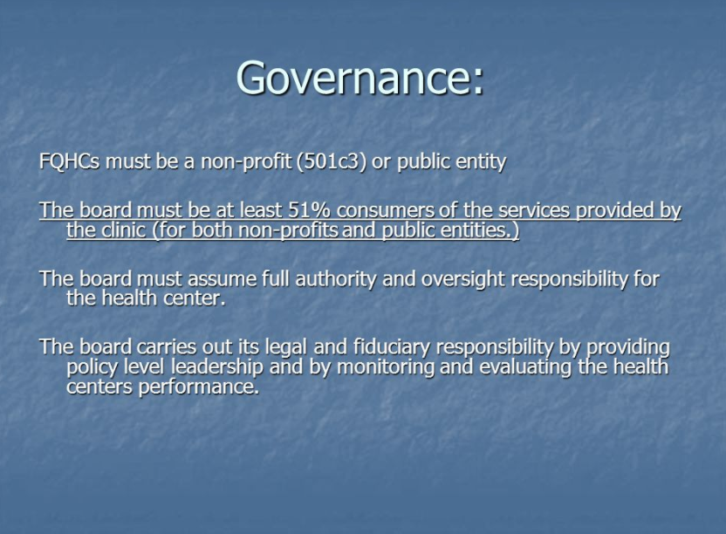

Slide 28
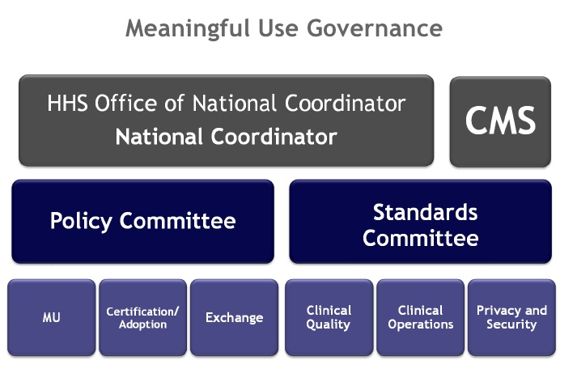

Slide 29
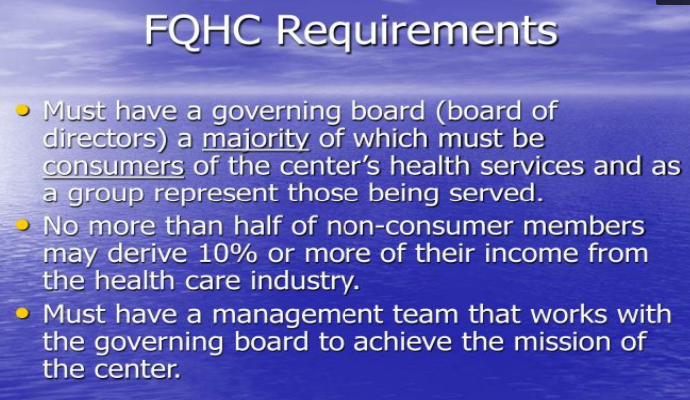

Slide 30
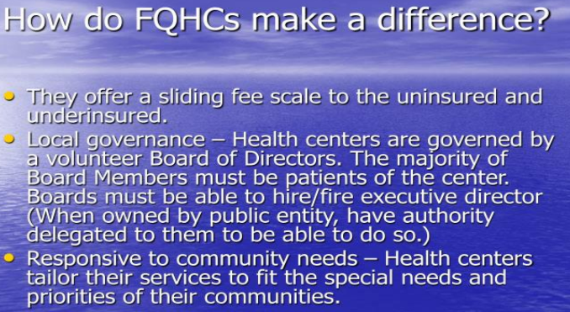

Slide 31
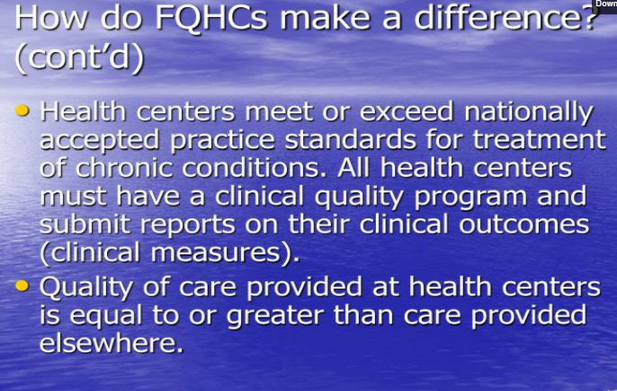

Slide 32
Health resources and services administration
Each Health Center team has compliance expectations to the Health Resources and Services Administration. The following is a summary of those expectations.
HRSA

Slide 33
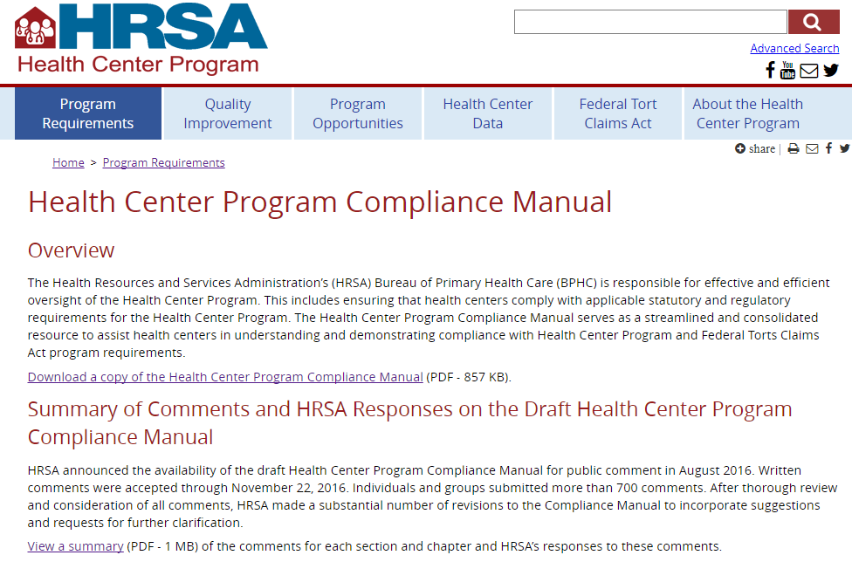

Slide 34

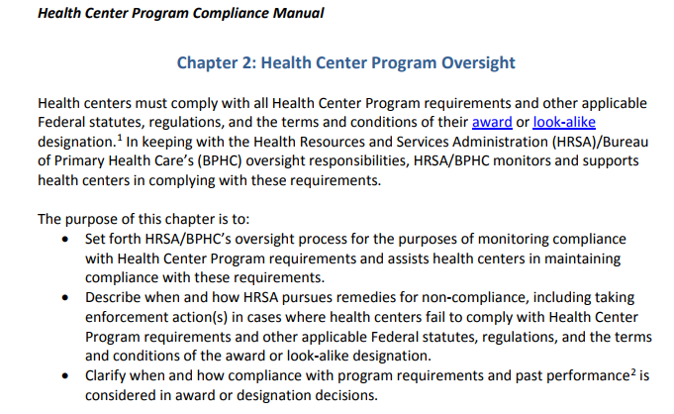

Slide 35
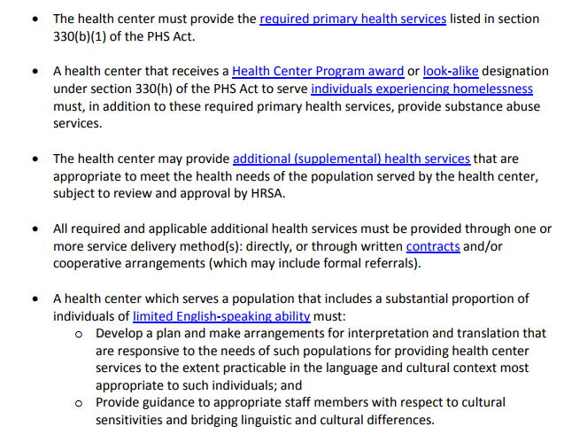

Slide 36
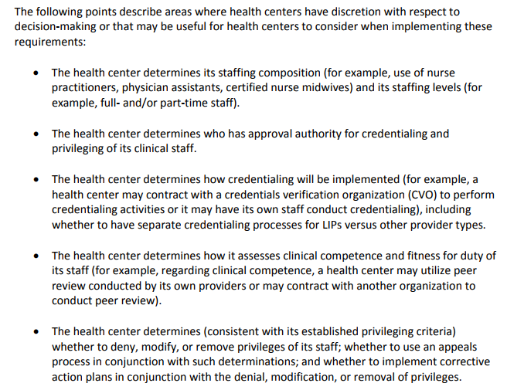

Slide 37
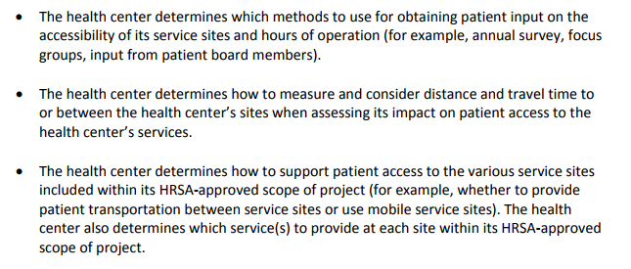

Slide 38
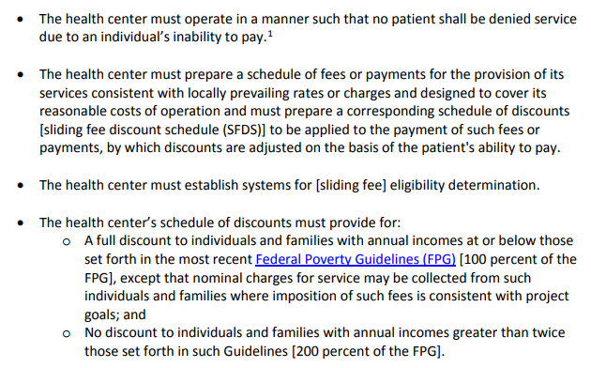

Slide 39
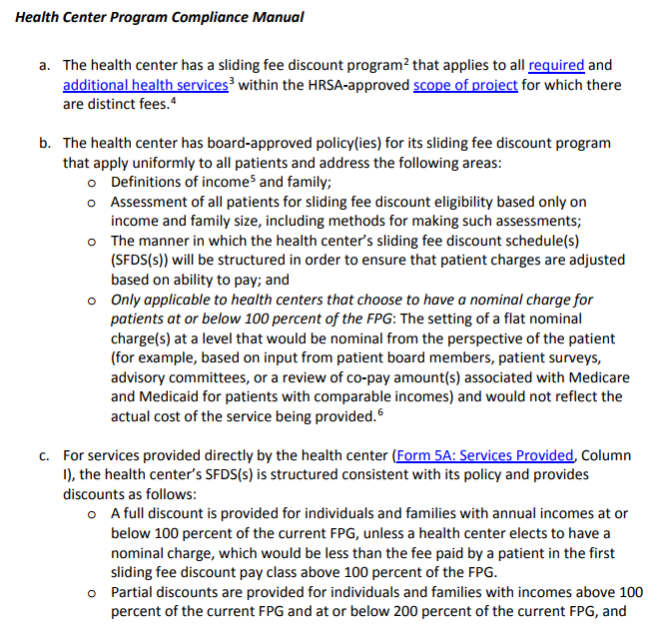

Slide 40
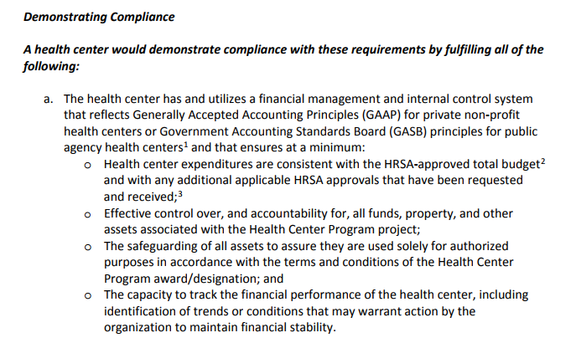

Slide 41
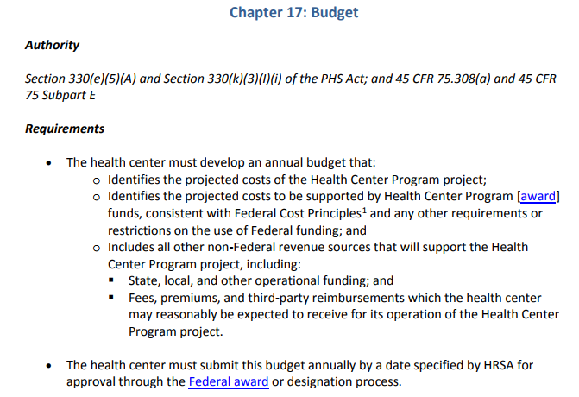

Slide 42
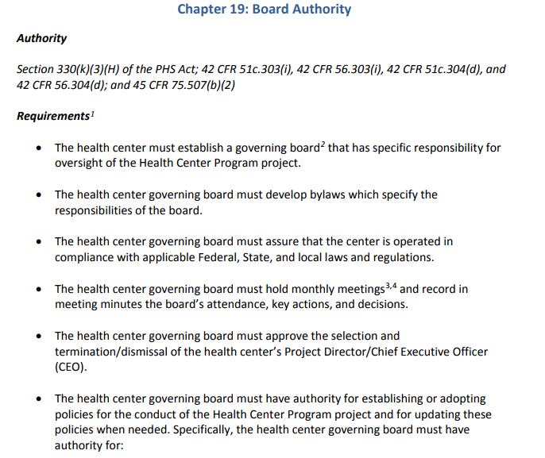

Slide 43
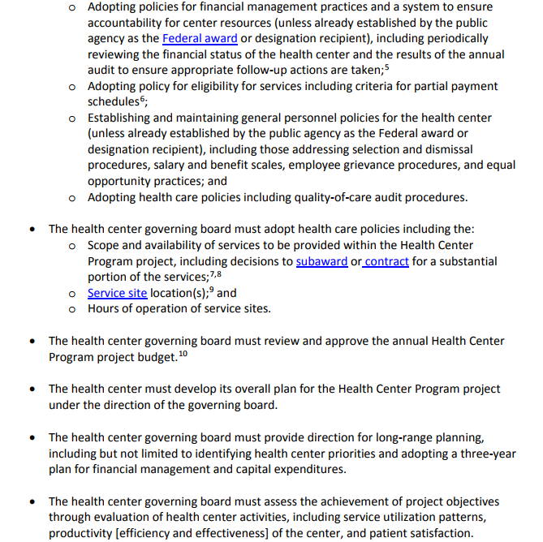

Slide 44
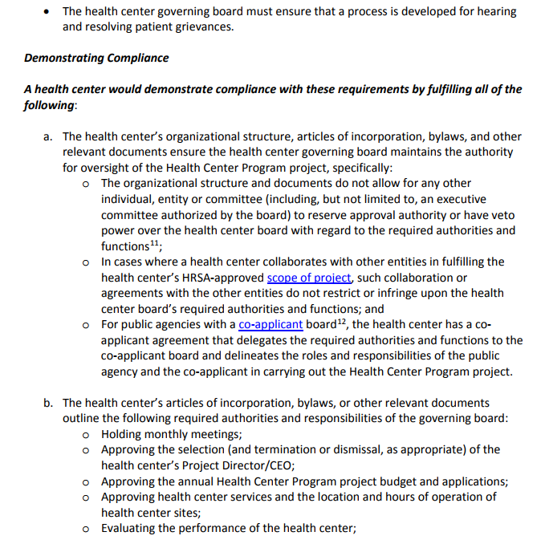

Slide 45
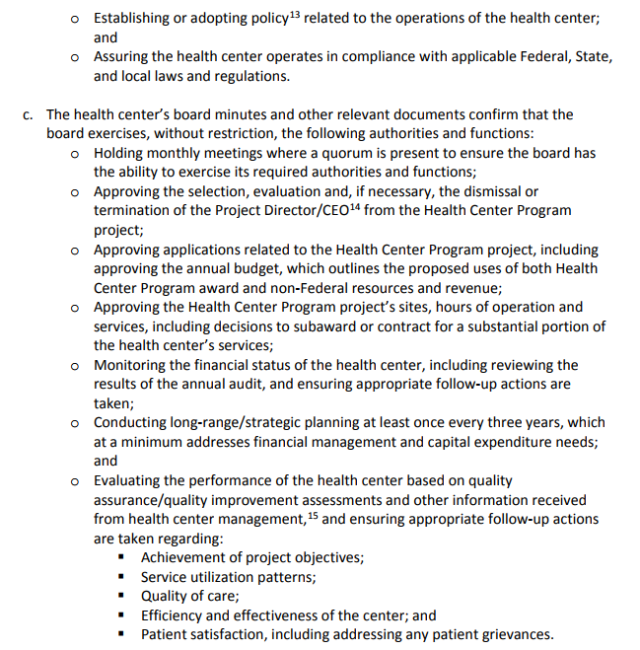

Slide 46
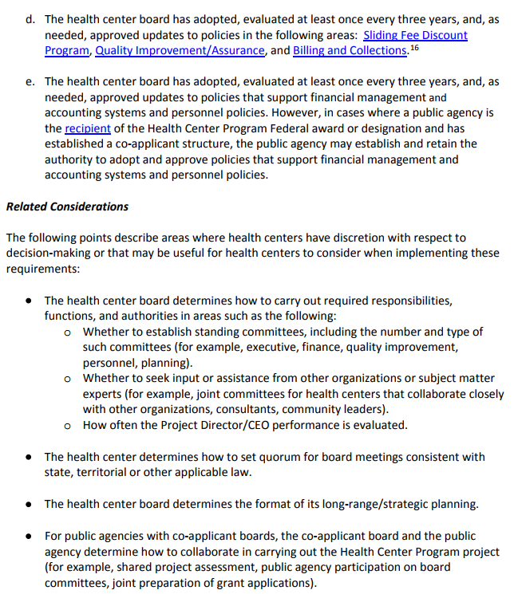

Slide 47
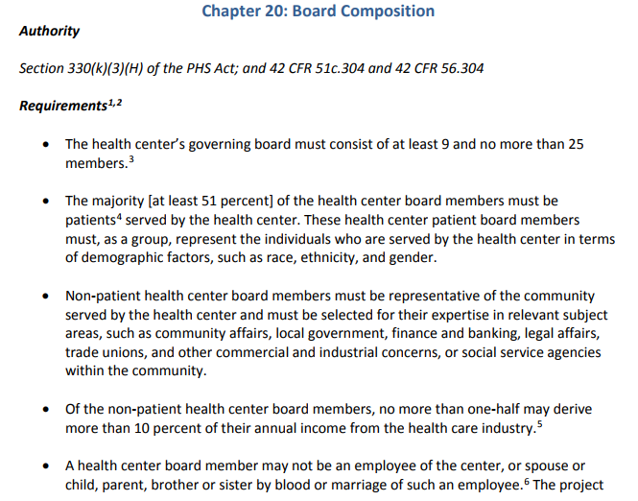

Slide 48
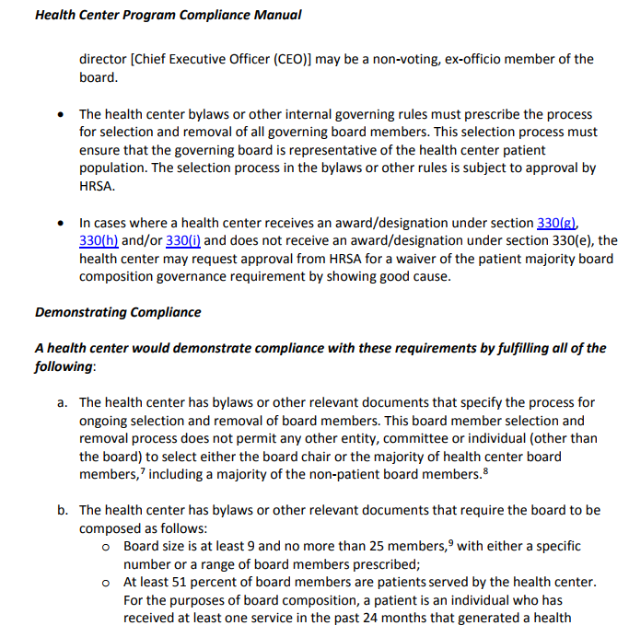

Slide 49
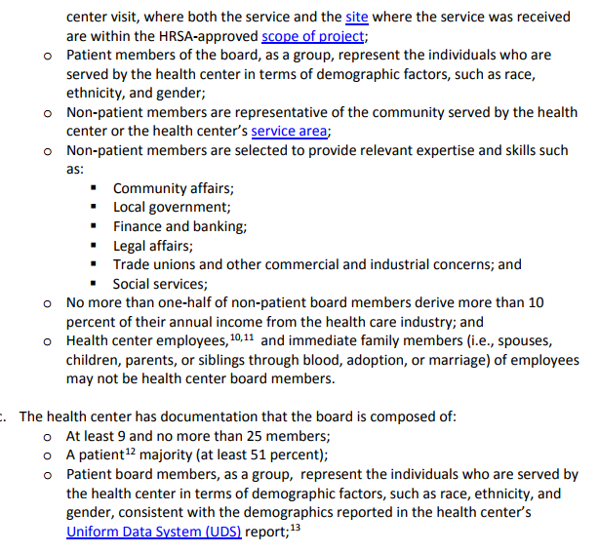

Slide 50
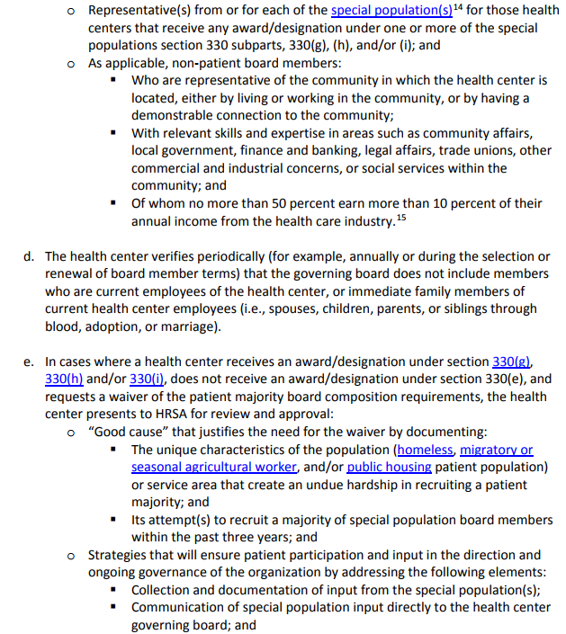

Slide 51
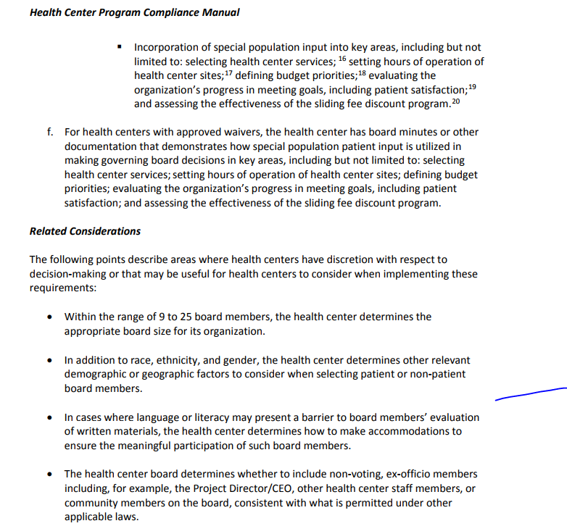

Slide 52
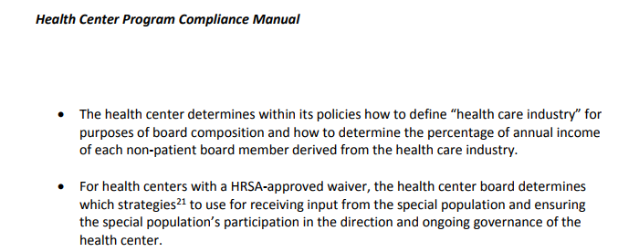

Slide 53
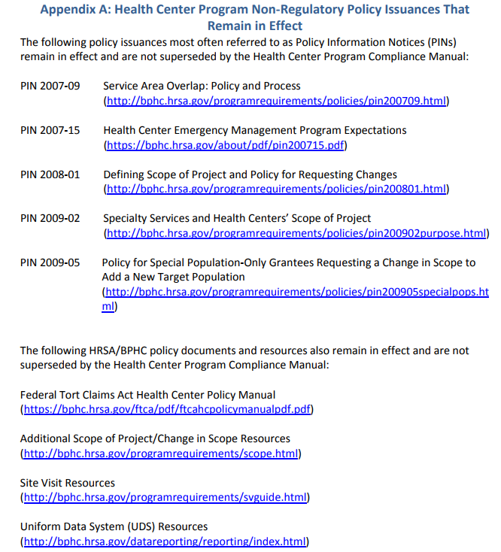

Slide 54
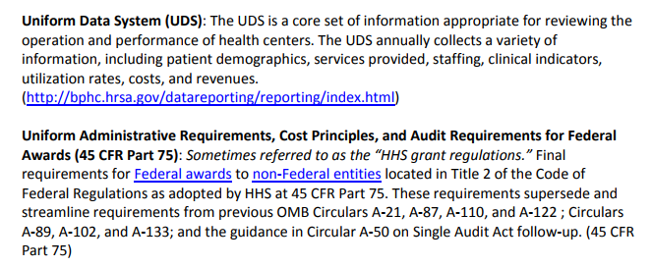

Slide 55
1. Which of the following statements is not true regarding governance at Community Health Centers
Each Board Member is responsible for their own liability insurance
The Board Composition must be at least 51% consumers of the services provided by the clinic
The Board must assume full authority and oversight responsibility for the health center
The Board carries out its legal and fiduciary responsibility by providing policy level leadership and by monitoring and evaluating the health centers performance

Slide 56
1. Which of the following statements is not true regarding governance at Community Health Centers
Each Board Member is responsible for their own liability insurance
The Board Composition must be at least 51% consumers of the services provided by the clinic
The Board must assume full authority and oversight responsibility for the health center
The Board carries out its legal and fiduciary responsibility by providing policy level leadership and by monitoring and evaluating the health centers performance

Slide 57
2. Please identify the correct chain of authority from the President to the Department of Health and Human Services on down to the level of a staff physician at a community health center
President of US → Department of Health and Human Services → HRSA → Community Health Center Board of Directors → Chief Executive Officer → Medical Director → Staff Physician
President of US → HRSA → Department of Health and Human Services → Chief Executive Officer → Medical Director → Staff Physician
President of US → HRSA→ Chief Executive Officer → Medical Director → Staff Physician

Slide 58
2.Please identify the correct chain of authority from the President to the Department of Health and Human Services on down to the level of a staff physician at a community health center
President of US → Department of Health and Human Services → HRSA → Community Health Center Board of Directors → Chief Executive Officer → Medical Director → Staff Physician
President of US → HRSA → Department of Health and Human Services → Chief Executive Officer → Medical Director → Staff Physician
President of US → HRSA→ Chief Executive Officer → Medical Director → Staff Physician

Slide 59
3. Which of the following is not an expectation of the annual competency clinical skills assessment evaluation
Demonstrates an ability to obtain additional funding programs to support care for the homeless
Demonstrate ability to place the patient’s health in proper perspective
Demonstrate professional priorities
Demonstrate role as a leader and functional health care team member
Demonstrate health care delivery knowledge and documentation skills
Demonstrate abilities to perform technical skills
Demonstrate knowledge of reporting expectations
Demonstrate knowledge of rules and regulations
Demonstrate understanding of behavioral expectations
Demonstrate knowledge of resource management

Slide 60
3. Which of the following is not an expectation of the annual competency clinical skills assessment evaluation
Demonstrates an ability to obtain additional funding programs to support care for the homeless
Demonstrate ability to place the patient’s health in proper perspective
Demonstrate professional priorities
Demonstrate role as a leader and functional health care team member
Demonstrate health care delivery knowledge and documentation skills
Demonstrate abilities to perform technical skills
Demonstrate knowledge of reporting expectations
Demonstrate knowledge of rules and regulations
Demonstrate understanding of behavioral expectations
Demonstrate knowledge of resource management

Slide 61
4. Which of the following is not a Federally Qualified Health Center Requirement
Must have a governing board ( board of directors ) a majority of which must be consumers of the center’s health centers services and as a group represent those being served
No more than half of non-consumer member may derive 10% or more of their income from the health care industry
Must have a management team that works with the governing board to achieve the mission of the center
Must own all building for clinic facilities outright

Slide 62
4. Which of the following is not a Federally Qualified Health Center Requirement
Must have a governing board ( board of directors ) a majority of which must be consumers of the center’s health centers services and as a group represent those being served
No more than half of non-consumer member may derive 10% or more of their income from the health care industry
Must have a management team that works with the governing board to achieve the mission of the center
Must own all building for clinic facilities outright

Slide 63
5. How do FQHCs make a difference?
They offer a sliding fee scale to the uninsured and underinsured
Local governance – Health centers are governed by a volunteer Board of Directors. The majority of Board Members must be patients of the center. Boards must be able to hire/fire executive director (When owned by public entity, have authority delegated to them to be able to do so)
Responsive to community needs – Health Centers tailor their services to fit the special needs and priorities of their communities
Health centers meet or exceed nationally accepted practice standards for treatment of chronic conditions. All health centers must have a clinical quality program and submit reports on their clinical outcomes (clinical measures)
Quality of care provided at health centers is equal to or greater that care provided elsewhere
All of the above

Slide 64
5. How do FQHCs make a difference?
They offer a sliding fee scale to the uninsured and underinsured
Local governance – Health centers are governed by a volunteer Board of Directors. The majority of Board Members must be patients of the center. Boards must be able to hire/fire executive director (When owned by public entity, have authority delegated to them to be able to do so)
Responsive to community needs – Health Centers tailor their services to fit the special needs and priorities of their communities
Health centers meet or exceed nationally accepted practice standards for treatment of chronic conditions. All health centers must have a clinical quality program and submit reports on their clinical outcomes (clinical measures)
Quality of care provided at health centers is equal to or greater that care provided elsewhere
All of the above

