Slide 1

MODULE three:
MEDICAL ADMINISTRATION
AND SERVICE DELIVERY
STRUCTURES IN COMMUNITY
HEALTH SETTINGS

Slide 2
MODULE three:
SECTION four:
Health Clinics
policies and
procedures

Slide 3

UNIT OBJECTIVE
To learn established standards within the medical units for the proper functioning of the institution

Slide 4
Health Clinics policies and procedures
Attendance and schedule
Documentation
Epidemiological surveillance
Reportable communicable diseases
Types of users
Committees, quality control, medical record management, safety, and patient safety
Complaint filing

Slide 5
ATTENDANCE AND SCHEDULE --
FOR PHYSICIANS
THE HEALTH OF THE PATIENTS WE SERVE IS THE MOST IMPORTANT OBJECTIVE OF OUR SYSTEM AT COMMUNITY HEALTH CENTERS
AVAILABILITY OF PHYSICIANS TO ATTEND TO PATIENTS IMPROVES TIMELY ASSESS TO TREATMENT, EVALUATION AND CONSISTENT CARE
AVAILABILITY OF A HEALTH CARE TEAM TO ASSIST THE PHYSICIAN IS NOT EFFICIENT IF THE PHYSICIAN IS NOT PRESENT AS THE TEAM LEADER WHEN SCHEDULED
HOWEVER EXCUSABLE ILLNESS AND EMERGENCIES DO OCCUR AND THERE IS POLICY AND PROCEDURE IN THE EMPLOYEE HANDBOOK AT EACH ONE OF THE COMMUNITY HEALTH CENTERS IN WHICH YOU WILL SERVE

Slide 6
DOCUMENTATION – EMR – NEXT GEN
ALL OF THE COMMUNITY HEALTH CENTERS IN WHICH YOU WILL BE SERVING USES THE ELECTRONIC MEDICAL RECORD (EMR) CALLED NEXT GEN OR E-CLINICAL WORKS FOR DOCUMENTATION PURPOSES
THE FOLLOWING REPRESENTS A TRAINING MANUAL AT CLINICA DE SALUD DEL VALLE SALINAS WHICH CAN PROVIDE SOME BASIC INFORMATION REGARDING NEX GEN EMR.
FURTHER INFORMATION WILL PROVIDED AT THE TIME OF ORIENTATION.

Slide 7
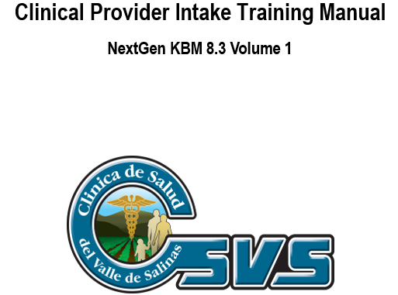

Slide 8
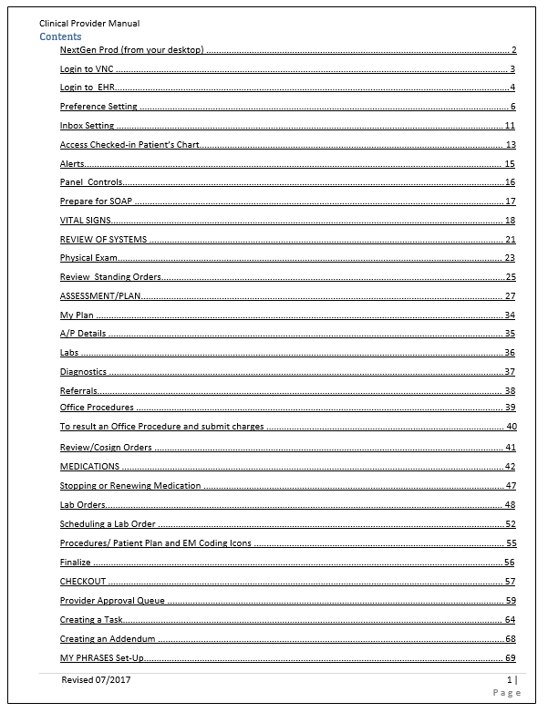
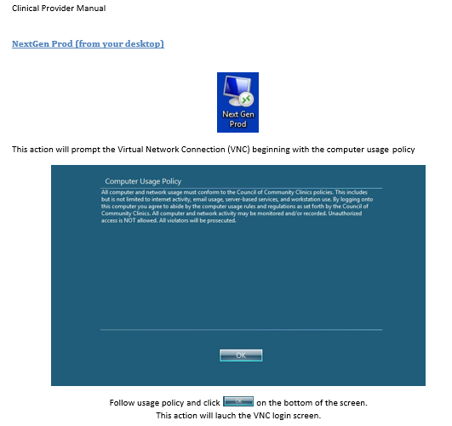


Slide 9
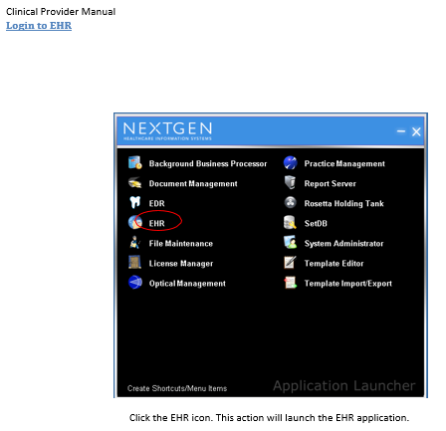
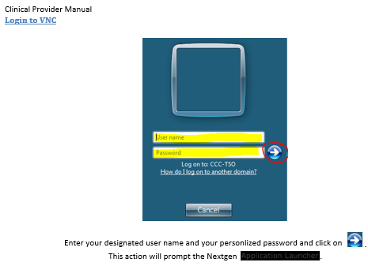


Slide 11
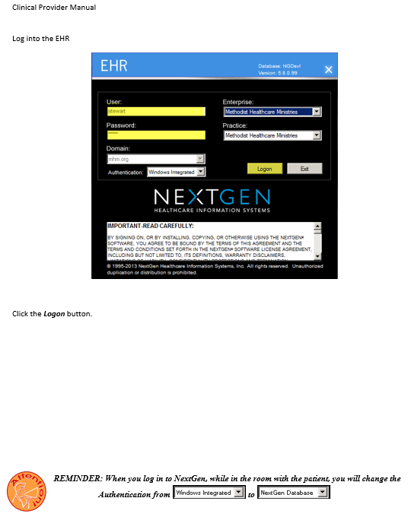
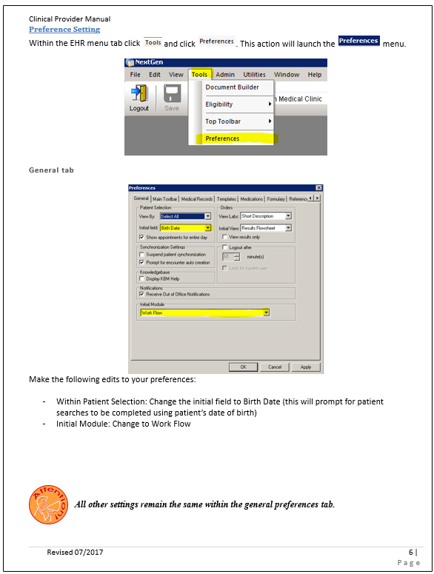

Slide 12
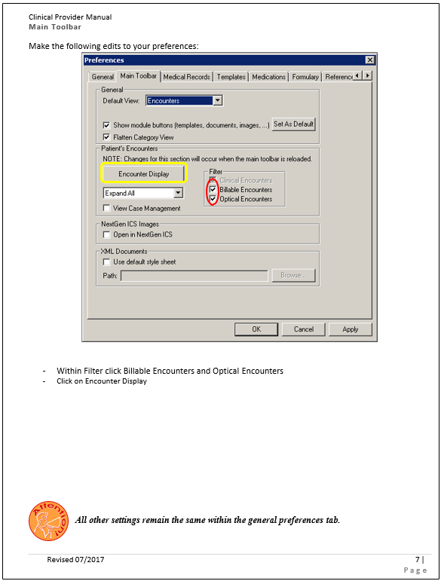
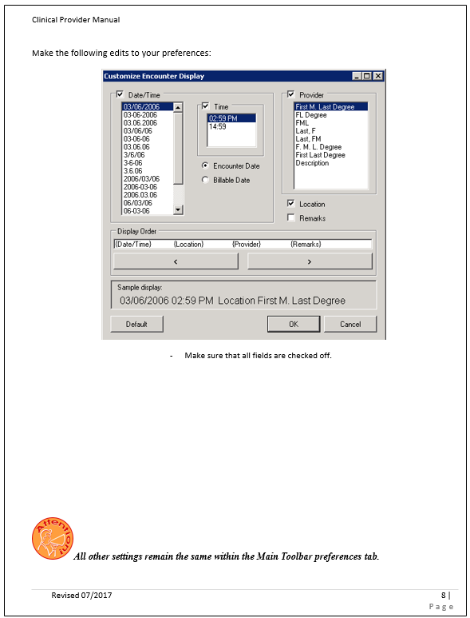

Slide 13
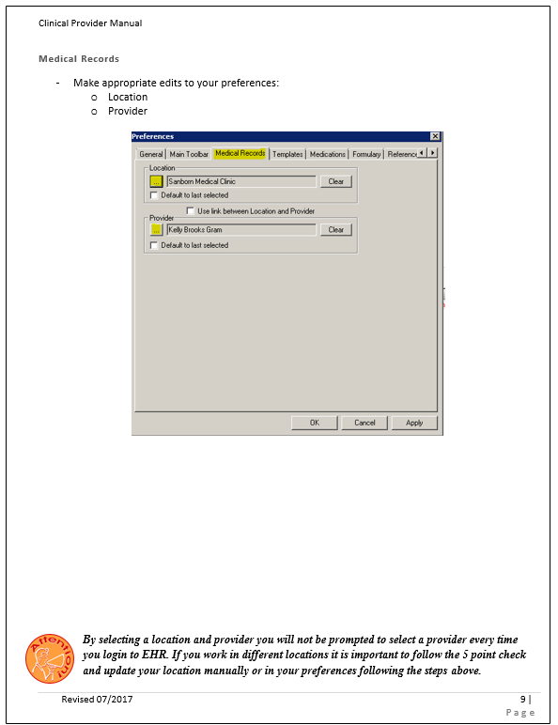
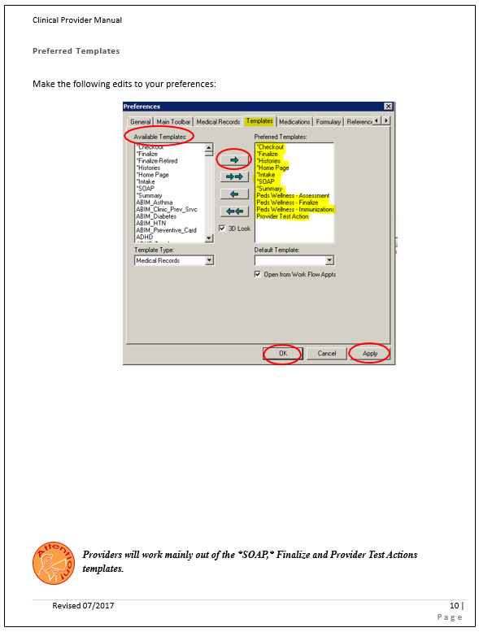

Slide 14
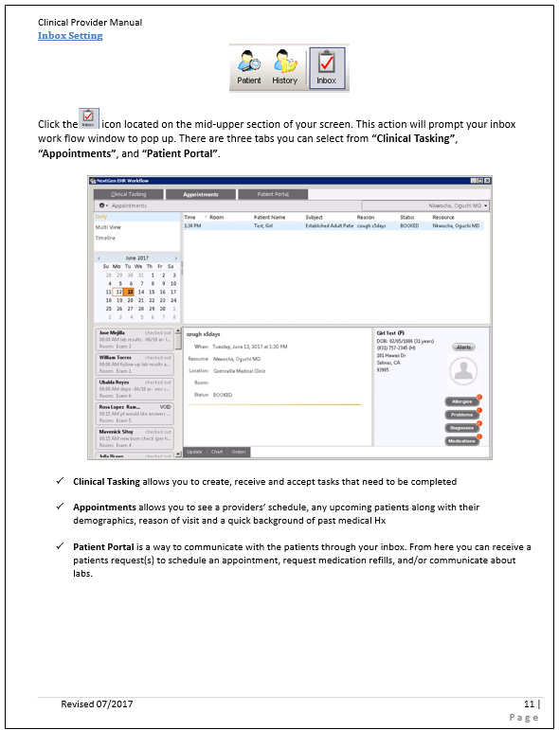
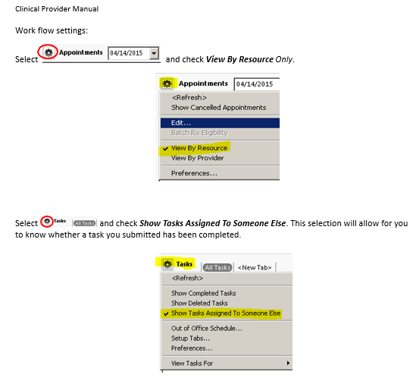

Slide 15
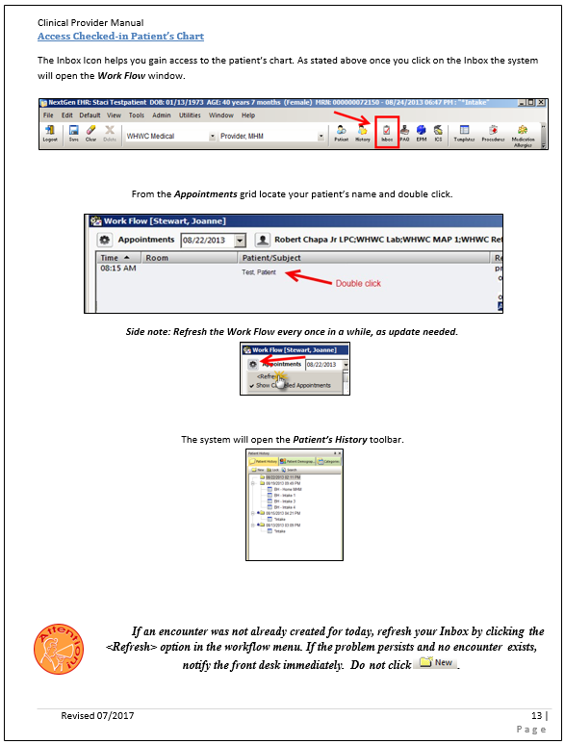
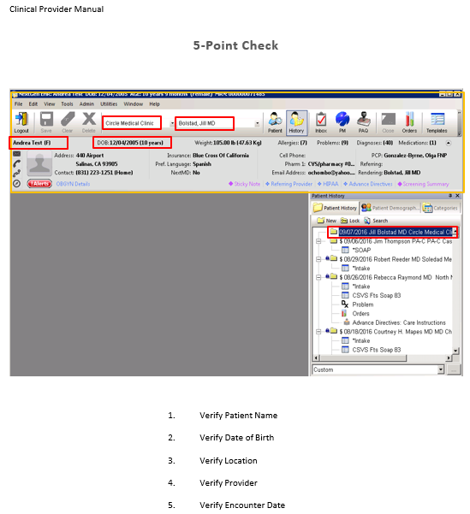


Slide 16
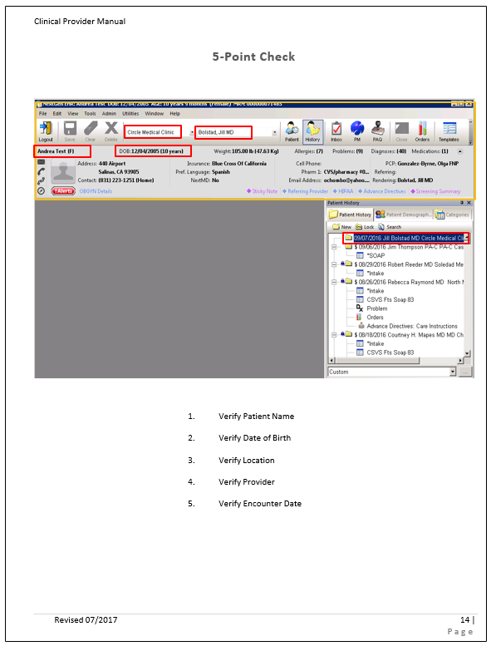
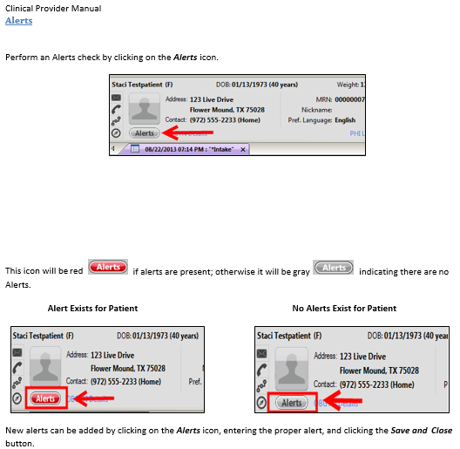


Slide 17
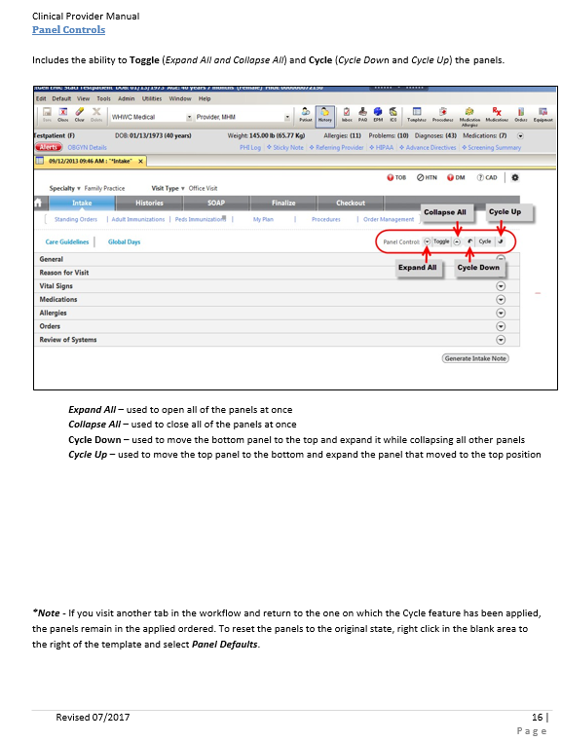
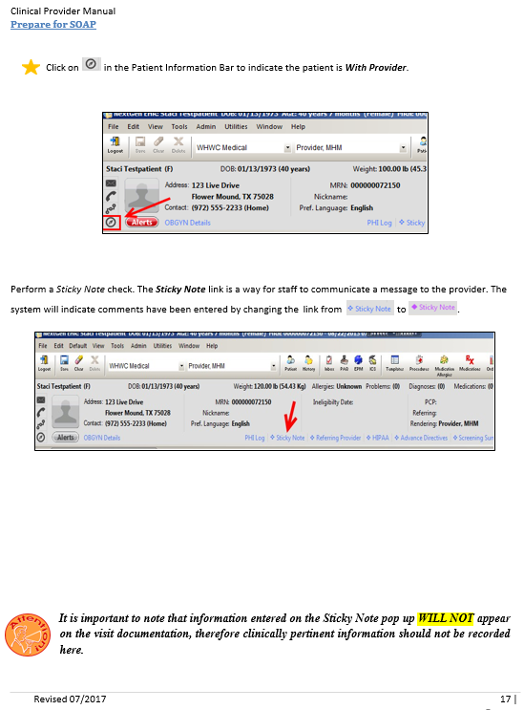

Slide 18
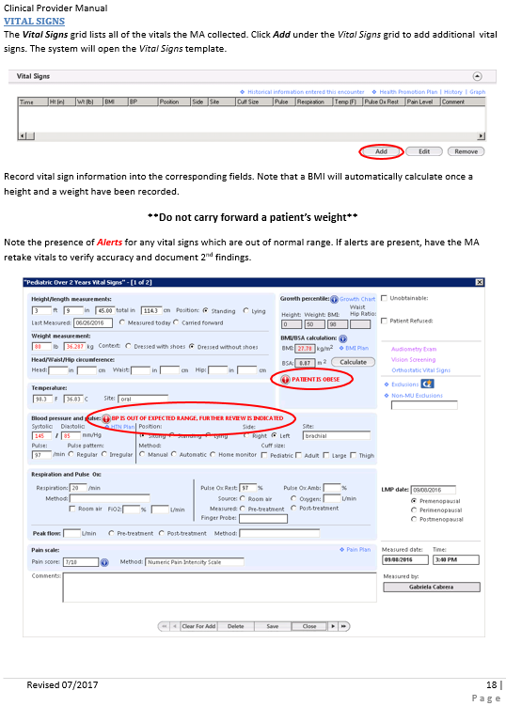
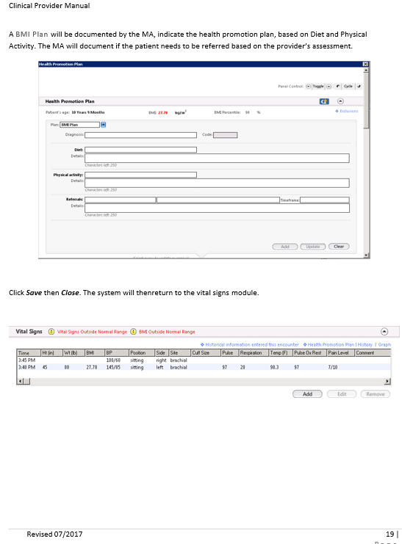

Slide 19
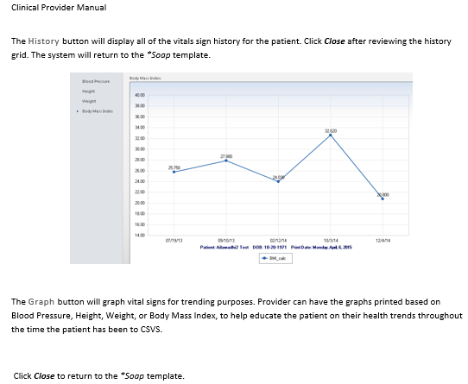

Slide 20
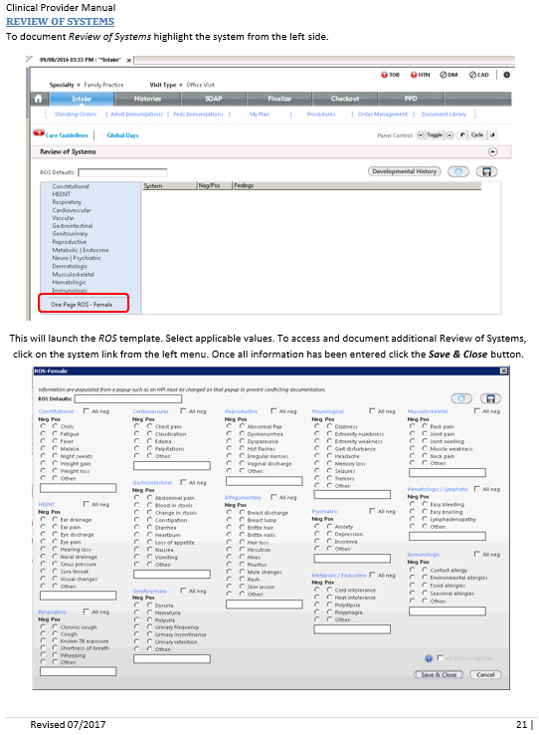
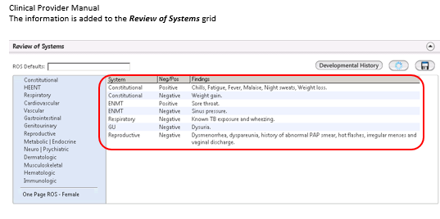

Slide 21
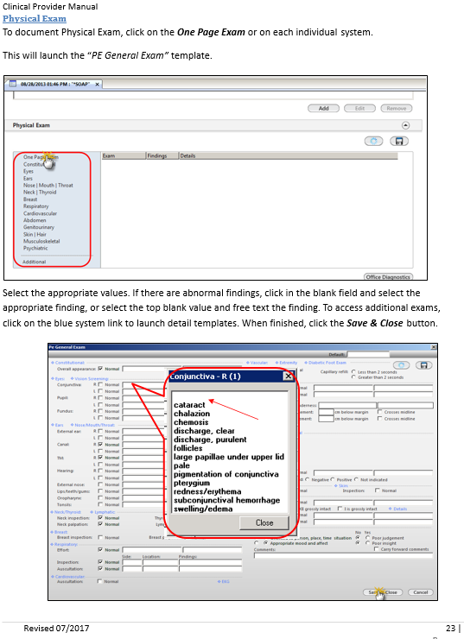
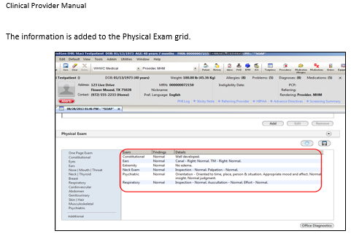

Slide 22
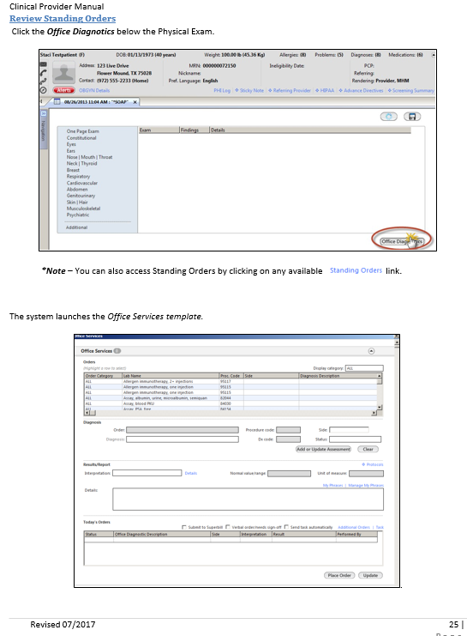
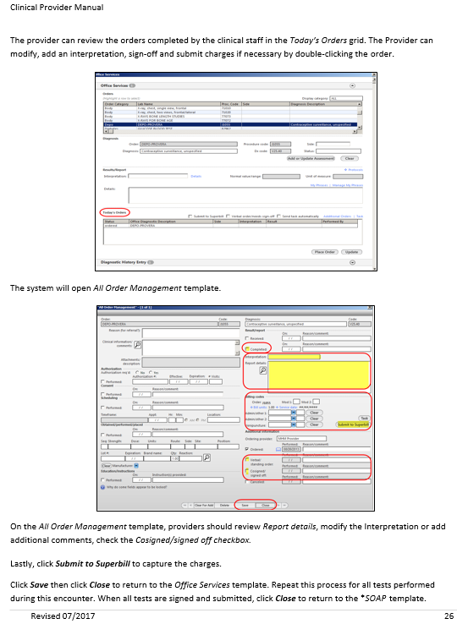

Slide 23
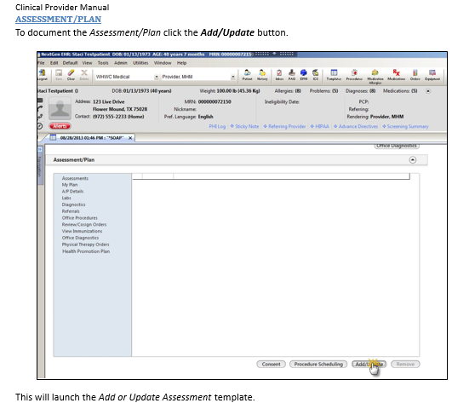

Slide 24
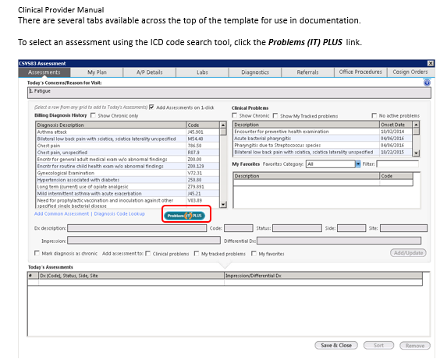

Slide 25
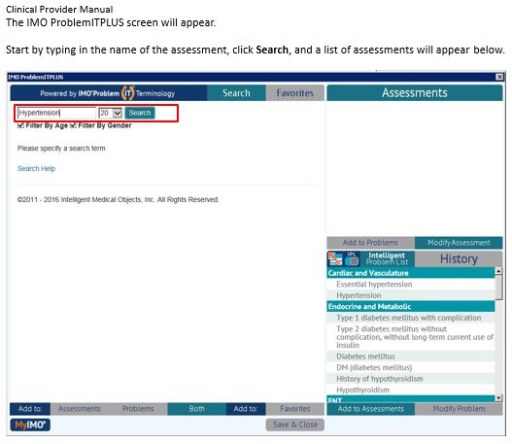

Slide 26
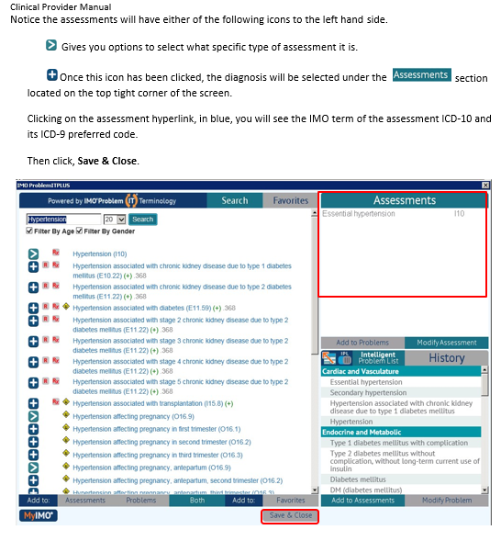

Slide 27
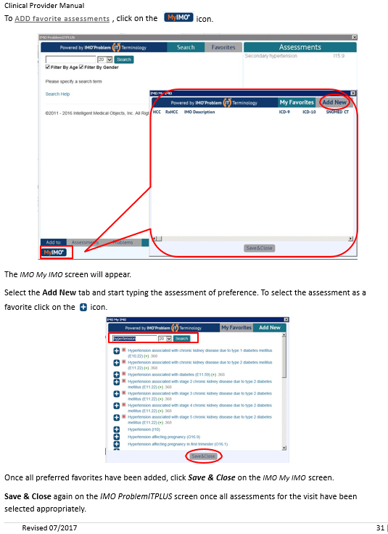
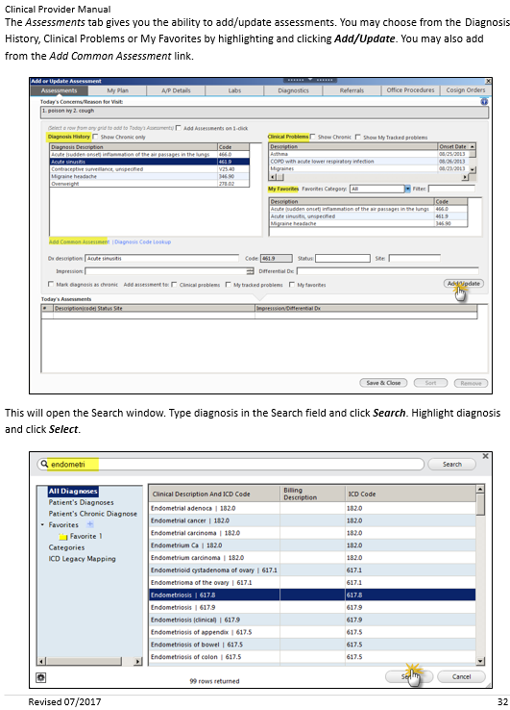

Slide 28
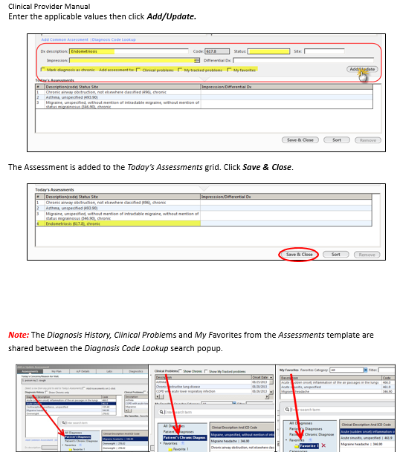
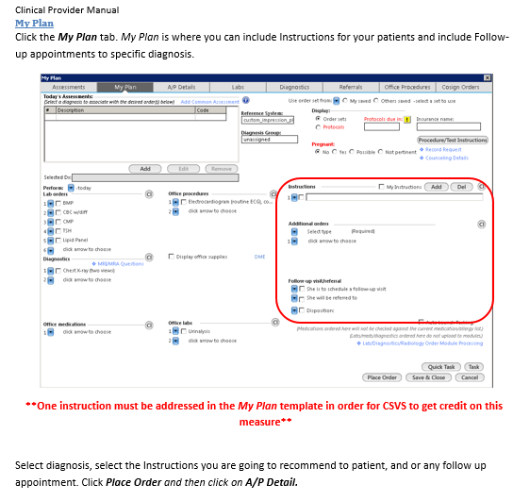

Slide 29
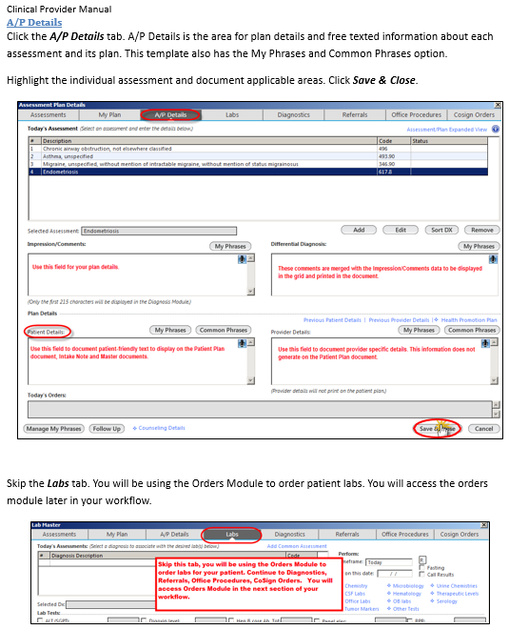
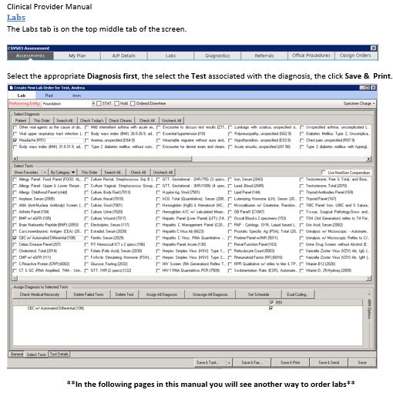

Slide 30
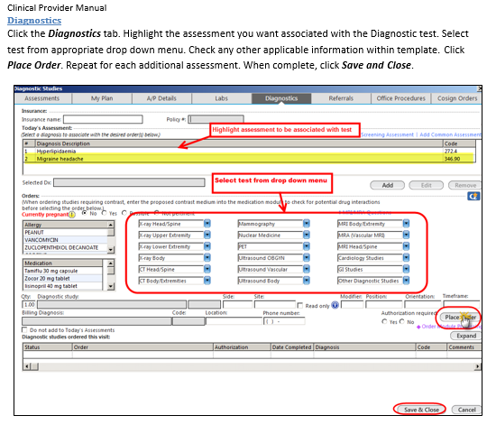

Slide 31
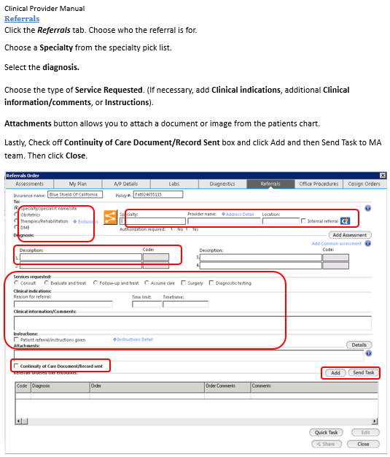
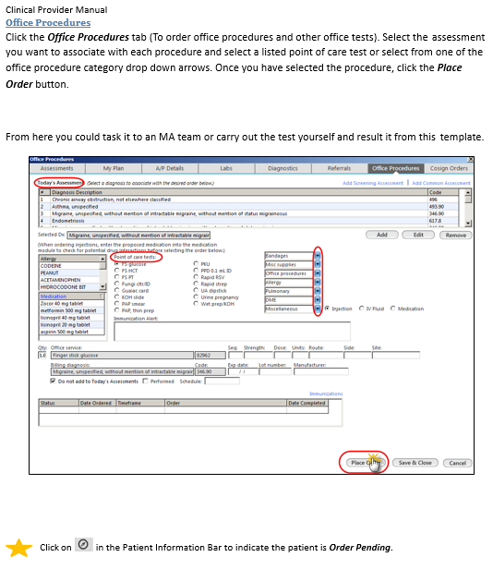

Slide 32
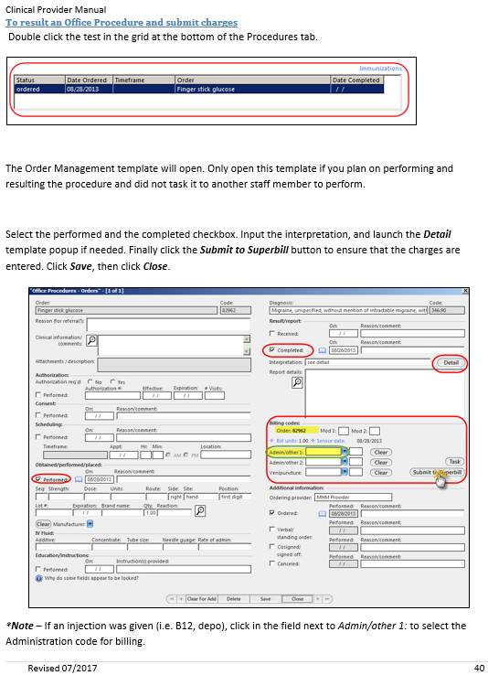
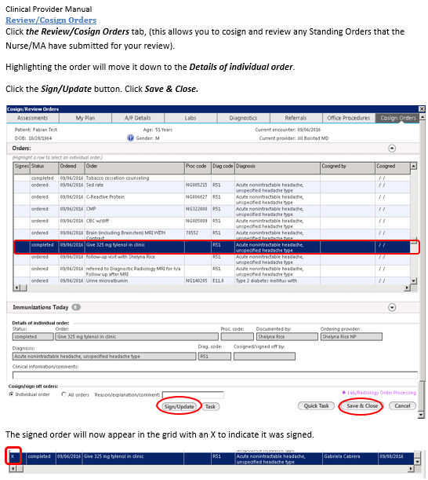

Slide 33
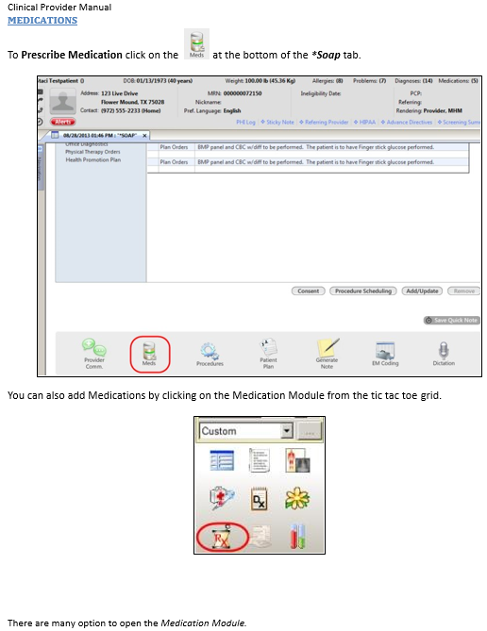
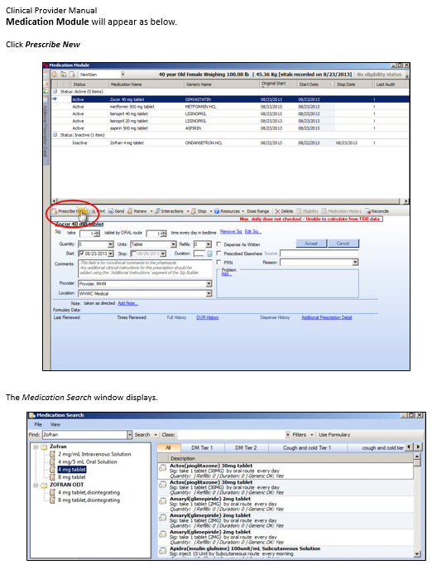

Slide 34
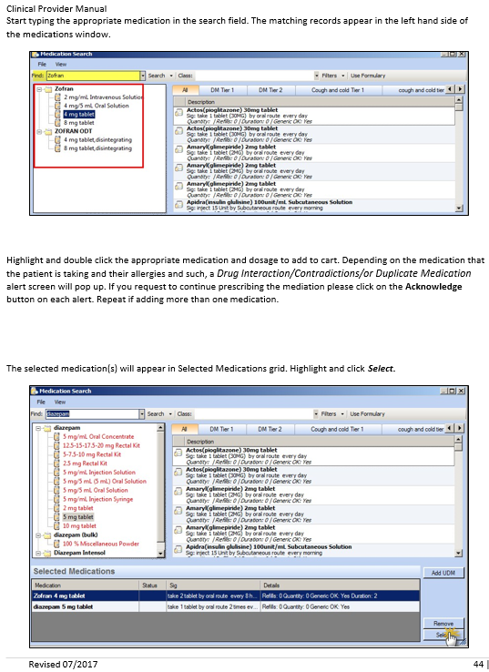
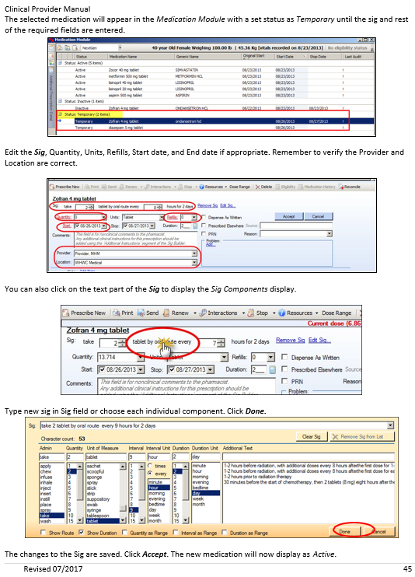

Slide 35
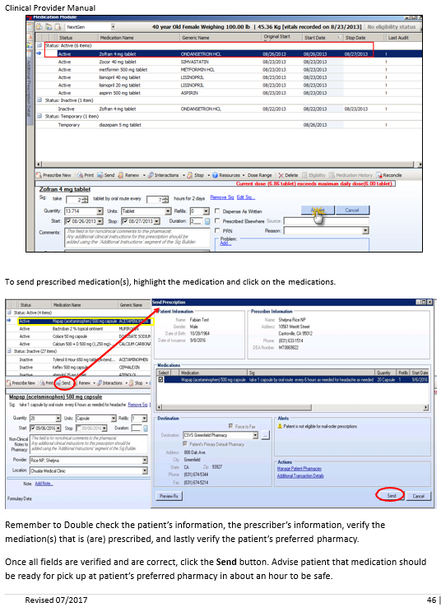
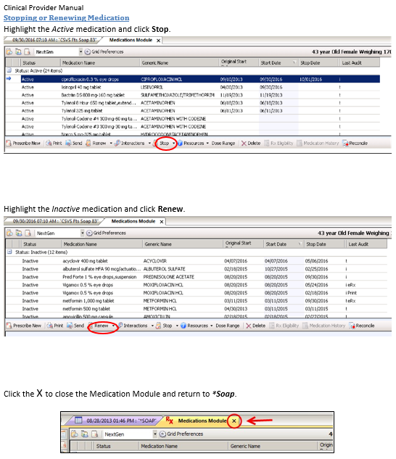

Slide 36
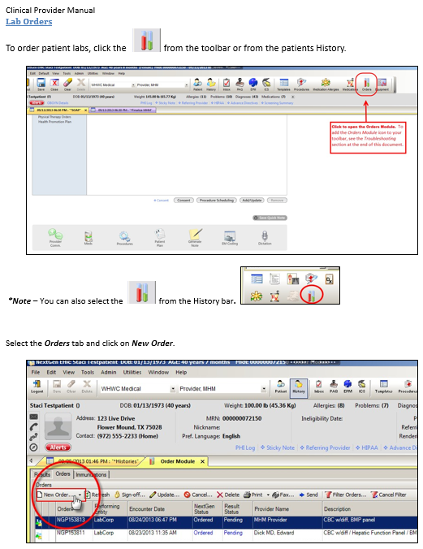


Slide 37



Slide 38



Slide 39



Slide 40



Slide 41



Slide 42



Slide 43



Slide 44



Slide 45



Slide 46



Slide 47



Slide 48

EPIDEMIOLOGICAL SURVEILLANCE
Each clinic that you will be serving reports their own unique data to HRSA and HEDIS to be used to measure the clinical effectiveness of the clinic as a whole and as a part of grant funding to the community health center organizations.

Slide 49





EACH COUNTY HAS THEIR OWN COUNTY PUBLIC HEALTH DEPARTMENT—EXAMPLE BELOW

Slide 50









REPORTABLE COMMUNICABLE
DISEASES

Slide 51
TYPES OF USERS-
PATIENT CLASSIFICATION SYSTEMS
MEDICAL CLASSIFICATIONS
FINANCIAL CLASSIFICATIONS
DEMOGRAPHIC CLASSIFICATIONS

Slide 52
TYPES OF USERS-PATIENT CLASSIFICATION SYSTEMS
Medical classifications include but are not limited to the following:
Acute illness
Chronic illness
Wellness/Preventive
Discipline classified --- pediatric, obstretrical, internal med, etc
Diagnostic related – as documented in the medical record

Slide 53
TYPES OF USERS-PATIENT CLASSIFICATION SYSTEMS
Financial classifications include but are not limited to the following:
Self pay
Commercial Insurance
Medicare
Medi-cal
Other special program

Slide 54
TYPES OF USERS-PATIENT CLASSIFICATION SYSTEMS
Demographic classifications include but are
not limited to the following:
Age
Gender
Marital status
Ethnicity
Sexual preference
Living circumstances
Employment status

Slide 55
COMMITTEES at EACH CLINIC WILL BE SIMILAR, BUT UNIQUE
QUALITY CONTROL—MULTIPLE DIFFERENT COMMITTEES TO REVIEW QUALITY MEASURES, GUIDELINES, OR PROTOCOLS FOR DIFFERENT SERVICE LINES
MEDICAL RECORD MANAGEMENT --- NEXT GEN EMR --- HIPAA COMPLIANCE POLICY --- CALIFORNIA DEPARTMENT OF HEALTH SERVICES REGULATIONS --- IT/COMPUTER SECURITY POLICIES
STAFF SAFETY----example: EMPLOYEE SAFETY INFORMATION FORM This form is for use by employees who wish to provide a safety suggestion or to report an unsafe workplace condition or practice. Turn in completed form to Patient Services Manager.
PATIENT SAFETY----example: The Patient Services Manager (PSM) shall be responsible for maintaining safety standards, developing safety rules, supervising and training staff in departmental standards. The PSM shall be responsible for notifying the Nursing Director in case of any safety hazard. All office staff shall report defective equipment, unsafe conditions, acts or safety hazards to the PSM.

Slide 56
COMPLAINT FILING BY PATIENT
AT COMMUNITY HEALTH CENTERS
To prevent complaint filing by exceeding our patient’s expectations is the best practice—however, if this is not possible it may be an opportunity for improvement, but will be reviewed by the quality assurance department.
Our patients’ most basic expectation is to be treated with courtesy, respect, and compassion.
We are committed to providing the highest quality of service and meeting their needs with utmost care and courtesy. This commitment must be reflected in our behavior as physicians.
Apologize if we do not meet a customer’s expectations. You are not apologizing for an error; you are apologizing for not meeting a patient’s expectations.

Slide 57
NAME ALL THE DIFFERENT WAYS EPIDEMIOLOGICAL SUVEILLANCE IMPROVES POPULATION HEALTH CARE AND MORE!
How does poor attendance adversely impact health care to patients?
Review the basic steps in medical record documentation on next gen from start to finish!
What illnesses or conditions are reportable to the local county public health department?
How is the best way to avoid patients filing complaints?

Slide 58
1. Medical classifications include all of the following except:
Acute illness
Chronic illness
Wellness/Preventive
Discipline classified --- pediatric, obstetrical, internal med, etc
Diagnostic related – as documented in the medical record
Self-Pay status

Slide 59
1. Medical classifications include all of the following except:
Acute illness
Chronic illness
Wellness/Preventive
Discipline classified --- pediatric, obstetrical, internal med, etc
Diagnostic related – as documented in the medical record
Self-Pay status

Slide 60
2. Financial classifications include but are not limited to the following except:
a) Board Members Status
b) Self pay
c) Commercial Insurance
d) Medicare
e) Medi-cal Other special program

Slide 61
2. Financial classifications include but are not limited to the following except:
a) Board Members Status
b) Self pay
c) Commercial Insurance
d) Medicare
e) Medi-cal Other special program

Slide 62
3. Demographic classifications include but are
not limited to the following except for which status:
Age
Gender
Marital status
Ethnicity
Sexual preference
Living circumstances
Employment status
Board Member Status

Slide 63
3. Demographic classifications include but are
not limited to the following:
Age
Gender
Marital status
Ethnicity
Sexual preference
Living circumstances
Employment status
Board Member Status

Slide 64
4. Which of the following statements are the most accurate:
To prevent complaint filing by exceeding our patient’s expectations is the best practice—however, if this is not possible it may be an opportunity for improvement, but will be reviewed by the quality assurance department.
Our patients’ most basic expectation is to be treated with courtesy, respect, and compassion.
We are committed to providing the highest quality of service and meeting their needs with utmost care and courtesy. This commitment must be reflected in our behavior as physicians.
Apologize if we do not meet a customer’s expectations. You are not apologizing for an error; you are apologizing for not meeting a patient’s expectations.
All of the above

Slide 65
4. Which of the following statements are the most accurate:
To prevent complaint filing by exceeding our patient’s expectations is the best practice—however, if this is not possible it may be an opportunity for improvement, but will be reviewed by the quality assurance department.
Our patients’ most basic expectation is to be treated with courtesy, respect, and compassion
We are committed to providing the highest quality of service and meeting their needs with utmost care and courtesy. This commitment must be reflected in our behavior as physicians
Apologize if we do not meet a customer’s expectations. You are not apologizing for an error; you are apologizing for not meeting a patient’s expectations
All of the above

Slide 66
5. How does poor attendance of physicians impact health care to patients:
Negatively impacts access to care
Negatively impacts quality of care
Negatively impacts eliminating health care disparities
All of the above

Slide 67
5. How does poor attendance of physicians impact health care to patients:
Negatively impacts access to care
Negatively impacts quality of care
Negatively impacts eliminating health care disparities
All of the above

