Slide 1

MODULE three : medical administration and service delivery structures in community health settings

Slide 2
MODULE three :
SECTION five:
patient centered
medical home
(PCMH) and Integrated
Care Teams and
Communication

Slide 3

UNIT OBJECTIVES
To understand the PCMH model and learn about PCMH initiatives within community health center settings in CA
To understand the role of providers and other clinical staff on PCMH care teams
To understand the interdisciplinary basis of the PCMH Model and learn effective clinical communication skills for relaying information across different medical fields

Slide 4
patient centered medical home (PCMH) and Integrated Care Teams and Communication
PCMH model
History of medical home
NCQA’s PCMH recognition
Benefits to clinicians, practices, and patients
Payer and medical board support
PCMH Content Expert Certification
PCMH implementation practices
Work flow
Job descriptions
Patient care and referral protocols
The role of administration
PCMH implementation practices
Work flow
Job descriptions
Patient care and referral protocols
The role of administration
Communication skills
Responsibility sharing and problem-solving skills

Slide 5
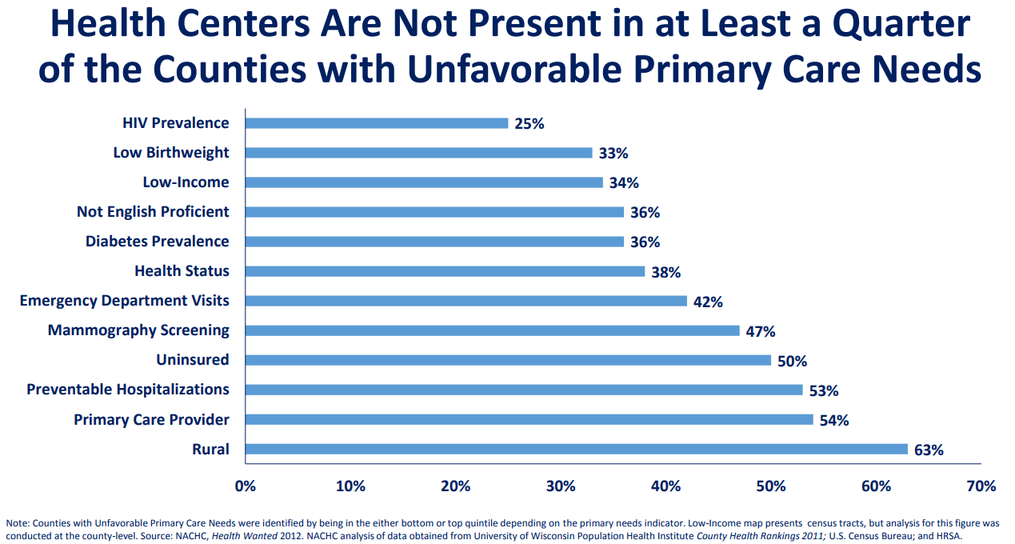
Example in another area of the country

Slide 6
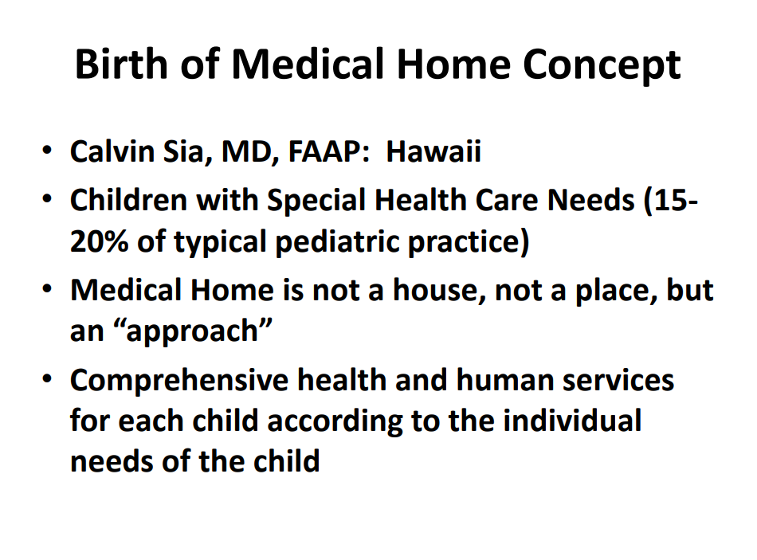

Slide 7
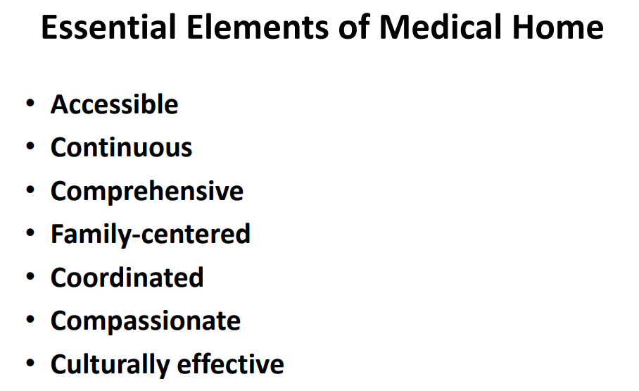

Slide 8
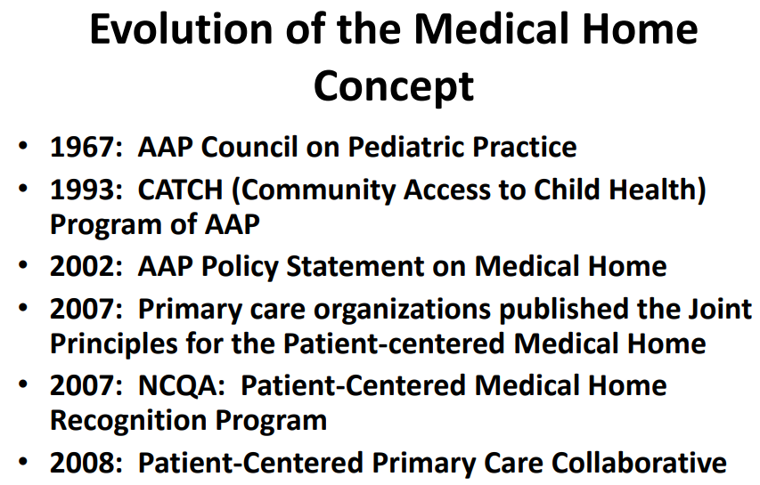

Slide 9
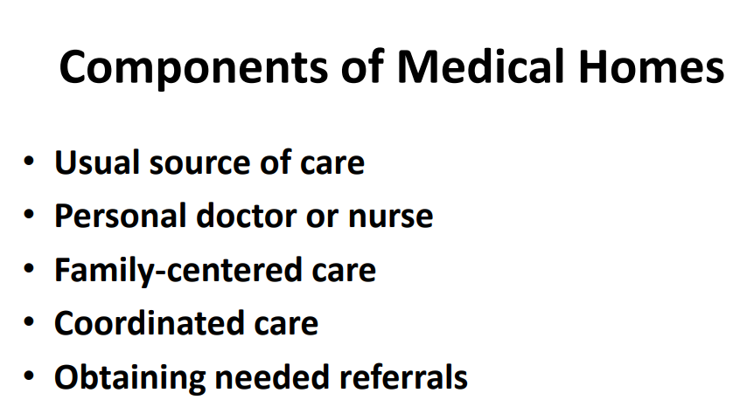

Slide 10
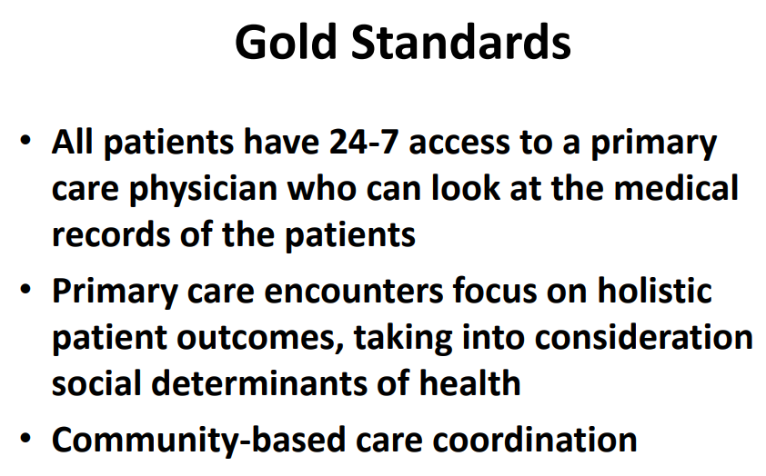

Slide 11
Defining the PCMH
The medical home model holds promise as a way to improve health care in America by transforming how primary care is organized and delivered.
Building on the work of a large and growing community, the Agency for Healthcare Research and Quality (AHRQ) defines a medical home not simply as a place but as a model of the organization of primary care that delivers the core functions of primary health care.

Slide 12
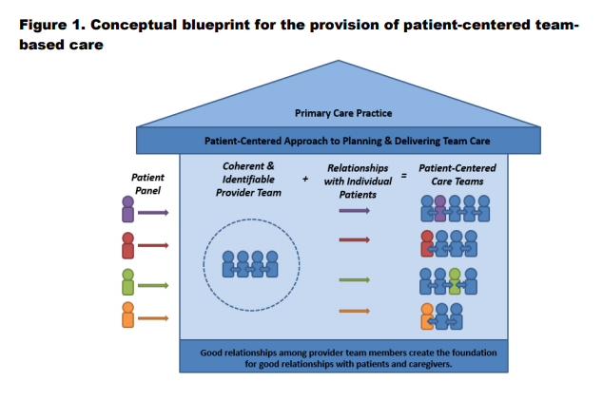

Slide 13
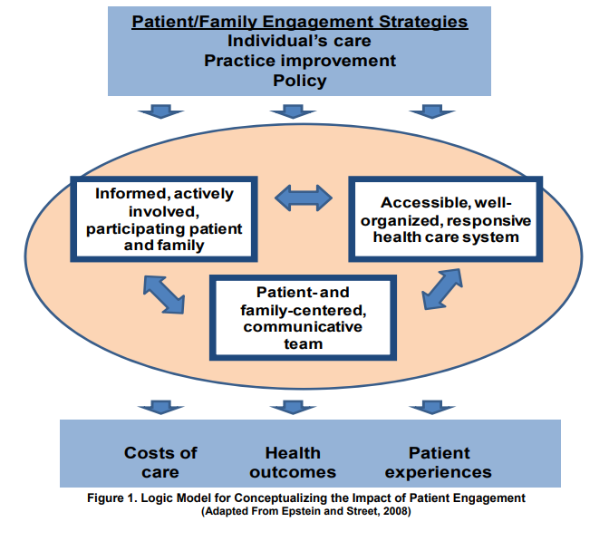

Slide 14
Defining the PCMH
1. Comprehensive Care
2. Patient-Centered
3. Coordinated Care
4. Accessible Services
5. Quality and Safety

Slide 15
Comprehensive Care
  A patient-centered medical home meets a patient's needs along the entire
  healthcare spectrum, from wellness services to acute and chronic care.
  Patients are treated holistically rather than one condition at a time

Slide 16
Patient-Centered Care
At the heart of a PCMH is a strong relationship between the healthcare provider, the patient, and the patient's family.
This provides a better understanding of the patient's health, as well as his or her unique needs and preferences

Slide 17
Coordinated Care
As patients move through various stages of care—for example, from hospital to home—their needs are met through coordination of family members and multiple healthcare providers.
In order to achieve this level of coordination, a patient-centered medical home supports clear and open communication between each involved party.

Slide 18
Accessible Services
Patients have needs outside of the standard 9–5 workday. In order to provide around-the-clock care, the patient-centered medical home relies on electronic or telephone access to members of the care team at any time of the day.
Patients can choose the communication style that best fits their needs and preferences

Slide 19
Quality and Safety
By making data-driven decisions about care, a PCMH can make a commitment to quality care that improves over time.
Taking into account patient and family experiences and satisfaction increases the quality and safety of care

Slide 20
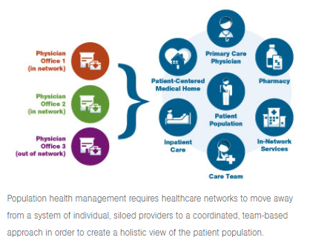

Slide 21
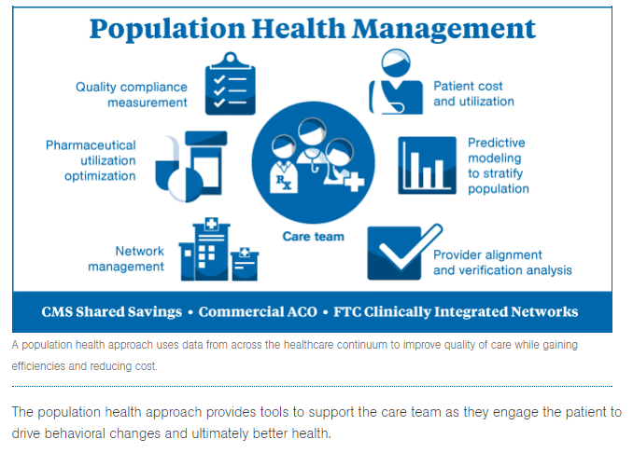

Slide 22
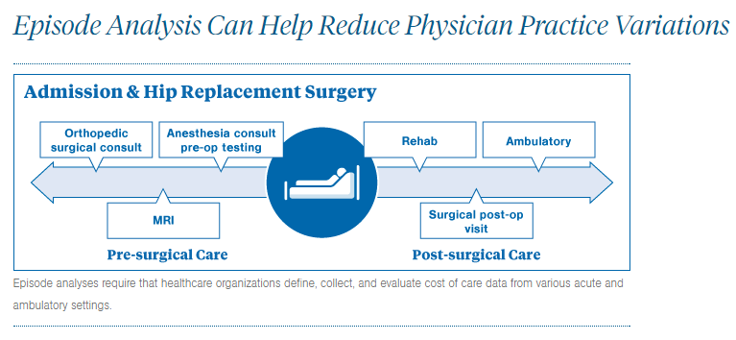

Slide 23
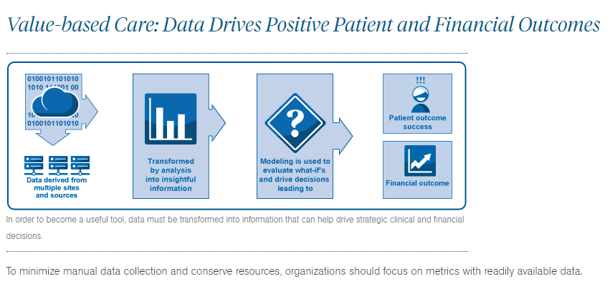

Slide 24
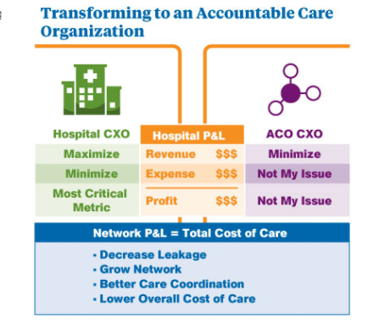

Slide 25
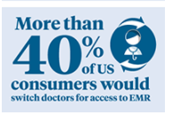
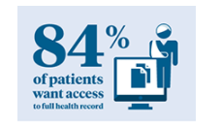
Creating a Patient Engagement Strategy
Building a Solid Patient Engagement Technology Strategy

Slide 26
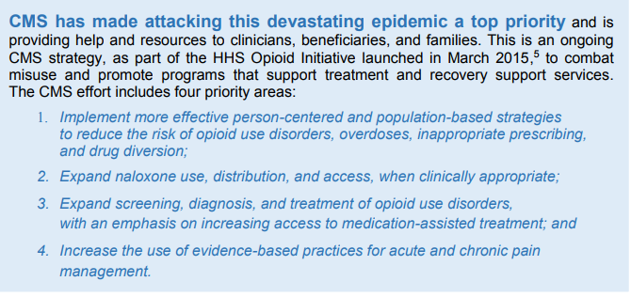

Slide 27
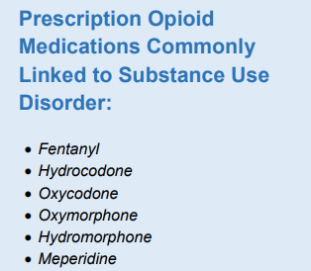

Slide 28
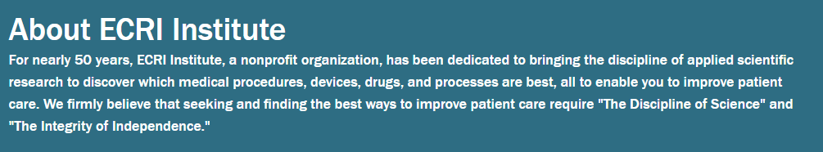

Emergency care research institute “ecri”
ECRI Institute has been designated as an Evidence-based Practice Center (EPC) with the U.S. Agency for Healthcare Research and Quality (AHRQ) since 1997. As an EPC, ECRI Institute has undertaken systematic reviews of clinical procedures using met analysis for the Medicare program, other federal and state agencies and clinical specialty organizations.
ECRI Institute Patient Safety Organization (PSO) is listed as a federal patient safety organization by the U.S. Department of Health and Human Services under the Patient Safety and Quality Improvement Act of 2005.
ECRI Institute entered into a licensing agreement to adapt the Pennsylvania Patient Safety Reporting System (PA-PSRS), to meet Pennsylvania-specific reporting requirements. The resulting PA-PSRS system is fully owned by the Pennsylvania Patient Safety Authority. The Pennsylvania Patient Safety Authority board voted unanimously to accept the proposal to fund the ECRI Institute contract through June 2019.

Slide 29

About ECRI Institute
For nearly 50 years, ECRI Institute's work in patient safety, adverse event reporting and analysis, and development of recommendations has improved patient care at hospitals and other providers around the world. ECRI Institute PSO is a component of ECRI Institute, a nonprofit 501(c)(3) organization dedicated to improving the safety, quality, and cost-effectiveness of patient care. ECRI Institute PSO has experience analyzing over 1.6 million adverse events and near misses. ECRI Institute has a long history of investigating events and publishing authoritative risk reduction strategies. ECRI Institute is designated as an Evidence-based Practice Center by the U.S. Agency for Healthcare Research and Quality.
PLYMOUTH MEETING, PA—The opioid epidemic is clearly one of the top public health concerns in the country. Rarely, though, do news stories address the safety risks from opioids used by patients in hospitals. Despite the focus on appropriate use of opioids for pain management, many hospitals continue to see adverse events in which patients are injured by unintentional overdoses.
Now, a more detailed picture of the risks related to opioid use in acute care is emerging, based on in-depth analysis of 7,218 events reported to ECRI Institute Patient Safety Organization (PSO).

Slide 30
ECRI OUTPATIENT RECOMMENDATIONS
Expand the use of best practices for evidenced-based pain management
Encourage the use of non-pharmacologic therapies, non-opioid pharmaceuticals, and multi-modal analgesia (MMA) as first options for pain management

Slide 31
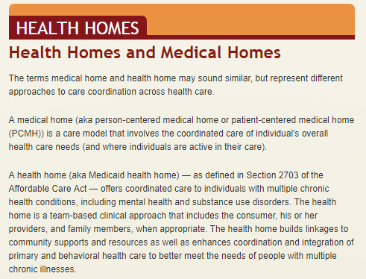

Slide 32
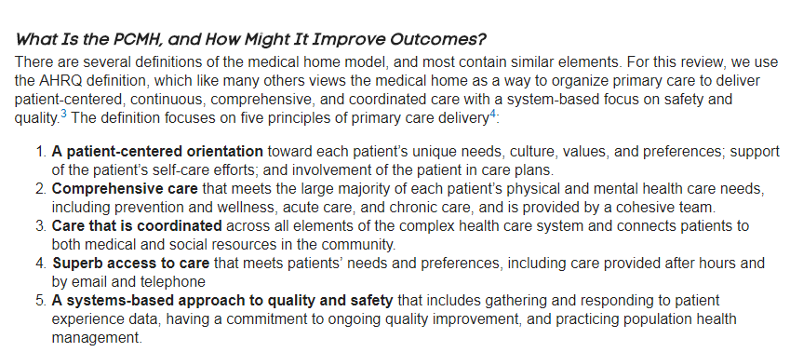

Slide 33
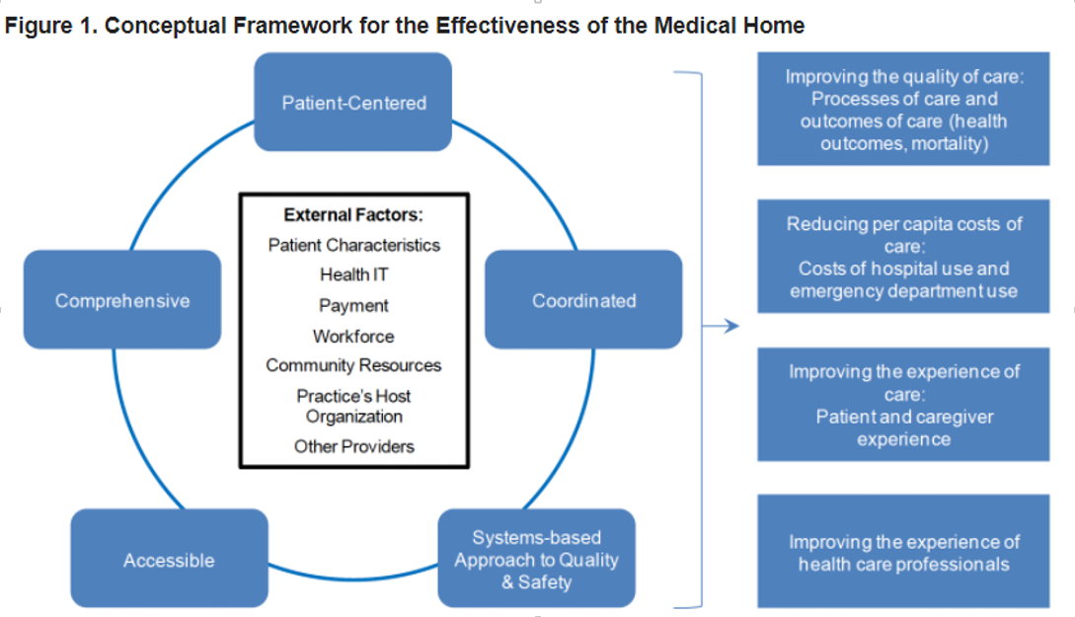

Slide 34
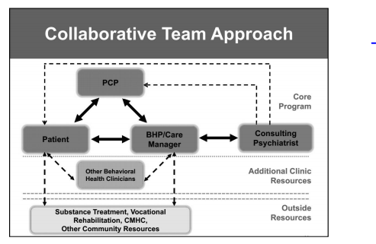

Slide 35
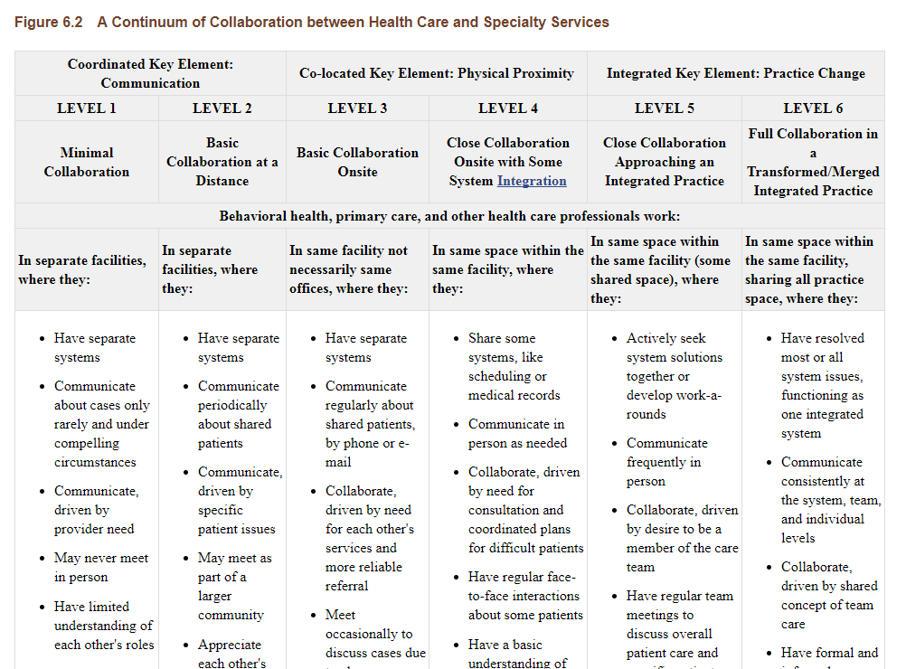

Slide 36

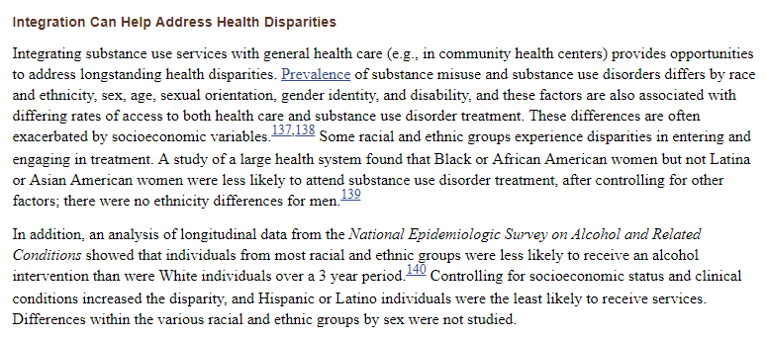

Slide 37
Patient centered medical home
Introduction
The Patient-Centered Medical Home (PC-MH) is an approach to providing comprehensive primary care for children, youth and adults. The PC-MH is a health care setting that facilitates partnerships between individual patients, and their personal physicians, and when appropriate, the patient’s family. The AAP, AAFP, ACP, and AOA, representing approximately 333,000 physicians, have developed the following joint principles to describe the characteristics of the PC-MH.

Slide 38
Patient centered medical home
Principles
Personal physician - each patient has an ongoing relationship with a personal physician trained to provide first contact, continuous and comprehensive care.
Physician directed medical practice – the personal physician leads a team of individuals at the practice level who collectively take responsibility for the ongoing care of patients.
Whole person orientation – the personal physician is responsible for providing for all the patient’s health care needs or taking responsibility for appropriately arranging care with other qualified professionals. This includes care for all stages of life; acute care; chronic care; preventive services; and end of life care.
Care is coordinated and/or integrated across all elements of the complex health care system (e.g., subspecialty care, hospitals, home health agencies, nursing homes) and the patient’s community (e.g., family, public and private community based services). Care is facilitated by registries, information technology, health information exchange and other means to assure that patients get the indicated care when and where they need and want it in a culturally and linguistically appropriate manner.

Slide 39
Patient centered medical home
Quality and safety are hallmarks of the medical home:
Practices advocate for their patients to support the attainment of optimal, patient-centered outcomes that are defined by a car planning process driven by a compassionate, robust partnership between physicians, patients, and the patient’s family.
Evidence-based medicine and clinical decision-support tools guide decision making.
Physicians in the practice accept accountability for continuous quality improvement through voluntary engagement in performance measurement and improvement.
Patients actively participate in decision-making and feedback is sought to ensure patients’ expectations are being met.
Information technology is utilized appropriately to support optimal patient care, performance measurement, patient education, and enhanced communication.
Practices go through a voluntary recognition process by an appropriate non-governmental entity to demonstrate that they have the capabilities to provide patient centered services consistent with the medical home model.
Patients and families participate in quality improvement activities at the practice level.

Slide 40
Patient centered medical home
Enhanced access to care is available through systems such as open scheduling, expanded hours and new options for communication between patients, their personal physician, and practice staff.

Slide 41
Patient centered medical home
Payment appropriately recognizes the added value provided to patients who have a patient-centered medical home. The payment structure should be based on the following framework:
It should reflect the value of physician and non-physician staff patient-centered care management work that falls outside of the face-to-face visit.
It should pay for services associated with coordination of care both within a given practice and between consultants, ancillary providers, and community resources.
It should support adoption and use of health information technology for quality improvement.
It should support provision of enhanced communication access such as secure e-mail and telephone consultation.
It should recognize the value of physician work associated with remote monitoring of clinical data using technology.
It should allow for separate fee-for-service payments for face-to face visits. (Payments for care management services that fall outside of the face-to-face visit, as described above, should not result in a reduction in the payments for face-to-face visits).
It should recognize case mix differences in the patient population being treated within the practice. It should allow physicians to share in savings from reduced hospitalizations associated with physician-guided care management in the office setting.
It should allow for additional payments for achieving measurable and continuous quality improvements.

Slide 42
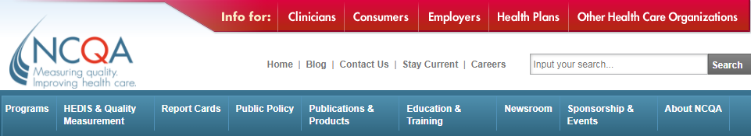
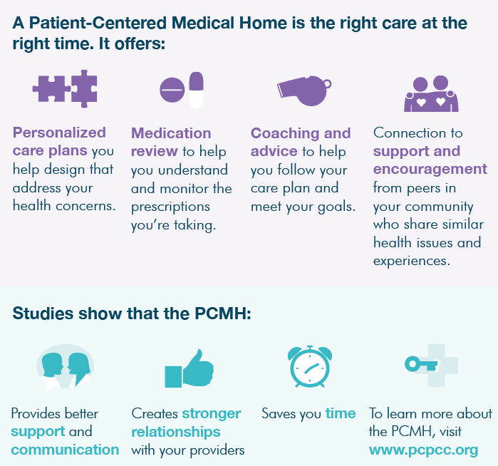
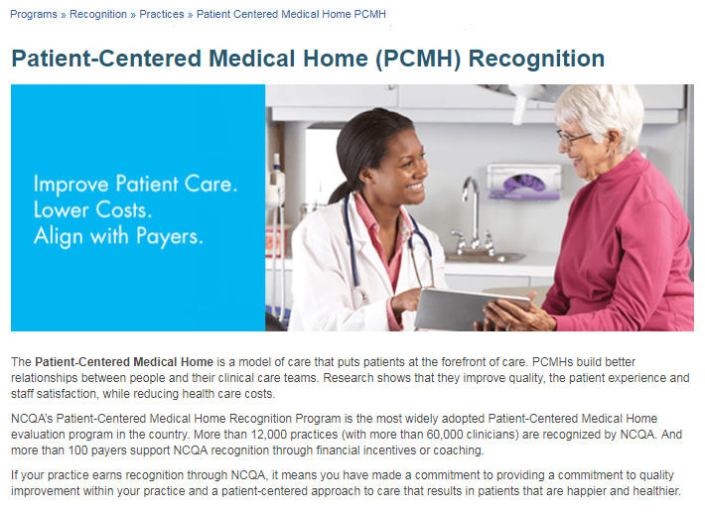
Patient centered medical home

Slide 43
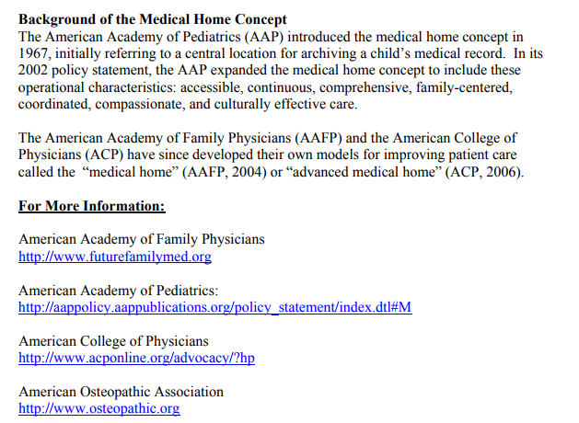
Patient centered medical home

Slide 44
1. Controlling for socioeconomic status and clinical conditions increased the disparity, and Hispanic or Latino individuals were the least likely to health care receive services
True
False

Slide 45
1. Controlling for socioeconomic status and clinical conditions increased the disparity, and Hispanic or Latino individuals were the least likely to health care receive services
True
False

Slide 46
2. The medical home holds promise as a way to improve health care in America by transforming how primary care is organized and delivered
True
False

Slide 47
2. The medical home holds promise as a way to improve health care in America by transforming how primary care is organized and delivered
True
False

Slide 48
3. The Patient Centered Medical Home has the following components except for the following:
Comprehensive Care
Patient-Centered
Coordinated Care
Accessible Services
Quality and Safety
Electronic Medical Records not required

Slide 49
3. The Patient Centered Medical Home has the following components except for the following:
Comprehensive Care
Patient-Centered
Coordinated Care
Accessible Services
Quality and Safety
Electronic Medical Records not required

Slide 50
4. CMS has made attacking this devastating epidemic a top priority and is providing help and resources to clinicians, beneficiaries, and families. This is an ongoing CMS strategy, as part of the HHS Opioid Initiative launched in March 2015, to combat misuse and promote programs that support treatment and recovery support services . The CMS effort includes four priority areas except for which of the following?
Continue use of opiates for treatment plan
Implement more effective person-centered and population-based strategies to reduce the risk of opioid use disorders, overdoses, inappropriate prescribing, and drug diversion
Expand naloxone use, distribution, and access, when clinically appropriate
Expand screening, diagnosis, and treatment of opioid use disorders, with an emphasis on increasing access to medication-assisted treatment
Increase the use of evidence based practices for acute and chronic pain management

Slide 51
4. CMS has made attacking this devastating epidemic a top priority and is providing help and resources to clinicians, beneficiaries, and families. This is an ongoing CMS strategy, as part of the HHS Opioid Initiative launched in March 2015, to combat misuse and promote programs that support treatment and recovery support services . The CMS effort includes four priority areas except for which of the following?
Continue use of opiates for treatment plan
Implement more effective person-centered and population-based strategies to reduce the risk of opioid use disorders, overdoses, inappropriate prescribing, and drug diversion
Expand naloxone use, distribution, and access, when clinically appropriate
Expand screening, diagnosis, and treatment of opioid use disorders, with an emphasis on increasing access to medication-assisted treatment
Increase the use of evidence based practices for acute and chronic pain management

Slide 52
5. Agency for Healthcare Research and Quality (AHRQ) defines a medical home not simply as a place but as a model of the organization of primary care that delivers the core functions of primary health care.
True
False

Slide 53
5. Agency for Healthcare Research and Quality (AHRQ) defines a medical home not simply as a place but as a model of the organization of primary care that delivers the core functions of primary health care.
True
False

