Slide 1

MODULE three:
MEDICAL ADMINISTRATION
AND SERVICE DELIVERY
STRUCTURES IN COMMUNITY
HEALTH SETTINGS

Slide 2
MODULE three:
SECTION eight:
Risk Management,
federal torts claims
act, and professional
liabilty

Slide 3

UNIT OBJECTIVES
To understand systems in place to identify and analyze potential hazards
To increase knowledge of key points of the FTCA and its relation to roles/responsibilities of Electronic Health Care Record

Slide 4
Risk Management, federal tort claims act, and professional liability
Claims management
Complaint resolution
Confidentiality and release of info
Reporting and management of adverse events
Benefits of FTCA coverage
Services covered under FTCA

Slide 5
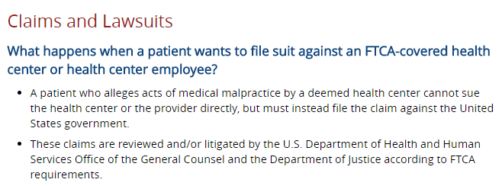
FTCA

Slide 6
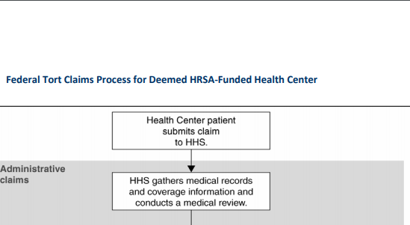
FTCA

Slide 7
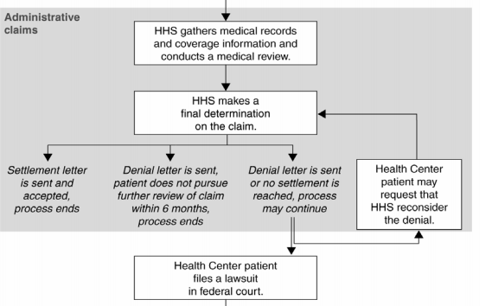

Slide 8
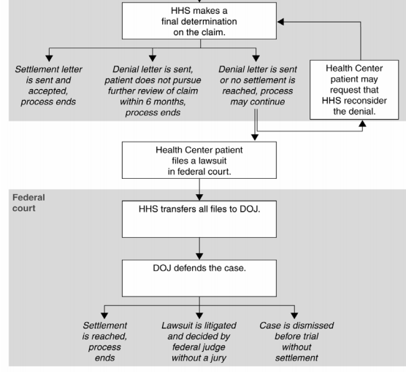

Slide 9
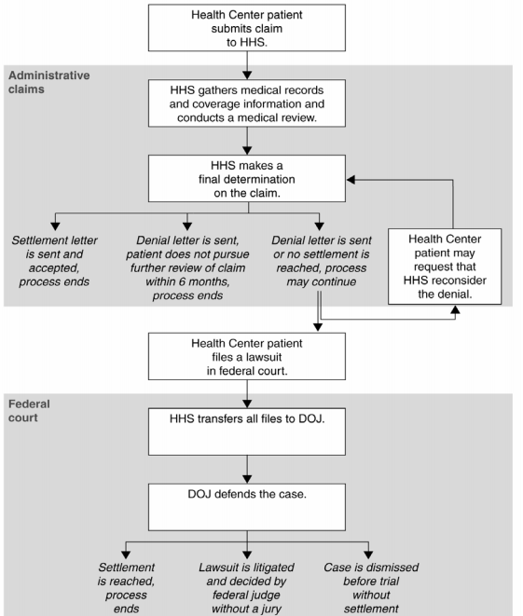
PROCESS IF LAW SUIT FILED UNDER FTCA

Slide 10
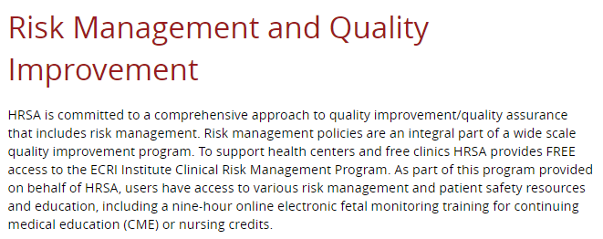
Emergency Care Research Institute
CLINICAL RISK MANAGEMENT PROGRAM
Emergency Care Research Institute

Slide 11
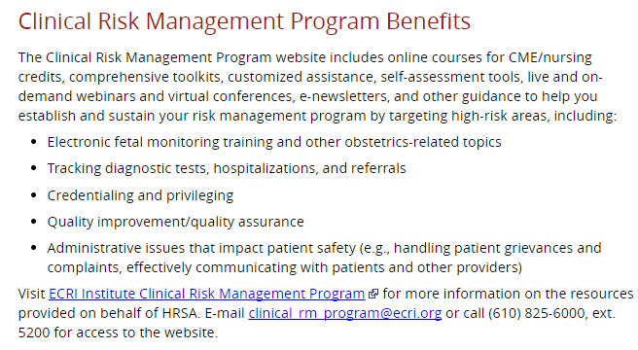
Emergency Care Research Institute

Slide 12
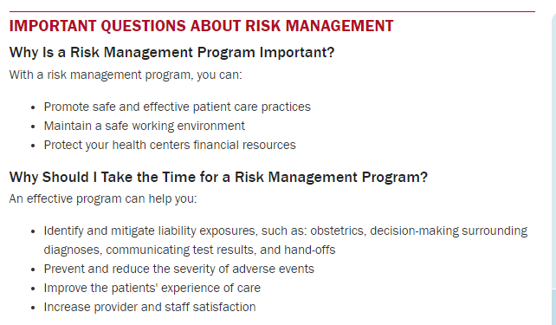
Emergency Care Research Institute

Slide 13

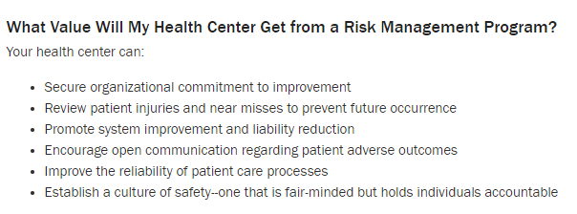
Emergency Care Research Institute

Slide 14

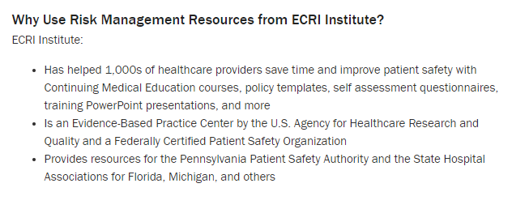
Emergency Care Research Institute

Slide 15
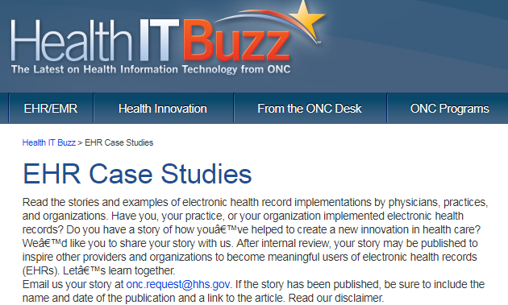
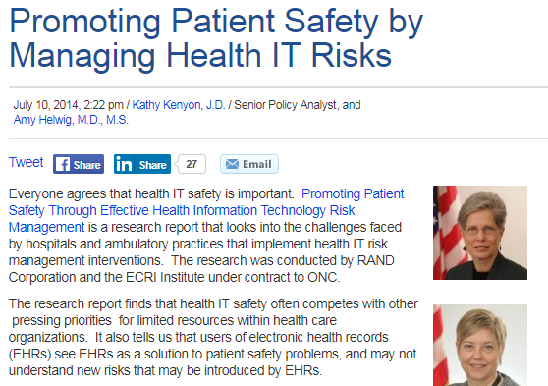
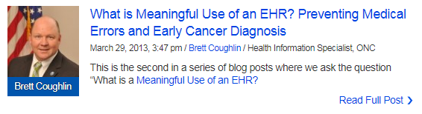
Electronic health records to reduce medical legal risks

Slide 16
1. What happens when a patient wants to file suit against an FTCA-covered health center employee? All of the following options are appropriate except for which of the following?
A patient who alleges acts of medical malpractice by a deemed health center cannot sue the health center or the provider directly, but must instead file the claim against the United States Government.
These claims are reviewed and/or litigated by the US Department of Justice according to FTCA requirements
Immediate settlement is issued by HRSA

Slide 17
1. What happens when a patient wants to file suit against an FTCA-covered health center employee? All of the following options are appropriate except for which of the following?
A patient who alleges acts of medical malpractice by a deemed health center cannot sue the health center or the provider directly, but must instead file the claim against the United States Government.
These claims are reviewed and/or litigated by the US Department of Justice according to FTCA requirements
Immediate settlement is issued by HRSA

Slide 18
2. HRSA is committed to a comprehensive approach to quality improvement/quality assurance that includes risk management. To support health centers and free clinics HRSA provides FREE access to the ECRI Institute Clinical Risk Management Program. As part of this program provided on behalf of HRSA, users have access to various risk management and patient safety recourses and education, including a nine-hour online electronic fetal monitoring training for continuing medical education (CME).
True
False

Slide 19
2. HRSA is committed to a comprehensive approach to quality improvement/quality assurance that includes risk management. To support health centers and free clinics HRSA provides FREE access to the ECRI Institute Clinical Risk Management Program. As part of this program provided on behalf of HRSA, users have access to various risk management and patient safety recourses and education, including a nine-hour online electronic fetal monitoring training for continuing medical education (CME).
True
False

Slide 20
3. Why should I take the time for a Risk Management Program? An effective program can help you in all of the following ways except for which response?
Identify and mitigate liability exposures, such as: obstetrics, decision-making surrounding diagnosis, communicating test results, and hand offs
Prevent and reduce the severity of adverse events
Improve the patients experience of care
Increase provider and staff satisfaction
Absolutely protect you from any legal actions

Slide 21
3. Why should I take the time for a Risk Management Program? An effective program can help you in all of the following ways except for which response?
Identify and mitigate liability exposures, such as: obstetrics, decision-making surrounding diagnosis, communicating test results, and hand offs
Prevent and reduce the severity of adverse events
Improve the patients experience of care
Increase provider and staff satisfaction
Absolutely protect you from any legal actions

Slide 22
4. What value will my health center get from a Risk Management Program?
Your health center can obtain all of the following benefits except for which response?
Protect the physician from all allegations against them
Secure organizational commitment to improvement
Review patient injuries and near misses to prevent future occurrence
Promote system improvement and liability reduction
Encourage open communication regarding patient adverse outcomes
Improve the reliability of patient care processes
Establish a culture of safety-one that is fair minded but holds individuals accountable

Slide 23
4. What value will my health center get from a Risk Management Program?
Your health center can obtain all of the following benefits except for which response?
Protect the physician from all allegations against them
Secure organizational commitment to improvement
Review patient injuries and near misses to prevent future occurrence
Promote system improvement and liability reduction
Encourage open communication regarding patient adverse outcomes
Improve the reliability of patient care processes
Establish a culture of safety-one that is fair minded but holds individuals accountable

Slide 24
5. Why use risk management resources from ECRI Institute?
The following list a number of reasonable responses except for which of the following?
Has helped 1,000s of healthcare providers save time and improve patient safety with continuing medical education courses, policy templates, self assessment questionnaires training Power Point presentations, and more
Is an evidence-based practice center by the U.S. agency for healthcare research and quality and a federally certified patient safety organization
Provides resources for the patient safety authority and the State Hospital associations, and others
Will make the physician immune from lawsuits

Slide 25
5. Why use risk management resources from ECRI Institute?
The following list a number of reasonable responses except for which of the following?
Has helped 1,000s of healthcare providers save time and improve patient safety with continuing medical education courses, policy templates, self assessment questionnaires training Power Point presentations, and more
Is an evidence-based practice center by the U.S. agency for healthcare research and quality and a federally certified patient safety organization
Provides resources for the patient safety authority and the State Hospital associations, and others
Will make the physician immune from lawsuits

