Slide 1

MODULE four:
MEDICAL PROTOCOLS
AND
QUALITY ASSURANCE

Slide 2
MODULE four:
SECTION one:
levels of care

Slide 3

UNIT OBJECTIVE
To review the levels of complexity in health care units, as well as the mechanism of referrals to medical clinics contracted within the institutional system

Slide 4
levels of care
Primary, secondary and tertiary care
Preventive care
Primary care clinics
Secondary level hospitals and specialty clinics
Tertiary referral hospitals
Mobile units

Slide 5
Primary Care
In defining primary care, it is necessary to describe the nature of services provided to patients, as well as to identify who are the primary care providers.
The domain of primary care includes the primary care physician, other physicians who include some primary care services in their practices, and some non-physician providers.
However, central to the concept of primary care is the patient. Therefore, such definitions are incomplete without including a description of the primary care practice.

Slide 6
Definition #1 - Primary Care
Primary care is that care provided by physicians specifically trained for and skilled in comprehensive first contact and continuing care for persons with any undiagnosed sign, symptom, or health concern (the "undifferentiated" patient) not limited by problem origin (biological, behavioral, or social), organ system, or diagnosis.

Slide 7
Definition #1 - Primary Care
Primary care includes health promotion, disease prevention, health maintenance, counseling, patient education, diagnosis and treatment of acute and chronic illnesses in a variety of health care settings (e.g., office, inpatient, critical care, long-term care, home care, day care, etc.).
Primary care is performed and managed by a personal physician often collaborating with other health professionals, and utilizing consultation or referral as appropriate.
Primary care provides patient advocacy in the health care system to accomplish cost-effective care by coordination of health care services. Primary care promotes effective communication with patients and encourages the role of the patient as a partner in health care.

Slide 8
Definition #2 - Primary Care Practice
A primary care practice serves as the patient's first point of entry into the health care system and as the continuing focal point for all needed health care services.
Primary care practices provide patients with ready access to their own personal physician, or to an established back-up physician when the primary physician is not available.

Slide 9
Definition #2 - Primary Care Practice
Primary care practices provide health promotion, disease prevention, health maintenance, counseling, patient education, diagnosis and treatment of acute and chronic illnesses in a variety of health care settings (e.g., office, inpatient, critical care, long-term care, home care, day care, etc.).

Slide 10
Definition #2 - Primary Care Practice
Primary care practices are organized to meet the needs of patients with undifferentiated problems, with the vast majority of patient concerns and needs being cared for in the primary care practice itself.
Primary care practices are generally located in the community of the patients, thereby facilitating access to health care while maintaining a wide variety of specialty and institutional consultative and referral relationships for specific care needs.
The structure of the primary care practice may include a team of physicians and non-physician health professionals.

Slide 11
Definition #3 - Primary Care Physician
A primary care physician is a specialist in Family Medicine, Internal Medicine or Pediatrics who provides definitive care to the undifferentiated patient at the point of first contact, and takes continuing responsibility for providing the patient's comprehensive care.
This care may include chronic, preventive and acute care in both inpatient and outpatient settings.
Such a physician must be specifically trained to provide comprehensive primary care services through training in acute and chronic care settings.

Slide 12
Definition #3 - Primary Care Physician
Primary care physicians devote the majority of their practice to providing primary care services to a defined population of patients.
The style of primary care practice is such that the personal primary care physician serves as the entry point for substantially all of the patient's medical and health care needs - not limited by problem origin, organ system, or diagnosis.
Primary care physicians are advocates for the patient in coordinating the use of the entire health care system to benefit the patient.

Slide 13
Definition #4 - Non-Primary Care Physicians Providing Primary Care Services
Physicians who are not trained in the primary care specialties of family medicine, general internal medicine, or general pediatrics may sometimes provide patient care services that are usually delivered by primary care physicians.
These physicians may focus on specific patient care needs related to prevention, health maintenance, acute care, chronic care or rehabilitation.
These physicians, however, do not offer these services within the context of comprehensive, first contact and continuing care.

Slide 14
What is preventive care?
Preventive care includes health services like screenings, check-ups, and patient counseling that are used to prevent illnesses, disease, and other health problems, or to detect illness at an early stage when treatment is likely to work best.
Getting recommended preventive services and making healthy lifestyle choices are key steps to good health and well-being.

Slide 15
Definition #4 - Non-Primary Care Physicians Providing Primary Care Services
The contributions of physicians who deliver some services usually found within the scope of primary care practice may be important to specific patient needs.
However, the absence of a full scope of training in primary care requires that these individuals work in close consultation with fully-trained, primary care physicians.
An effective system of primary care may utilize these physicians as members of the health care team with a primary care physician maintaining responsibility for the function of the health care team and the comprehensive, ongoing health care of the patient.

Slide 16
Definition #5 - Non-Physician Primary Care Providers
There are providers of health care other than physicians who render some primary care services.
Such providers may include nurse practitioners, physician assistants and some other health care providers.
These providers of primary care may meet the needs of specific patients.
They should provide these services in collaborative teams in which the ultimate responsibility for the patient resides with the primary care physician.

Slide 17
Use of Term
The AAFP recognizes the term "primary care" and that family physicians provide services commonly recognized as primary care. However, the terms, "primary care" and "family medicine" are not interchangeable.
"Primary care" does not fully describe the activities of family physicians nor the practice of family medicine.
Similarly, primary care departments do not replace the form or function of family medicine departments.

Slide 18
WHAT DOES PRIMARY CARE ENTAIL?
WHAT TYPES OF PATIENT CARE SERVICES DOES PRIMARY CARE INVOLVE?
WHAT IS PREVENTIVE CARE?
CAN SPECIALITY CARE PHYSICIANS PROVIDE PRIMARY CARE?
HOW MANY DIFFERENT TYPES OF PHYSICIANS ARE CONSIDERED PRIMARY CARE PHYSICIANS?
WHAT IS PRIMARY CARE PRACTICE?

Slide 19
Secondary Care Specialists
PATIENT PERSPECTIVE
When your primary care provider refers you to a specialist, you are then in "secondary care."
Secondary care simply means you will be taken care of by someone who has more specific expertise in what is ailing you.
Specialists focus either on a specific system of the body or on a specific disease or condition.

Slide 20
Secondary Care Specialists
PATIENT PERSPECTIVE
For example, cardiologists focus on the heart and its pumping system.
Endocrinologists focus on hormone systems and some specialize in diseases like diabetes or thyroid disease.
Oncologists have a specialty in treating cancers and many focus on a specific type of cancer.

Slide 21
Secondary Care Specialists
PATIENT PERSPECTIVE
There are times when problems with specialty care develop. One reason may be that you have been referred to the wrong kind of specialist. For example, your initial symptoms may indicate one thing when in reality it is another condition that requires a different specialist.
You may also experience problems while seeing more than one specialist if each is treating a different condition. In these cases, your care may not be fully coordinated. The specialists should work with your primary care health team to ensure everyone knows what the other is recommending.

Slide 22
WHAT IS A SECONDARY CARE SPECIALIST?
HOW DO THEY RELATE TO A PRIMARY CARE SPECIALIST IN THE CARE OF A PATIENT?
WHO SHOULD COORDINATE THE CARE OF MULTIPLE SPECIALISTS?
HOW IMPORTANT IS COMMUNICATION IN COORDINATING CARE?

Slide 23
Tertiary Care and Hospitalization
Once a patient is hospitalized and needs a higher level of specialty care within the hospital, he may be referred to "tertiary care." Tertiary care requires highly specialized equipment and expertise.
At this level, you will find procedures such as coronary artery bypass surgery, renal or hemodialysis, and some plastic surgeries or neurosurgeries. It also includes severe burn treatments and any other very complex treatments or procedures.
A small, local hospital may not be able to provide these services, so you may need to be transferred to a medical center that provides highly specialized tertiary level services.

Slide 24
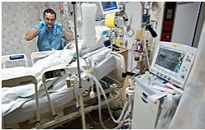
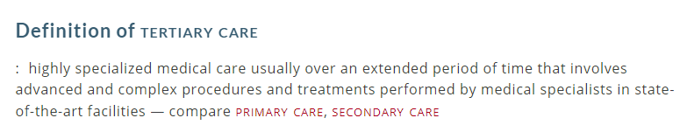
Tertiary care
Once a patient is hospitalized, they may require highly specialized treatment and care within the hospital. Tertiary care requires professionals, usually surgeons, with specific expertise in a given field, to carry out investigation and treatment for the patient. Examples include neurosurgery, cardiac surgery and cancer management.

Slide 25
Quaternary Care
Quaternary care is considered to be an extension of tertiary care. It is even more specialized and highly unusual. Because it is so specific, not every hospital or medical center offers quaternary care.
Some may only offer quaternary care for particular medical conditions or systems of the body.
The types of care that might be considered to be quaternary would be experimental medicine and procedures as well as highly uncommon and specialized surgeries.

Slide 26
WHAT IS TERTIARY CARE AND HOSPITALIZATION?
GIVE EXAMPLES OF TERTIARY CARE?
GIVE EXAMPLES OF DIFFERENT SITES FOR TERTIARY CARE?
HOW DOES TERTIARY CARE DIFFER FROM QUATERNARY CARE?

Slide 27
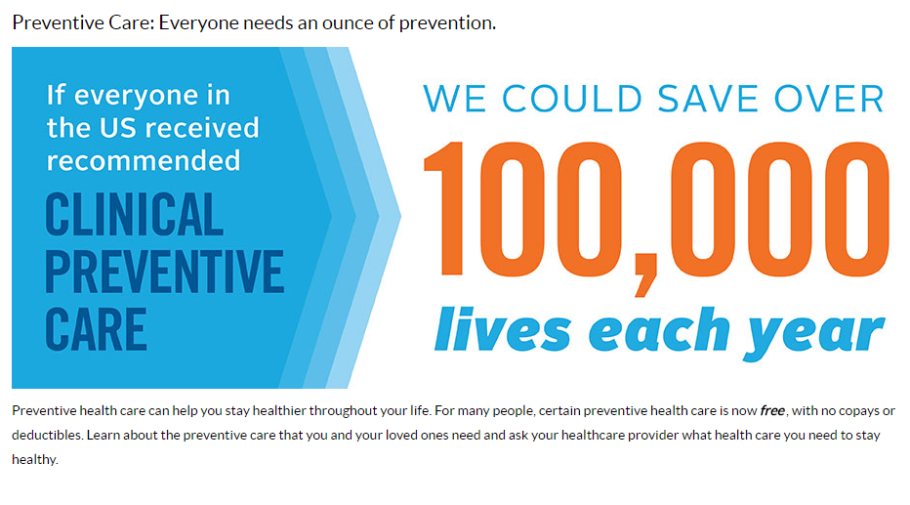

Slide 28

PREVENTIVE MEDICAL CARE
SIMPLE VITAL SIGNS AND LABORATORY TESTING

Slide 29

SCREENING MEASURES FOR EARLY
DETECTION OF CANCER

Slide 30
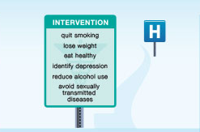
HEALTHY LIVING AND RISK
REDUCTION STRATEGIES
EAT SALAD

Slide 31

HEALTHY LIVING AND RISK
REDUCTION STRATEGIES

Slide 32
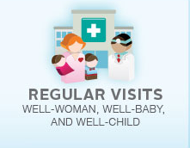
PREVENTIVE CARE FOR
CHILDREN AND WOMEN

Slide 33

QUALITY PRENATAL CARE TO OPTIMIZE
THE OUTCOME FOR MOTHER AND NEWBORN

Slide 34
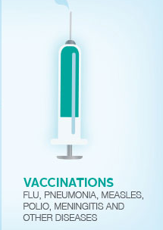

ALL AGES NEWBORN
THROUGH
GERIATRIC
PREVENTIVE
MEDICINE
THROUGH
VACCINATIONS
OF ALL AGES

Slide 35
Preventive care benefits for adults
All Marketplace health plans and many other plans must cover the previous preventive services without charging the patient a copayment or coinsurance. This is true even if they haven’t met their yearly deductible.

Slide 36
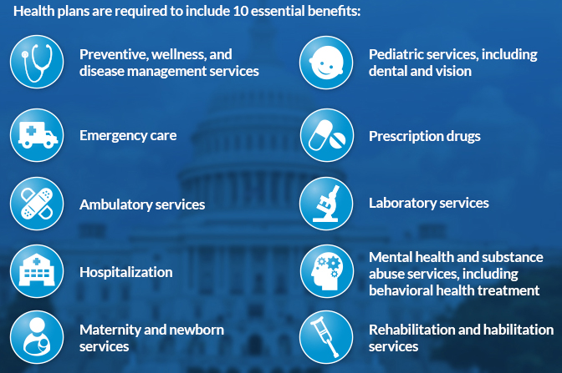

Slide 37
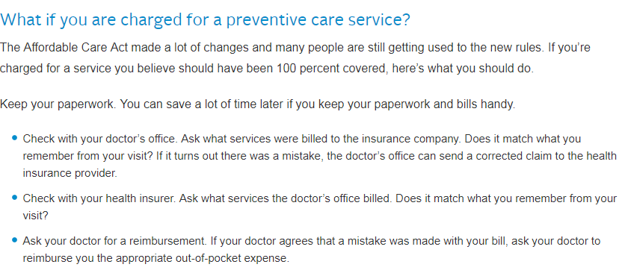
PATIENT PERSPECTIVE ON PREVENTIVE CARE

Slide 38
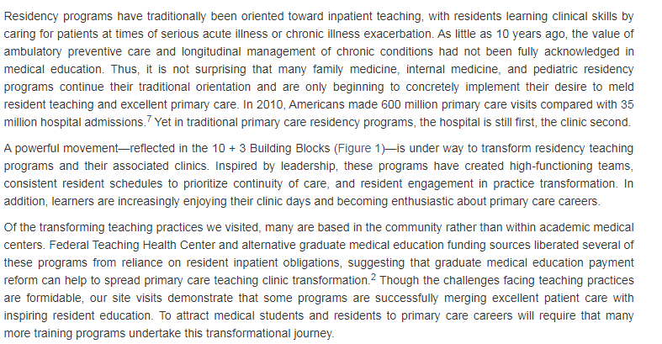

Slide 39

DECREASING BARRIERS TO CARE

Slide 40
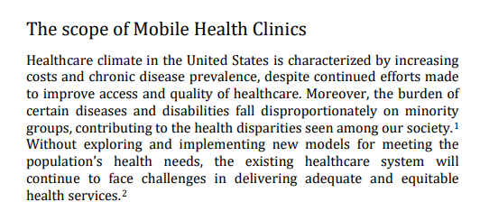
IMPROVING ACCESS TO QUALITY CARE AND
REDUCING HEALTH CARE DISPARITIES

Slide 41
1. Primary Care entails all of the following except for which phrase below?
Health promotion
Disease prevention
Health maintenance
Counseling
Patient education
Radiation oncology treatment

Slide 42
1. Primary Care entails all of the following except for which phrase below?
Health promotion
Disease prevention
Health maintenance
Counseling
Patient education
Radiation oncology treatment

Slide 43
2. Preventive care includes health services like screenings, check-ups, and patient counseling that are used to prevent illnesses, disease, and other health problem, or to detect illness at an early stage when treatment is likely to work best.
True
False

Slide 44
2. Preventive care includes health services like screenings, check-ups, and patient counseling that are used to prevent illnesses, disease, and other health problem, or to detect illness at an early stage when treatment is likely to work best.
True
False

Slide 45
3. If everyone in the USA received the recommended Clinical Preventative care that could save how many lives/year?
Less than 100 lives /year
101-1000 lives/year
1001-10,000 lives/year
Over 100,000 lives/year

Slide 46
3. If everyone in the USA received the recommended Clinical Preventative care that could save how many lives/year?
Less than 100 lives /year
101-1000 lives/year
1001-10,000 lives/year
Over 100,000 lives/year

Slide 47
4. Early intervention can improve health living and reduce risks by which of the following phrases? Select the best response.
Avoid smoking/quit smoking
Lose weight if obese
Identify depression early in course
Avoid risk of sexually transmitted diseases
All of the above

Slide 48
4. Early intervention can improve health living and reduce risks by which of the following phrases? Select the best response.
Avoid smoking/quit smoking
Lose weight if obese
Identify depression early in course
Avoid risk of sexually transmitted diseases
All of the above

Slide 49
5. All marketplace health plans and many other plans must cover the previous preventive services without charging the patients a copayment or coinsurance. This is true even if they haven’t met their yearly deductible.
True
False

Slide 50
5. All marketplace health plans and many other plans must cover the previous preventive services without charging the patients a copayment or coinsurance. This is true even if they haven’t met their yearly deductible.
True
False

