Slide 1

MODULE Four:
MEDICAL PROTOCOLS
AND
QUALITY ASSURANCE

Slide 2
MODULE Four:
SECTION two:
Diagnostic and
Treatment Protocols

Slide 3
UNIT OBJECTIVE
To understand the technical standards and algorithms, adopted in the United States in regard to the most common diseases

Slide 4
Diagnostic and Treatment Protocols
Primary care concept in the U.S. and California
Diagnostic team members and tasks
Laboratory medicine and medical imaging referrals and consultation
Diabetes mellitus type 2
Obesity and pre-obesity
Healthy life styles
Adolescent care
Screening for age-related risk factors
Arterial hypertension
Ischemic heart disease
Normal pregnancy
High-risk pregnancy
Newborn care
Care to children
Others

Slide 5
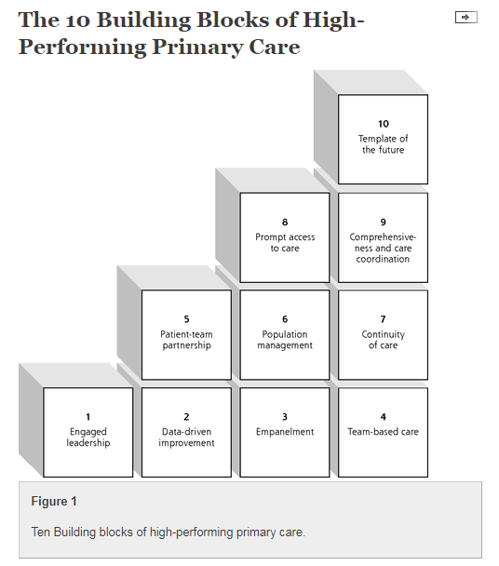
Primary care concept and team members
The 10 building blocks provide a practical conceptual model that can help practices in the journey toward becoming high-performing patient-centered medical homes. This model was derived from our observations of highly regarded primary care practices and from our engagement with other clinics on the journey of transformation. The building blocks focus on design elements largely under the control of the practice or practice organization.

Slide 6
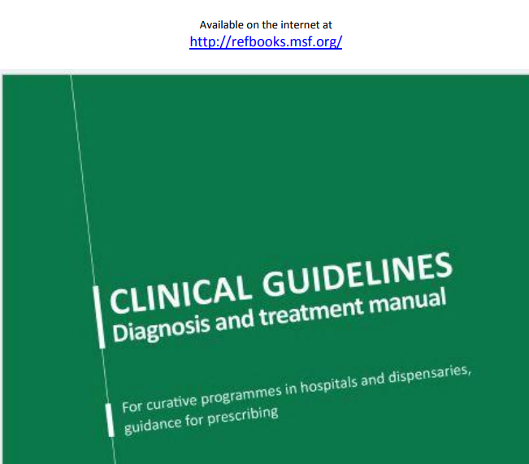
Resource options for information

Slide 7
Laboratory medicine and medical imaging referrals and consultation
The integration of laboratory medicine, medical imaging referrals, and consultation referrals will all be different in terms names, locations, and other details. However, the need to capture the information or data in the electronic medical record and view all of these functions as part of a patient-centered medical home is vitally important in optimizing the quality of the care provided to the individual patient as well fueling evidence- based population management.

Slide 8
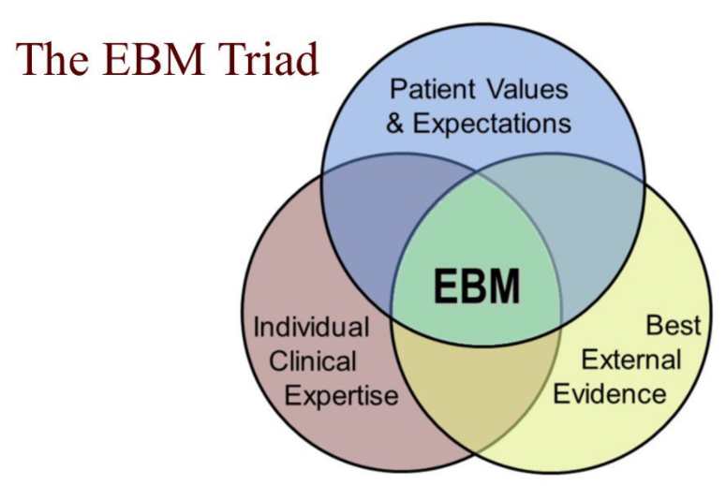
EVIDENCE-BASED
MEDICINE VALUABLE INPUT TO THE PRACTICE OF MEDICINE
UP TO DATE IS A VALUABLE
RESOURCE

Slide 9
Type 2 diabetes
Glycolated hemoglobin (A1C) test. This blood test indicates your average blood sugar level for the past two to three months. It measures the percentage of blood sugar attached to hemoglobin, the oxygen-carrying protein in red blood cells. The higher your blood sugar levels, the more hemoglobin you'll have with sugar attached. An A1C level of 6.5 percent or higher on two separate tests indicates you have diabetes. A result between 5.7 and 6.4 percent is considered prediabetes, which indicates a high risk of developing diabetes. Normal levels are below 5.7 percent.

Slide 10
Type 2 diabetes
Random blood sugar test. A blood sample will be taken at a random time. Blood sugar values are expressed in milligrams per deciliter (mg/dL) or millimoles per liter (mmol/L). Regardless of when you last ate, a random blood sugar level of 200 mg/dL (11.1 mmol/L) or higher suggests diabetes, especially when coupled with any of the signs and symptoms of diabetes, such as frequent urination and extreme thirst.
Fasting blood sugar test. A blood sample will be taken after an overnight fast. A fasting blood sugar level less than 100 mg/dL (5.6 mmol/L) is normal. A fasting blood sugar level from 100 to 125 mg/dL (5.6 to 6.9 mmol/L) is considered prediabetes. If it's 126 mg/dL (7 mmol/L) or higher on two separate tests, you have diabetes.

Slide 11
DIABETES ---TYPE 2
DIAGNOSTIC CRITERIA
Symptoms of hyperglycemia — The diagnosis of diabetes mellitus is easily established when a patient presents with classic symptoms of hyperglycemia (thirst, polyuria, weight loss, blurry vision) and has a random blood glucose value of 200 mg/dL (11.1 mmol/L) or higher.
Asymptomatic — The diagnosis of diabetes in an asymptomatic individual can be established with any of the following criteria (table 1):
●Fasting plasma glucose (FPG) values ≥126 mg/dL (7.0 mmol/L)
●Two-hour plasma glucose values of ≥200 mg/dL (11.1 mmol/L) during an oral glucose tolerance test (OGTT)
●A1C values ≥6.5 percent (48 mmol/mol)

Slide 12
Management of persistent hyperglycemia in type 2 diabetes mellitus
Initial treatment of patients with type 2 diabetes mellitus includes education, with emphasis on lifestyle changes including diet, exercise, and weight reduction when appropriate.
Monotherapy with metformin is indicated for most patients, and insulin may be indicated for initial treatment for some.
Although several studies have noted remissions of type 2 diabetes mellitus that may last several years, most patients require continuous treatment in order to maintain normal or near-normal glycemia.

Slide 13
Refractory management of persistent hyperglycemia in type 2 diabetes mellitus
Bariatric surgical procedures in obese patients that result in major weight loss have been shown to lead to remission in a substantial fraction of patients.
Regardless of the initial response to therapy, the natural history of most patients with type 2 diabetes is for blood glucose concentrations to rise gradually with time.

Slide 14
DIABETES TYPE 2 TREATMENT OPTIONS
Metformin monotherapy failure — For patients who fail initial therapy, there are a number of agents that are available and can be used with metformin.
Insulin is the preferred second-line medication for patients with A1C >8.5 percent or with symptoms of hyperglycemia despite initial therapy with metformin and lifestyle intervention.
For those close to A1C target, we prefer to add a shorter-duration sulfonylurea (such as glipizide, to reduce the risk of hypoglycemia compared with longer-acting sulfonylureas) rather than insulin.

Slide 15
DIABETES -TYPE 2 ---- OTHER TREATMENTS
Repaglinide, which can be considered in individuals who do not reach glycemic goals with metformin, if there are contraindications to sulfonylureas or patient preference limits the use of insulin.
Repaglinide is principally metabolized by the liver, with less than 10 percent renally excreted.
Thus, it can be used safely in patients with chronic kidney disease.

Slide 16
DIABETES TYPE 2 ---OTHER TREATMENTS
GLP-1 receptor agonists may be appropriate to use in certain clinical settings, eg, when weight loss or avoidance of hypoglycemia is a primary consideration, the A1C level is close to target, and cost is not a major barrier.
A prior history of myocardial infarction or stroke might also favor choosing liraglutide as the second drug to be added to metformin, based on the results of the liraglutide and cardiovascular outcomes study.

Slide 17
DIABETES TYPE 2 OTHER TREATMENTS
Empagliflozin may also be considered in patients with established cardiovascular disease (CVD).
Although both liraglutide and empagliflozin appear to decrease cardiovascular morbidity and mortality in patients with type 2 diabetes and established CVD, the balance between benefits and risks have not been examined in the long term.
In addition, there are few data on benefits and risks in patients who have not had a major CVD event.

Slide 18
DIABETES TYPE 2 – OTHER TREATMENTS
DPP-4 inhibitors can be considered as add-on drug therapy for patients who are inadequately controlled on metformin. However, the modest glucose-lowering effectiveness, expense, and limited long-term clinical experience may temper enthusiasm for these drugs.

Slide 19
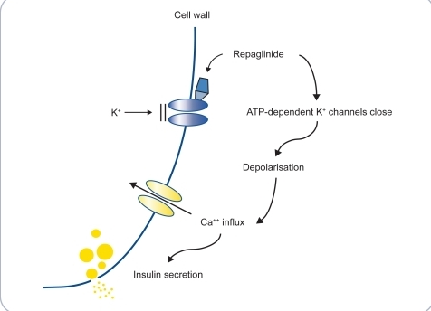
MECHANISM OF ACTION FOR REPAGLINIDE
CAN BE USED IN DIABETES WITH CHRONIC KIDNEY
DISEASE AS IT IS ONLY 10% RENALLY EXCRETED

Slide 20
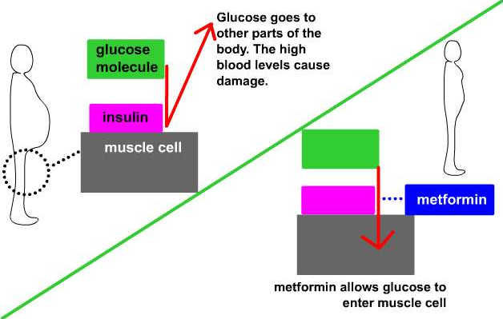

Slide 21
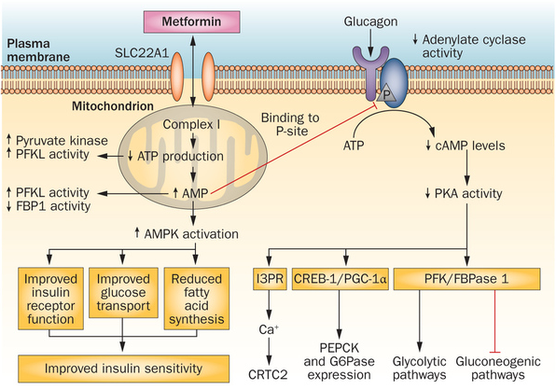

Slide 22

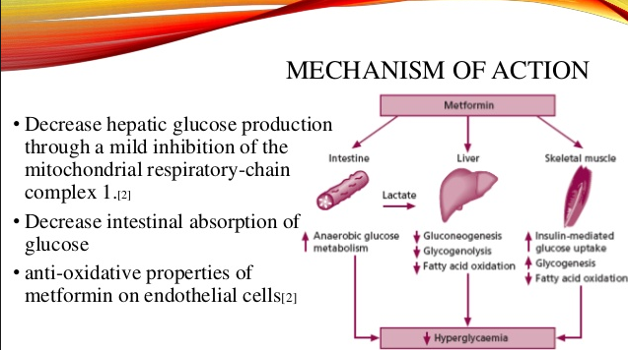

Slide 23
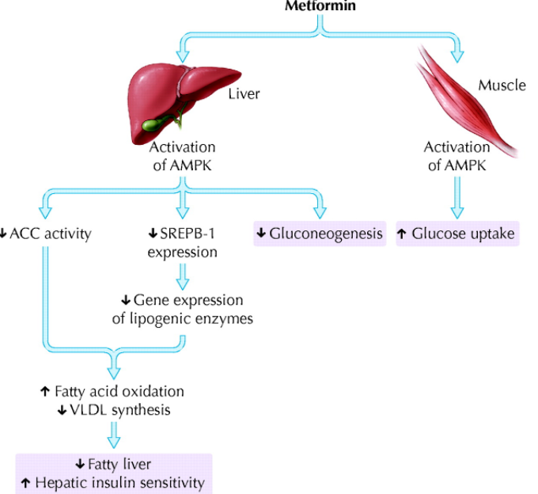

Slide 24
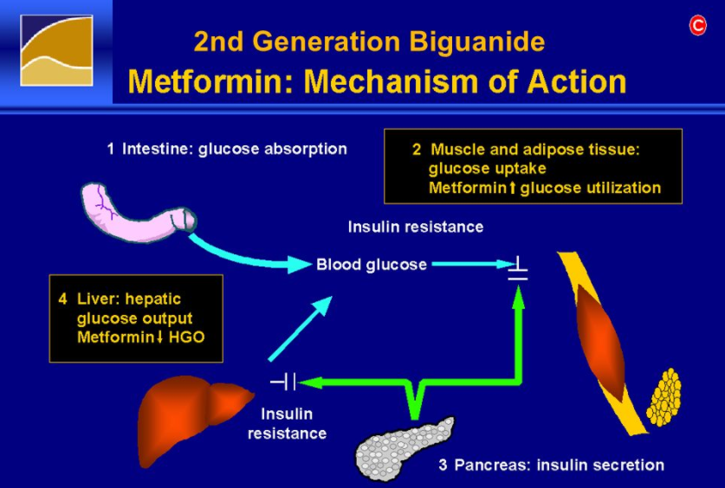

Slide 25
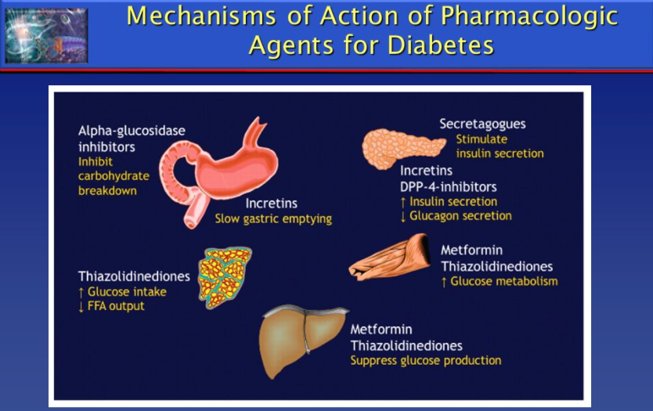

Slide 26
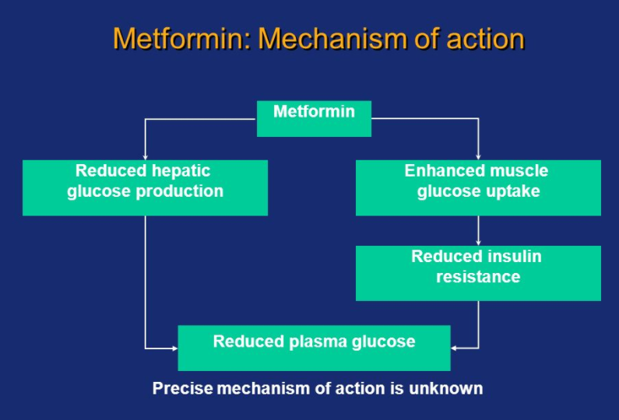

Slide 27
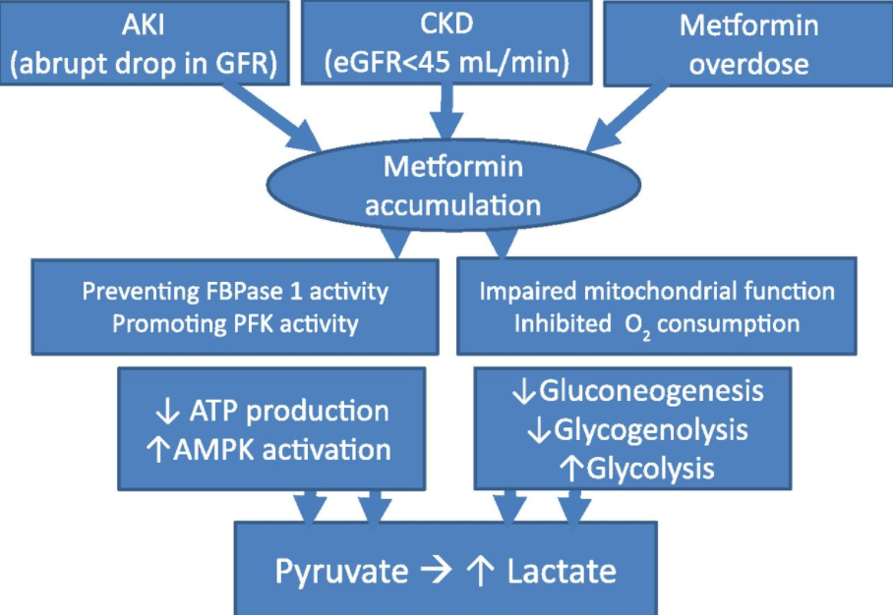

Slide 28
DIABETES TYPE 2 TREATMENT OPTIONS
WITH CONCERNS
Thiazolidinediones are not considered first-choice agents, due to the risk of congestive heart failure (HF) and fractures. However, in certain clinical settings, such as especially high risk for hypoglycemia or intolerance of or contraindications to sulfonylureas, a thiazolidinedione may be added. As an example, in a patient who would be at particularly high risk if hypoglycemia occurred (eg, a construction worker) and who has inadequate glycemic control on metformin (A1C >7 but <8.5 percent), pioglitazone (where available) could be used. The use of rosiglitazone is not recommended, because of the greater concern about its atherogenic lipid profiles and a potential increased risk for cardiovascular events. In 2010, the European Medicines Agency suspended sales of rosiglitazone, owing to concern regarding cardiovascular safety and the availability of alternative therapies, including pioglitazone, that do not have the same concerns. In 2010, the US Food and Drug Administration (FDA) imposed marked restrictions on the prescribing of rosiglitazone because of concerns about increased risk of acute myocardial infarction and cardiovascular deaths. These restrictions were largely removed by the FDA in 2013, although the absence of an adverse effect of rosiglitazone on cardiovascular risk has not been excluded. In 2011, the French and German Medicines Agencies suspended the use of pioglitazone because of the potential increased risk of bladder cancer and the concern that the overall risks of pioglitazone exceed its benefits. The European Medicines Agency, the FDA, and Japanese regulators withheld action on pioglitazone pending results of ongoing review of the data.

Slide 29
DIABETES TYPE 2 ----- COMBINATION MEDICATIONS WITH METFORMIN
Combination tablets of metformin and other oral agents are available in several doses.
For patients who are doing well on these particular doses, the combination tablets offer the convenience of taking fewer pills.
However, if the patient needs the dose of either drug to be changed independent of the other drug, then a fixed combination is unhelpful.
In addition, the cost of the brand name combinations is substantially greater than taking the generic components individually.

Slide 30
DIABETES TYPE 2 ----WHEN CONTRAINDICATIONS TO METFORMIN EXIST
Sulfonylurea monotherapy failure — In individuals with contraindications to metformin, sulfonylureas are often first-line therapy.
Shorter-acting sulfonylureas, such as glipizide, are less likely to cause hypoglycemia than the older, long-acting sulfonylureas and therefore are the preferred sulfonylureas, especially in older patients.

Slide 31
DIABETES TYPE 2 ---- WHEN CONTRAINDICATIONS TO METFORMIN EXIST
In patients with inadequate glycemic control on sulfonylureas and with A1C >8.5 percent, we suggest switching to insulin. In patients who are intolerant or cannot take metformin for any reason and who have an A1C that is <8.5 percent but not at target on sulfonylurea alone, there are a number of agents that are available and can be used with a sulfonylurea. The choice of therapy should be individualized based upon patient characteristics, preferences, and costs. Options include thiazolidinediones, DPP-4 inhibitors, GLP-1 agonists, sodium-glucose co-transporter 2 (SGLT2) inhibitors, alpha-glucosidase inhibitors, and insulin. All of these medications have advantages and disadvantages (table 2), and all of the newer medicines that are not available in generic form are relatively expensive. Hypoglycemia remains a risk when any of these medications are used in combination with a sulfonylurea. In general, sulfonylureas are tapered and stopped if insulin is added and especially if the insulin regimen includes preprandial rapid-acting insulin.

Slide 32
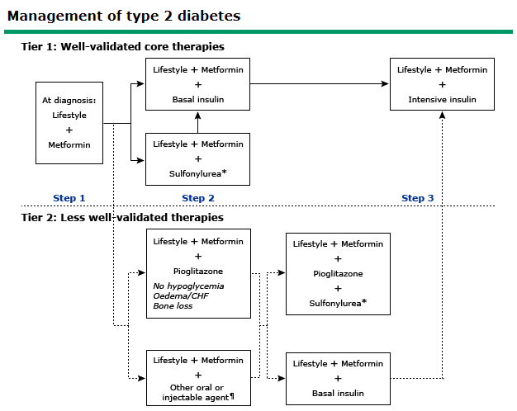
Up to Date

Slide 33
DIABETES TYPE 2 ---- WHEN CONTRADICTIONS TO METFORMIN EXIST
GLP-1 receptor agonists may be appropriate to use in combination with sulfonylureas in certain clinical settings, eg, when weight loss is a primary consideration and the A1C level is close to target. A prior history of myocardial infarction or stroke might also favor choosing liraglutide as the second drug, based on the results of the liraglutide and cardiovascular outcomes study. Empagliflozin may also be considered in patients with established CVD. (See "Glucagon-like peptide-1 receptor agonists for the treatment of type 2 diabetes mellitus", section on 'Cardiovascular effects' and "Sodium-glucose co-transporter 2 inhibitors for the treatment of type 2 diabetes mellitus", section on 'Cardiovascular effects'.)

Slide 34
DIABETES TYPE 2 ----- ONLY UNDER SPECIAL CIRCUMSTANCES DUE TO RISKS
Pioglitazone is an option but can be associated with fluid retention, weight gain, and HF. DPP-4 inhibitors or SGLT2 inhibitors can be considered as add-on drug therapy to sulfonylureas in patients who have contraindications to metformin and pioglitazone. However, the modest glucose-lowering effectiveness, expense, and limited long-term clinical experience with these drugs temper our enthusiasm. (See "Dipeptidyl peptidase-4 (DPP-4) inhibitors for the treatment of type 2 diabetes mellitus", section on 'Candidates' and "Sodium-glucose co-transporter 2 inhibitors for the treatment of type 2 diabetes mellitus", section on 'Candidates'.)

Slide 35
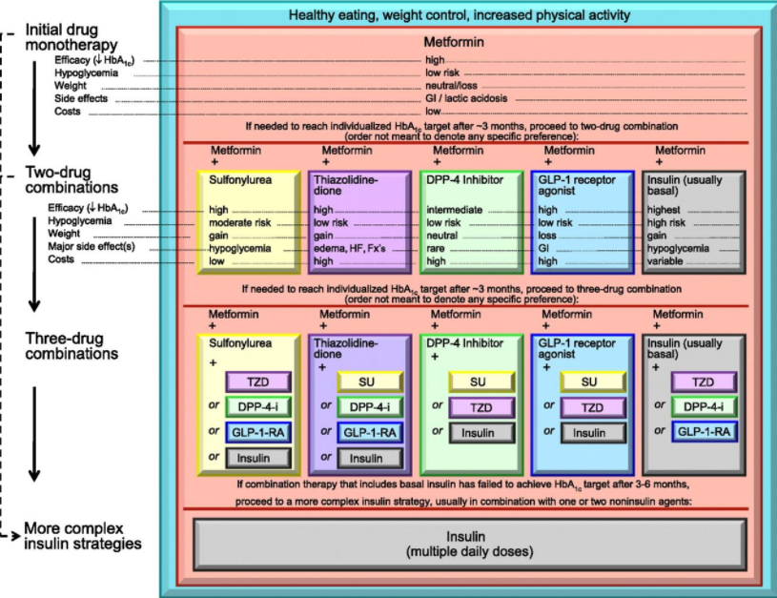

Slide 36
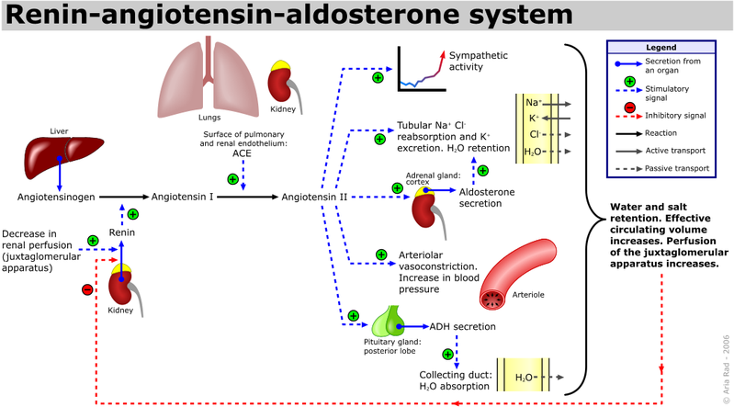

Slide 37
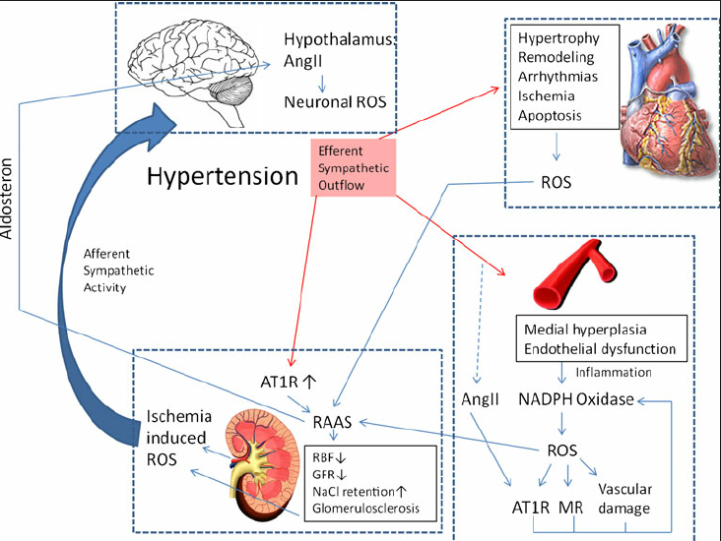

Slide 38
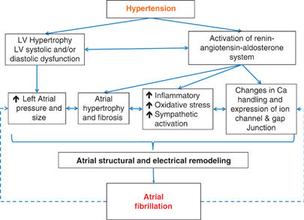

Slide 39
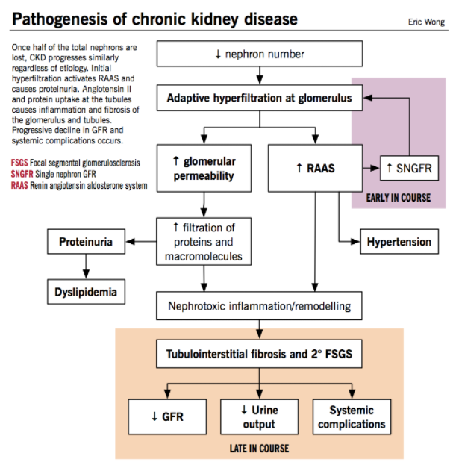

Slide 40
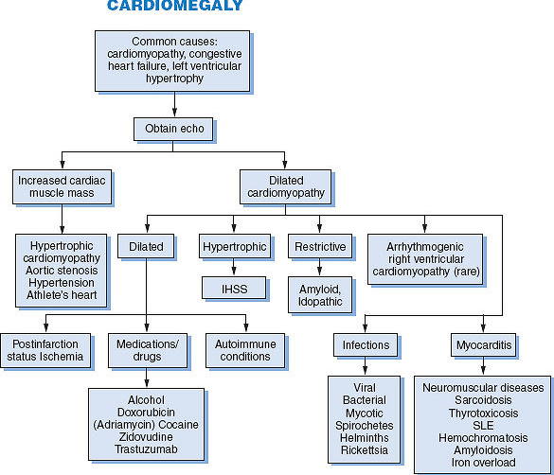

Slide 41
OBESITY AND PRE-OBESITY
The morbidity and mortality associated with being overweight or obese have been known to the medical profession since the time of Hippocrates more than 2500 years ago. Overweight refers to a weight above the "normal" range, with normal defined on the basis of actuarial data. This is determined by calculating the body mass index (BMI, defined as the weight in kilograms divided by height in meters squared). Overweight is defined as a BMI of 25 to 29.9 kg/m²; obesity is defined as a BMI of ≥30 kg/m². Severe obesity is defined as a BMI ≥40 kg/m² (or ≥35 kg/m² in the presence of comorbidities). Although these categorical definitions are clinically useful, it is clear that the risks imparted by increasing body mass follow a continuum.

Slide 42
Obesity in adults: Dietary therapy
The optimal management of overweight and obesity requires a combination of diet, exercise, and behavioral modification. In addition, some patients eventually require pharmacologic therapy or bariatric surgery.
The risk of overweight to the subject should be evaluated before beginning any treatment program. Selection of treatment can then be made using a risk-benefit assessment.
The choice of therapy is dependent on several factors including the degree of overweight or obesity and patient preference.

Slide 43


Slide 44
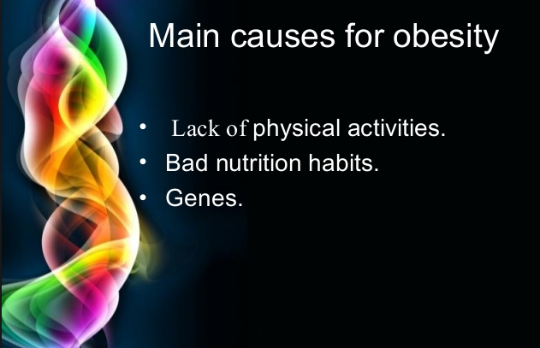

Slide 45
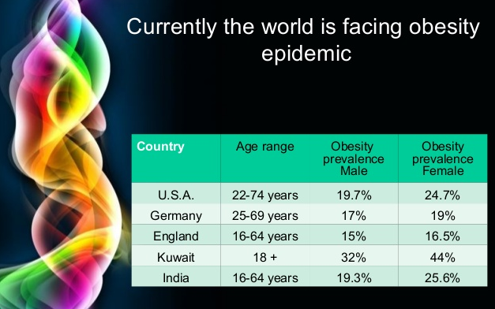

Slide 46
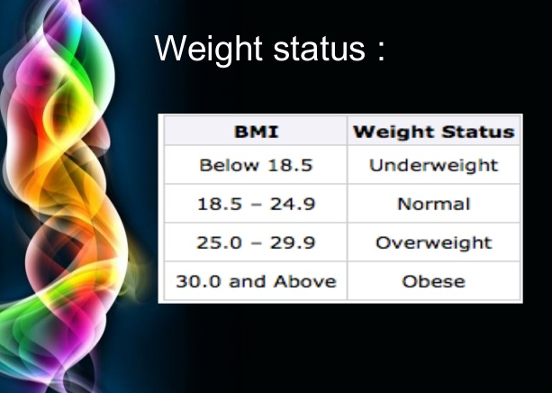
40.0 and Above
Morbidly Obese

Slide 47
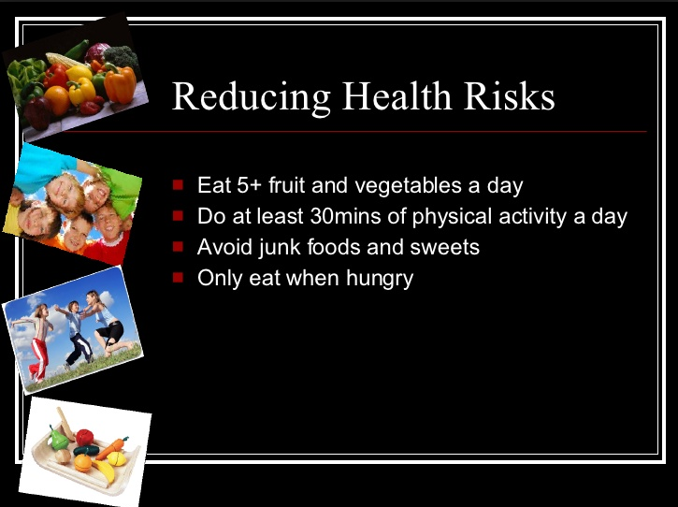

Slide 48
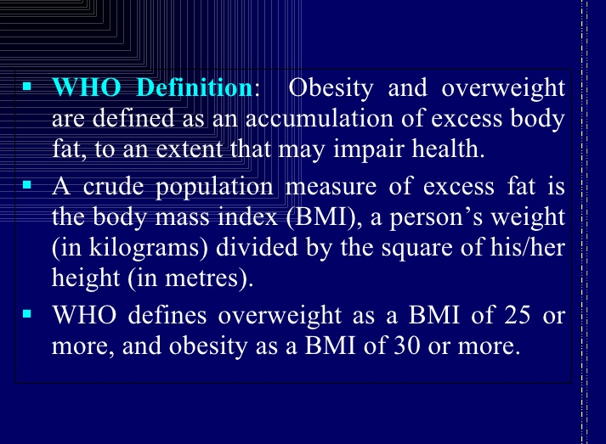

Slide 49
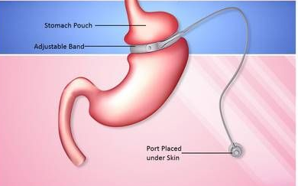

Slide 50
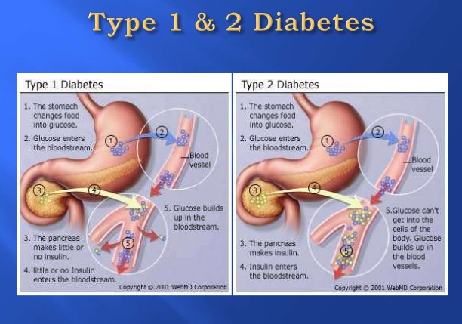

Slide 51
Drugs available as adjuncts to diet and exercise for treatment of obesity --- Orlistat
Pancreatic lipase inhibitor approved for long-term use
Not a controlled substance
120 mg three times daily with fat-containing meals.
A reduced dose of 60 mg¶ is an option for patients who do not tolerate 120 mg.
Cramps, flatulence, fecal incontinence, oily spotting, absorption of fat-soluble vitamins may be reduced. Rarely reported: severe liver injury, oxalate-kidney injury.
Contraindicated during pregnancy.

Slide 52
Drugs available as adjuncts to diet and exercise for treatment of obesity ----- Lorcaserin
Serotinin-2C receptor agonist approved for long-term use
Controlled Substance -- C-IV
10 mg twice daily; re-evaluate after 12 weeks.
Headache, dizziness, nausea, dry mouth, constipation (non-diabetic patients). Hypoglycemia, headache, back pain, cough (diabetic patients).
Avoid in patients with severe hepatic or renal insufficiency (CrCl <30 mL/min).
Preferably avoid use with other serotoninergic agents (including most antidepressants, triptan anti-migraine medications, 5HT3-antagonist antiemetic's, tramadol, dextromethorphan, and some muscle relaxants) due to risk of serotonin toxicity.
Neuropsychiatric side effects and valvulopathy were not significantly increased in clinical trials, but few long-term safety data are available.
Contraindicated with ergot derivatives (eg, ergotamine) and during pregnancy.
May cause psychic dependence and/or euphoria at higher than recommended doses.
Possible increase in cancer risk based on murine model data.

Slide 53
Drugs available as adjuncts to diet and exercise for treatment of obesity -- Phentermine-topiramate
Combination of phentermine-topiramate approved for long-term use
Controlled Substance C-IV (due to phentermine component)
Initial: 3.75 mg phentermine/23 mg topiramate once daily in the morning for 14 days.
Then titrate based upon response: 7.5 mg phentermine/46 mg topiramate daily for 12 weeks, then 11.25 mg phentermine/69 mg topiramate daily for 14 days.
Maximum dose: 15 mg phentermine/92 mg topiramate daily;
re-evaluate after 12 weeks.

Slide 54
Drugs available as adjuncts to diet and exercise for treatment of obesity -- Phentermine-topiramate
Adverse effects and precautions*
Dry mouth, taste disturbance, constipation, paraesthesias, depression, anxiety, elevated heart rate, cognitive disturbances, insomnia (higher dose).
Abuse potential due to phentermine component.
Topiramate is teratogenic (increased risk of oral cleft defects, T1); negative pregnancy test prior to and during treatment and two forms of contraception necessary for women of child-bearing potential.
Actions of topiramate component include inhibition of carbonic anhydrase; rarely metabolic acidosis and kidney stones may result from renal bicarbonate loss.
Maximum dose with moderate hepatic or renal impairment (CrCl <50 mL/min) 7.5 mg phentermine/46 mg topiramate once daily.
Upon discontinuation, tapering of dose over at least one week using every other day dosing is recommended.
Contraindicated during pregnancy, hyperthyroidism, glaucoma, patients taking MAO inhibitors.

Slide 55
Drugs available as adjuncts to diet and exercise for treatment of obesity -- Bupropion-naltrexone
Combination of bupropion-naltrexone approved for long-term use
Not a controlled substance
Week 1: One tablet (8 mg naltrexone/90 mg bupropion) once daily.
Week 2: One tablet twice daily.
Week 3: Two tablets in morning and one tablet in evening.
Week 4: Two tablets twice daily.
Maximum daily dose: Four tablets (32 mg naltrexone/360 mg bupropion); re-evaluate after 12 weeks.

Slide 56
Drugs available as adjuncts to diet and exercise for treatment of obesity -- Bupropion-naltrexone
Adverse effects and precautions*
Nausea, constipation, headache, vomiting, dizziness, insomnia, dry mouth.
Transient increase in blood pressure (1 to 2 mmHg on average) during initial 12 weeks of treatment; heart rate may also be increased.
Contraindicated in patients with uncontrolled hypertension, seizure disorder, eating disorder, use of other bupropion-containing products, chronic opioid use, use within 14 days of MAO inhibitors, pregnancy, or breastfeeding.

Slide 57
Drugs available as adjuncts to diet and exercise for treatment of obesity ---- Liraglutide
GLP-1 agonist approved for long-term use
Not a controlled substance
Initial: 0.6 mg subcutaneously daily.
Increase at weekly intervals (1.2, 1.8, 2.4 mg) until recommended dose of 3 mg daily; re-evaluate after 16 weeks.

Slide 58
Drugs available as adjuncts to diet and exercise for treatment of obesity ---- Liraglutide
Adverse effects and precautions*
Nausea, vomiting, diarrhea, constipation, hypoglycemia in patients with T2DM (more common if used in conjunction with diabetes medications known to cause hypoglycemia), injection site reactions, increased lipase, increased heart rate. Rarely reported: pancreatitis, gallbladder disease, renal impairment, suicidal thoughts.
Advise patients to avoid dehydration in relation to GI side effects.
Monitor blood glucose in diabetic patients and adjust co-administered sulfonylureas (eg, reduce dose by 50 percent) and other anti-diabetic medications as needed to prevent potentially severe hypoglycemia.
Causes a modest delay of gastric emptying.
Use is not recommended in severe renal impairment (CrCl <30 mL/min), severe hepatic impairment, or children/adolescents ≤18 years and adults ≥75 years; safety and efficacy data are lacking.
Possible increase in thyroid cancer risk based on murine model data.
Contraindicated in pregnancy and in patients with a personal or family history of medullary thyroid cancer or multiple endocrine neoplasia 2A or 2B.

Slide 59
Drugs available as adjuncts to diet and exercise for treatment of obesity --- Benzphetamine
Noradrenergic sympathomimetic drugs approved for short-term use
Controlled Substance -- C-III
Initial: 25 mg once daily; may titrate up to 25 to 50 mg one to three times daily.
Maximum dose: 50 mg three times daily.

Slide 60
Drugs available as adjuncts to diet and exercise for treatment of obesity ---- Diethylpropion
Noradrenergic sympathomimetic drugs approved for short-term use
Controlled Substance --- C-IV
Immediate release: 25 mg three times daily before meals.
Controlled release: 75 mg every morning.

Slide 61
Drugs available as adjuncts to diet and exercise for treatment of obesity --- Phentermine
Noradrenergic sympathomimetic drugs approved for short-term use
Controlled Substance --- C-IV
Immediate release: 15 to 37.5 mg daily or divided twice-daily.
Orally disintegrating tablet (ODT): 15 to 37.5 mg once daily in the morning.

Slide 62
Drugs available as adjuncts to diet and exercise for treatment of obesity --- Phendimetrazine
Noradrenergic sympathomimetic drugs approved for short-term use
Controlled Substance --- C-III
Immediate release: 17.5 to 35 mg two or three times daily, one hour before meals.
Maximum dose: 70 mg three times daily.
Sustained release: 105 mg daily in the morning.

Slide 63
Noradrenergic sympathomimetic drugs approved for short-term use – same for all
Applies to all sympathomimetic agents:
Due to their side effects and potential for abuse, we suggest not prescribing sympathomimetic for weight loss.
If prescribed, limit to short-term (≤12 weeks) use.
Adverse effects include increase in heart rate, blood pressure, insomnia, dry mouth, constipation, nervousness.
Abuse potential due to amphetamine-like effects.
May counteract effect of blood pressure medications.
Avoid in patients with heart disease, poorly controlled hypertension, pulmonary hypertension, or history of addiction or drug abuse.
Contraindicated in patients with a history of CVD, hyperthyroidism, glaucoma, MAO inhibitor-therapy, agitated states, pregnancy, or breast feeding.

Slide 64
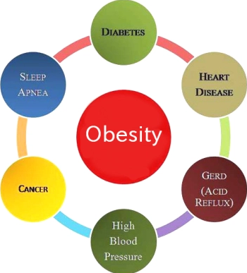
BEST PRACTICE --- AVOID MEDICATION THERAPY FOR OBESITY TREATMENT if possible
DIETARY RECOMMENDATIONS TREAT UNDERLYING
BEHAVIORAL MODIFICATION THERAPY MEDICAL CONDITIONS
APPROPRIATE EXERCISE PROGRAM
AVOID INTRODUCING ADVERSE RISK TREATMENT REGIMENS

Slide 65
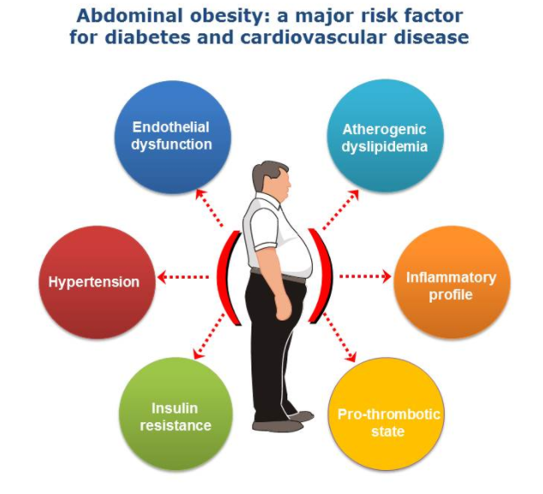


Slide 66
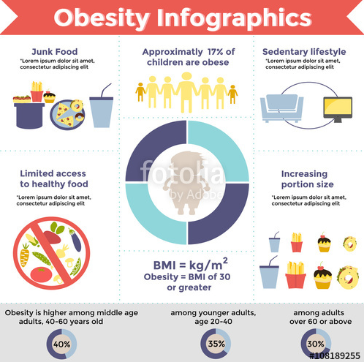

Slide 67
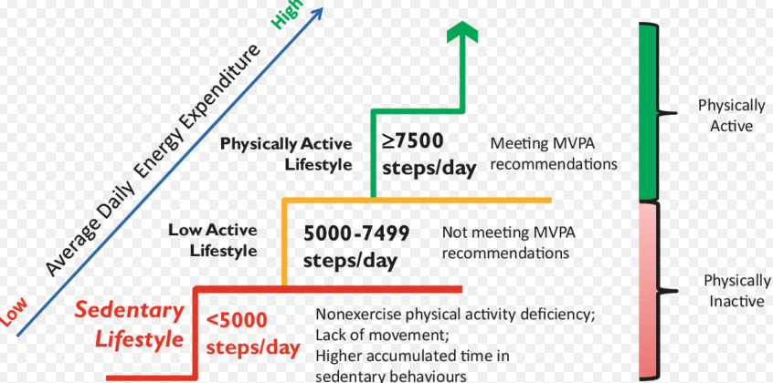

Slide 68
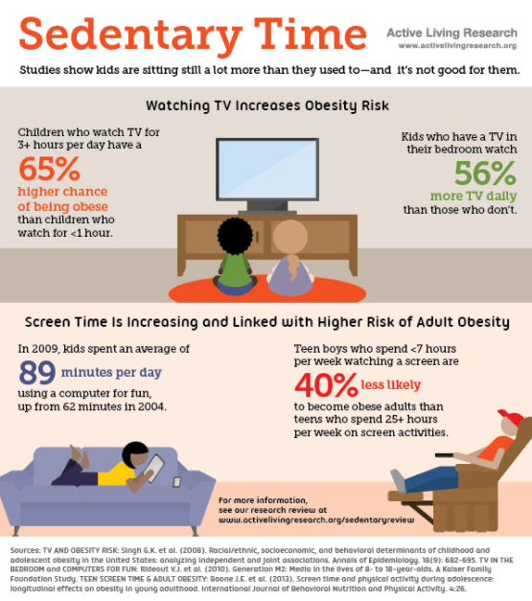

Slide 69
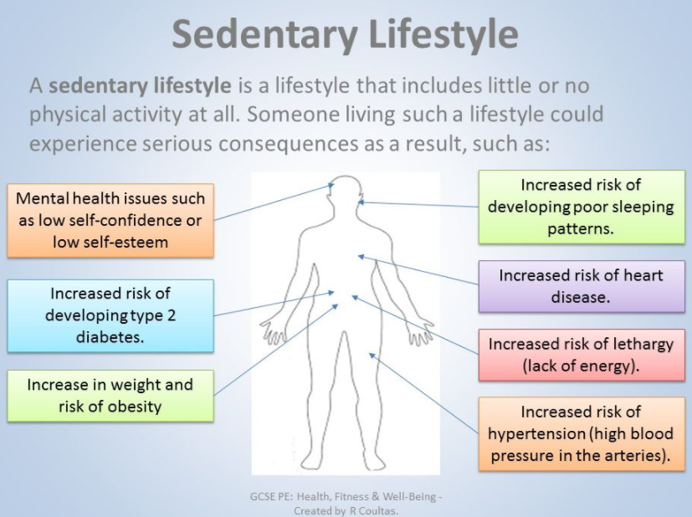

Slide 70


Slide 71
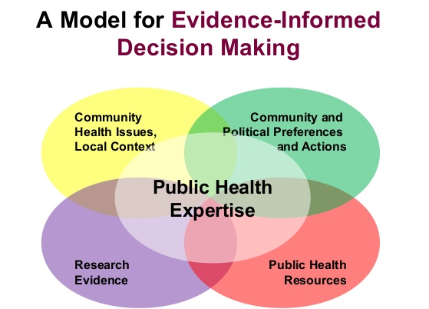

Slide 72
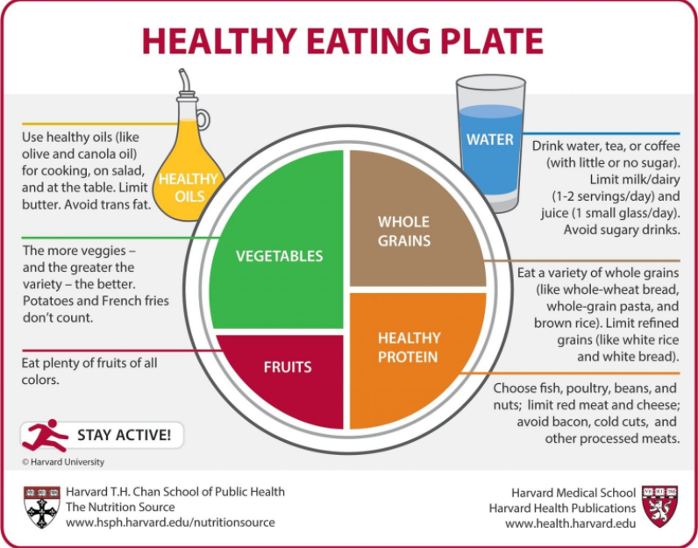

Slide 73


Slide 74


Slide 75
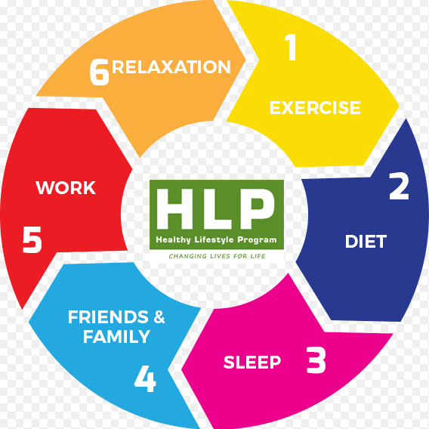

Slide 76


Slide 77
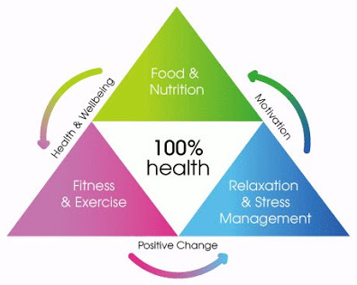

Slide 78


Slide 79




Slide 80


Slide 81
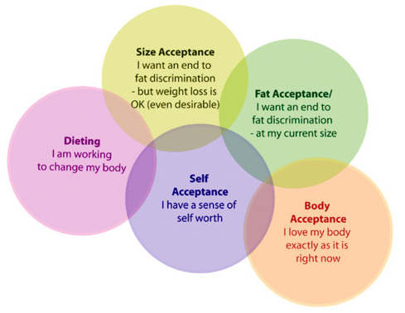

Slide 82
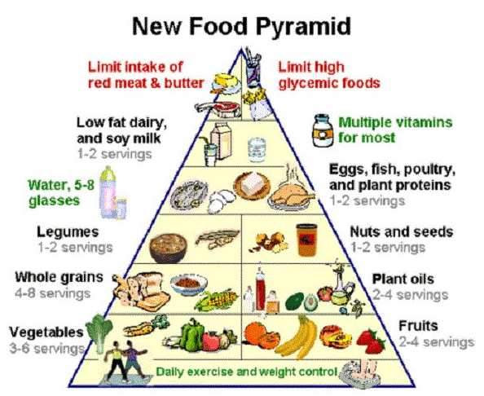

Slide 83
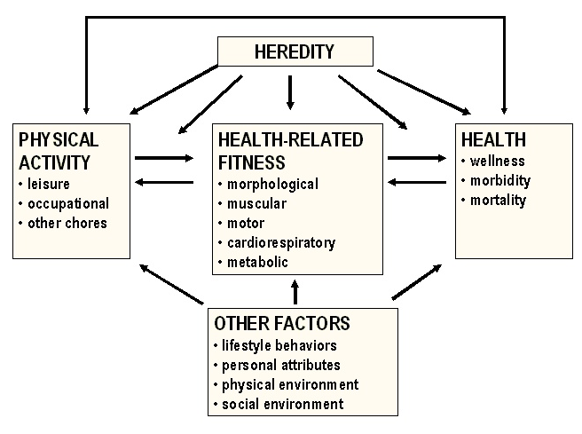

Slide 84
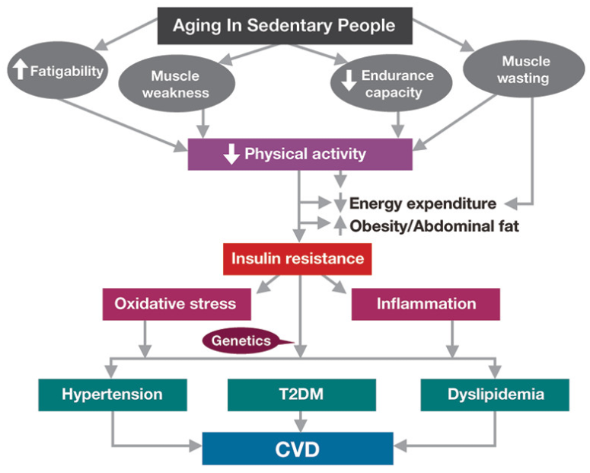

Slide 85
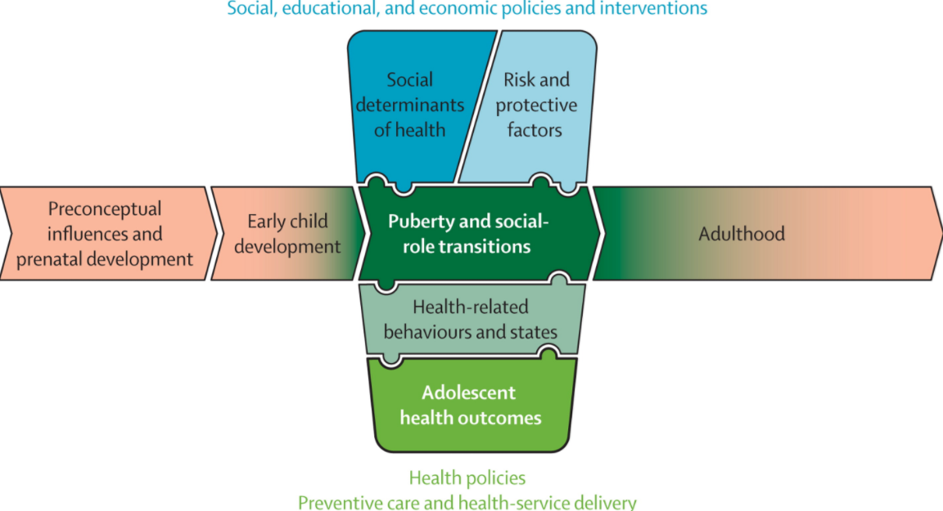

Slide 86
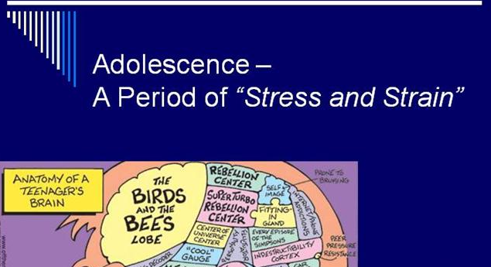
ADOLESCENCE

Slide 87
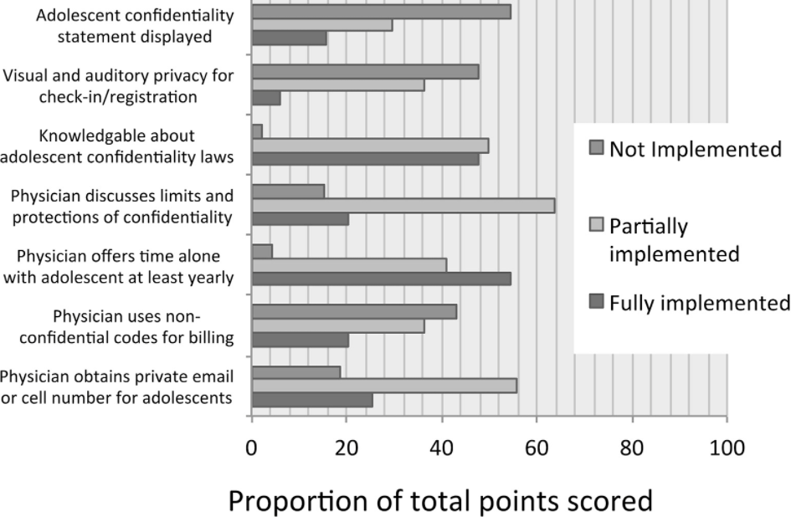

Slide 88
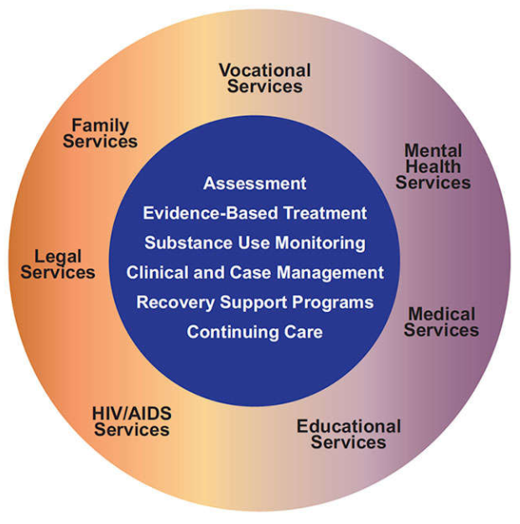
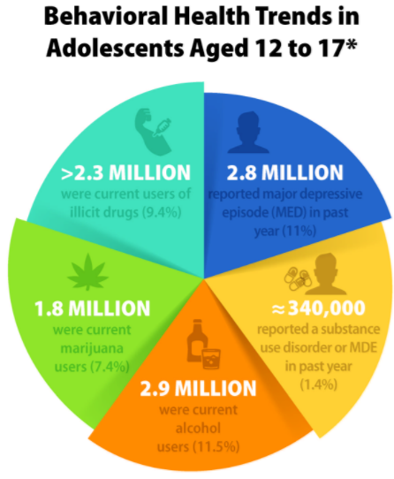

Slide 89


Slide 90
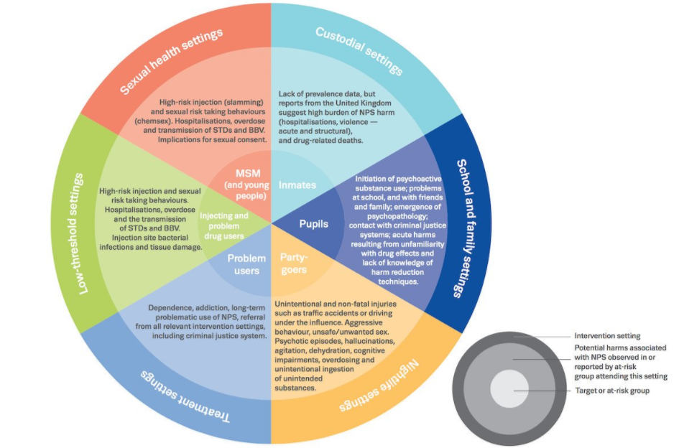

Slide 91
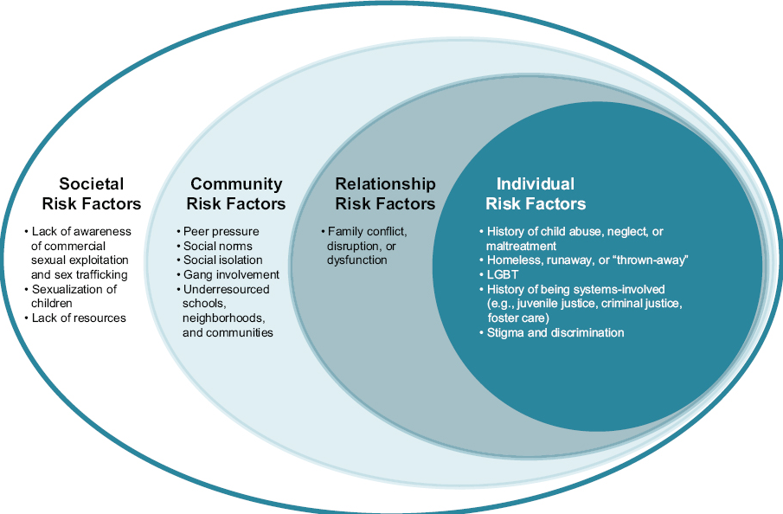

Slide 92
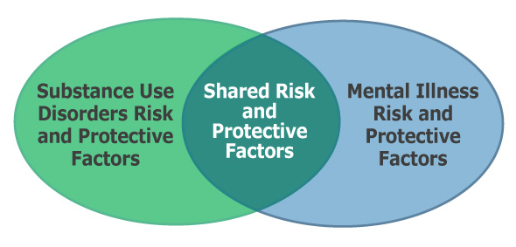

Slide 93


Slide 94


Slide 95
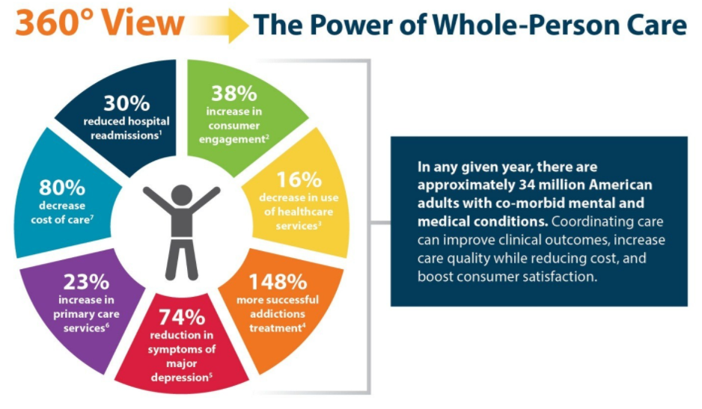

Slide 96


Slide 97
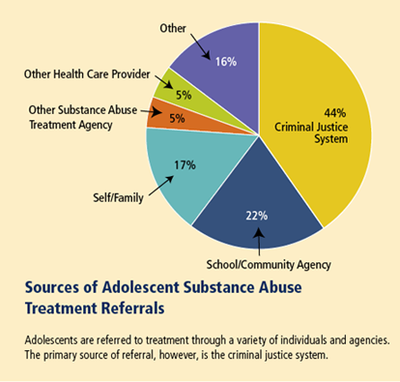

Slide 98


Slide 99

CDC

Slide 100


Slide 101


Slide 102


Slide 103


Slide 104


Slide 105


Slide 106


Slide 107


Slide 108


Slide 109


Slide 110


Slide 111


Slide 112


Slide 113


Slide 114


Slide 115


Slide 116


Slide 117


Slide 118


Slide 119


Slide 120


Slide 121


Slide 122


Slide 123



Slide 124


Slide 125


Slide 126


Slide 127


Slide 128


Slide 129


Slide 130


Slide 131


Slide 132


Slide 133




Slide 134

American Cancer Society Guidelines for the Early Detection of Cancer

Slide 135




American Cancer Society Guidelines for the Early Detection of Cancer
OTHER RECOMENDATIONS

Slide 136

American Cancer Society Guidelines for the Early Detection of Cancer

Slide 137

American Cancer Society Guidelines for the Early Detection of Cancer

Slide 138

American Cancer Society Guidelines for the Early Detection of Cancer

Slide 139

American Cancer Society Guidelines for the Early Detection of Cancer

Slide 140

American Cancer Society Guidelines for the Early Detection of Cancer

Slide 141

RESOURCES FOR PREVENTITIVE SCREENING INFORMATION

Slide 142





Screening for age-related risk factors

Slide 143

HYPERTENSION TREATMENT HISTORICAL MEDICATION PERSPECTIVE

Slide 144






Slide 145



Slide 146



TABLE
5

Slide 147


Slide 148



Slide 149


Slide 150


Slide 151


Slide 152



ISCHEMIC
HEART
DISEASE

Slide 153

ISCHEMIC HEART DISEASE

Slide 154

ISCHEMIC HEART DISEASE

Slide 155


Prenatal care

Slide 156


Slide 157


High risk pregnancy consultation and/or special care required

Slide 158
High risk pregnancy
Existing Health Conditions
High blood pressure
Polycystic Ovary Syndrome
Diabetes
Kidney Disease
Autoimmune Disease
Thyroid Disease
Infertility
Obesity
HIV/AIDS

Slide 159

High risk pregnancy age

Slide 160

High risk pregnancy lifestyle factors

Slide 161

High risk pregnancy conditions of pregnancy

Slide 162


Slide 163


Newborn evaluation

Slide 164



Newborn evaluation

Slide 165


Newborn evaluation

Slide 166



Newborn evaluation

Slide 167



Newborn evaluation

Slide 168



Newborn evaluation

Slide 169



Newborn evaluation

Slide 170




Newborn evaluation

Slide 171



Newborn evaluation

Slide 172




Newborn evaluation

Slide 173


Newborn evaluation

Slide 174




Newborn evaluation

Slide 175


Newborn evaluation

Slide 176





Newborn evaluation

Slide 177


Preventive Care for children

Slide 178




Preventive Care for children

Slide 179


Slide 180
1. What is the normal level of a Glycated hemoglobin A1C test?
Above 6.5%
Between 5.7 and 6.4%
Below 5.7%

Slide 181
1. What is the normal level of a Glycated hemoglobin A1C test?
Above 6.5%
Between 5.7 and 6.4%
Below 5.7%

Slide 182
2. Metformin is generally recommended when non medicinal measures have failed except in which circumstances
Obesity
HgB A1C over 9
Renal insufficiency
Refusing insulin therapy

Slide 183
2. Metformin is generally recommended when non medicinal measures have failed except in which circumstances
Obesity
HgB A1C over 9
Renal insufficiency
Refusing insulin therapy

Slide 184
3. Shorter-acting sulfonylureas, such as glipizide, are less likely to cause hypoglycemia than the older, long-acting sulfonylureas and therefore are the preferred sulfonylureas, especially in older patients.
True
False

Slide 185
3. Shorter-acting sulfonylureas, such as glipizide, are less likely to cause hypoglycemia than the older, long-acting sulfonylureas and therefore are the preferred sulfonylureas, especially in older patients.
True
False

Slide 186
4. World Health Organization defines obesity as over a body mass index over 30.
True
False

Slide 187
4. World Health Organization defines obesity as over a body mass index over 30.
True
False

Slide 188
5. The “Best Practice” is to avoid medication therapy for obesity if possible.
True
False

Slide 189
5. The “Best Practice” is to avoid medication therapy for obesity if possible.
True
False

