Slide 1

MODULE Four:
MEDICAL
PROTOCOLS
AND QUALITY
ASSURANCE

Slide 2
MODULE Four:
SECTION Three:
Electronic Medical
records (EMR)

Slide 3

UNIT OBJECTIVE
To understand the use of electronic medical records (EMRs)

Slide 4
Electronic Medical records (EMR)
Scope, meaningful use, and limitations
Structure
Operation
Administrative responsibility
Legal responsibility
Differences in implementation across settings

Slide 5
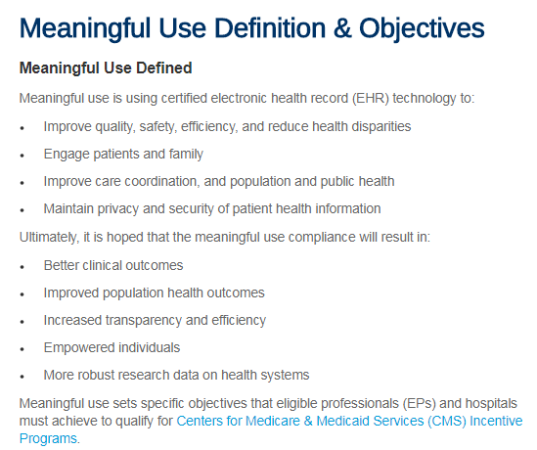


Meaningful use scope and limitations

Slide 6

Emr options software structure
YOUR SPECIFIC
CLINICAL SITE
WILL PROVIDE
MORE SPECIFIC
INFORMATION
ABOUT THE EMR
SYSTEM YOU WILL
USE FOR YOUR
CARE OF PATIENTS

Slide 7

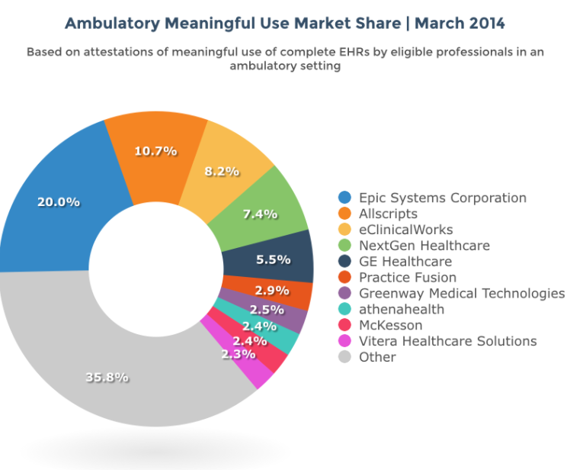

Slide 8
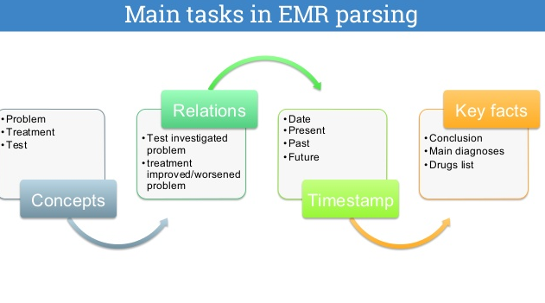

Slide 9
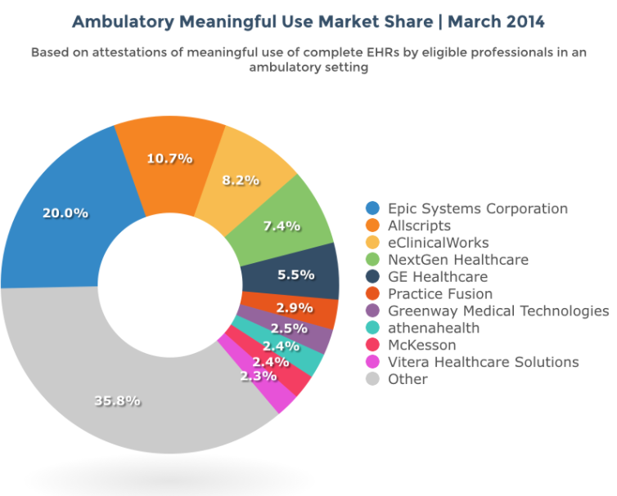

Slide 10



Slide 11


Slide 12
Health information technology capacity at federally qualified health centers: a mechanism for improving quality of care
The American Recovery and Reinvestment Act of 2009 (ARRA) investment in health information technology was enacted with the expectation that HIT would improve the care delivery process and quality of care.
We examined the relationship between HIT capacity in FQHC association between greater HIT capacity and quality of care, measured by receipt of discharge summaries, patient reminder systems for preventive services and follow-up care, and timely appointment for specialty care.
Considering the promise of HIT as a tool for improving quality of care, systematic examination of organizational structure and processes that facilitate “meaningful use” must be a key component of health center operations, particularly facilities that serve vulnerable populations.
These strategies are essential to translating gains from efficiency/intermediate benefits (i.e., improvements in service delivery and quality of care) to effectiveness gains, such as improvements in clinical outcomes.
These might include greater utilization of technology that directly influences health outcomes and not just the quality of care.

Slide 13
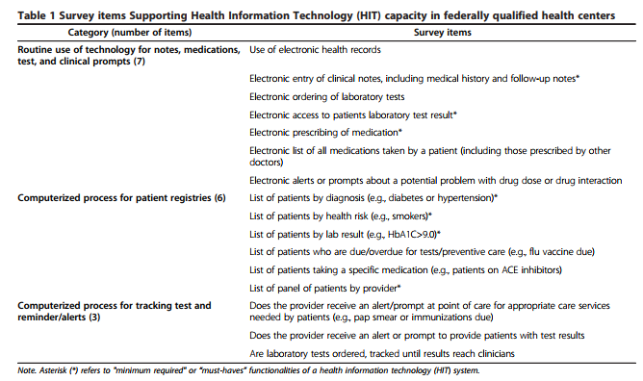
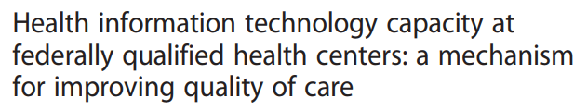

Slide 14
Recent perspectives of electronic medical record systems Benefits/effects of EMRs
EMRs are perceived to have direct and indirect benefits for healthcare in several areas. EMRs are expected to have positive effects on access to data and the quality of the data since they can be accessed whenever needed and the documentation is more legible. A computer can also improve completeness and accuracy through validation checks on data entered, and prompts on missing data. In addition, EMRs are expected to improve the efficiency of the care process in terms of time efficiency, as well as improving the quality of care rendered through, for instance, increased adherence to protocols and reduced medical errors. Furthermore, ultimately, EMRs are expected to improve the clinical outcomes in terms of the health status. However, its acceptance clinically is controversial as there are factors that affect clinical outcomes. Apart from these benefits on patient care, secondary uses of EMR data in administration, disease surveillance, management and monitoring of the services are also expected to improve health services. Other expected benefits are reduced financial costs over time through savings on, for instance, billings, transcription costs, patient cycle time, utilization of services and support staff salary.

Slide 15
Recent perspectives of electronic medical record systems (Review) Functionality of EMR systems
MRs are not simply an electronic version of the paper record, but constitute a part of a comprehensive system, which has additional information management tools.
The scope of functionality in EMR systems varies in different contexts. However, recent findings indicated that a comprehensive EMR system should comprise the following functional components: an integrated view of patient data, clinical decision support, clinician/provider order entry, access to knowledge resources, integrated communication support and analysis of aggregated data.
An integrated view of patient data stems from the provider's need for a historical overview of the patient's health status.
This creates a need for the exchange of health information between different systems for the continuity of patient care among different healthcare service providers.

Slide 16
1. EMR’s are not simply an electronic version of the paper record of the paper record, but constitute a part of a comprehensive system, which has additional information management tools.
True
False

Slide 17
1. EMR’s are not simply an electronic version of the paper record of the paper record, but constitute a part of a comprehensive system, which has additional information management tools.
True
False

Slide 18
2. EMRs are expected to improve the efficiency of the care process in terms of time efficiency, as well ass improving the quality of care rendered through, for instance, increased adherence to protocols and reduced medical errors
True
False

Slide 19
2. EMRs are expected to improve the efficiency of the care process in terms of time efficiency, as well ass improving the quality of care rendered through, for instance, increased adherence to protocols and reduced medical errors
True
False

Slide 20
3. What is the main advantage of an electronic medical record as opposed to a paper record.
Population health data assistance
Time to learn system
Face time with patient

Slide 21
3. What is the main advantage of an electronic medical record as opposed to a paper record.
Population health data assistance
Time to learn system
Face time with patient

Slide 22
4. Health information technology capacity at federally qualified health centers: A mechanism for improving quality of care
True
False

Slide 23
4. Health information technology capacity at federally qualified health centers: A mechanism for improving quality of care
True
False

Slide 24
5. How many EMR system options are available for clinics in the US
One
Two
At least 5 or more

Slide 25
5. How many EMR system options are available for clinics in the US
One
Two
At least 5 or more

