Slide 1

MODULE Four:
MEDICAL PROTOCOLS
AND
QUALITY ASSURANCE

Slide 2
MODULE Four:
SECTION Four:
Quality Care structures
and peer review

Slide 3

UNIT OBJECTIVES
To understand quality care structures and policies in place
To understand the peer review process

Slide 4
Quality Care structures and peer review
Accountable Care Organizations (ACOs) for Medicare
Performance measures: structural, process, and outcome
Health outcomes and disparities
Accountable Care Organizations (ACOs) for Medicare
Performance measures: structural, process, and outcome
Health outcomes and disparities

Slide 5
The latest data and information for all types of ACOs
Definitive Healthcare offers the most comprehensive ACO database available anywhere, and it keeps growing daily. With Definitive Healthcare’s daily intelligence, you’ll be kept up to date on the newest developments on all types of ACOs, including Medicare, commercial, employer-operated, and Medicaid organizations. Users can also search Medicare ACOs by criteria such as benchmark spending and shared savings amount.
Detailed ACO profiles including start date, patient population, number of physicians, and Medicare Shared Saving Program data
Key executive contacts with phone number and email (where available)
Organization members including hospitals, payers, physician groups, and other healthcare providers
Technology implementation
Quality, spending, and benchmark information
Daily news and intelligence
Fully integrated into Definitive Healthcare’s suite of data

Slide 6
Accountable Care Organizations
How ACOs work
Local health care providers and hospitals volunteer to work together to provide you with coordinated care.
The doctors and other providers who are helping care for you will communicate with each other, and partner with you in making health care decisions.
You may spend less time filling out medical history paper work because your doctors may already have this information in an electronic health record.
You’ll likely have fewer repeated medical tests because your doctors and hospitals will share information and coordinate your care.
You’ll be in the center of care, and your doctors will be better able to keep you informed, and to keep listening and honoring your choices.
Unlike HMOs, managed care, or some insurance plans, an ACO can't tell you which health care providers to see and can't change your Medicare benefits. Only people with Original Medicare can be assigned to an ACO. You can’t be assigned to an ACO if you have a Medicare Advantage Plan (Part C), like an HMO or a PPO.

Slide 7
Accountable Care Organizations
How ACOs share information
Medicare will share certain health information with ACOs working with your doctors and other health care providers about the care you get from your doctors and other providers.
The poster in your doctor’s office (or written notice) should let you know whether the doctor or ACO has asked Medicare for access to your information about the care you get through Medicare.
The privacy and security of your medical information is protected by federal law. You'll continue to get the same rights enjoyed by all people with Medicare.
You can ask Medicare not to share certain information with the ACO about the care you got from your doctors and other health care providers. To do this, call us at 1-800-MEDICAREand tell us you don’t want us to share this information.
You can call us at 1-800-MEDICARE
to change your data sharing preferences at any time.

Slide 8

Types of Quality Measures
Measures used to assess and compare the quality of health care organizations are classified as either a structure, process, or outcome measure. Known as the Donabedian model, this classification system was named after the physician and researcher who formulated it.

Slide 9
Structural Measures
Structural measures give consumers a sense of a health care provider’s capacity, systems, and processes to provide high-quality care. For example:
Whether the health care organization uses electronic medical records or medication order entry systems.
The number or proportion of board-certified physicians.
The ratio of providers to patients.

Slide 10
Process Measures
Process measures indicate what a provider does to maintain or improve health, either for healthy people or for those diagnosed with a health care condition. These measures typically reflect generally accepted recommendations for clinical practice. For example:
The percentage of people receiving preventive services (such as mammograms or immunizations).
The percentage of people with diabetes who had their blood sugar tested and controlled.
Process measures can inform consumers about medical care they may expect to receive for a given condition or disease, and can contribute toward improving health outcomes. The majority of health care quality measures used for public reporting are process measures.

Slide 11
Outcome Measures
Outcome measures reflect the impact of the health care service or intervention on the health status of patients. For example:
The percentage of patients who died as a result of surgery (surgical mortality rates).
The rate of surgical complications or hospital-acquired infections.
Outcome measures may seem to represent the “gold standard” in measuring quality, but an outcome is the result of numerous factors, many beyond providers’ control. Risk-adjustment methods—mathematical models that correct for differing characteristics within a population, such as patient health status—can help account for these factors. However, the science of risk adjustment is still evolving. Experts acknowledge that better risk-adjustment methods are needed to minimize the reporting of misleading or even inaccurate information about health care quality.

Slide 12
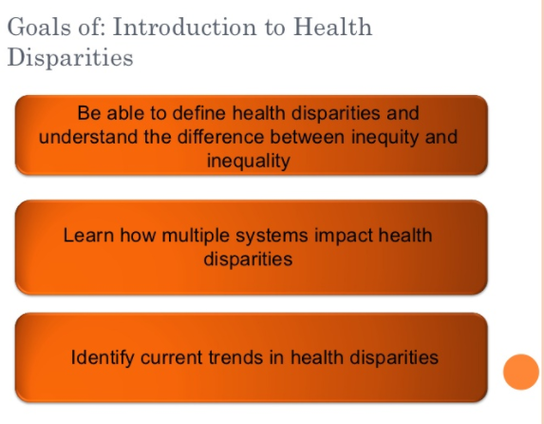

Slide 13

Health Disparities
Differences in health
outcomes
between groups
that reflect social
inequalities

Slide 14
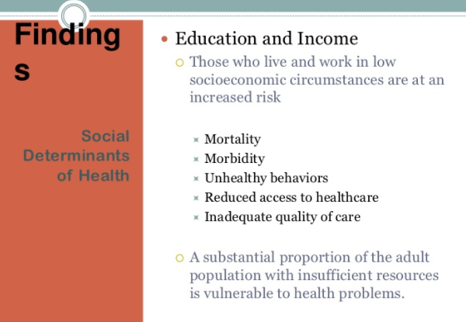
Findings
Social
Determinants
of Health

Slide 15
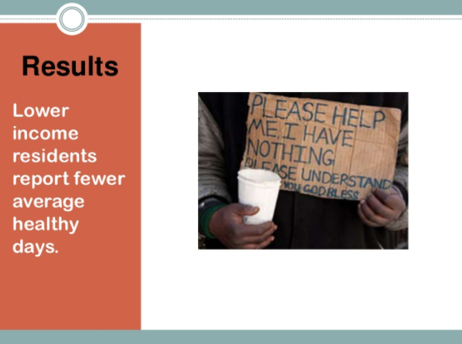
Results
Lower
income
residents
Report fewer
average
healthy
days

Slide 16

Environmental Hazard

Slide 17

Air Pollution
THIS WILL NOT GENERALLY BE THE CASE
IN YOUR FUTURE PRACTICE LOCATION
Urban
counties are
generally
near
sources of
air pollution

Slide 18
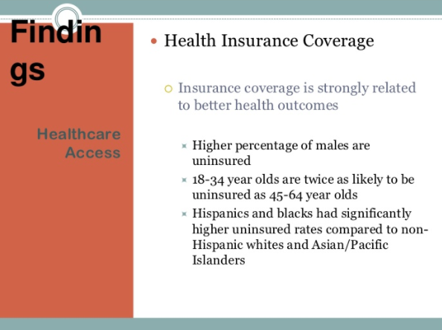
Findings
Healthcare
Access

Slide 19
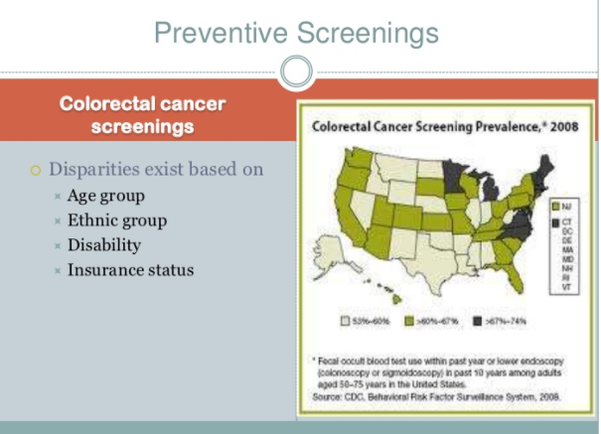
Preventative Screenings

Slide 20

Mortality

Slide 21
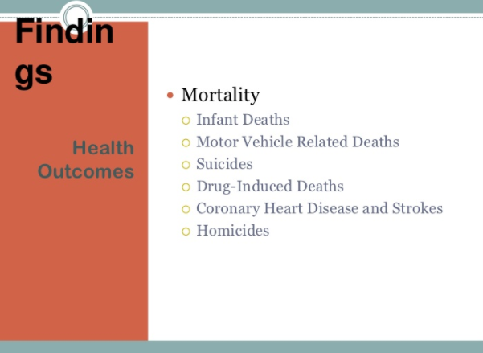
Findings
Health
Outcomes

Slide 22
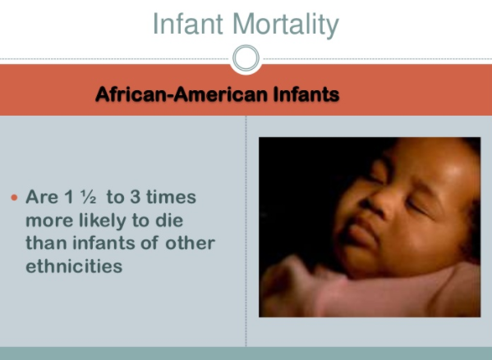
Infant Mortality

Slide 23
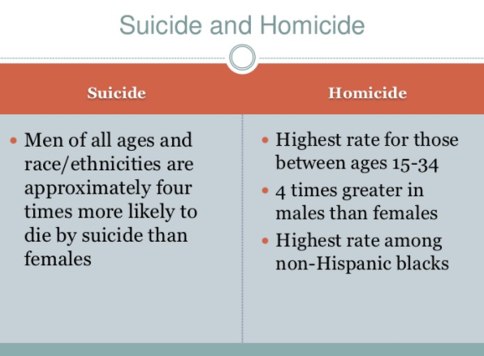
Suicide and Homicide

Slide 24
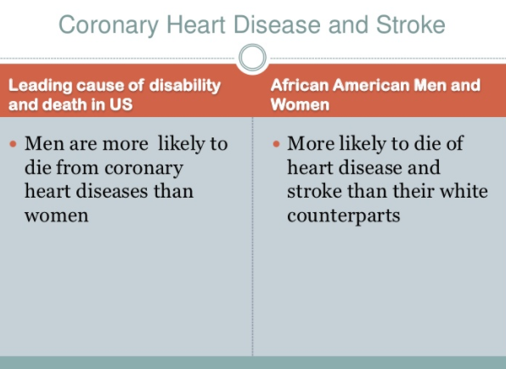
Coronary Heart Disease and Stroke

Slide 25
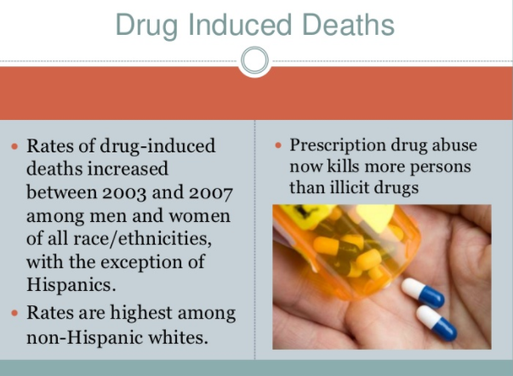
Drug Induced Deaths

Slide 26
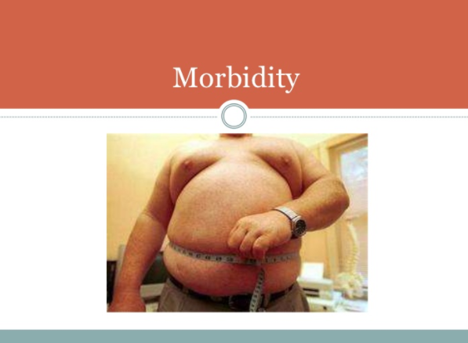
Morbidity

Slide 27
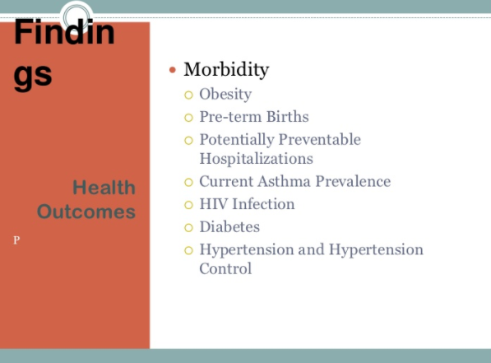
Findings
Health
Outcomes

Slide 28
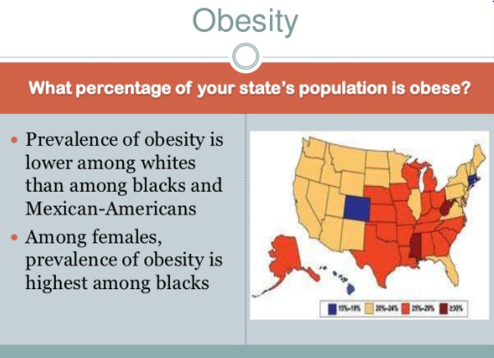
Obesity

Slide 29
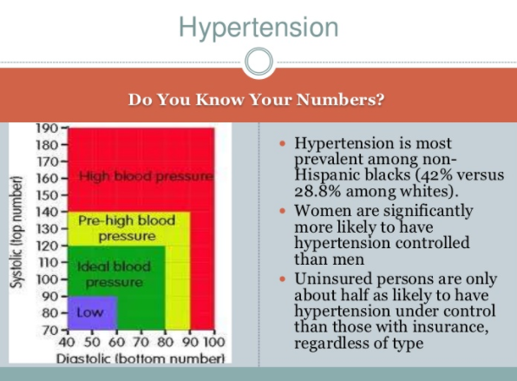
Hypertension
High
Blood
Pressure
Pre
High
Blood
Pressure
Ideal
Blood
Pressure

Slide 30


Behavioral Risk Factors

Slide 31
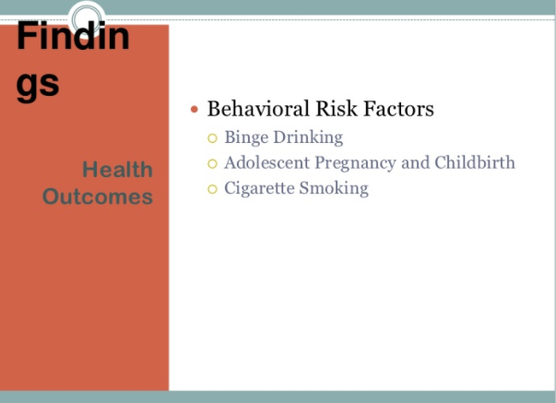
Findings
Health
Outcomes

Slide 32
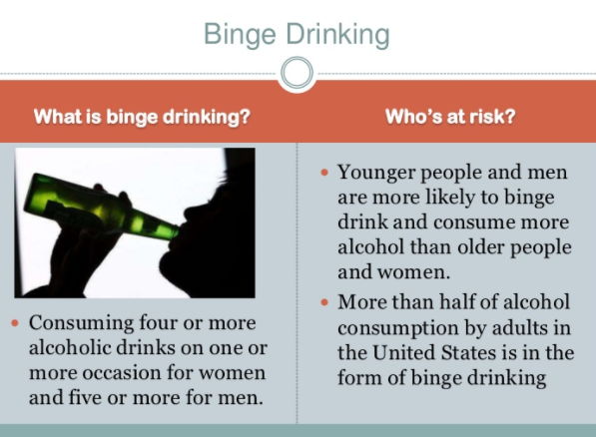
Binge Drinking

Slide 33
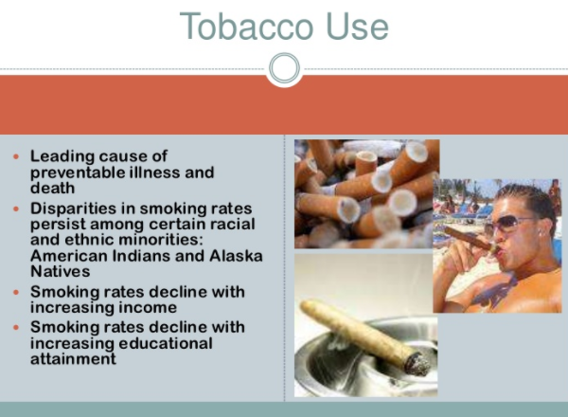
Tobacco Use

Slide 34
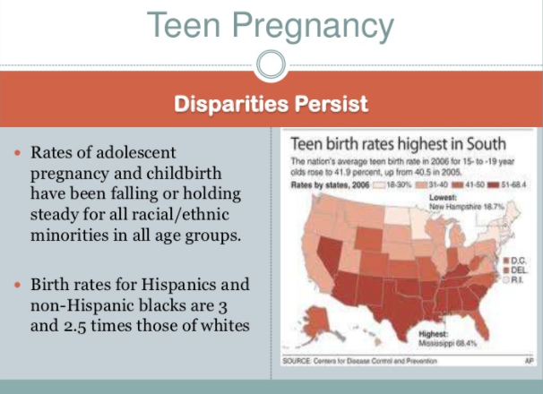
Teen Pregnancy

Slide 35




Slide 36
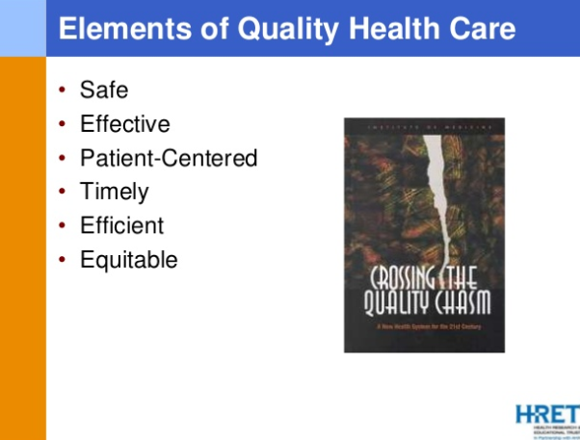

Slide 37
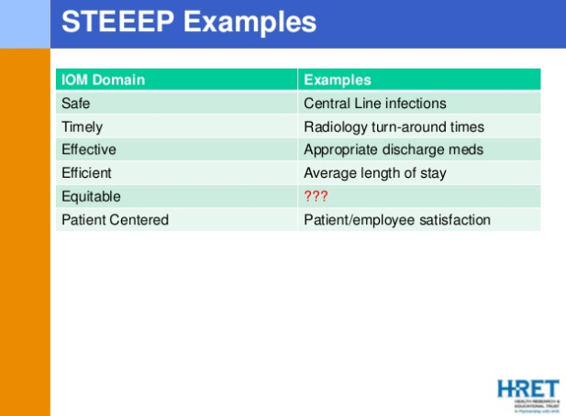

Slide 38
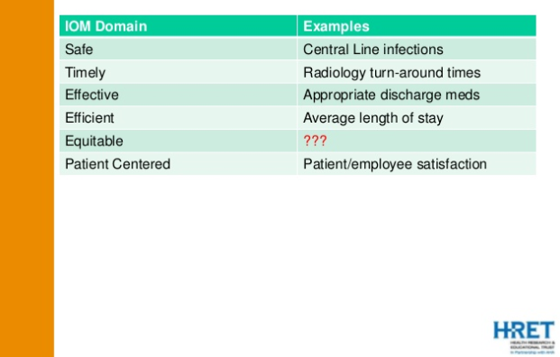

Slide 39


Slide 40
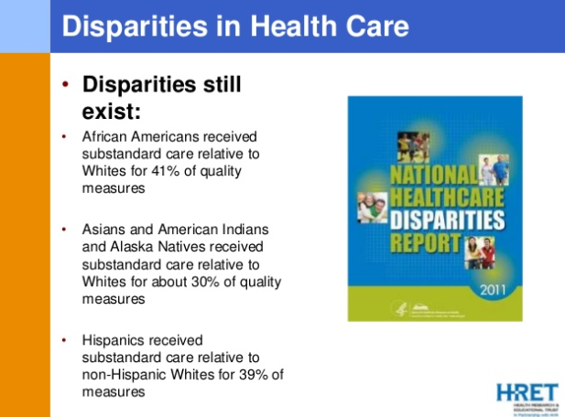

Slide 41
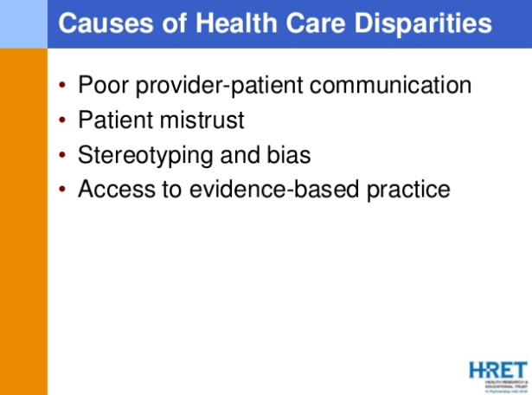

Slide 42
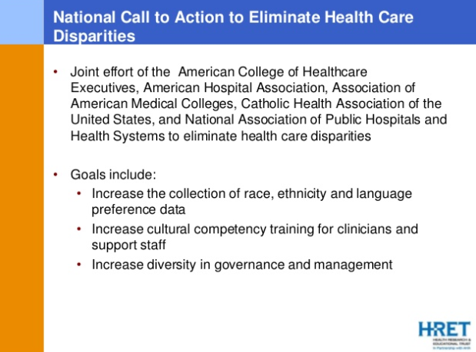

Slide 43


Slide 44
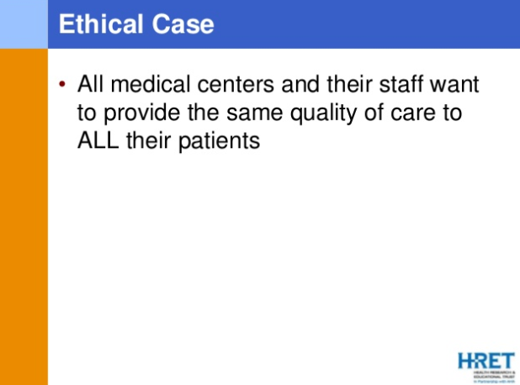

Slide 45
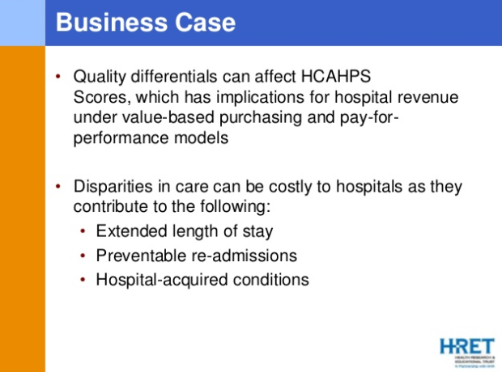

Slide 46
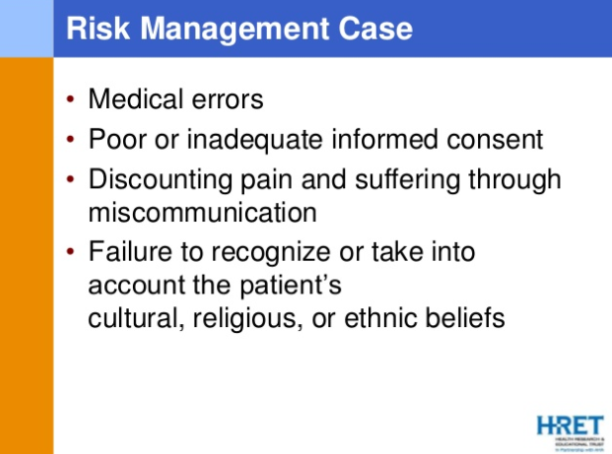

Slide 47
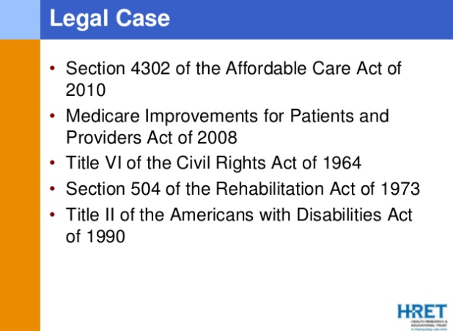

Slide 48
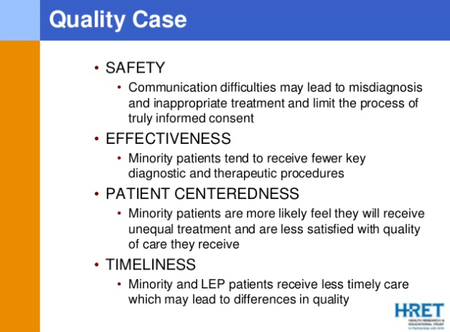

Slide 49
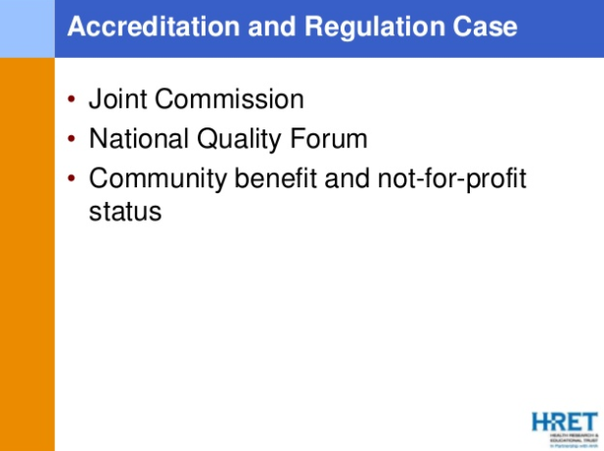

Slide 50
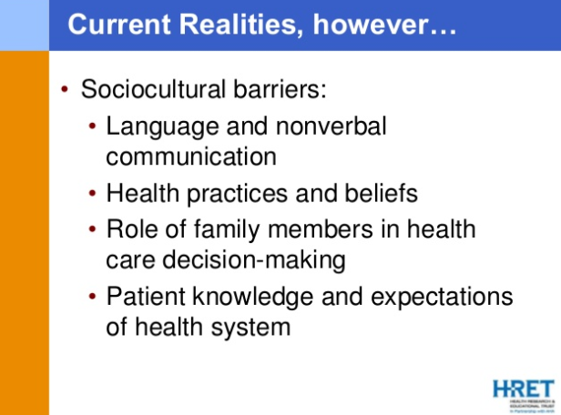

Slide 51
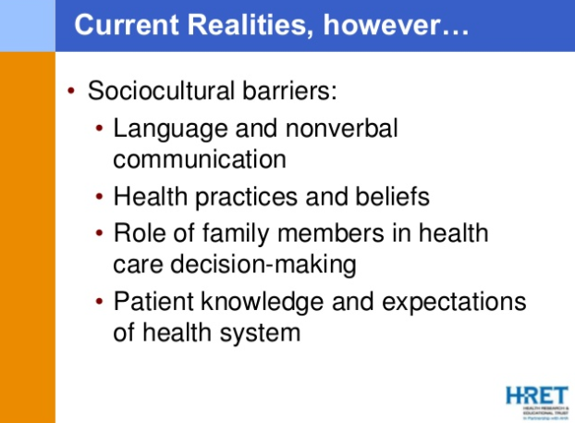

Slide 52


Slide 53


Slide 54
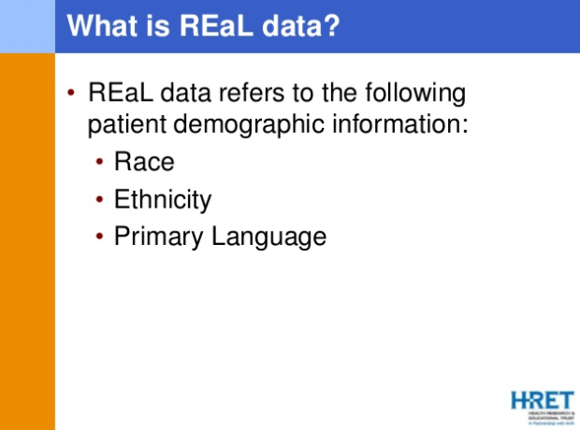

Slide 55


Slide 56


Slide 57
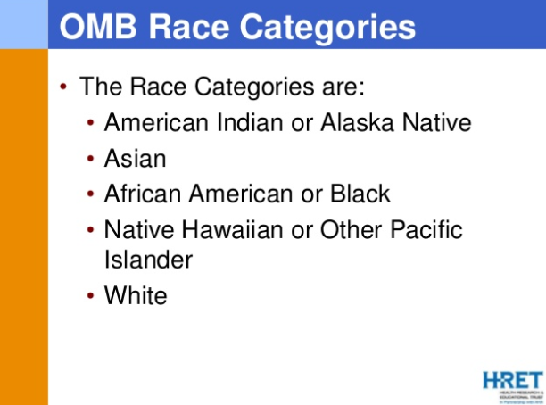
The Office of Management and Budget (OMB) serves the President of the United States in overseeing the implementation of his vision across the Executive Branch. Specifically, OMB’s mission is to assist the President in meeting his policy, budget, management and regulatory objectives
and to fulfill the agency’s statutory responsibilities.

Slide 58
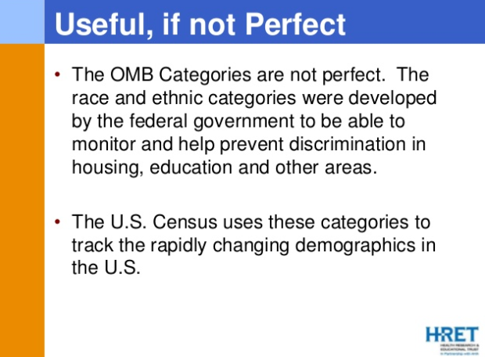
The Office of Management and Budget (OMB) serves the President of the United States in overseeing the implementation of his vision across the Executive Branch. Specifically, OMB’s mission is to assist the President in meeting his policy, budget, management and regulatory objectives
and to fulfill the agency’s statutory responsibilities.

Slide 59
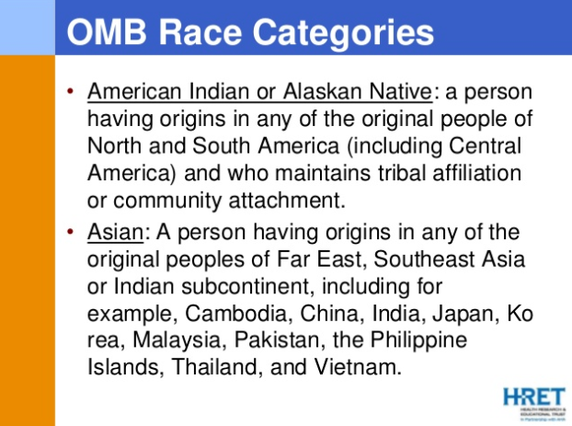

Slide 60
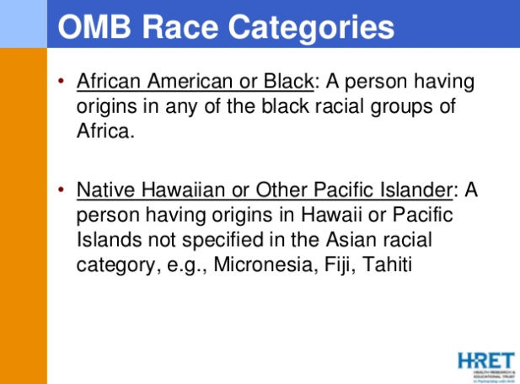

Slide 61
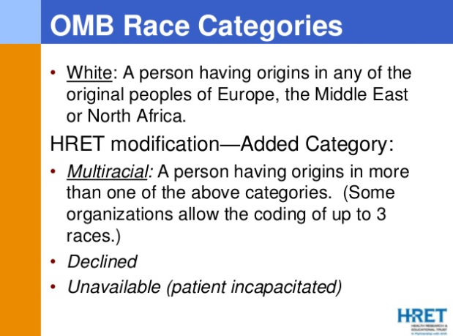

Slide 62


Slide 63
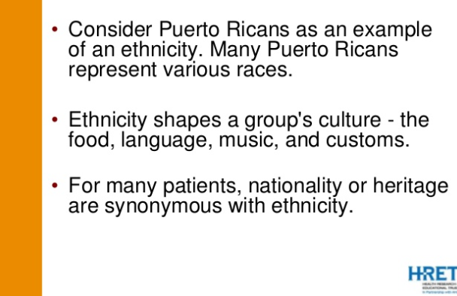

Slide 64
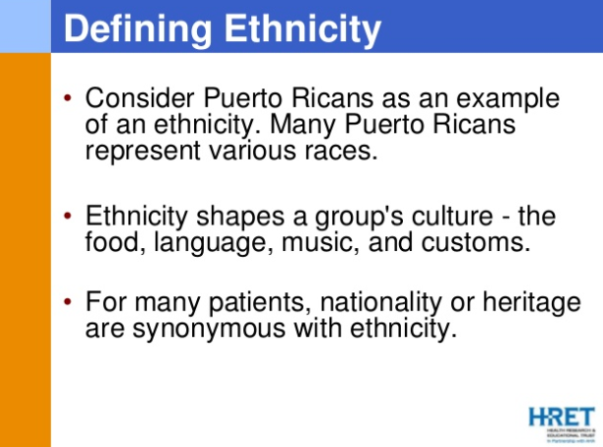

Slide 65
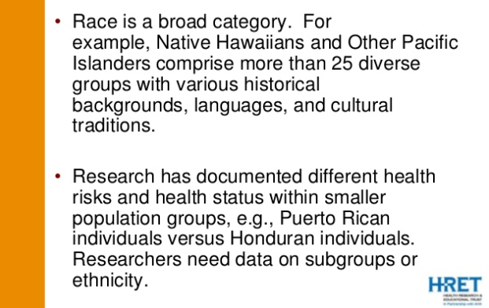

Slide 66
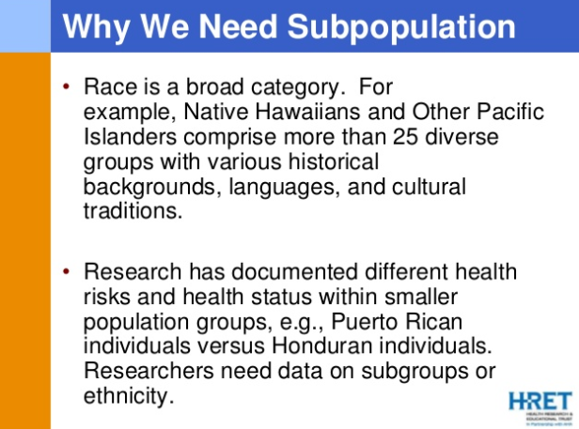

Slide 67


Slide 68


Slide 69
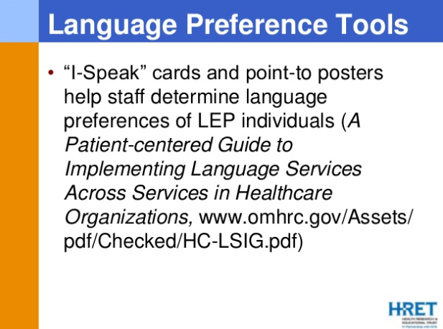

Slide 70
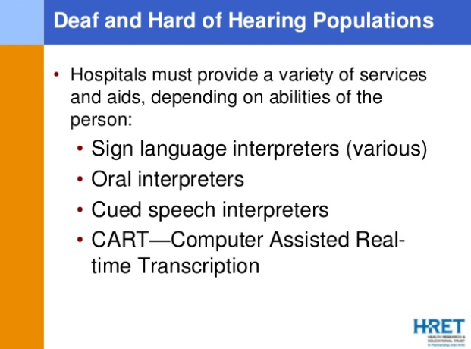

Slide 71


Slide 72
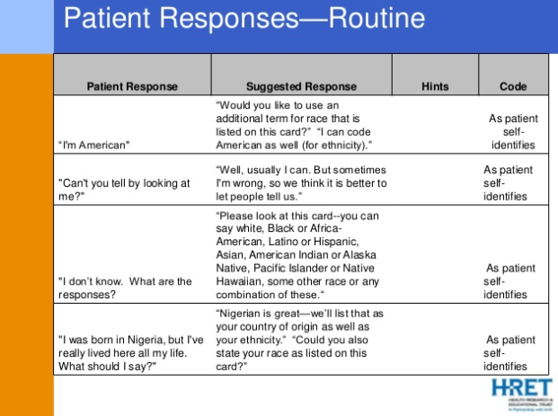

Slide 73
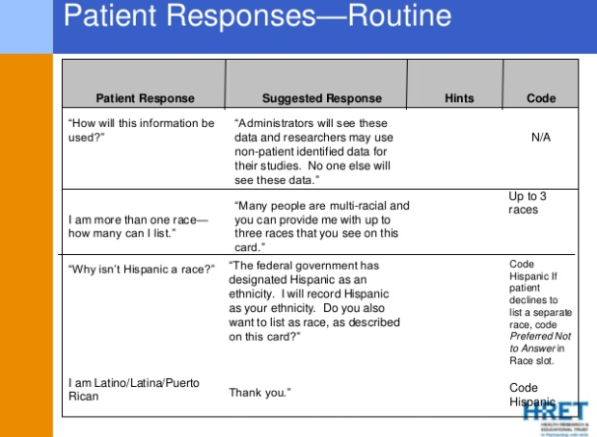
Hispanic

Slide 74
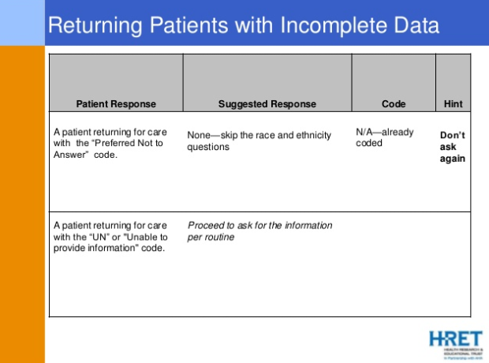

Slide 75
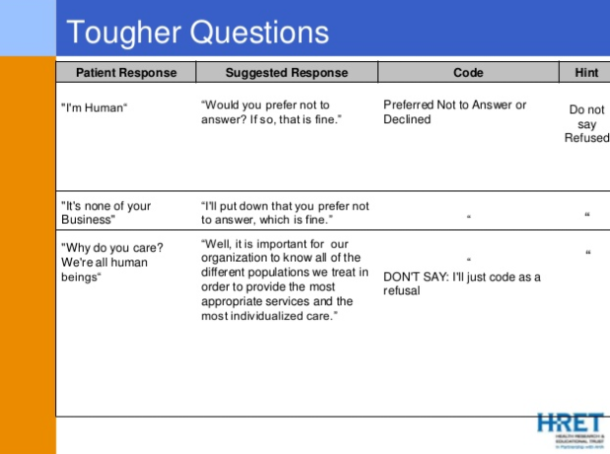

Slide 76


Slide 77


Slide 78
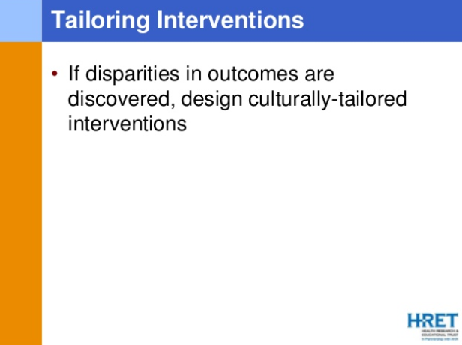

Slide 79
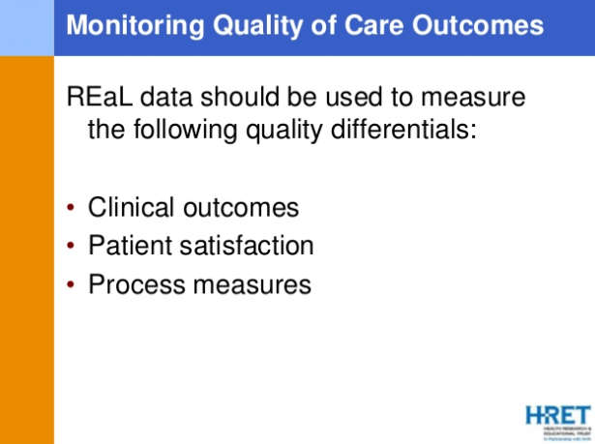

Slide 80


Slide 81


Slide 82
1. Process measures indicate what a provider does to maintain or improve health, either for healthy people or for those diagnosed with a health care condition. These measures typically reflect generally accepted recommendations for clinical practice
True
False

Slide 83
1. Process measures indicate what a provider does to maintain or improve health, either for healthy people or for those diagnosed with a health care condition. These measures typically reflect generally accepted recommendations for clinical practice
True
False

Slide 84
2. Which of the following answer is the best answer with regard to hypertension?
Hypertension is most prevalent among non-Hispanic blacks (42% versus 28.8% among whites)
Women are significantly more likely to have hypertension controlled than men
Uninsured persons are only about half as likely to have hypertension under control than those with insurance, regardless of type
All of the above if correct
None of the above is correct

Slide 85
2. Which of the following answer is the best answer with regard to hypertension?
Hypertension is most prevalent among non-Hispanic blacks (42% versus 28.8% among whites)
Women are significantly more likely to have hypertension controlled than men
Uninsured persons are only about half as likely to have hypertension under control than those with insurance, regardless of type
All of the above if correct
None of the above is correct

Slide 86
3. Which of the following is the best answer regarding teen pregnancy?
Rates of adolescents pregnancy and childbirth have been falling or holding steady for all racial/ethnic minorities in all age groups
Birth rates for Hispanics and non-Hispanic black are 3 and 2.5 time those of whites
Teen birth rates highest in South
All of the above

Slide 87
3. Which of the following is the best answer regarding teen pregnancy?
Rates of adolescents pregnancy and childbirth have been falling or holding steady for all racial/ethnic minorities in all age groups
Birth rates for Hispanics and non-Hispanic black are 3 and 2.5 time those of whites
Teen birth rates highest in South
All of the above

Slide 88
4. Which of the following statements is thought to be incorrect regarding smoking?
Leading cause of preventable illness and death
Disparities in smoking rates persist among certain racial ethnic minorities: American Indians and Alaska Natives
Smoking rates decline with increasing income
Smoking rates decline with increasing educational attainment
Smoking has been shown to reduce depression

Slide 89
4. Which of the following statements is thought to be incorrect regarding smoking?
Leading cause of preventable illness and death
Disparities in smoking rates persist among certain racial ethnic minorities: American Indians and Alaska Natives
Smoking rates decline with increasing income
Smoking rates decline with increasing educational attainment
Smoking has been shown to reduce depression

Slide 90
5. Which of the following is not a correct statement?
Consuming four or more alcoholic drinks on one or more occasion for women and five or more for men
Younger people and men are more likely to binge drink and consume more alcohol than older people and women
More than half of alcohol consumption by adults in the United States is in the form of binge drinking
Drinking four or more alcoholic drink every day dramatically improves health by lowering cholesterol

Slide 91
5. Which of the following is not a correct statement?
Consuming four or more alcoholic drinks on one or more occasion for women and five or more for men
Younger people and men are more likely to binge drink and consume more alcohol than older people and women
More than half of alcohol consumption by adults in the United States is in the form of binge drinking
Drinking four or more alcoholic drink every day dramatically improves health by lowering cholesterol

