Slide 1

MODULE Four:
MEDICAL PROTOCOLS
AND
QUALITY ASSURANCE

Slide 2
MODULE Four:
SECTION Five:
System Certification and
Accreditation, Quality
of Medical Units and Staff,
Joint Commission and
National Committee for
Quality Assurance (NCQA)

Slide 3
UNIT OBJECTIVE
To know the importance of the Joint Commission and specialty Boards’ processes of accreditation and standards of quality

Slide 4
System Certification and Accreditation, Quality of Medical Units and Staff,
Joint Commission and National Committee for Quality Assurance (NCQA)
Joint Commission accreditation
Evaluation of daily medical practice
Certification and recertification of specialists
Continuing education for physicians

Slide 5
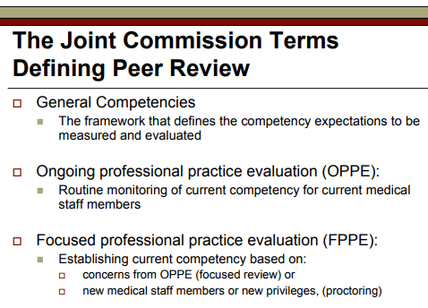

Slide 6
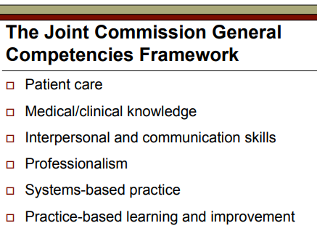

Slide 7


Slide 8
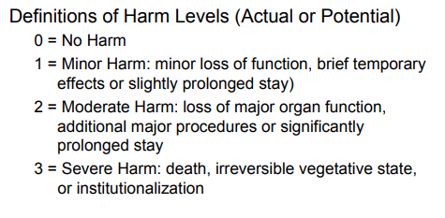

Slide 9
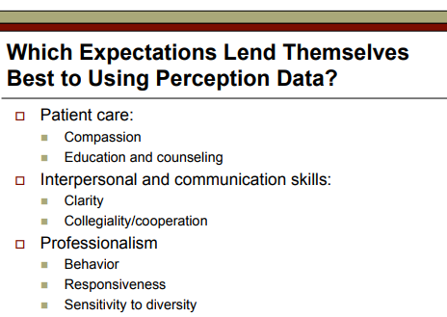

Slide 10
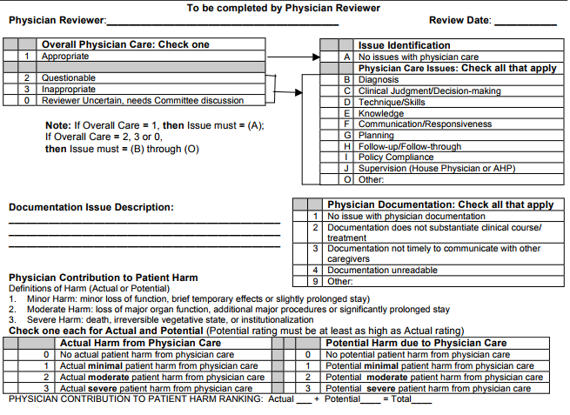
Peer Review Case Rating Form

Slide 11
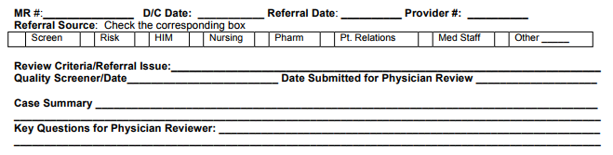
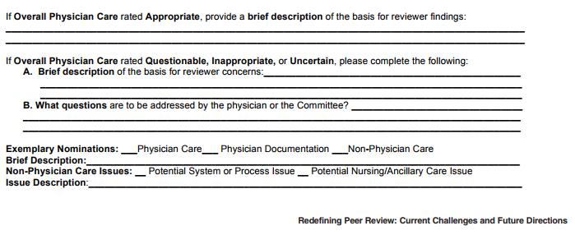
Peer Review
Case Rating Form

Slide 12
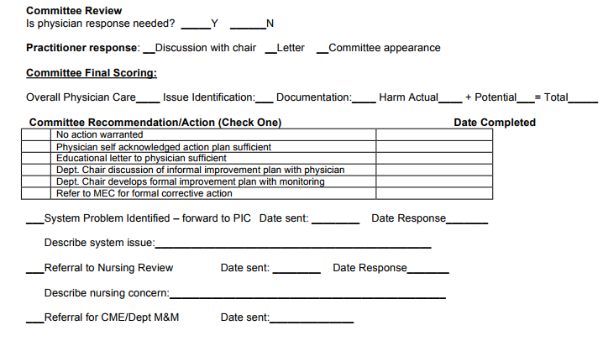
Peer Review
Case Rating Form continued

Slide 13
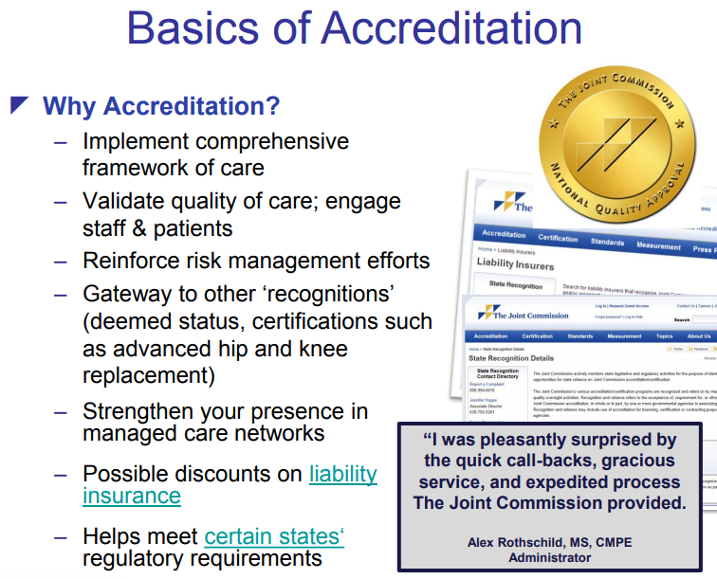

Slide 14
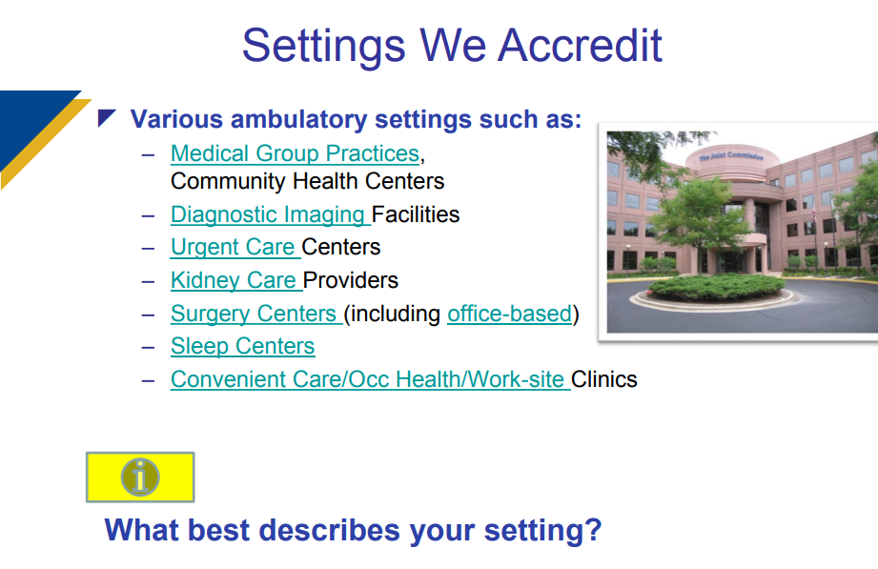

Slide 15
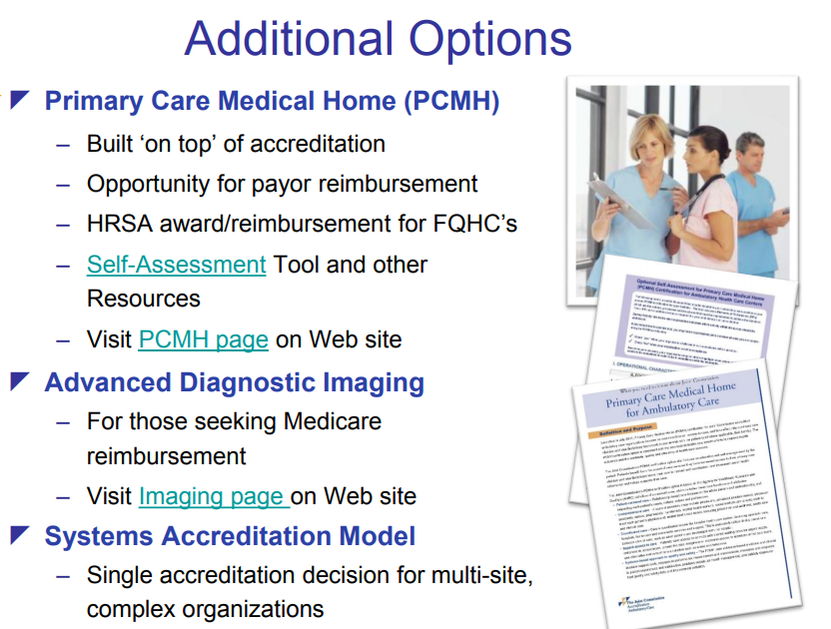

Slide 16
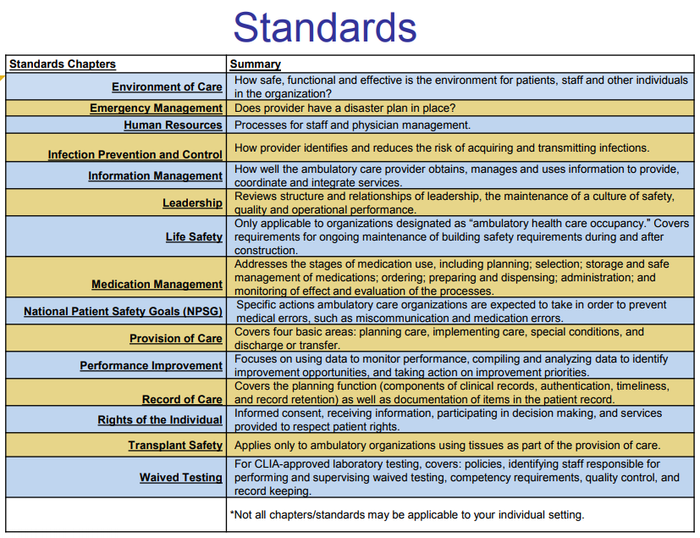

Slide 17
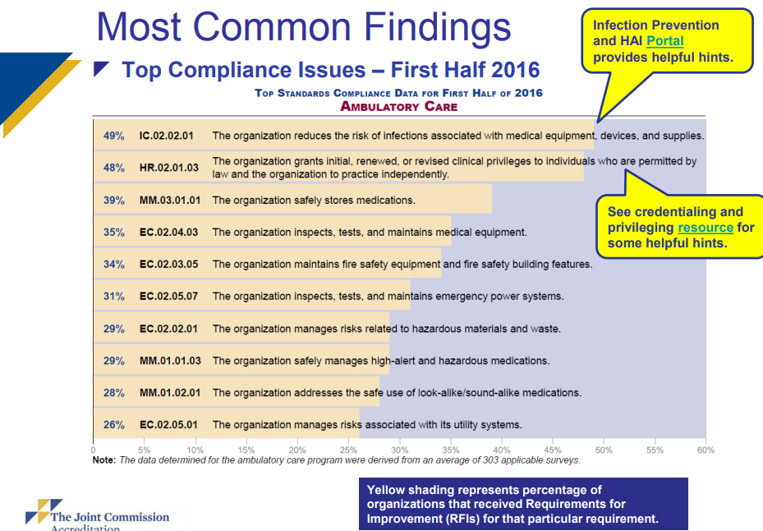

Slide 18
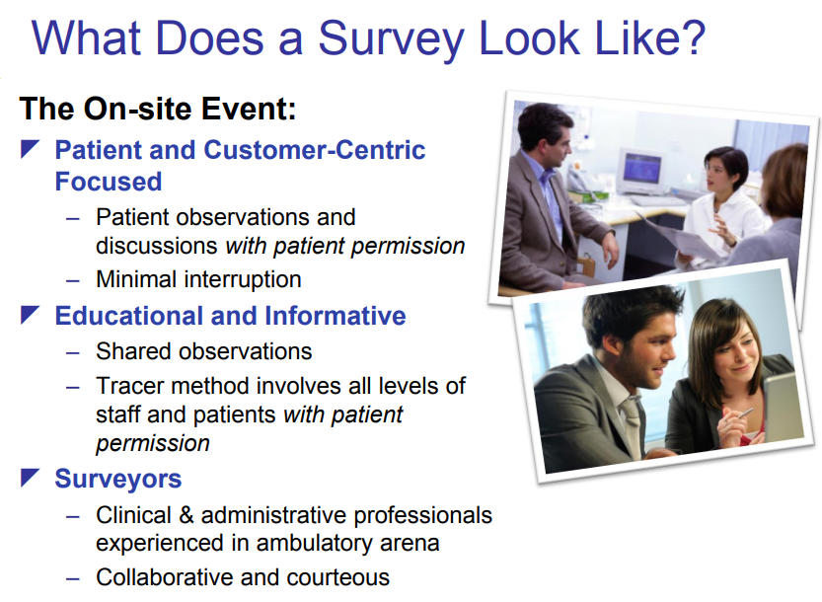

Slide 19
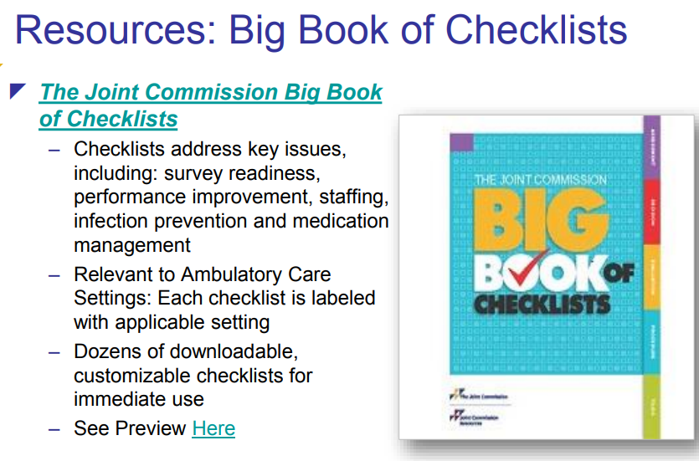

Slide 20
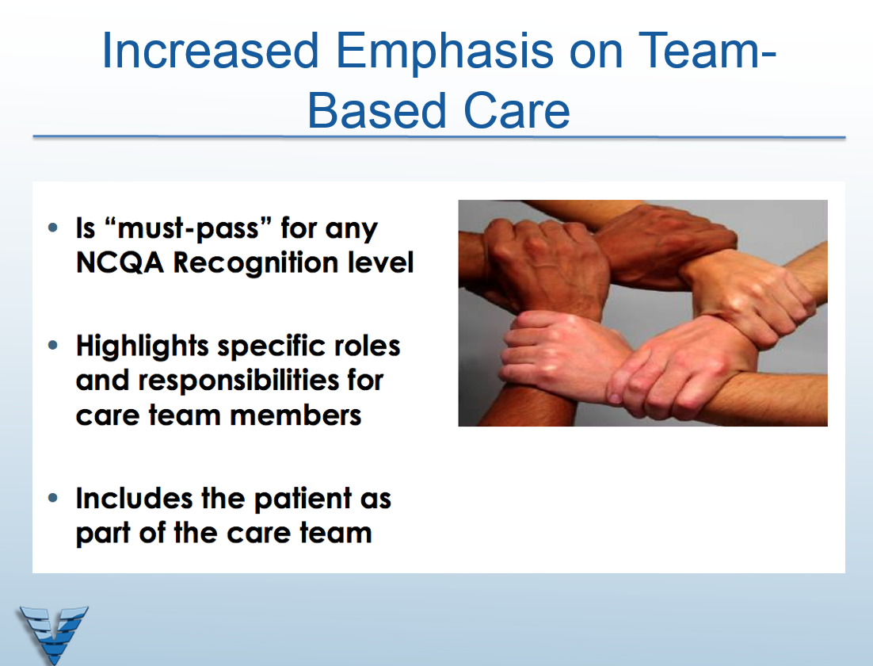

Slide 21
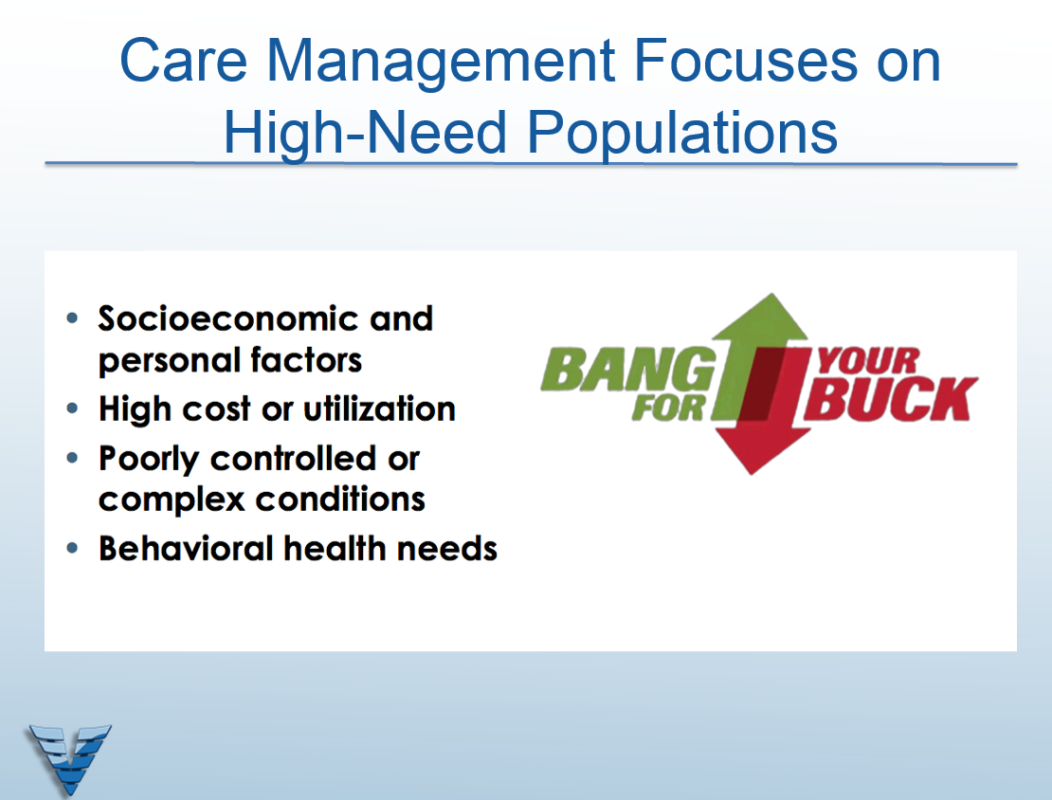

Slide 22
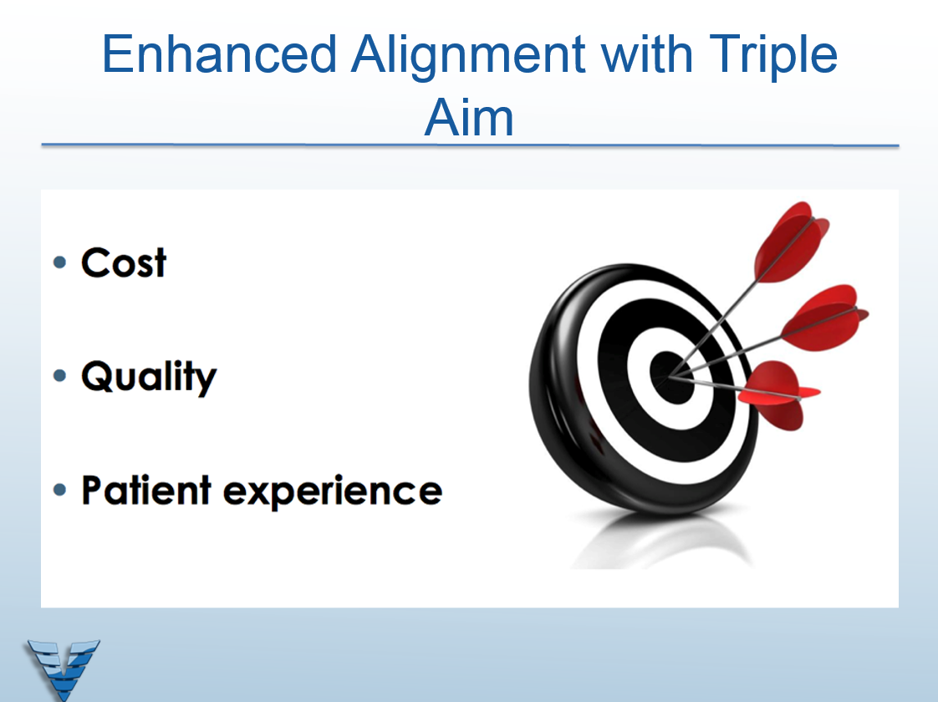

Slide 23
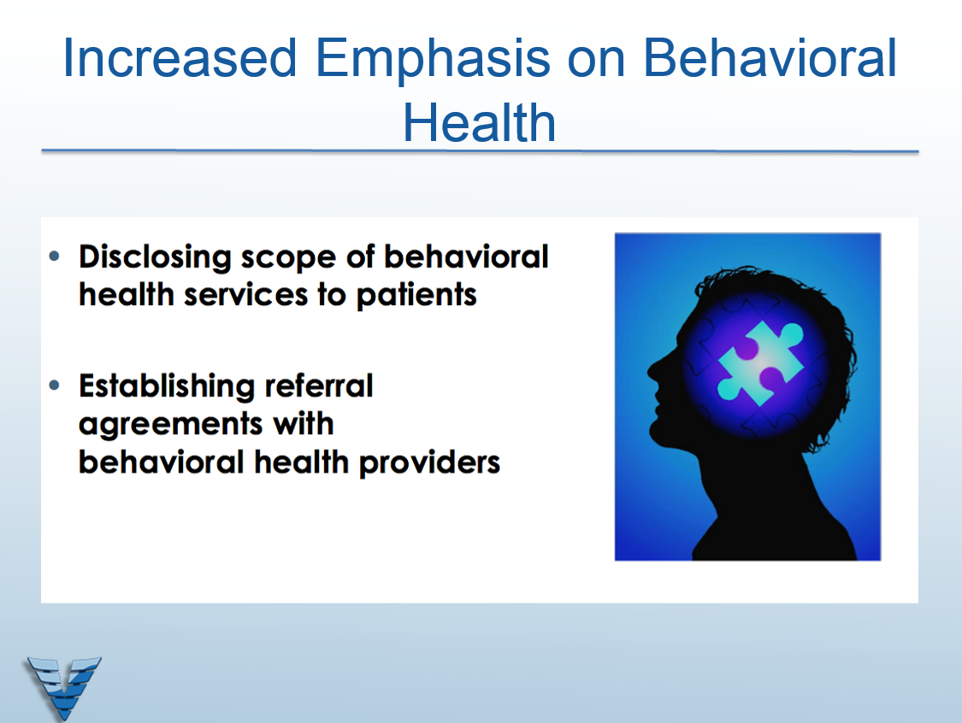

Slide 24
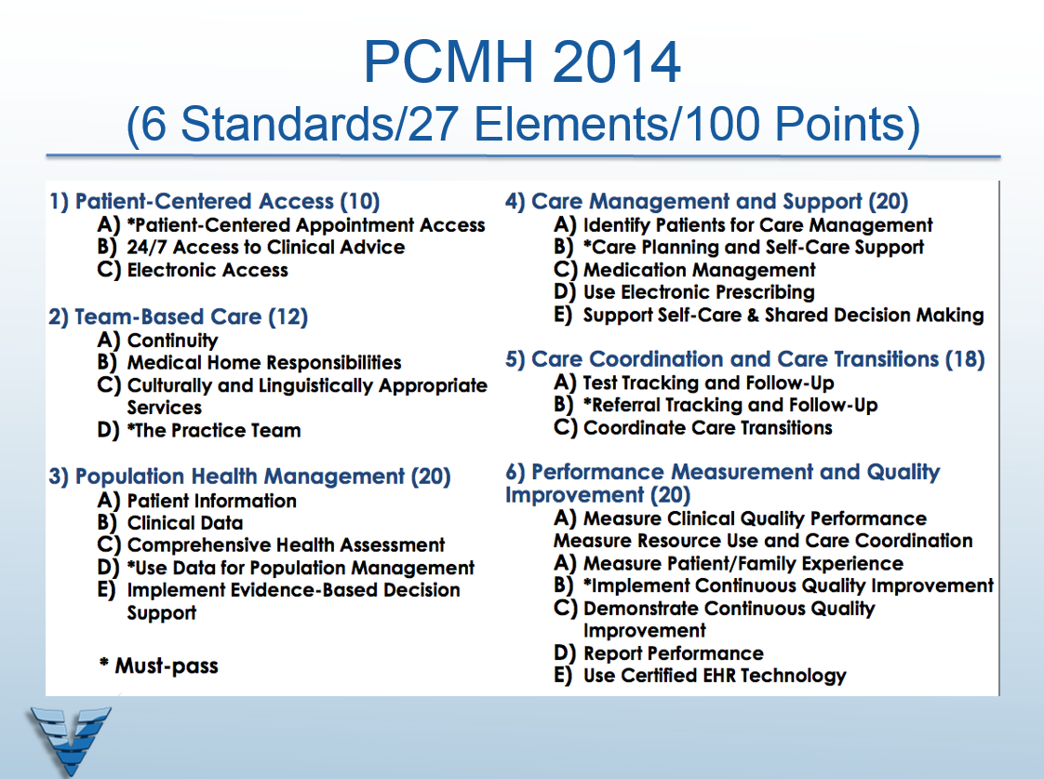


Slide 25
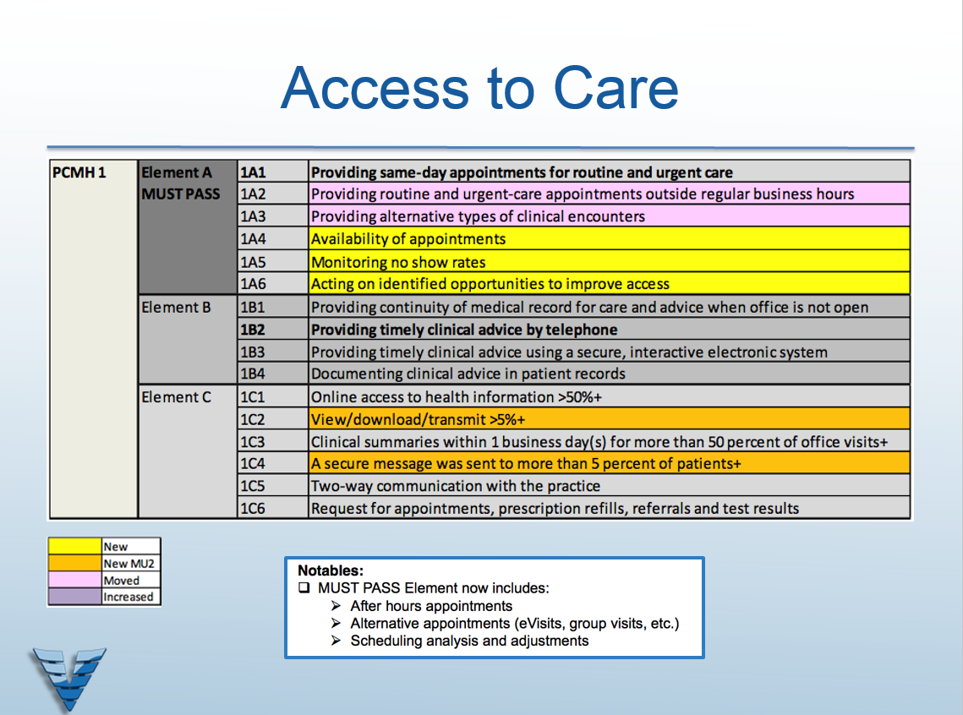

Slide 26
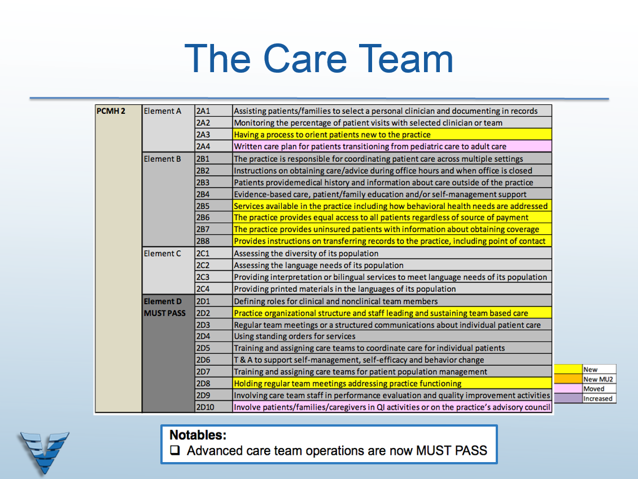

Slide 27
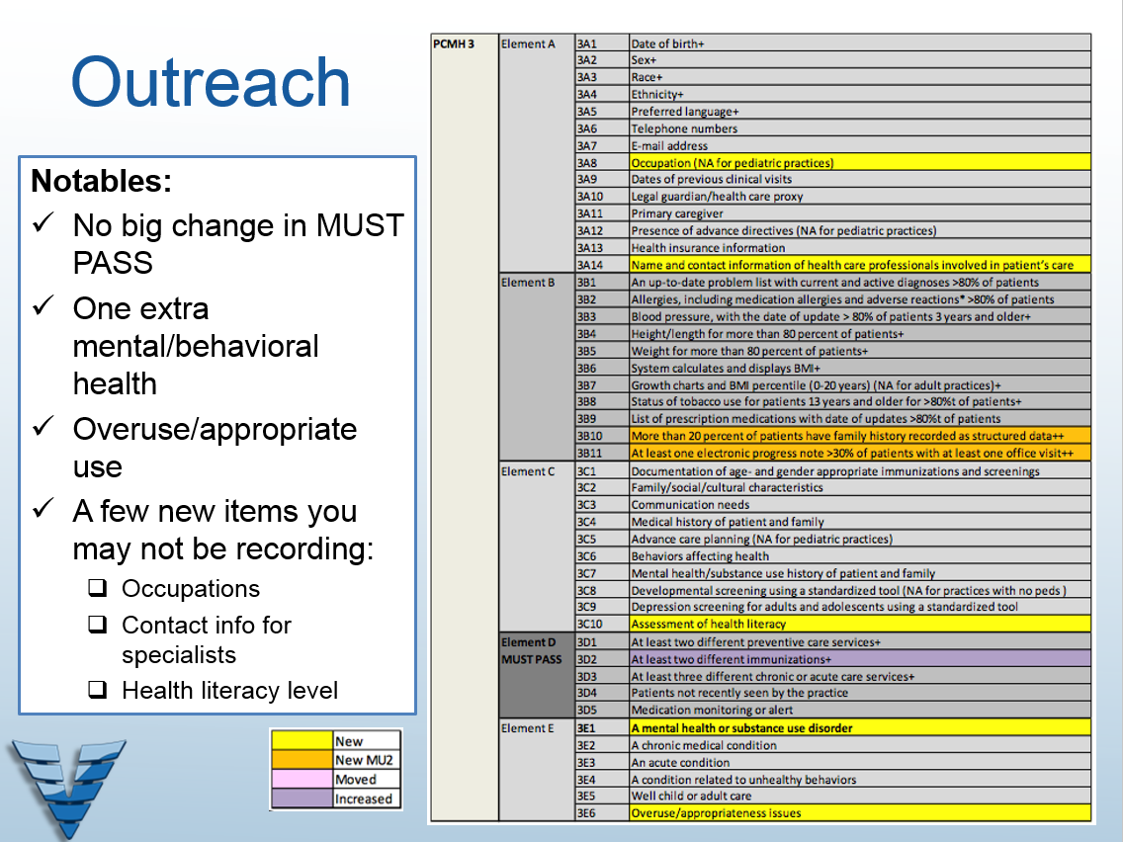

Slide 28
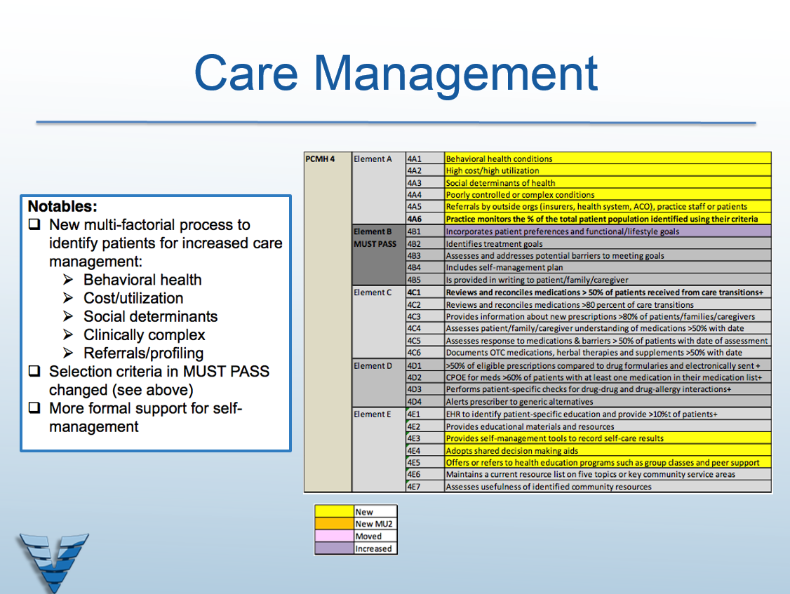

Slide 29
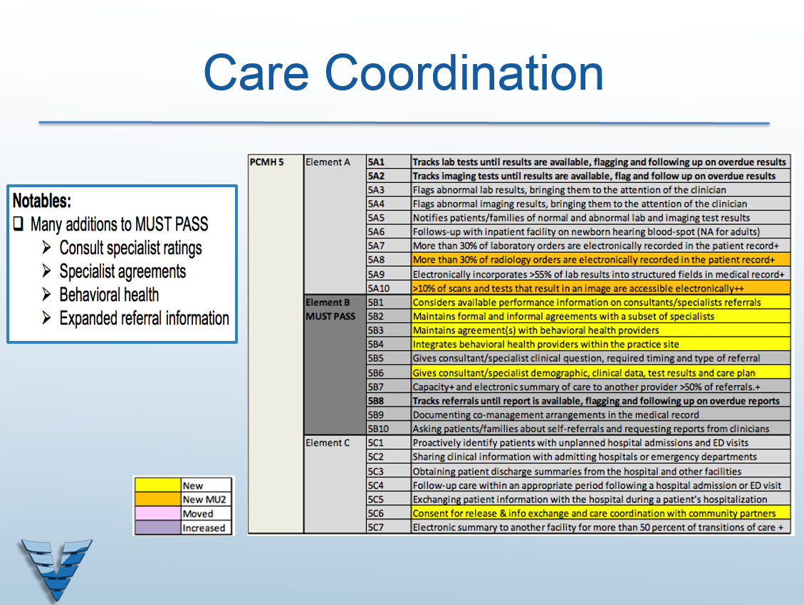

Slide 30
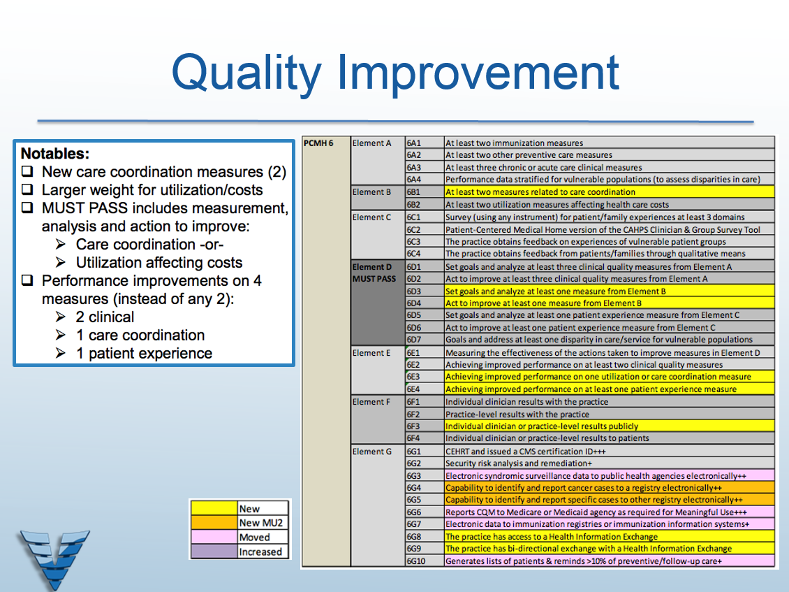

Slide 31

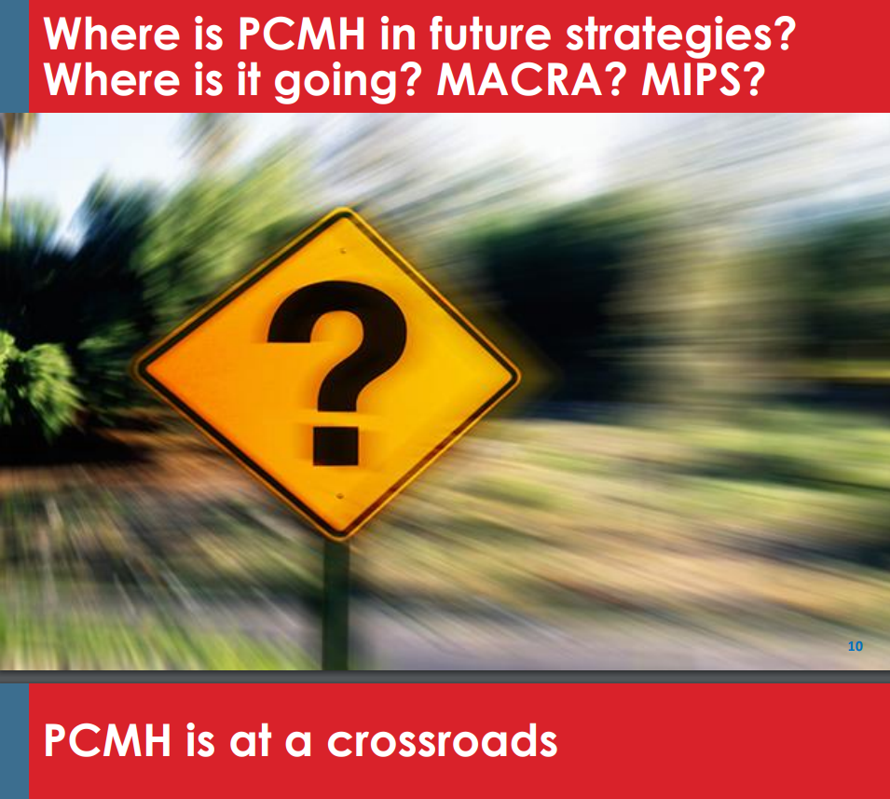

Slide 32
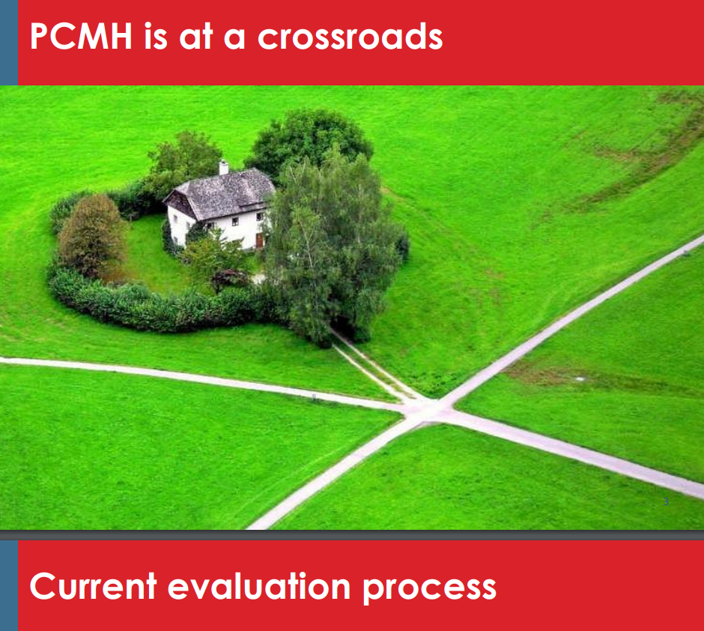

Slide 33
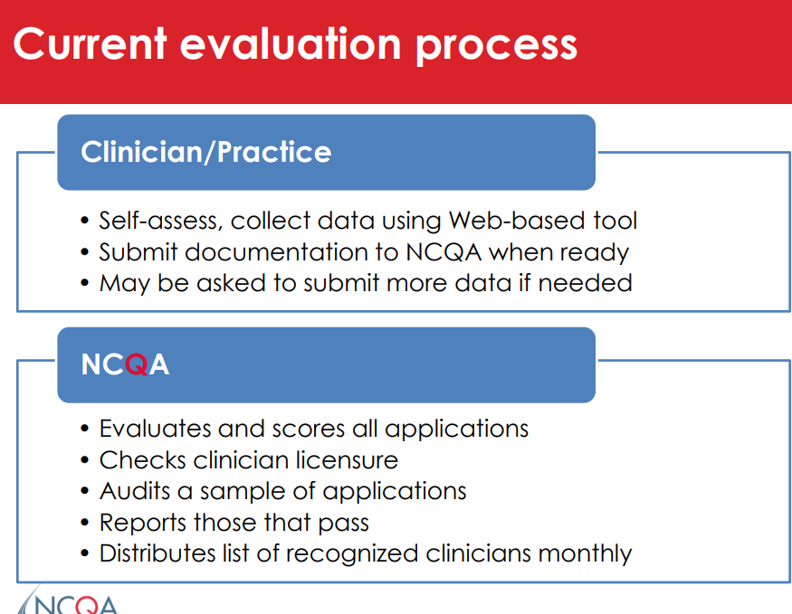

Slide 34
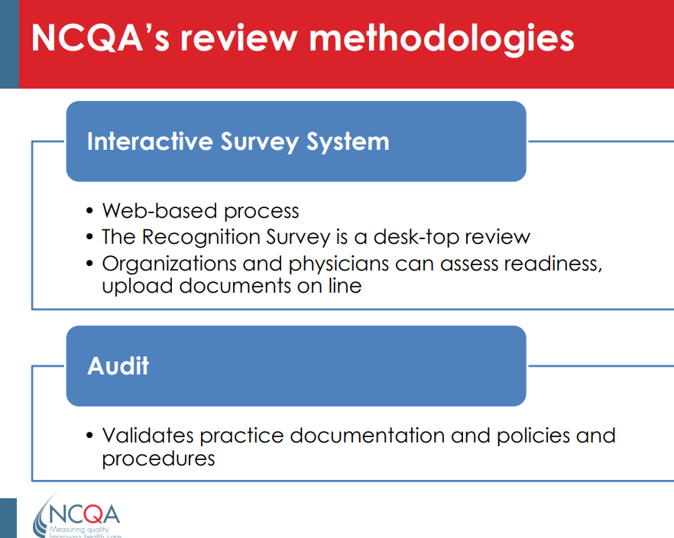

Slide 35
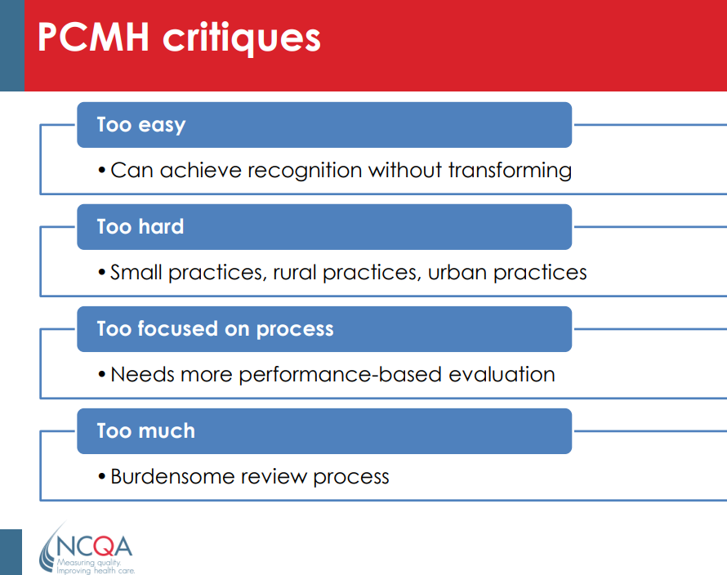

Slide 36
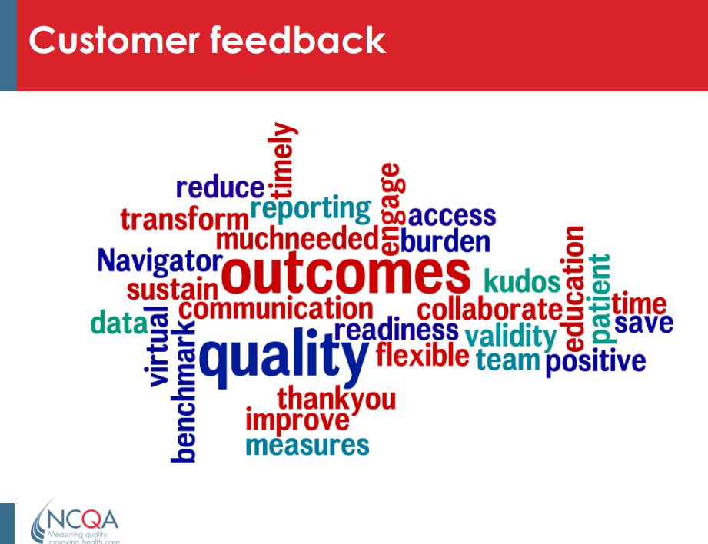

Slide 37
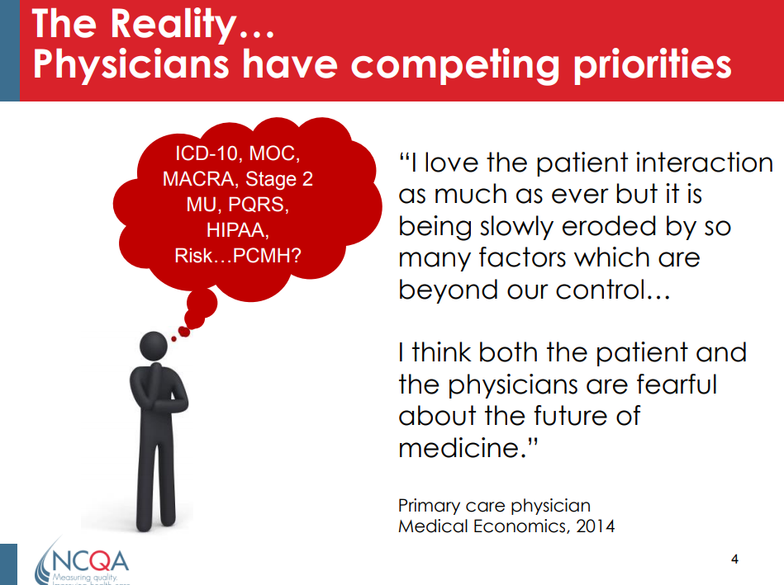

Slide 38
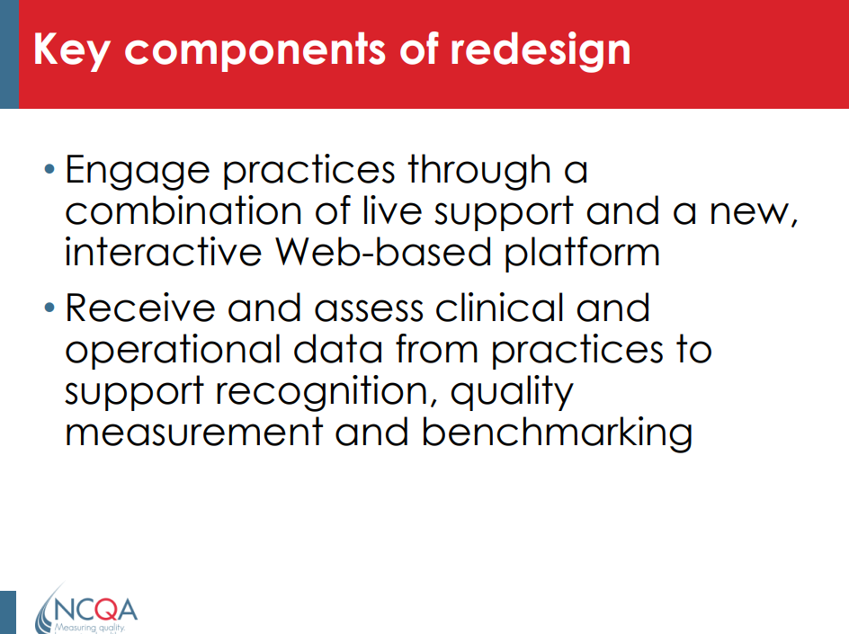

Slide 39
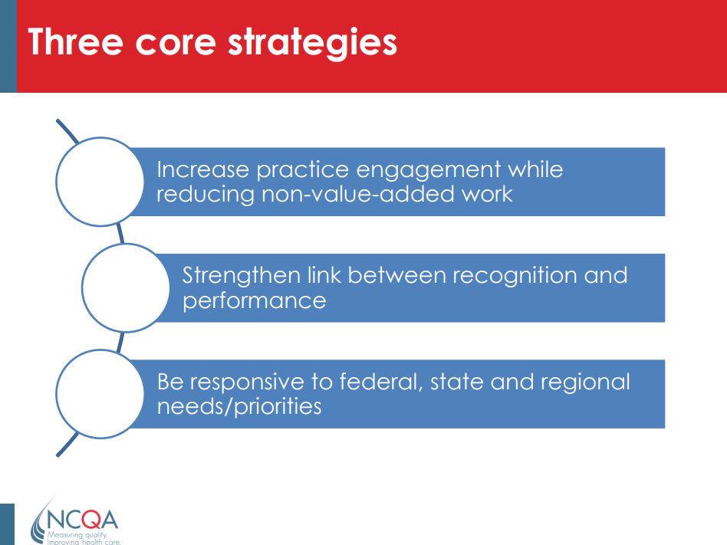

Slide 40
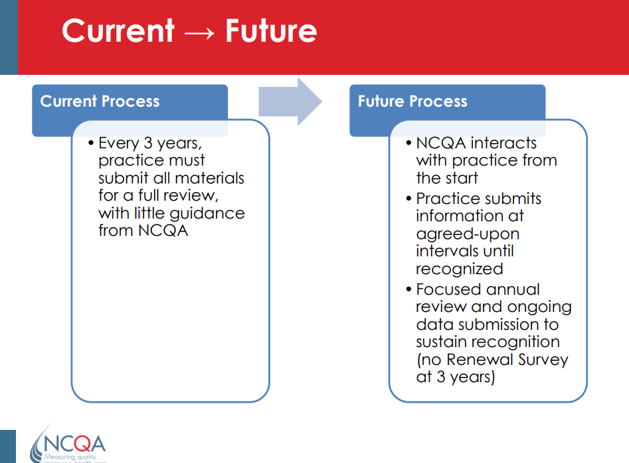

Slide 41
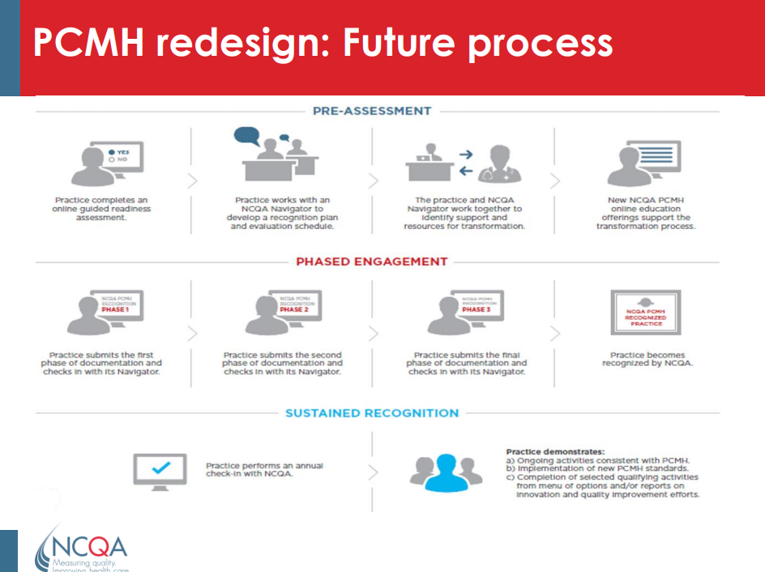

Slide 42
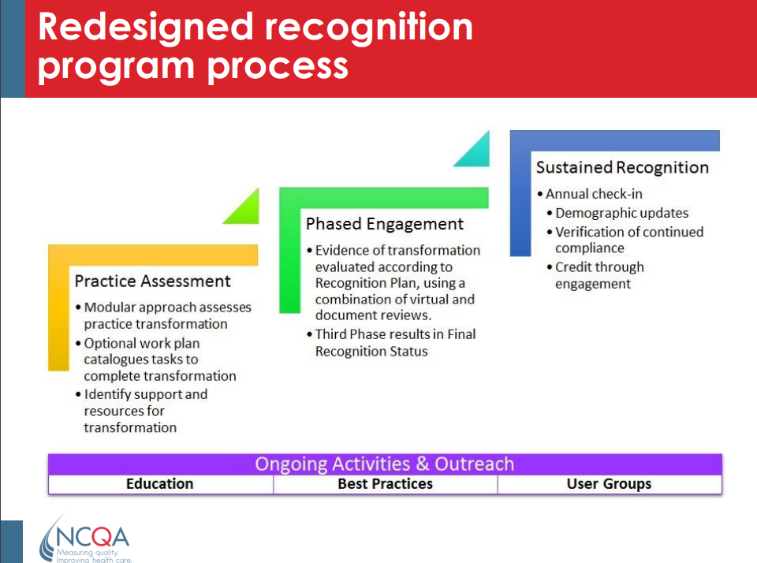

Slide 43
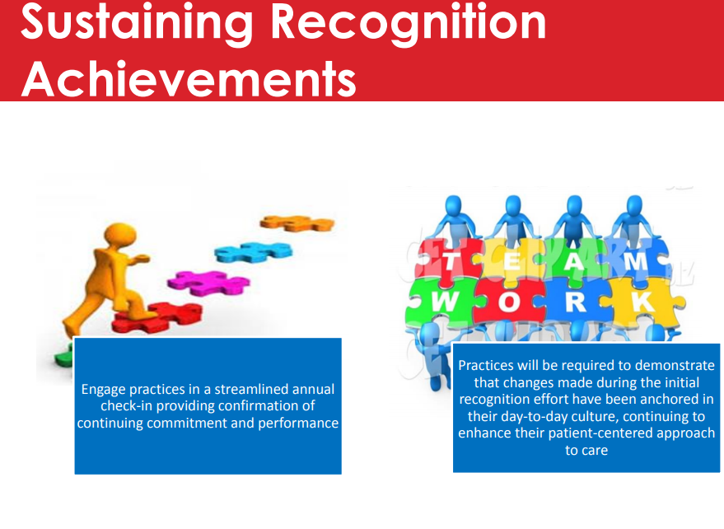

Slide 44
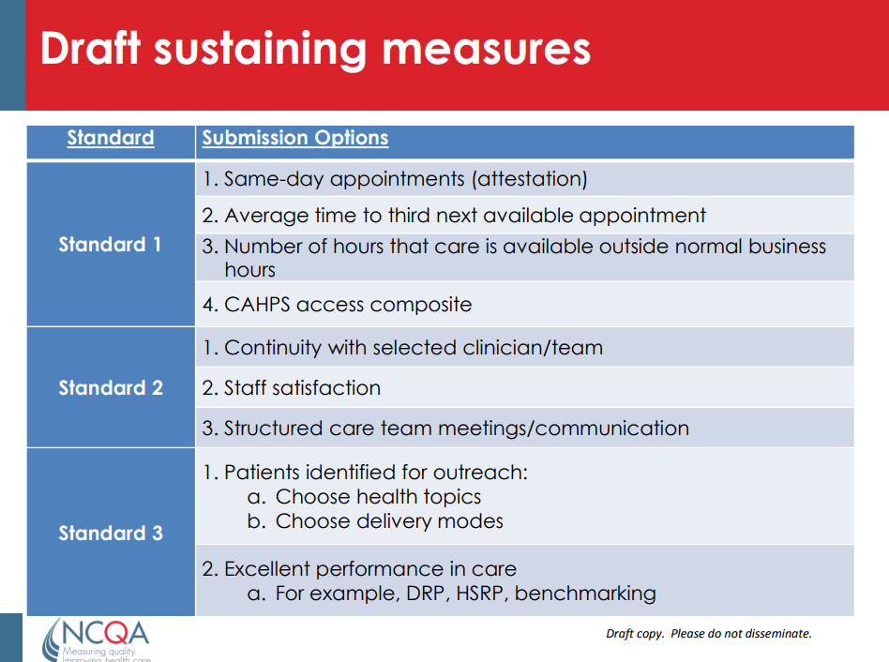
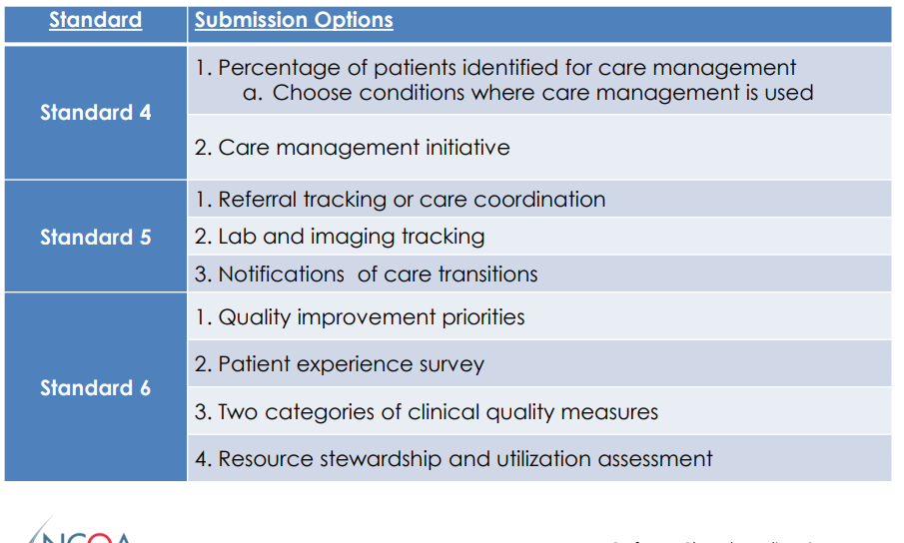

Slide 45
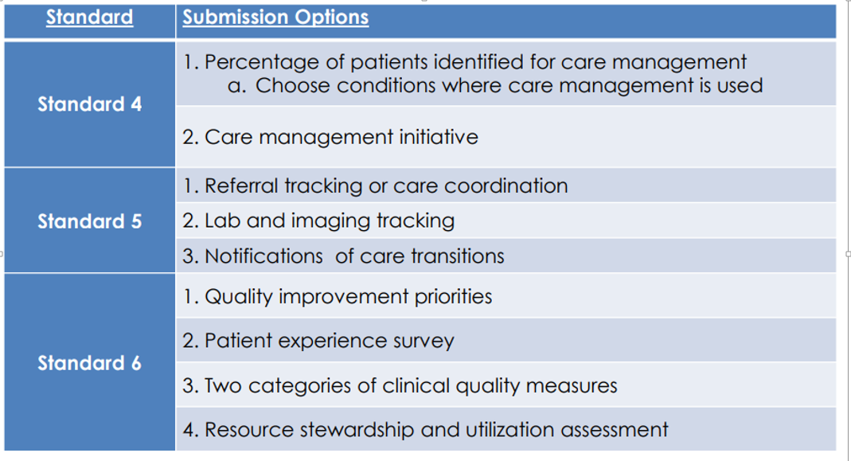

Slide 46
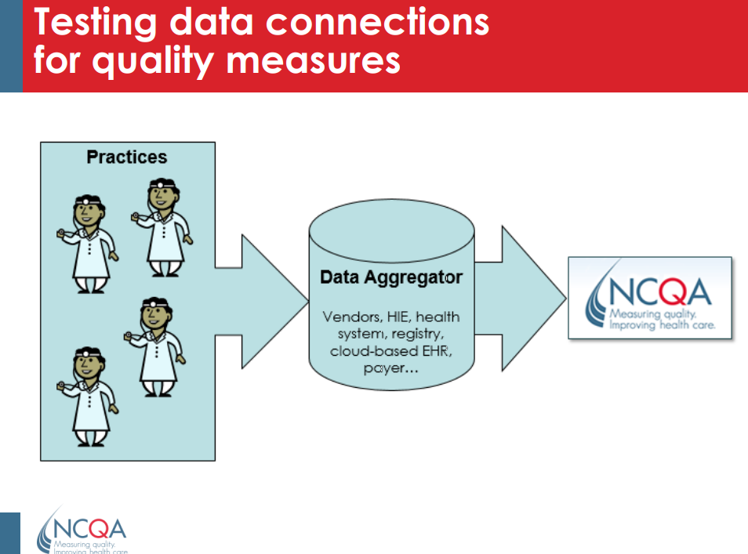

Slide 47
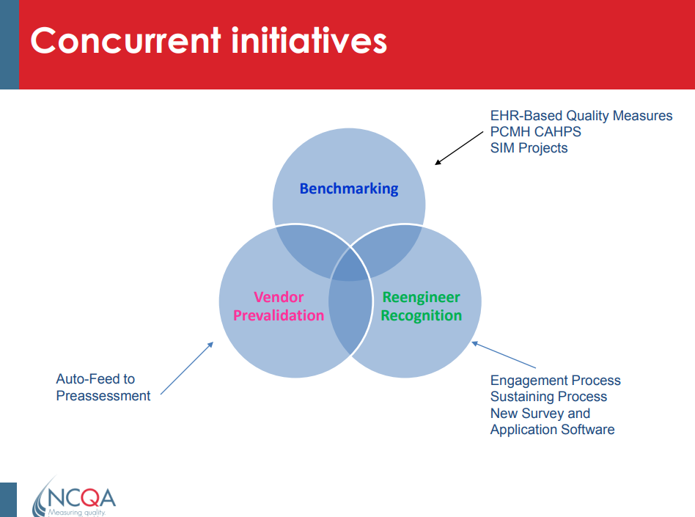

Slide 48
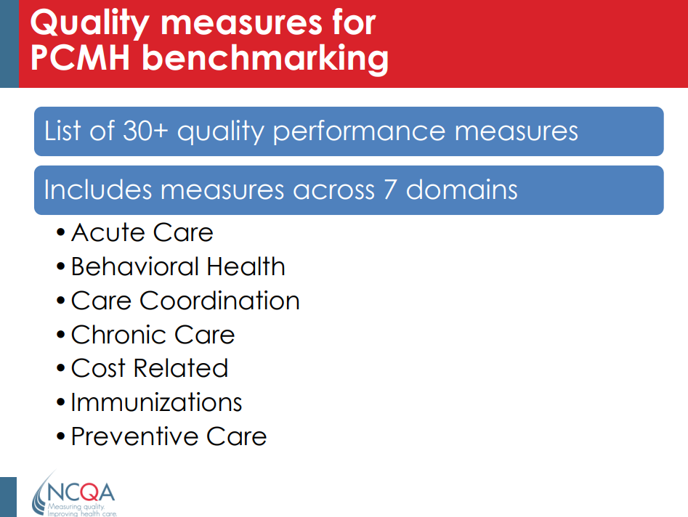

Slide 49
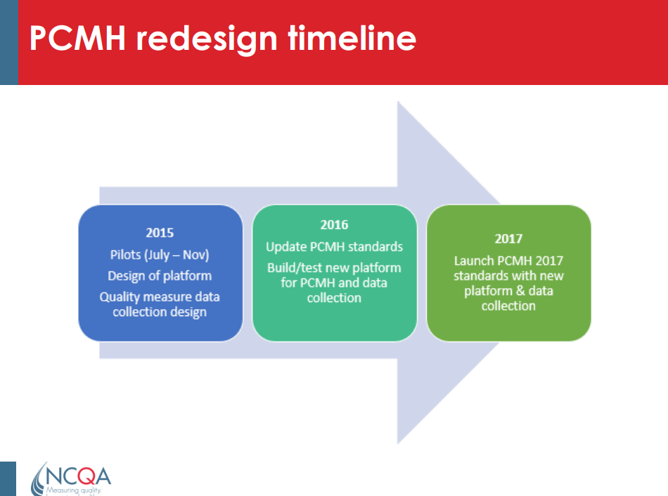

Slide 50
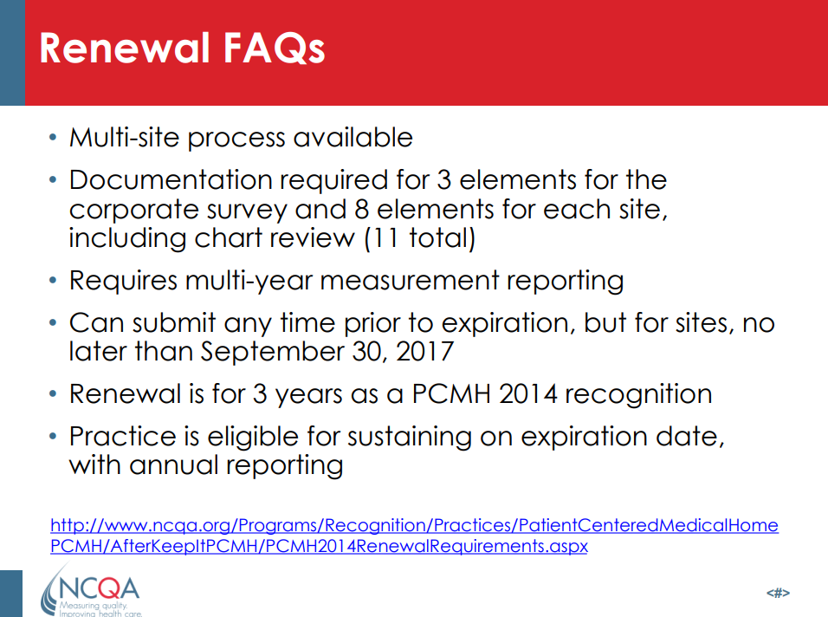

Slide 51
Continuing medical education for general practitioners: a practice format
How do adults learn?
Adults are results-oriented and show a great need to know: why is it important to learn something, what must one do to learn and what will they have been taught?
Adults are autonomous and self-directed: adults like to be able to exercise control over the techniques and goals within the learning.
Adults have a lot of life experiences and knowledge as a basis, and they have a need to connect this basis with the learning content. Previous experiences of the adult learner also have an impact on the learning process by providing individual differences, creating prejudices and give an identity to the adult.
Adults are relevancy oriented. They must have a motive to learn, for example, because their life situation creates a certain learning need. This is linked to the willingness to learn.
Adults are generally practical. They learn best when knowledge is presented in a realistic (real-life) context.
Adults show a high motivation to learn when they can get new information that can help them to solve significant problems in their lives/work.

Slide 52
Motivation versus resistance to learn
Confronted with the reality of (the combination of) work and family, professional doctors usually need an extra or particular motivation to commit to continuing education as compared with students in (under) graduate training. Professional physicians typically experience more barriers to learning.
For physicians, who often spend a lot of time in practice, it is not easy to find the time and opportunity to engage in a structured continuing education program. Physicians, therefore, often revert to self-assessment of (deficiencies in) their own skills and knowledge. In order to meet their self-assessed learning needs, physicians tend to use rather unstructured strategies to improve themselves: randomly searching for literature, consulting the Internet, reading the free and sponsored non-scientific medical journals. Furthermore, professionals differ in the time spent on learning new things and that the confrontation with new learning situations often brings fear or uncertainty with it.

Slide 53
Conditions for (the establishment of) an effective and efficient CME
The continuing education offering is subject to the goals of the organizing institute, but even more to the needs and desires of the end user.
The development and evaluation of a continuing education program should be a strategic objective of each educational institute.
To be efficient and accessible, continuing education should meet a number of conditions that relate to the needs of the ‘student’, to the learning objectives, to the content, to the format and to the learning outcomes at the micro and macro levels.
Therefore, it is important to carefully define (to know) the target population and the subject (addressing the learning needs), to clearly define the learning objectives and to align with the format and the program structure.

Slide 54
CME Main messages
Continuing medical education should go beyond the sheer acquisition of knowledge.
The continuing education offerings are subject to the goals of the organizing institution, but even more to the needs and desires of the end user.
The program must be built up strategically.

Slide 55
CME Current research questions
Should focus on new learning strategies in terms of educational outcome measures.
Should focus on outcome of learning on healthcare quality.
Should focus on metacognition or the self-awareness of knowledge and skills.

Slide 56
Why do physicians need continuing medical education (CME) credit?
Physicians use CME credit to demonstrate that they have participated in educational activities and obtained CME credit to document meeting the requirements of state medical boards, medical specialty societies, specialty boards, hospital medical staffs, the Joint Commission, insurance groups, and others.

Slide 57
AMA PRA Category 1 Credit™
What does AMA PRA Category 1 Credit™ represent?
AMA PRA Category 1 Credit™ represents that the physician has participated in an educational activity, and completed all requirements for such an activity, that is expected to “serve to maintain, develop, or increase the knowledge, skills, and professional performance and relationships that a physician uses to provide services for patients, the public or the profession” as stated in the AMA’s definition of CME.

Slide 58


Slide 59
1. What are the three most important general aspects of medical care under NCQA and Joint Commission Review? Please select the best answer.
Patient experience of care, quality of care, cost of care
CPR certification, brand name drug utilization, and CME documentation

Slide 60
1. What are the three most important general aspects of medical care under NCQA and Joint Commission Review? Please select the best answer.
Patient experience of care, quality of care, cost of care
CPR certification, brand name drug utilization, and CME documentation

Slide 61
2. Under the evaluation of the Patient Centered Medical Home, which of the following is not a standard under NCQA on Joint Commission for outpatient clinic reviews?
Patient-Centered Access
Team-Based Care
Population Health Management
Care Management and Support
Care Coordination and Care Transitions
Performance Measurement and Quality Improvement
EMTALA Rule Adherence

Slide 62
2. Under the evaluation of the Patient Centered Medical Home, which of the following is not a standard under NCQA on Joint Commission for outpatient clinic reviews?
Patient-Centered Access
Team-Based Care
Population Health Management
Care Management and Support
Care Coordination and Care Transitions
Performance Measurement and Quality Improvement
EMTALA Rule Adherence

Slide 63
3. Which of the following is not a measure of Assess to care recognized by NCQA on Joint Commission?
Providing same-day appointments for routine and urgent care
Providing routine and urgent-care appointments outside regular business hours
Providing alternative types of clinical encounters
Availability of appointments
Monitoring no show rates
Acting on identified opportunities to improve access
Providing continuity of medical record for care and advice when office is not open
Documenting how often a patient can be seen at other clinics when unable to obtain an appointment with PCMH provider

Slide 64
3. Which of the following is not a measure of Assess to care recognized by NCQA on Joint Commission?
Providing same-day appointments for routine and urgent care
Providing routine and urgent-care appointments outside regular business hours
Providing alternative types of clinical encounters
Availability of appointments
Monitoring no show rates
Acting on identified opportunities to improve access
Providing continuity of medical record for care and advice when office is not open
Documenting how often a patient can be seen at other clinics when unable to obtain an appointment with PCMH provider

Slide 65
4. Core strategies include which of the following? Select the best answer.
Increase practice engagement while reducing non-value added work
Strengthen link between recognition and performance
Be responsive to federal, state and regional needs/priorities
All of the above

Slide 66
4. Core strategies include which of the following? Select the best answer.
Increase practice engagement while reducing non-value added work
Strengthen link between recognition and performance
Be responsive to federal, state and regional needs/priorities
All of the above

Slide 67
5. Quality measures for PCMH bench marketing includes the following domains except for which area?
Acute care
Behavioral Health
Care coordination
Chronic care
Cost related
Immunizations
Preventive care
General “well established” Health Care Provisions

Slide 68
5. Quality measures for PCMH bench marketing includes the following domains except for which area?
Acute care
Behavioral Health
Care coordination
Chronic care
Cost related
Immunizations
Preventive care
General “well established” Health Care Provisions

