Slide 1

MODULE FOUR:
MEDICAL PROTOCOLS
AND
QUALITY ASSURANCE

Slide 2
MODULE FOUR:
SECTION six:
Clinical Pathways,
Evidence-Based Medicine,
Population Health and
Pay for Performance

Slide 3
UNIT OBJECTIVES
To define clinical pathways
To learn about evidence based medicine (EBM) and its importance
To understand population health and the different approaches
To learn about pay-for-performance (P4P) initiatives

Slide 4
Clinical Pathways, Evidence-Based Medicine, Population Health and Pay for Performance
Definition and purpose of clinic pathways
Staffing roles and responsibilities
Improvement of patient satisfaction
Definition of evidence based medicine and the EBM triad
Five step model of EBM
Importance of AEBM
EBM oriented clinicians
Gaps between research and practice
Collaboration with research institutions
Definition and concepts of population health
Implementation within community health centers
Definition and process for financial incentives to providers/clinics
P4P model
ACA and P4P implementation
Quality measures
California P4P program

Slide 5
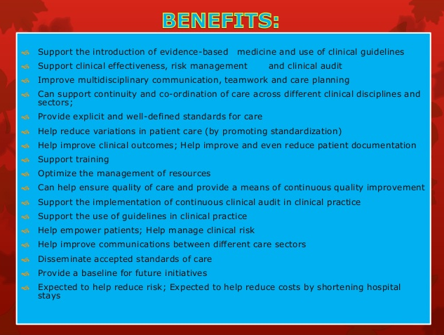

Slide 6
ADVANTAGES OF CLINICAL PROTOCOLS
Produces Workflow
Reduces Discrepancies
Brings uniformity to patient management
Eradicates omissions
Reduces confusion of staff
Makes record amenable to audit
Makes record keeping easy
Makes cost saving possible
Optimal use of limited resources
Improves compliance of physicians (and patients)

Slide 7


Slide 8
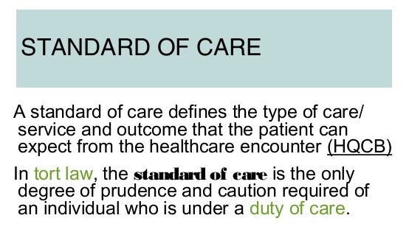

Slide 9
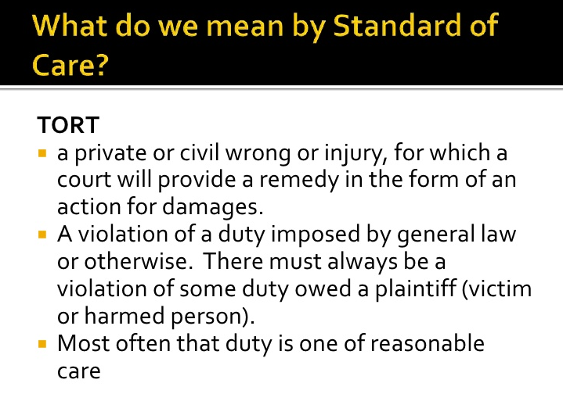

Slide 10
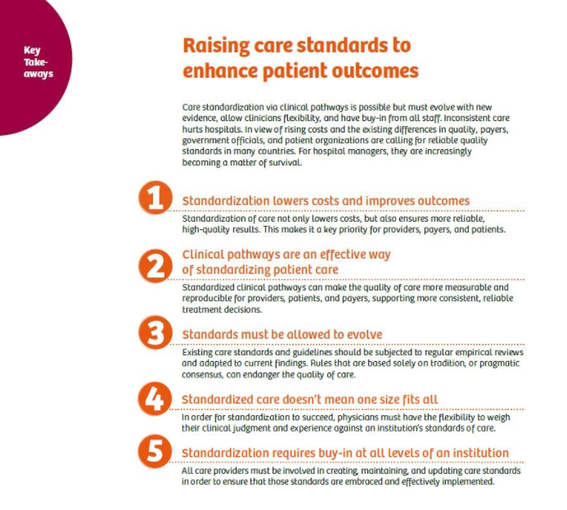

Slide 11
KEY MESSAGES
Process and outcome variables can be altered by the use of a treatment pathway assuring conformity to guidelines, particularly when the pathway involved frequent conformity checks with feedback to the treating staff. Guideline-consistent diagnostic and therapeutic measures can improve patient safety. The relation of guideline conformity to patient outcomes is unclear The process of generating a clinical pathway improves the specialized skills of all participating staff members on a clinic service (both doctors and nurses). These findings need to be replicated for diseases for which treatment guidelines exist.
1. Define an important topic | Is it: A common problem with variable current practice? One that has high-risk outcomes? With potential cost savings or practice standardization?
2. Keep it simple | Have you: Ensured that its implementation is realistic locally? Solicited input from key Stakeholders in the ED? Evaluated its impact on current workflow?
3. Think Administratively | Have you: Vetted it with any external stakeholders outside the ED? Incorporated easy to capture, meaningful metrics? Evaluated impact on hospital economics?
4. Implement then measure | Have you: Done ongoing quality assurance of outcomes? Provided feedback to key individuals? Made appropriate changes based on results?

Slide 12


Slide 13
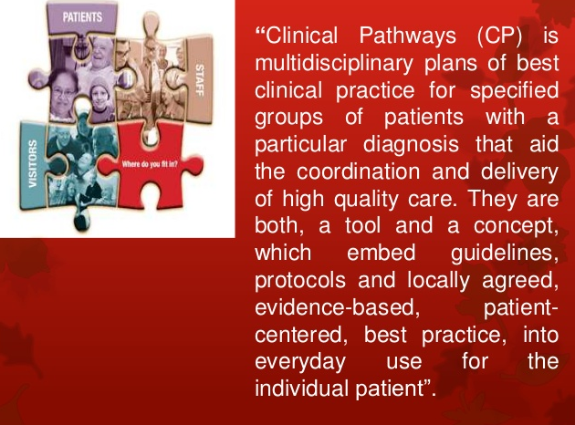

Slide 14
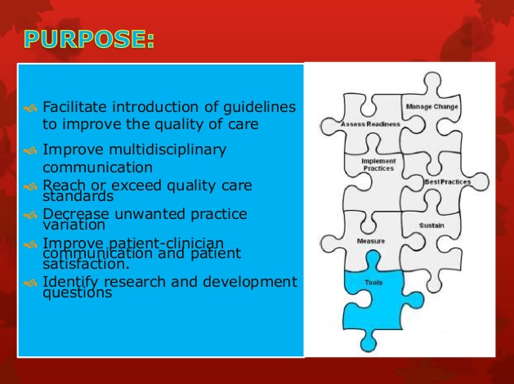

Slide 15
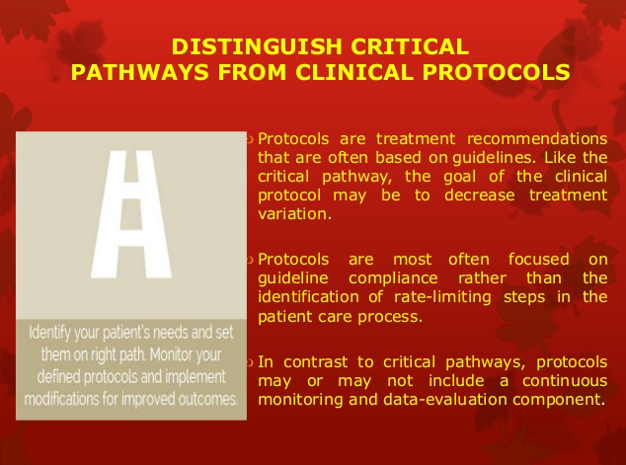

Slide 16

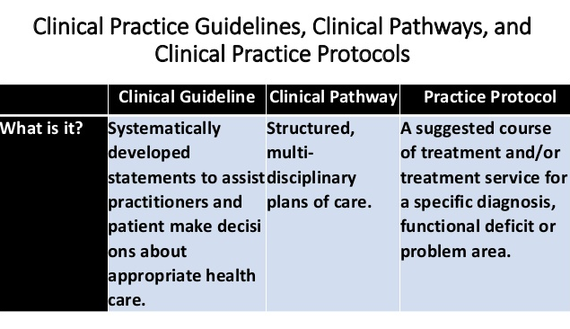

Slide 17
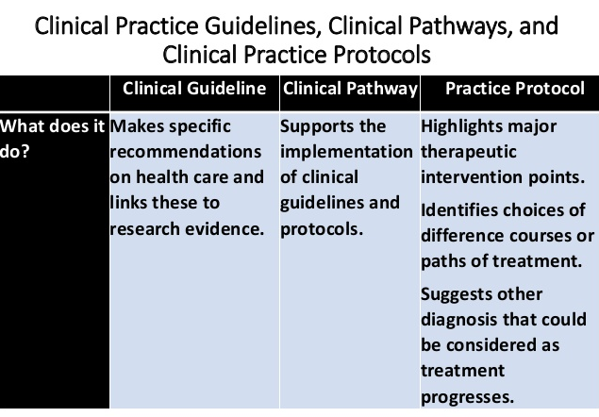

Slide 18
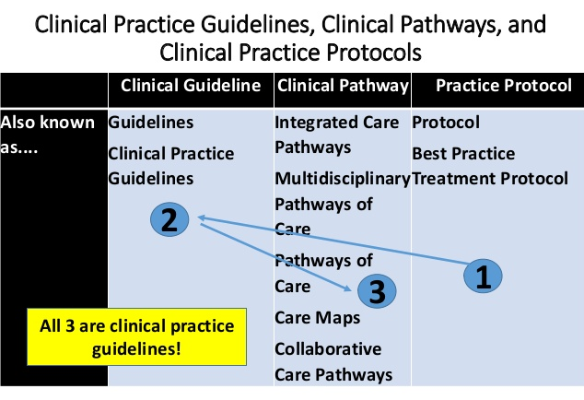

Slide 19
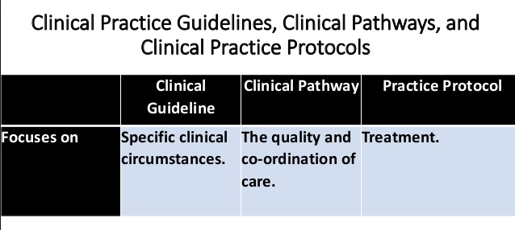

Slide 20
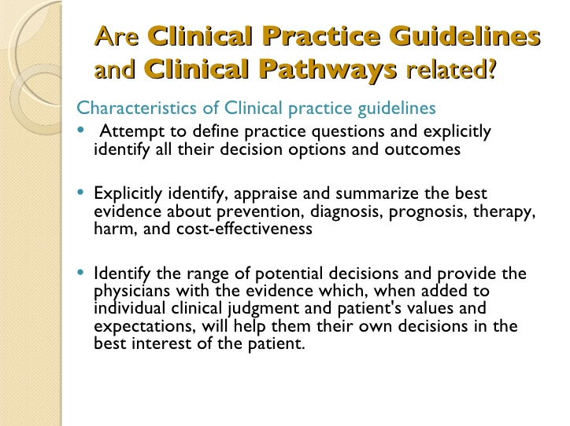

Slide 21
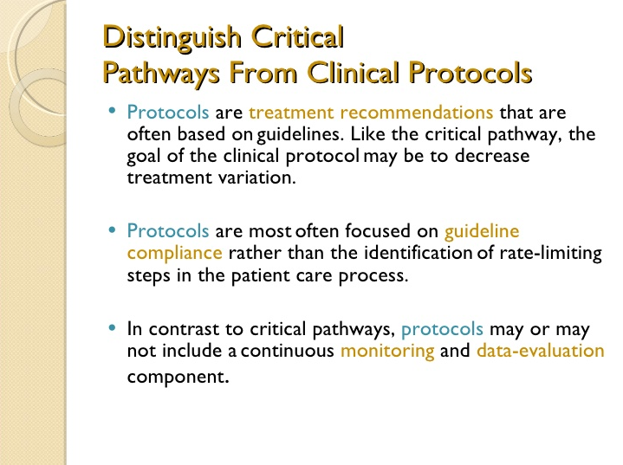

Slide 22
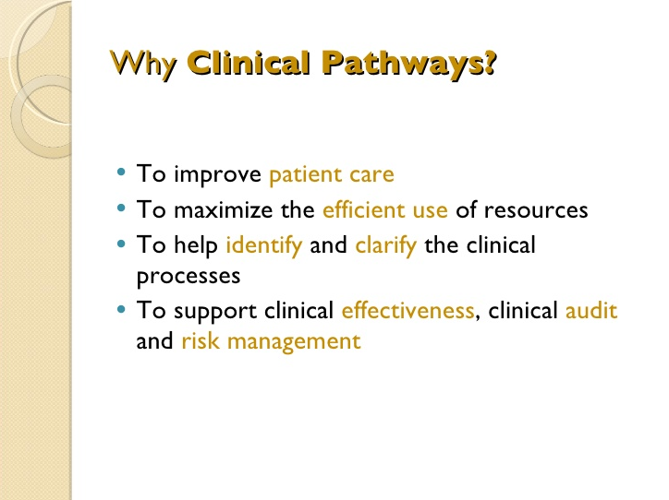

Slide 23
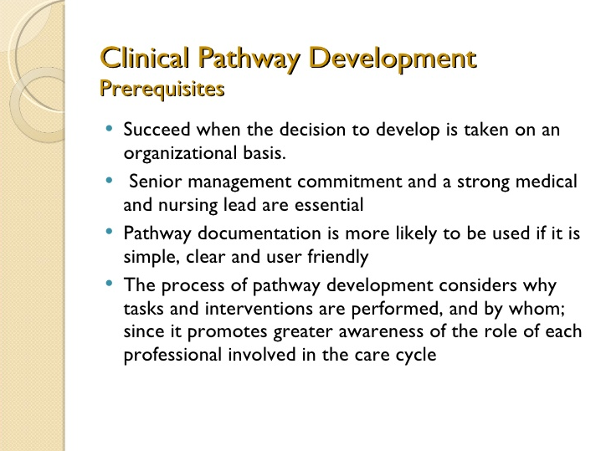

Slide 24
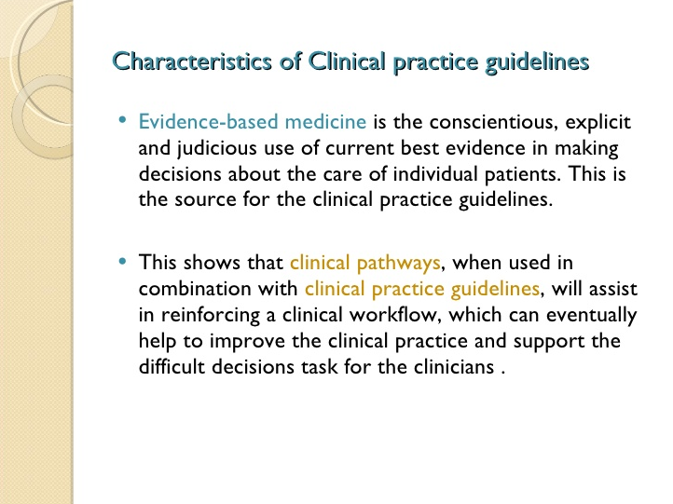

Slide 25
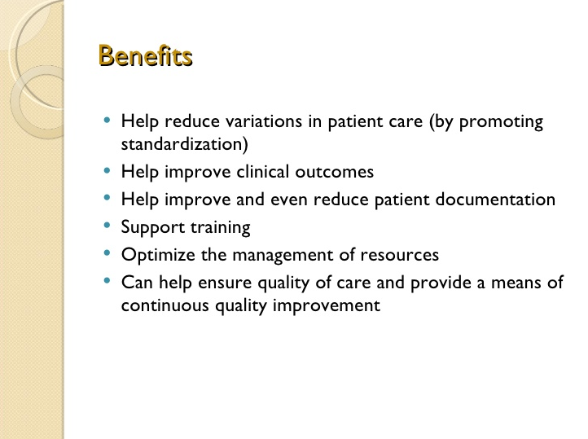

Slide 26
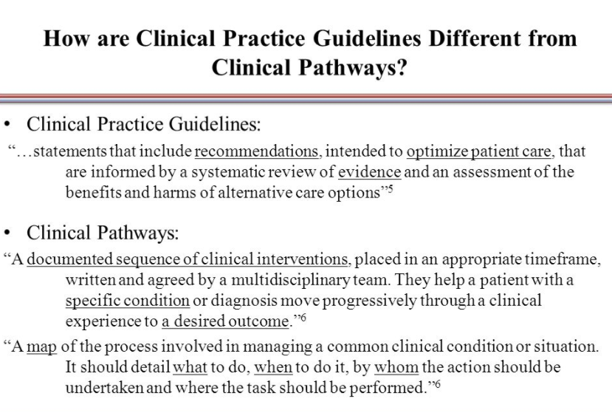

Slide 27
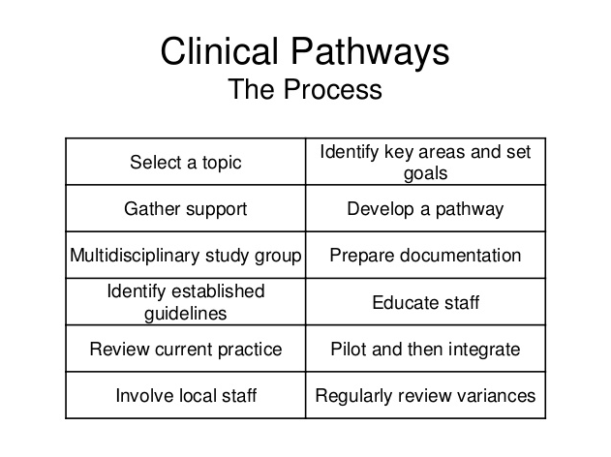

Slide 28
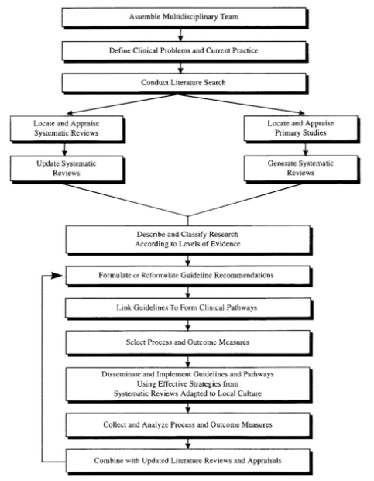
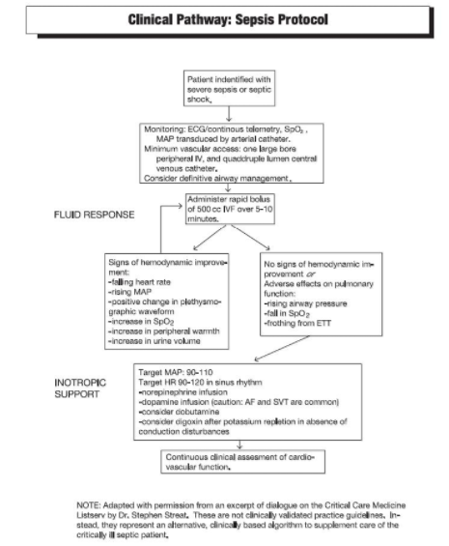
E
XAMPLES
ONLY

Slide 29
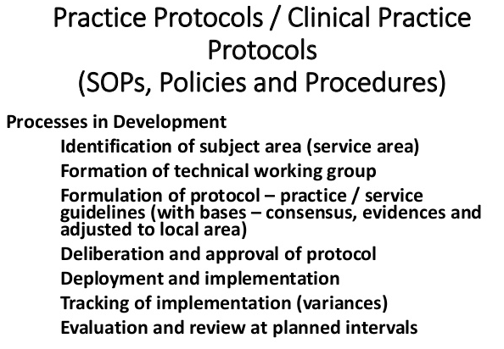

Slide 31
CLINICAL PRACTICE
GUIDELINE
Clinical practice guideline definition by National guideline clearing house as:
“ Clinical practice guidelines are systematically developed statements to assist practitioners and patient decision about appropriate healthcare for specific clinical circumstances.”
Please note that most practice guidelines are on based Evidence based Medicine.
Evidence based practice guidelines are the clinical foundation of Disease Management Program
E.g.., a child is experiencing repeated asthma attack at school and is taken to a clinic, if the physicians utilize evidence based treatment for childhood asthma accepted by their specialty such descriptions for specific clinical condition are best known as clinical practice guidelines.

Slide 32
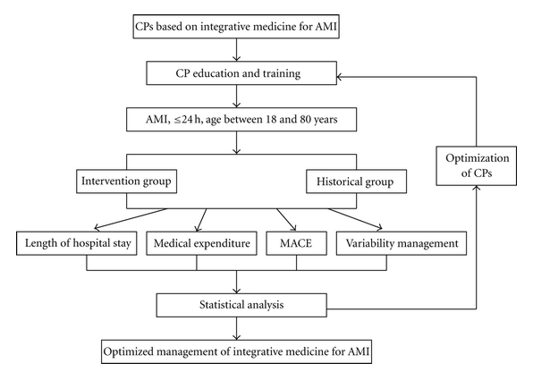

Slide 33
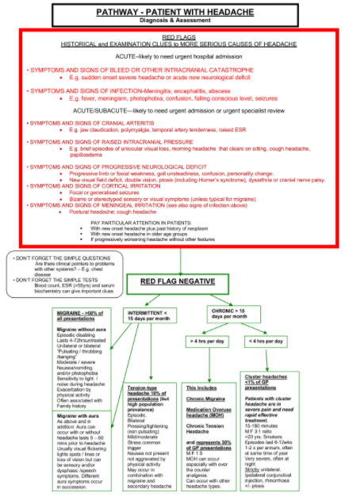
EXAMPLE ONLY

Slide 34
EXAMPLE ONLY

Slide 35
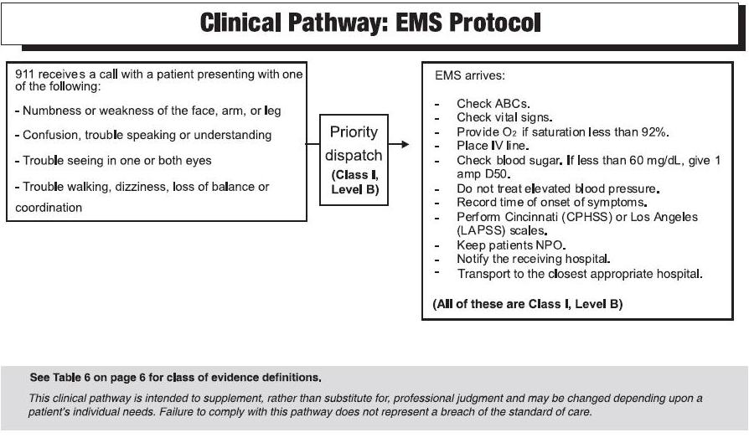

Slide 36
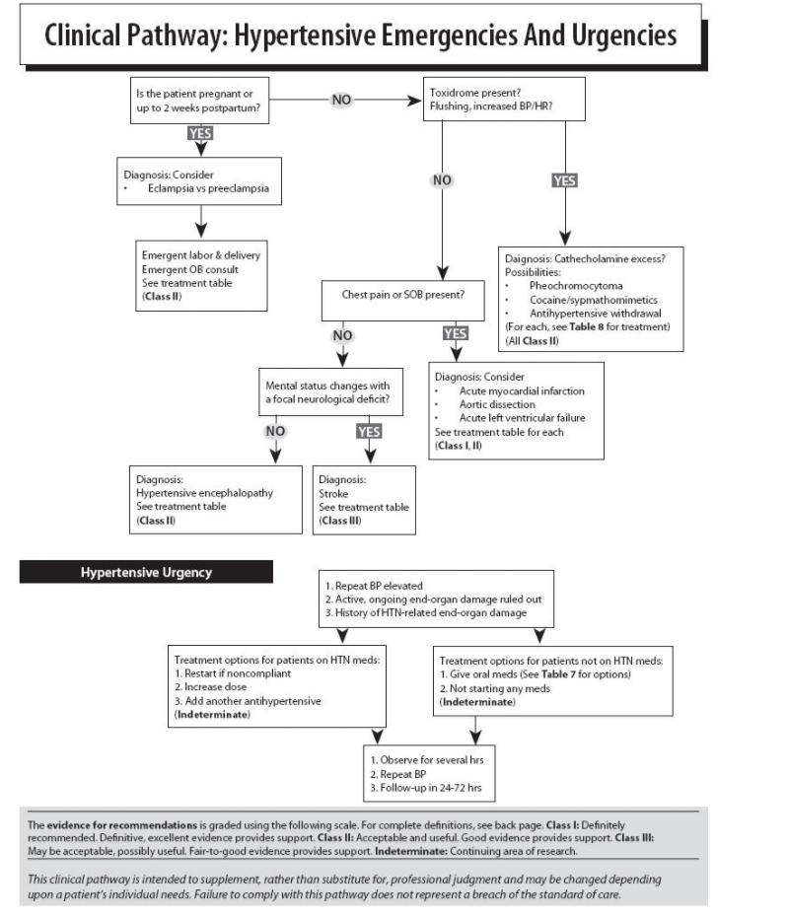
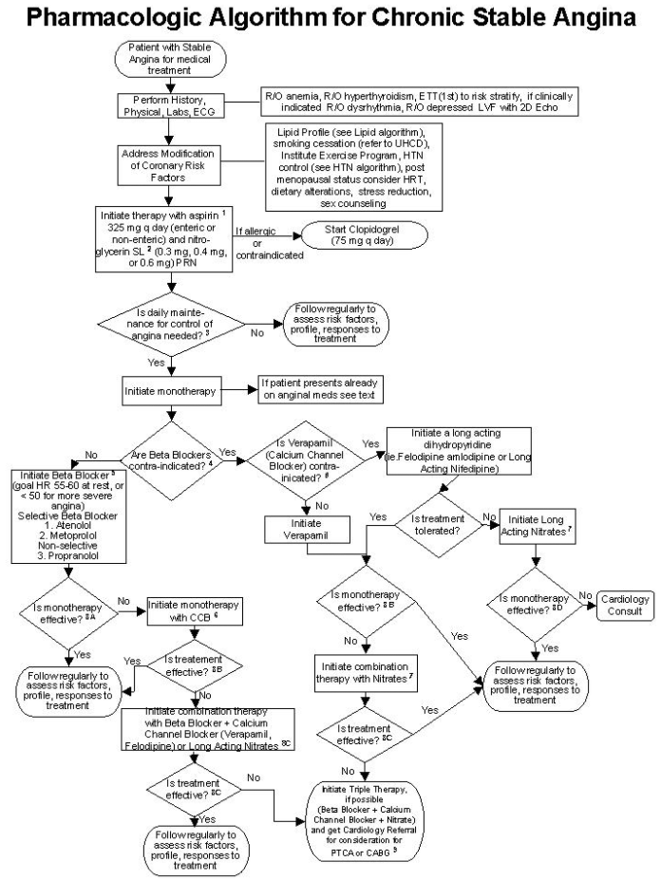
EXAMPLE
ONLY

Slide 37
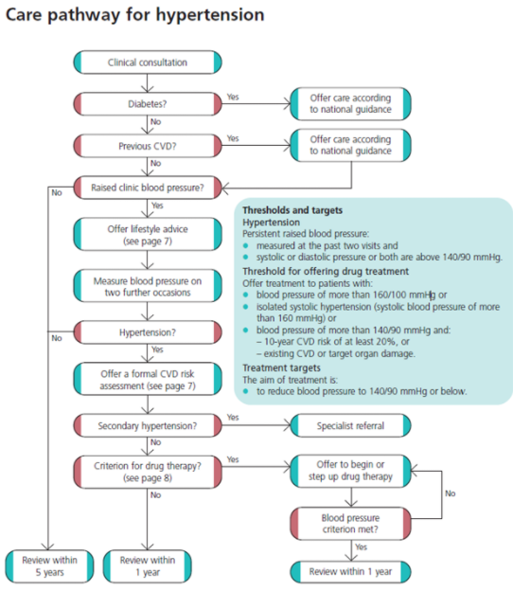
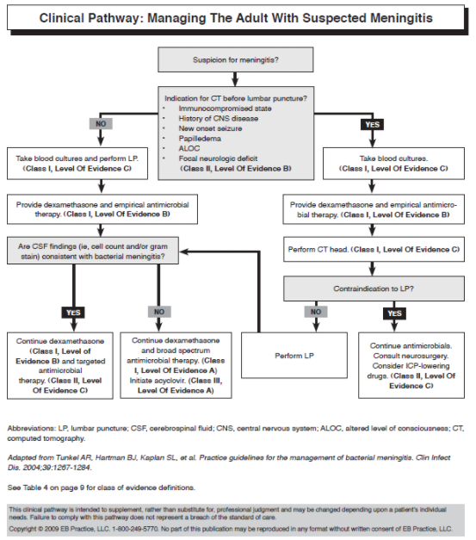
EXAMPLE
ONLY

Slide 38
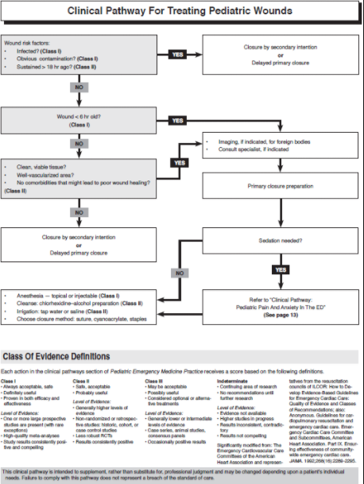
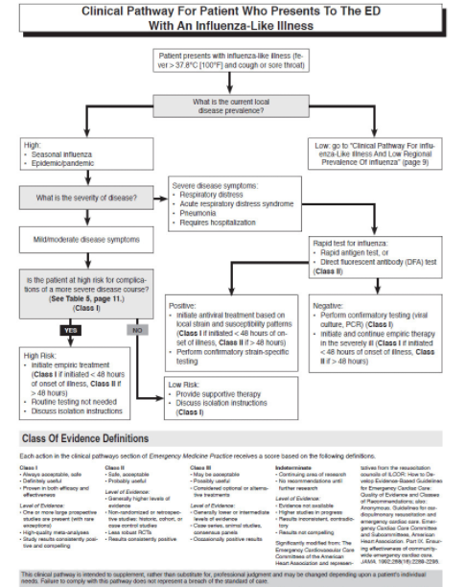
EXAMPLES
ONLY

Slide 39
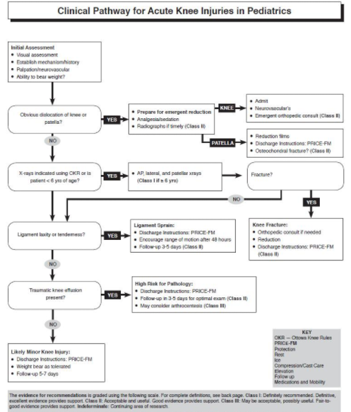
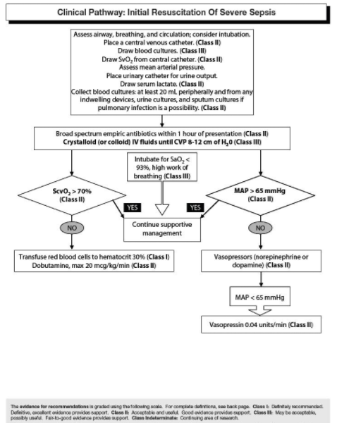
EXAMPLES
ONLY

Slide 40
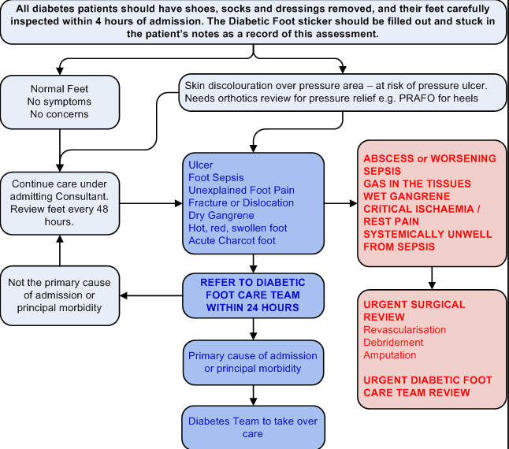

Slide 41
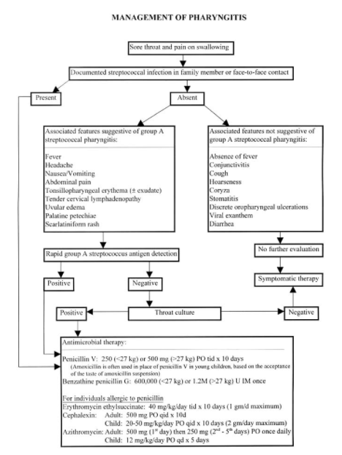
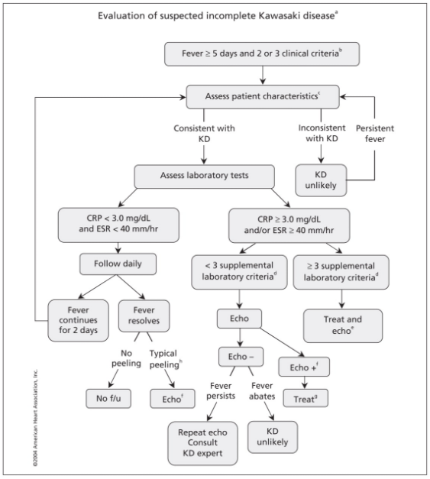
EXAMPLE
ONLY

Slide 42
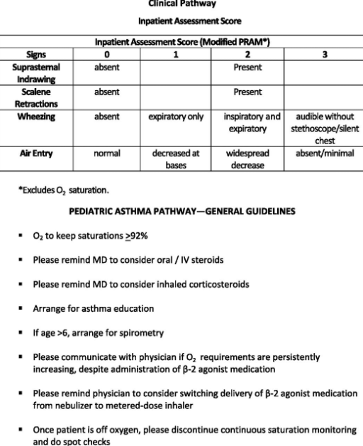
EXAMPLE
ONLY

Slide 43
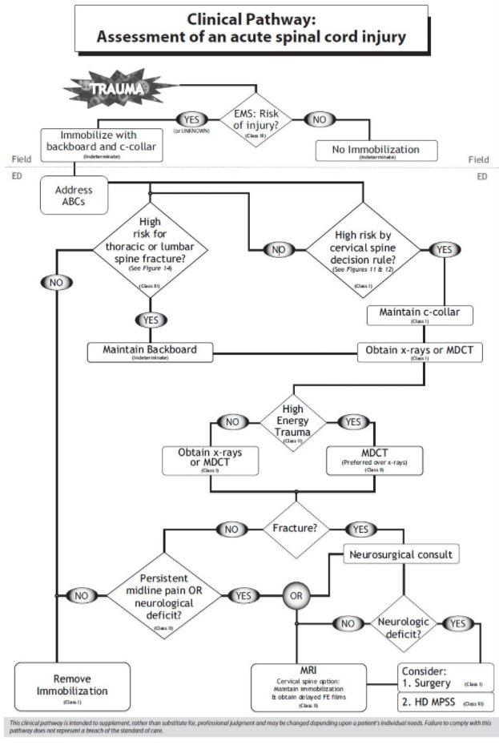
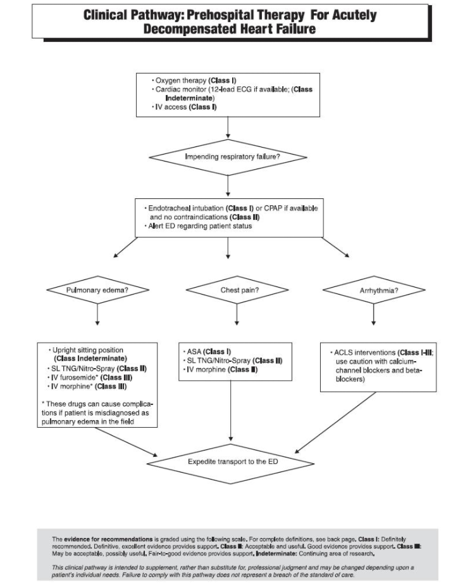
EXAMPLE
ONLY
EXAMPLE
ONLY

Slide 44
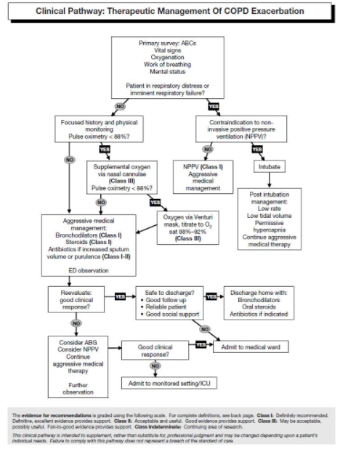
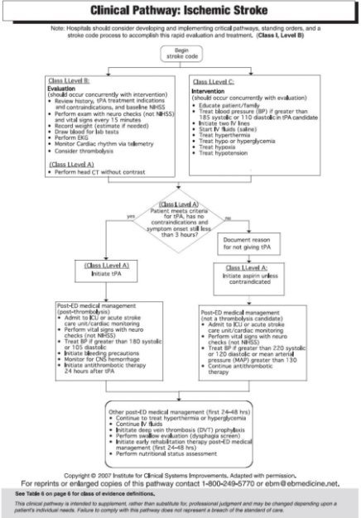
EXAMPLE
ONLY
EXAMPLE
ONLY

Slide 45
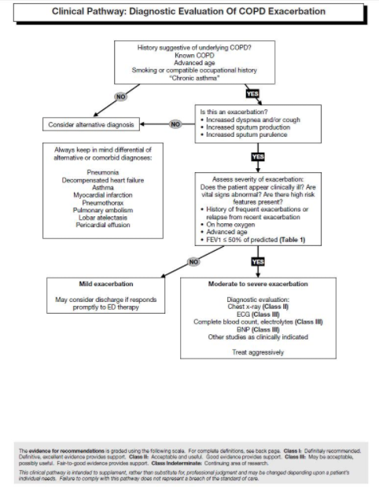
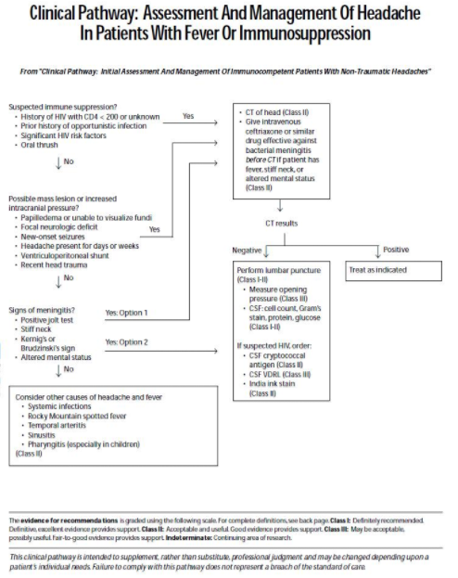
EXAMPLE
ONLY
EXAMPLE
ONLY

Slide 46
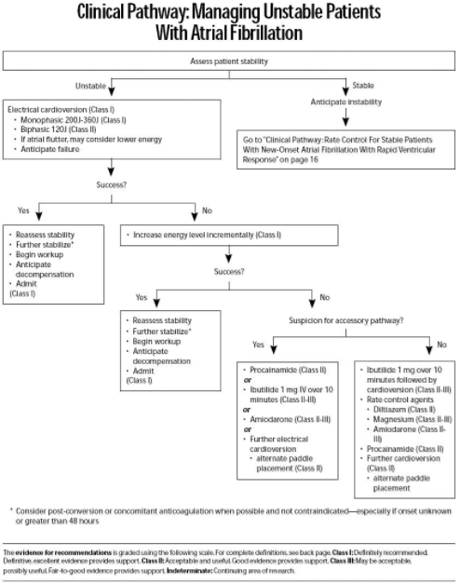
EXAMPLE ONLY

Slide 47
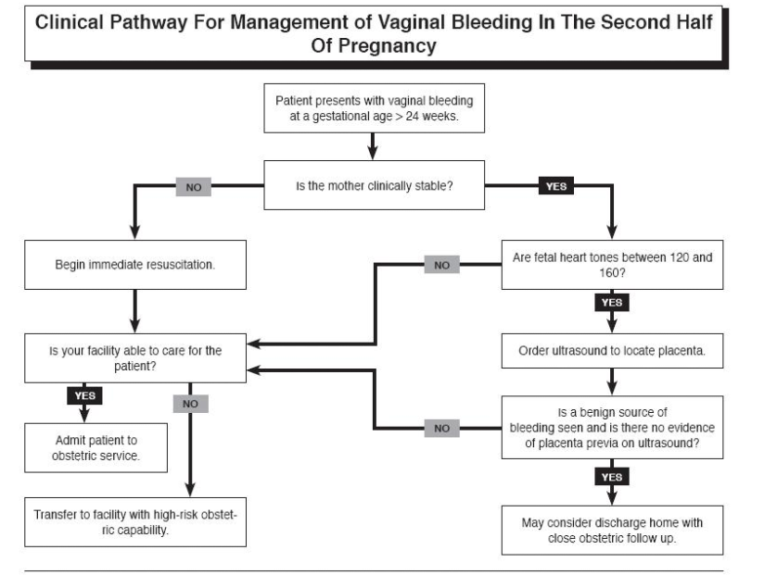
EXAMPLE
ONLY

Slide 48
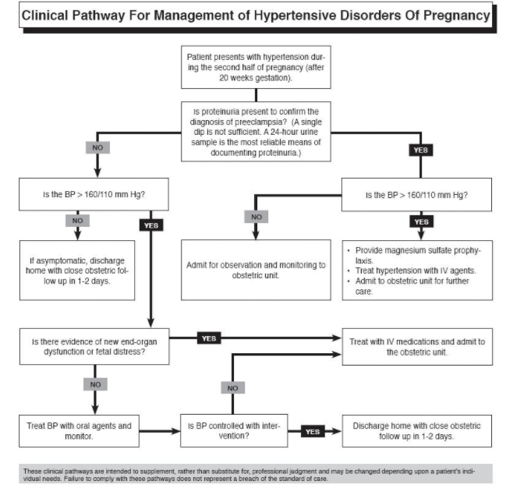
EXAMPLE
ONLY

Slide 49
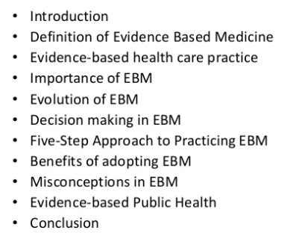


Introduction
Definition of Evidence Based Medicine
Evidence-based health care practice
Importance of EBM
Evolution of EBM
Decision making in EBM
Five-Step Approach to Practicing EBM
Benefits of adopting EBM
Misconceptions in EBM
Evidence-based Public Health
Conclusion

Slide 50
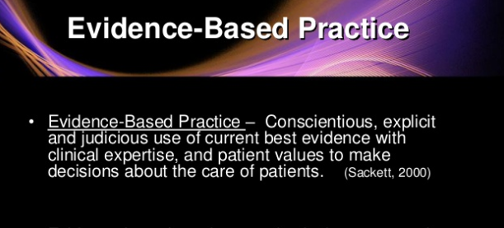


Slide 51
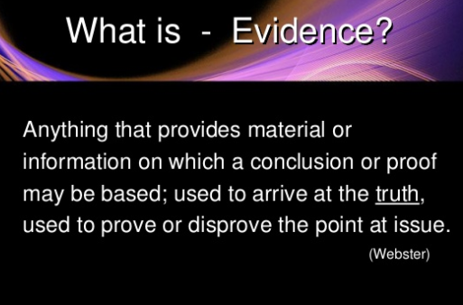

Slide 52
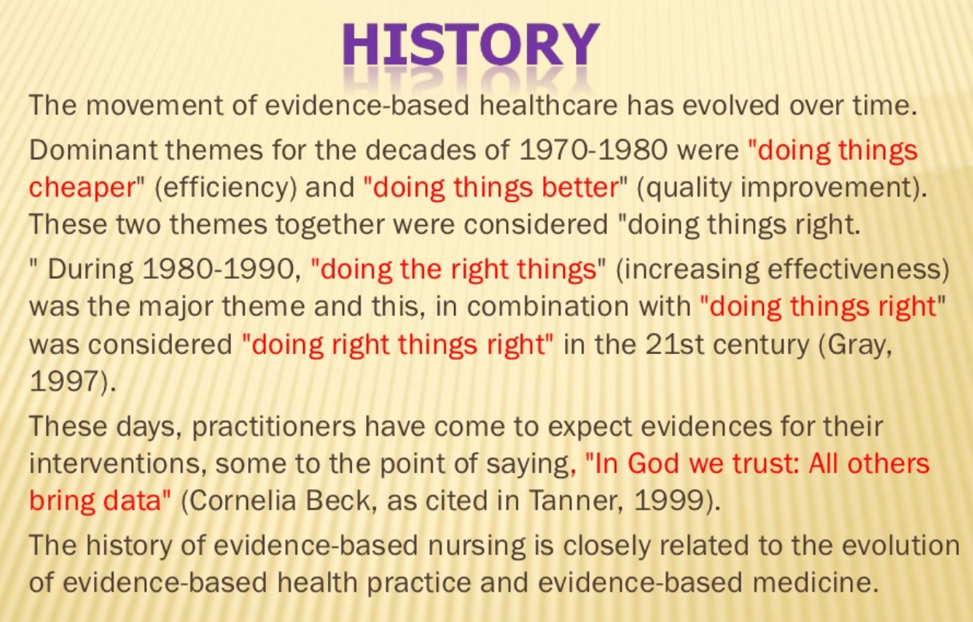

Slide 53


Slide 54


Slide 55


Slide 56


Slide 57


Slide 58


Slide 59


Slide 60

IT IS A PROCESS------------------------------------

Slide 61


Slide 62


Slide 63


Slide 64


Slide 65


Slide 66


Slide 67


Slide 68


Slide 69


Slide 70


Slide 71


Slide 72


Slide 73


Slide 74


Slide 75


Slide 76


Slide 77


Slide 78


Slide 79


Slide 80


Slide 81


Slide 82



Slide 83


Slide 84



Slide 85


Slide 86


Slide 87


Slide 88


Slide 89


Slide 90


Slide 91


Slide 92


Slide 93


Slide 94


Slide 95


Slide 96


Slide 97


Slide 98


Slide 99


Slide 100


Slide 101



Slide 102


Slide 103


Slide 104


Slide 105


Slide 106


Slide 107


Slide 108


Slide 109


Slide 110


Slide 111


Slide 112


Slide 113


Slide 114


Slide 115


Slide 116


Slide 117

NO

Slide 118


Slide 119


Slide 120


Slide 121


Slide 122


Slide 123


Slide 124


Slide 125


Slide 126


Slide 127


Slide 128


Slide 130


Slide 131


Slide 132


Slide 133


Slide 134


Slide 135


Slide 136


Slide 137


Slide 138


Slide 139


Slide 140


Slide 141


Slide 143


Slide 144


Slide 145
The patient’s circumstances
The patient’s wishes
The evidence
Developing
Evidence based
Clinical policies
Applying
the policies
Synthesizing
the evidence
Generating evidence form research
Making clinical
decisions

Slide 146


Slide 147


Slide 148


Slide 149


Slide 150



Slide 151

REVIEW

Slide 152

REVIEW

Slide 153

REVIEW

Slide 154

REVIEW

Slide 155

REVIEW

Slide 156

REVIEW

Slide 157

REVIEW

Slide 158

EXAMPLE OF CHALLENGES

Slide 159


Slide 160


Slide 161


Slide 162


Slide 163


Slide 164


Slide 165


Slide 166


Slide 167


Slide 168


Slide 169


Slide 170

REVIEW

Slide 171


Slide 172

REVIEW

Slide 173




Slide 174
What Is Population Health?
The idea that population health is a field of study or a research approach focused on determinants seems to have evolved from this work.
Early discussions at the Canadian Institute for Advanced Research also considered the definition and measurement of health and the processes of health policymaking, but the dominant emphasis evolved to the determinants themselves, particularly the nonmedical determinants.
John Frank, the scientific director of the recently created Canadian Institute of Population and Public Health, has similarly called population health “a newer research strategy for understanding the health of populations.”

Slide 175
POPULATION HEALTH
DEFINITION AND CONCEPT
is only concerned with the independent variables (the multiple determinants),
is only concerned with the dependent variables (health outcomes), or
is concerned with both the definition and measurement of health outcomes and the roles of determinants.
While none of the three is normatively correct or incorrect, we believe that the latter is more appropriate, primarily because the concept and measurement of health and health outcomes focuses attention and research effort on the impact of each determinant and their interactions on some appropriate outcome.
It also allows one to consider health inequality and inequity and the distribution of health across subpopulations, as well as the ethical and value considerations underpinning these issues.

Slide 176




Slide 177


Slide 178



Slide 179


Slide 180


Slide 181


Slide 182


Slide 183


Slide 184


Slide 185


Slide 186
Hospitals' contribution to the high cost of U.S. health care
Nuoya Li Contributor: Jules Clark August 21, 2014 Hospitals Contribution to the High Cost of U.S. Health Care Introduction U.S health care costs have been burdening taxpayers and driving down the U.S. economy for decades: they made up 17.2 percent of the Gross Domestic Product (GDP) in 2012 and are projected to grow at an average rate of 5.8 percent from 2012-2022 , according to the Centers for Medicare & Medicaid Services (CMS).

Slide 187


Slide 188


Slide 189


Slide 190


Slide 191


Slide 192


Slide 193


Slide 194


Slide 195


Slide 196


Slide 197


Slide 198


Slide 199


Slide 200
Pay for Performance (P4P) – Concepts
Pay for Performance (P4P) is, to an extent, a misnomer.
That’s because fee-for-service (FFS) is a form of pay-for-performance – it pays for every service and the performance sought is production of volume.
However, P4P is commonly used to describe payment reform efforts that link a portion of a clinician’s or hospital’s revenue to certain performance criteria.

Slide 201


Slide 202


Slide 203



Slide 204


Slide 205


Slide 206


Slide 207


Slide 208


Slide 209


Slide 210


Slide 211


Slide 212


Slide 213


Slide 214


Slide 215


Slide 216


Slide 217


Slide 218


Slide 219


Slide 220


Slide 221


Slide 222


Slide 223


Slide 224


Slide 225


Slide 226


Slide 227


Slide 228


Slide 229


Slide 230


Slide 231


Slide 232


Slide 234


Slide 235


Slide 236


Slide 237


Slide 238


Slide 239


Slide 240


Slide 241


Slide 242


Slide 243


Slide 244


Slide 245


Slide 246


Slide 247


Slide 248


Slide 249


Slide 250


Slide 251


Slide 252


Slide 253

KEY PERFORMANCE INDICATORS

Slide 254


Slide 255


Slide 256


Slide 257


Slide 258


Slide 259



Slide 260
1. Clinical pathways are intended to result in all of the following except for which of the following statements:
To improve patient care
To maximize the efficient use of resources
To help identify and clarify the clinical processes
To support clinical effectiveness, clinical audit and risk management
To disregard clinical experience and clinical intuition

Slide 261
1. Clinical pathways are intended to result in all of the following except for which of the following statements:
To improve patient care
To maximize the efficient use of resources
To help identify and clarify the clinical processes
To support clinical effectiveness, clinical audit and risk management
To disregard clinical experience and clinical intuition

Slide 262
2. Which of the following is the most correct response regarding evidence based Medicare?
It ignores clinical experience and clinical intuition
Understanding of basic investigation and pathophysiology plays no part in it
It ignores standard aspects of clinical training such as the history taking, physical examination etc.
All of the above are correct

Slide 263
2. Which of the following is the most correct response regarding evidence based Medicare?
It ignores clinical experience and clinical intuition
Understanding of basic investigation and pathophysiology plays no part in it
It ignores standard aspects of clinical training such as the history taking, physical examination etc.
All of the above are correct

Slide 264
3. In Evidence Based Medicine the question is defined in a specific way referred to as a PICO question: What is not a part of this process?
Profit
Patient information
Problem involved
Patient outcome
Patient intervention options

Slide 265
3. In Evidence Based Medicine the question is defined in a specific way referred to as a PICO question: What is not a part of this process?
Profit
Patient information
Problem involved
Patient outcome
Patient intervention options

Slide 266
4. “Evidence-based medicine is the integration of the best research evidence with clinical expertise and patient values”
True
False

Slide 267
4. “Evidence-based medicine is the integration of the best research evidence with clinical expertise and patient values”
True
False

Slide 268
5. Beta-blockers were initially avoided after MI thinking that they would decrease compensatory sympathetic mechanisms. Later shown to decrease hospitalization & death based on evidence based medicine research.
True
False

Slide 269
5. Beta-blockers were initially avoided after MI thinking that they would decrease compensatory sympathetic mechanisms. Later shown to decrease hospitalization & death based on evidence based medicine research.
True
False

