Slide 1

MODULE FOUR:
MEDICAL PROTOCOLS
AND
QUALITY ASSURANCE

Slide 2
MODULE FOUR:
SECTION Seven:
Patient Satisfaction

Slide 3
UNIT OBJECTIVE
To learn about patient satisfaction and patient-reported quality measures

Slide 4
Patient Satisfaction
Patient satisfaction in a value-based model
Consumer Assessment of Healthcare Providers and Systems (CAHPS) surveys
Patient Reported Outcomes Measurement Information System (PROMIS)
Patient Satisfaction Questionnaire (PSQ) – RAND Health

Slide 5


Slide 6
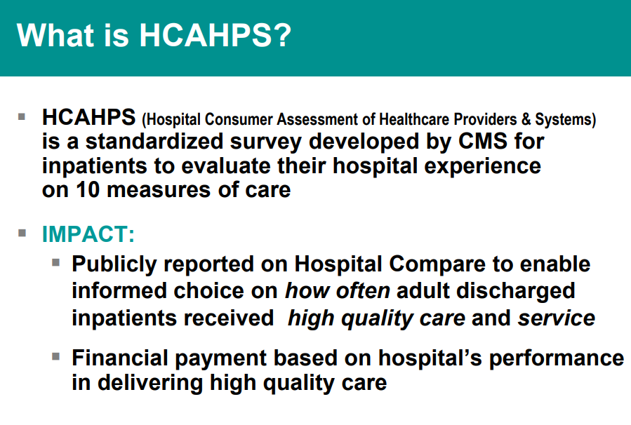

Slide 7
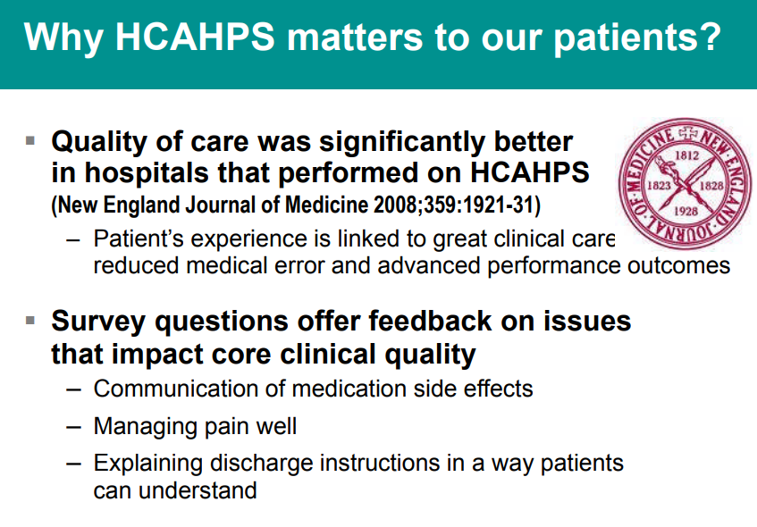

Slide 8
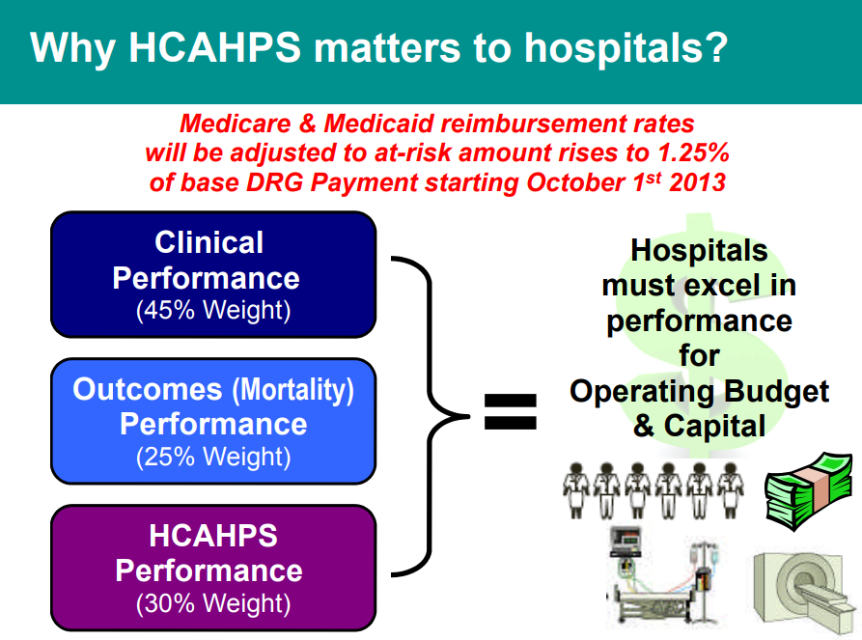

Slide 9
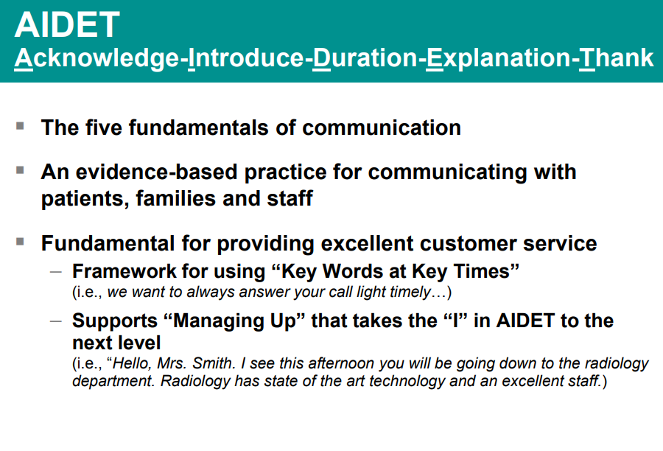

Slide 10
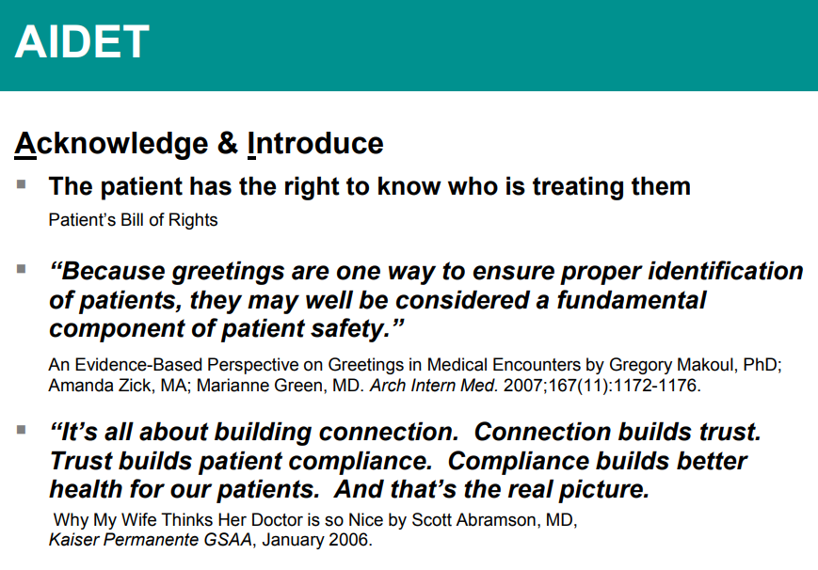

Slide 11
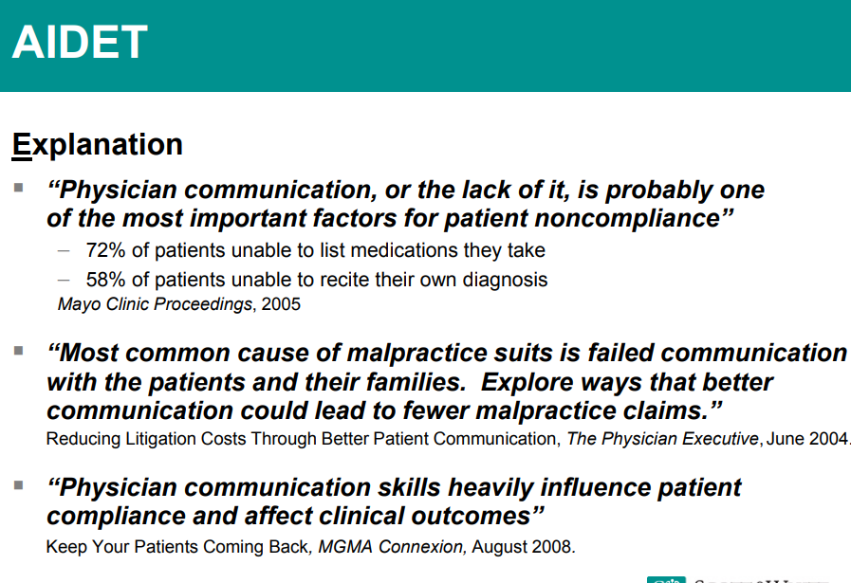

Slide 12
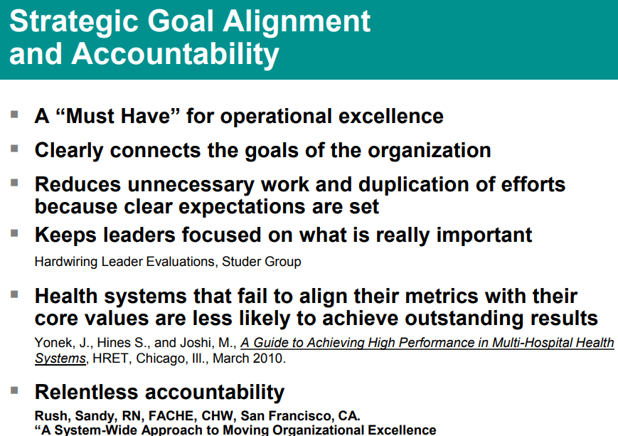

Slide 13
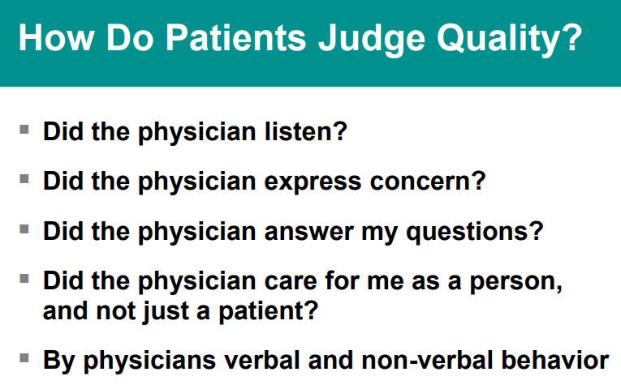

Slide 14
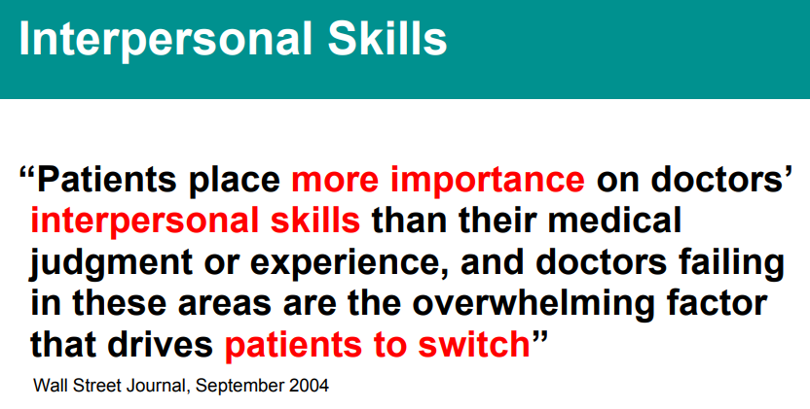

Slide 15
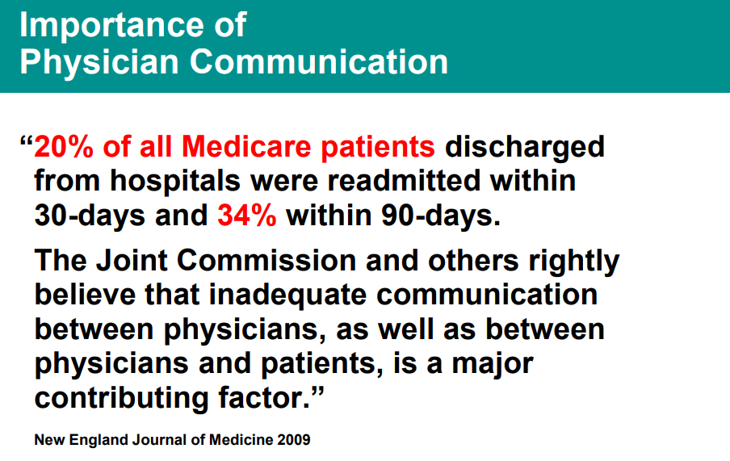

Slide 16
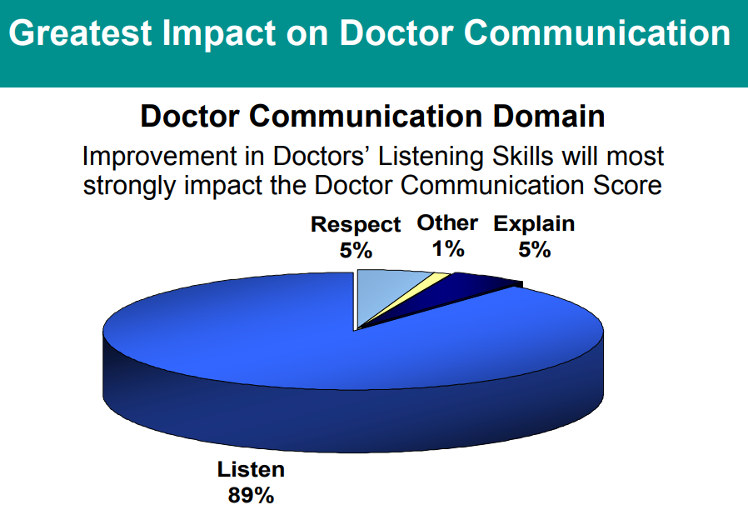

Slide 17
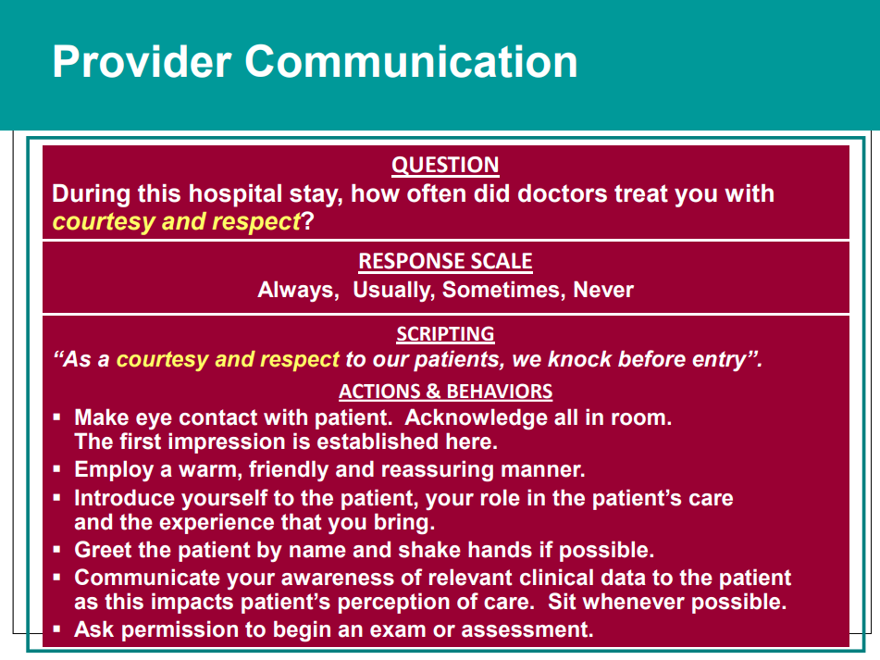

Slide 18
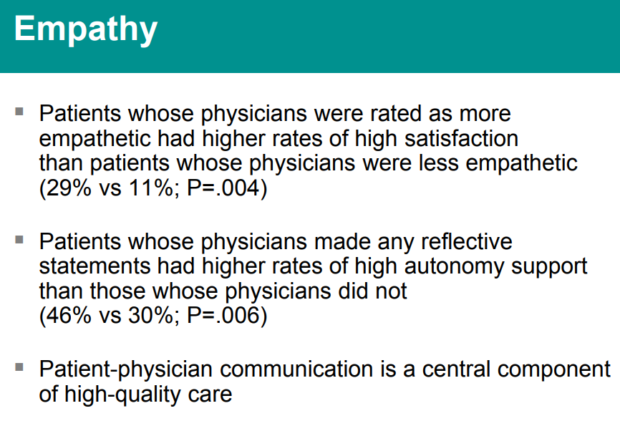

Slide 19
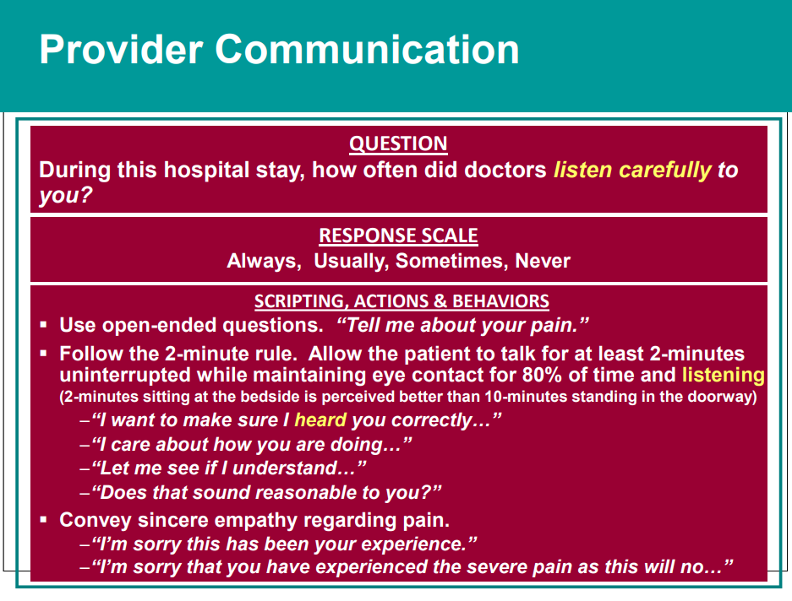

Slide 20
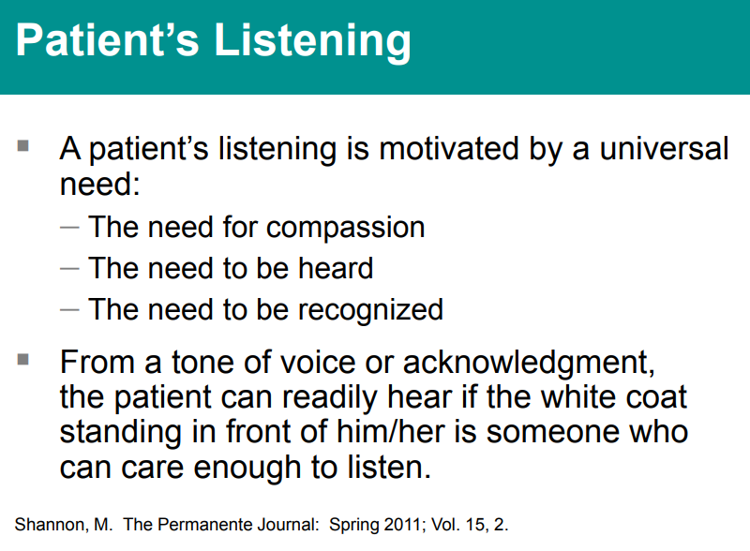

Slide 21
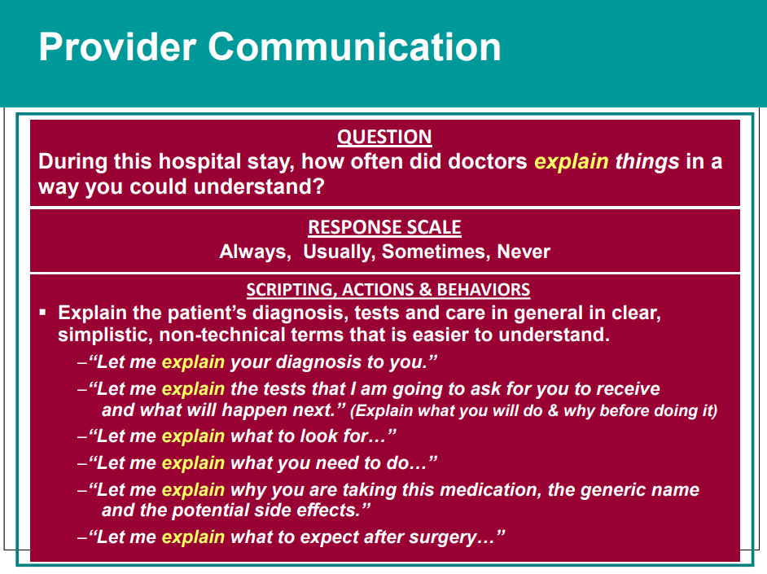

Slide 22
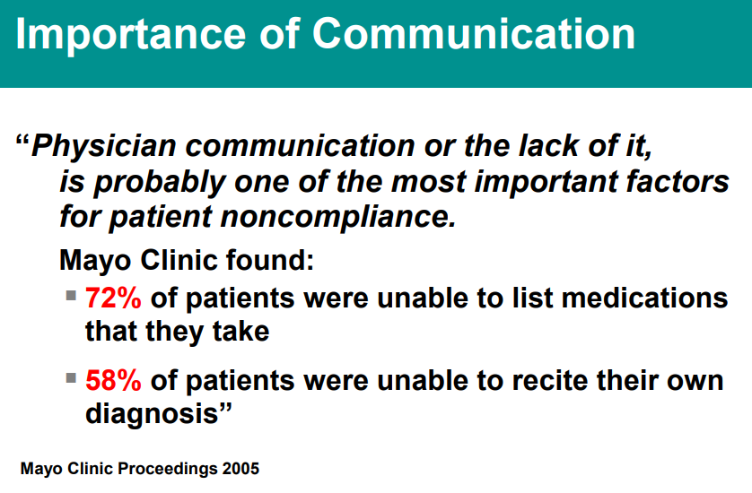

Slide 23
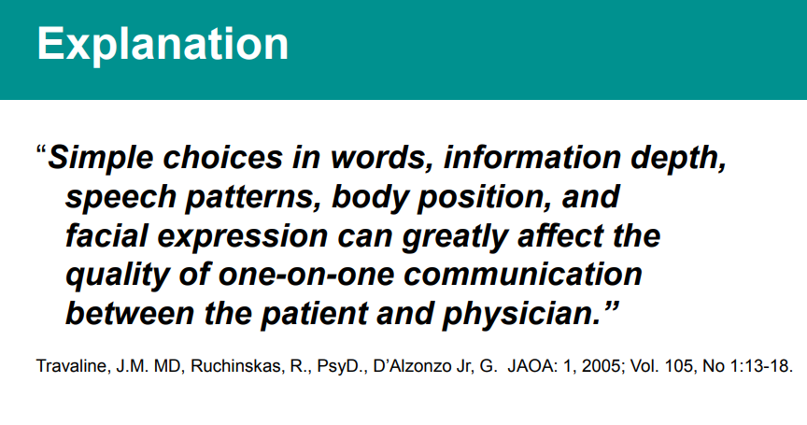

Slide 24
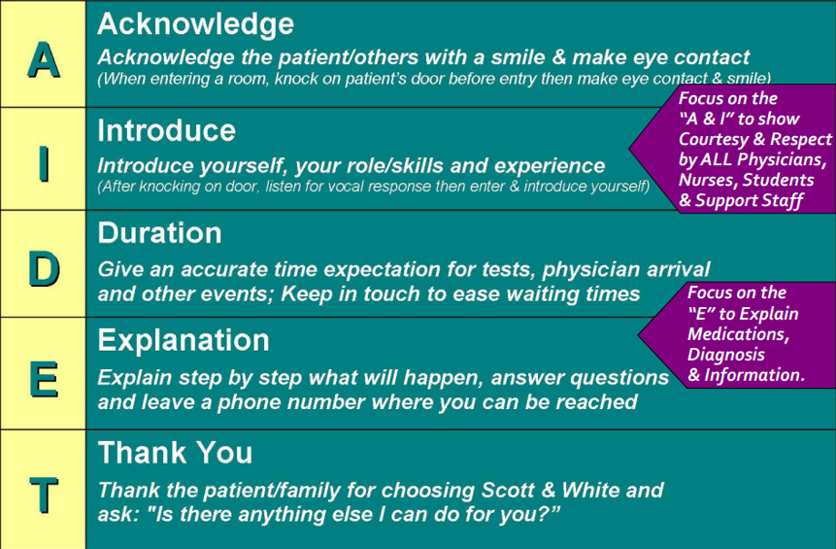


Slide 25

About CAHPS
Consumer Assessment of Healthcare Providers and Systems (CAHPS®) surveys ask consumers and patients to report on and evaluate their experiences with health care. These surveys cover topics that are important to consumers and focus on aspects of quality that consumers are best qualified to assess, such as the communication skills of providers and ease of access to health care services. The acronym "CAHPS" is a registered trademark of the Agency for Healthcare Research and Quality (AHRQ).

Slide 26
The CAHPS Program
The Consumer Assessment of Healthcare Providers and Systems (CAHPS®) program is a multi-year initiative of the Agency for Healthcare Research and Quality (AHRQ) to support and promote the assessment of consumers' experiences with health care. The goals of the CAHPS program are twofold:
Develop standardized patient questionnaires that can be used to compare results across sponsors and over time.
Generate tools and resources that sponsors can use to produce understandable and usable comparative information for both consumers and health care providers.

Slide 27
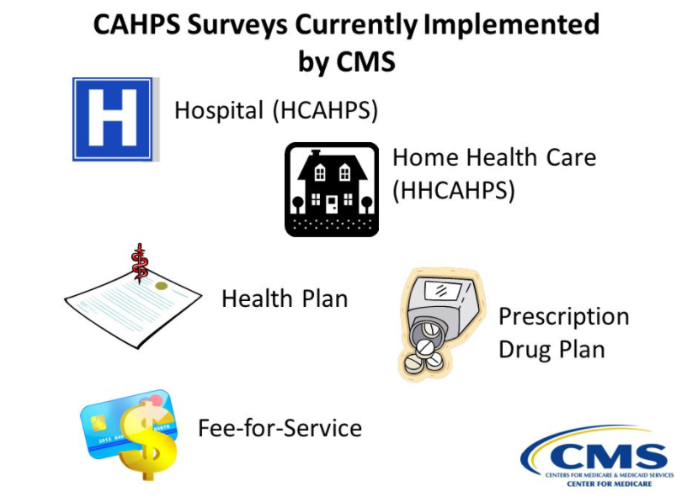

Slide 28
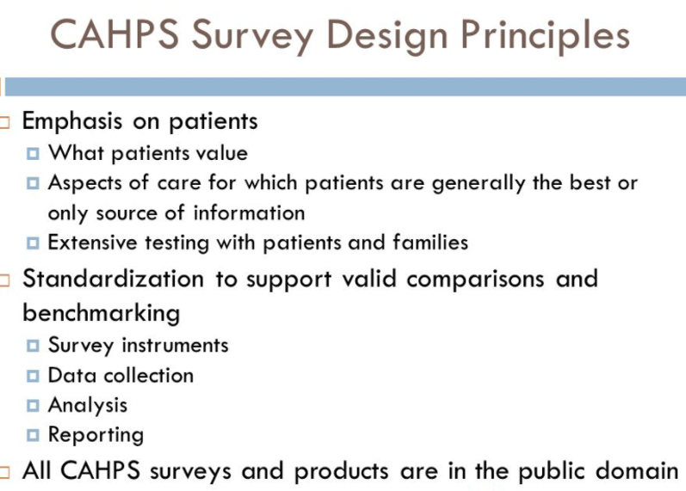

Slide 29
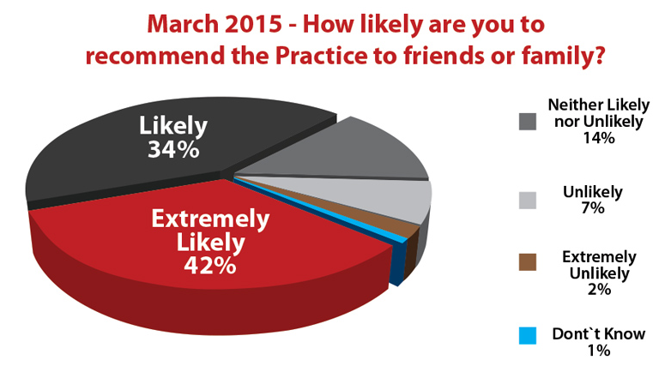

Slide 30
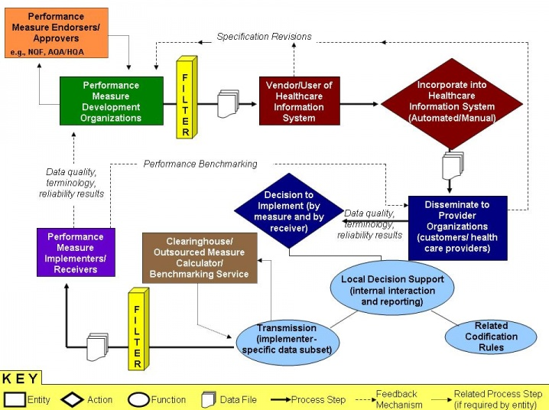

Slide 31
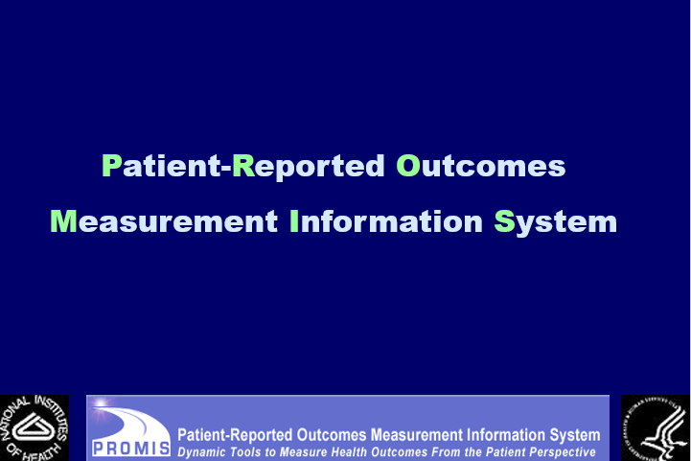

Slide 32
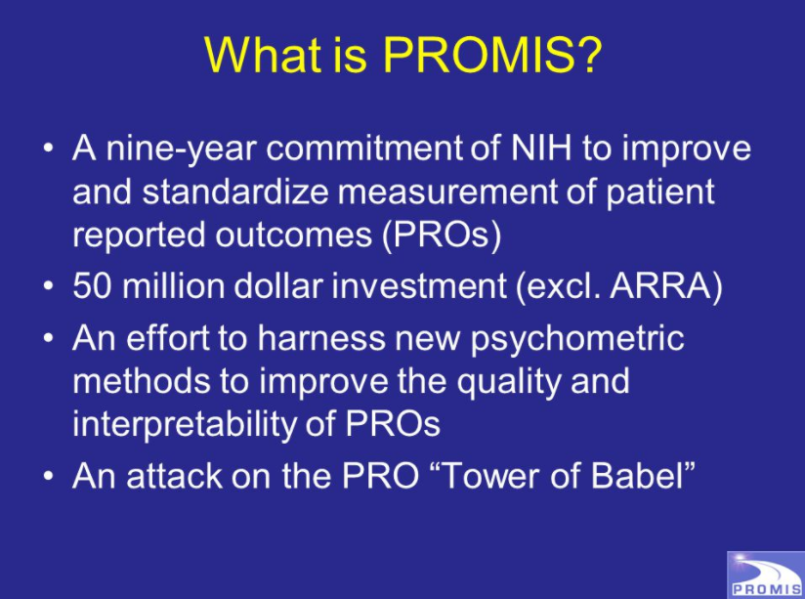

Slide 33
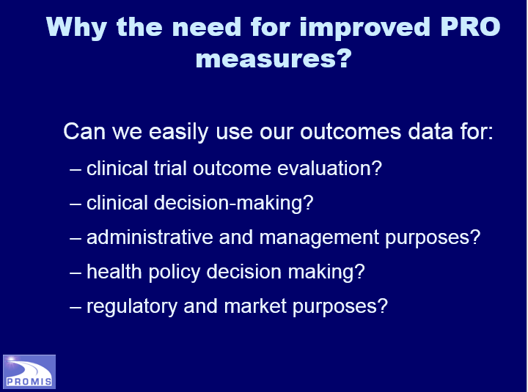

Slide 34
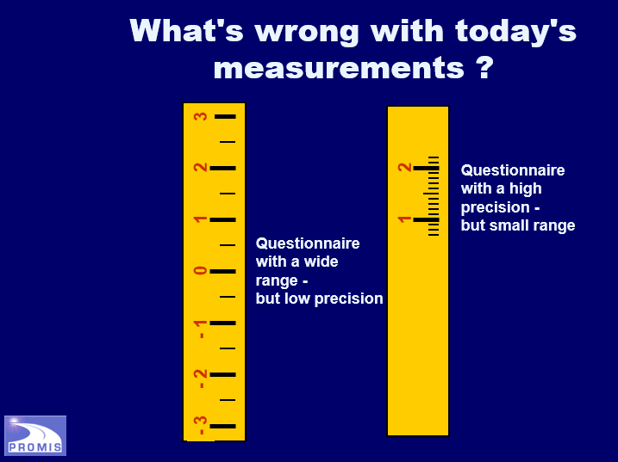

Slide 35
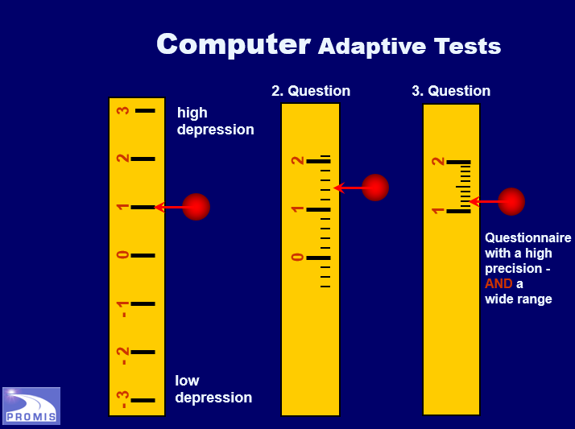

Slide 36


Slide 37
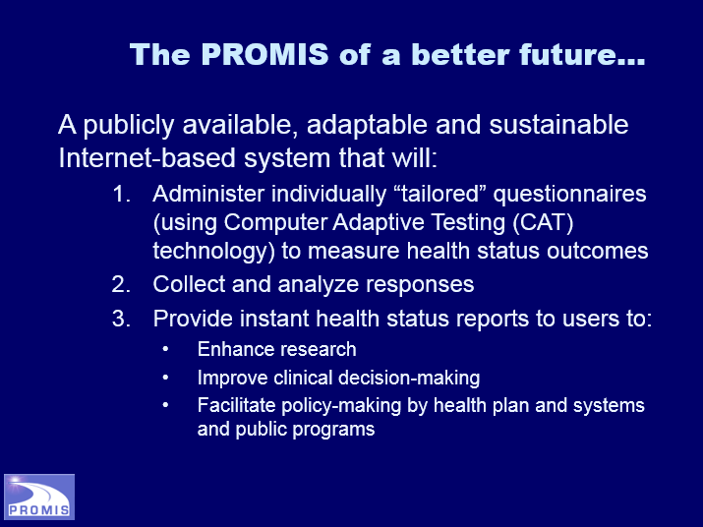

Slide 38
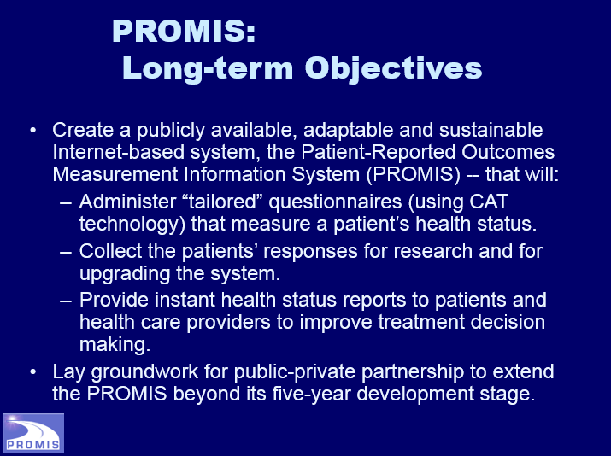

Slide 39
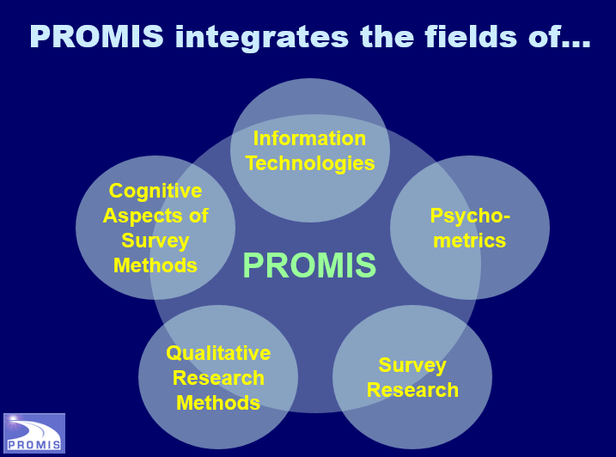

Slide 40
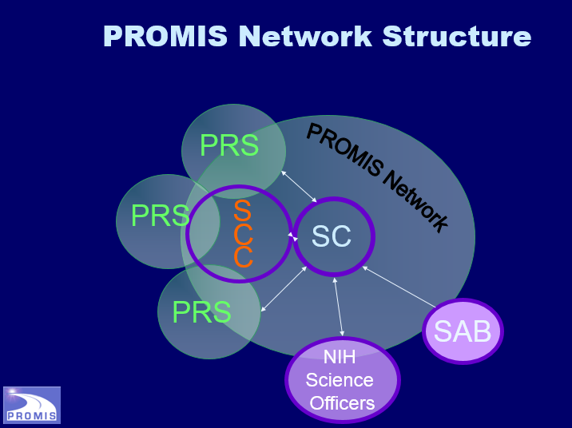

Slide 41


Slide 42
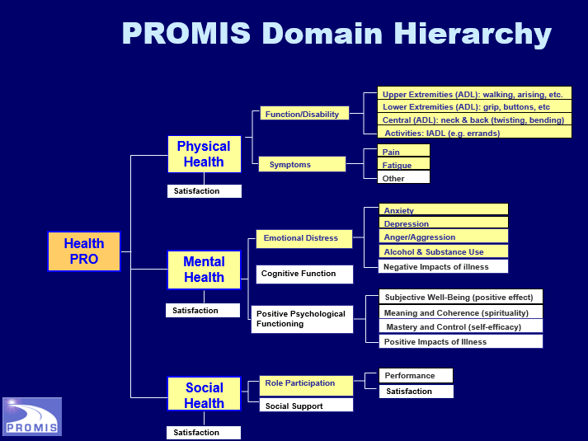

Slide 43
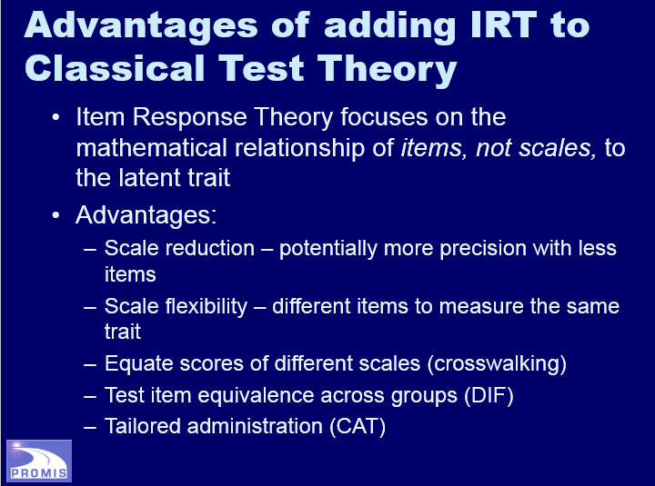

Slide 44
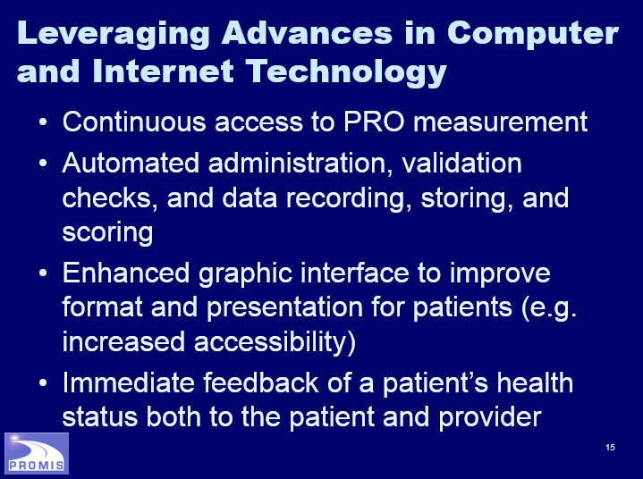

Slide 45
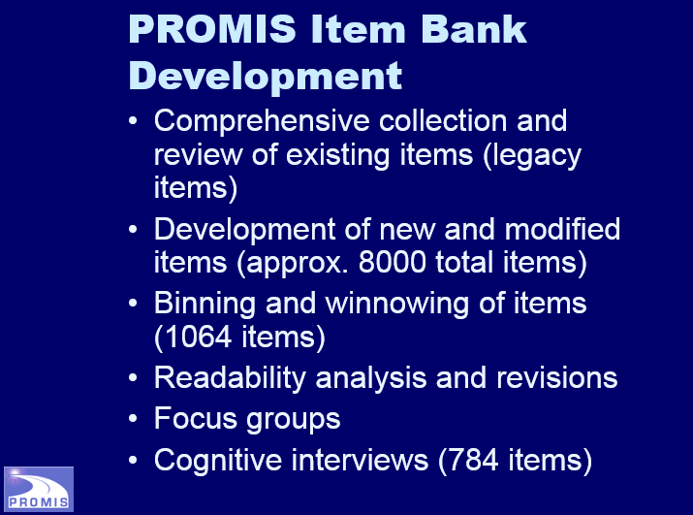

Slide 46
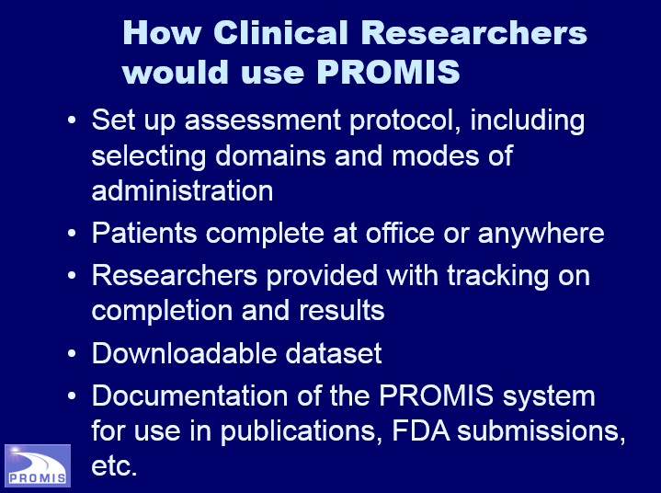

Slide 47
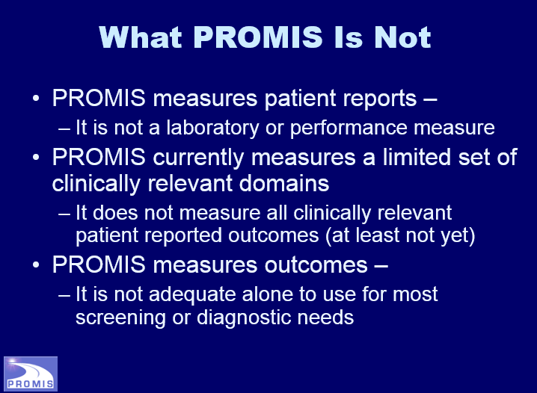

Slide 48
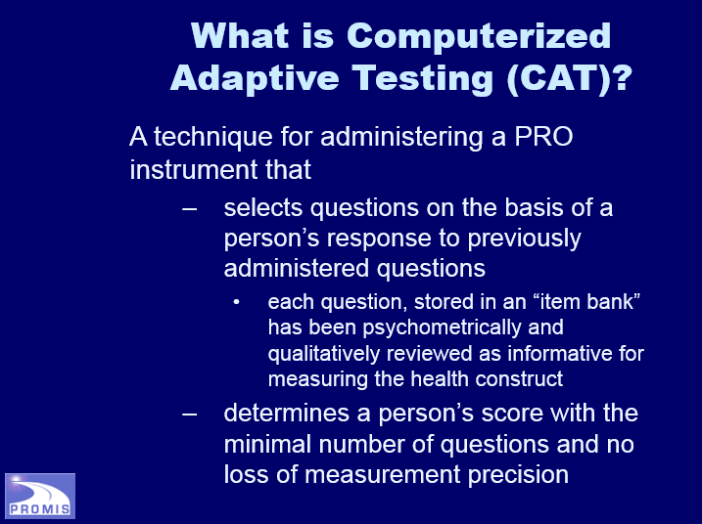

Slide 49
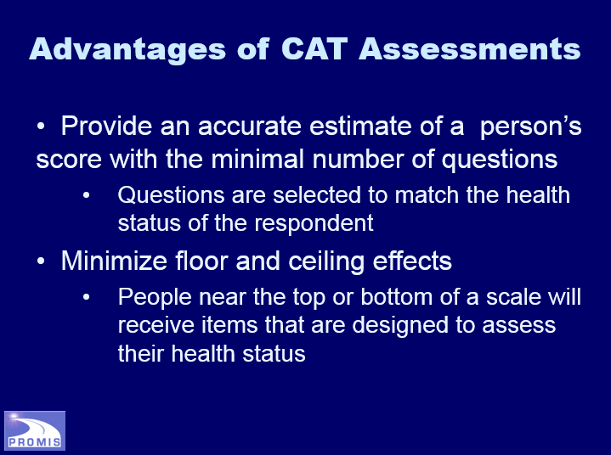

Slide 50
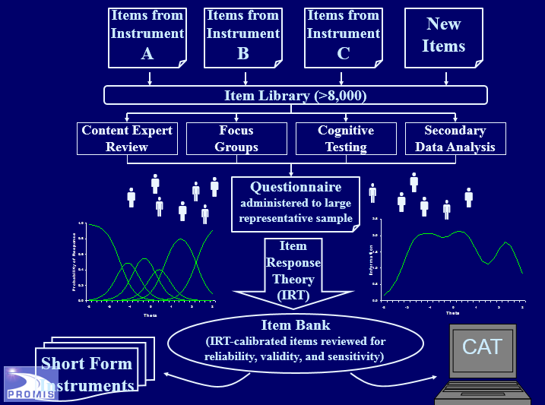

Slide 51
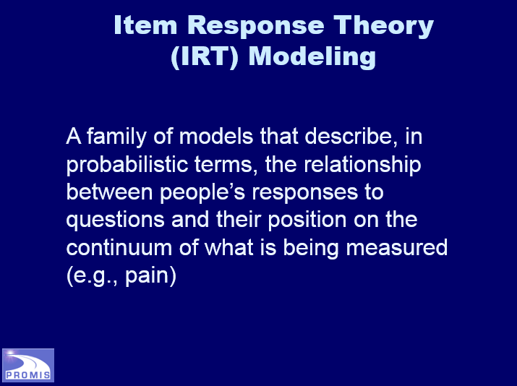

Slide 52
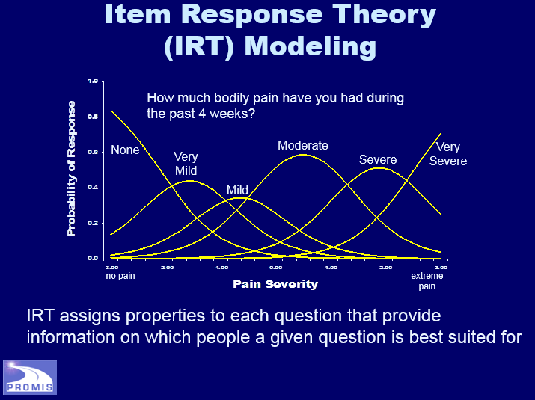

Slide 53
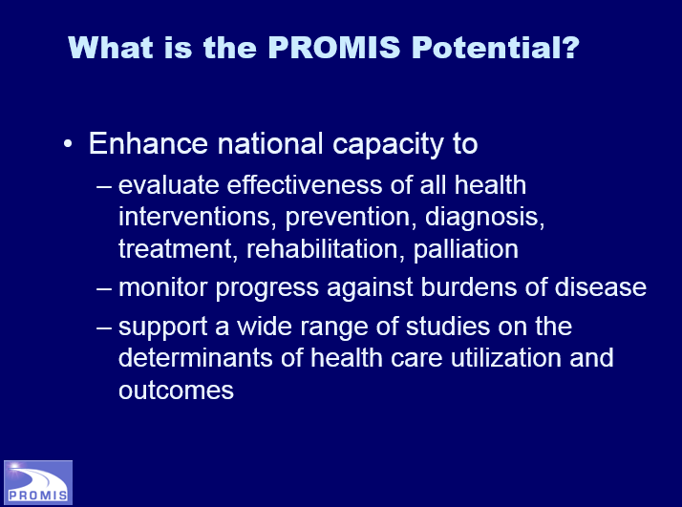

Slide 54
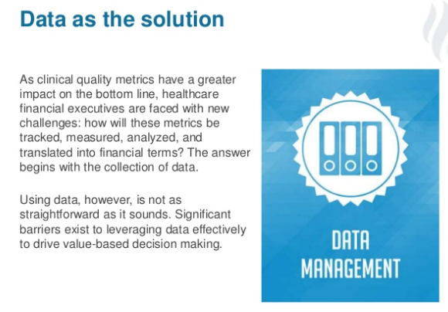

Slide 55
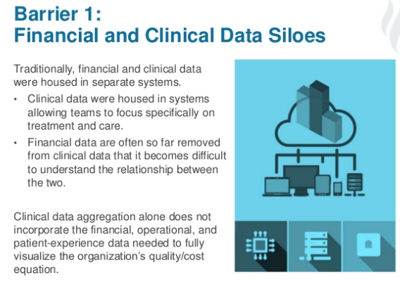

Slide 56
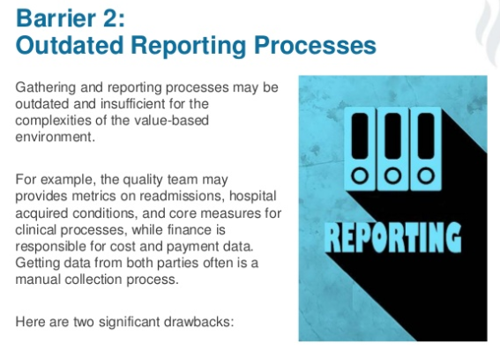

Slide 57


Slide 58


Slide 59
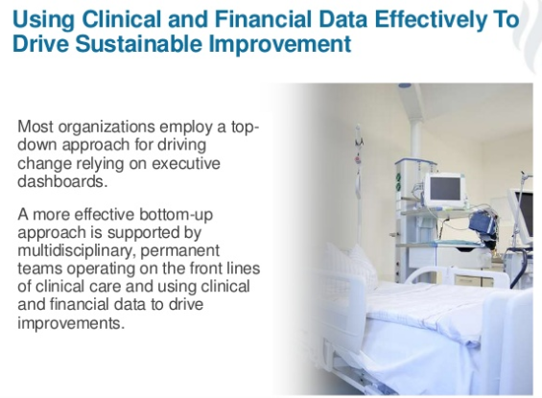

Slide 60


Slide 61
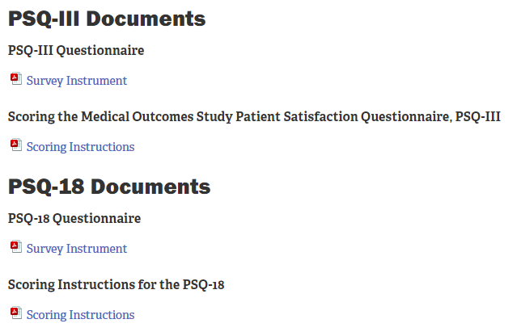


Slide 62
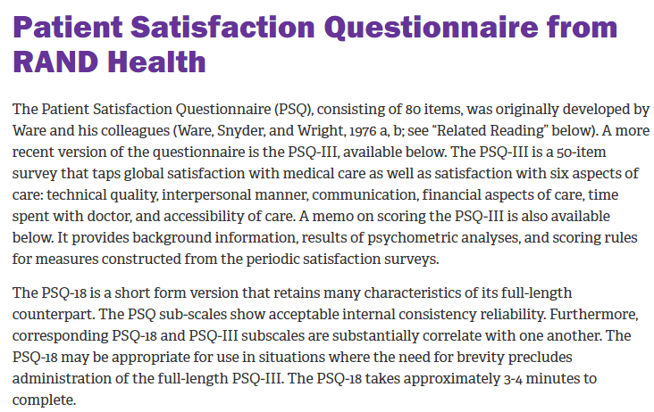

Slide 63
1. Patients whose physicians were rated as more empathetic had higher rates of high satisfaction than patients whose physicians were less empathetic.
True
False

Slide 64
1. Patients whose physicians were rated as more empathetic had higher rates of high satisfaction than patients whose physicians were less empathetic.
True
False

Slide 65
2. How do patients least judge quality?
By the physician demonstration of knowledge and expertise
Did the physician listen?
Did the physician express concern?
Did the physician answer my questions?
Did the physician care for me as a person and not just a patient?
By physicians verbal and non-verbal behavior

Slide 66
2. How do patients least judge quality?
By the physician demonstration of knowledge and expertise
Did the physician listen?
Did the physician express concern?
Did the physician answer my questions?
Did the physician care for me as a person and not just a patient?
By physicians verbal and non-verbal behavior

Slide 67
3. What are the evidence-based practice sequence key words of process for communicating with patients and families. Please select the correct answer from the choices below.
Hello–What-How-Why-Bye
Acknowledge-Introduce-Duration-Explanation-Thank
Praise-Compliment-Encourage-Depart
Background-Delegate-Nurse-Depart

Slide 68
3. What are the evidence-based practice sequence key words of process for communicating with patients and families. Please select the correct answer from the choices below.
Hello–what-how-why-bye
Acknowledge-Introduce-Duration-Explanation-Thank
Praise-Compliment-Encourage-Depart
Background-Delegate-Nurse-Depart

Slide 69
4. PROMIS measures which of the following?
Laboratory performance measure
A limited set of clinically relevant domains
All screening or diagnostic needs

Slide 70
4. PROMIS measures which of the following?
Laboratory performance measure
A limited set of clinically relevant domains
All screening or diagnostic needs

Slide 71
5. What does the governmental sponsored organization PROMIS stand for? Which of the follow responses is correct
Problem-Related-Outside-Management Investigation Search
Patient-Reported Outcomes-Measurement Information System
Patterned Responses-Options Major-Investment Site

Slide 72
5. What does the governmental sponsored organization PROMIS stand for? Which of the follow responses is correct
Problem-Related-Outside-Management Investigation Search
Patient-Reported Outcomes-Measurement Information System
Patterned Responses-Options Major-Investment Site

