Slide 1

MODULE four:
MEDICAL PROTOCOLS
AND
QUALITY ASSURANCE

Slide 2
MODULE four:
SECTION eight:
Mandatory reporting
including
hedis measures

Slide 3

UNIT OBJECTIVES
To learn about mandatory reporting requirements and systems for health care practitioners in California
To learn about HEDIS measures and reporting

Slide 4
Mandatory reporting including hedis measures
Nationally notifiable conditions
California reporting laws (e.g., The California Child Abuse & Neglect Reporting Law)
Physician quality reporting system
Electronic medical records (EMRs)
Healthcare Effectiveness Data and Information Set (HEDIS)
Accreditation and certification performance measures
HEDIS quality care
Overview of standards, policies and procedures

Slide 5
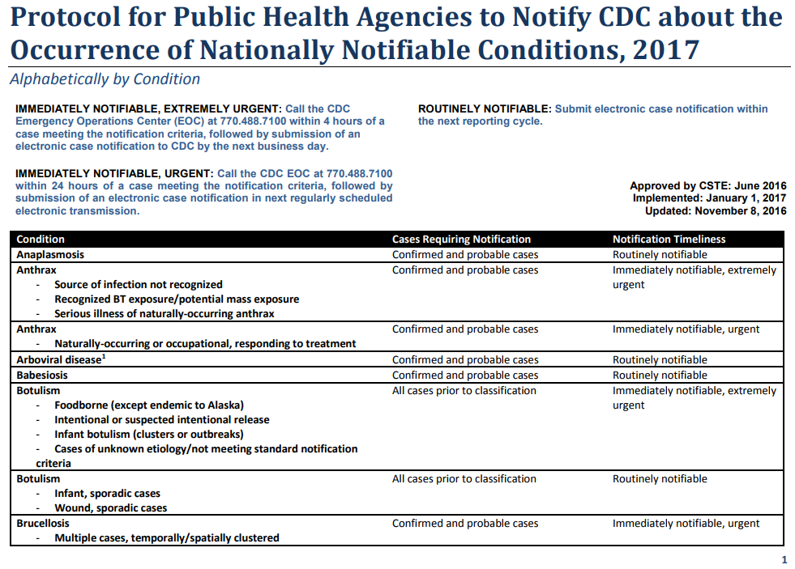

Slide 6
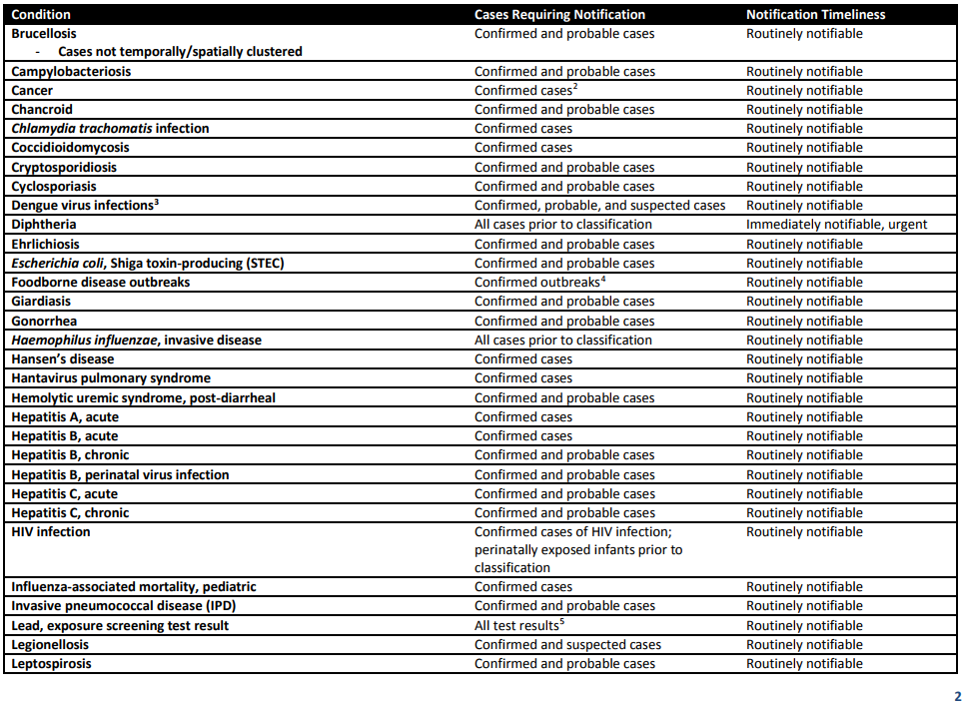


Slide 7
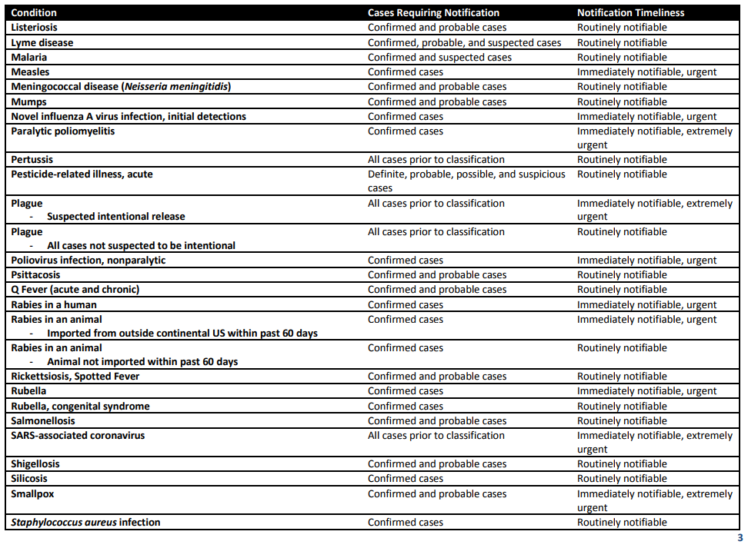

Slide 8
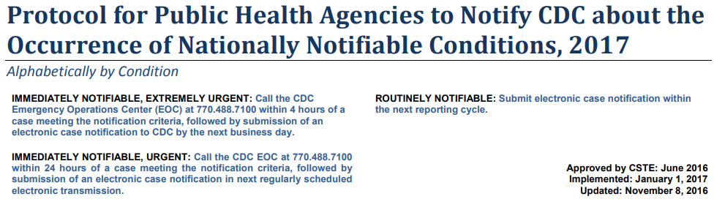
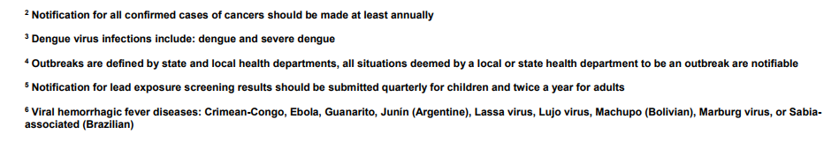

Slide 9
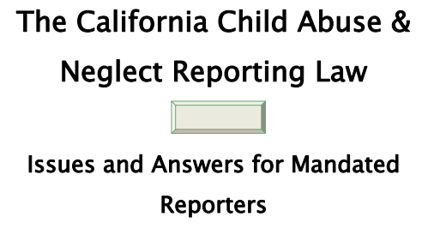

A PHYSICIAN AT A COMMUNITY HEALTH CENTER
IN CALIFORNIA IS A MANDATED REPORTER

Slide 10


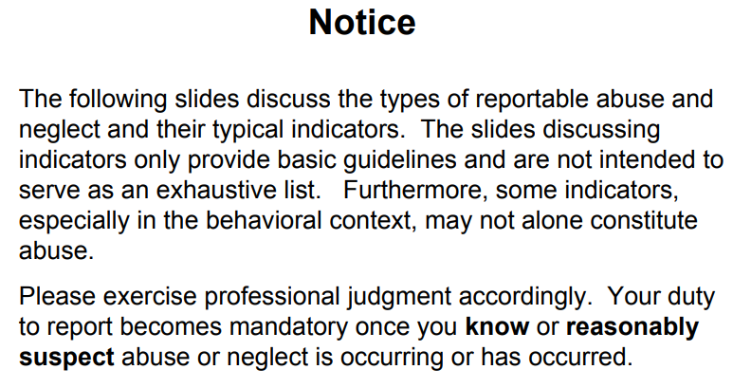


Slide 11


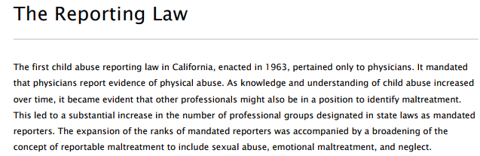

Slide 12
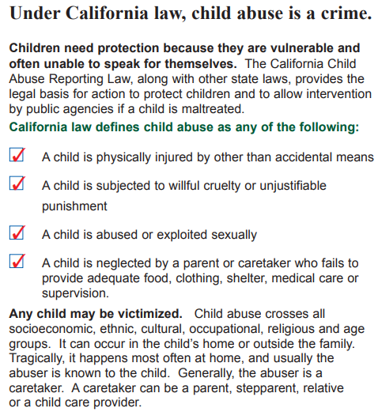
What is
child
abuse?

Slide 13
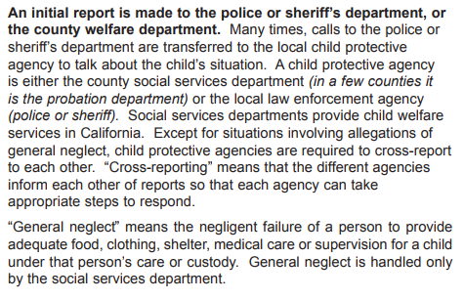
How does Child
Abuse get reported?

Slide 14
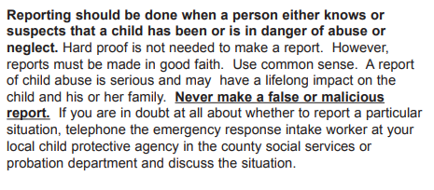
When do I know when
to report child abuse?

Slide 15

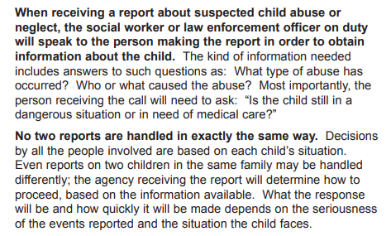
What happens after a
report is made?

Slide 16
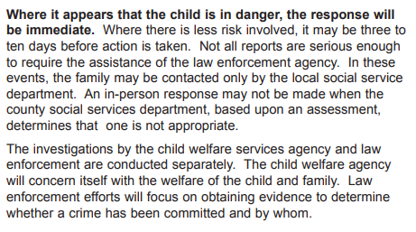
What happens after a
report is made?

Slide 17
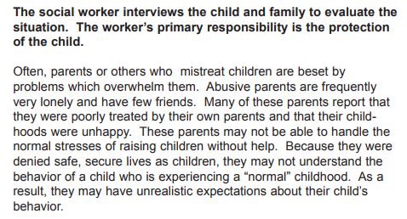
What does the social
worker do?

Slide 18
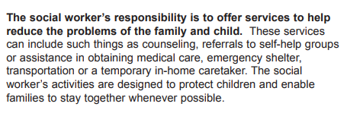
What does the social worker do?

Slide 19
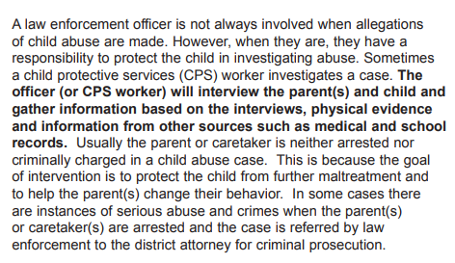
What does the law
enforcement
officer do?

Slide 20
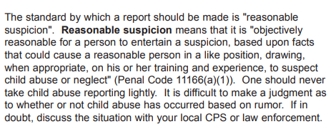
I heard a rumor that someone
is abusing their child.
Do I report it?.....

Slide 21

What is the fine line between physical abuse and discipline?

Slide 22

What if a adult states he/she was abused as a child?

Slide 23
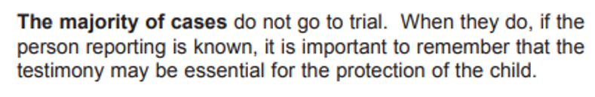
What about testifying in court?

Slide 24
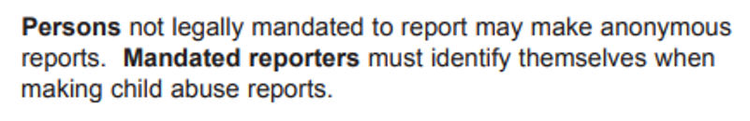
May reports be made anonymously?

Slide 25
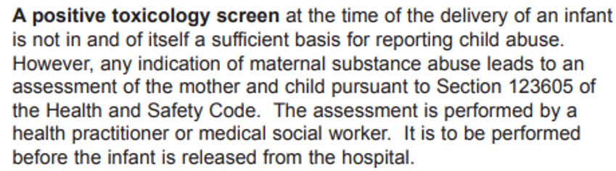
Does a positive toxicology screen at time of delivery require a child abuse report?

Slide 26
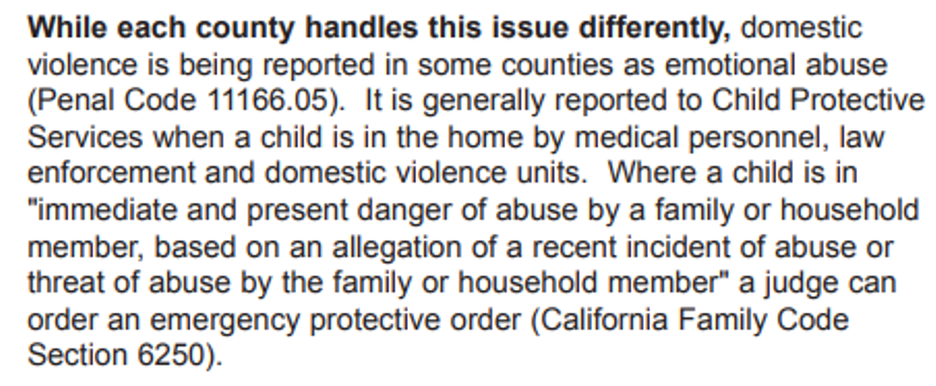
In cases of domestic violence when there is a child in the home is it reportable as child abuse?

Slide 27
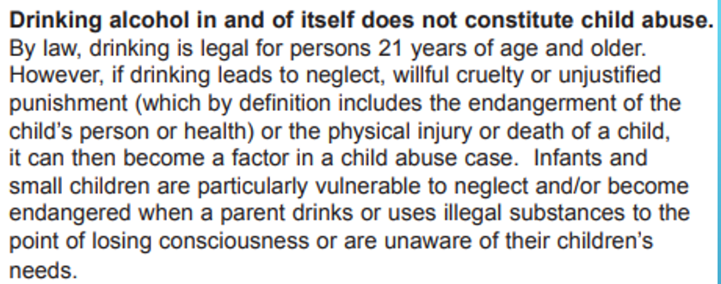
Friends of mine, with a small child, often drink in their home. At what point is drinking considered abuse?
A QUESTION YOU MIGHT BE ASKED BY ANOTHER PATIENT

Slide 28
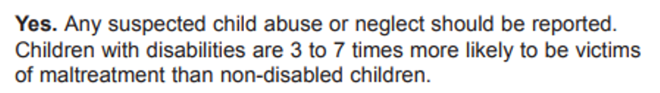
If you suspect abuse of a disabled child in a home or institution, is it reportable as child abuse?

Slide 29
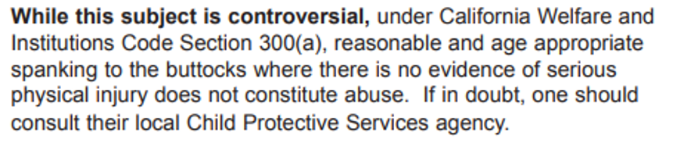
Is spanking a form of child abuse?

Slide 30
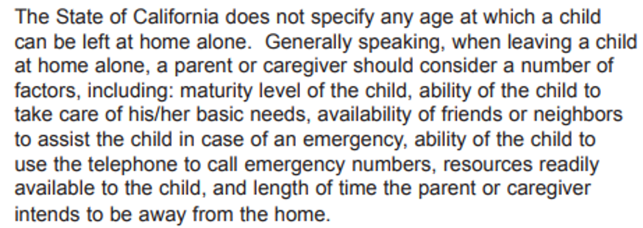
At what age can a child legally be left alone?

Slide 31
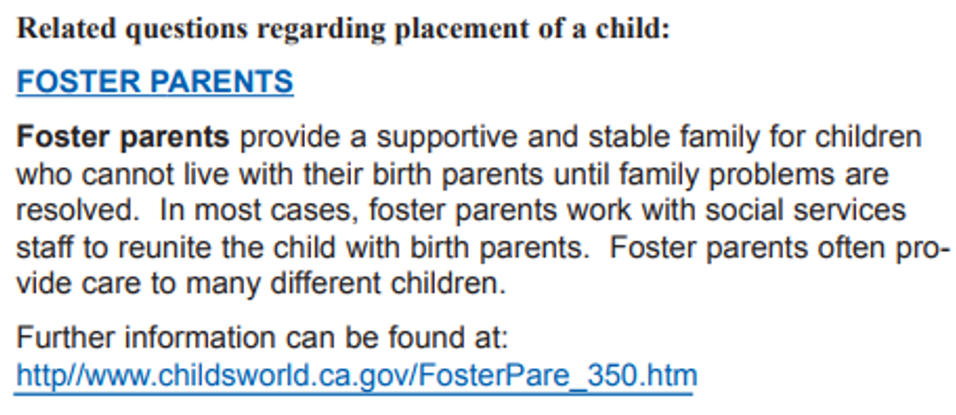
What is the role of foster parents?

Slide 32
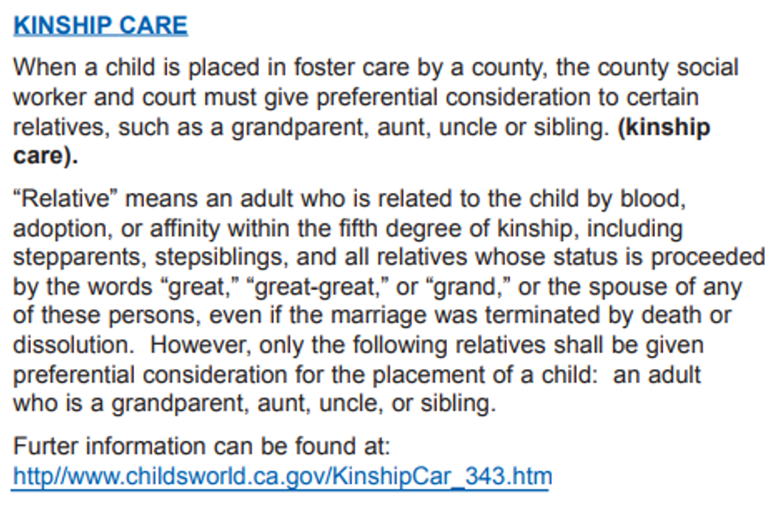
What are the laws regarding kinship care?

Slide 33
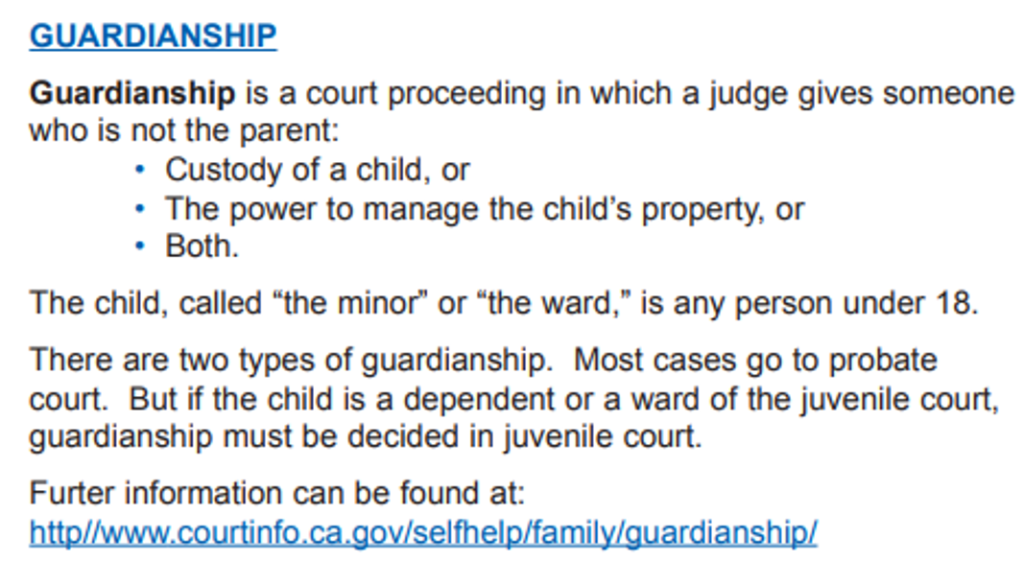
What is guardianship?

Slide 34
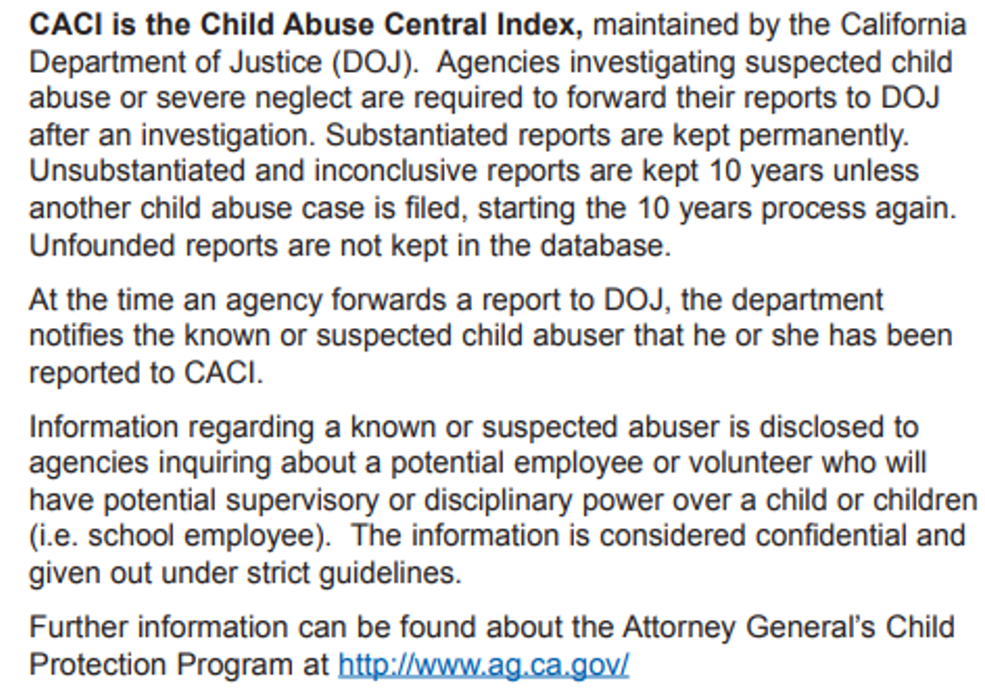
What is caci?
How do I find out if
I’ve been reported?

Slide 35
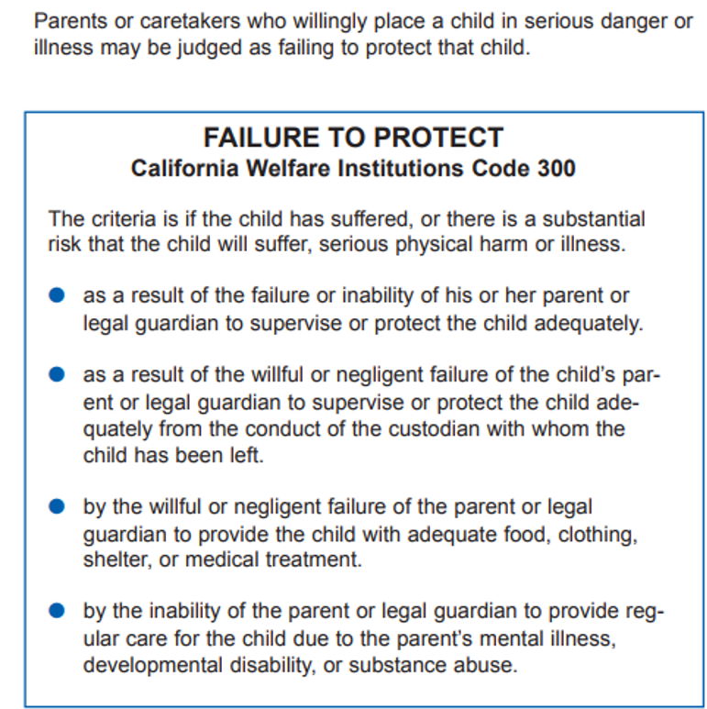
What is failure to protect?

Slide 36
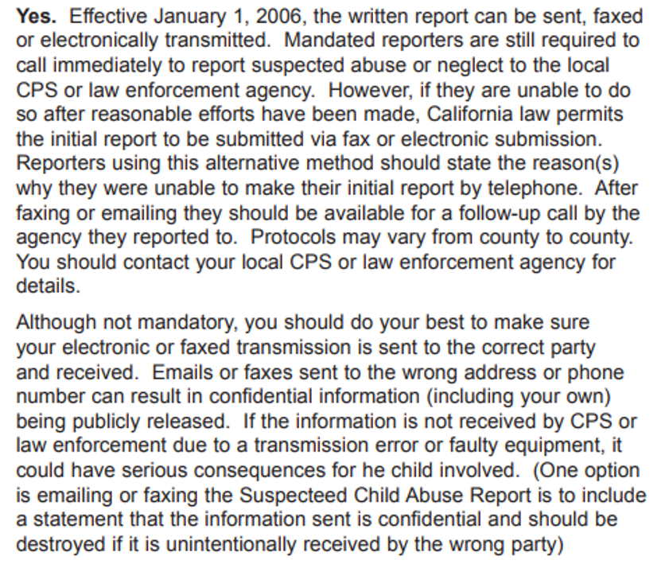
As a mandatory reporter, can I fax or electronically submit a Suspected Child Abuse Report?

Slide 37
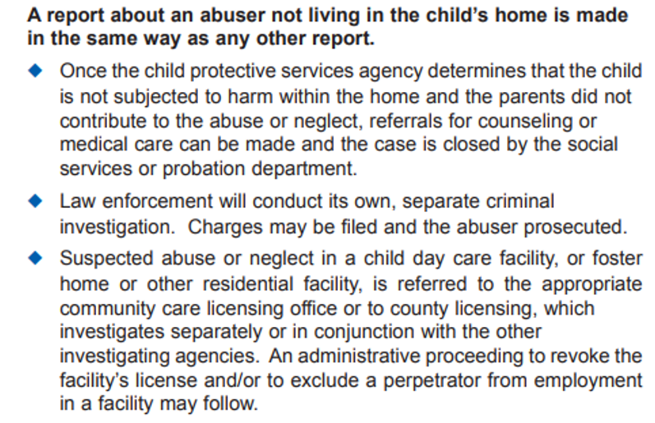
What happens if the abuser is someone outside the household?

Slide 38
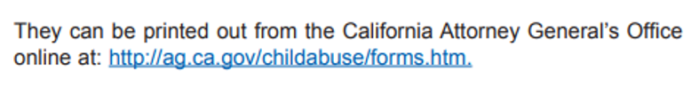
As a physician I am a mandated reporter. Where can I get a suspected child abuse reporting form?

Slide 39
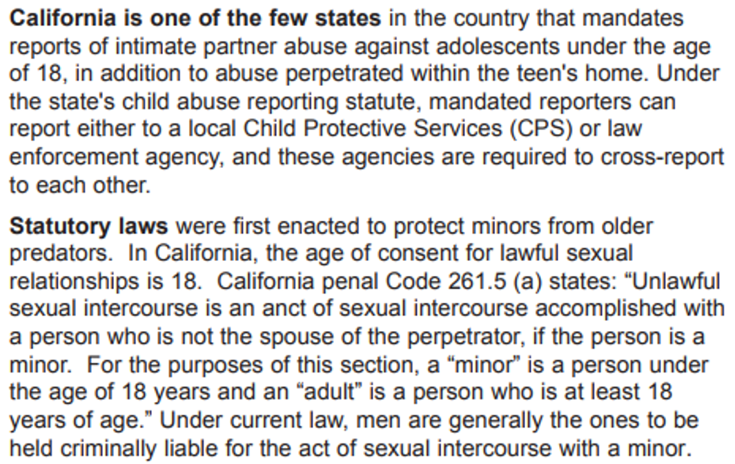
What does the law say about sex between minors?

Slide 40
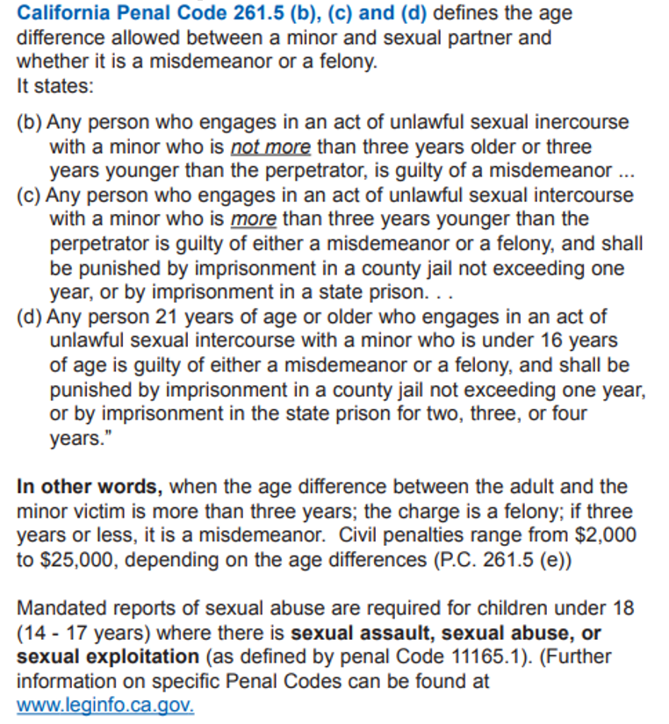
California Penal Code 261.5 (b), © and (d) defines the age difference allowed between a minor and sexual partner and whether it is a misdemeanor or a felony.

Slide 41
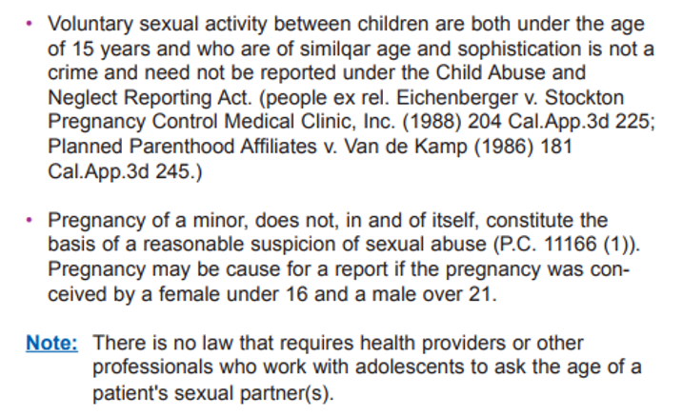
What is not reportable?

Slide 42
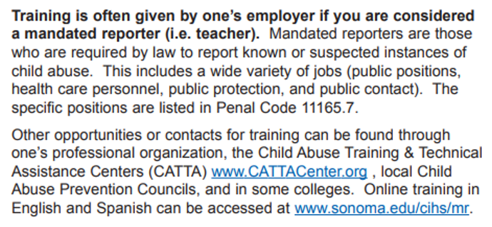
How do I get training for mandated reporting of child abuse?

Slide 43
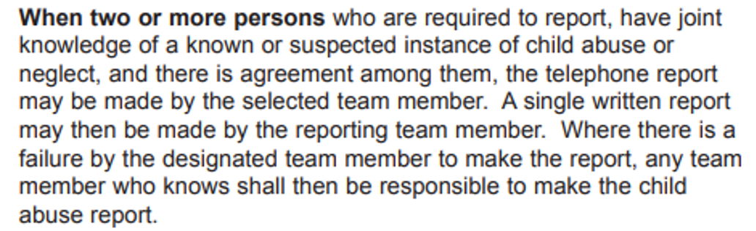
What if more than one mandated reporter sees an incident of child abuse, who reports it?

Slide 44
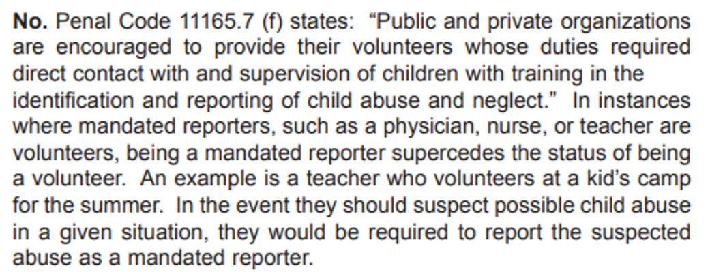
Are volunteers mandated reporters of child abuse?

Slide 45
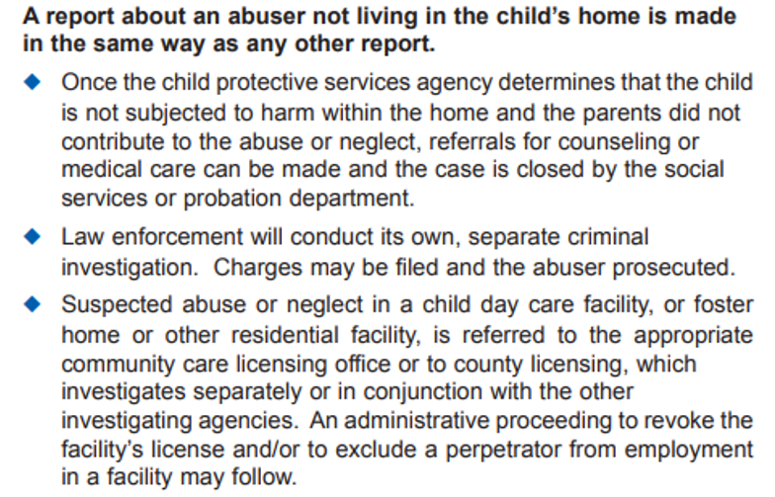
What happens if the abuser is someone outside the household?

Slide 46

Since as a physician I am a mandated reporter, where can I obtain a suspected child abuse reporting form?

Slide 47
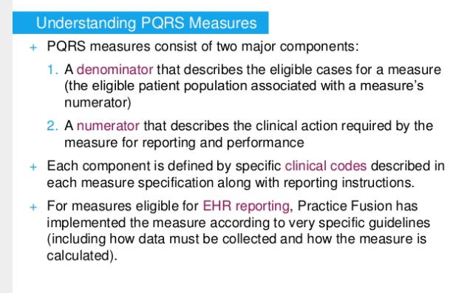

Slide 48
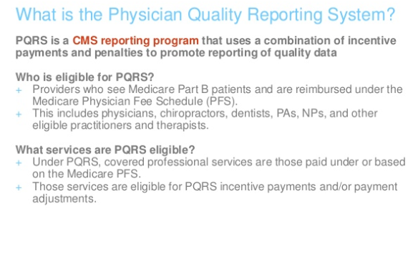

Slide 49
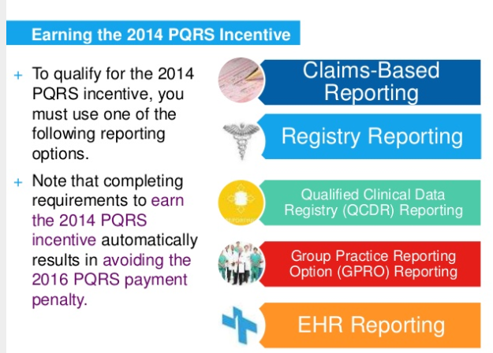

Slide 50
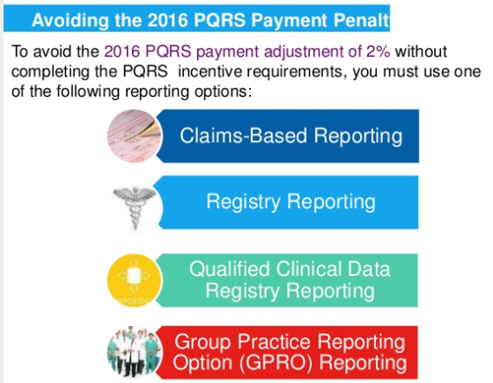

y

Slide 51
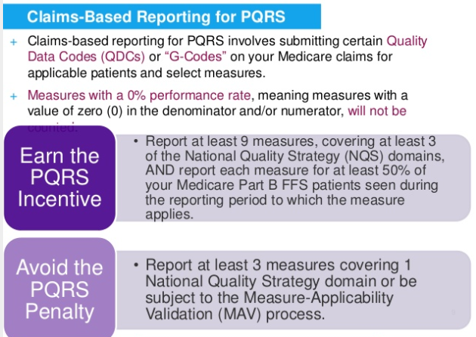

Slide 52
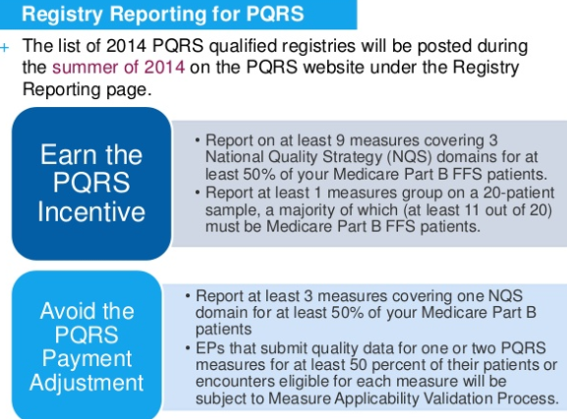

Slide 53
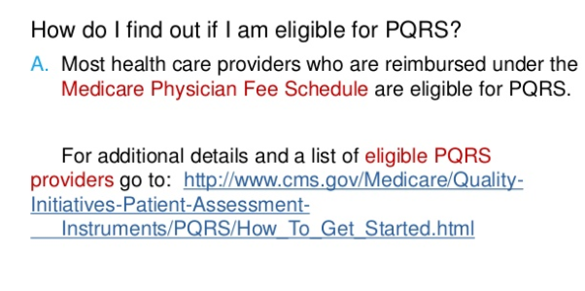

Slide 54
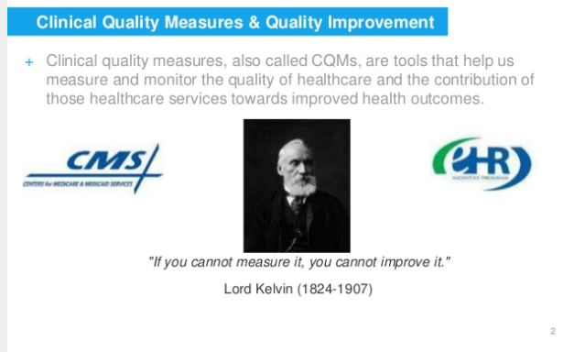

Slide 55
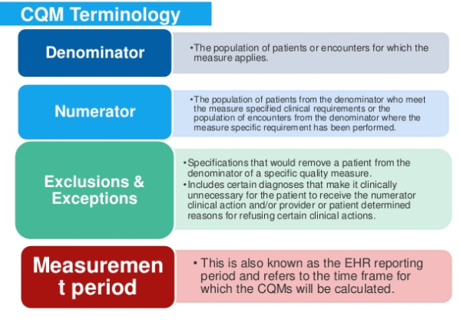

Slide 56
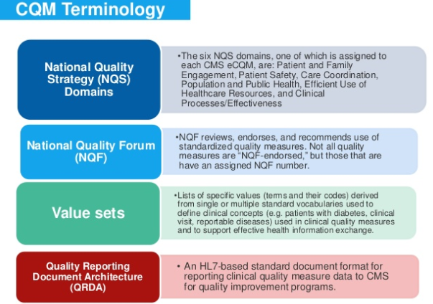

Slide 57


Slide 58


Slide 59


Slide 60


Slide 61

NOW WOULD USE ICD-10-CM,CPT CODES

Slide 62



Slide 63

EXAMPLE OF REVIEW

Slide 64


Slide 65


Slide 66


Slide 67

EXAMPLE

Slide 68


Slide 69


Slide 70


Slide 71


Slide 72


Slide 73

Electronic health record documentation

Slide 74




Slide 75

Objectives for emr
Explain medical errors and EMRs
Understand how errors are made
Determine how EMRs can help
Identify the advantages and disadvantages
Understand the future of EMRs in the medical field

Slide 76

Emr provides safeguard to prevent prescribing errors
Drug-to-drug interactions
Drug-allergy interactions
Drug-disease incorrect dosage
Incorrect duration
Drug-pregnancy conflict
Drug gender conflict
OTC drugs and herbal adverse interactions

Slide 77

Data retrieval enhancement
Prescribing error reduction
Available strength of drug
Alternative class medications
Reduce refill time
Provide patient data surveillance
Formularies are available electronically
I can’t wait to have EMR

Slide 78

Reduction of dispensing errors improved efficiency and safety
Complete prescription information
Less errors in interpreting
Quicker access to provider
Quicker refill authorization’
More access to patient’s profile

Slide 79

Safety improved errors reduced
Drug-to-drug interactions
Drug-allergy interactions
Drug-disease incorrect dosage
Incorrect duration
Drug-pregnancy conflict
Drug gender conflict

Slide 80

Advantages over paper medical records
Efficiency:
Retrieve patient profiles quicker
Patient access to profiles
Reduce errors
Easy to transfer information:
Example: In natural disasters
Example: If practice has relocated or or patient
has moved or transferred care

Slide 81

Advantages of emr system
Saves money:
Cost of filing folder and paper
Cost of labor
Patients saving money
Easier billing
Saves space:
Faster work flow

Slide 82


Slide 83


Slide 84

ISSUES TO
CONSIDER
POTENTIAL EMR

Slide 85


Slide 86


Slide 87


Slide 88


Slide 89


Slide 90


Slide 91

EXAMPLE OF WHAT NOT TO DO!!!!!!!!!!!!!

Slide 92


Slide 93


Slide 94


Slide 95


Slide 96


Slide 97


Slide 98


Slide 99


Slide 100


Slide 101


Slide 102


Slide 103


Slide 104


Slide 105


Slide 106


Slide 107

CLINIC ADMINISTRATION PHYSICIAN
QUESTIONS IN EMR DOCUMENTATION

Slide 108


Slide 109



Slide 110


Slide 111
WHO DEVELOPED THIS SYSTEM OR PROGRAM?
It is a standardized set of performance measurements developed by the National Committee for Quality Assurance (NCQA) to evaluate consumer health care.

Slide 112


Slide 113
GOAL
TRANSLATE THE EXCELLENT CLINICAL CARE YOU ARE GOING TO PROVIDE INTO GREAT HEDIS RATES

Slide 114


Slide 115
Team work with your staff to mutually understand the HEDIS guidelines and establish priorities for follow through and monitoring with best practice clinical practice using evidence based medicine clinical practice guidelines.
Establish or develop work habits to continue repeating best practice so there is a clinic culture of providing the best possible care for your patients as a routine that is documented appropriately so that again your excellent care will translate into great health care and great team HEDIS rates.
WHAT DOES HEDIS MEAN TO ME AT THE START OF MY NEW JOB AS A PHYSICIAN

Slide 116


Slide 117
YOU MAY BE CONCERNED ABOUT HEALTH INFORMATION PRIVACY AS IT RELATES TO HEDIS – not to fear
Just remember this process is an attempt to promote the best quality, most efficient, data driven, most cost effective population health care management system with the goal of eliminating health care disparities and utilizing preventive medicine principles to either directly or indirectly improve the health of all patients.

Slide 118


Slide 119
HEDIS® is a retrospective review or look backwards at the year or year(s) prior depending on the measure.
Some measures have only a one year look-back period, while other measures the look-back period can extend up to ten years, like for colorectal cancer screening.
It is a review of the services and clinical care provided to your patients.

Slide 120


Slide 121
REMEMBER IN GOD WE TRUST --- FOR EVERYTHING IT REQUIRES DATA TO VERIFY AND EVALUATE OUTCOMES WITH EVIDENCE-BASED MEDICINE PRACTICES
THE GOAL OF GOVERNMENT AGENCIES IS TO FINANCIALLY REWARD PRACTICES THAT HAVE DEMONSTRATED QUALITY, COST EFFECTIVENESS, DATA CONFIRMED PRACTICES THROUGH VARIOUS AUDIT PROCESSES VIA EMR DRIVEN ADMINISTRATIVE DATA THROUGH CLAIMS, PRESCRIPTIONS, AND LAB INFORMATION AS WELL AS EMR MEDICAL RECORD REVIEW
HEDIS IS THE REPORT CARD DOCUMENTING THAT YOUR EXCELLENT MEDICAL CARE IS A VARIFIABLE REALITY

Slide 122


Slide 123
ENSURE QUALITY CARE VERIFICATION BY DOCUMENTION IN THE MEDICAL RECORD
Ensure all clinical care is performed with a culture of team work and commitment to evidence-based knowledge acquisition and the repetition of the fulfilment of the expected clinical measures to optimize care to your patients.
In other words develop a team oriented system that works and just keep on doing the same system over and over again.

Slide 124


Slide 125


Slide 126


Slide 127


Slide 128


Slide 129


Slide 130
ADULT BMI ASSESSMENT – LOW COST DATA
Adult BMI Assessment time frame was two years
Expectations and Clinical Measures are constantly changing in an attempt to continually improve population health over time

Slide 131


Slide 132


Slide 133


Slide 134
BE AWARE OF SPECIAL CIRCUMSTANCES
Appropriate screening exams include: a Fecal Occult Blood Test, also known as a FOBT or Fit test, a sigmoidoscopy, and a colonoscopy.
A change for this measure in 2016 is the stipulation that any FOBT testing done in the doctor’s office or any stool sample collected by digital rectal exam during the patient visit cannot be used. Make sure this testing is not completed during an office visit .
If at all possible try to have your patient agree to have a colonoscopy or sigmoidoscopy completed. It is not only more reliable it only needs to be completed every ten or five years.

Slide 135


Slide 136


Slide 137


Slide 138


Slide 139


Slide 140


Slide 141


Slide 142


Slide 143


Slide 144


Slide 145


Slide 146


Slide 147


Slide 148


Slide 149


Slide 150


Slide 151


Slide 152
HEDIS® made easy for you??? The physician!
You’ve learned that HEDIS® stands for the Healthcare Effectiveness Data and Information Set and is a standardized set of performance measures developed by NCQA to evaluate the quality of consumer health care.
Your role in HEDIS® is to make sure preventive health care screening is done, it’s completed in the right time frame, and then documented in the medical record.
The medical record must be legible and readable. And, if you receive a fax request. Care documentation needs to be sent usually within five business days.
Remember, you do not need to send the entire record. Only send the documentation as stated on the Medical Record request form.
And if you have any questions about what to send, just phone the contact telephone number on the fax and ask the representative to answer any questions you may have.

Slide 153


Slide 154


Slide 155


Slide 156


Slide 157


Slide 158


Slide 159


Slide 160


Slide 161


Slide 162


Slide 163


Slide 164


Slide 165


Slide 166


Slide 167


Slide 168


Slide 169


Slide 170


Slide 171


Slide 172


Slide 173


Slide 174


Slide 175
1. As a mandatory reporter your duty to report becomes mandatory once you know or reasonably suspect abuse or neglect is occurring or has occurred?
True
False

Slide 176
1. As a mandatory reporter your duty to report becomes mandatory once you know or reasonably suspect abuse or neglect is occurring or has occurred?
True
False

Slide 177
2. Usually the parent or caretaker is neither arrested nor criminally charged in a child abuse case.
True
False

Slide 178
2. Usually the parent or caretaker is neither arrested nor criminally charged in a child abuse case.
True
False

Slide 179
3. What can the social worker do to help in a case where CPS is involved?
Expedite counseling
Expedite attention
Expedite shelter
All of the above

Slide 180
3. What can the social worker do to help in a case where CPS is involved?
Expedite counseling
Expedite attention
Expedite shelter
All of the above

Slide 181
4. All reports of child abuse are handled in the exact same process.
True
False

Slide 182
4. All reports of child abuse are handled in the exact same process.
True
False

Slide 183
5. California law defines child abuse as any of the following except:
A child is physically injured by other than accidental means
A child is subjected to willful cruelty or unjustifiable punishment
A child is neglected by a parent or caretaker who fails to provide adequate food, clothing, shelter, medical care or supervision
A child is told no by their parents

Slide 184
5. California law defines child abuse as any of the following except:
A child is physically injured by other than accidental means
A child is subjected to willful cruelty or unjustifiable punishment
A child is abused or exploited sexually
A child is neglected by a parent or caretaker who fails to provide adequate food, clothing, shelter, medical care or supervision
A child is told no by their parents

Slide 185
5. California law defines child abuse as any of the following except:
A child is physically injured by other than accidental means
A child is subjected to willful cruelty or unjustifiable punishment
A child is abused or exploited sexually
A child is neglected by a parent or caretaker who fails to provide adequate food, clothing, shelter, medical care or supervision
A child is told no by their parents

