Slide 1

MODULE five:
PROFESSIONALISM,
ETHICS, AND BIOETHICS

Slide 2
MODULE five:
SECTION one:
Physician
Professionalism
and
Responsibilities

Slide 3

UNIT OBJECTIVES
To reaffirm the principles, fundamentals and universal values of professionalism. These remain ideals to be achieved by all doctors
To learn the concepts of responsibility, professional responsibility and professional responsibility of the physician; iatrogenic and iatrogeny; mal Badly medical practice; and the importance of the clinical record as a legal document

Slide 4
Physician Professionalism and Responsibilities
FUNDAMENTAL PRINCIPLES:
  Principle of predominance of patient welfare
  Principle of patient autonomy
  Principle of social justice

Slide 5
Physician Professionalism and Responsibilities
PROFESSIONAL RESPONSIBILITIES:
  Commitment to professional competence
  Commitment to be honest to patients
  Commitment to protect patient confidentiality
  Commitment to maintain appropriate relationships with patients
  Commitment to improve the quality of care
  Commitment on improving access to care
  Commitment for a fair distribution of limited resources
  Commitment to scientific knowledge and continuing education
  Commitment to disclose potential conflicts of interest
  Commitment with professional responsibilities
  Professional responsibility
  Licensing
  CME requirements
  Liability
  Quality of care
  Malpractice suits
  Malpractice insurance
  Physician-patient relationship

Slide 6
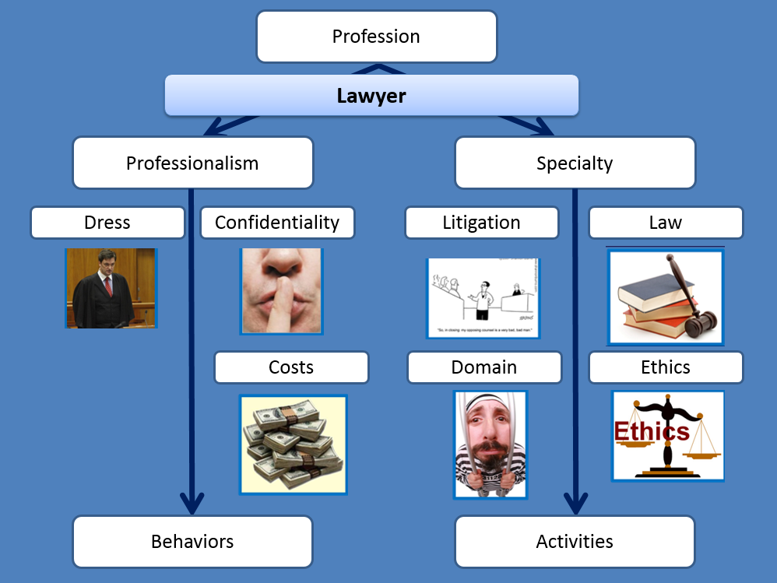
PROFESSIONALISM AND RESPONSIBILITIES
LAWYERS ARE EXAMPLES OF OTHER PROFESSIONALS

Slide 7

Professionalism - physician
AMA Code of Ethics 1847
ACP Ethics Manual 2005
A Physician Charter: ABIM, ACP
European Federation of Internal
Medicine 2007
Stern’s professionalism model
Institutional codes of conduct and policies

Slide 8
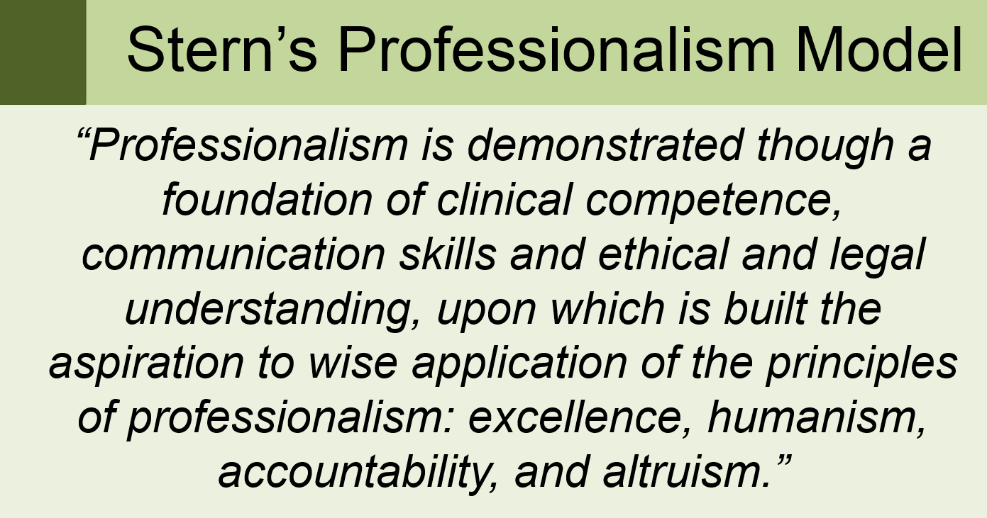

Slide 9
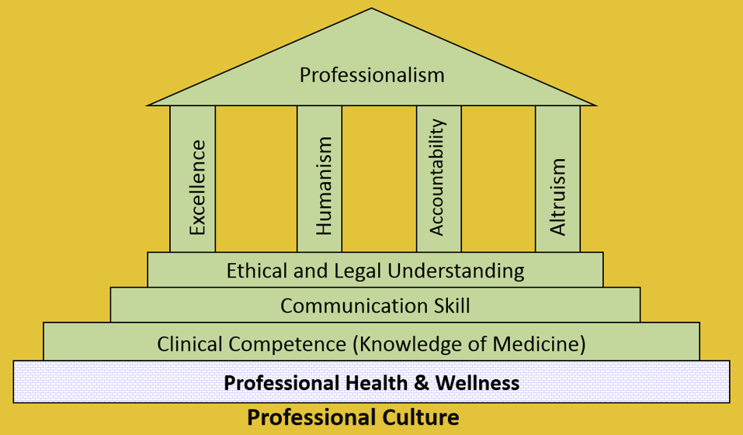
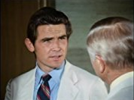
professionalism

Slide 10
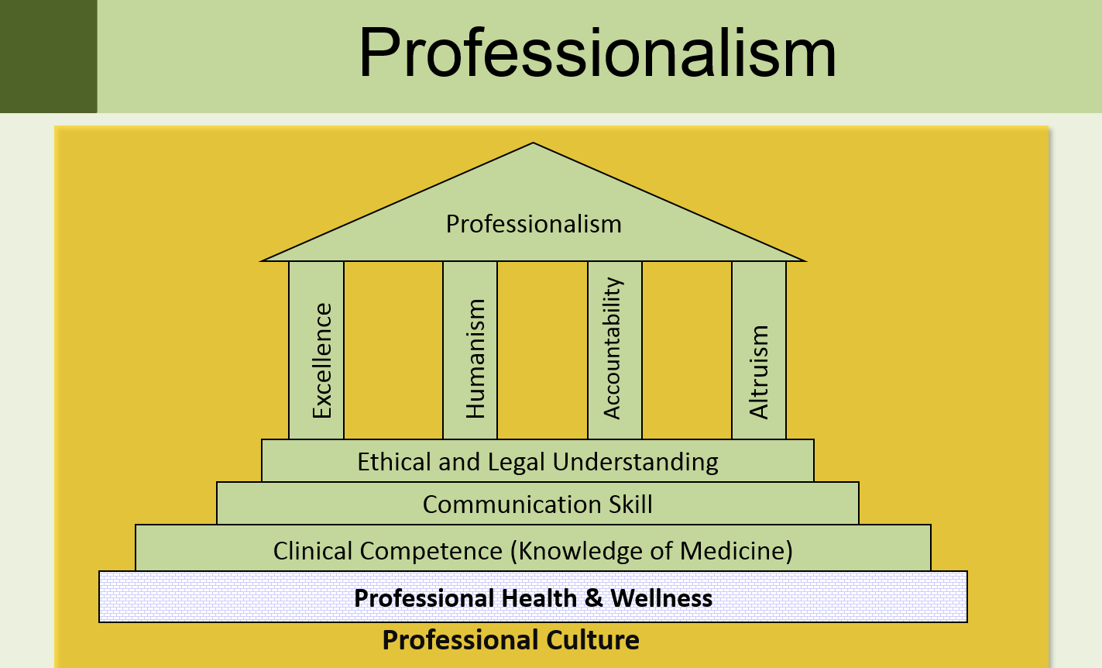

Slide 11
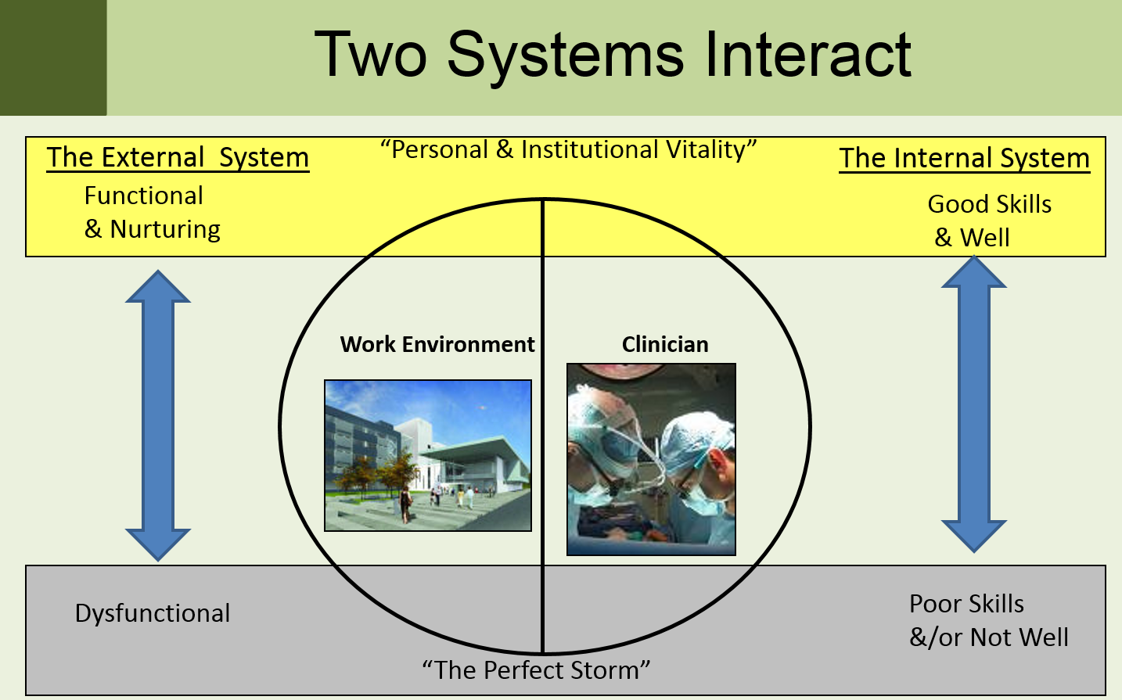

Slide 12
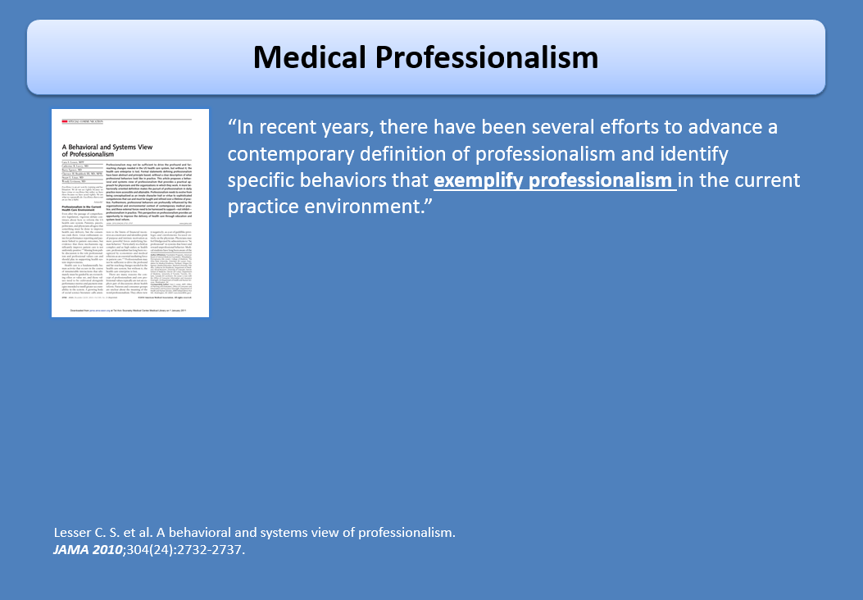

Slide 13
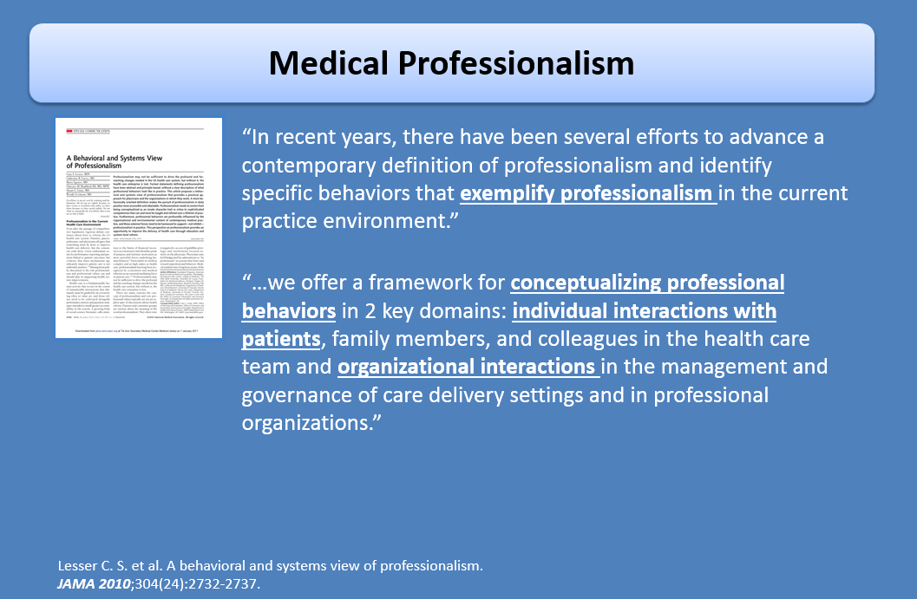

Slide 14
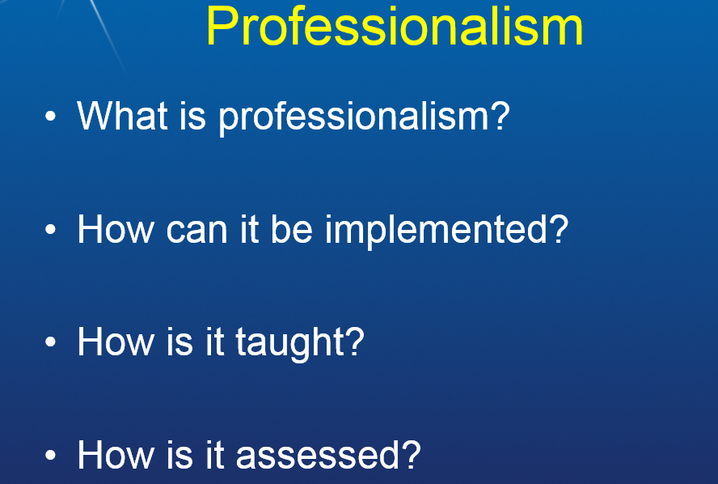

Slide 15




Slide 16
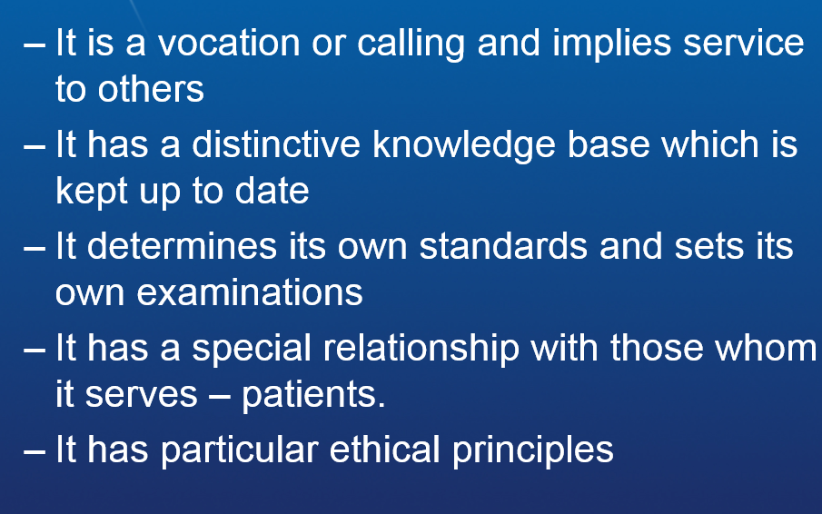

PROFESSIONALISM

Slide 17




Slide 18



Slide 19




Slide 20
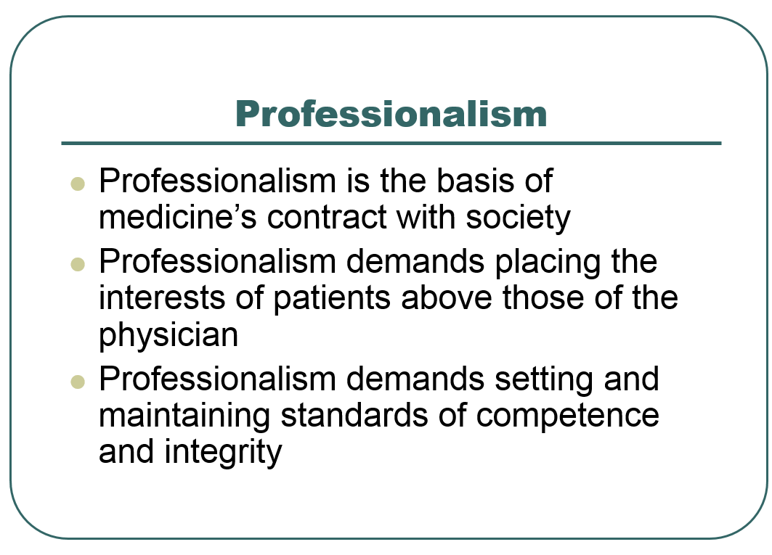

Slide 21
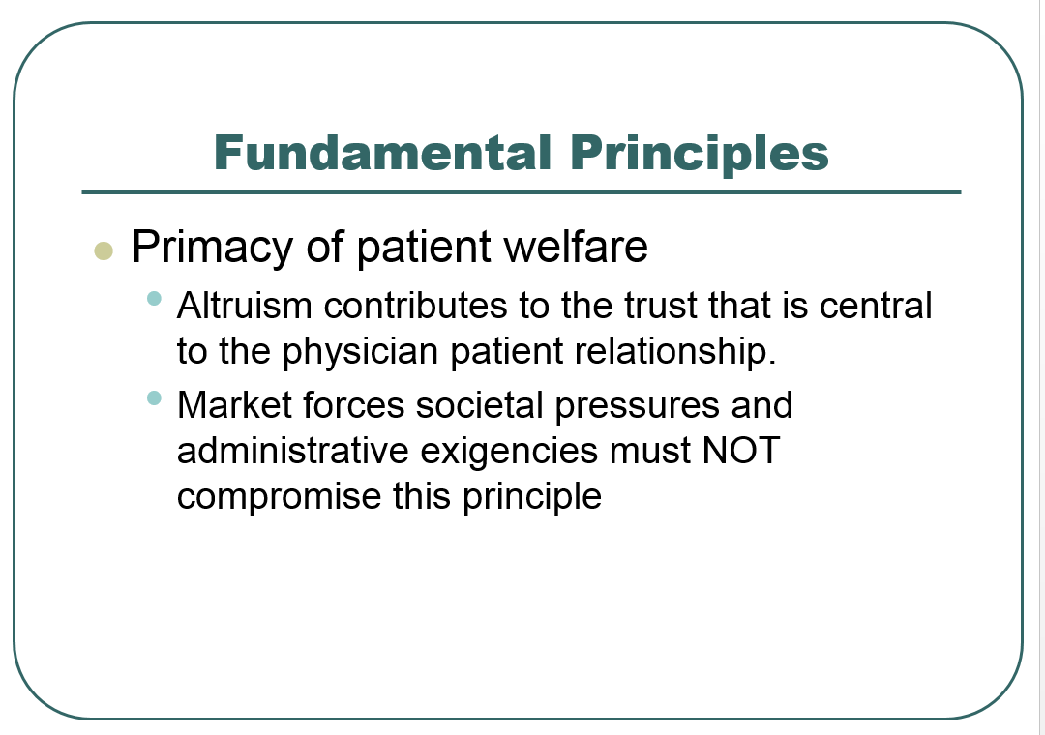

Slide 22
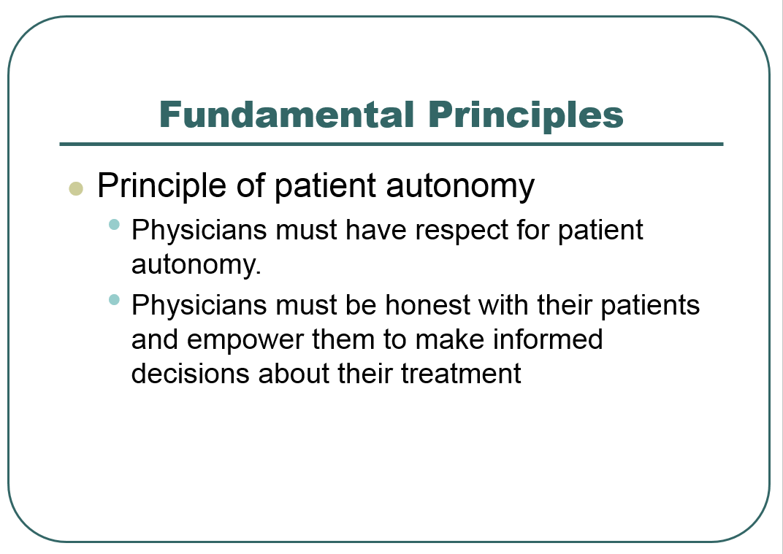

Slide 23
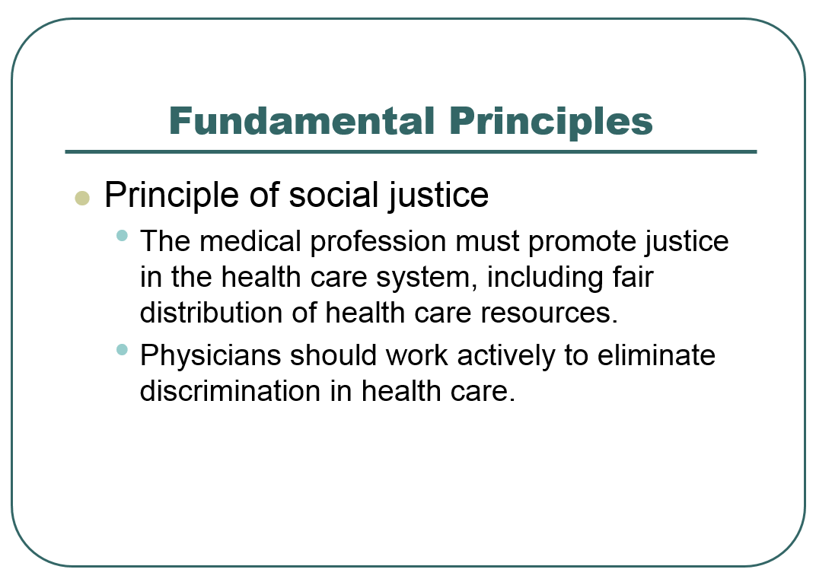

Slide 24
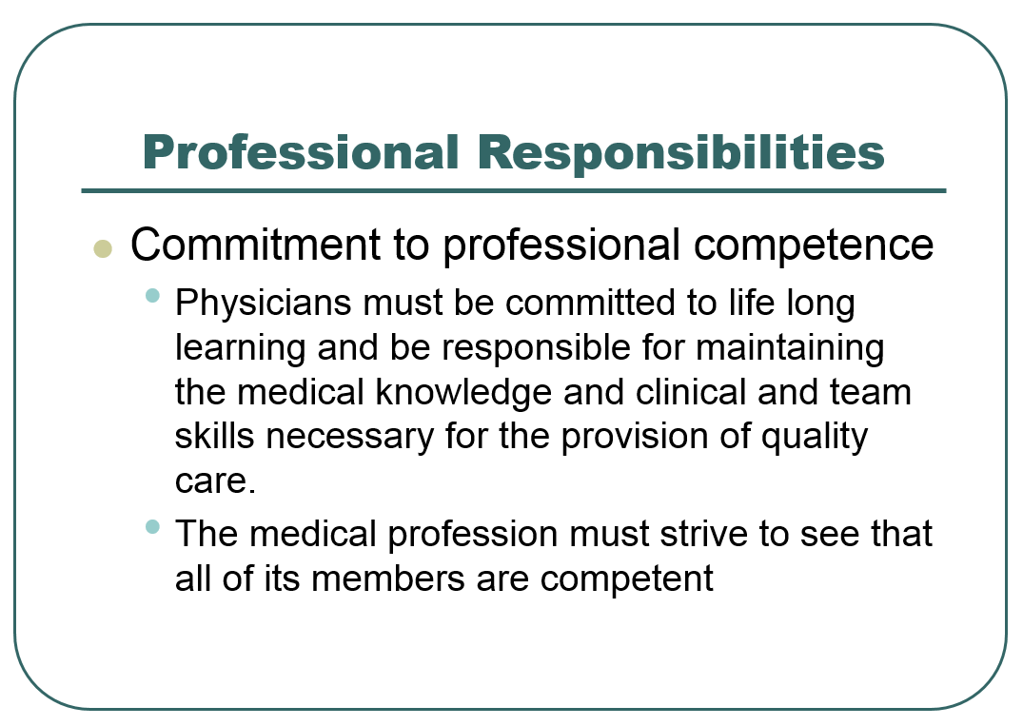

Slide 25
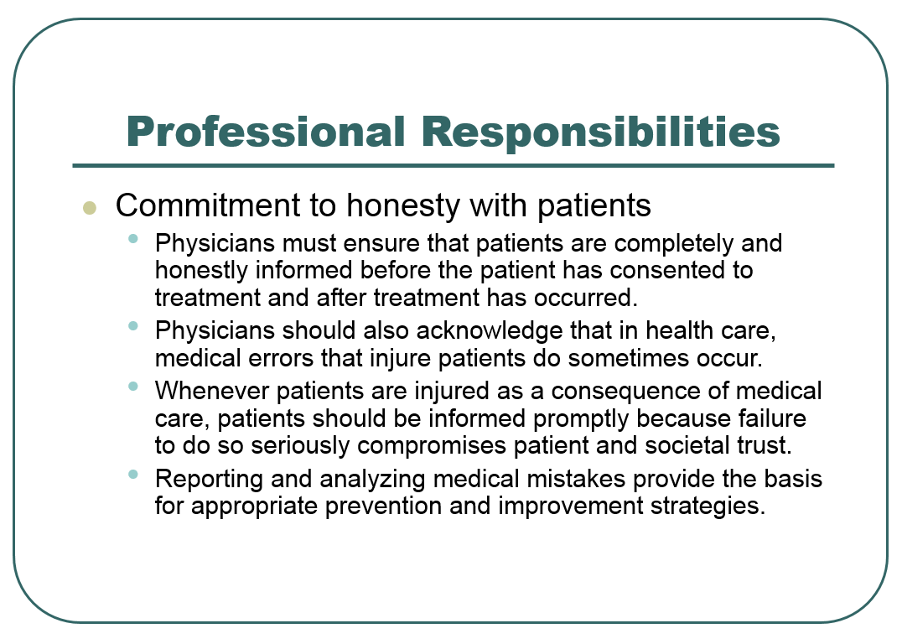

Slide 26
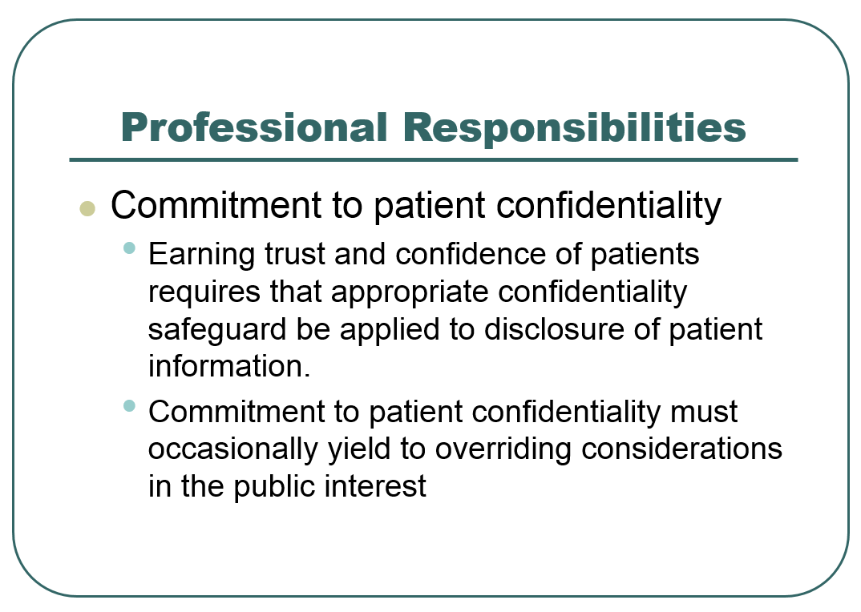

Slide 27
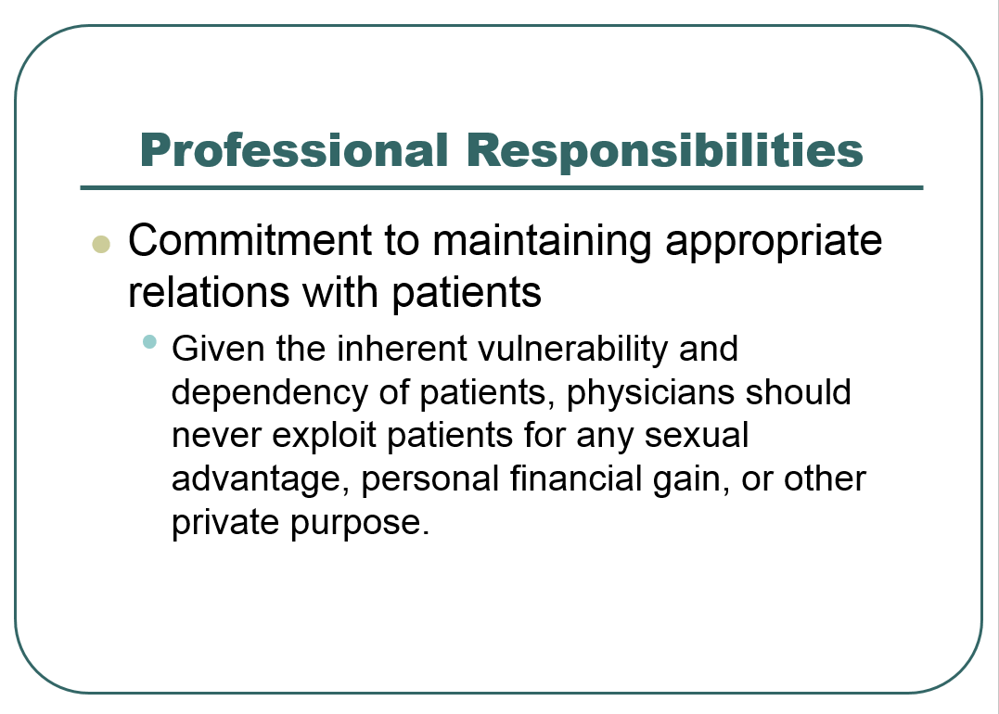

Slide 28
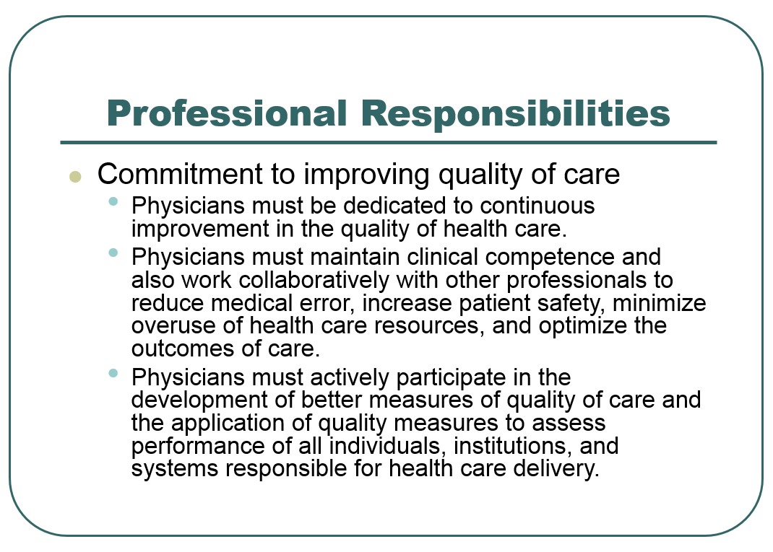

Slide 29
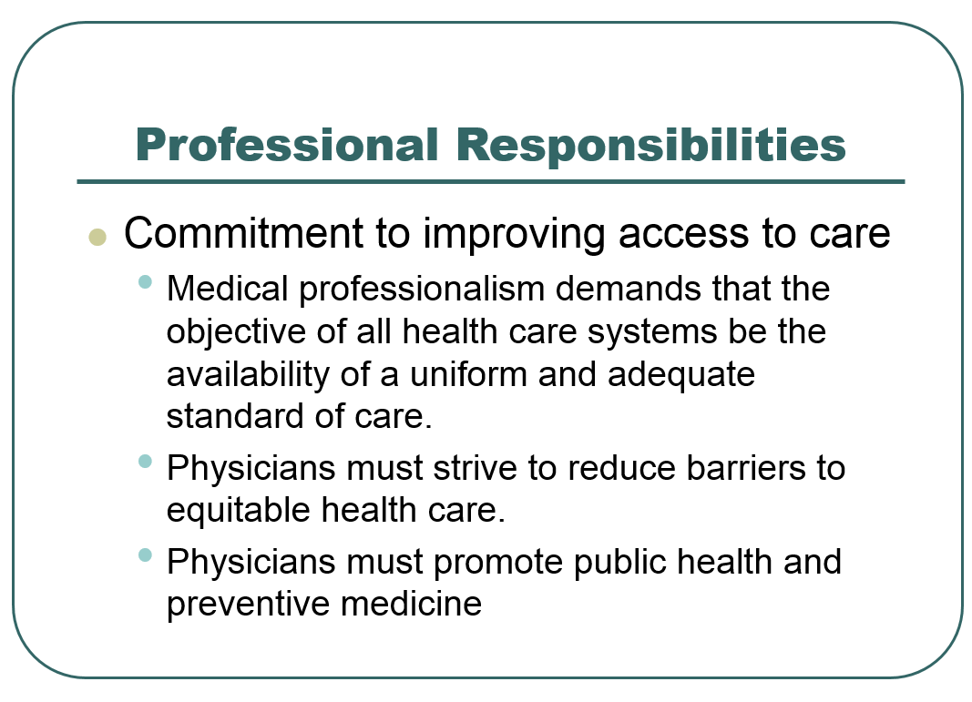

Slide 30
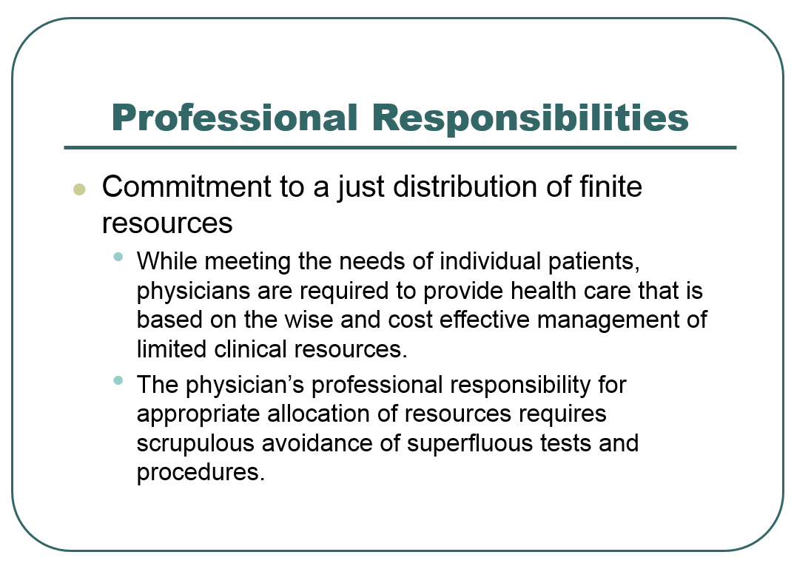

Slide 31
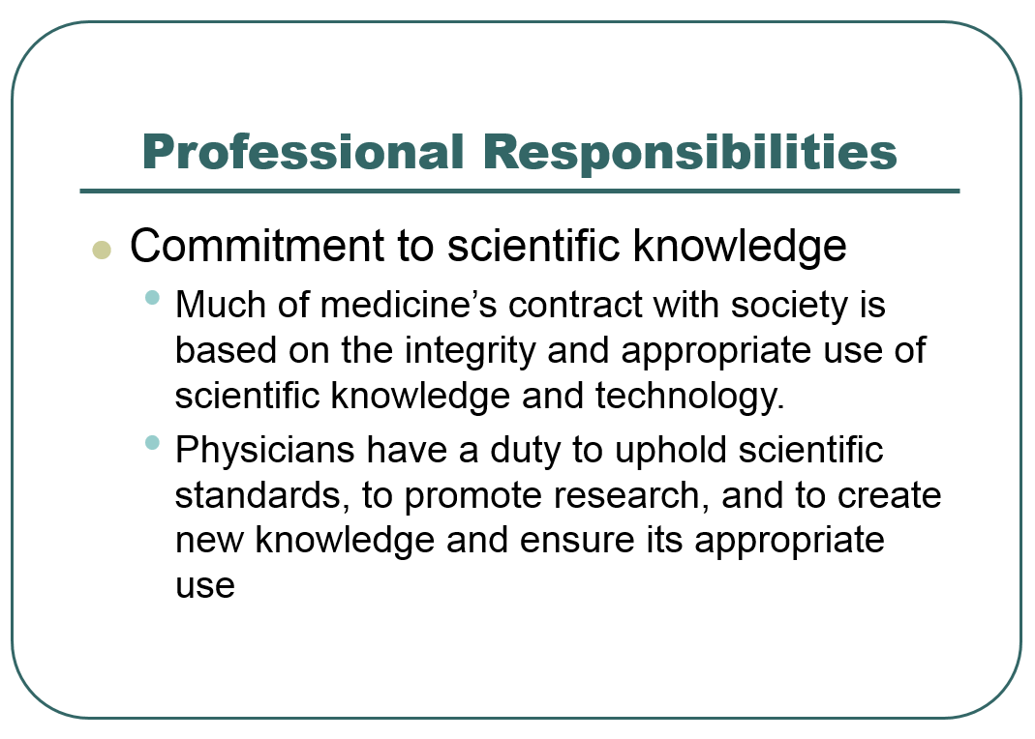

Slide 32
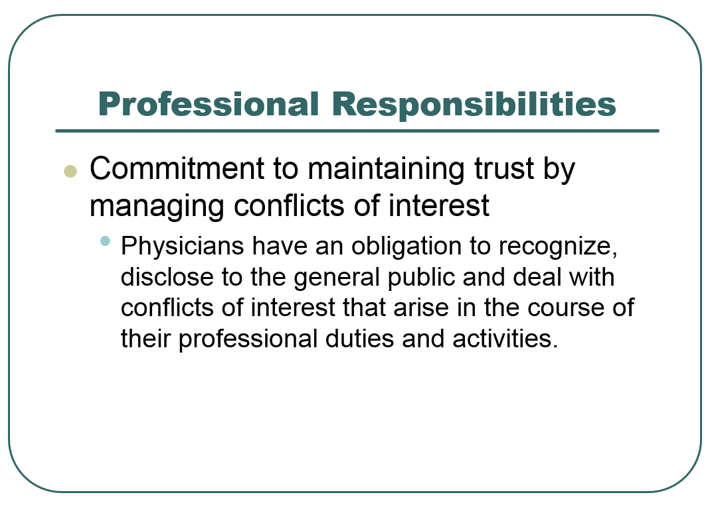

Slide 33
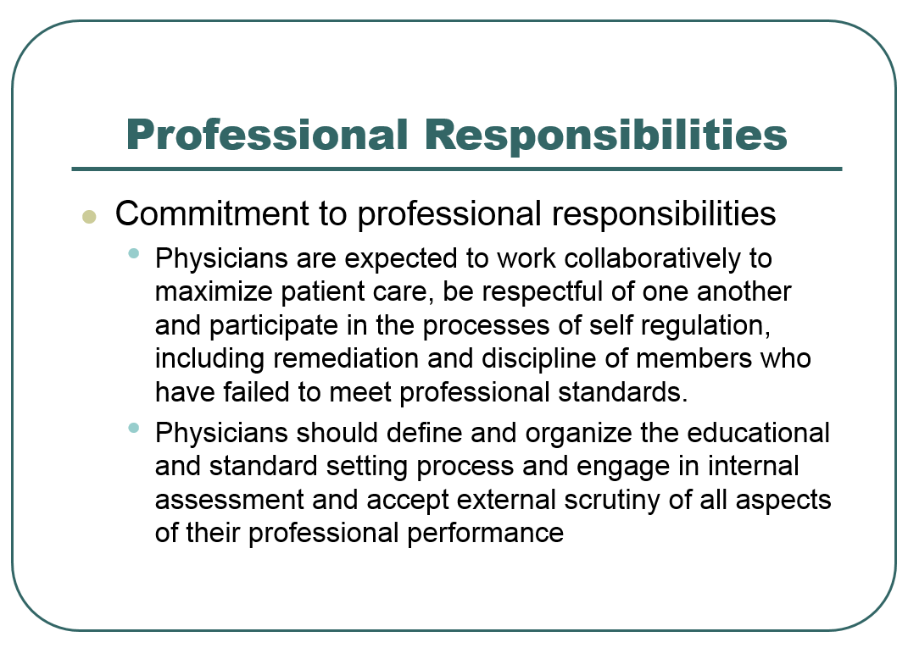

Slide 34
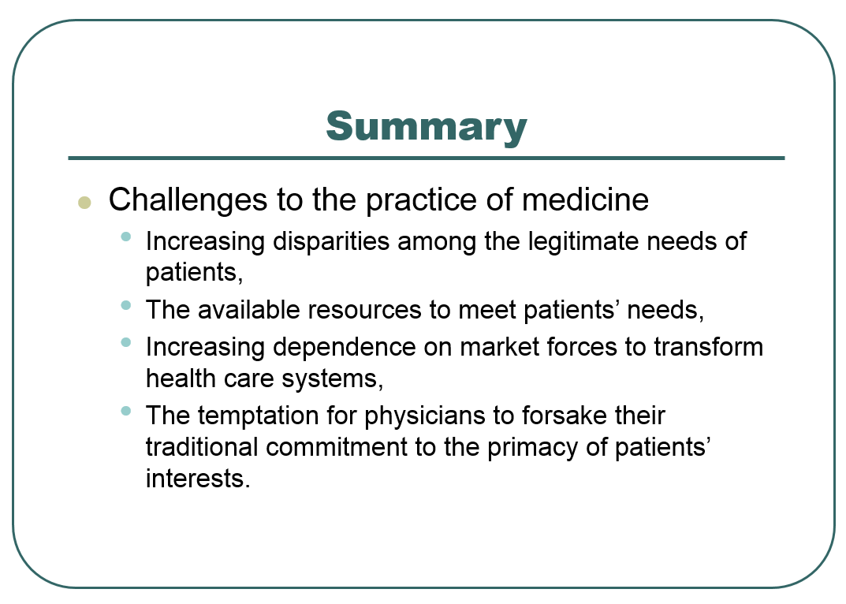

Slide 35
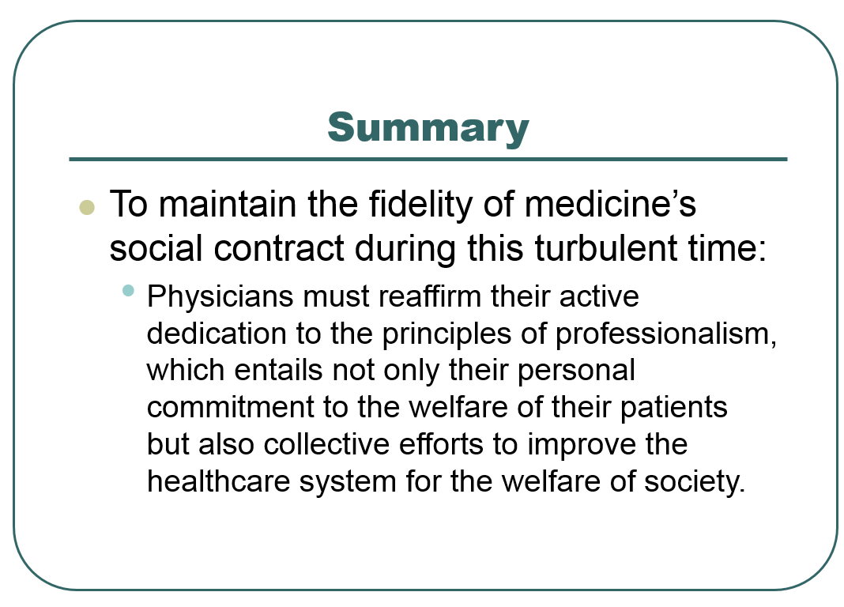

Slide 36



Slide 37



CHARACTERISTICS OF
PROFESSIONAL CONDUCT

Slide 38
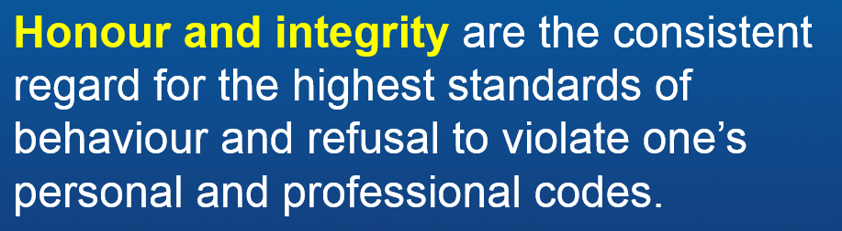

CHARACTERISTICS OF
PROFESSIONAL CONDUCT

Slide 39
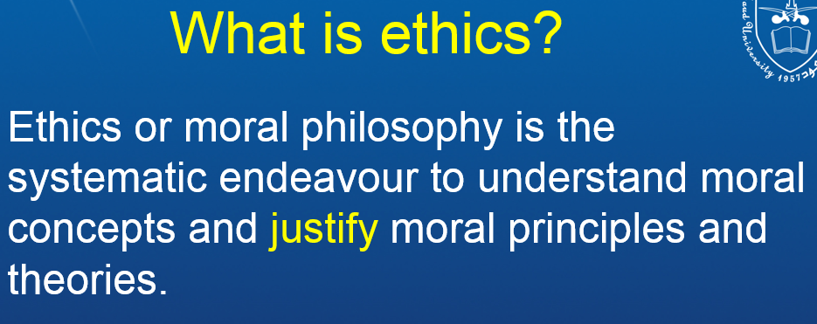



Slide 40
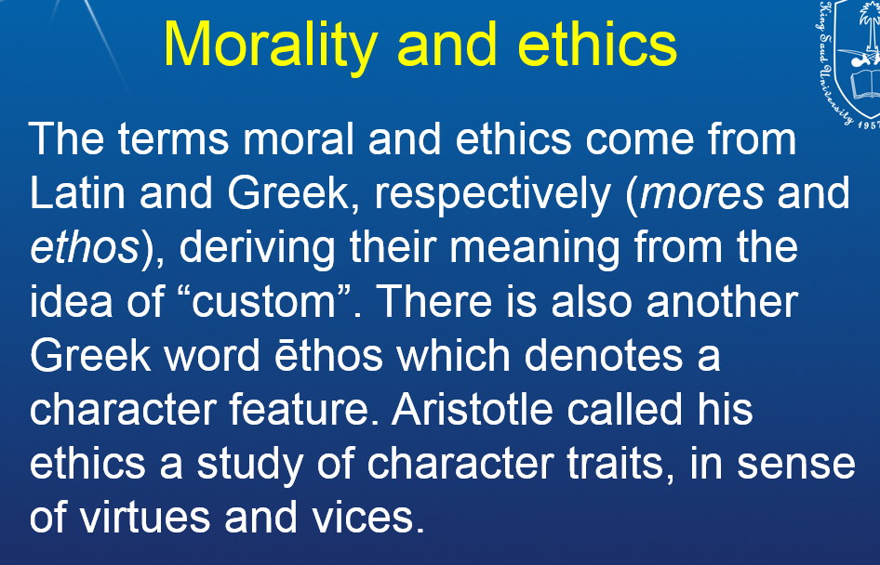

Slide 41
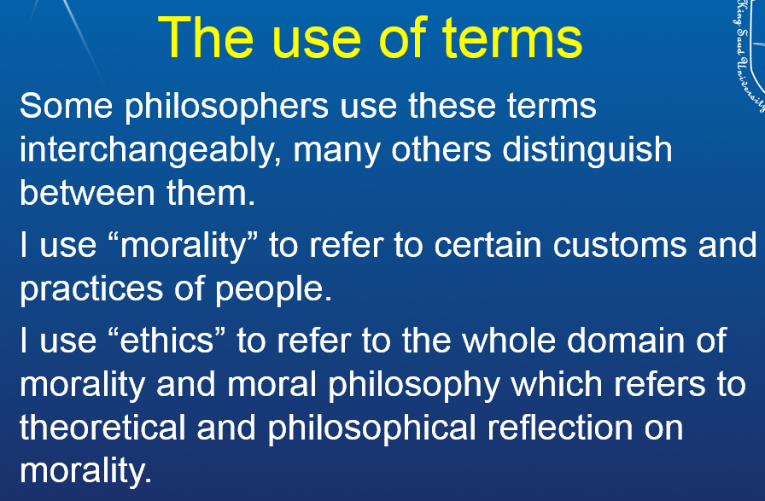


Slide 42

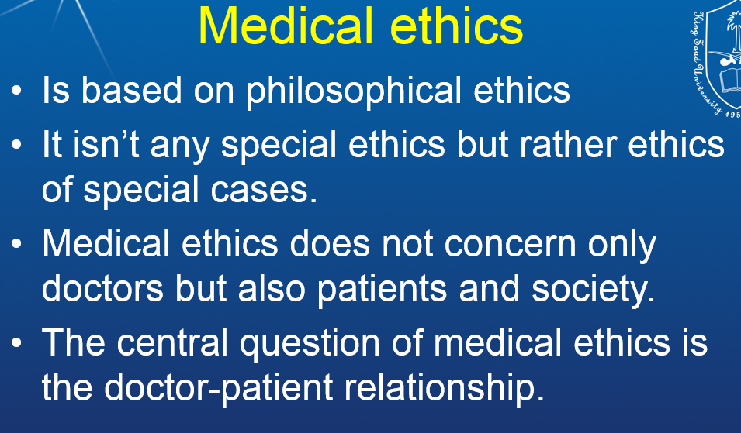

Slide 43

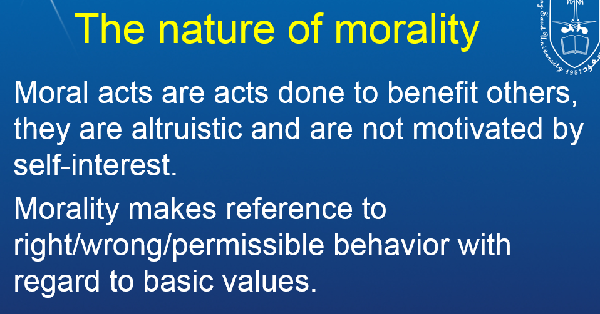

Slide 44
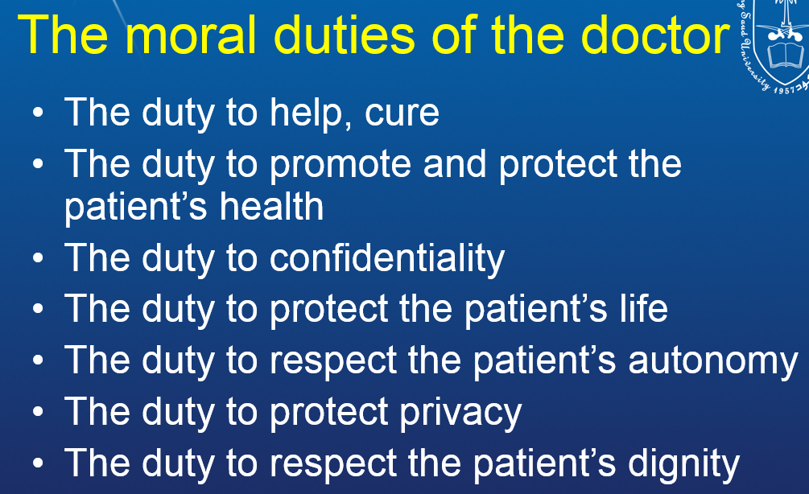


Slide 45
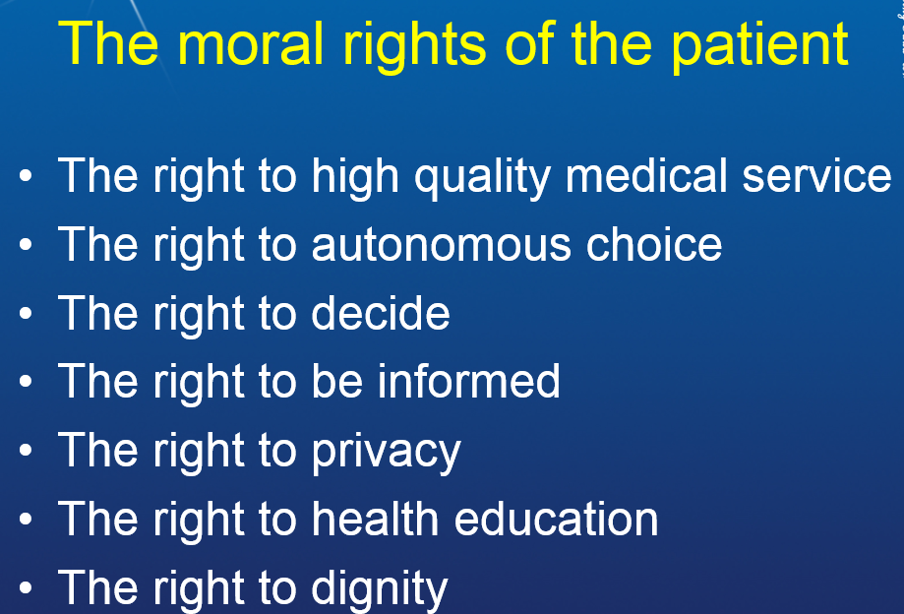

Slide 46
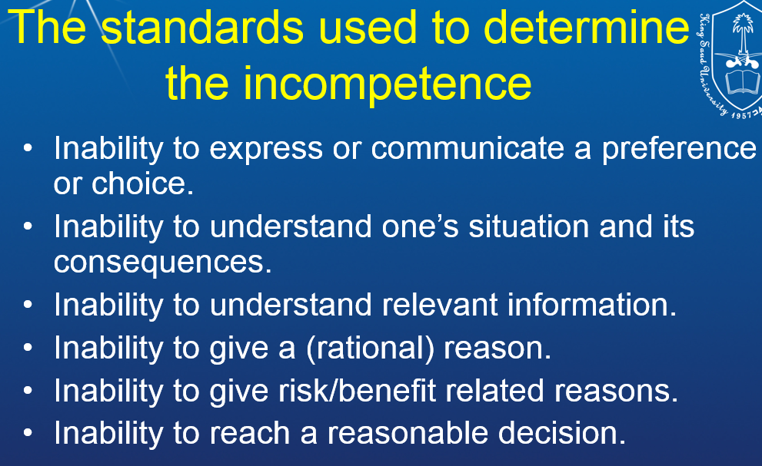


Slide 47
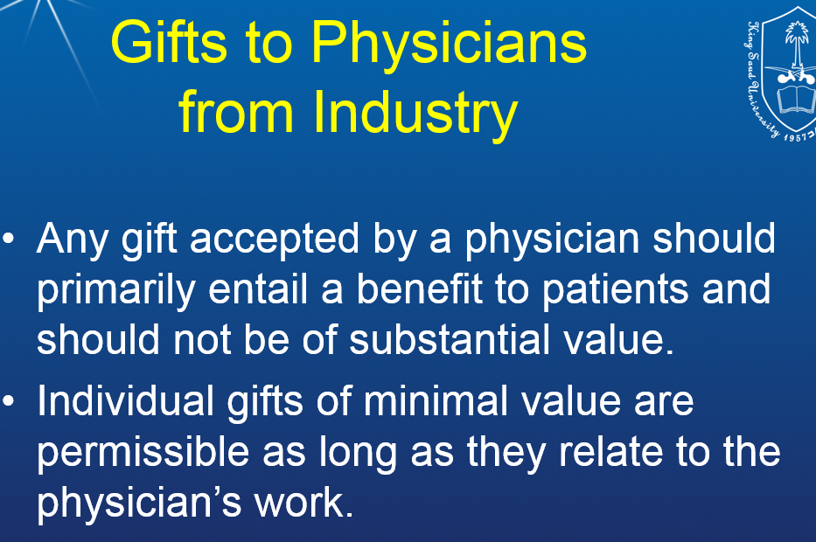


Slide 48

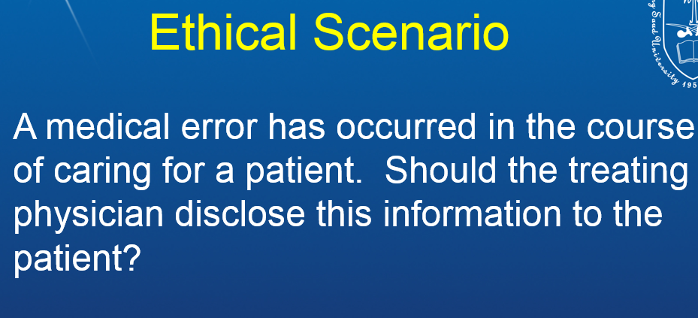
?????

Slide 49
YES

Slide 50
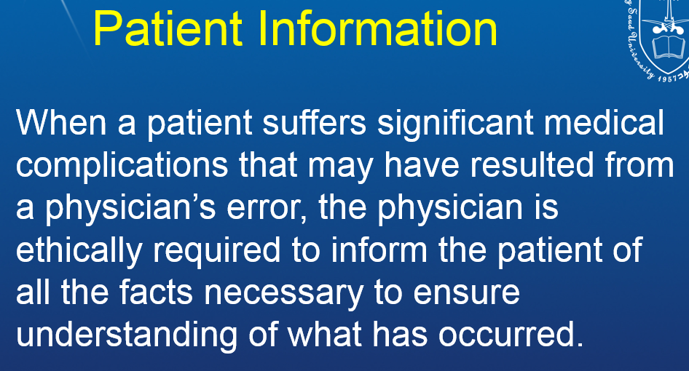


Slide 51
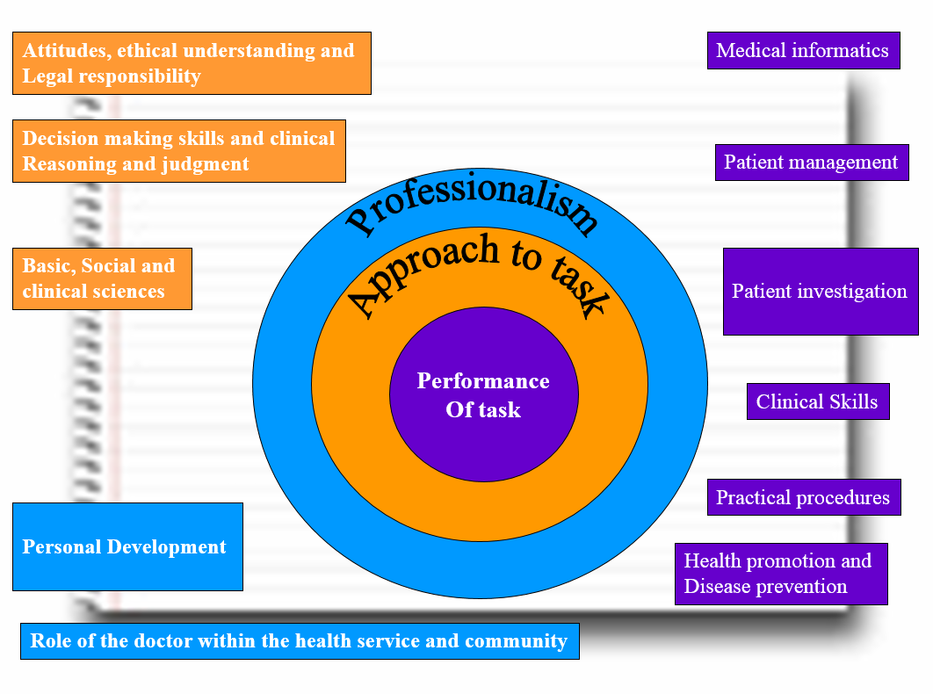

Slide 52
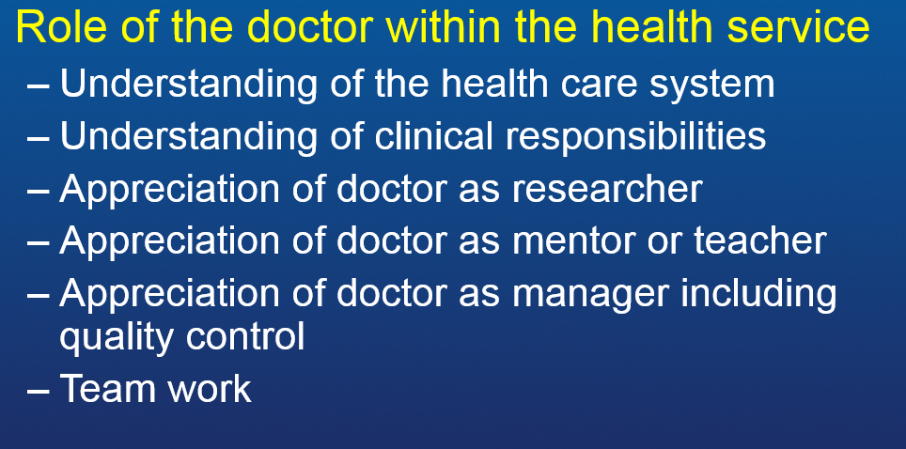

Slide 53
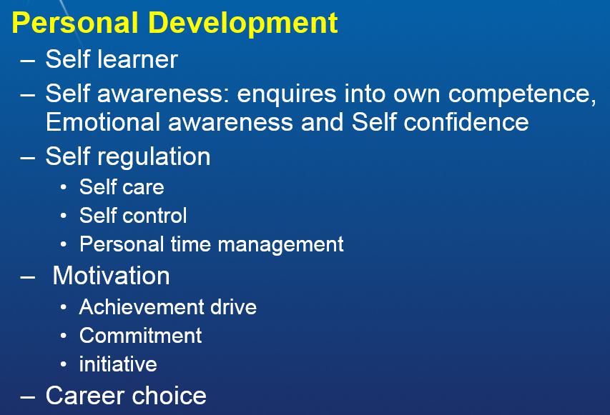

Slide 54
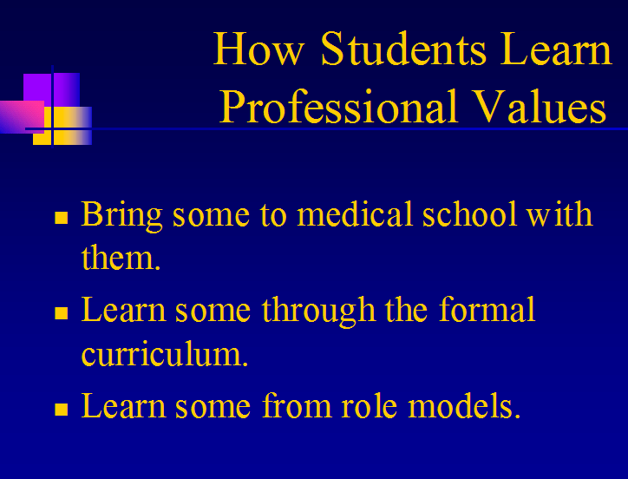

Slide 55
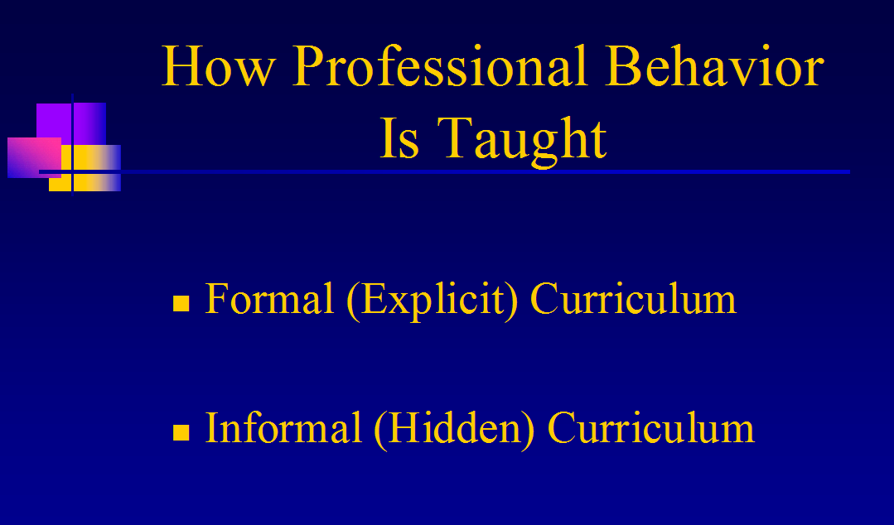

Slide 56
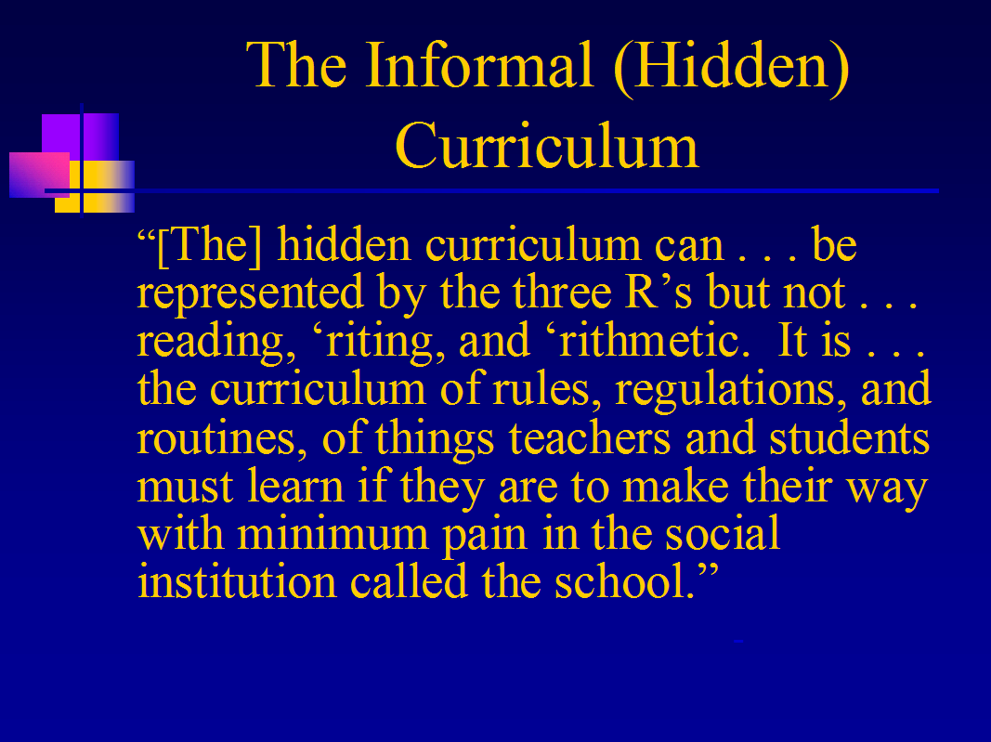

Slide 57
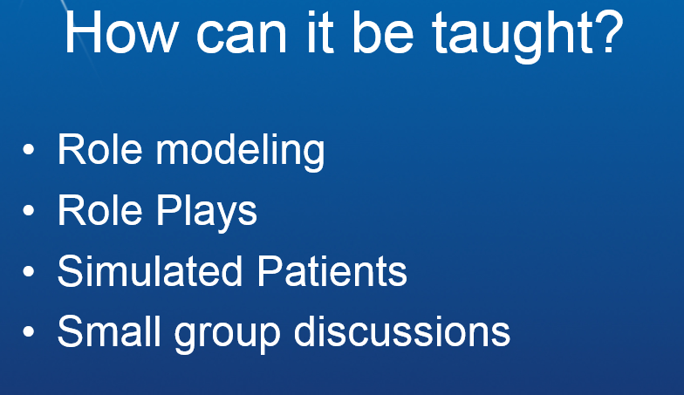

Slide 58
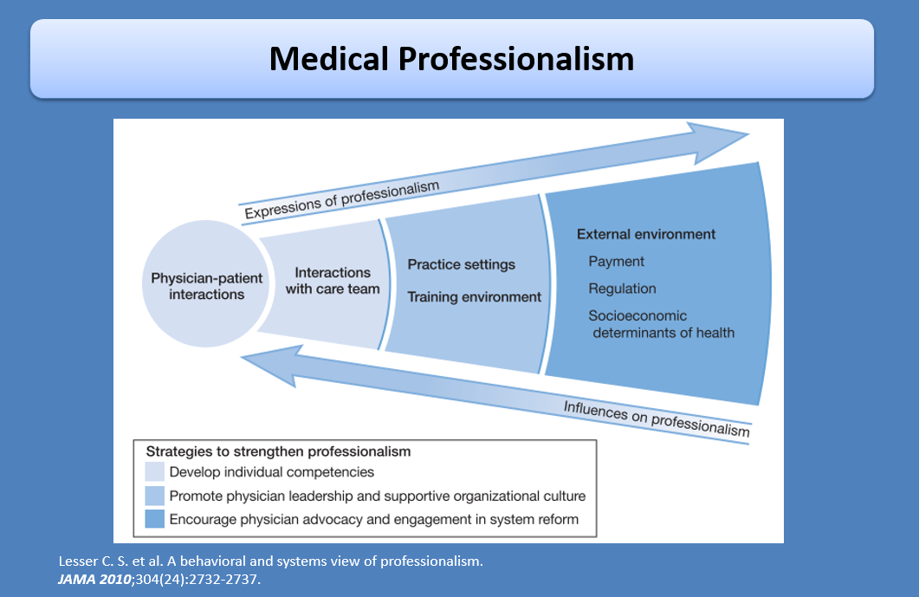

Slide 59
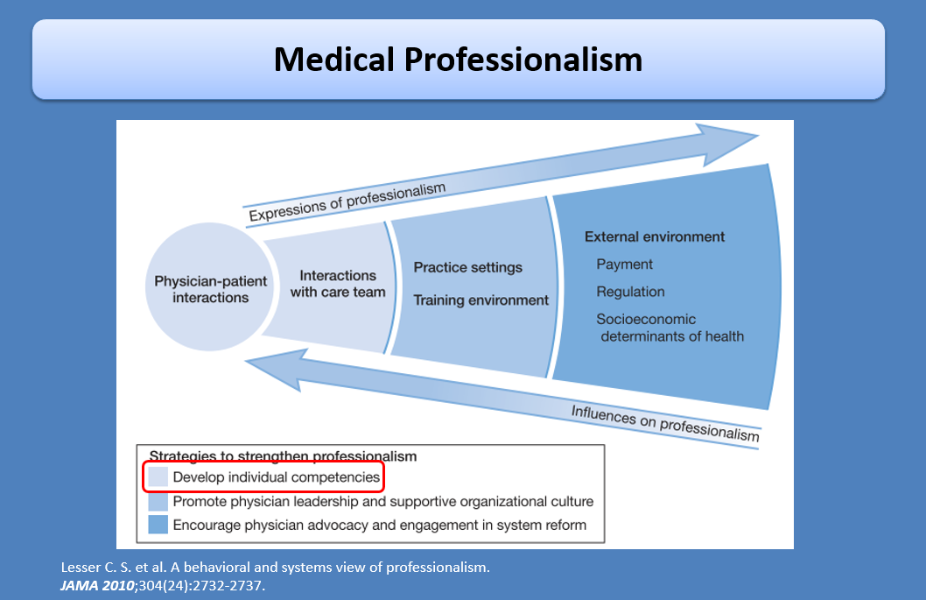

Slide 60
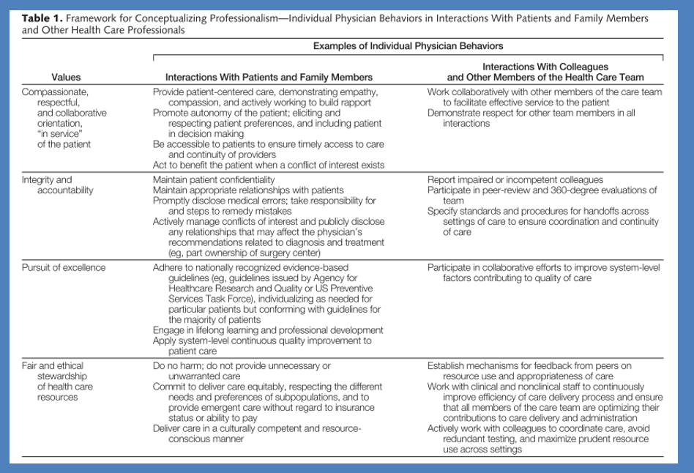

Slide 61
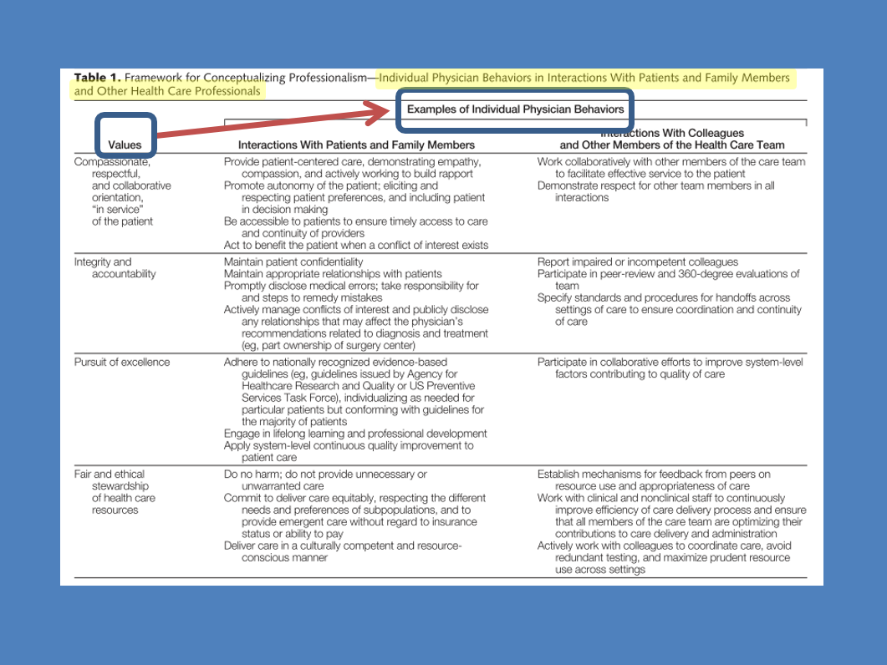

Slide 62
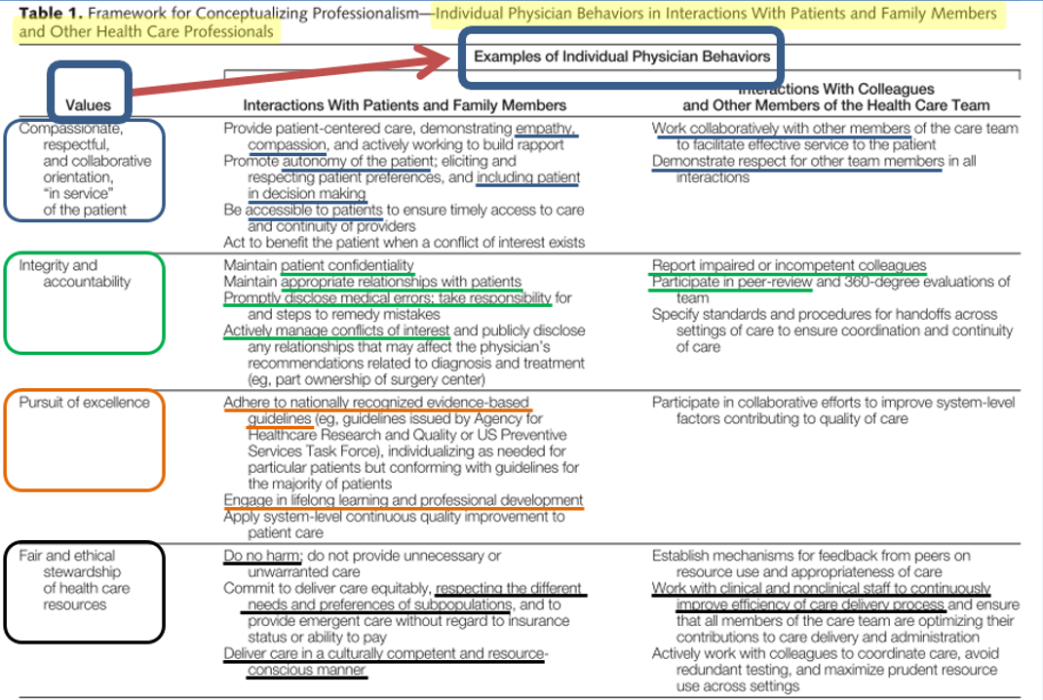

Slide 63


Slide 64


Slide 65


Slide 66





Slide 67


Slide 68




Slide 69


Slide 70


Slide 71



Slide 72

Professional verses unprofessional

Slide 73

TELEVISION PROGRAMS THAT SHOW CASE UNPROFESSIONAL BEHAVIOR

Slide 74


Slide 75


Slide 76


Slide 77


Slide 78


Slide 79


Slide 80



Distressed/disruptive behaviors

Slide 81


Slide 82


Slide 83


Slide 84


Slide 85


Slide 86

Physician boundary violations

Slide 87


Slide 88


Slide 89



Slide 90




Slide 91

Physician impairment

Slide 92


Slide 93


Slide 94

PREVENTION OF PROFESSIONAL LAPSE IS KEY

Slide 95


Slide 96


Slide 97


Slide 98


Slide 99


Slide 100


Slide 101


Slide 102


Slide 103


Slide 104


Slide 105


Slide 106


Slide 107


Slide 108


Slide 109


Slide 110


Slide 111


Slide 112


Slide 113


Slide 114


Slide 115

Physician license application process

Slide 116


Slide 117


Slide 118

Continuing Medical Education - Options Available

Slide 119


Slide 120


Slide 121


Slide 122


Slide 123


Slide 124


Slide 125


Slide 126


Slide 127


Slide 128


Slide 129


Slide 130


Slide 131


Slide 132


Slide 133


Slide 134


Slide 135


Slide 136


Slide 137


Slide 138


Slide 139


Slide 140


Slide 141


Slide 142


Slide 143


Slide 144


Slide 145


Slide 146


Slide 147


Slide 148


Slide 149


Slide 150


Slide 151


Slide 152


Slide 153

WHAT NOT TO DO

Slide 154


Slide 155


Slide 156


Slide 157


Slide 158

1. Which of the following best defines of altruism?
Independence
Selflessness
Compassionate
Respectful

Slide 159
1. Which of the following best defines of altruism?
Independence
Selflessness
Compassionate
Respectful

Slide 160
2. Social justice in the health care system is best reflected by:
Latinos are less likely than whites to receive care for depression an even likely to receive quality depression care
b)Of Hmong Americans, who have the highest poverty rate and the highest proportion of linguistic isolation of all Asian Americans more than 90 percent have health insurance

Slide 161
2. Social justice in the health care system is best reflected by:
Latinos are less likely than whites to receive care for depression an even likely to receive quality depression care
b)Of Hmong Americans, who have the highest poverty rate and the highest proportion of linguistic isolation of all Asian Americans more than 90 percent have health insurance

Slide 162
3. Dr. S. in the postoperative discussion of surgery with the patient’s family apologizes for misdiagnosing the patient’s condition and explains the alternative surgery that was performed. This is an example of which professional responsibility
Commitment of professional competence
Commitment to patient confidentiality
Commitment to honesty with patients

Slide 163
3. Dr. S. in the postoperative discussion of surgery with the patient’s family apologizes for misdiagnosing the patient’s condition and explains the alternative surgery that was performed. This is an example of which professional responsibility
Commitment of professional competence
Commitment to patient confidentiality
Commitment to honesty with patients

Slide 164
4. Major professionalism lapses include all of the following except:
Altruism and kindness to patients
Distressed/disruptive behaviors
Boundary violations
Improper prescribing narcotics
Impairment due to medical or mental health or drug abuse

Slide 165
4. Major professionalism lapses include all of the following except:
Altruism and kindness to patients
Distressed/disruptive behaviors
Boundary violations
Improper prescribing narcotics
Impairment due to medical or mental health or drug abuse

Slide 166
5. To preserve the quality of their performance, physicians have a responsibility to maintain their health and wellness, construed broadly as preventing or treating acute or chronic diseases, including mental illness, disabilities, and occupational stress
True
False

Slide 167
5. To preserve the quality of their performance, physicians have a responsibility to maintain their health and wellness, construed broadly as preventing or treating acute or chronic diseases, including mental illness, disabilities, and occupational stress
True
False

