Slide 1

MODULE five:
PROFESSIONALISM,
ETHICS, AND BIOETHICS

Slide 2
MODULE five:
SECTION two:
introduction
of ethics and
bioethics

Slide 3

UNIT OBJECTIVE
To learn the definitions of and differentiate between ethics and morality

Slide 4
introduction of ethics and bioethics
Definition of ethics
Definition of morality
Historical aspects
Examples of ethical behavior
Major bioethical currents
Human dignity
Principles
Respecting the autonomy
Informed consent
Principle of charity
Privacy and confidentiality

Slide 5
ETHICS DEFINITION
(used with a singular or plural verb) a system of moral principles: the ethics of a culture.
(used with a plural verb) the rules of conduct recognized in respect to a particular class of human actions or a particular group, culture, etc: medical ethics; Christian ethics.
(used with a plural verb) moral principles, as of an individual:
His ethics forbade betrayal of a confidence.

Slide 6
MORALITY DEFINITION
Conformity to the rules of right conduct;
Moral or virtuous conduct
Moral quality or character
Virtue in sexual matters; chastity
A doctrine or system of morals
Moral instruction
A moral lesson, precept, discourse, or utterance
Morality play

Slide 7
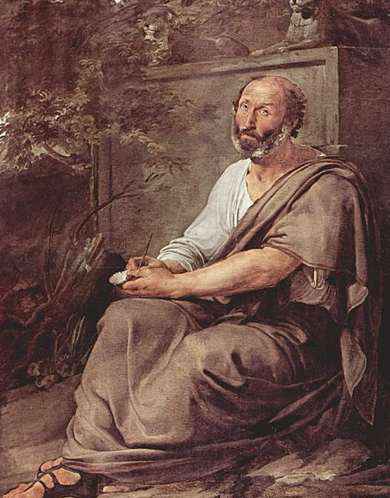
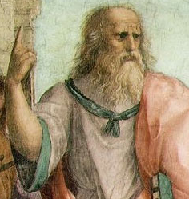
Historical aspects
Many positions of ethics in history were based on western philosophy. Plato and Aristotle played a crucial role in its development. Plato thought people were more likely to be good than bad. He believed that people did not understand for the most part that they did wrong and that there wrong came from error, not intent.
ARISTOTLE
PLATO

Slide 8
Historical aspects
Plato also suggested four virtues: wisdom, courage, justice and temperance; Aristotle agreed but added others, like generosity, truthfulness, friendliness and prudence." However, Aristotle expanded from Plato's work and said in his Nicomachean Ethics "that goodness is in the actor, not the action; that is, an act is virtuous because of the manner in which a person has chosen it." The idea was important because it showed that we could chose to be good. That gives rise to be able to question how shall we live? And a possible answer could be by being good, instead of by doing good. The outcome of such a notion was the beginning of building an ethical system.
Aristotle and Plato never continued on to develop normative ethics. Tales, and epics thereafter, became away of displaying virtue, duty and consequence became a way to practically display such normal behavior. Values like justice and/or loyalty were displayed by their illustration and use. In many of the stories depicted by homer the gods made mistakes and this portrayed how ethics should be lived by.

Slide 9
Historical aspects
David Hume first discusses ethics in his writing A Treatise of Human Nature. later, he will discuss it further in his writing An Enquiry Concerning the Principles of Morals. Hume's approach to his ethics is obviously an empirical one. Hume, instead of trying to establish how one should think that morality should function, strives to tell us how we as humans make our moral judgements. It seems Humes is asking or even trying to possibly imply that we tend to make our moral judgements based on or in self-interest. This seems to be a difference from the approach of his fellow empiricist Thomas Hobbes.

Slide 10
Historical aspects
Gottfried Wilhelm Leibniz contributed to the philosophical conversation of ethics with the idea that three kinds of evil exist in the world: Metaphysical evil, physical evil, and moral evil.
Metaphysical evil is the limitation of all things due to their finite state. A theist, Leibniz believed that an infinitely perfect God existed, and that anything that is not part of God (including the world) is finite, with a limited amount of perfectness.
Metaphysical evil is unavoidable, and no being can be held responsible for its existence. Physical evil is a lack of perfection of worldly things due to their nature. Humans can not be held responsible for this kind of evil, since God gave things their natures.
Leibniz argued that this kind of evil exists to make the overall state of things better. An analogy is a shadowy portion of a painting which accentuates a brighter portion; the shadowy portion is necessary to make the overall work of art as beautiful as it is. The last kind of evil Leibniz recognized, moral evil, is the result of humans choosing to defy God’s will.
With this theory of evils, man can measure the goodness of their behavior by how closely it is aligned with God’s will, but physical and metaphysical evils will ensure imperfection in the world regardless of man’s moral behavior.

Slide 11

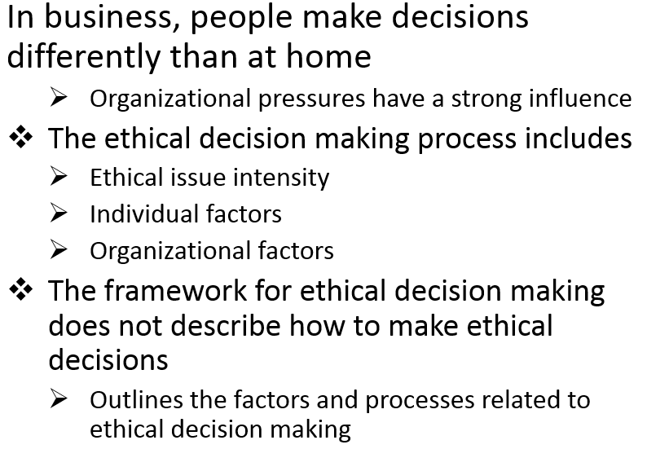

Slide 12
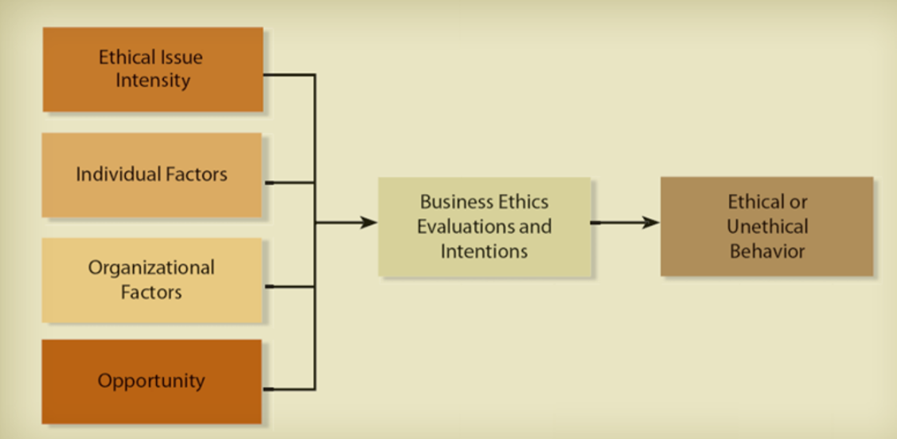
Business ethics and professionalism

Slide 13
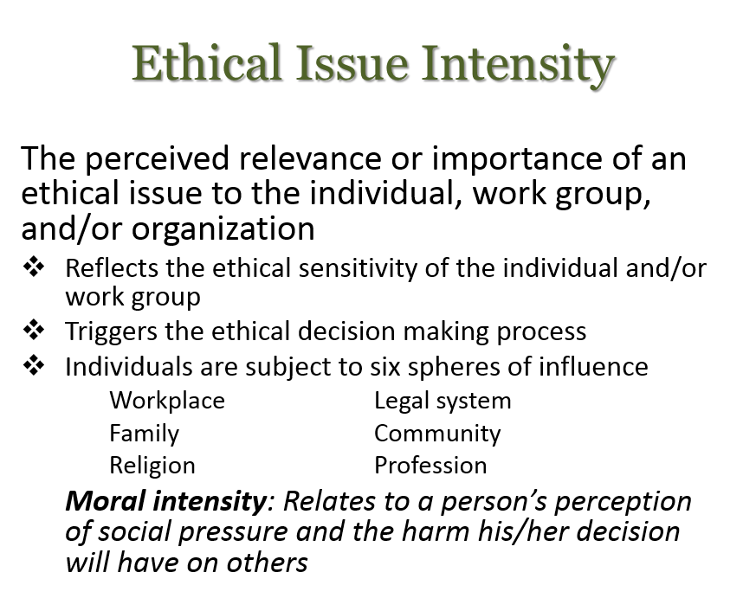

Slide 14
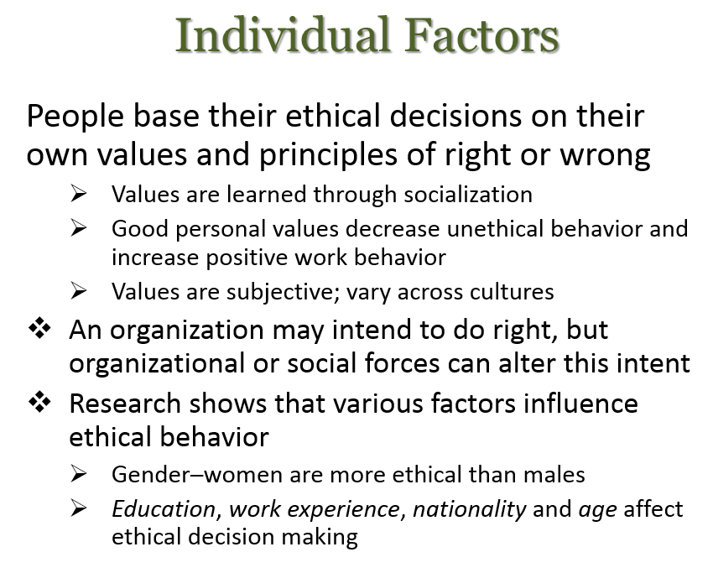

Slide 15
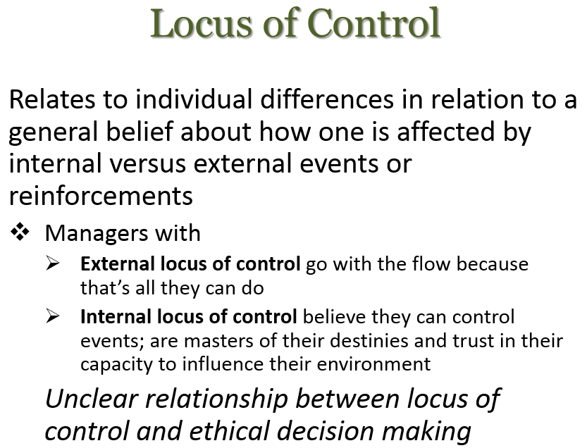

Slide 16
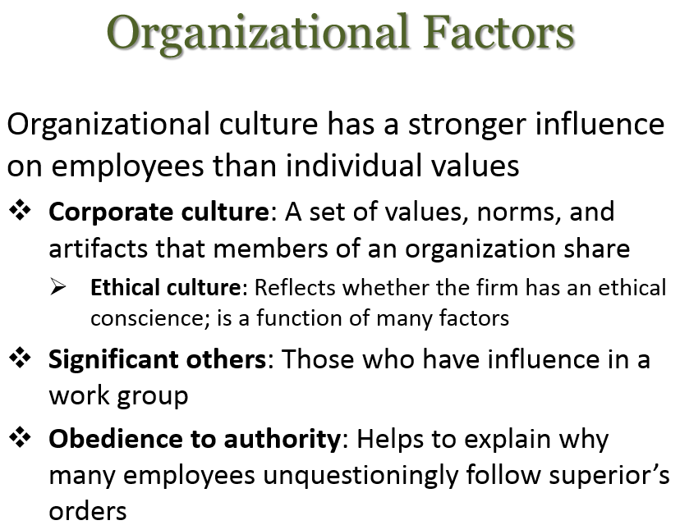

Slide 17
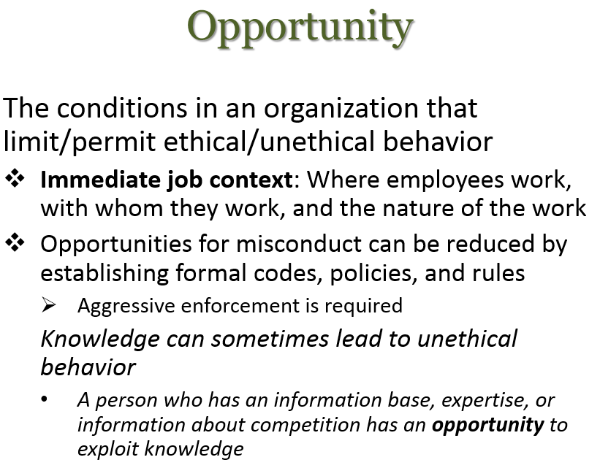

Slide 18
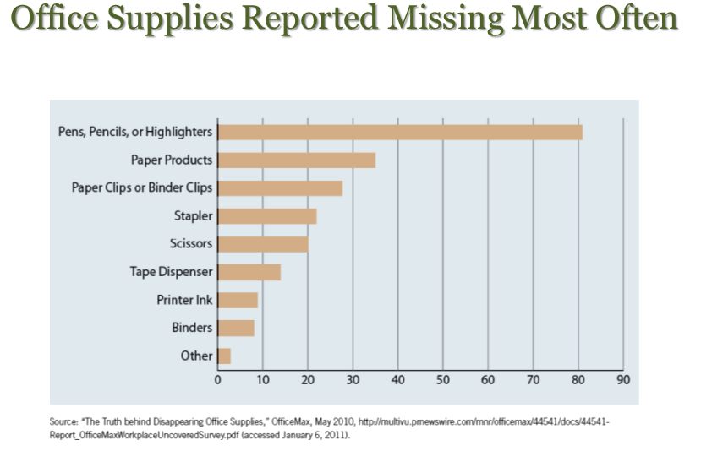

Slide 19
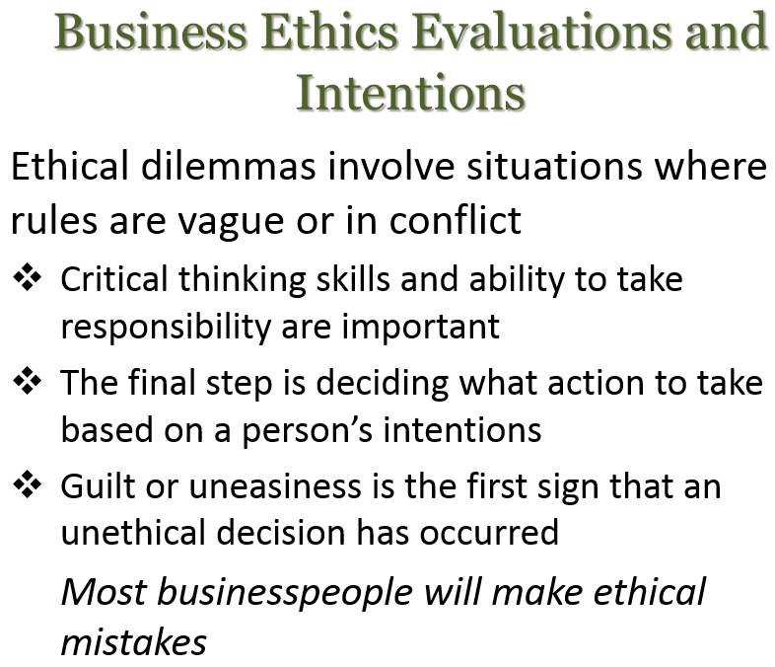

Slide 20
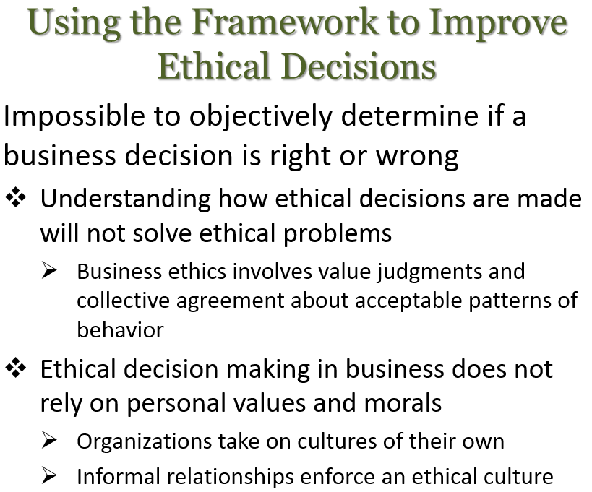

Slide 21
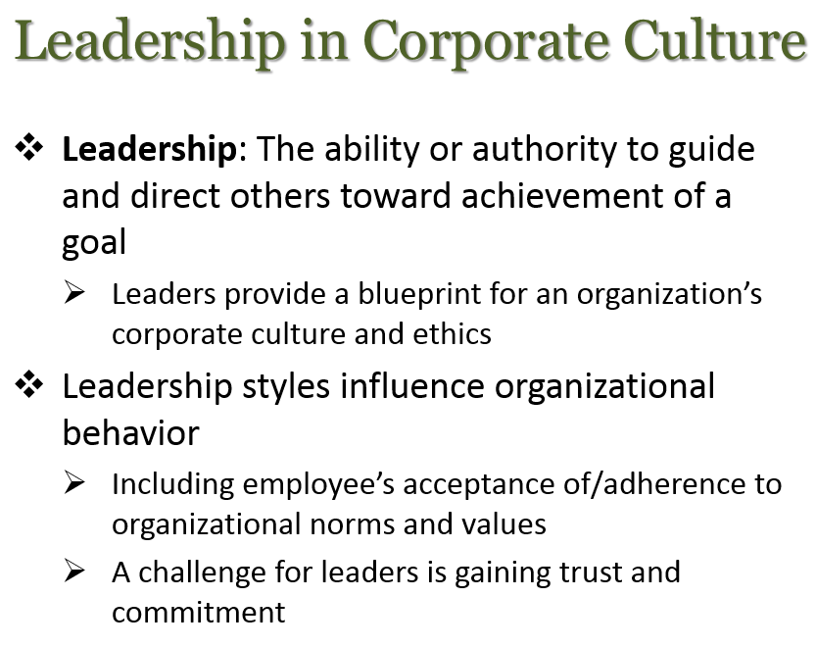

Slide 22
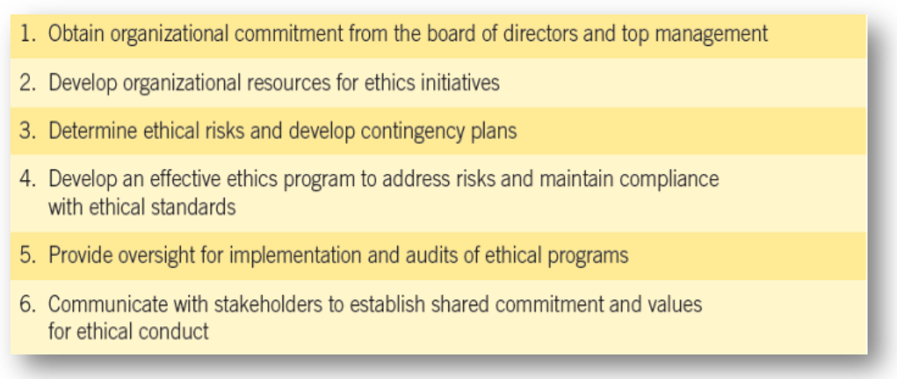
The managerial role in developing program leadership

Slide 23
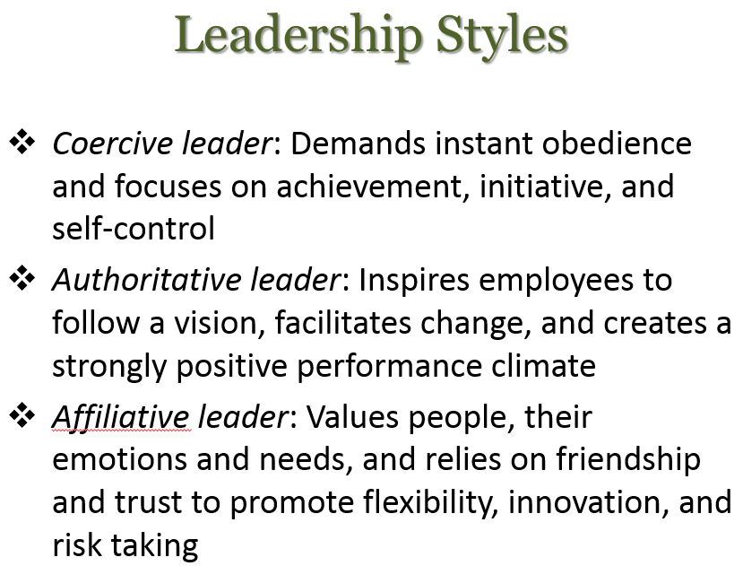

Slide 24
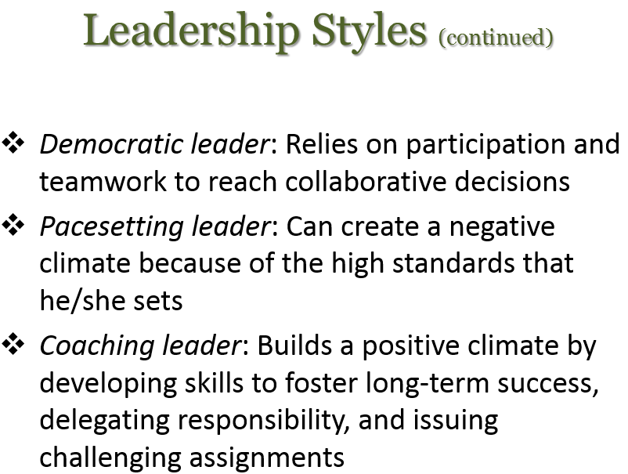

Slide 25
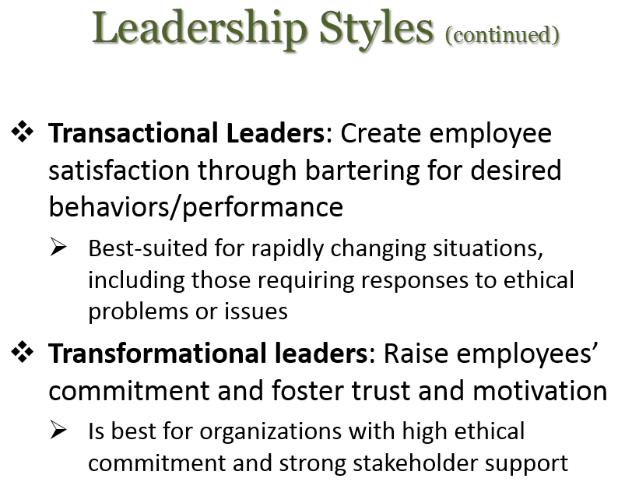

Slide 26
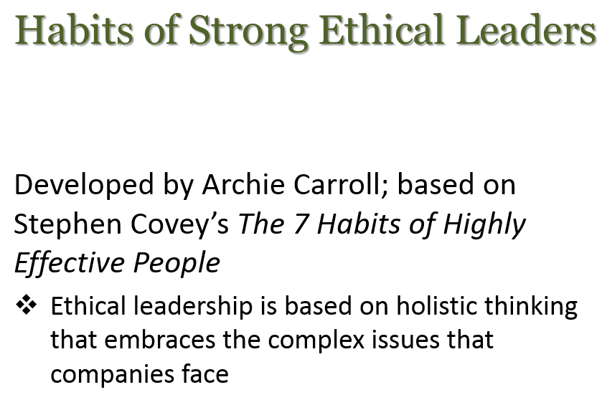

Slide 27
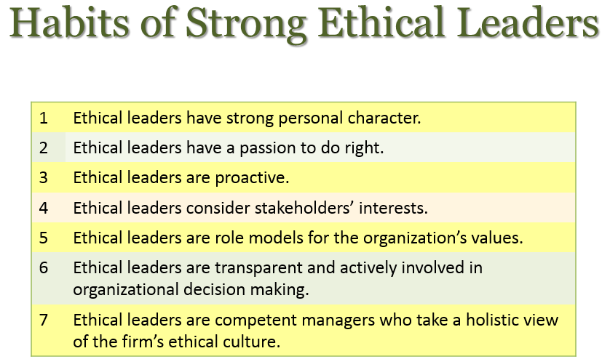

Slide 28
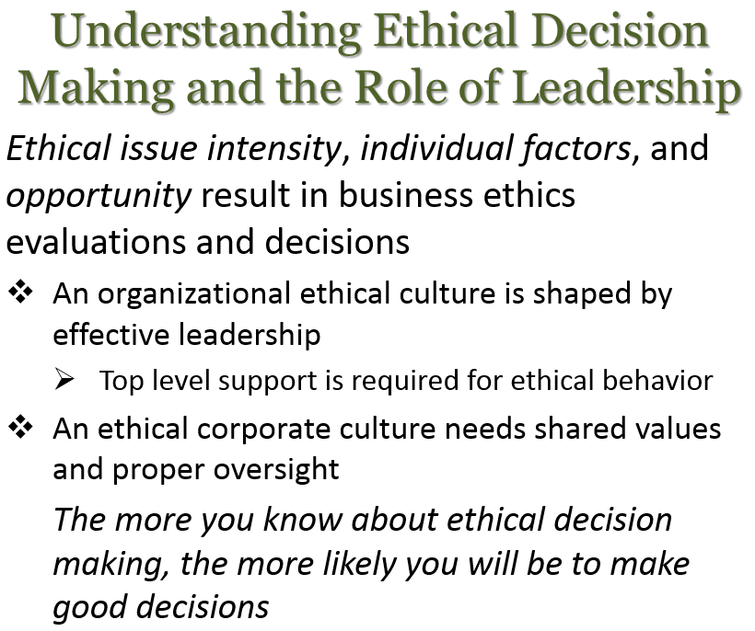

Slide 29
Major bioethical currents
Bioethics is an activity; it is a shared, reflective examination of ethical issues in health care, health science, and health policy. These fields have always had ethical standards, of course, handed down within each profession, and often without question. About forty years ago, however, it became obvious that we needed a more public, and more critical, discussion of these standards.
Bioethics is that discussion. It takes place in the media, in the academy, in classrooms, and in labs, offices, and hospital wards. It involves not just doctors, but patients, not just scientists and politicians but the general public. Traditional ethical standards have been articulated, reflected on, challenged, and sometimes revised; standards for new issues have been created – and then challenged and revised. The conversation is often sparked by new developments, like the possibility of cloning. But bioethics also raises new questions about old issues, like the use of placebos and the treatment of pain.

Slide 30
Human dignity
The mercurial concept of human dignity features in ethical, legal, and political discourse as a foundational commitment to human value or human status. The source of that value, or the nature of that status, are contested.
The normative implications of the concept are also contested, and there are two partially, or even wholly, different deontic conceptions of human dignity implying virtue-based obligations on the one hand, and justice-based rights and principles on the other.
Added to this, the different practical and philosophical presuppositions of law, ethics, and politics mean that definitive adjudication between different meanings is frustrated by disciplinary incommensurability.

Slide 31
Ethical principles
Ethical principles provide a generalized framework within which particular ethical dilemmas may be analyzed. As we will see later in this module, these principles can provide guidance in resolving ethical issues that codes of ethics may not necessarily provide. What follows are definitions of five ethical principles that have been applied within a number of professions (Beauchamp & Childress, 1979):
1. Respecting autonomy
2. Doing no harm (no maleficence)
3. Benefiting others (beneficence)
4. Being just (justice)
5. Being faithful (fidelity)

Slide 32
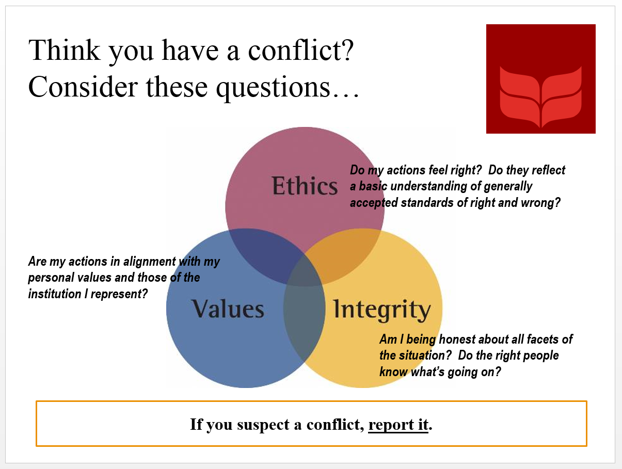


Slide 33
Respecting autonomy
The individual has the right to act as a free agent.
That is, human beings are free to decide how they live their lives as long as their decisions do not negatively impact the lives of others.
Human beings also have the right to exercise freedom of thought or choice.

Slide 34

Informed consent
Informed consent is based on the moral and legal premise of patient autonomy: You as the patient have the right to make decisions about your own health and medical conditions.

Slide 35
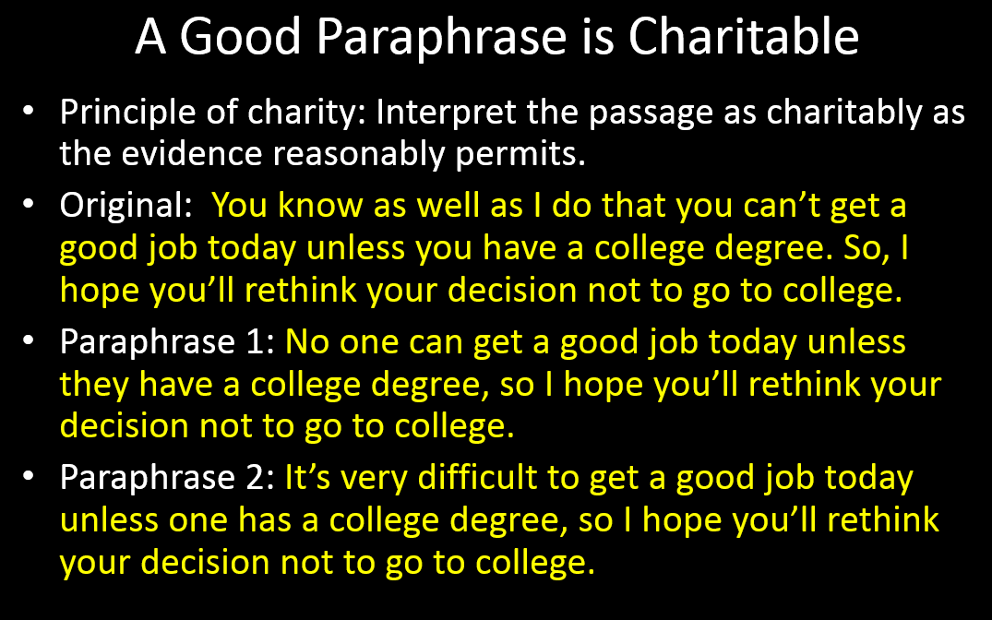

Slide 36
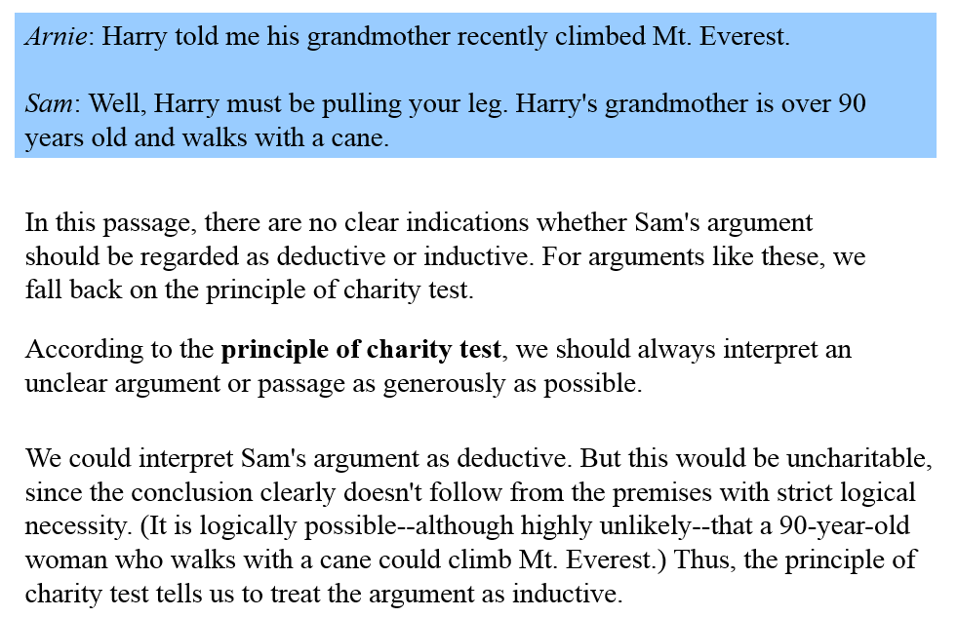
The principle of charity

Slide 37
privacy
Privacy is the control over the extent, timing, and circumstances of sharing oneself (physically, behaviorally, or intellectually) with others.

Slide 38
confidentiality
Confidentiality pertains to the treatment of information that an individual has disclosed in a relationship of trust and with the expectation that it will not be divulged to others without permission in ways that are inconsistent with the understanding of the original disclosure.

Slide 39
1. Habits of strong ethical leaders include all of the following except for:
Ethical leaders have to make sure their compensation is the highest of the group to justify their influence
Ethical leaders have strong personal character
Ethical leaders have a passion to right
Ethical leaders consider stakeholders’ interests
Ethical leaders are role models for the organization’s values
Ethical leaders are transparent and actively involved in organizational decision making
Ethical leaders are competent managers who take a holistic view of the firm’s ethical culture

Slide 40
1. Habits of strong ethical leaders include all of the following except for:
Ethical leaders have to make sure their compensation is the highest of the group to justify their influence
Ethical leaders have strong personal character
Ethical leaders have a passion to right
Ethical leaders consider stakeholders’ interests
Ethical leaders are role models for the organization’s values
Ethical leaders are transparent and actively involved in organizational decision making
Ethical leaders are competent managers who take a holistic view of the firm’s ethical culture

Slide 41
2. Ethical dilemmas involve situations where rules are vague or in conflict include all of the following except:
Critical thinking skills and ability to take responsibility are important
The final step is deciding what action to take based on a person’s intentions
Guilt or uneasiness is the first sign that an unethical decision has occurred
Robbing a bank to assist with cash flow to keep the business open

Slide 42
2. Ethical dilemmas involve situations where rules are vague or in conflict include all of the following except:
Critical thinking skills and ability to take responsibility are important
The final step is deciding what action to take based on a person’s intentions
Guilt or uneasiness is the first sign that an unethical decision has occurred
Robbing a bank to assist with cash flow to keep the business open

Slide 43
3. Moral Intensity: Relates to a person’s perception of social pressure and the harm his/her decision will have on others.
True
False

Slide 44
3. Moral Intensity: Relates to a person’s perception of social pressure and the harm his/her decision will have on others.
True
False

Slide 45
4. Research shows that various factors influence ethical behavior. For example women are more ethical than males. Please answer if you believe this answer to be True or False.
True
False

Slide 46
4. Research shows that various factors influence ethical behavior. For example women are more ethical than males. Please answer if you believe this answer to be True or False.
True
False

Slide 47
5. Informed consent is based on the moral and legal premise of the patient autonomy: You as the patient have the right to make decisions about your own health and medical conditions.
True
False

Slide 48
5. Informed consent is based on the moral and legal premise of the patient autonomy: You as the patient have the right to make decisions about your own health and medical conditions.
True
False

