Slide 1

MODULE five: professionalism, ethics, and bioethics

Slide 2
MODULE five:
SECTION four:
Human rights

Slide 3
Unit OBJECTIVE
To learn the history of human rights and the classifications of human rights, as well as the importance of the right to health and its importance in medical ethics

Slide 4
Human rights
History
Classification of human rights
Right to health
Right to live and die with dignity

Slide 5


Slide 6


Slide 7


Slide 8
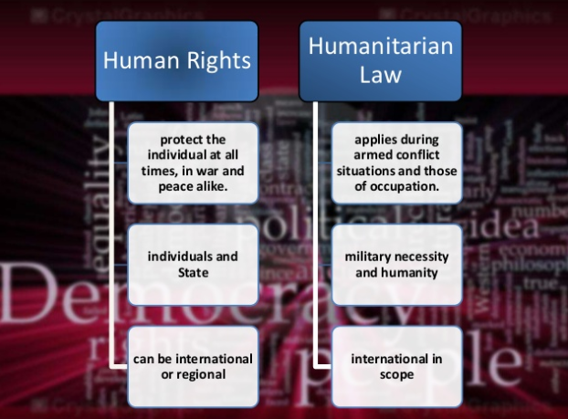

Slide 9


Slide 10


Slide 11


Slide 12


Slide 13


Slide 14


Slide 15


Slide 16


Slide 17


Slide 18


Slide 19


Slide 20


Slide 21


Slide 22


Slide 23
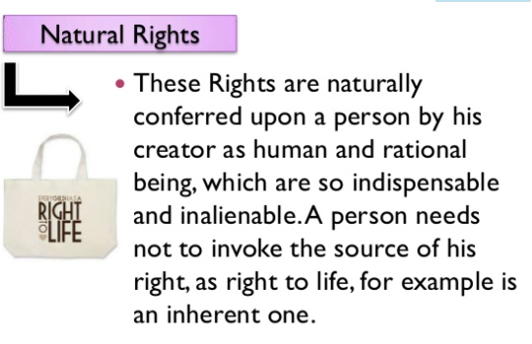

Slide 24
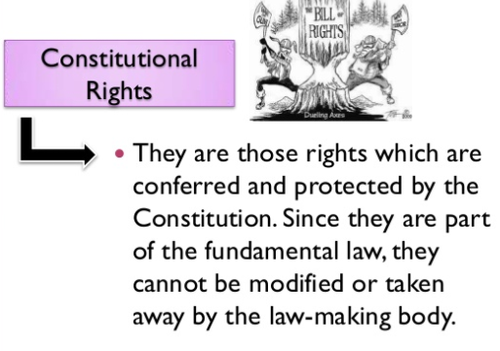

Slide 25
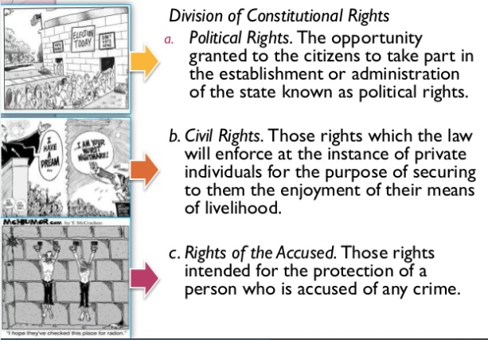

Slide 26
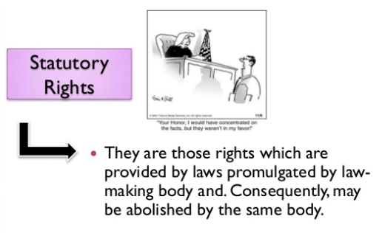

Slide 27


Slide 28


Slide 29


Slide 30


Slide 31
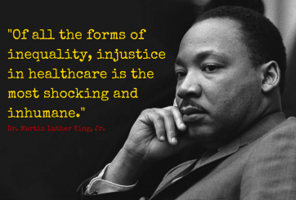

Slide 32

HOWEVER NOT ALL
AGREE WITH THIS
OPINION

Slide 33

Your Health Care Rights
To have an appointment when you need one. There are limits on how long you have to wait for an appointment.
To have an appointment with a specialist when you need one.
To request continuity of care if your doctor or medical group leaves your plan.
To receive treatment for certain mental health conditions.
To get a second doctor's opinion.
To know why your plan denies a service or treatment.
You Have the Right to Understand Your Health Problems and Treatments
To see a written diagnosis (description of your health problem).
To give informed consent when you have a treatment.

Slide 34
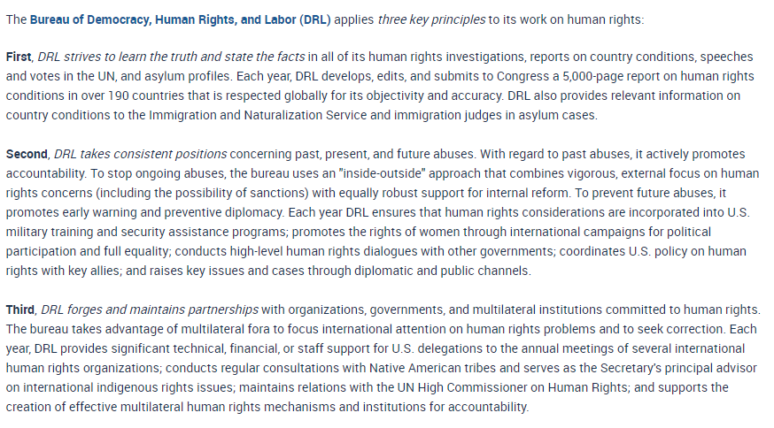


Slide 35
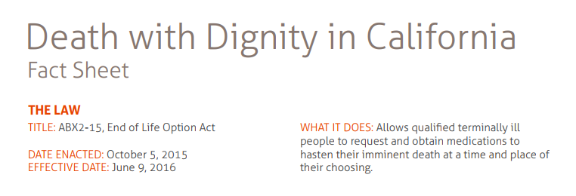
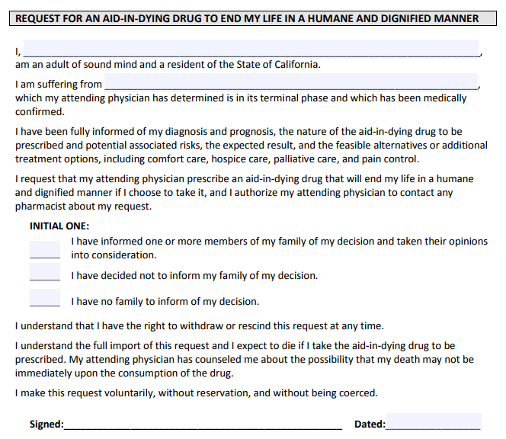
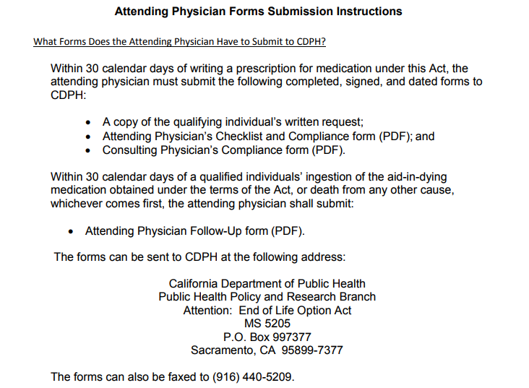
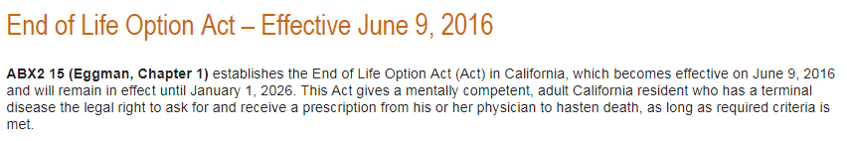


Slide 36
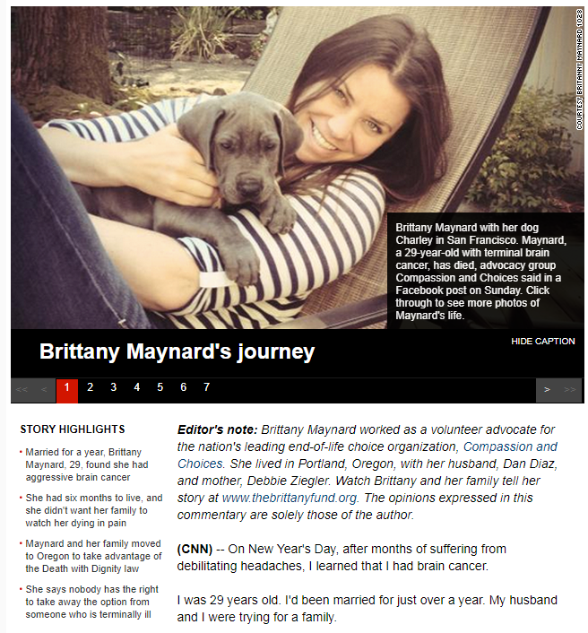
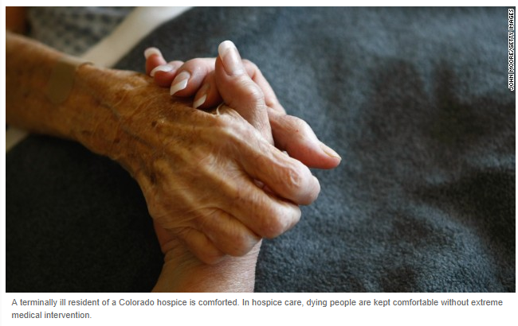

Multiple view points exist

Slide 37
AMA Principles of Medical Ethics
Preamble
The medical profession has long subscribed to a body of ethical statements developed primarily for the benefit of the patient. As a member of this profession, a physician must recognize responsibility to patients first and foremost, as well as to society, to other health professionals, and to self. The following Principles adopted by the American Medical Association are not laws, but standards of conduct that define the essentials of honorable behavior for the physician.

Slide 38
AMA Principles of Medical Ethics
I. A physician shall be dedicated to providing competent medical care, with compassion and respect for human dignity and rights.
II. A physician shall uphold the standards of professionalism, be honest in all professional interactions, and strive to report physicians deficient in character or competence, or engaging in fraud or deception, to appropriate entities.
III. A physician shall respect the law and also recognize a responsibility to seek changes in those requirements which are contrary to the best interests of the patient.

Slide 39
AMA Principles of Medical Ethics
IV. A physician shall respect the rights of patients, colleagues, and other health professionals, and shall safeguard patient confidences and privacy within the constraints of the law.
V. A physician shall continue to study, apply, and advance scientific knowledge, maintain a commitment to medical education, make relevant information available to patients, colleagues, and the public, obtain consultation, and use the talents of other health professionals when indicated.
VI. A physician shall, in the provision of appropriate patient care, except in emergencies, be free to choose whom to serve, with whom to associate, and the environment in which to provide medical care.

Slide 40
AMA Principles of Medical Ethics
VII. A physician shall recognize a responsibility to participate in activities contributing to the improvement of the community and the betterment of public health.
VIII. A physician shall, while caring for a patient, regard responsibility to the patient as paramount.
IX. A physician shall support access to medical care for all people.

Slide 41
1. Principles adopted by the American Medical Association are not laws, but standards of conduct that define the essentials of honorable behavior for the physician.
A physician shall, in the provision of appropriate patient care, except in emergencies, be free to choose whom to serve, with whom to associate, and the environment in which to provide medical care. Indicate below whether this statement is true or false.
True
False

Slide 42
1. Principles adopted by the American Medical Association are not laws, but standards of conduct that define the essentials of honorable behavior for the physician.
A physician shall, in the provision of appropriate patient care, except in emergencies, be free to choose whom to serve, with whom to associate, and the environment in which to provide medical care. Indicate below whether this statement is true or false.
True
False

Slide 43
2. Principles adopted by the American Medical Association are not laws, but standards of conduct that define the essentials of honorable behavior for the physician. A physician shall uphold the standards of professionalism, be honest in all professional interactions, but is not obligated to report physicians deficient in character or competence, or engaging in fraud or deception, to appropriate entities. Indicate below whether this statement is true or false.
True
False

Slide 44
2. Principles adopted by the American Medical Association are not laws, but standards of conduct that define the essentials of honorable behavior for the physician. A physician shall uphold the standards of professionalism, be honest in all professional interactions, but is not obligated to report physicians deficient in character or competence, or engaging in fraud or deception, to appropriate entities. Indicate below whether this statement is true or false.
True
False

Slide 45
3. According to the Department of Managed Health Care in California
the health care rights of the patient include but are not limited to all of the
following except for which of the following choices?
To have an appointment with a specialist when you need one.
To request continuity of care if your doctor or medical group leaves your plan.
To receive treatment for certain mental health conditions.
To get a second doctor's opinion.
To be reimbursed if your waiting time is over one hour at the doctors office at a rate of $50 per hour

Slide 46
3. According to the Department of Managed Health Care in California
the health care rights of the patient include but are not limited to all of the
following except for which of the following choices?
To have an appointment with a specialist when you need one.
To request continuity of care if your doctor or medical group leaves your plan.
To receive treatment for certain mental health conditions.
To get a second doctor's opinion.
To be reimbursed if your waiting time is over one hour at the doctors office at a rate of $50 per hour over the hour limit.

Slide 47
4. The Universal Declaration of Human Rights (UDHR) is a milestone document in the history of human rights.
True
False

Slide 48
4. The Universal Declaration of Human Rights (UDHR) is a milestone document in the history of human rights.
True
False

Slide 49
5. The death with dignity in California Law allows qualified terminally ill people to request and obtain medications to hasten their imminent death at time and place of their choosing
True
False

Slide 50
5. The death with dignity in California Law allows qualified terminally ill people to request and obtain medications to hasten their imminent death at time and place of their choosing
True
False

