Slide 1

MODULE five: professionalism, ethics, and bioethics

Slide 2
MODULE five:
SECTION five:
Ethical decision-making

Slide 3
Unit objective
To identify the steps of moral reasoning and identify the steps for addressing an ethical dilemma

Slide 4
Ethical decision-making
Moral Reasoning
Ethical dilemma

Slide 5
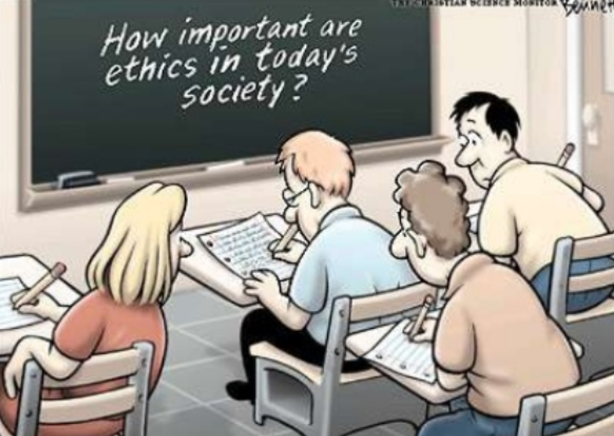
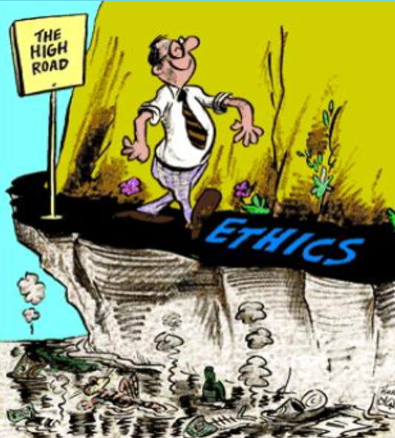
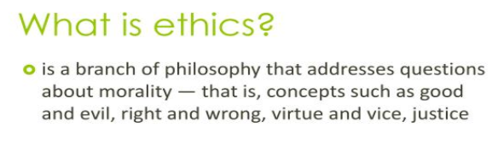

Slide 6
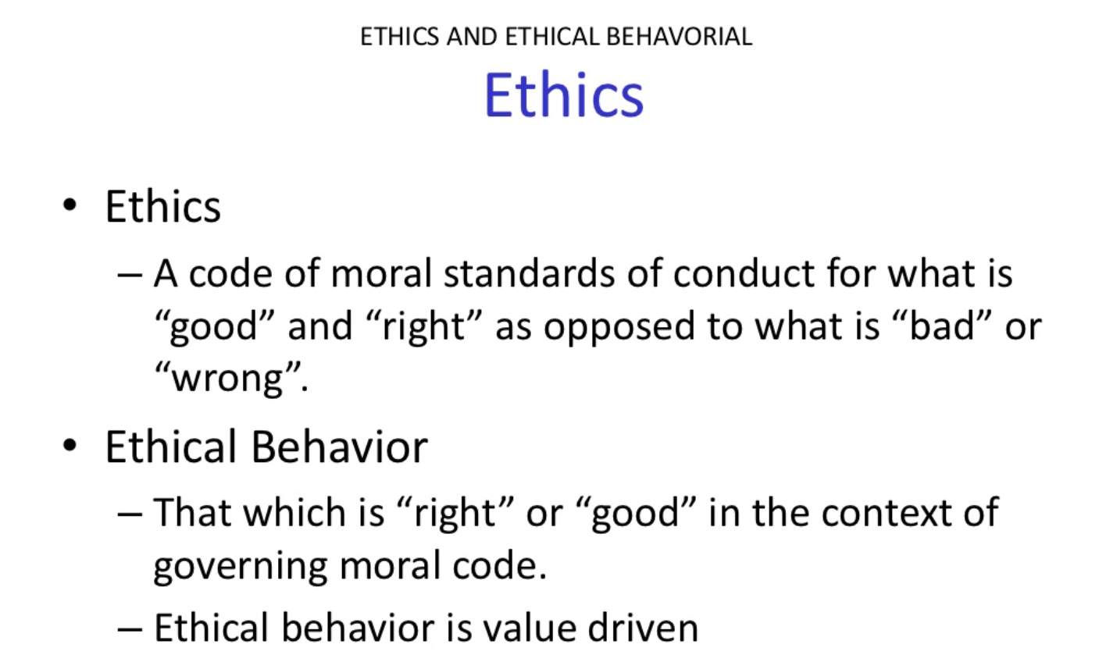

Slide 7
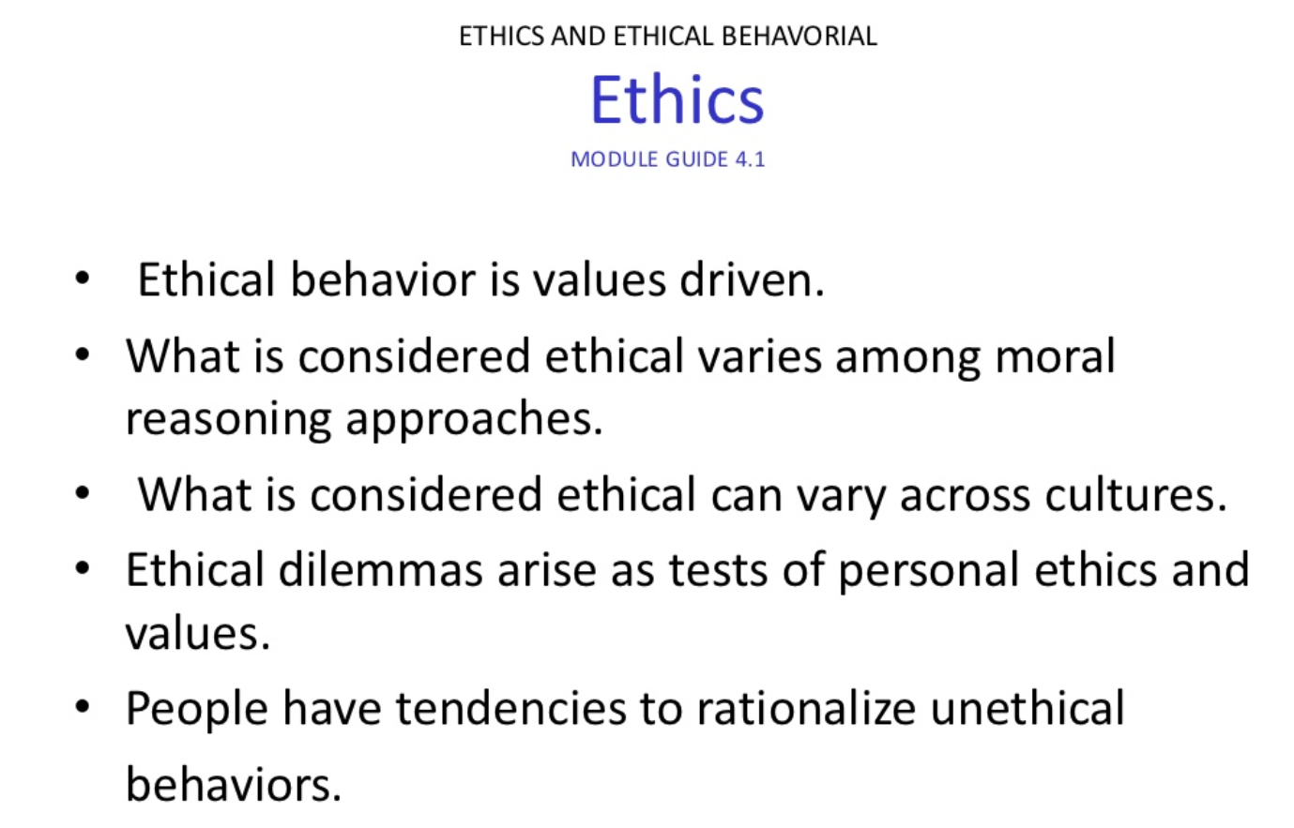


Slide 8
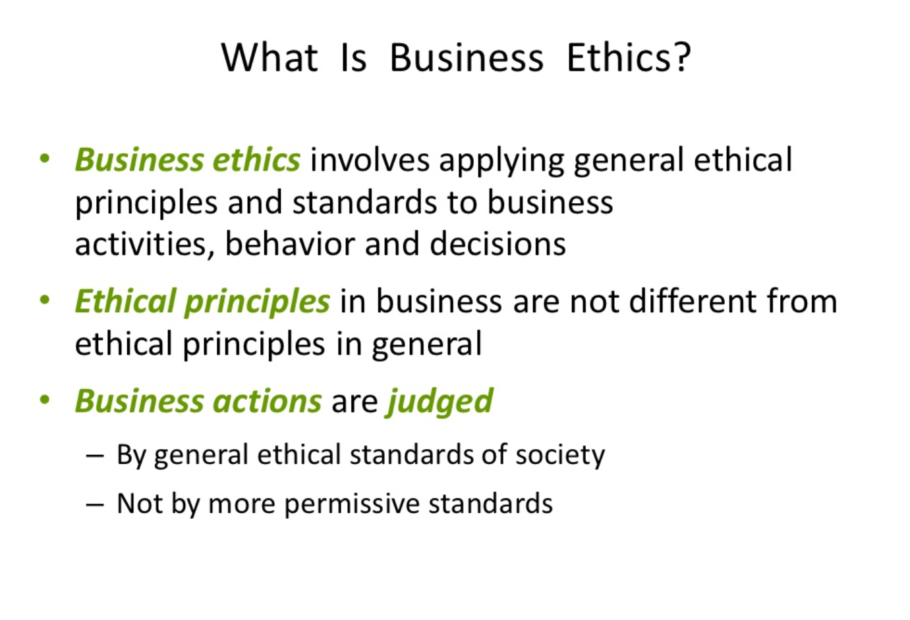

Slide 9
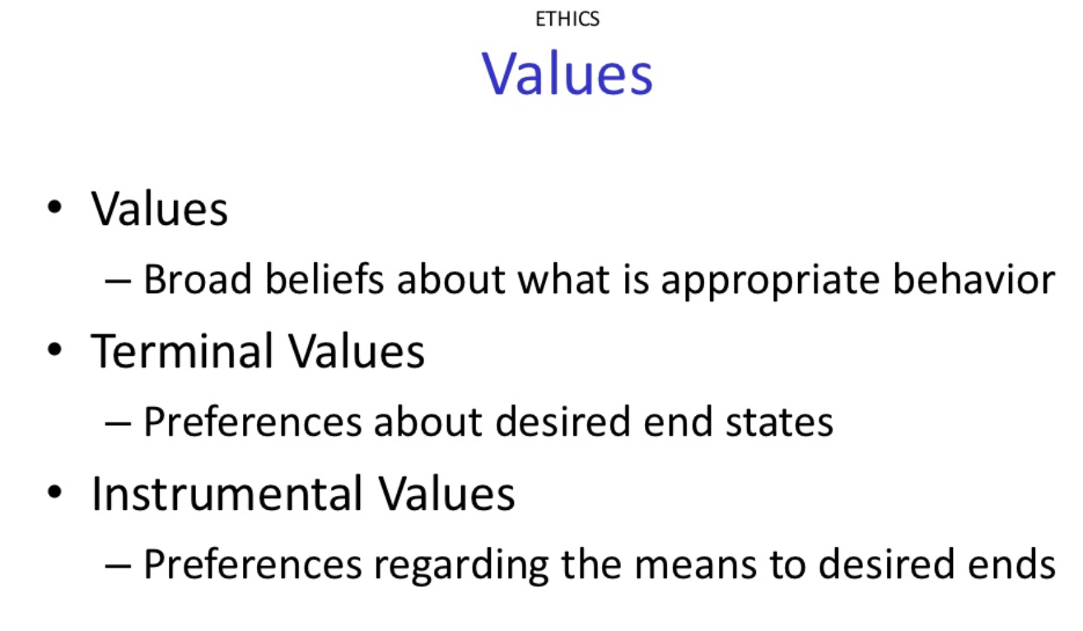

Slide 10
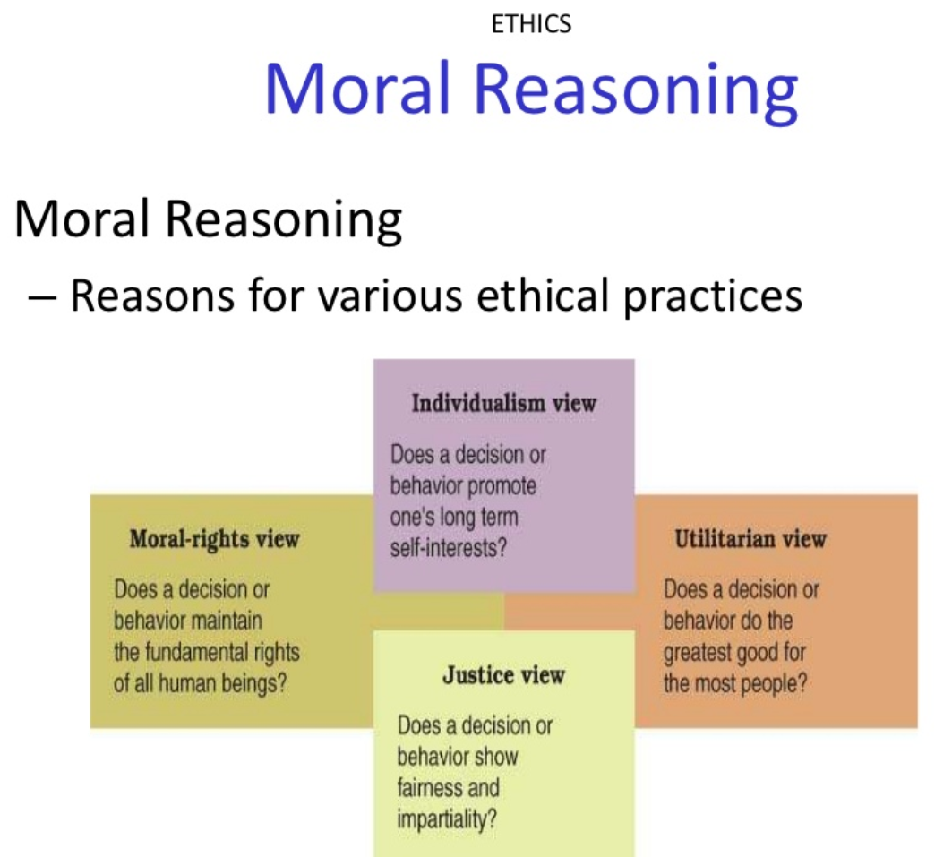

Slide 11
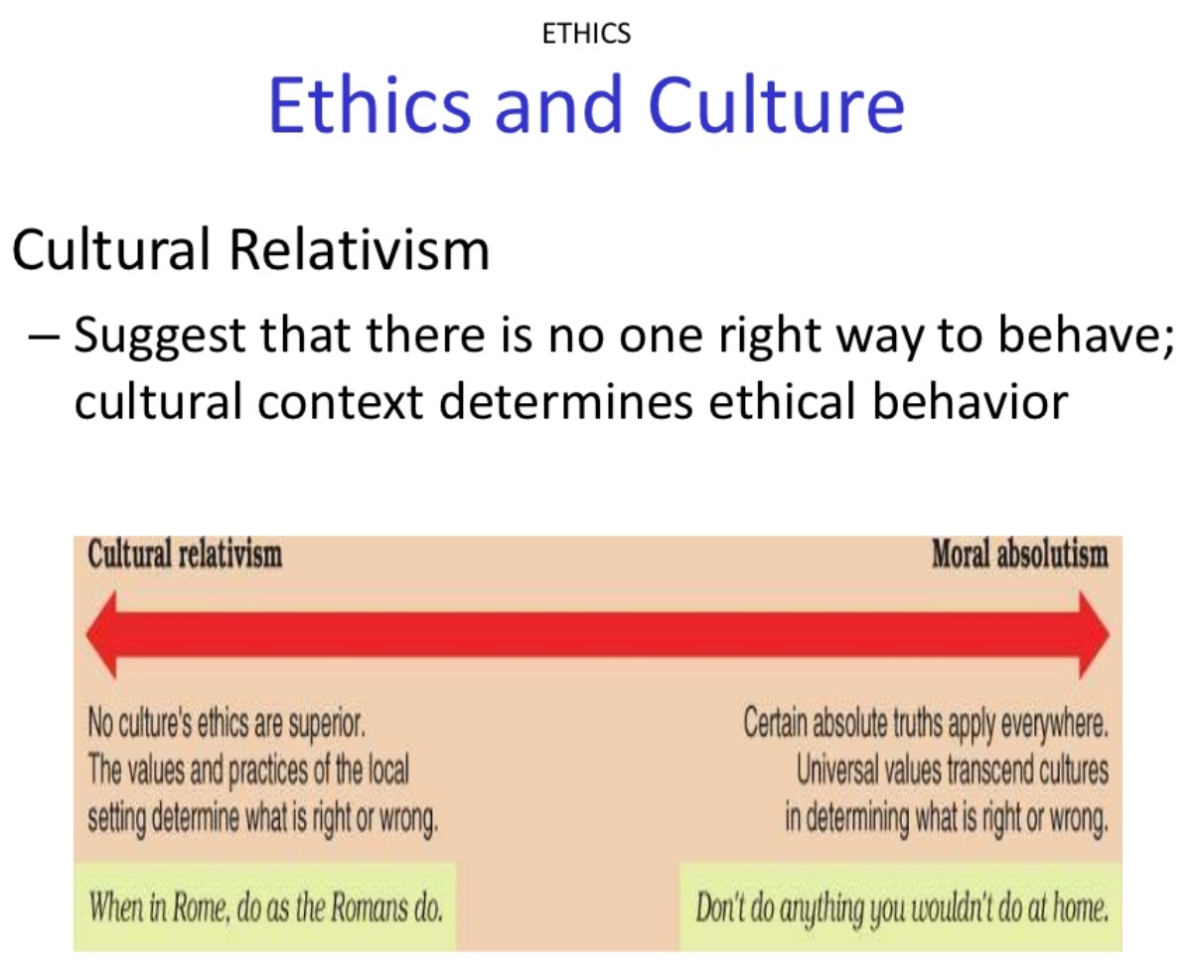

Slide 12
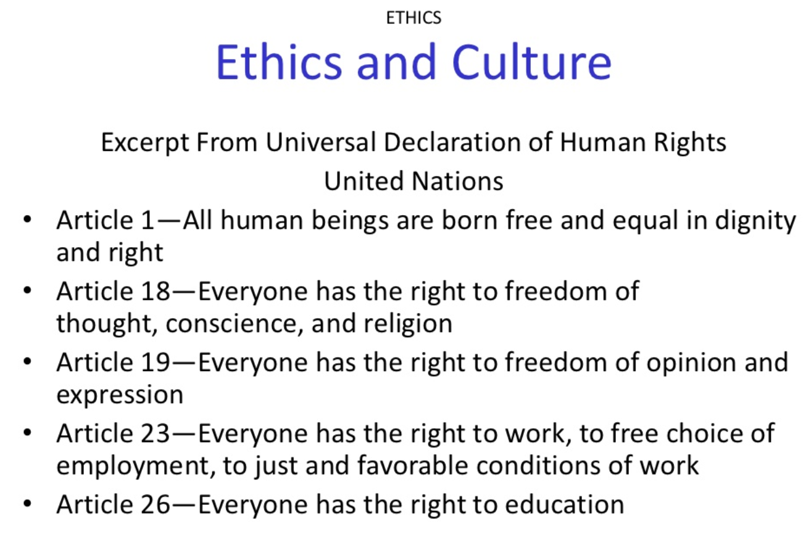

Slide 13
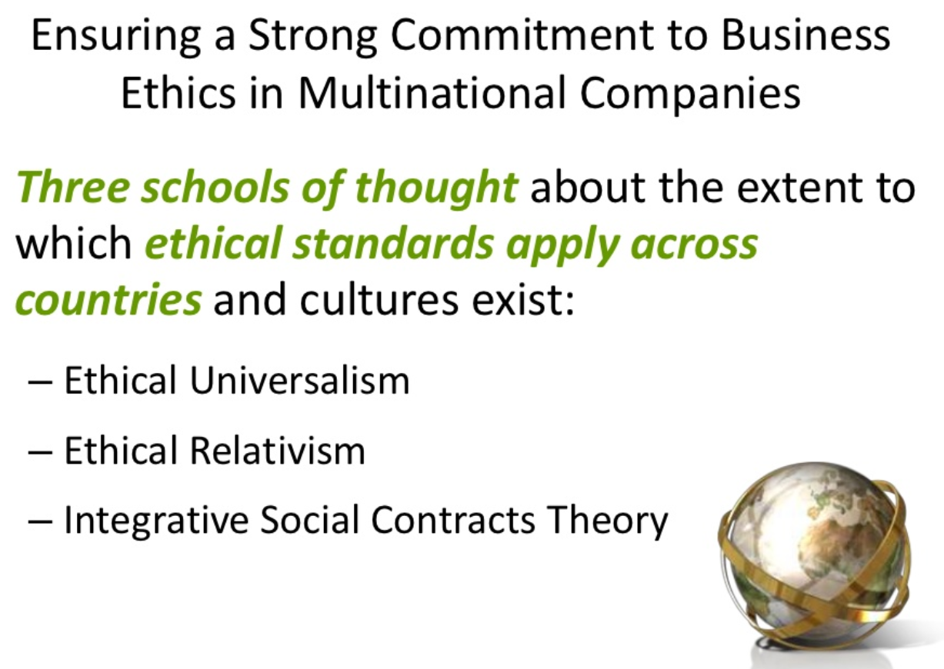

Slide 14
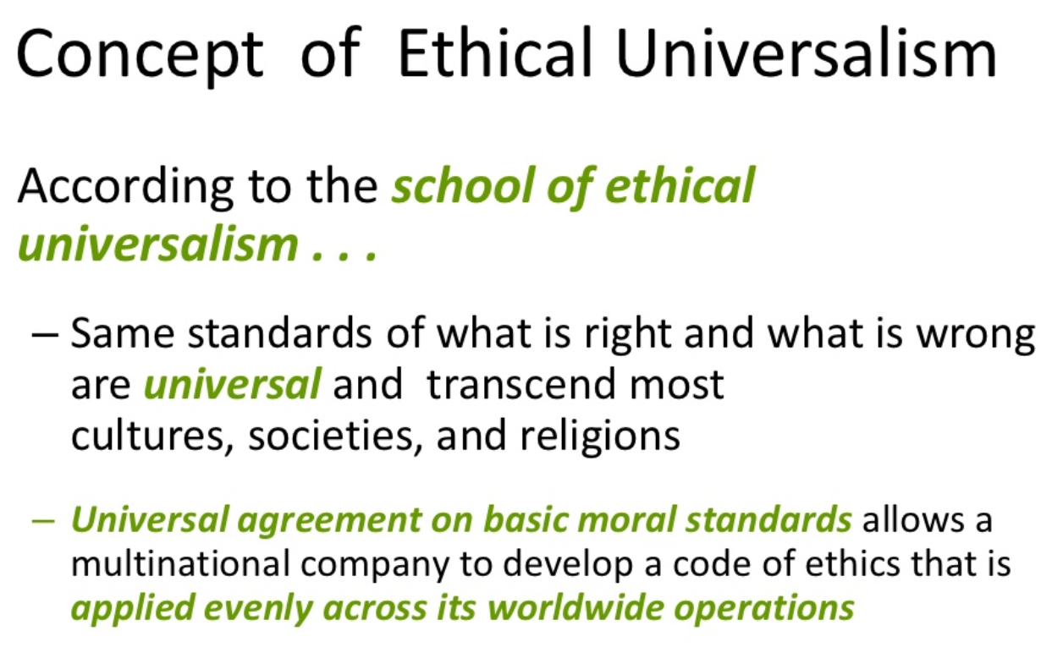

Slide 15
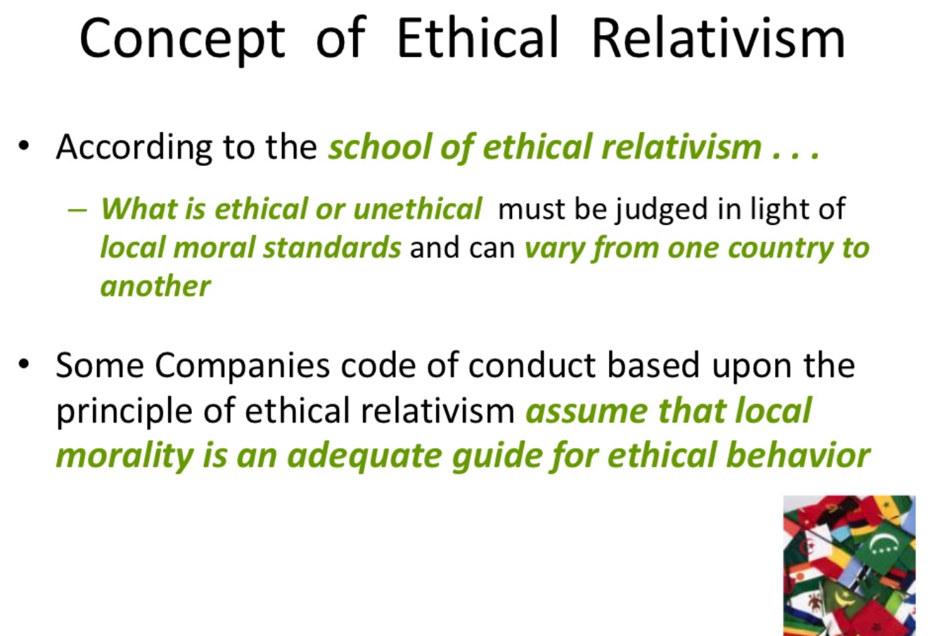

Slide 16
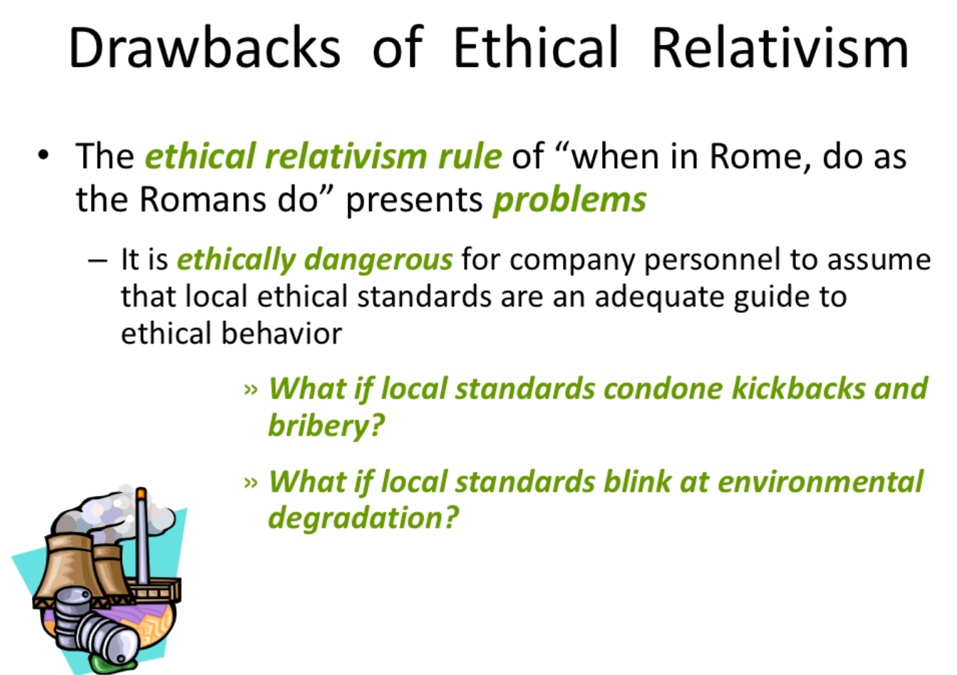

Slide 17
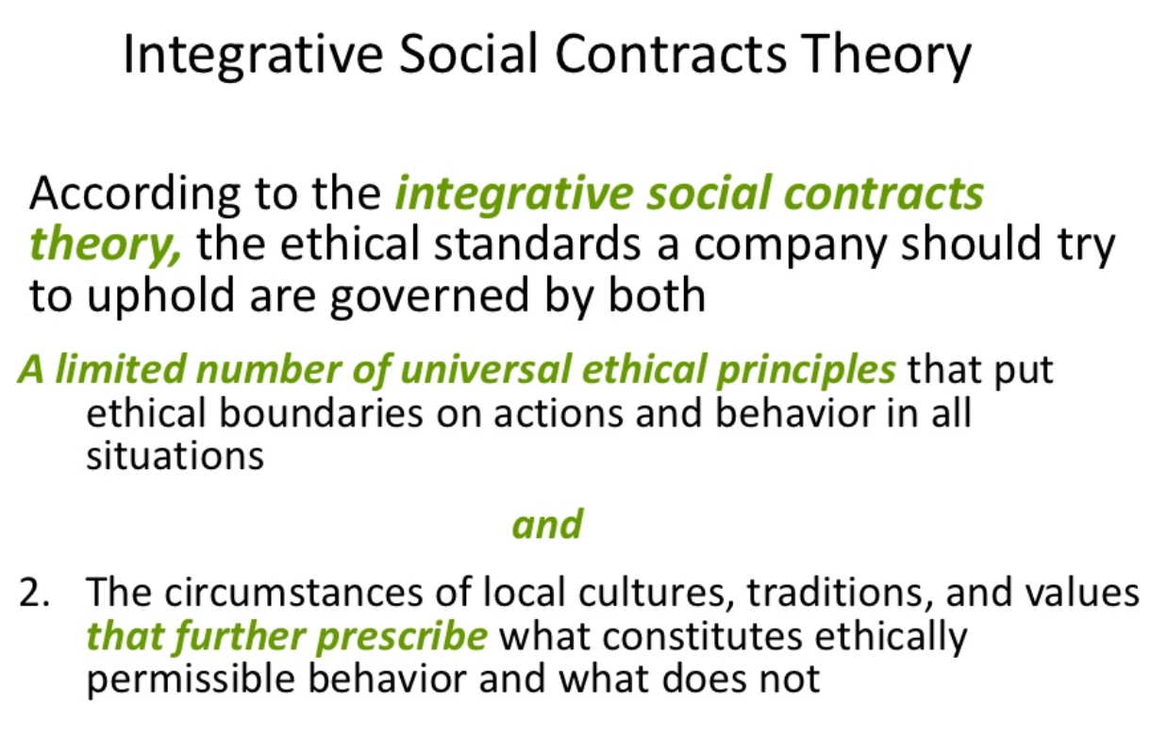

Slide 18
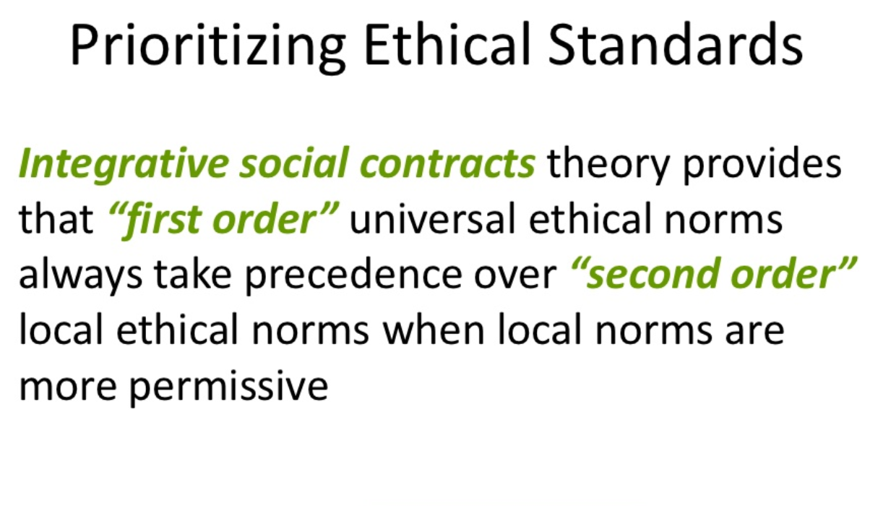


Slide 19
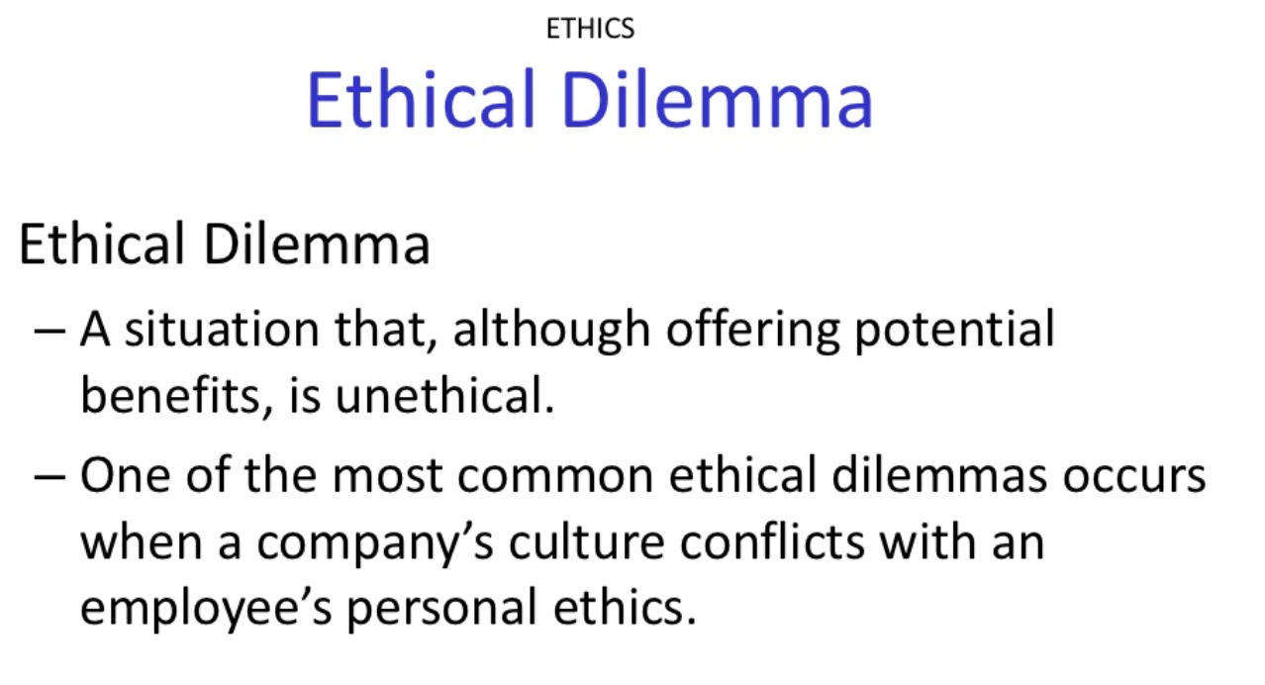

Slide 20
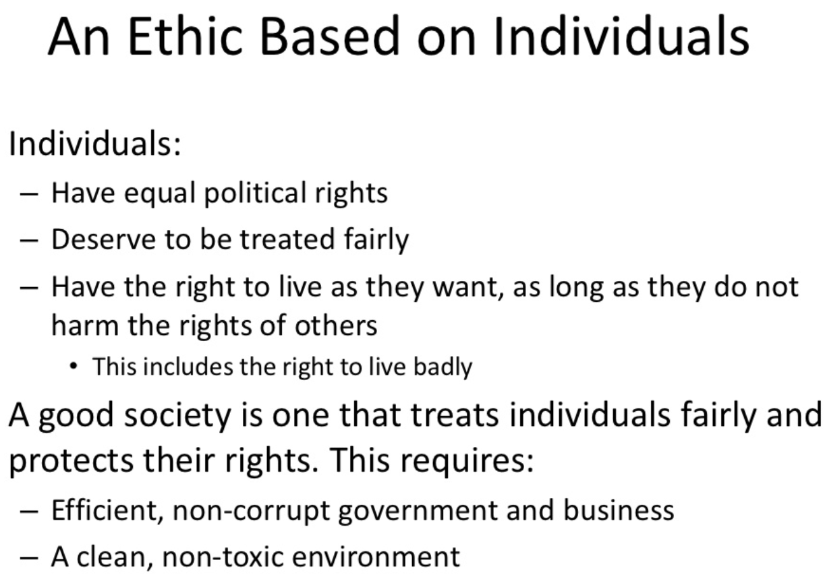

Slide 21
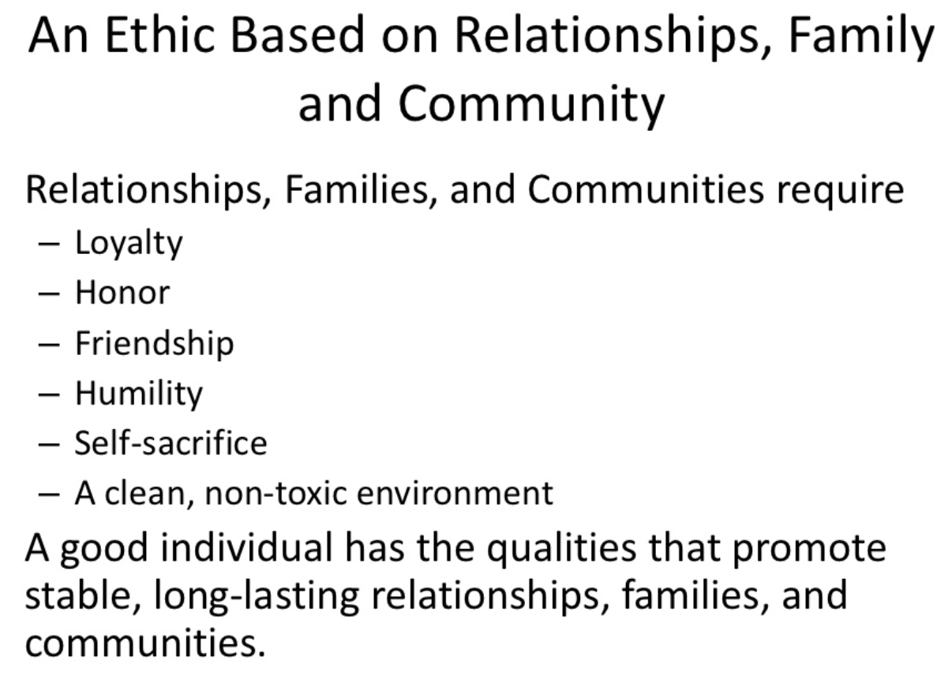

Slide 22
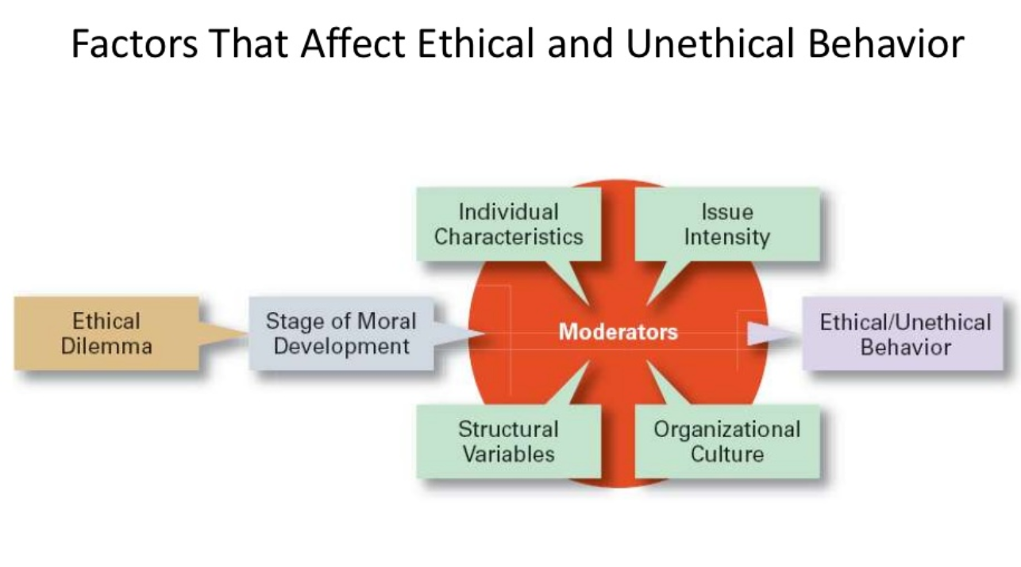

Slide 23
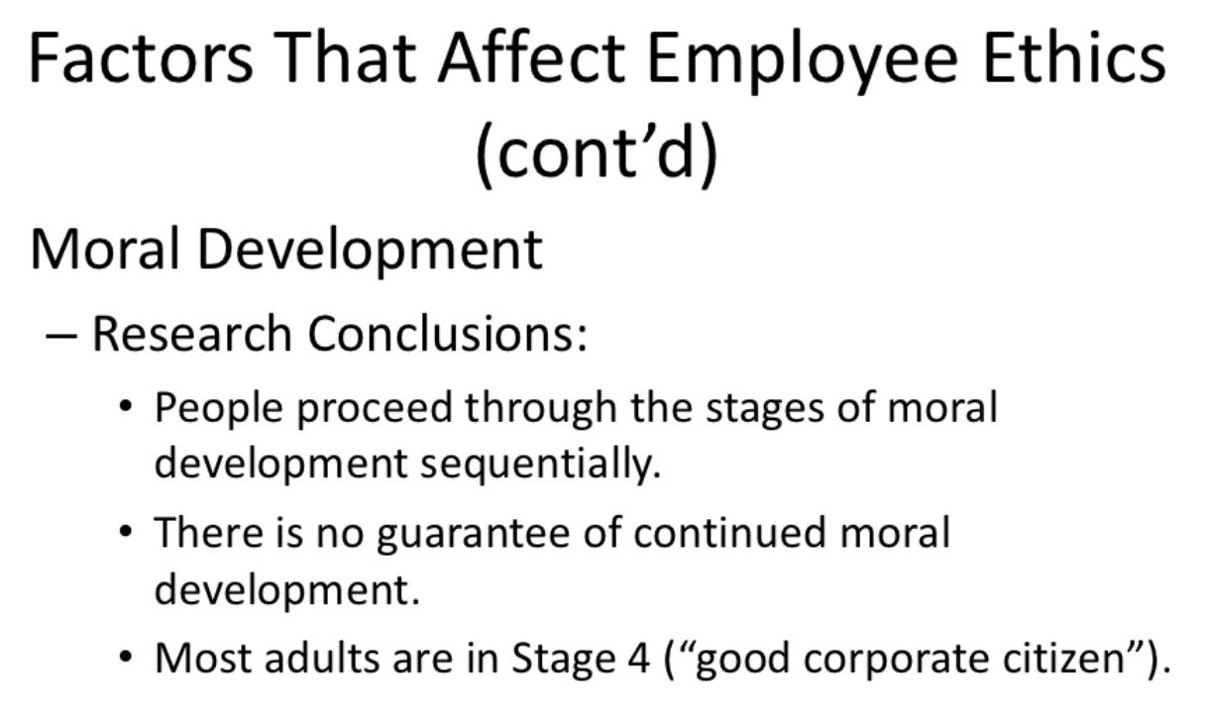

Slide 24
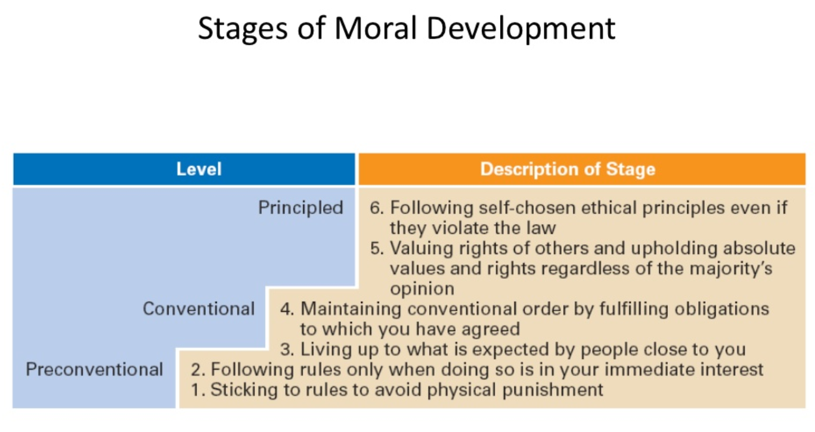

Slide 25
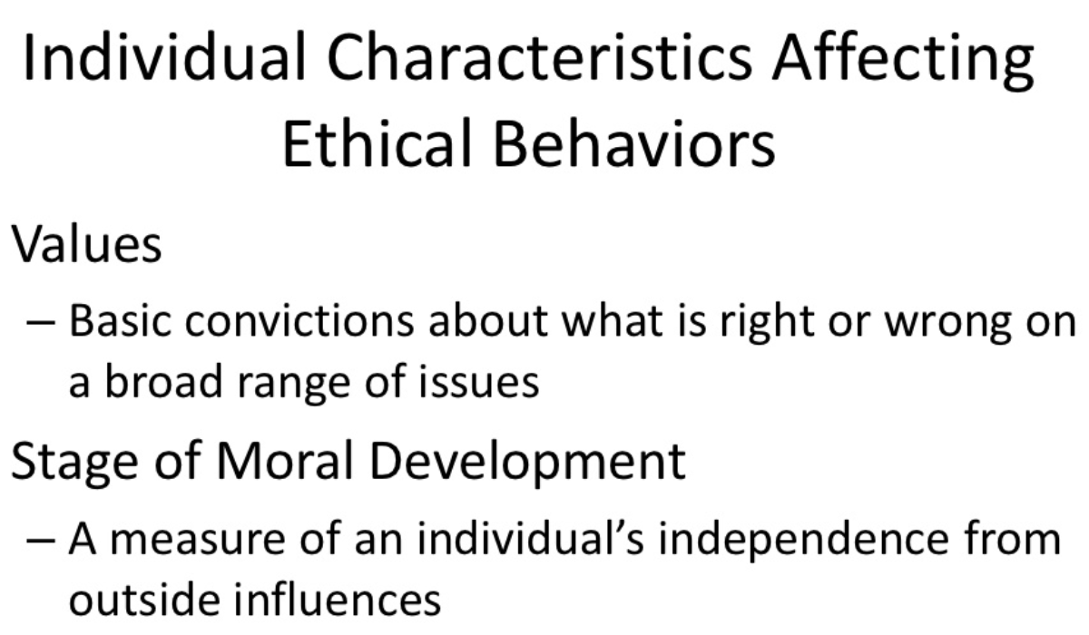

Slide 26
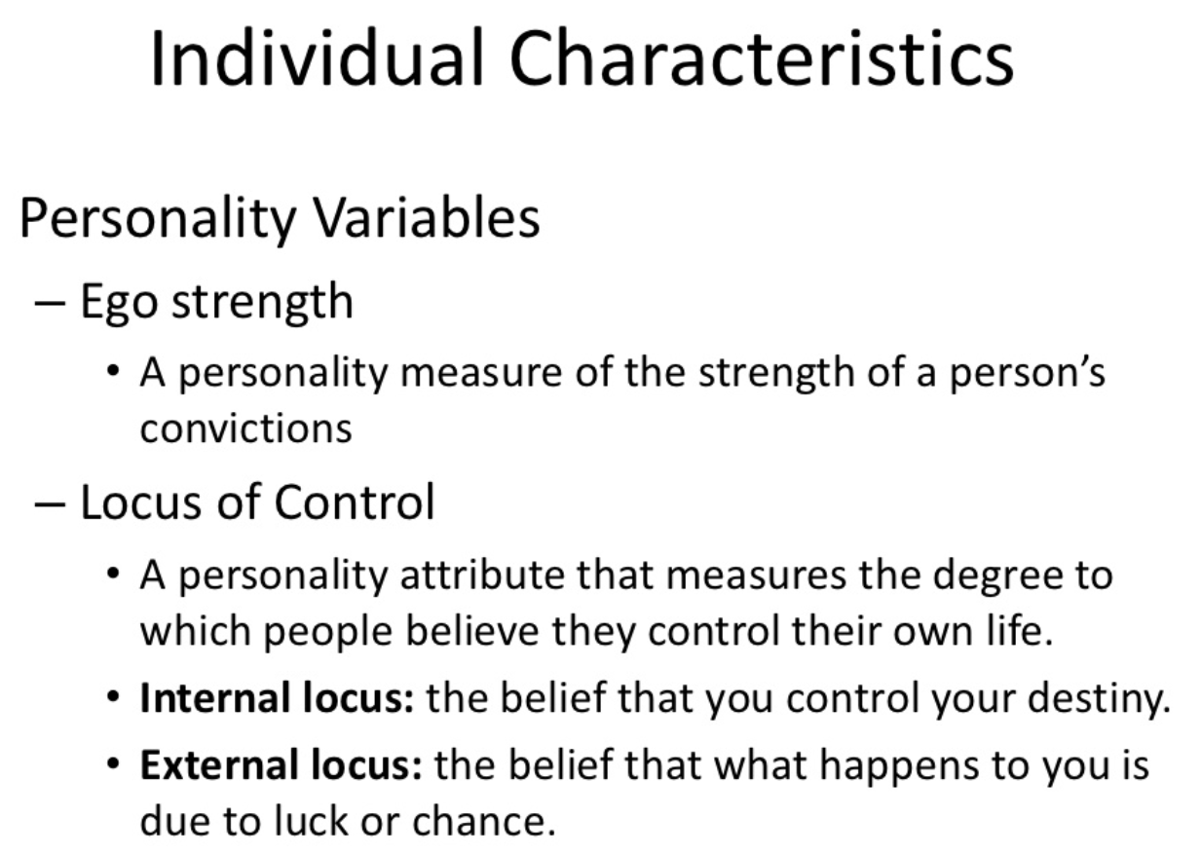

Slide 27
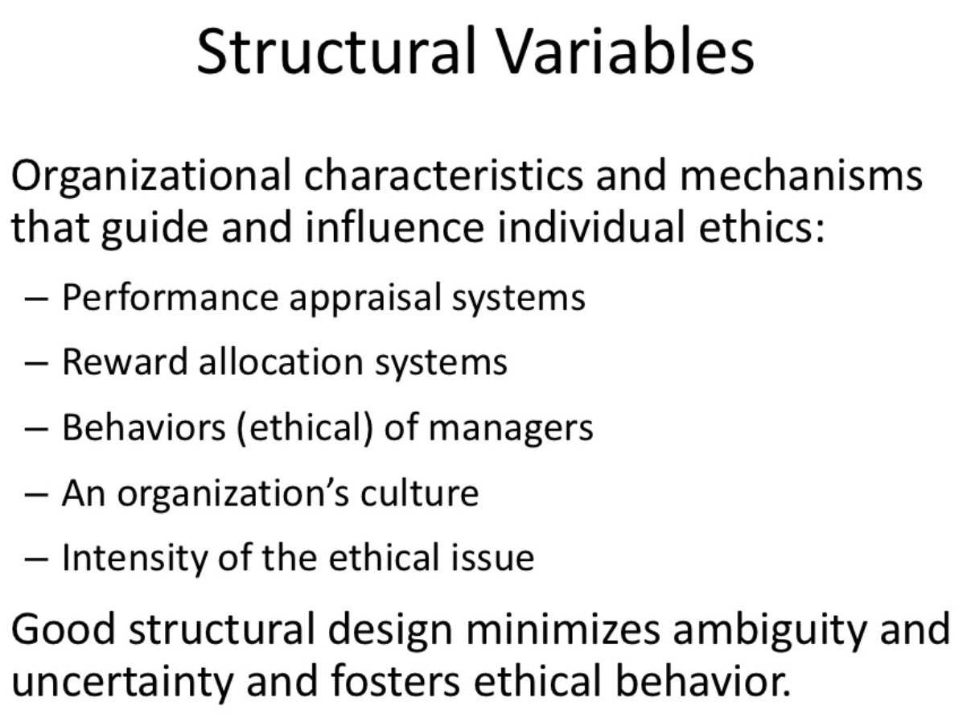

Slide 28
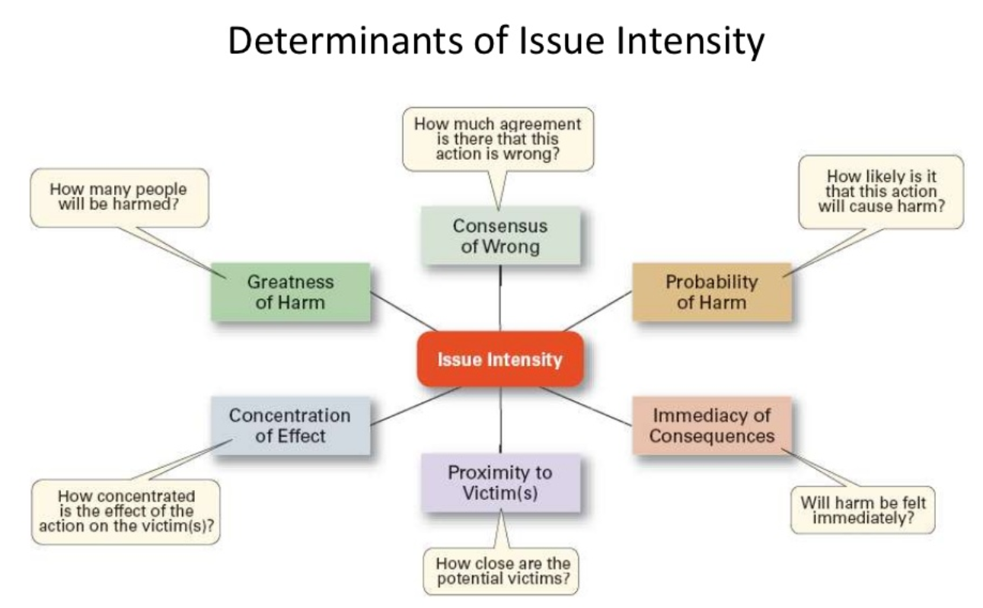

Slide 29
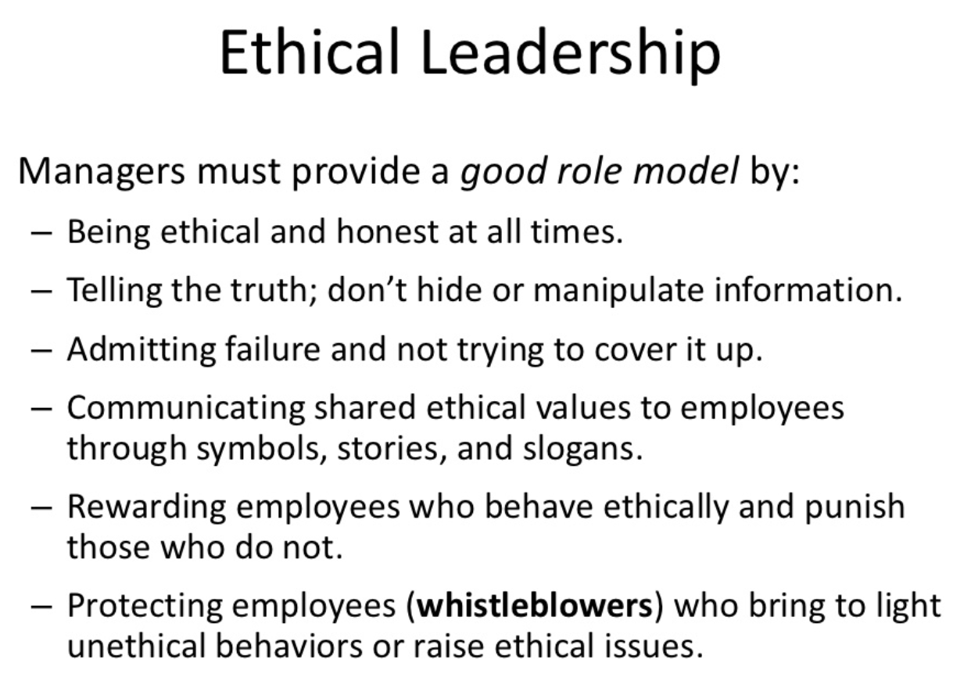

Slide 30
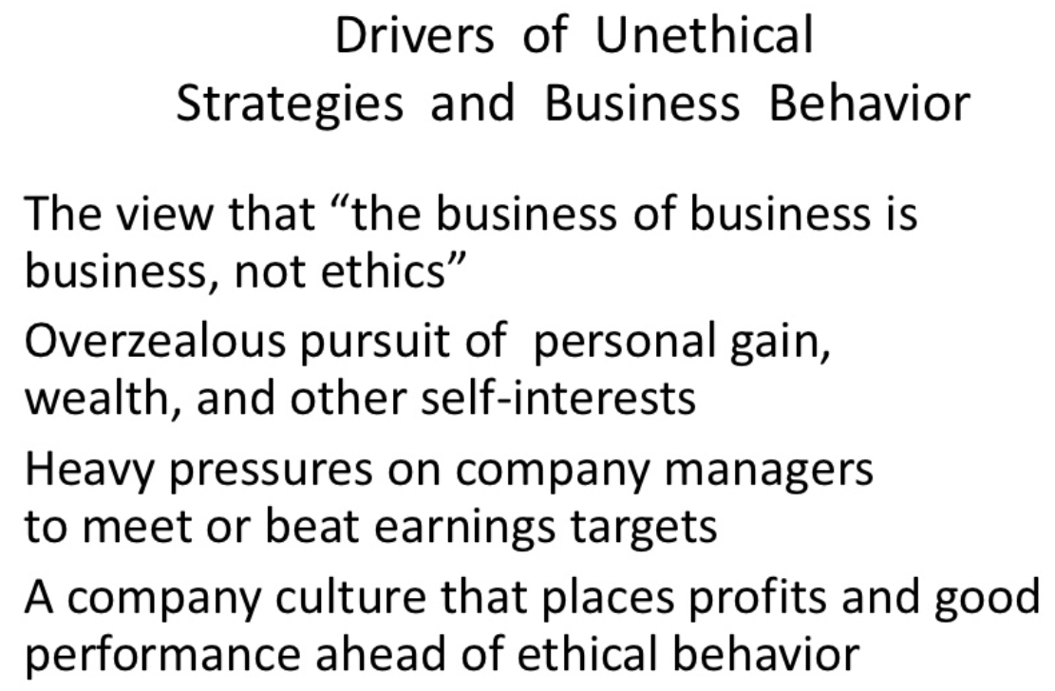


Slide 31
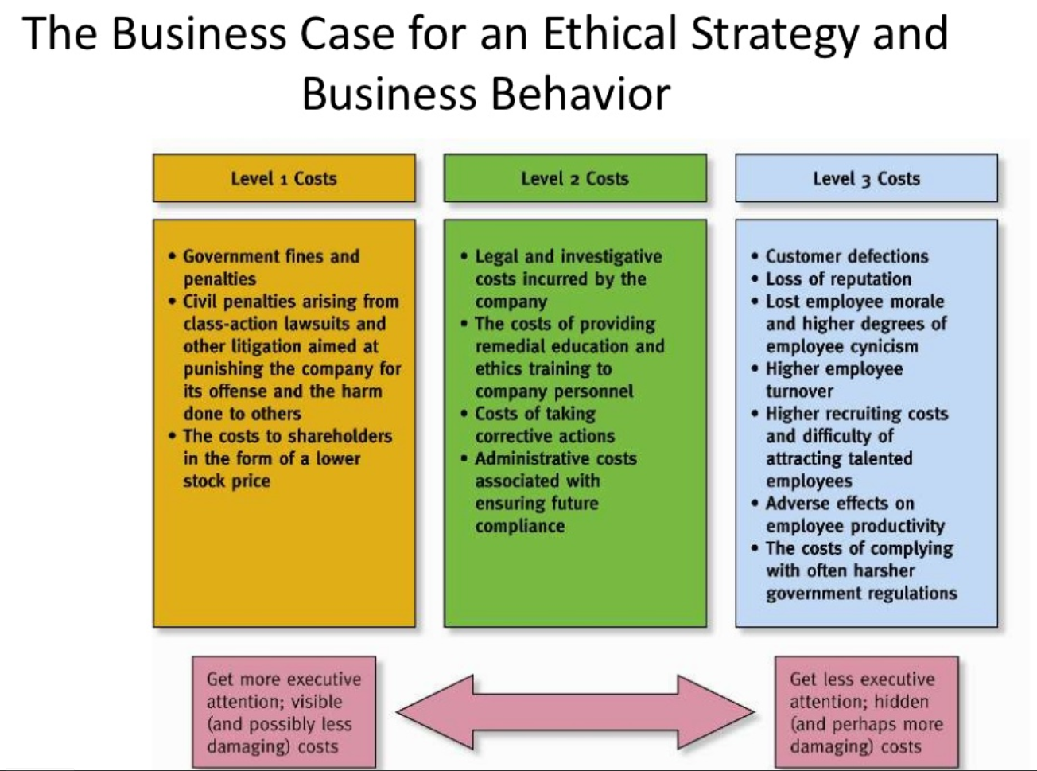

Slide 32
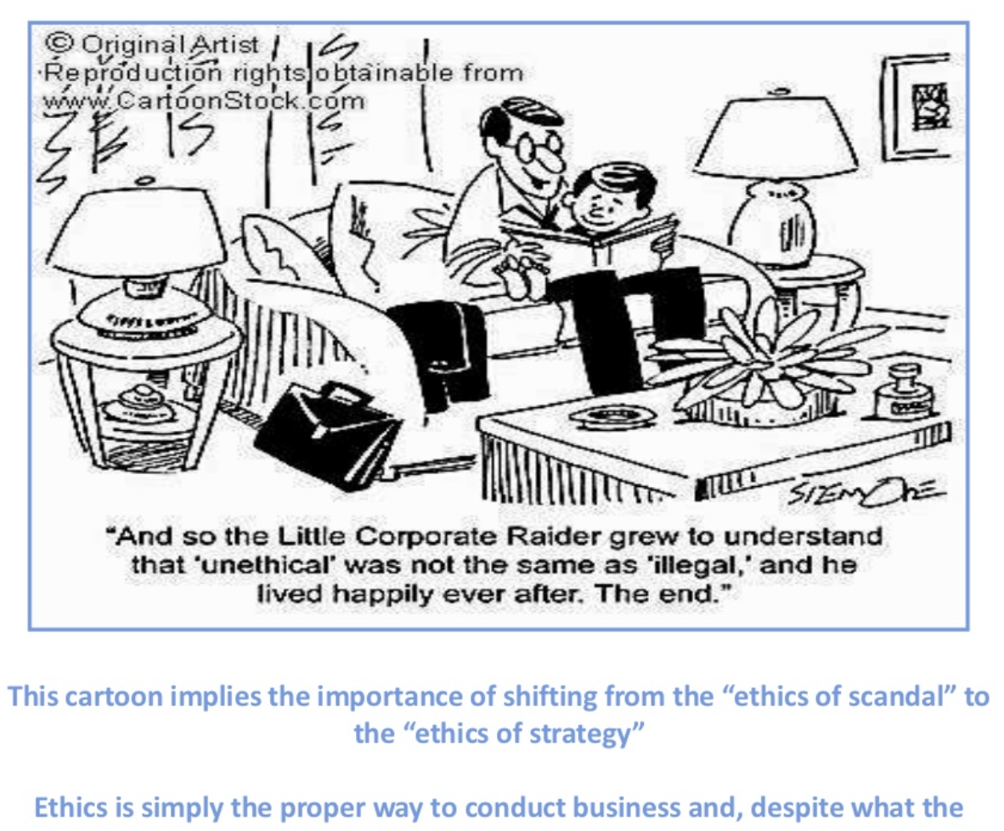

Slide 33
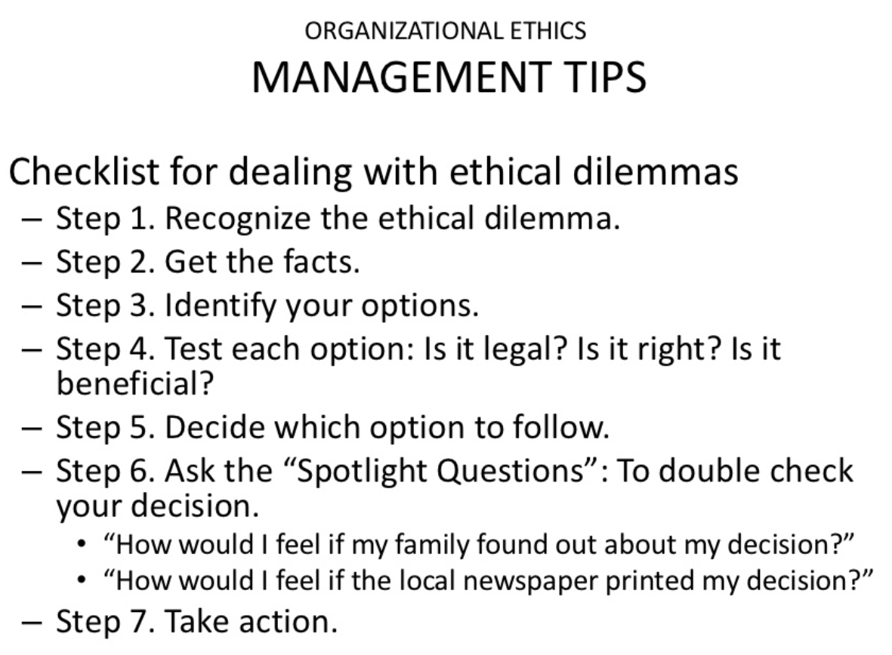

Slide 34
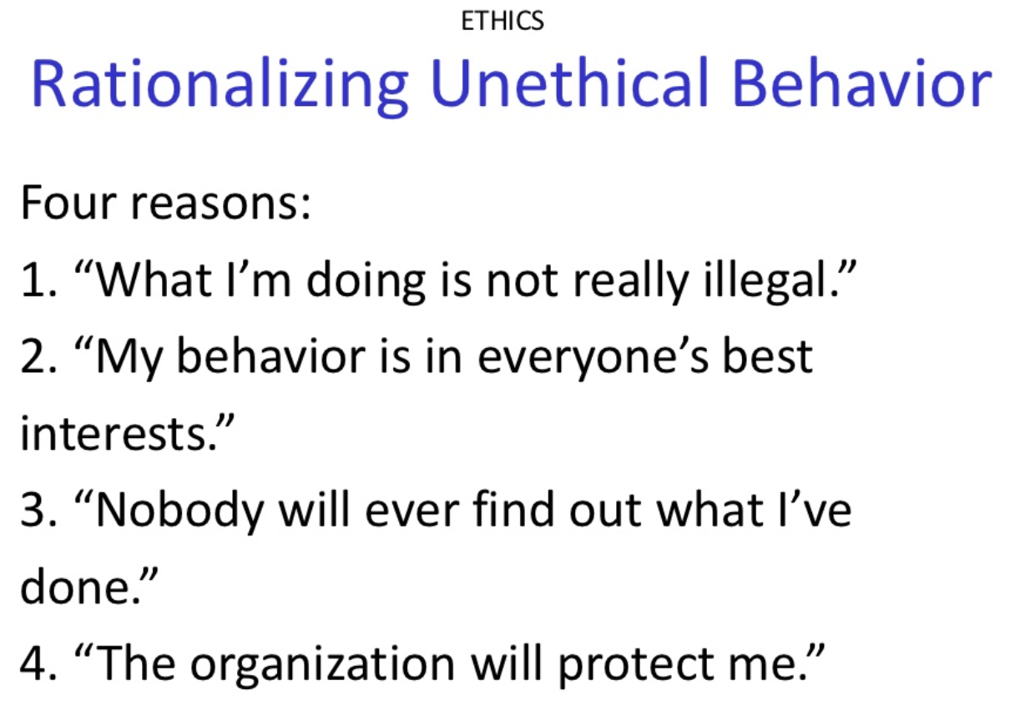

Slide 35
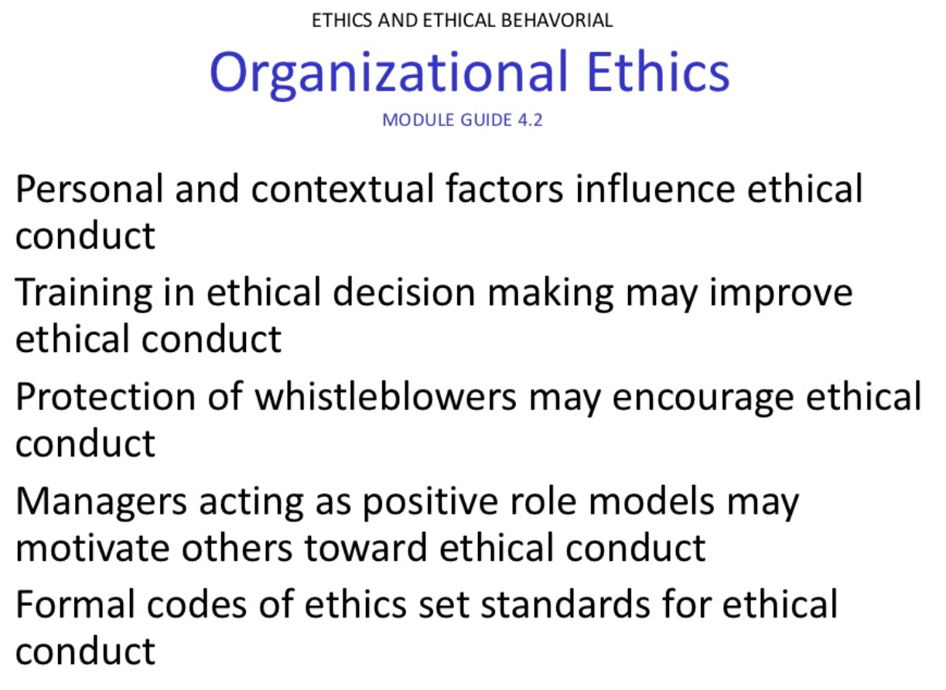

Slide 36
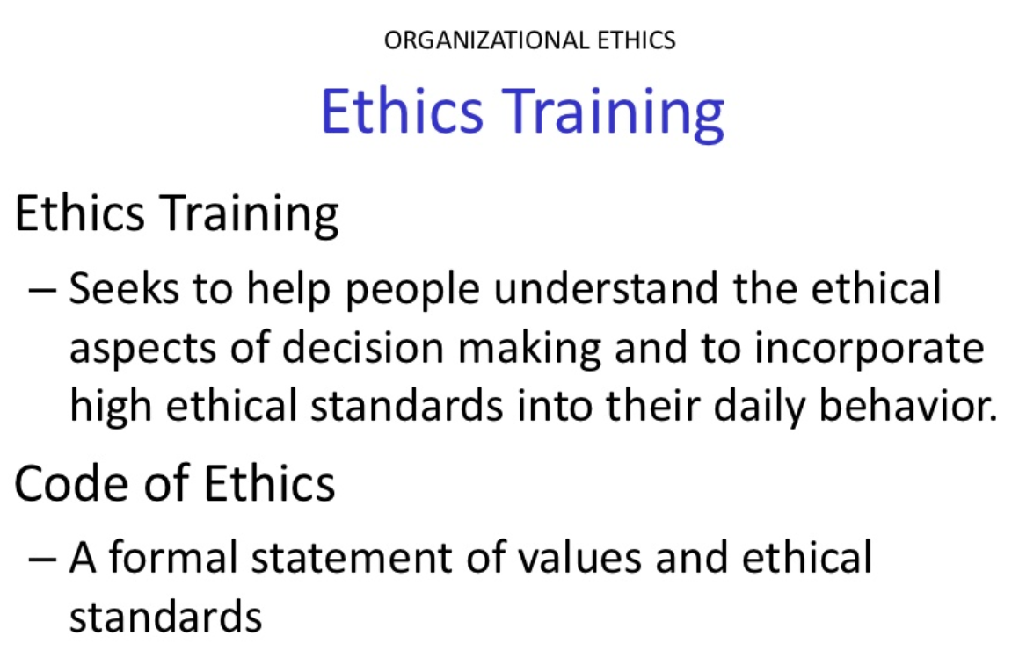

Slide 37
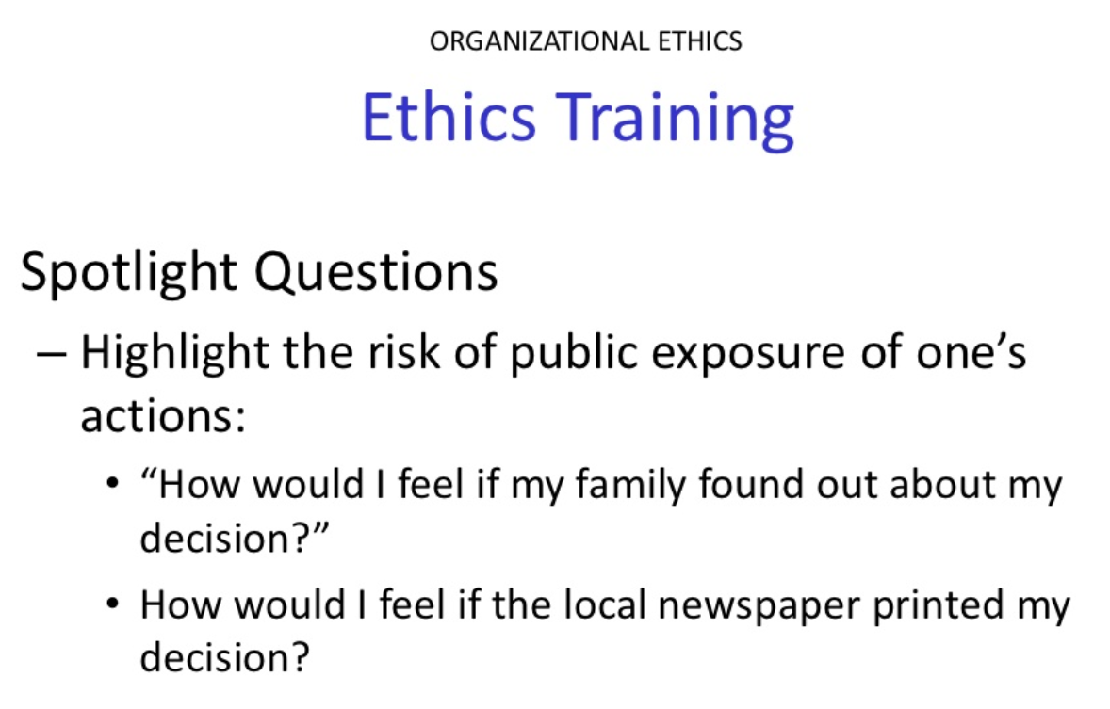

Slide 38
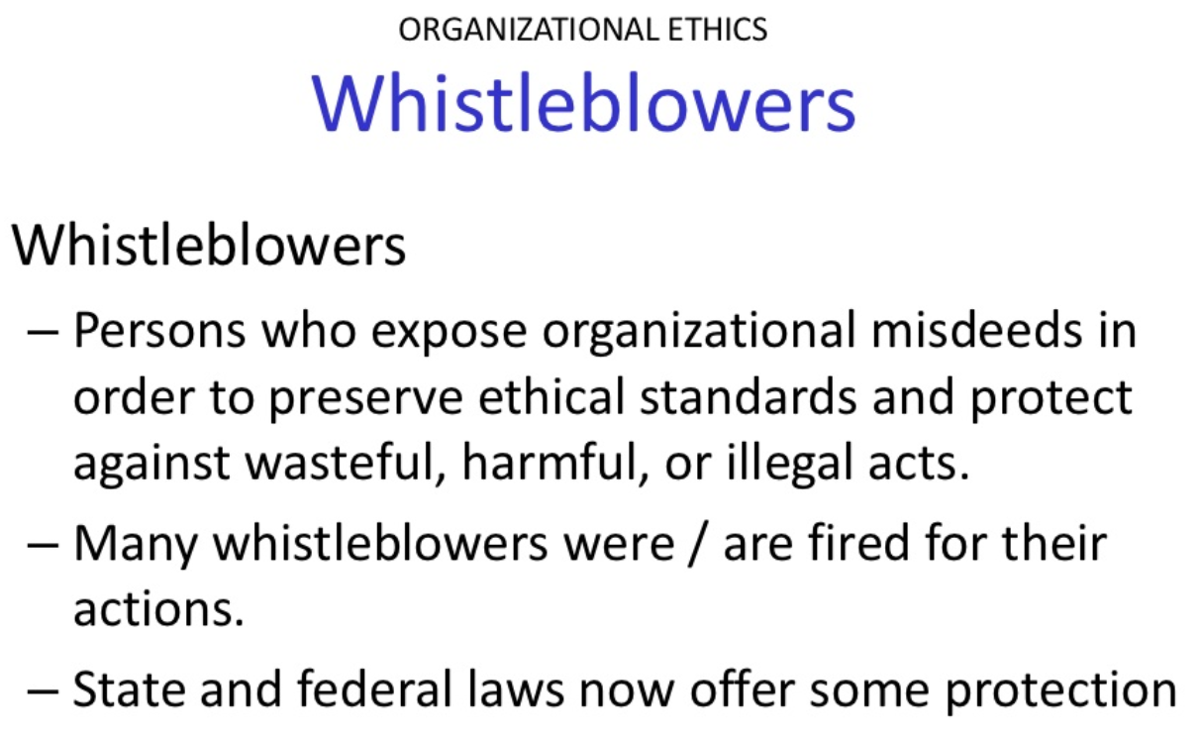

Slide 39
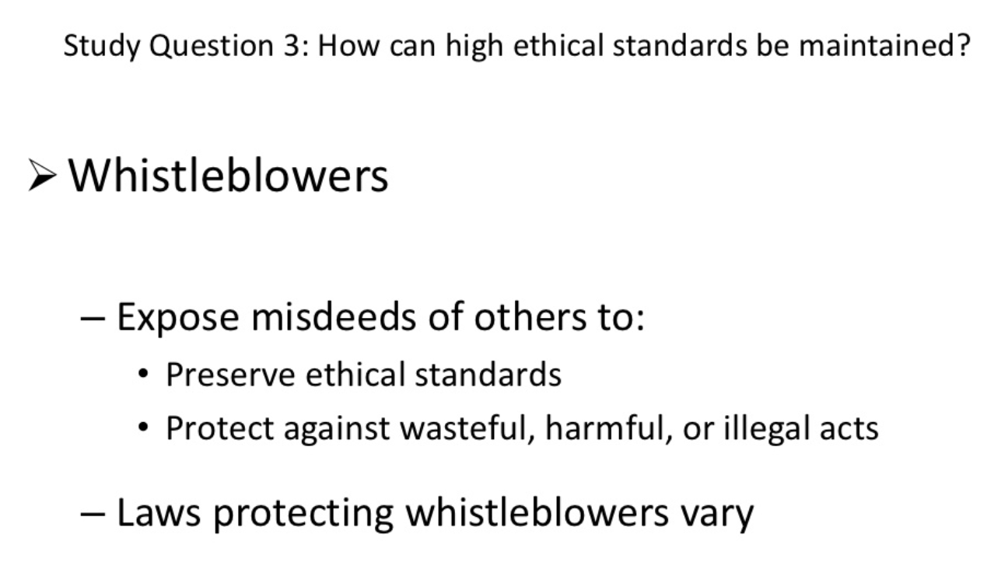

Slide 40
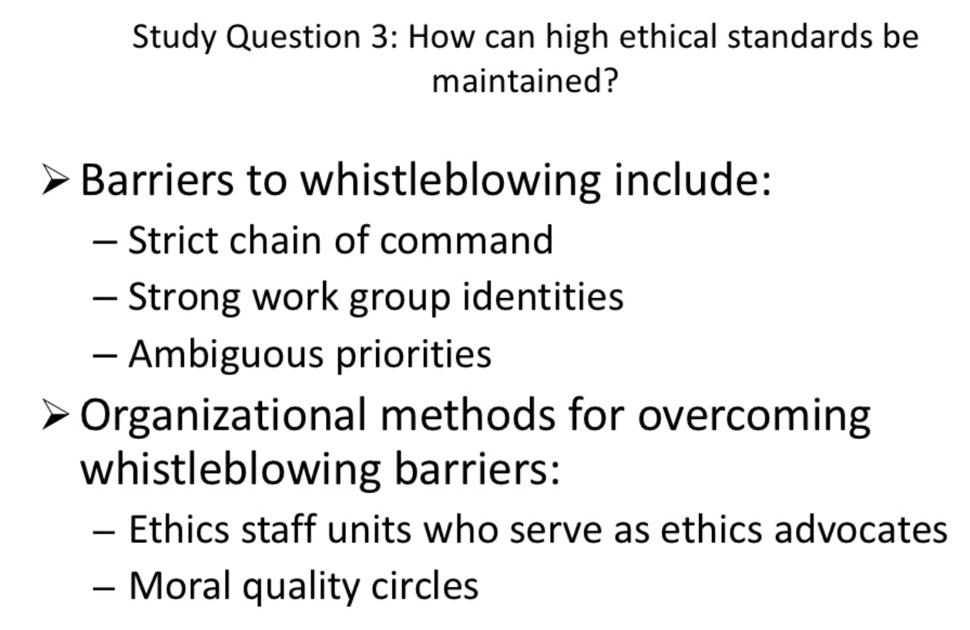

Slide 41
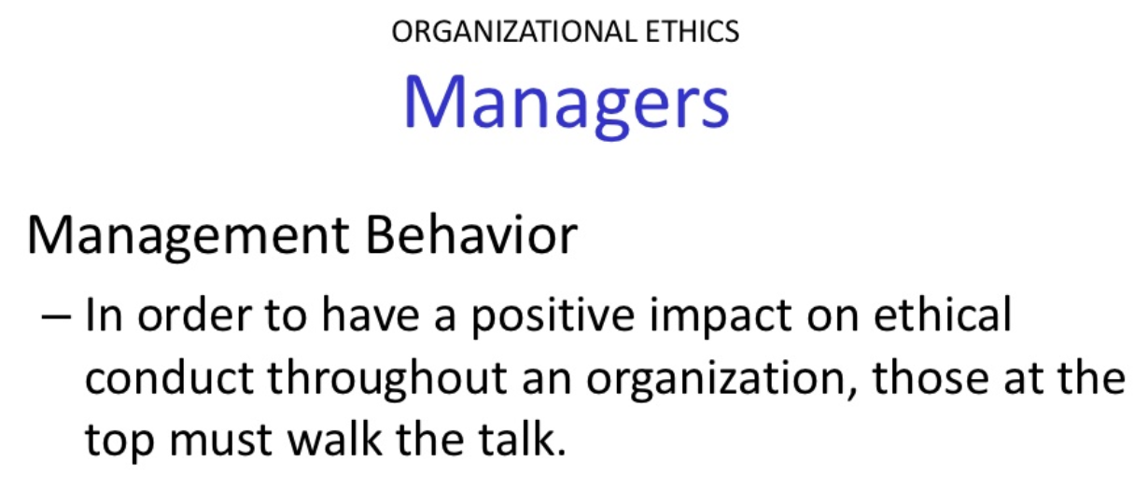

Slide 42
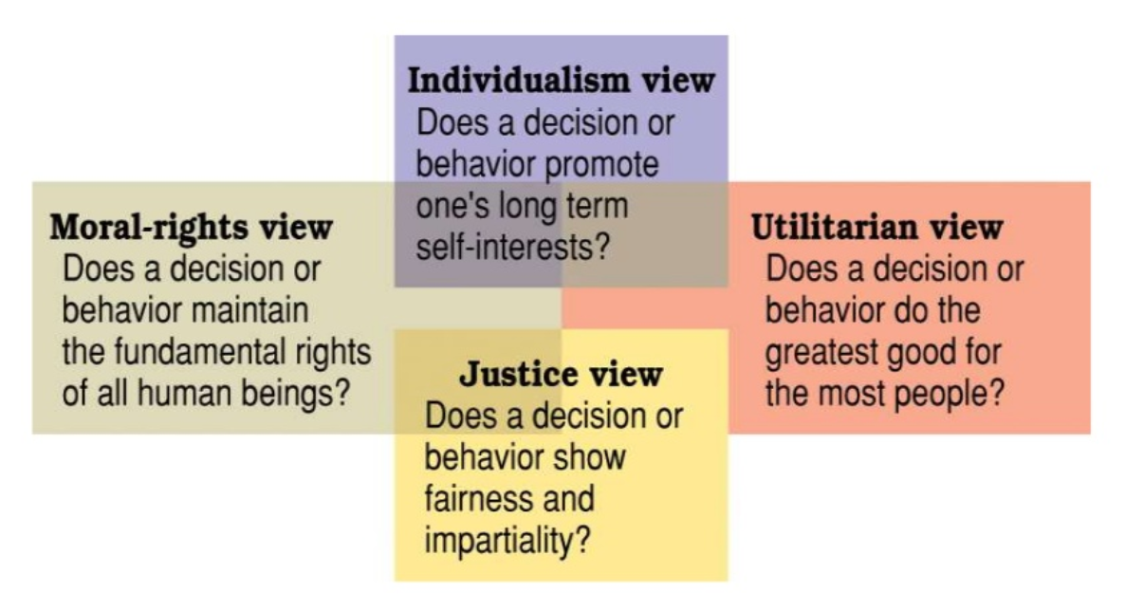

Slide 43
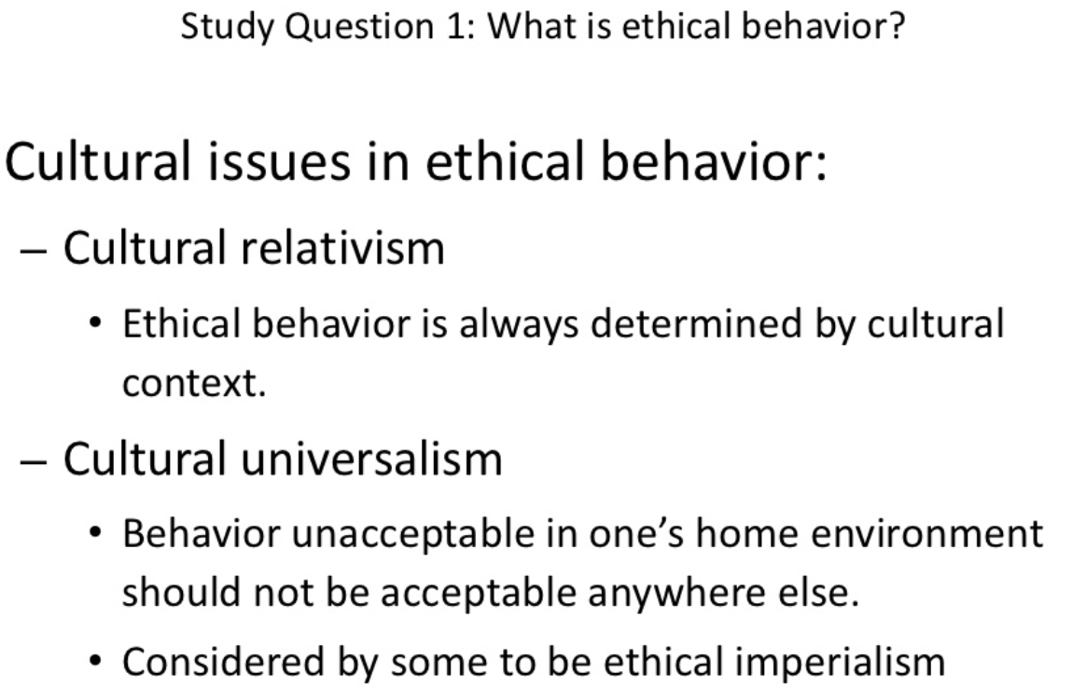

Slide 44
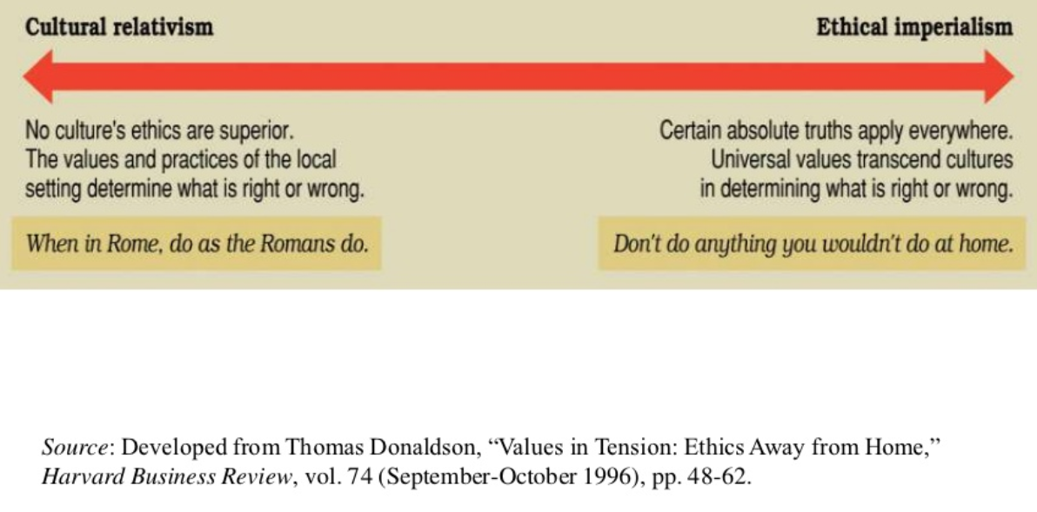
The extremes of cultural relativism and ethical imperialism in international business ethics.

Slide 45
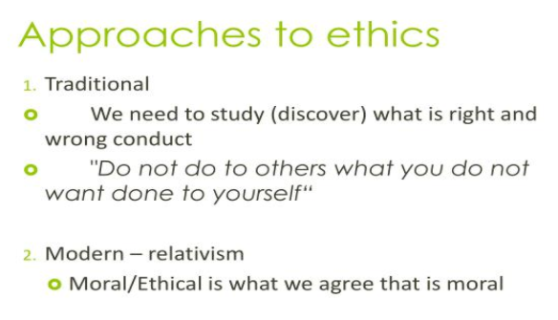

Slide 46
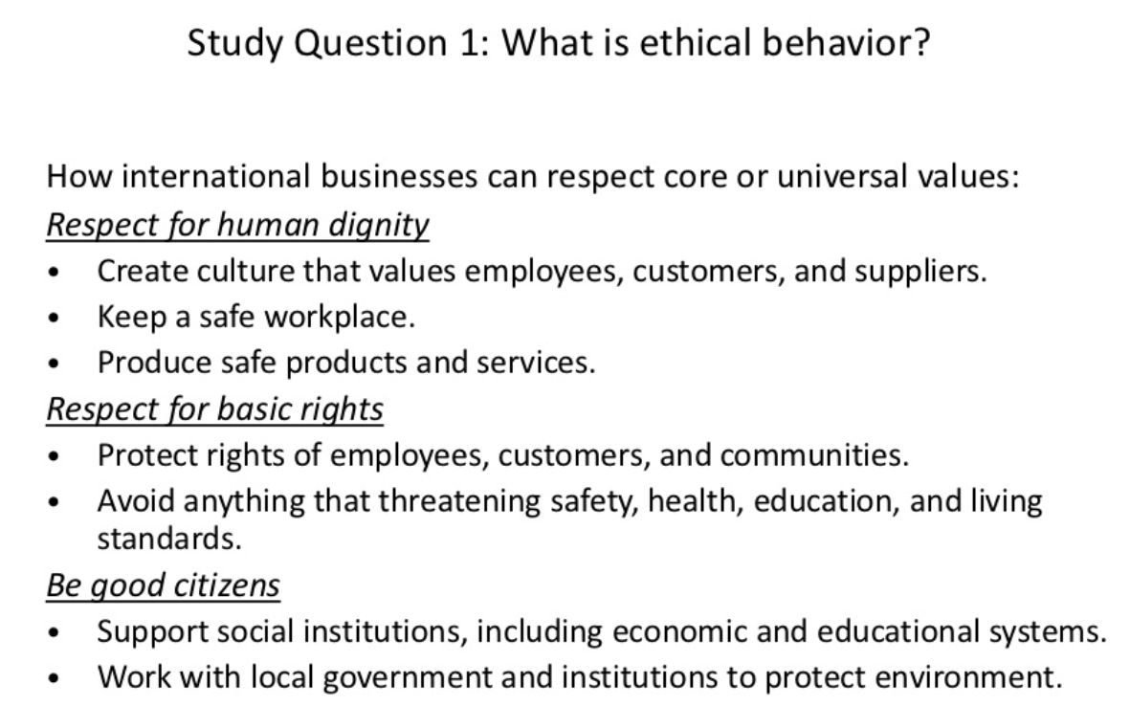

Slide 47
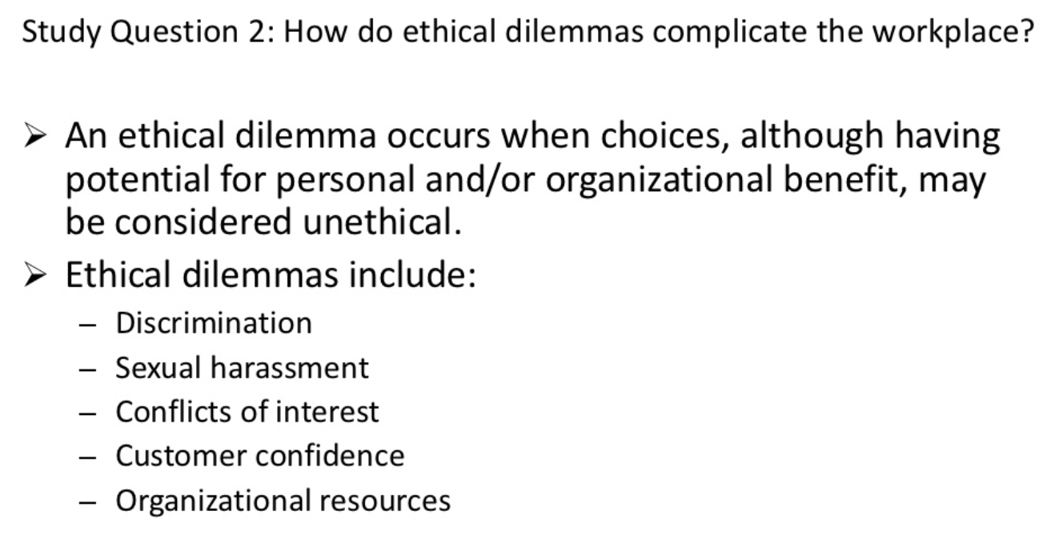

Slide 48
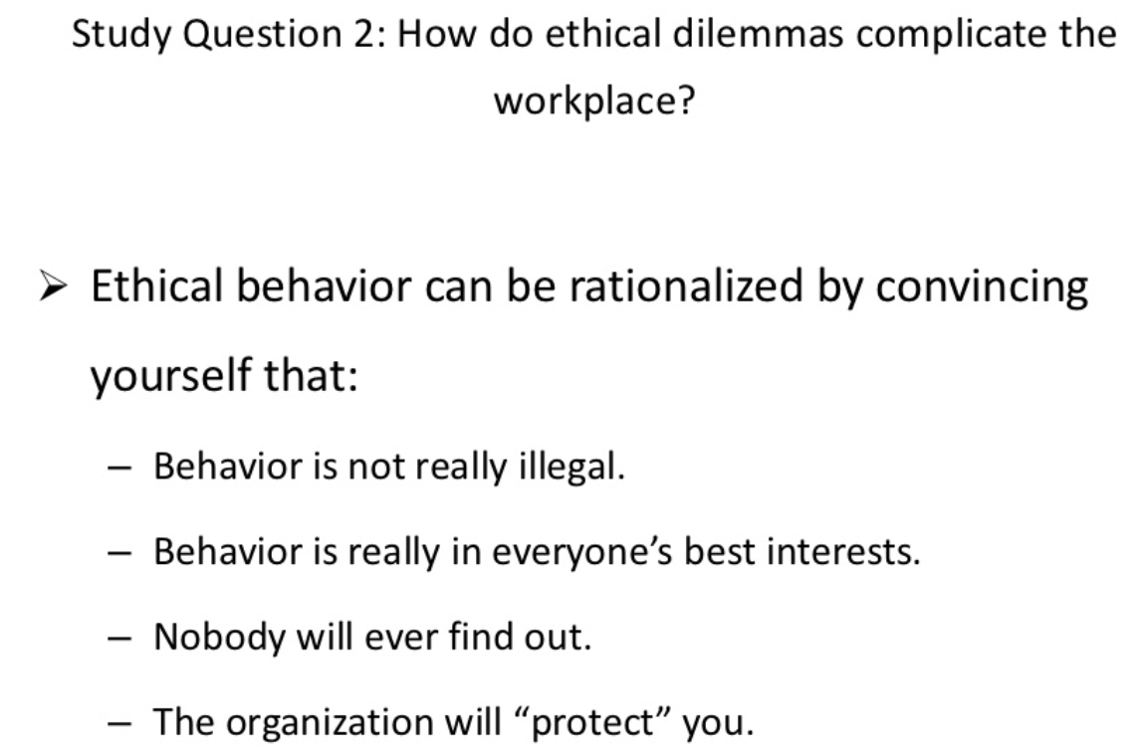

Slide 49
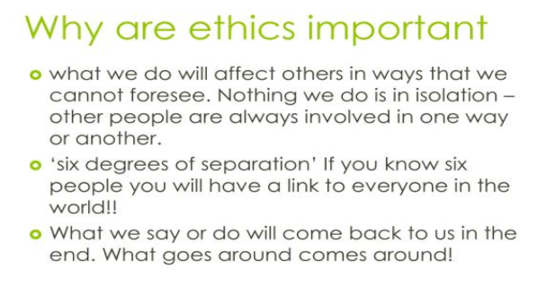

Slide 50
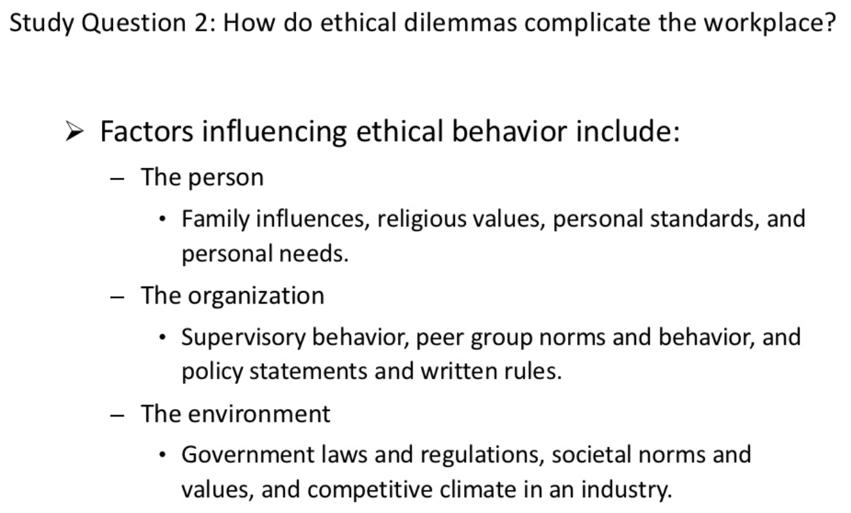

Slide 51
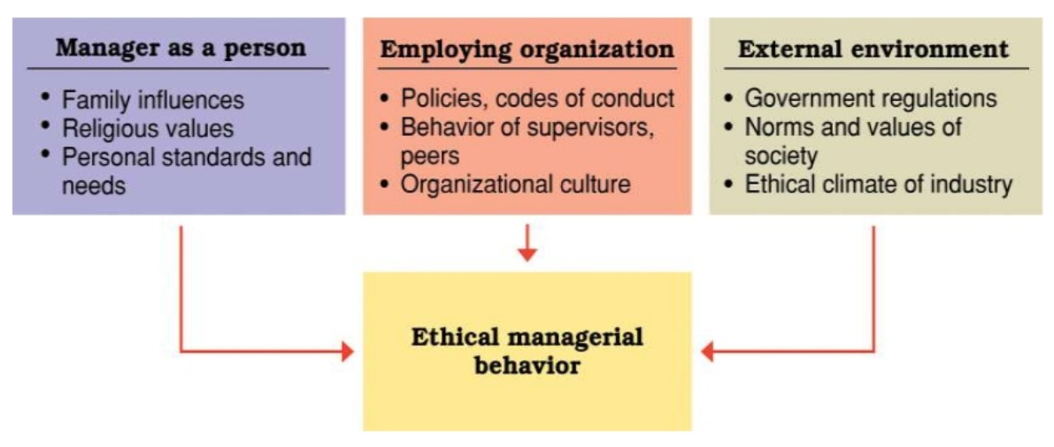
Factors influencing ethical managerial behavior--- the person, organization, and environment.

Slide 52
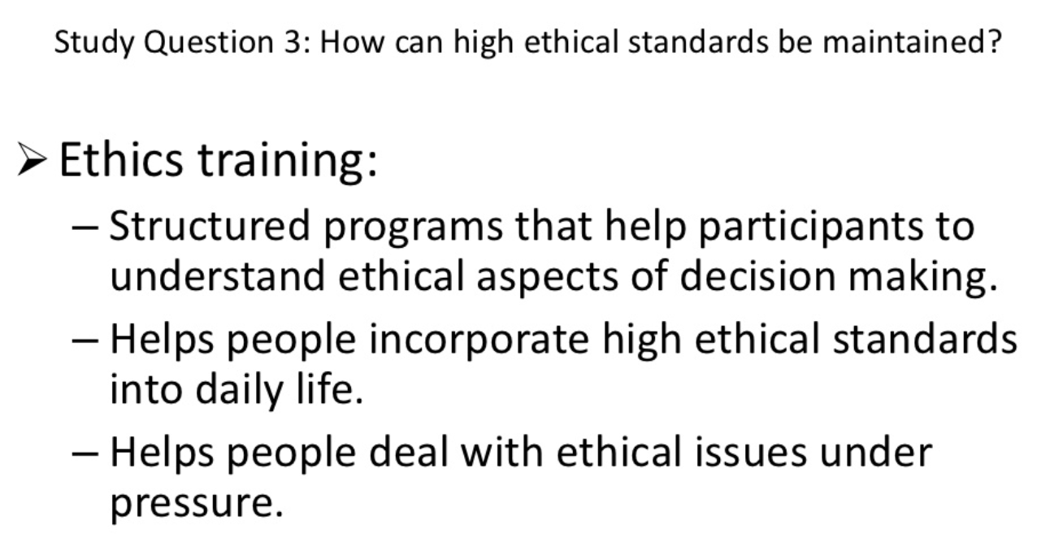

Slide 53


Slide 54


Slide 55


Slide 56


Slide 57


Slide 58


Slide 59


Slide 60


Slide 61


Slide 62


Slide 63


Slide 64


Slide 65


Slide 66


Slide 67


Slide 68


Slide 69


Slide 70


Slide 71


Slide 72


Slide 73

Standards of conduct

Slide 74


Slide 75


Slide 76


Slide 77


Slide 78


Slide 79


Slide 80


Slide 81


Slide 82


Slide 83


Slide 84

ethics

Slide 85

ethics

Slide 86


ethics

Slide 87

Ethics moral reasoning

Slide 88

Ethics moral reasoning

Slide 89
Kohlberg’s moral dilemmas
Hypothetical situations in which no choice is clearly and indisputably right.

Slide 90
Ethics carol Gilligan “In a different voice” 1977, 1981
Moral reasoning is delimited by “…two moral perspectives that Organize thinking in different ways.”
Men: define morality in terms of justice.
Women: less in terms of rights and more in terms of standards of responsibility and care.

Slide 91

The Heinz dilemma

Slide 92

Ethics
Kohlberg’s work

Slide 93

Ethics
Kohlberg’s work

Slide 94

Ethics Kohlberg’s work

Slide 95

Ethics carol Gilligan “In a different voice” 1977, 1981

Slide 96
1. All of the following are examples of ethics rationalizing unethical behavior except for which response?
If this were in the newspaper tomorrow we would be in trouble
What I'm doing is not really illegal
My behavior is in everyone's best interests
Nobody will ever find out what I’ve done
The organization will protect me

Slide 97
1. All of the following are examples of ethics rationalizing unethical behavior except for which response?
If this were in the newspaper tomorrow we would be in trouble
What I'm doing is not really illegal
My behavior is in everyone's best interests
Nobody will ever find out what I’ve done
The organization will protect me

Slide 98
2. To maintain high ethical standards, ethical role models are important. Please select an example of an unethical manager scenario.
Top managers serve as ethical role models
All managers can influence the ethical behavior of people who work for and with them
Excessive pressure can foster unethical behavior
Managers should be realistic in setting performance goals for others
Managers should select employees for promotion based on favors provided outside of company work scope

Slide 99
2. To maintain high ethical standards, ethical role models are important. Please select an example of an unethical manager scenario.
Top managers serve as ethical role models
All managers can influence the ethical behavior of people who work for and with them
Excessive pressure can foster unethical behavior
Managers should be realistic in setting performance goals for others
Managers should select employees for promotion based on favors provided outside of company work scope

Slide 100
3. When dealing with ethical dilemmas you should do one of the steps not ask which of the following questions:
How would I feel if my family found out about my decision?
How would I feel if the local newspaper printed my decision?
How can I get away with this action without getting caught?

Slide 101
3. When dealing with ethical dilemmas you should do one of the steps not ask which of the following questions:
How would I feel if my family found out about my decision?
How would I feel if the local newspaper printed my decision?
How can I get away with this action without getting caught?

Slide 102
4. The ethical relativism rule of “when in Rome, do as the Romans do” presents problems and it is ethically dangerous for company personnel to assume that local ethical standards are an adequate guide to ethical behavior except in which of the following circumstances?
Local standards condone kickbacks
Local standards have respect for the letter and spirit of the law and strive to respect all parties involved in the business in the most ethical manner possible

Slide 103
4. The ethical relativism rule of “when in Rome, do as the Romans do” presents problems and it is ethically dangerous for company personnel to assume that local ethical standards are an adequate guide to ethical behavior except in which of the following circumstances?
Local standards condone kickbacks
Local standards have respect for the letter and spirit of the law and strive to respect all parties involved in the business in the most ethical manner possible

Slide 104
5. Please select the organizational characteristics and mechanisms that guide and influence individual ethics in a negative fashion
Performance appraisal systems are set up to reward high ethical standards
Reward allocation systems are developed to reward the highest ethical standard
Behaviors (ethical) of managers is held to the highest ethical standard
An organization’s culture supporting ethical behavior
Intensity of the ethical issue are carefully weighed
Endorses systems that foster uncertainty and optimize ambiguity

Slide 105
5. Please select the organizational characteristics and mechanisms that guide and influence individual ethics in a negative fashion
Performance appraisal systems are set up to reward high ethical standards
Reward allocation systems are developed to reward the highest ethical standard
Behaviors (ethical) of managers is held to the highest ethical standard
An organization’s culture supporting ethical behavior
Intensity of the ethical issue are carefully weighed
Endorses systems that foster uncertainty and optimize ambiguity

