Slide 1

MODULE five:
PROFESSIONALISM,
ETHICS, AND BIOETHICS

Slide 2
MODULE five:
SECTION six:
Conflict of interest

Slide 3

Unit objective
To learn about conflicts of interest policies within medical practice

Slide 4
Conflict of interest
Description and examples of conflict of interest
Conflict of interest policies

Slide 5
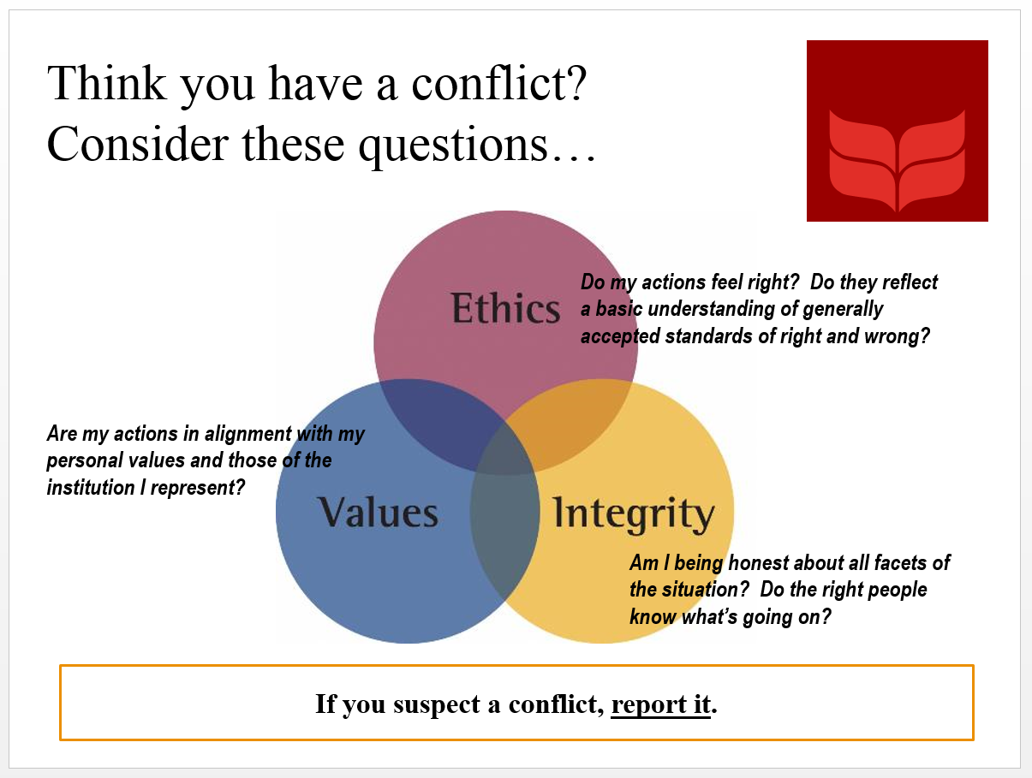


Slide 6
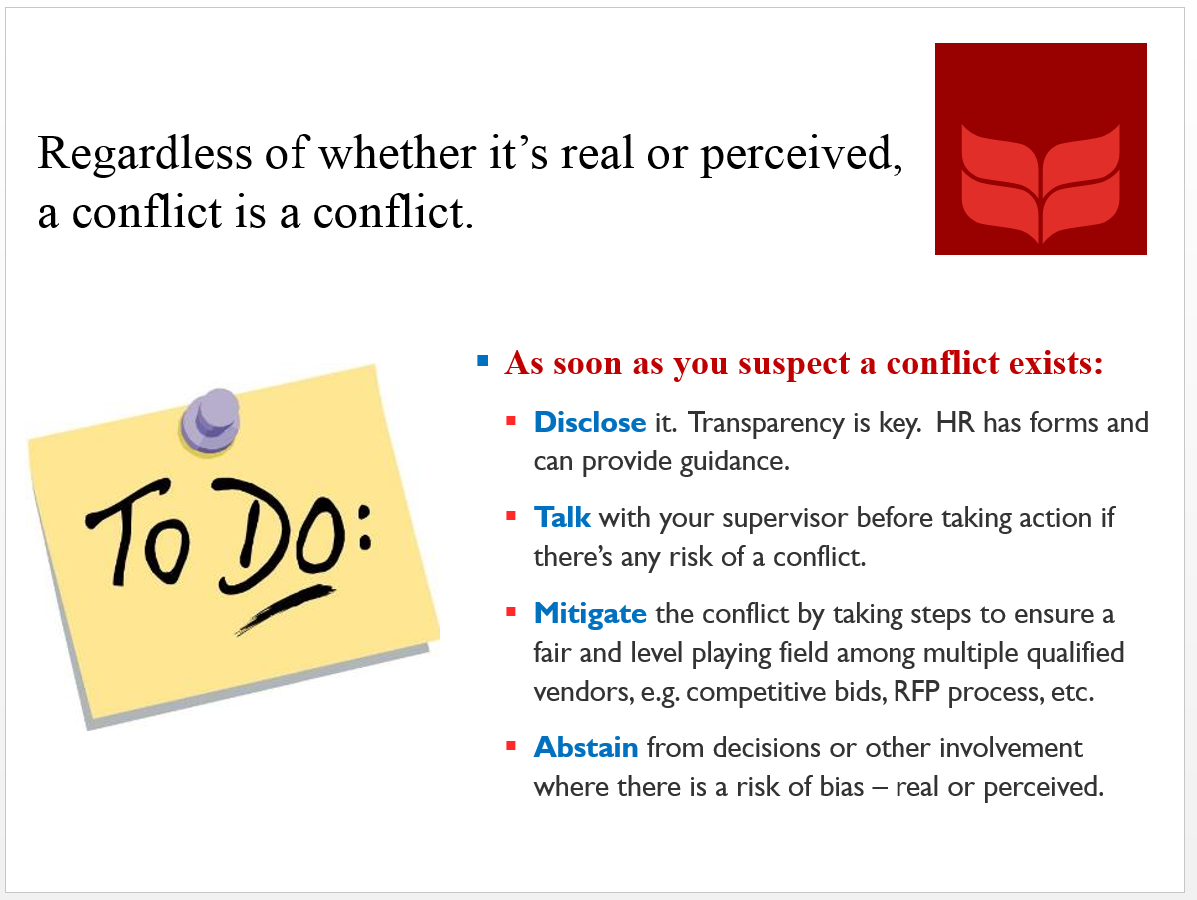

Slide 7

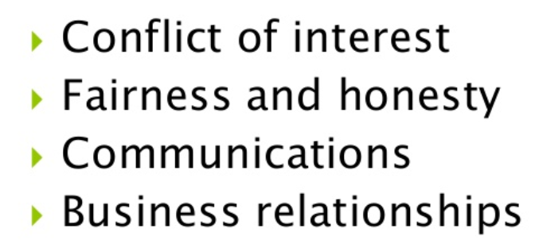
Ethical issue categories

Slide 8
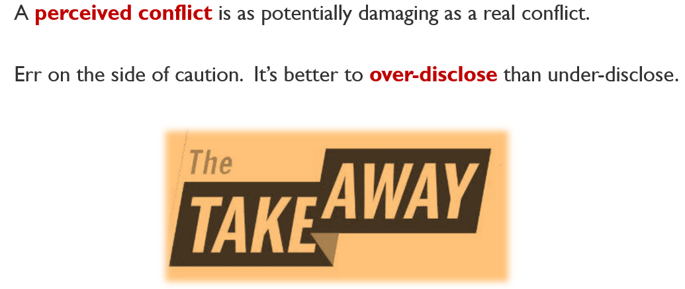

Slide 9
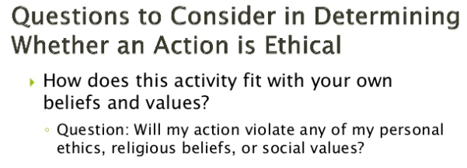
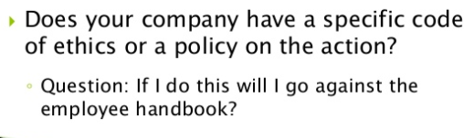

Slide 10
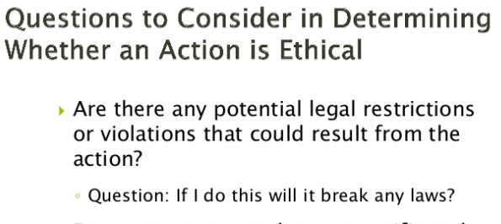

Slide 11
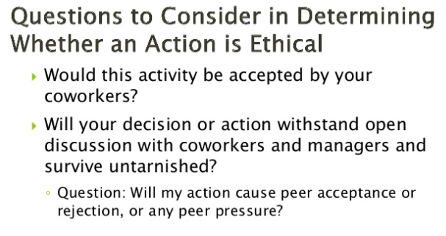

Slide 12

Conflict of interest
Conflict of interest occurs when a person must choose whether to advance their own personal interest or those of others

Slide 13
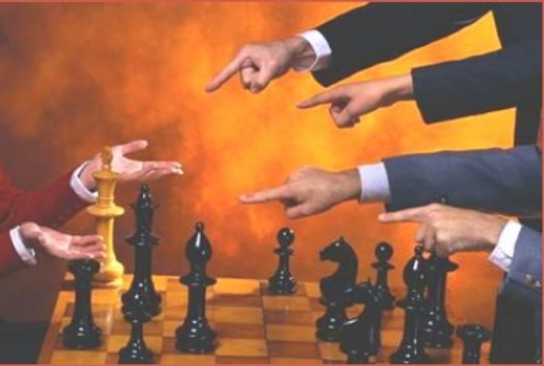
Fairness and honesty
The heart of business ethics
General values of decision
makers

Slide 14
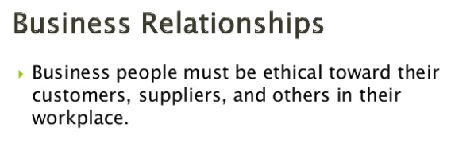

Slide 15
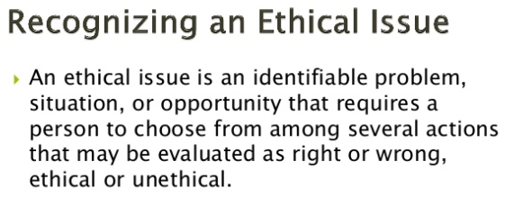

Slide 16
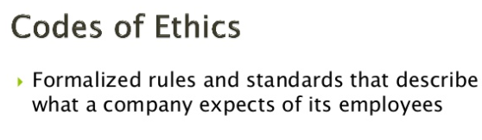

Slide 17
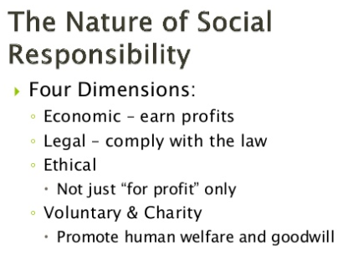

Slide 18
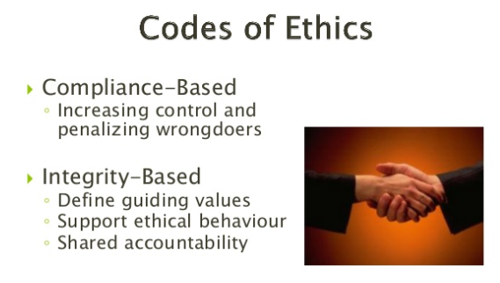

Slide 19
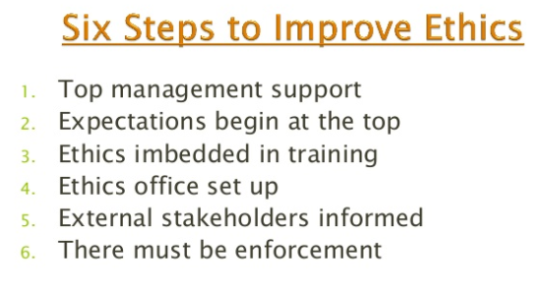

Slide 20
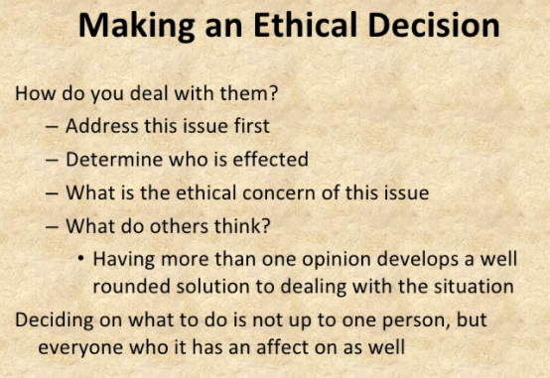

Slide 21
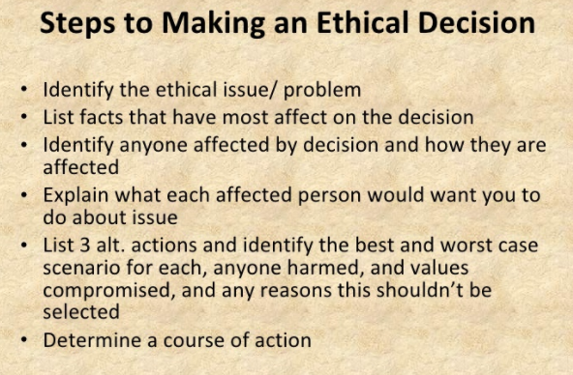

Slide 22
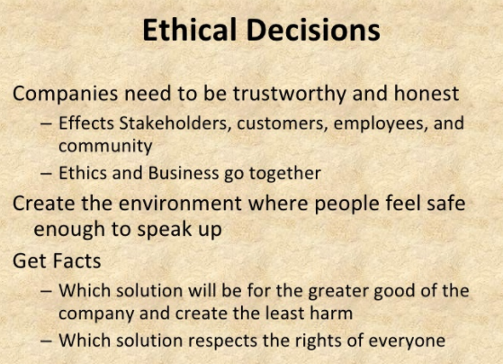

Slide 23
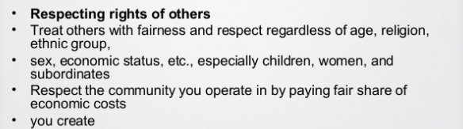

Slide 24
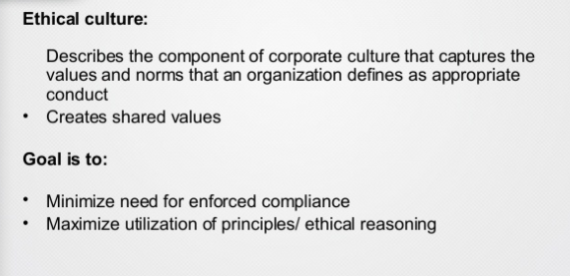

Slide 25
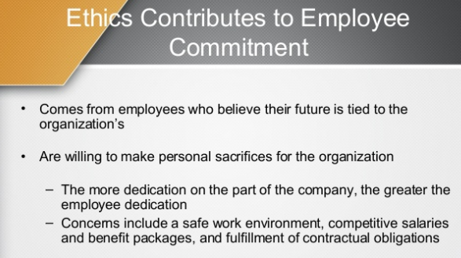

Slide 26
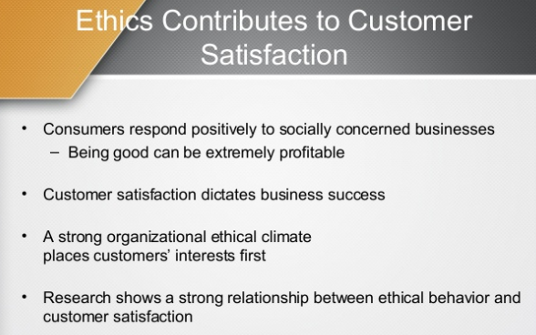

Slide 27
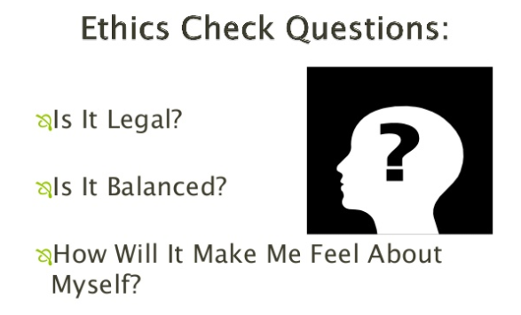

Slide 28
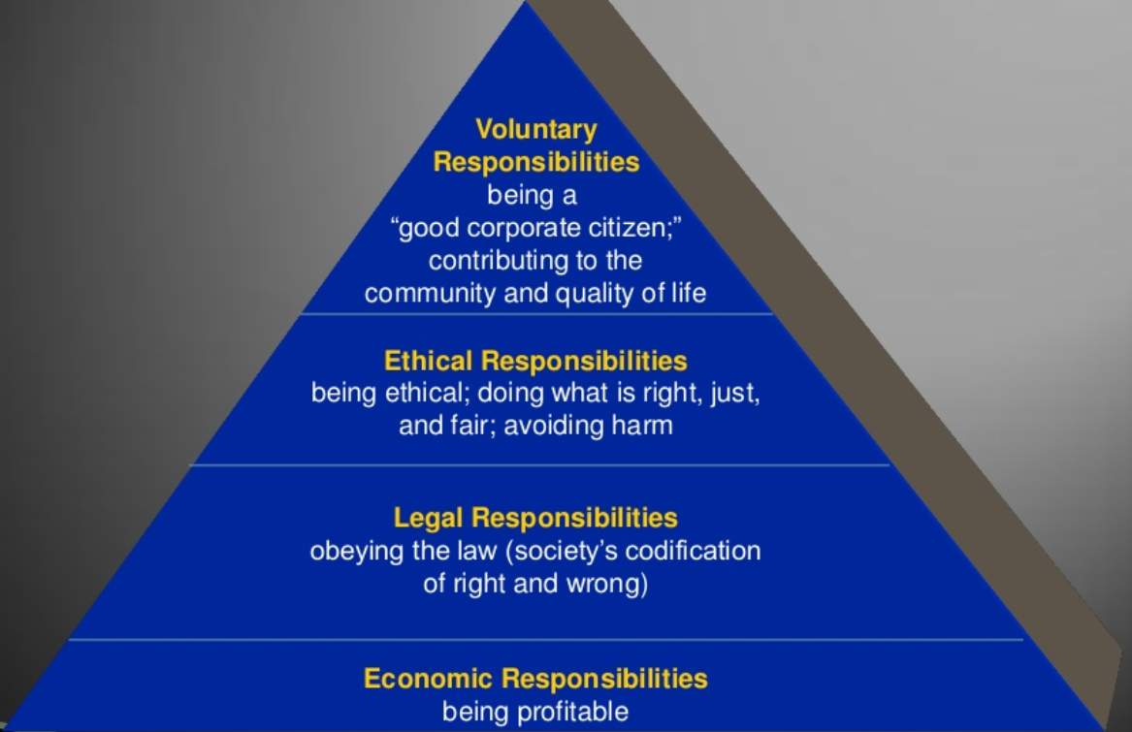

Slide 29

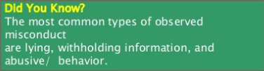


Slide 30
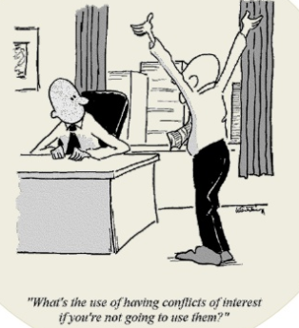
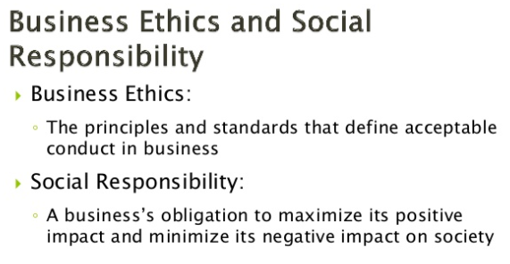
PREVENTION OF
CONFLICT
OF INTEREST

Slide 31
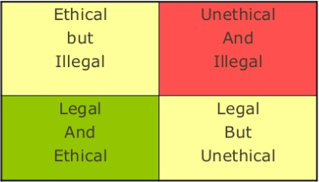
WHAT OPTION IS THE BEST CHOICE?

Slide 32
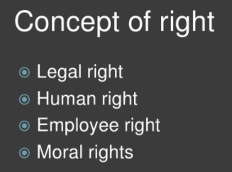
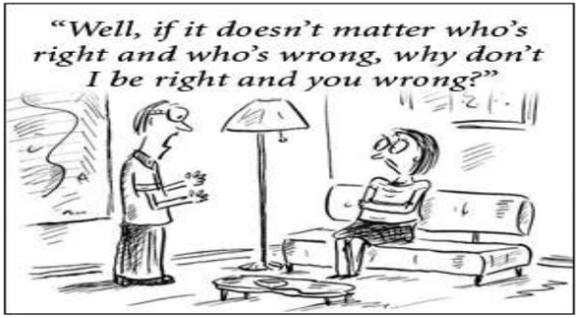
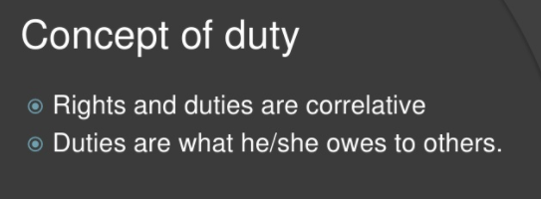

Slide 33
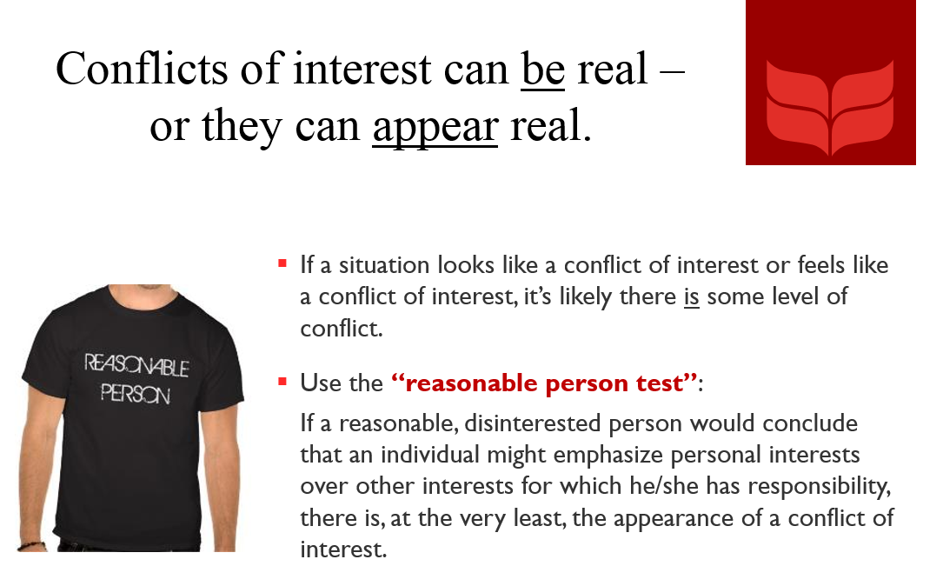
CONFLICT OF INTEREST????

Slide 34
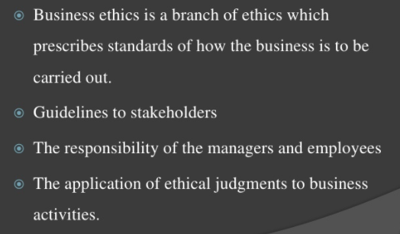

Slide 35
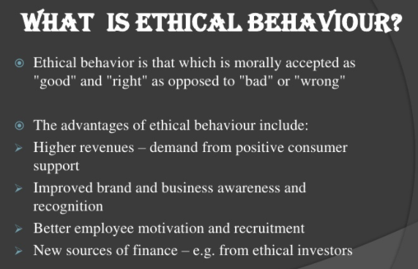

Slide 36
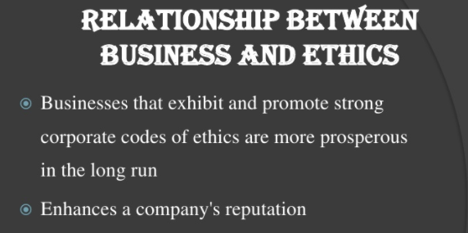

Slide 37
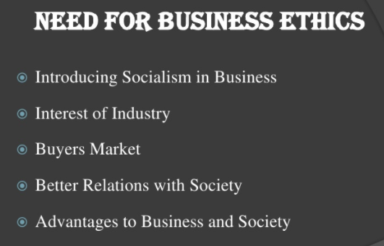

Slide 38
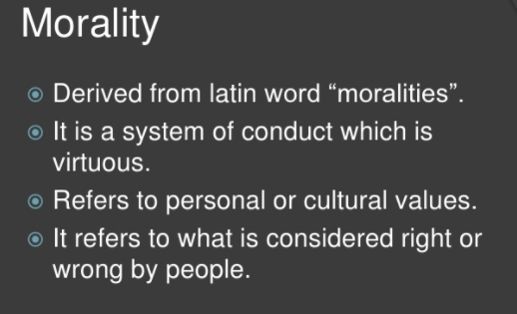

Slide 39
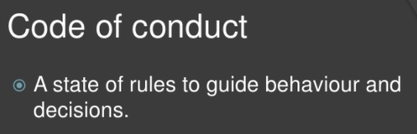
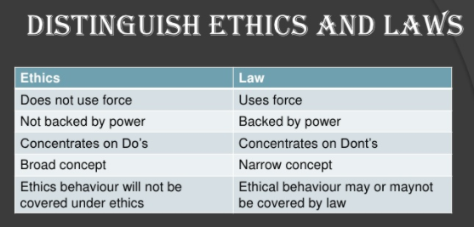
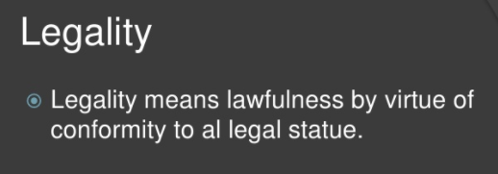

Slide 40
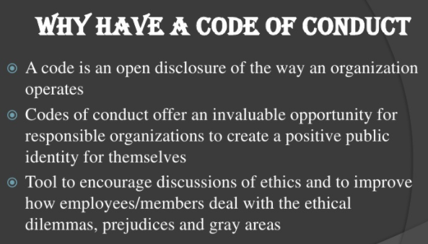

Slide 41
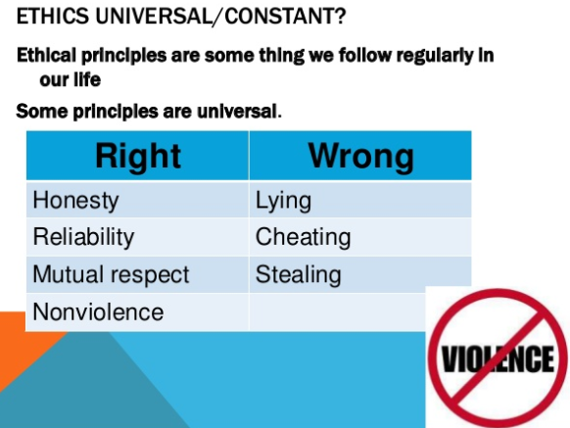

Slide 42
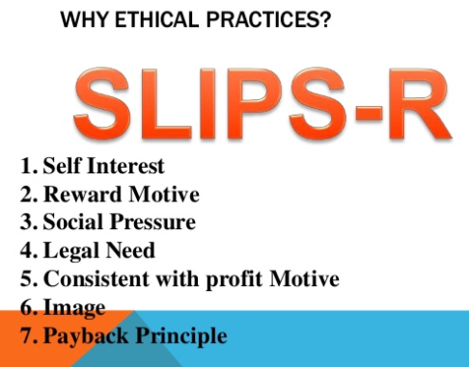

Slide 43
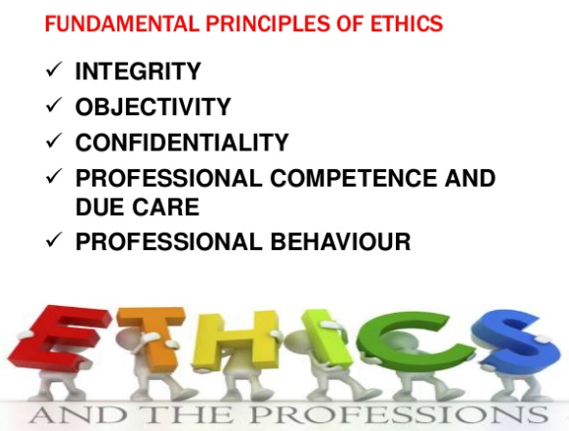

Slide 44
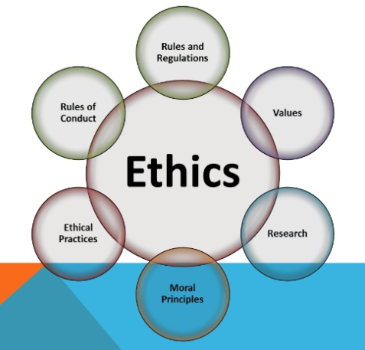

Slide 45
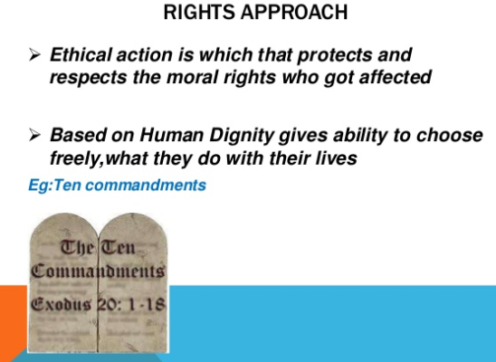

Slide 46
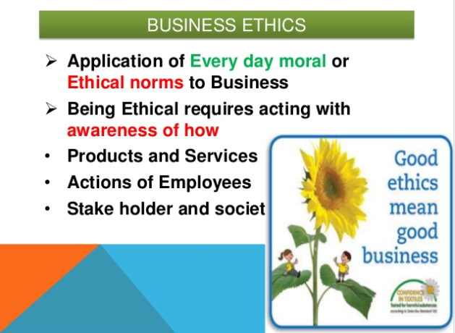

Slide 47
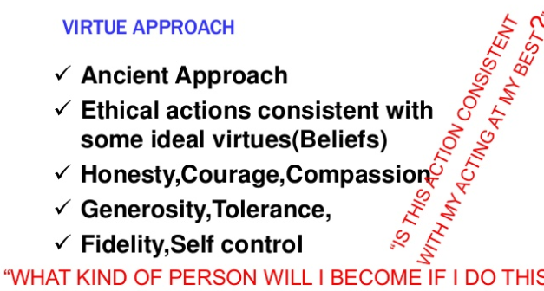

Slide 48
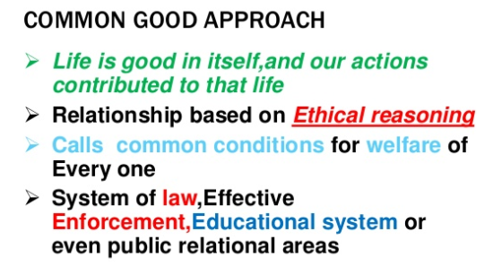

Slide 49
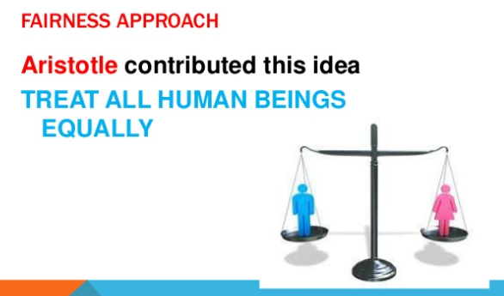

Slide 50


Slide 51


Slide 52


Slide 53


Slide 54


Slide 55


Slide 56


Slide 57

1. Research shows a strong relationship between ethical behavior and customer satisfaction.
a) True
b) False

Slide 58
1. Research shows a strong relationship between ethical behavior and customer satisfaction.
a) True
b) False

Slide 59
2. Which of the following is not one of Gandhi's 7 dangers to human virtue ?
Altruism without being mean
Wealth without work
Pleasure without conscience
Knowledge without character
Business without ethics
Science without humanity
Religion without sacrifice
Politics without principle

Slide 60
2. Which of the following is not one of Gandhi's 7 dangers to human virtue ?
Altruism without being mean
Wealth without work
Pleasure without conscience
Knowledge without character
Business without ethics
Science without humanity
Religion without sacrifice
Politics without principle

Slide 61
3. Under ethical leadership managers must provide a good role model by all of the following except which of the response below?
Being ethical and honest except when it would compromise company business
Admitting failure and not trying to cover it up
Communicating shared ethical values to employees through symbols, stories, and slogans.
Rewarding employees who behave ethically and punish those who do not
Protecting employees (whistleblowers) who bring to light unethical behaviors or raise ethical issues

Slide 62
3. Under ethical leadership managers must provide a good role model by all of the following except which of the response below?
Being ethical and honest except when it would compromise company business
Admitting failure and not trying to cover it up
Communicating shared ethical values to employees through symbols, stories, and slogans.
Rewarding employees who behave ethically and punish those who do not
Protecting employees (whistleblowers) who bring to light unethical behaviors or raise ethical issues

Slide 63
4. All of the following are benefits of following business ethics except for which of the following:
Strong team work and productivity
Guarantee that personnel policies are legal
Helps to detect violations easily
Help to manage values associated with quality management, strategic planning
Optimizes wealth, superior power and individual interests

Slide 64
4. All of the following are benefits of following business ethics except for which of the following:
Strong team work and productivity
Guarantee that personnel policies are legal
Helps to detect violations easily
Help to manage values associated with quality management, strategic planning
Optimizes wealth, superior power and individual interests

Slide 65
5. A perceived conflict is as potentially damaging as a real conflict.
True
False

Slide 66
5. A perceived conflict is as potentially damaging as a real conflict.
True
False

