Slide 1

MODULE six: pharmacology

Slide 2
MODULE six:
SECTION two:
Medication: Fda - and
not fda -approved

Slide 3
UNIT Objective
To become familiar with resources available to research the medications and other products that are approved and not approved by the FDA in the United States

Slide 4
Medication: fda-approved and not fda-approved
Emergency preparedness
Drug approvals
Drugs not approved
Vaccines, blood products and biologics

Slide 5
FDA LINKS FOR INFORMATION/RESOURCES
Emergency preparedness https://google2.fda.gov/search?q=Emergency+preparedness&client=FDAgov&site=FDAgov&lr=&proxystylesheet=FDAgov&requiredfields=-archive%3AYes&output=xml_no_dtd&getfields=*

Slide 6
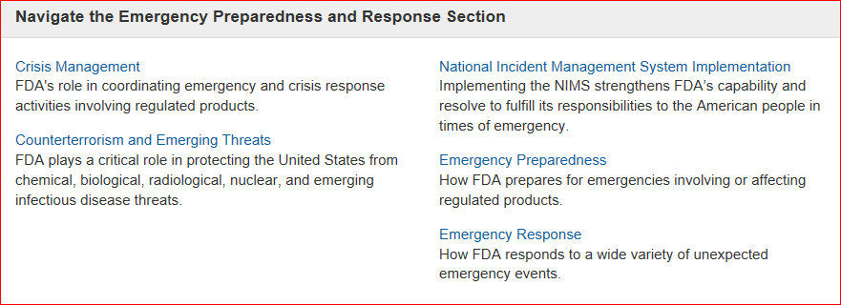
Emergency preparedness and response

Slide 7
FDA LINKS FOR INFORMATION/RESOURCES
Drug approvals
https://google2.fda.gov/search?q=Drug+approvals&client=FDAgov&site=FDAgov&lr=&proxystylesheet=FDAgov&requiredfields=-archive%3AYes&output=xml_no_dtd&getfields=*

Slide 8
Drug approvals from the fda
FDA Approvals.
It takes on average 12 years and over US $350 million to get a new drug from the laboratory onto the pharmacy shelf. Once a company develops a drug, it undergoes around three and a half years of laboratory testing, before an application is made to the U.S. Food and Drug Administration (FDA) to begin testing the drug in humans.

Slide 9
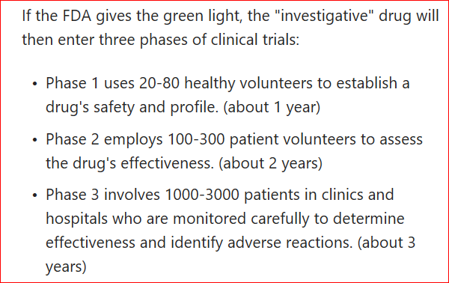
Drug approvals from the fda

Slide 10
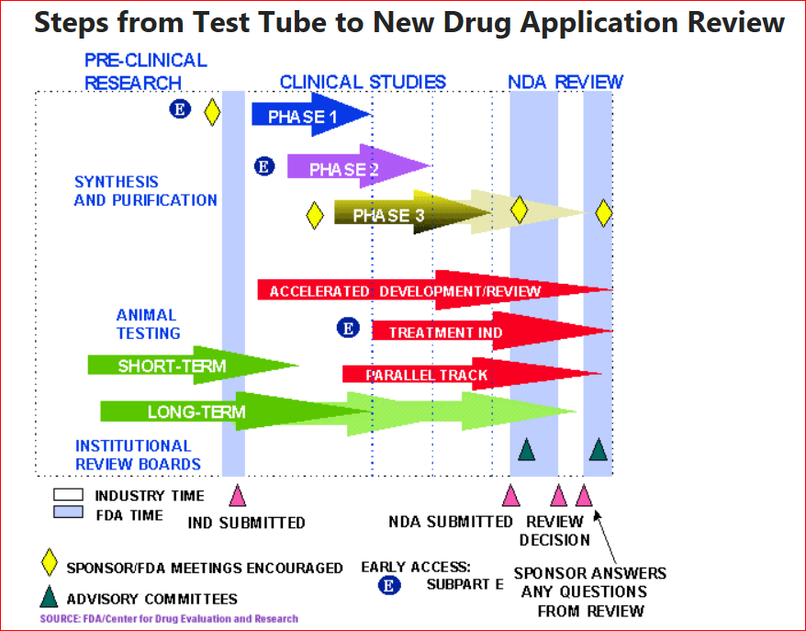
Drug approvals from the fda
Only one in 1000 of the compounds that enter laboratory testing will ever make it to human testing.

Slide 11
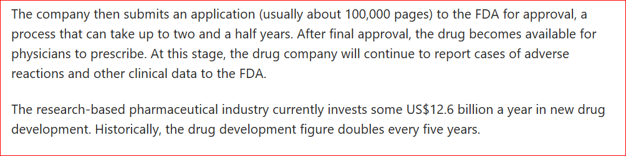
Drug approvals from the fda

Slide 12
FDA LINKS FOR INFORMATION/RESOURCES
Drugs not approved
https://google2.fda.gov/search?q=Drug+approvals&client=FDAgov&site=FDAgov&lr=&proxystylesheet=FDAgov&requiredfields=-archive%3AYes&output=xml_no_dtd&getfields=*

Slide 13
Drugs not approved by the fda
The original Federal Food and Drugs Act of 1906 brought drug regulation under federal law.
That Act prohibited the sale of adulterated or misbranded drugs, but did not require that drugs be approved by FDA.
In 1938, Congress required that new drugs be approved for safety.

Slide 14
Drugs not approved by the fda
Unapproved Drugs Initiative.
In June 2006, the FDA announced a new drug safety initiative to remove unapproved drugs from the market, including a final guidance entitled "Marketed Unapproved Drugs-Compliance Policy Guide (CPG)," outlining its enforcement policies aimed at efficiently and rationally bringing all such drugs into the approval process.

Slide 15
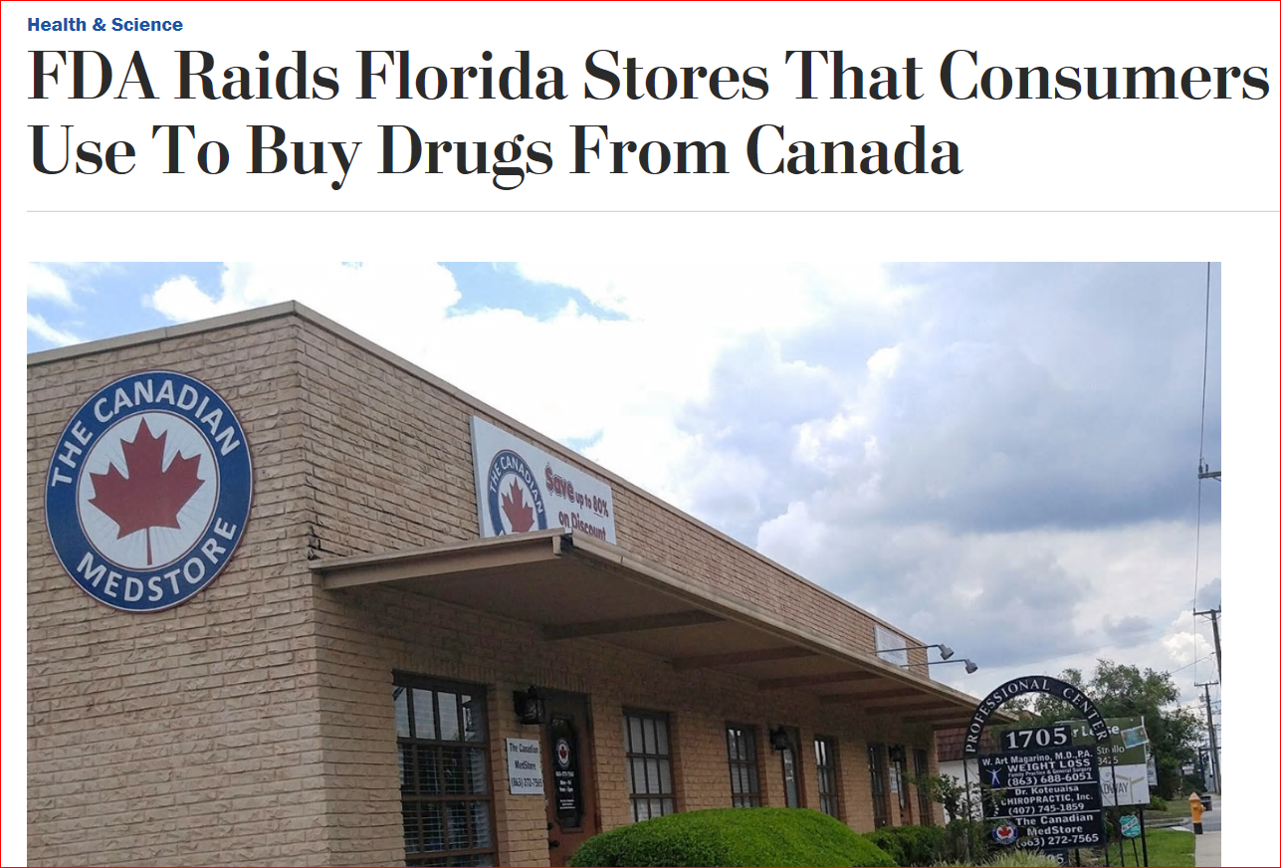
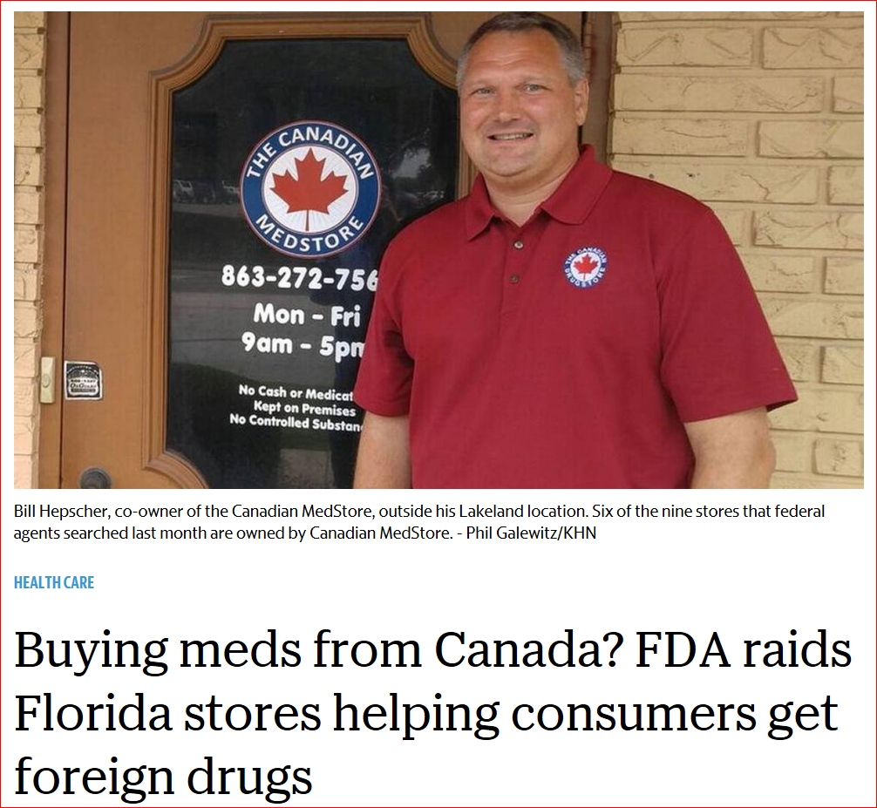
Drugs not approved by the fda

Slide 16
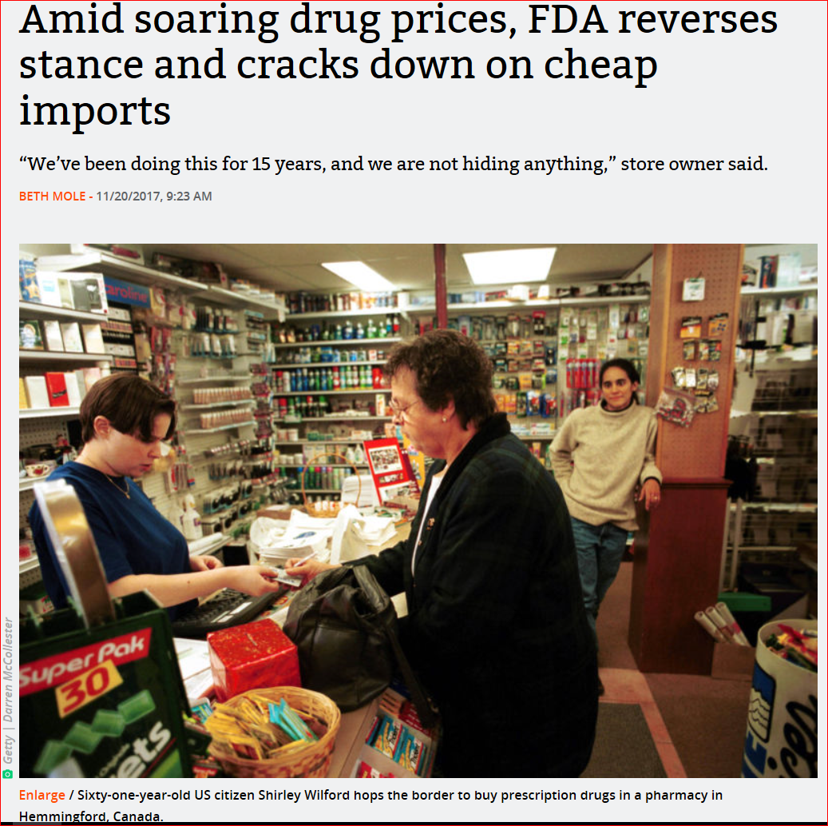
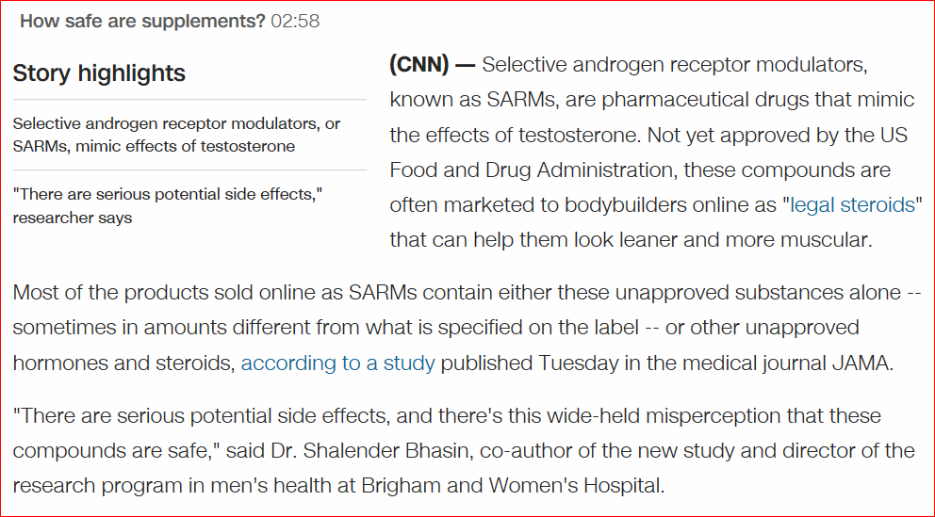
Drugs not approved by the fda

Slide 17
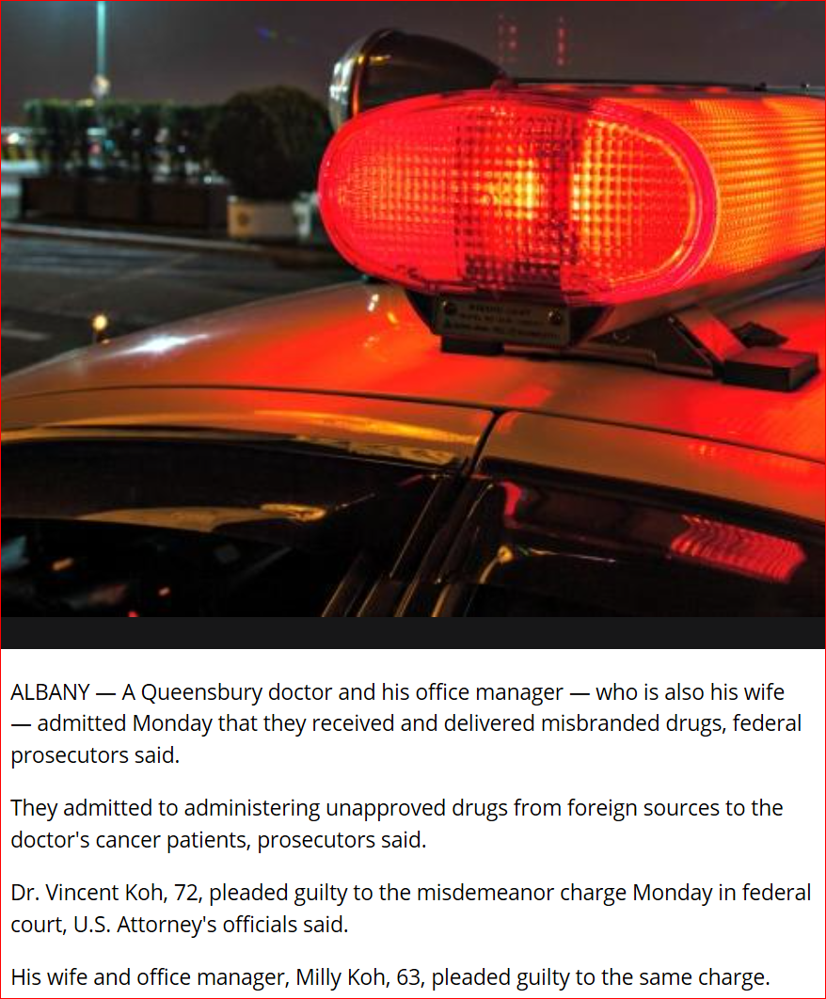
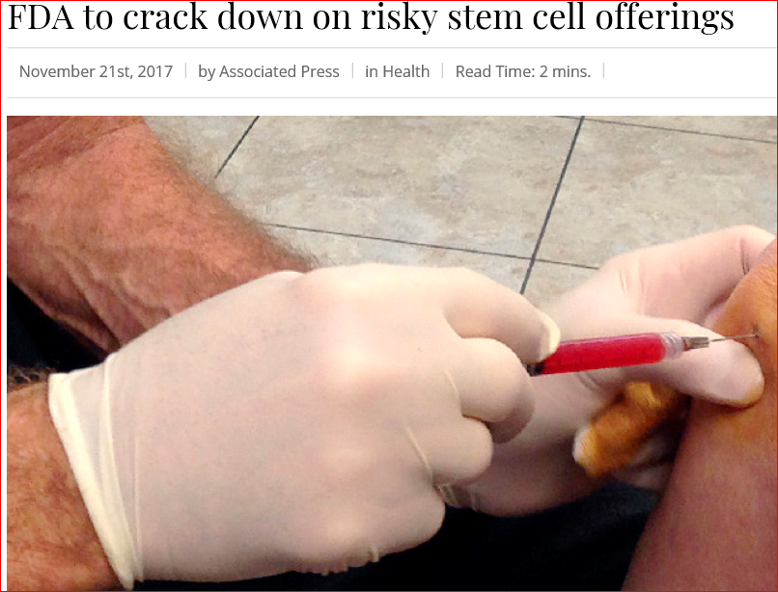
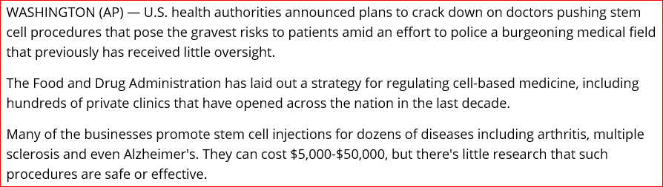
Drugs not approved by the fda

Slide 18
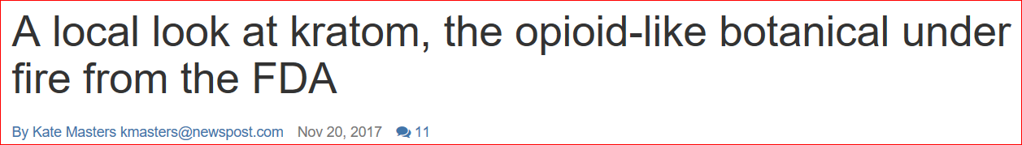
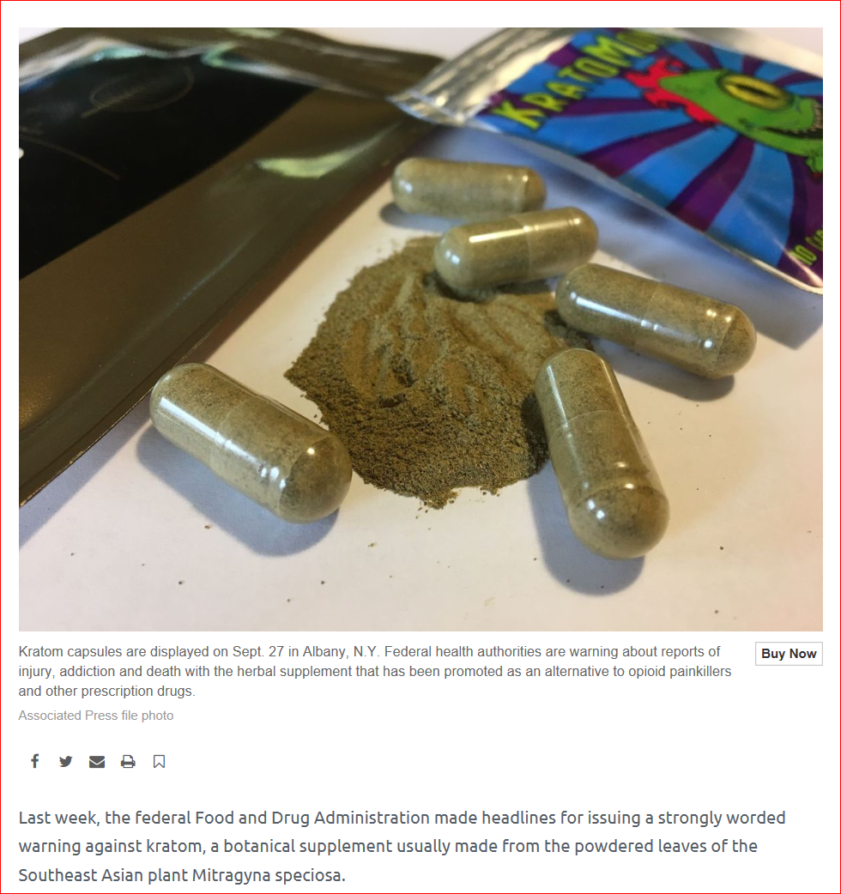
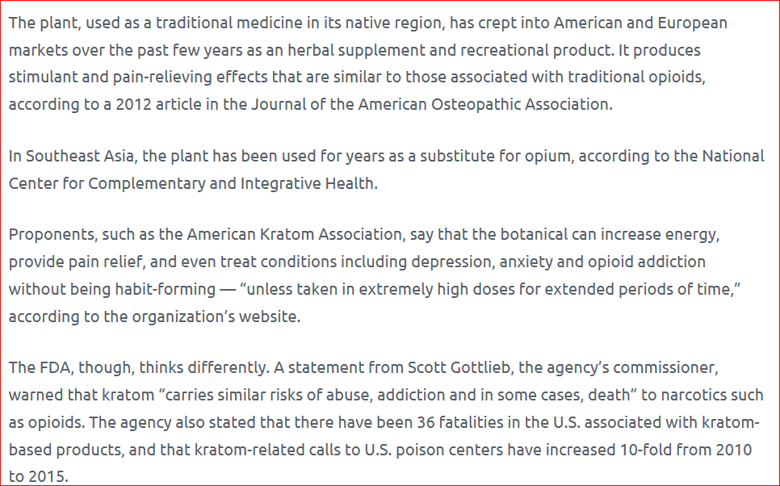
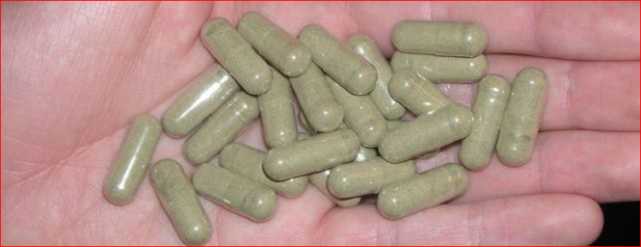
Drugs not approved by the fda

Slide 19
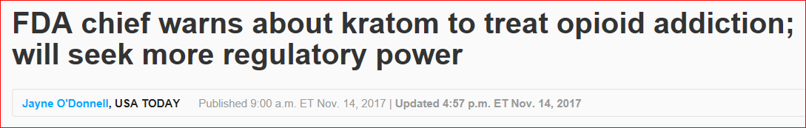
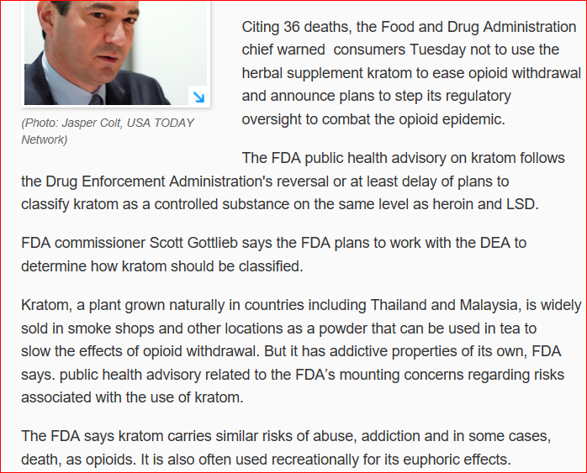
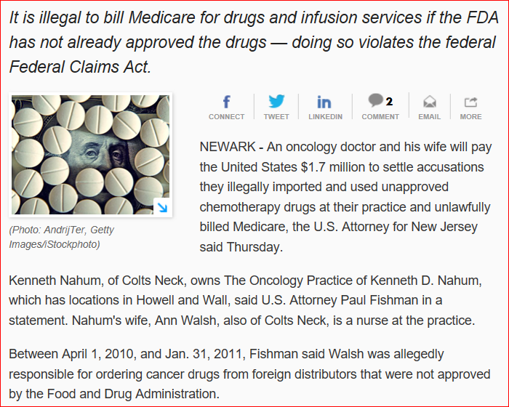
Take home message need fda approval to legally endorse medicines

Slide 20
FDA LINKS FOR INFORMATION/RESOURCES
Vaccines blood products and biologics
https://google2.fda.gov/search?q=Vaccines+blood+products+and+biologics&client=FDAgov&site=FDAgov&lr=&proxystylesheet=FDAgov&requiredfields=-archive%3AYes&output=xml_no_dtd&getfields=*

Slide 21
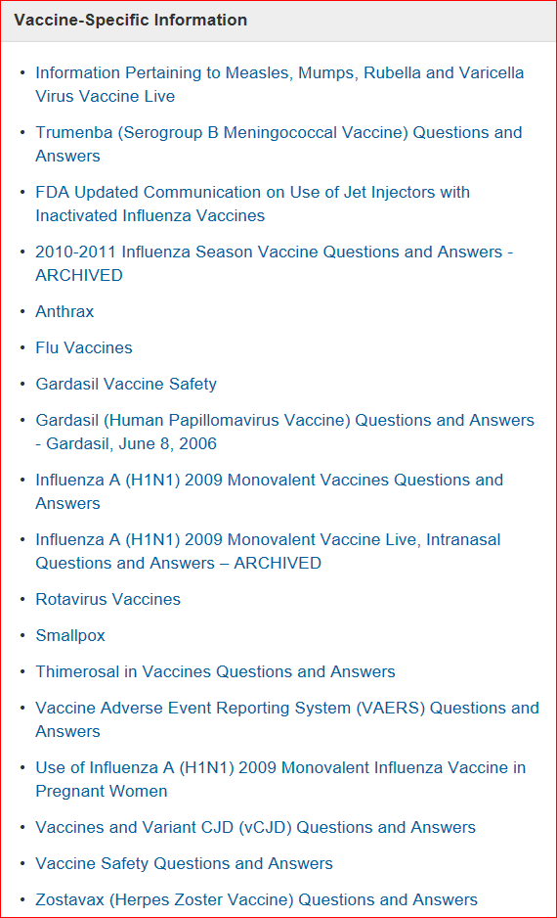
vaccines
The Center for Biologics Evaluation and Research (CBER) regulates vaccine products.
General and specific information about vaccines can be found in the following links.

Slide 22
Fda and blood related applications
FDA is responsible for ensuring the safety of the Nation's blood supply. While a blood supply with zero risk of transmitting infectious disease may not be possible, there are several measures taken by FDA to protect and enhance the safety of blood products.
The blood safety system established by FDA is dependent upon:
1) accurate and complete educational material for donors so that they can assess their risk;
2) sensitive communication of the donor screening questions;
3) donor understanding and honesty;
4) quality controlled infectious marker testing procedures; and
5) appropriate handling and distribution of blood and blood products for patient use. Because of the improvements in donor screening procedures and the use of a variety of new tests in the last few years, the blood supply is safer from infectious diseases than it has been at any other time.

Slide 23
biologics
Biological products include a wide range of products such as vaccines, blood and blood components, allergenics, somatic cells, gene therapy, tissues, and recombinant therapeutic proteins. The Center for Biologics Evaluation and Research (CBER) is responsible for ensuring the safety and efficacy of the biological products.
An Investigational New Drug Application (IND) is a request for authorization from the Food and Drug Administration (FDA) to administer an investigational drug or biological product to humans. Such authorization must be secured prior to interstate shipment and administration of any new drug or biological product that is not the subject of an approved New Drug Application or Biologics/Product License Application. In rare instances a physician may request an Emergency Use IND for a patient. Contact information for Emergency Use IND Requests:
For investigational biological products regulated by CBER, call 240-402-7800
For all other investigational drugs, call 301-796-3400 or 1-855-543-3784
After working hours, call FDA's Office of Emergency Operations at 301-796-8240

Slide 24
Take home message this fda information should be used for background information or as a potential future resource
QUESTION TO FOLLOW
This information from the FDA would rarely be utilized in your clinical practice, but is presented for background information and as a resource just in case some particular technical question comes up, in which case, these links may be a valuable resource.

Slide 25
1. If the FDA gives the green light to an investigative trial the drug will enter three phases. How many patients are usually involved in phase three trials and over what time course?
80 patients over one year
200 patients over two years
1000-3000 patients over three years

Slide 26
1. If the FDA gives the green light to an investigative trial the drug will enter three phases. How many patients are usually involved in phase three trials and over what time course?
80 patients over one year
200 patients over two years
1000-3000 patients over three years

Slide 27
2. What is the average cost to get a new drug approved by the FDA
Less than one million
One-three million
Three to ten million
Over two hundred million

Slide 28
2. What is the average cost to get a new drug approved by the FDA
Less than one million
One-three million
Three to ten million
Over two hundred million

Slide 29
3. How long does it take for a new drug to be approved by the FDA on average?
Two years
Five years
Over ten years

Slide 30
3. How long does it take for a new drug to be approved by the FDA on average?
Two years
Five years
Over ten years

Slide 31
4. The FDA is not involved in which of the following activities:
Political verbal threats
Chemical threats
Biological threats
Radiologic threats
Nuclear threats
Infectious disease threats

Slide 32
4. The FDA is not involved in which of the following activities:
Political verbal threats
Chemical threats
Biological threats
Radiologic threats
Nuclear threats
Infectious disease threats

Slide 33
5. Only one in 1,000 of the components that enter laboratory testing will ever make it to human testing
True
False

Slide 34
5. Only one in 1,000 of the components that enter laboratory testing will ever make it to human testing
True
False

Slide 35
6. The FDA is involved in enforcement of unapproved drugs or dietary supplements.
True
False

Slide 36
6. The FDA is involved in enforcement of unapproved drugs or dietary supplements.
True
False

