Slide 1

MODULE six: pharmacology

Slide 2
MODULE six:
SECTION three:
pharmacologic
protocols for
common diseases

Slide 3

UNIT OBJECTIVE
To learn the pharmacological protocols for the most common diseases in the State of California

Slide 4
pharmacologic protocols for common diseases
Ischemic heart disease
Renal failure
Dyslipidemia
Arterial hypertension
Diabetes mellitus
Infectious disease
Others

Slide 5
FDA LINKS FOR INFORMATION/RESOURCES
Ischemic heart disease
https://google2.fda.gov/search?q=Vaccines+blood+products+and+biologics&client=FDAgov&site=FDAgov&lr=&proxystylesheet=FDAgov&requiredfields=-archive%3AYes&output=xml_no_dtd&getfields=*

Slide 6

Pharmacological protocols ischemic heart disease
PHARMACOLOGIC TREATMENT OF STABLE CORONARY HEART DISEASE — A clinical diagnosis of angina has an extremely high predictive accuracy for the presence of coronary artery disease. The reverse may not be true in the chronic dialysis population, especially those with concurrent diabetes. Many dialysis patients with underlying CHD may not have angina. The management of stable angina involves pharmacologic intervention to prevent or minimize ischemia, reduction of risk factors for CHD, and revascularization in some patients.
The following sections will review the pharmacologic management of stable CHD.
Up to Date

Slide 7
Antianginal therapy three classes of medication
ANTIANGINAL THERAPY — There are three classes of anti-ischemic drugs commonly used in the management of angina pectoris: beta blockers, calcium channel blockers, and nitrates. Often, a combination of these agents is used for control of symptoms.
Up to Date

Slide 8
Antianginal beta blockers
Beta blockers —Up to Date agrees with the 2012 American College of Cardiology Foundation/American Heart Association/American College of Physicians/American Association for Thoracic Surgery/Preventive Cardiovascular Nurses Association/Society for Cardiovascular Angiography and Interventions/Society of Thoracic Surgeons guideline for the diagnosis and management of patients with stable ischemic heart disease (SIHD), which recommends beta blockers as first line therapy to reduce anginal episodes and improve exercise tolerance.
Up to Date

Slide 9
Antianginal beta blockers
Beta blockers relieve anginal symptoms by reducing both heart rate and contractility. Since beta blockers reduce the heart rate-blood pressure product during exercise, the onset of angina or the ischemic threshold during exercise is delayed or avoided. All types of beta blockers appear to be equally effective in exertional angina.
Up to Date

Slide 10
Antianginal beta blockers
In addition, beta blockers are the only antianginal drugs proven to prevent re-infarction and to improve survival in patients who have sustained a myocardial infarction.
Beta blockers should not be used in patients with vasospastic or variant (Prinzmetal) angina. In such patients, they are ineffective and may increase the tendency to induce coronary vasospasm from unopposed alpha-receptor activity.
Up to Date

Slide 11
Antianginal with failed monotherapy
Angina that persists with monotherapy — Although beta blockers and calcium channel blockers have similar efficacy in the management of stable angina, we prefer starting with the former. This is based principally on the observation of survival benefit with beta blockers in patients with prior myocardial infarction or impaired left ventricular systolic function. Such a benefit has not been observed with calcium channel blockers.
Addition of a second drug (usually either a calcium channel blocker or a nitrate) is indicated if angina persists with monotherapy. The efficacy of combination therapy was illustrated in a study that randomly assigned 397 patients to four weeks of monotherapy with felodipine or metoprolol or a combination of felodipine and metoprolol. Combination therapy was more effective for increasing exercise duration and better tolerated than monotherapy.
Although a third class of antianginal drug can be added in patients who have limiting angina on two agents, many physicians would consider coronary angiography in such patients and revascularization if indicated.
Up to Date

Slide 12
Antianginal calcium channel blockers
Calcium channel blockers — In general, calcium channel blockers are used in combination with beta blockers when initial treatment with beta blockers is not successful or as a substitute for a beta blocker when beta blockers are contraindicated or cause side effects.
Calcium channel blockers improve anginal symptomatology by causing coronary and peripheral vasodilatation and reducing contractility. The degree to which these changes occur varies with the type of calcium channel blocker given.
Up to Date

Slide 13
Antianginal calcium channel blockers
Long-acting diltiazem or verapamil or a second generation dihydropyridine (amlodipine or felodipine) are preferred. Short-acting dihydropyridines, especially nifedipine, should be avoided unless used in conjunction with a beta blocker in the management of SIHD because of evidence of an increase in mortality after a myocardial infarction and an increase in acute myocardial infarction in hypertensive patients.
Up to Date

Slide 14
Antianginal nitrates
Nitrates — Nitrates, usually in the form of a sublingual preparation, are the first-line therapy for the treatment of acute anginal symptoms. Patients should be instructed to use them at the onset of angina. They may also be recommended for the prophylaxis of anginal episodes.
The use of nitrates as well as their side effects, including nitrate tolerance, is discussed elsewhere.
Up to Date

Slide 15
Preventive antianginal therapy ischemic heart disease
PREVENTIVE THERAPIES — The optimal management of patients with stable angina requires more than antianginal therapy.
Therapies aimed at preventing cardiovascular events are central to long-term care.
Up to Date agrees with the 2012 American College of Cardiology Foundation/American Heart Association/American College of Physicians/American Association for Thoracic Surgery/Preventive Cardiovascular Nurses Association/Society for Cardiovascular Angiography and Interventions/Society of Thoracic Surgeons guideline for the diagnosis and management of patients with stable ischemic heart disease (SIHD), which recommends that all patients with SIHD should receive education and counseling about issues such as medication compliance, control of risk factors, and regular exercise.
Up to Date

Slide 16
Preventive antianginal therapy antiplatelet therapy
Antiplatelet therapy — In the absence of a contraindication, all patients should be treated with aspirin. We believe that doses of aspirin from 75 to 325 mg daily are associated with the best risk/benefit ratio. Some experts prefer to stay within the 75 to 162 mg per day range.
Patients who have a gastrointestinal bleed on low-dose aspirin should, after the episode is controlled, be treated with aspirin (81 mg/day) plus a proton pump inhibitor. Clopidogrel is an alternative in patients who are allergic to aspirin.
Up to Date

Slide 17
Preventive antianginal therapy
>angiotensin converting enzyme
>angiotensin receptor blockers
ACE inhibitors or ARBs — The potential role for Angiotensin converting enzyme (ACE) inhibitors and angiotensin receptor blockers (ARBs) as preventive therapy in patients with stable ischemic heart disease or those at high risk is discussed elsewhere.
There are conflicting data regarding whether ACE inhibitors reduce exercise-induced ischemia. We believe the evidence is not convincing and do not recommend ACE inhibitors (or angiotensin-receptor blockers) to improve angina.
These agents have been shown to be of benefit in subsets of patients with SIHD, such as those with hypertension, diabetes mellitus, a left ventricular ejection fraction of less than 40 percent, or chronic kidney disease. Their use in these patients is discussed elsewhere.
Up to Date

Slide 18
Ischemic heart disease pharmacological treatment summary questions to follow
SUMMARY — The principal goals in the care of patients with stable ischemic heart disease, also referred to as coronary heart disease, are to secure the diagnosis, relieve symptoms, and to prevent future cardiac events such as acute coronary syndromes, revascularization, or death. The following is a summary of the strategy to achieve these goals:
●Patients in whom the diagnosis of ischemic heart disease is suspected but not previously secured should undergo a complete history and physical examination and receive a 12 lead electrocardiogram. Most patients should undergo some form of stress testing to either secure the diagnosis or evaluate its severity.
●Beta blockers are preferred for initial treatment of symptoms. Calcium channel blockers and nitrates are used routinely to relieve symptoms when initial treatment with beta blockers is not successful or if beta blockers are contraindicated or cause side effects. Ranolazine has been used successfully to improve anginal symptoms in patients who have not been successfully treated with nitrates, beta blockers, or calcium channel blockers. Regular exercise may reduce anginal symptoms.
●Therapies known to reduce the incidence of adverse cardiovascular events such as death and myocardial infarction should be started. These include aspirin, statin, smoking cessation, control of blood pressure and excess weight, and optimal management of diabetes. Regular exercise and stress reduction are also recommended.
●The optimal management of these patients also requires periodic evaluation of the patient's clinical status, using the history, physical examination, and on occasion the electrocardiogram.
Up to Date

Slide 19
FDA LINKS FOR INFORMATION/RESOURCES
Renal failure
REFERRAL TO NEPHROLOGISTS — Patients with Chronic Kidney Disease should be referred to a nephrologist when the estimated glomerular filtration rate (eGFR) is <30 mL/min/1.73 m² in order to discuss and potentially plan for renal replacement therapy, or sooner depending on other comorbidities. There is less consensus about referral for patients with higher eGFRs.
https://google2.fda.gov/search?q=Vaccines+blood+products+and+biologics&client=FDAgov&site=FDAgov&lr=&proxystylesheet=FDAgov&requiredfields=-archive%3AYes&output=xml_no_dtd&getfields=*
Up to Date

Slide 20
Renal failure prevention by not using nephrotoxic drugs
Administration of nephrotoxic drugs — The administration of drugs or diagnostic agents that adversely affect renal function is a frequent cause of worsening renal function. Among patients with CKD, common offenders include aminoglycoside antibiotics (particularly with unadjusted doses), NSAIDs, and radiographic contrast material. The administration of such drugs should therefore be avoided or used with caution in patients with underlying CKD.
Certain drugs also interfere with either creatinine secretion or the assay used to measure the serum creatinine. These include cimetidine, trimethoprim, cefoxitin, and flucytosine. In these settings, there will be no change in the true GFR; the clinical clue that this may have occurred is the absence of a concurrent elevation in the blood urea nitrogen (BUN).
Up to Date

Slide 21
Renal failure prevention by use of ace inhibitors or arb agents
Principal targets for renal protection — Therapy to slow the rate of progression in patients with CKD, independent of treatment of the underlying disease, is centered on attaining the blood pressure goal and, in patients with proteinuric disease, attaining the proteinuria goal. Blood pressure goals for nondiabetic and diabetic patients are discussed in detail elsewhere.
In addition to blood pressure control, specific goals related to a reduction in urinary protein excretion have been formulated to slow the rate of progression of proteinuric CKD. Proteinuria goals and the use of ACE inhibitors or angiotensin receptor blocker (ARB) agents in patients with proteinuric CKD are discussed elsewhere.
Up to Date

Slide 22
Renal failure hyperkalemia management review
Hyperkalemia — The ability to maintain potassium excretion at near-normal levels is generally maintained in patients with renal disease as long as both aldosterone secretion and distal flow are maintained. Thus, hyperkalemia generally develops in the patient who is oliguric or who has an additional problem such as a high-potassium diet, increased tissue breakdown, or hypoaldosteronism (due in some cases to the administration of an ACE inhibitor or ARB). Impaired cell uptake of potassium also may contribute to the development of hyperkalemia in advanced CKD.
Hyperkalemia due to ACE inhibitor or ARB therapy is most likely to occur in patients in whom the serum potassium concentration is elevated or in the high-normal range prior to therapy.
There are several measures that may help prevent hyperkalemia in patients with CKD. These include ingestion of a low-potassium diet (eg, <40 to 70 mEq/day [1500 to 2700 mg/day]) and avoiding, if possible, the use of drugs that raise the serum potassium concentration, such as NSAIDs. Nonselective beta blockers may result in a postprandial rise in the serum potassium concentration but do not cause persistent hyperkalemia.
Up to Date

Slide 23
Renal failure metabolic acidosis management review
Metabolic acidosis — There is an increasing tendency to retain hydrogen ions among patients with Chronic Kidney Disease. This can lead to a progressive metabolic acidosis, with the serum bicarbonate concentration tending to stabilize between 12 and 20 mEq/L and rarely falling below 10 mEq/L . Metabolic acidosis may be treated with bicarbonate supplementation. Bicarbonate supplementation requires careful monitoring of volume status because bicarbonate is administered with sodium.
Up to Date

Slide 24
Renal failure mineral and bone disorders review
Mineral and bone disorders (MBD) — Hyperphosphatemia is a common complication of CKD. A tendency toward phosphate retention begins early in renal disease due to the reduction in the filtered phosphate load. Although this problem is initially mild, with hyperphosphatemia being a relatively late event, phosphate retention is intimately related to the common development of secondary hyperparathyroidism.
From the viewpoint of calcium and phosphate balance, the hypersecretion of parathyroid hormone (PTH) is initially appropriate since PTH can correct both hyperphosphatemia and hypocalcemia. As a result, phosphate balance and a normal serum phosphate concentration are generally maintained in patients with an eGFR of >30 mL/min/1.73 m² . The price paid is secondary hyperparathyroidism and the development of renal osteodystrophy.
.
Up to Date

Slide 25
Renal failure mineral and bone disorders review
Mineral and bone disorders (MBD) — Dietary phosphate restriction and oral phosphate binders may limit the development of secondary hyperparathyroidism in patients with CKD . There is no consensus about whether calcium-containing or noncalcium-containing phosphate binders should be used in CKD patients. All are effective in lowering phosphate. However, there is controversy over whether calcium-containing and noncalcium-containing binders are equally safe for long-term use. Some studies have suggested that noncalcium-containing phosphate binders decrease mortality among CKD patients. A number of studies have compared individual agents, with conflicting results.
.
Up to Date

Slide 26
Renal failure mineral and bone disorders review
The increased intake of calcium may enhance coronary arterial calcification in this setting. This is thought by some to be associated with the development of coronary atherosclerosis and may be related to the presence and/or consequences of elevated serum phosphorus, calcium, and PTH levels. Detailed discussions of these issues, including specific KDIGO guidelines, can be found separately. The KDIGO clinical practice guidelines for MBD in CKD, as well as other KDIGO guidelines, can be accessed through the KDIGO website.
Changes in bone structure are an almost universal finding with progressive CKD. The principal types of renal bone disease include osteitis fibrosa, osteomalacia, and adynamic bone disease.
Osteitis fibrosa results from secondary hyperparathyroidism. Although an exact relationship is unclear, PTH levels appear to increase when renal function decreases beyond a certain threshold value, with evidence suggesting that hormone levels begin to rise when the creatinine clearance is <40 to 70 mL/min.
Up to Date

Slide 27
Renal failure mineral and bone disorders review
To help guide preventive measures, PTH levels should therefore be assessed among such patients as hormonal abnormalities are one of the earliest markers of abnormal mineral and bone metabolism with progressive CKD. Prevention and/or treatment of osteitis fibrosis in patients with predialysis CKD are primarily based upon dietary phosphate restriction, the administration of oral phosphate binders, and the administration of calcitriol (or vitamin D analogs) to directly suppress the secretion of PTH.
Circulating calcitriol (1,25-dihydroxyvitamin D), the most active metabolite of vitamin D, is principally synthesized in the kidney. Circulating calcitriol levels begin to fall when the eGFR is <40 mL/min/1.73 m² and are typically markedly reduced in patients with ESRD. In addition to the loss of functioning renal mass, calcitriol production is also reduced by phosphate retention.
Up to Date

Slide 28
Renal failure mineral and bone disorders review
Calcimimetics are agents that allosterically increase the sensitivity of the calcium-sensing receptor in the parathyroid gland to calcium. The calcium-sensing receptor is the principal factor regulating parathyroid gland PTH secretion and hyperplasia. The separate target offers the potential to suppress PTH secretion by mechanisms complementary and potentially synergistic with vitamin D analogs that target the vitamin D receptor. Although not approved for patients with CKD not yet on dialysis, cinacalcet, the only currently available calcimimetic, is an emerging option in the treatment of secondary hyperparathyroidism in predialysis patients with CKD.
Target serum levels for PTH, as well as the approach to the management of this issue, are discussed separately.
Up to Date

Slide 29
Renal failure mineral and bone disorders review
Osteitis fibrosa results from secondary hyperparathyroidism. Although an exact relationship is unclear, PTH levels appear to increase when renal function decreases beyond a certain threshold value, with evidence suggesting that hormone levels begin to rise when the creatinine clearance is <40 to 70 mL/min.
To help guide preventive measures, PTH levels should therefore be assessed among such patients as hormonal abnormalities are one of the earliest markers of abnormal mineral and bone metabolism with progressive CKD. Prevention and/or treatment of osteitis fibrosis in patients with predialysis CKD are primarily based upon dietary phosphate restriction, the administration of oral phosphate binders, and the administration of calcitriol (or vitamin D analogs) to directly suppress the secretion of PTH.
Circulating calcitriol (1,25-dihydroxyvitamin D), the most active metabolite of vitamin D, is principally synthesized in the kidney. Circulating calcitriol levels begin to fall when the eGFR is <40 mL/min/1.73 m² and are typically markedly reduced in patients with ESRD. In addition to the loss of functioning renal mass, calcitriol production is also reduced by phosphate retention.
Up to Date

Slide 30
Renal failure mineral and bone disorders review
Calcimimetics are agents that allosterically increase the sensitivity of the calcium-sensing receptor in the parathyroid gland to calcium. The calcium-sensing receptor is the principal factor regulating parathyroid gland PTH secretion and hyperplasia. The separate target offers the potential to suppress PTH secretion by mechanisms complementary and potentially synergistic with vitamin D analogs that target the vitamin D receptor. Although not approved for patients with CKD not yet on dialysis, cinacalcet, the only currently available calcimimetic, is an emerging option in the treatment of secondary hyperparathyroidism in predialysis patients with CKD.
Target serum levels for PTH, as well as the approach to the management of this issue, are discussed separately in Up to Date.
Up to Date

Slide 31
Renal failure hypertension as a comorbid condition
Hypertension — Hypertension is present in approximately 80 to 85 percent of patients with CKD. Treating hypertension can both slow the progression of proteinuric CKD and reduce the rate of cardiovascular complications.
The desired degree of blood pressure control can usually be safely achieved with combined therapy, which usually begins with an ACE inhibitor or ARB (also given to slow disease progression, as noted above) and a diuretic. Issues surrounding the treatment of hypertension among patients with diabetic nephropathy are discussed in detail separately.
Up to Date

Slide 32
Renal failure hypertension as a comorbid condition
Volume expansion, often in the absence of overt edema, contributes to the elevation in blood pressure in most forms of CKD. As a result, before other medications are added, the dose of diuretics should be increased until the blood pressure is normalized or the patient has attained "dry weight," which, in the presence of persistent hypertension, is defined as the weight at which further fluid loss will lead either to symptoms (fatigue, orthostatic hypotension) or to decreased tissue perfusion, as evidenced by an otherwise unexplained elevation in the BUN and plasma creatinine concentration.
A loop diuretic is recommended for the treatment of hypertension and edema in patients with CKD. The thiazide diuretics in conventional dosing become less effective as monotherapy when the eGFR falls below 20 mL/min/1.73 m². They do, however, produce an additive effect when administered with a loop diuretic for refractory edema.
The optimal blood pressure in hypertensive patients with CKD is uncertain. The rate of loss of eGFR appears to be more rapid when the mean arterial pressure remains at or above 100 mmHg (which reflects a diastolic pressure of 80 to 85 mmHg in the absence of systolic hypertension). To slow progression of CKD, the optimal blood pressure depends in part on the degree of proteinuria.
Up to Date

Slide 33
Renal failure hypertension as a comorbid condition
Up to Date recommendations for blood pressure goals in patients with proteinuric CKD are discussed elsewhere.
Up to Date recommendations for blood pressure goals in patients with nonproteinuric CKD are discussed elsewhere.
Blood pressure targets should be individualized based on such factors as age, comorbidities, presence of underlying cardiovascular disease, risk of progression of kidney disease, and patient tolerance to treatment.
Up to Date

Slide 34
Renal failure anemia as a comorbid condition
Anemia — The anemia of CKD is, in most patients, normocytic and normochromic and is due primarily to reduced production of erythropoietin by the kidney (a presumed reflection of the reduction in functioning renal mass) and to shortened red cell survival. Anemia is a common feature in many patients with CKD who do not yet require dialysis, with anemia becoming increasingly common as eGFRs decline below 60 mL/min/1.73 m², particularly among diabetics. As an example, based upon over 15,000 participants in the National Health and Nutrition Examination Survey (NHANES), the prevalence of anemia (hemoglobin [Hb] <12 g/dL in men and <11 g/dLin women) increased from 1 percent at an eGFR of 60 mL/min/1.73 m² to 9 percent at an eGFR of 30 mL/min/1.73 m² and to 33 to 67 percent at an eGFR of 15 mL/min/1.73 m².
Up to Date

Slide 35
Renal failure anemia as a comorbid condition
The 2012 KDIGO guidelines suggest that, among patients who do not have anemia, the Hgb concentration should be checked when it is clinically indicated and at least yearly among all patients with stage 3 CKD (ie, eGFR 30 to 59 mL/min/1.73 m²), at least every six months among patients with stage 4 to 5 CKD (ie, eGFR ≤29 mL/min/1.73 m²), and at least every three months among patients who are on dialysis. Among patients who are known to have anemia and are not treated with erythropoiesis-stimulating agents (ESAs), Hgb should be checked when it is clinically indicated and at least every three months among patients with stage 3 to 5 (ie, eGFR ≤59 mL/min/1.73 m²) who are not on hemodialysis (including patients who are on peritoneal dialysis); patients on hemodialysis should be monitored monthly.
As stated in the 2012 KDIGO guidelines, the evaluation of anemia in those with CKD should begin when the Hb level is <12 g/dL in females and <13 g/dL in adult males [9,33]. These values are consistent with the World Health Organization (WHO) definition of anemia. If untreated, the Hgb level of patients with advanced CKD normally stabilizes at approximately 8 g/dL in the absence of bleeding or hemolysis.
Up to Date

Slide 36
Renal failure anemia as a comorbid condition
The anemia observed with CKD is largely diagnosed by excluding nonrenal causes of anemia in the patient with a suitably decreased eGFR. The evaluation of patients should therefore include red blood cell indices, absolute reticulocyte count, serum iron, total iron-binding capacity, percent transferrin saturation, serum ferritin, white blood cell count and differential, platelet count, B12 and folate concentrations if the mean corpuscular volume (MCV) is increased, and testing for blood in stool. This work-up should be performed prior to administering ESA therapy.
Evaluating the adequacy of iron stores in patients with CKD and issues relating to iron therapy in such patients are presented elsewhere.
Although primarily used in patients with ESRD, ESAs such as erythropoietin and darbepoetin alfa also correct the anemia in those with CKD who do not yet require dialysis.
Up to Date

Slide 37
Renal failure dyslipidemia as a comorbid condition
Dyslipidemia — Abnormal lipid metabolism is common in patients with renal disease. The primary finding in CKD is hypertriglyceridemia, with the total cholesterol concentration usually being normal (perhaps due in part to malnutrition in some patients). All CKD patients should be evaluated and potentially treated for dyslipidemia.
Follow-up testing may be performed among patients who are age <50 years who are not already on a statin in order to assess cardiovascular risk and the need for statin therapy. Follow-up evaluation may also be performed to assess adherence to statin treatment, if there is a change in the modality of renal replacement therapy, or if there is concern about new secondary causes of dyslipidemia (such as nephrotic syndrome, hypothyroidism, diabetes, excessive alcohol consumption, or liver disease). In the patient with hypercholesterolemia, a statin with or without ezetimibe can effectively and safely lower the plasma cholesterol concentration to or near acceptable levels.
Up to Date
Questions to follow

Slide 38
FDA LINKS FOR INFORMATION/RESOURCES
Dyslipidemia
https://google2.fda.gov/search?q=Dyslipidemia&client=FDAgov&site=FDAgov&lr=&proxystylesheet=FDAgov&requiredfields=-archive%3AYes&output=xml_no_dtd&getfields=+*

Slide 39
Dyslipidemia review of statin therapy
Lipid altering agents encompass several classes of drugs that include hydroxymethylglutaryl (HMG) CoA reductase inhibitors or statins, fibric acid derivatives, bile acid sequestrants, cholesterol absorption inhibitors, and nicotinic acid. These drugs differ with respect to mechanism of action and to the degree and type of lipid lowering. Thus, the indications for a particular drug are influenced by the underlying lipid abnormality. Conventional dosing regimens and common adverse reactions are described in the following table and the range of expected changes in the lipid profile are listed in the next table.
Lipid lowering, at least with statins, is beneficial for primary and secondary prevention of coronary heart disease in patients with dyslipidemias.
The mechanisms of benefit seen with lipid lowering are incompletely understood. Regression of atherosclerosis occurs in only a minority of patients; furthermore, clinical benefits of lipid lowering are seen in as little as six months, before significant regression could occur. Thus, other factors must contribute; these include plaque stabilization, reversal of endothelial dysfunction, and decreased thrombogenicity.
Up to Date

Slide 40
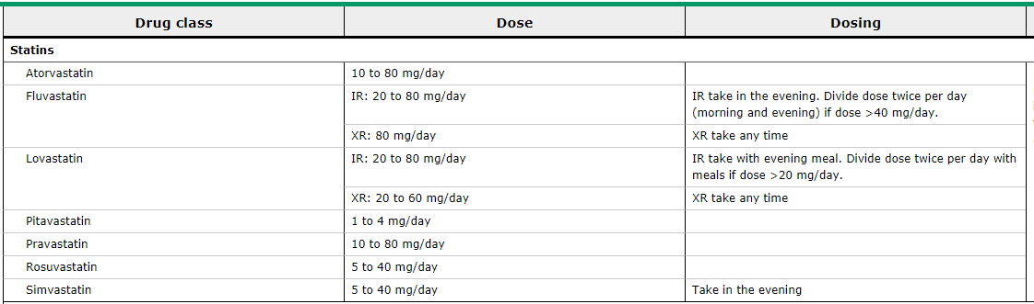
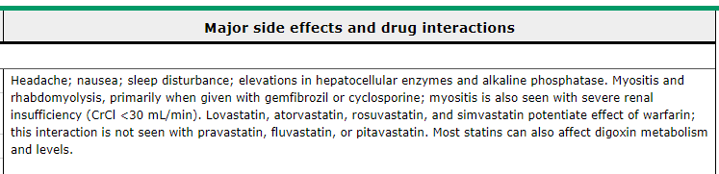
Dyslipidemia review of statin therapy
Up to Date

Slide 41
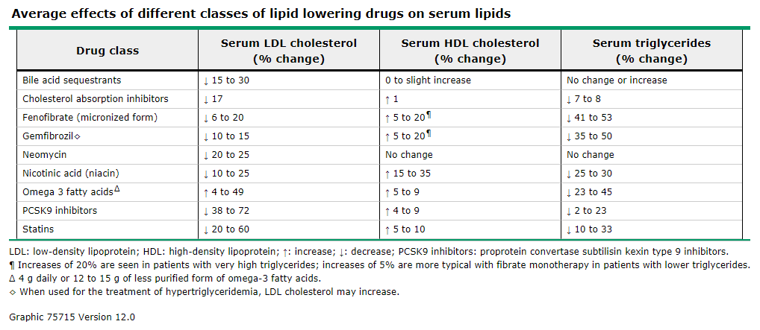
Dyslipidemia review of statin therapy
Up to Date

Slide 42
Dyslipidemia review of statin therapy
Question: What are the factors thought responsible for the beneficial effect of statin therapy to prevent vascular complications?
ANSWER: 1. plaque stabilization
2. reversal of endothelial dysfunction
3. decrease thombogenicity

Slide 43
FDA LINKS FOR INFORMATION/RESOURCES
Arterial hypertension
https://google2.fda.gov/search?q=Arterial+Hypertension&client=FDAgov&site=FDAgov&lr=&proxystylesheet=FDAgov&requiredfields=-archive%3AYes&output=xml_no_dtd&getfields=*

Slide 44
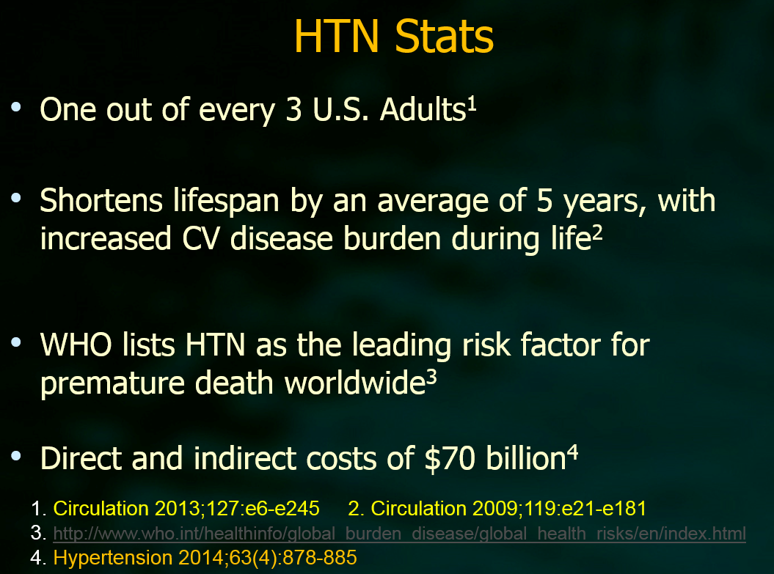

Slide 45
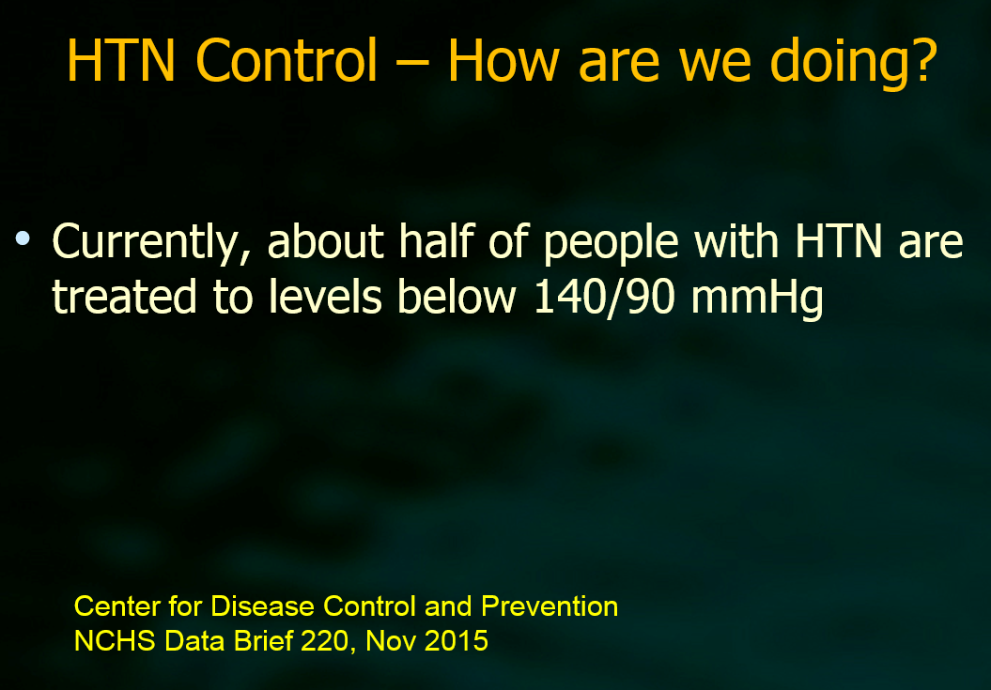

Slide 46
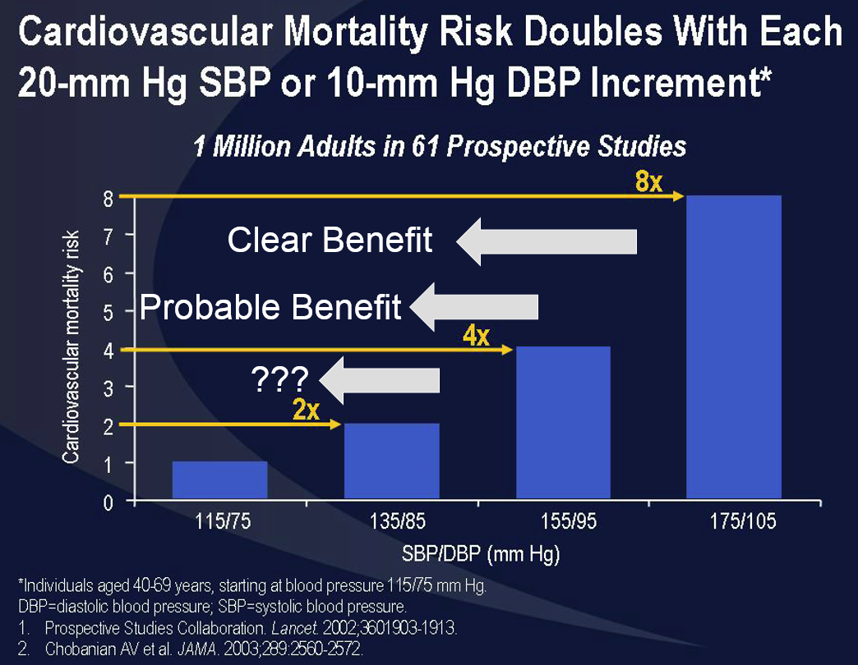

Slide 47
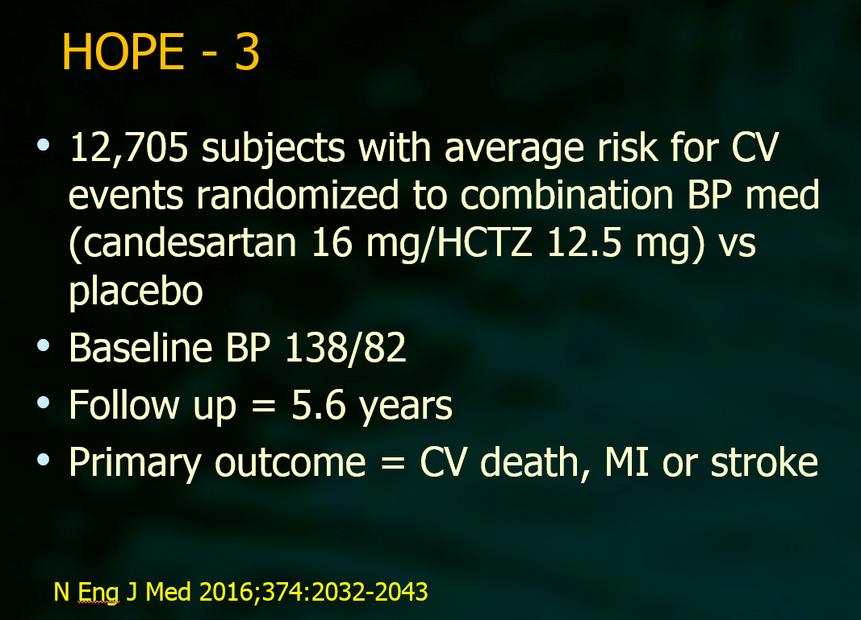

Slide 48
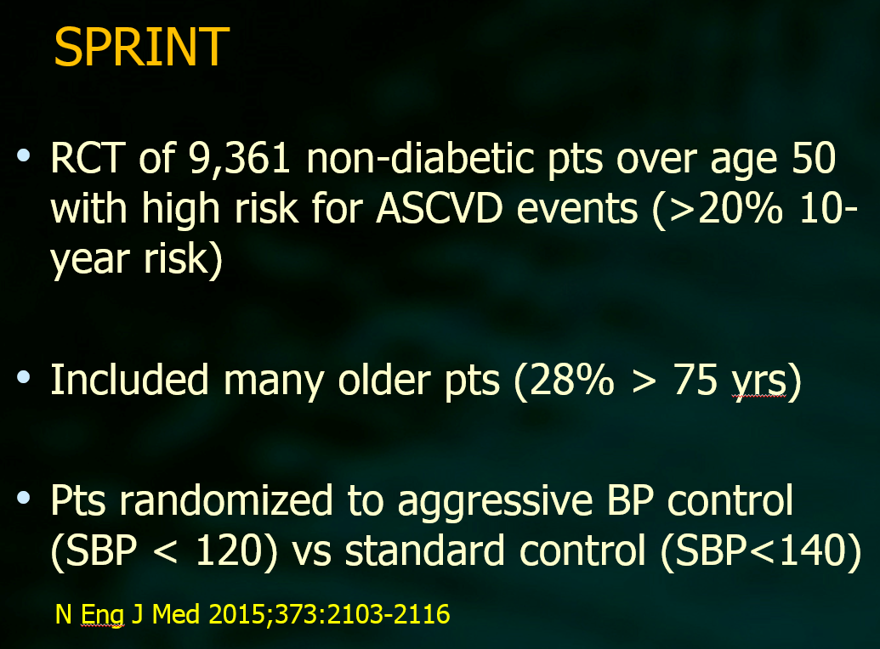

Slide 49
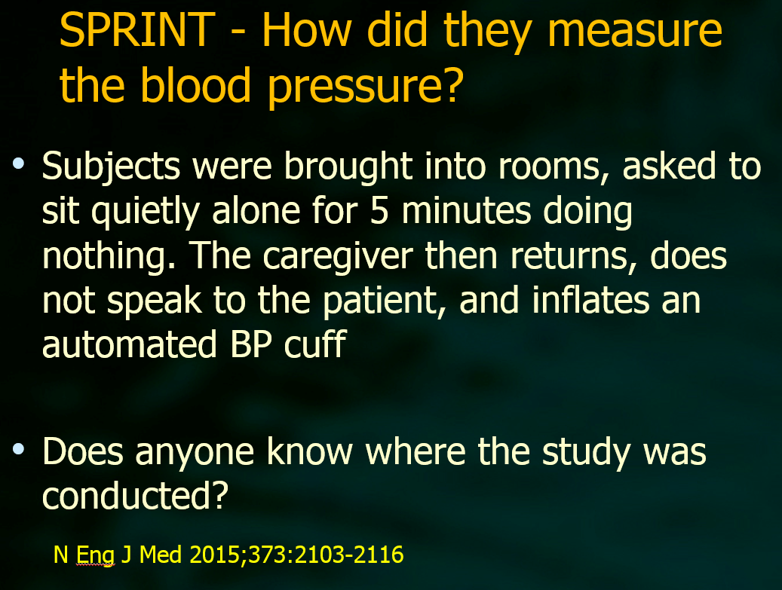

Slide 50
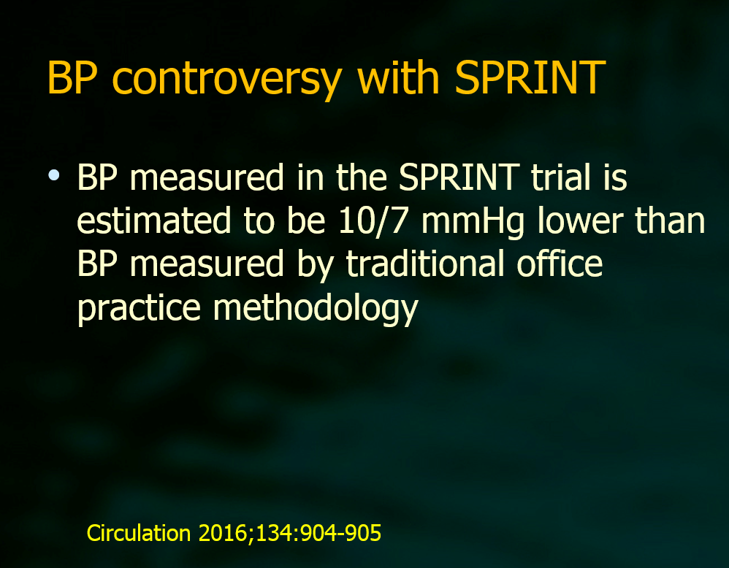

Slide 51
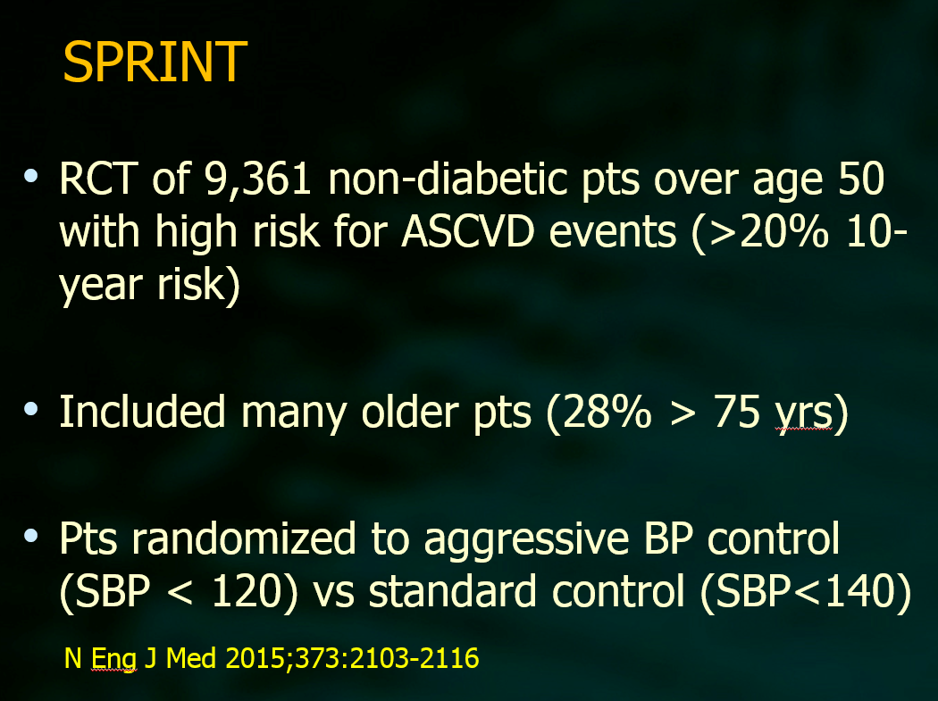

Slide 52
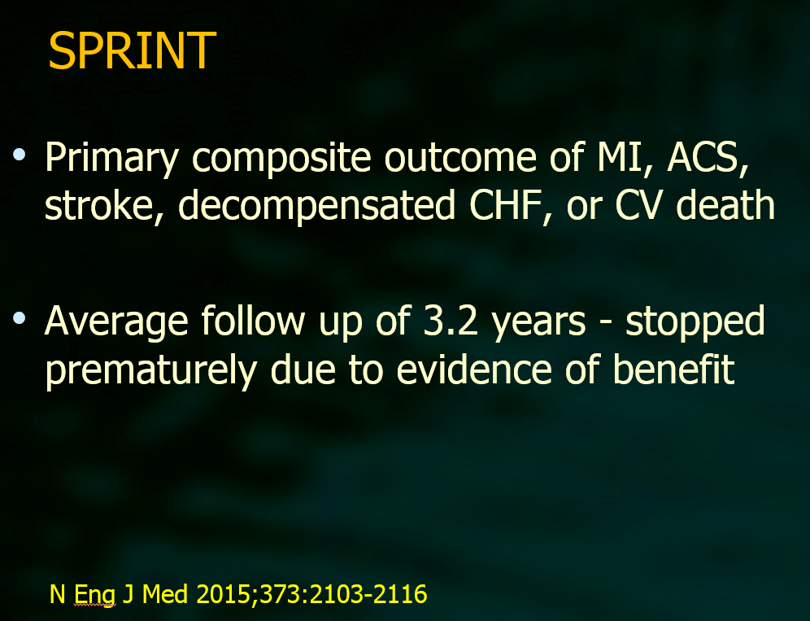

Slide 53
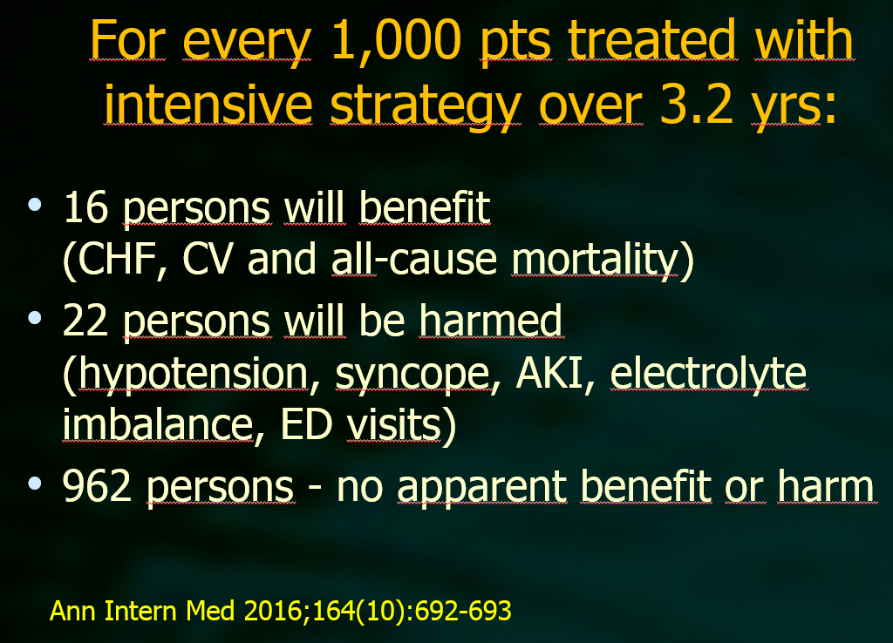

Slide 54
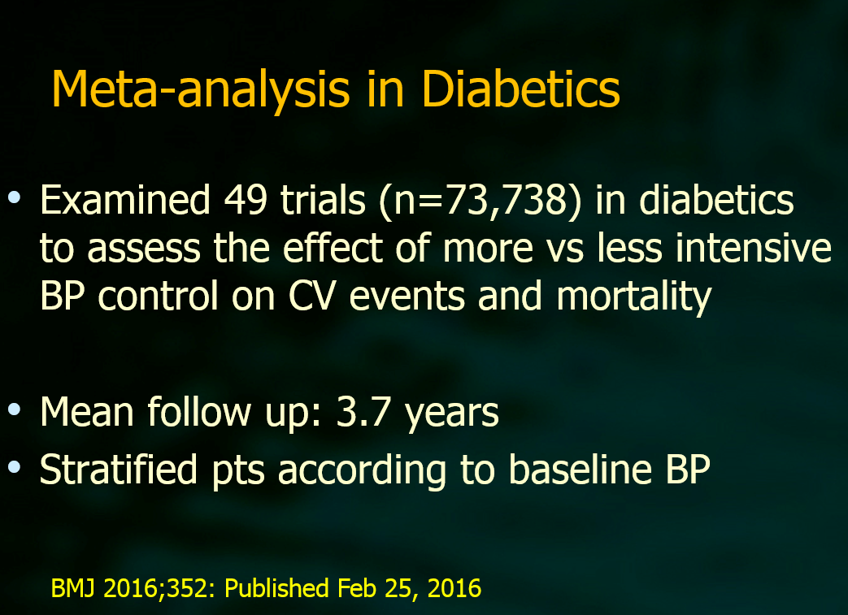

Slide 55
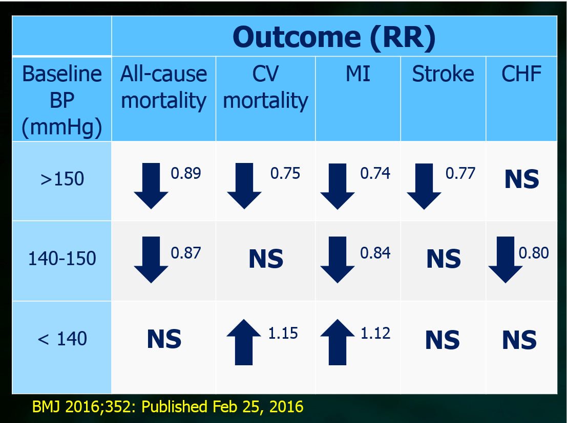

Slide 56
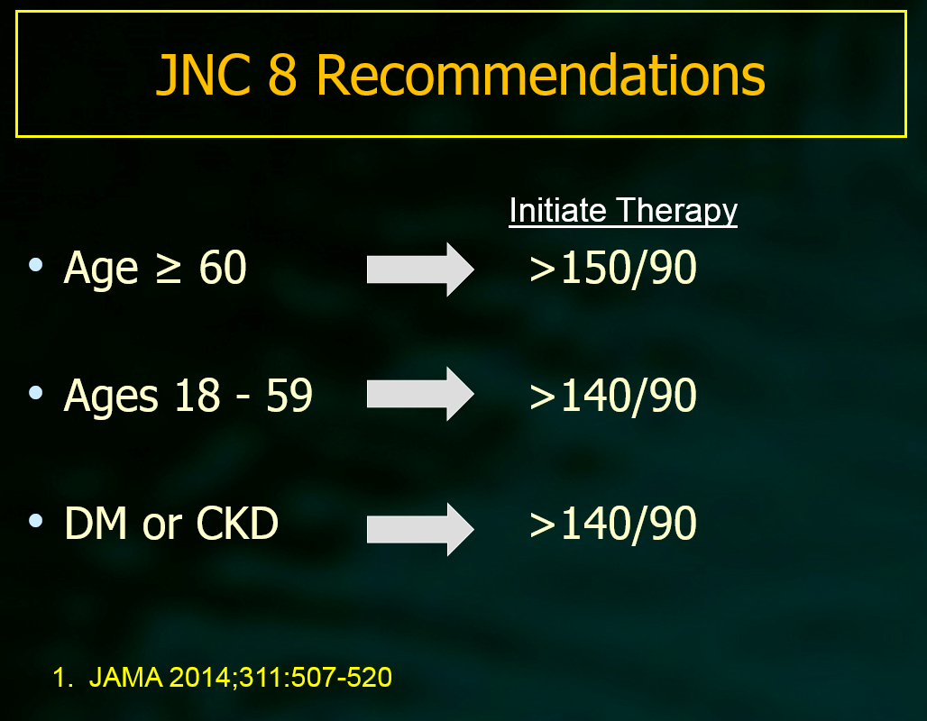

Slide 57
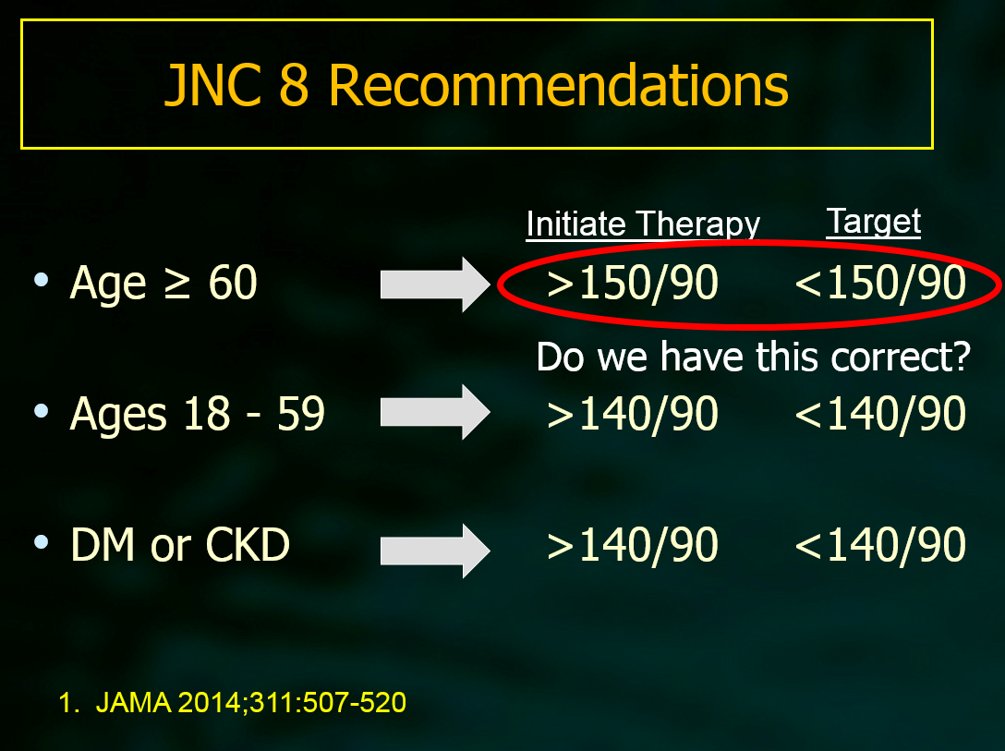

Slide 58
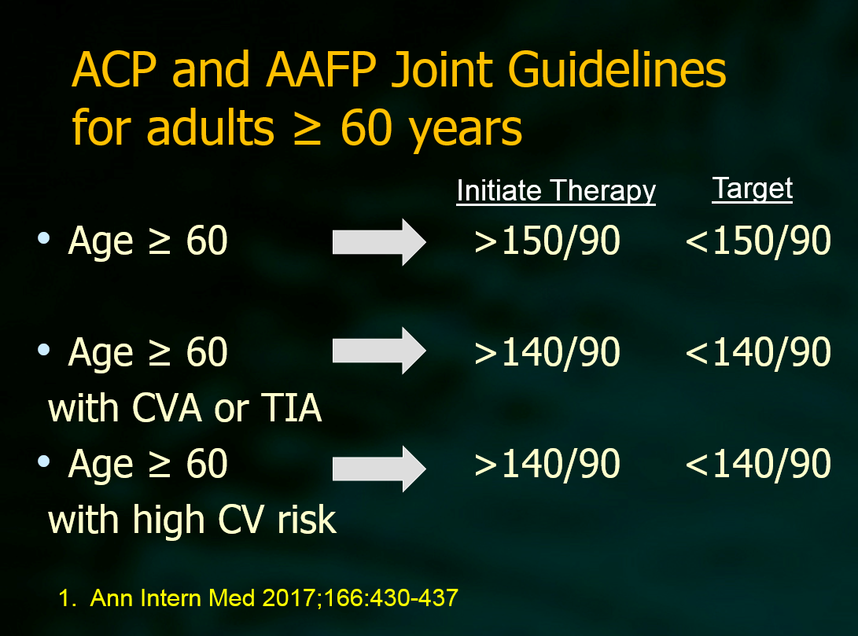

Slide 59
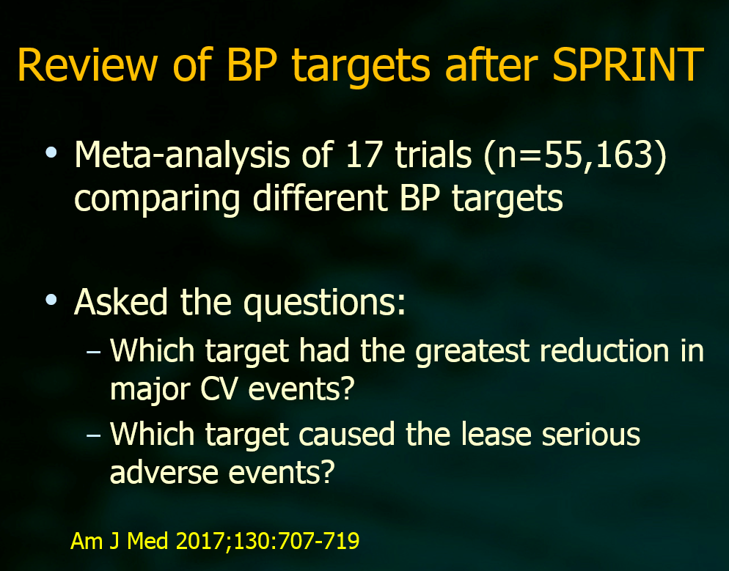

Slide 60
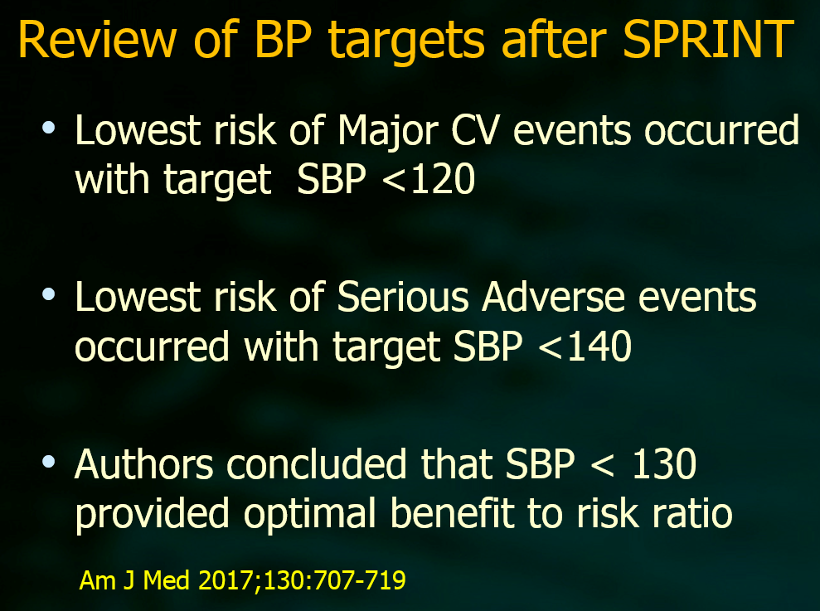

Slide 61
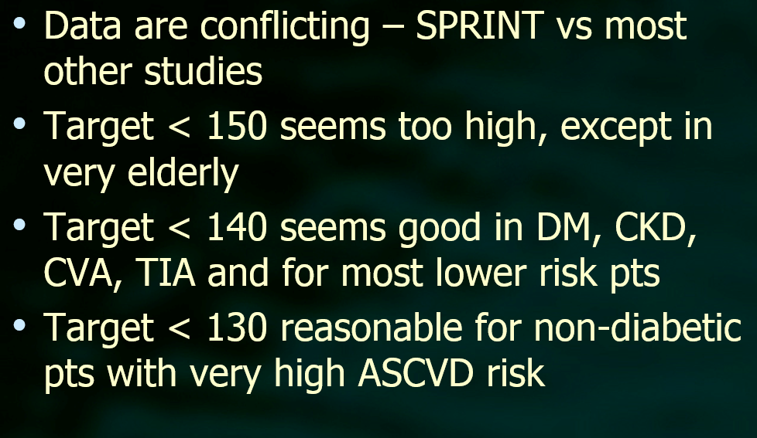

Slide 62
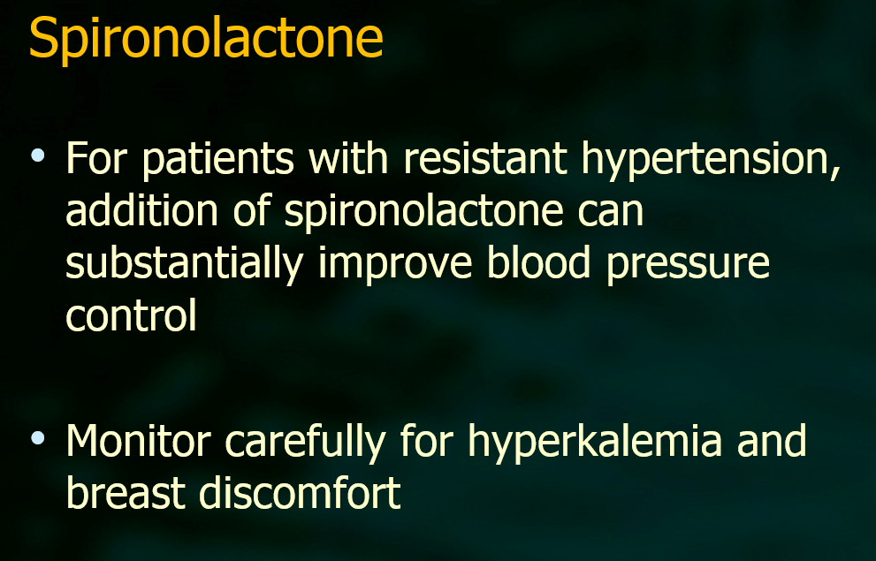

Slide 63
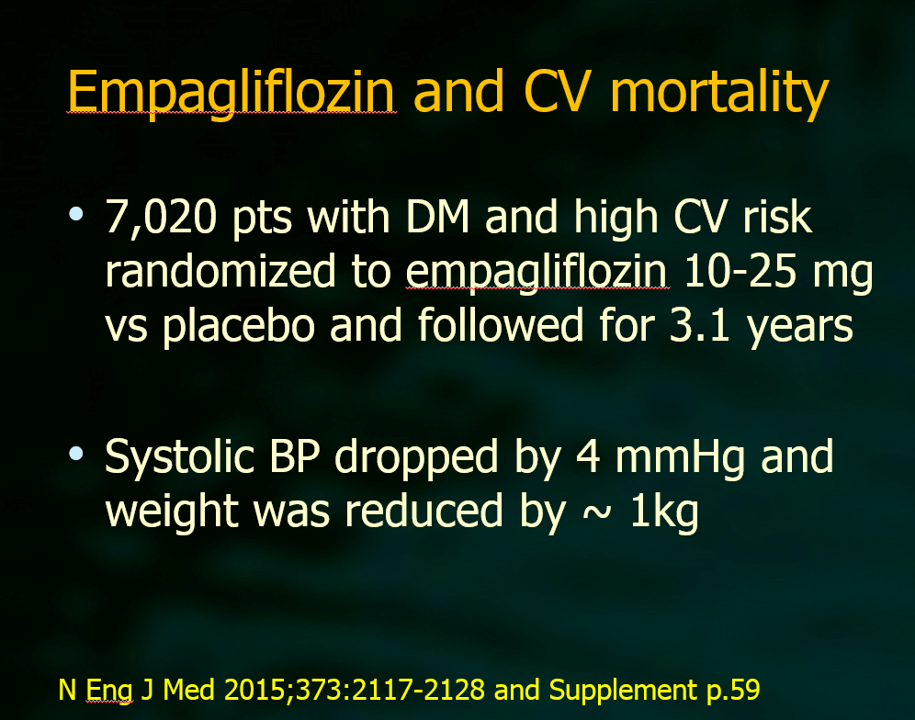

Slide 64
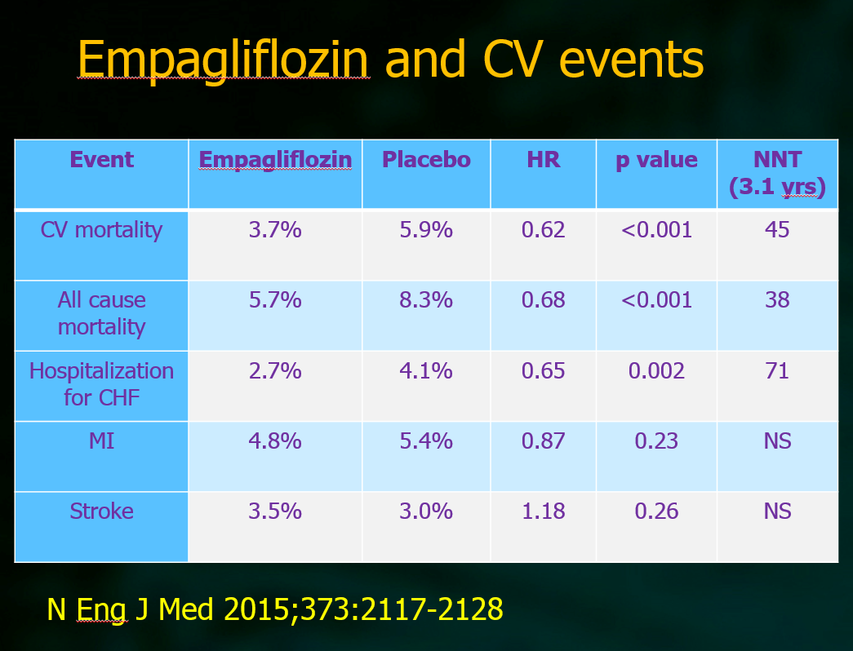

Slide 65
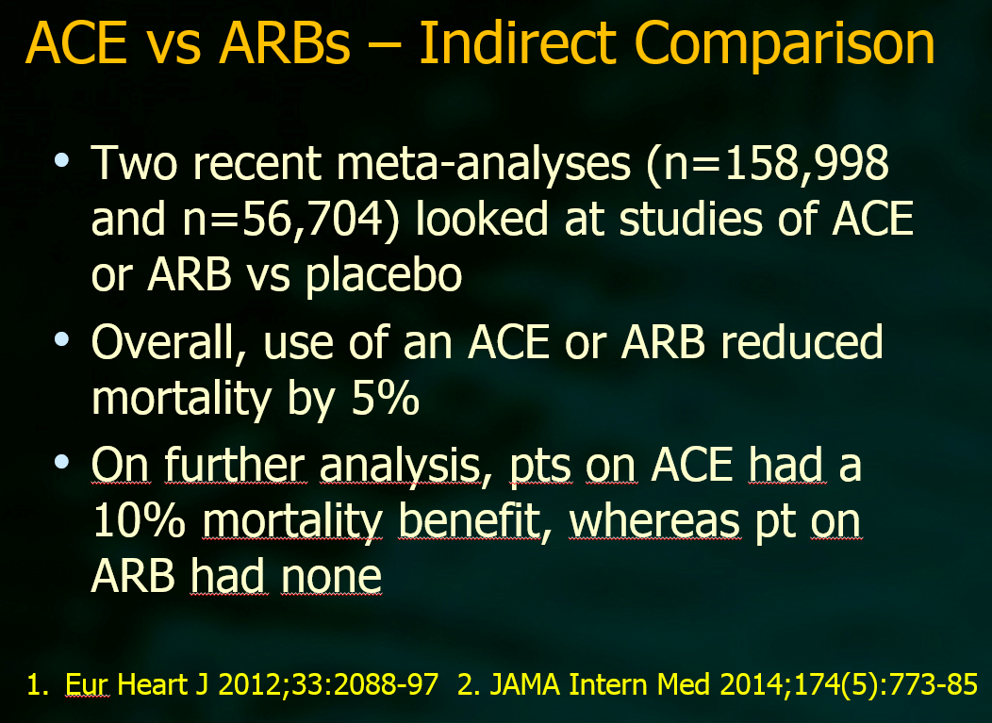

Slide 66
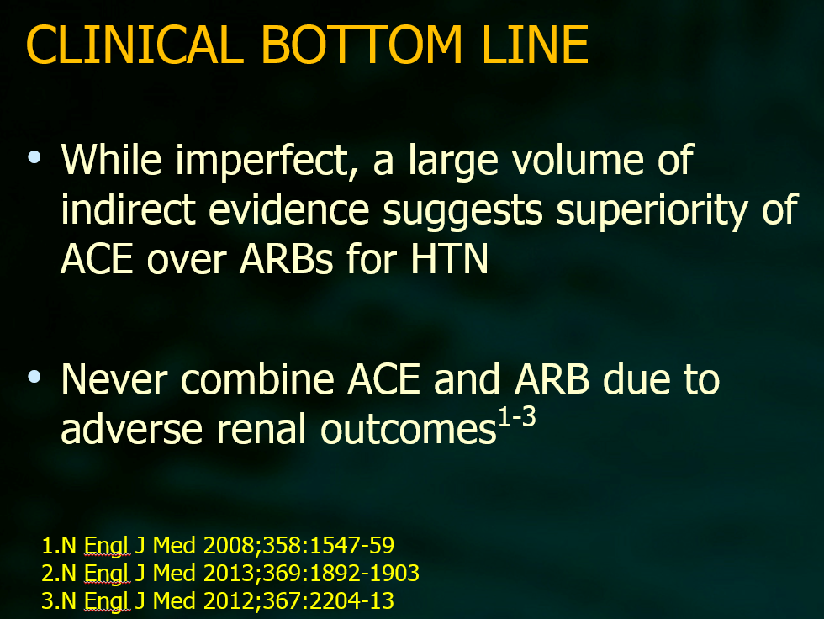

Slide 67
Arterial hypertension pharmacologic review of therapy
INTRODUCTION — There is no uniform agreement as to which antihypertensive drugs should be given for initial therapy. The major options are:
●Thiazide-type diuretics
●Angiotensin-converting enzyme (ACE) inhibitors/angiotensin II receptor blockers (ARBs)
●Calcium channel blockers
●Beta blockers, which are now rarely used for initial therapy in the absence of a specific indication for their use
Up to Date

Slide 68
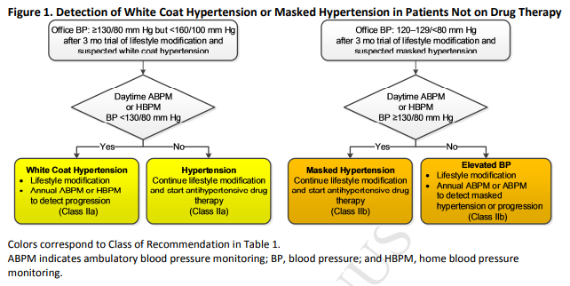
Arterial hypertension pharmacologic review of therapy

Slide 69
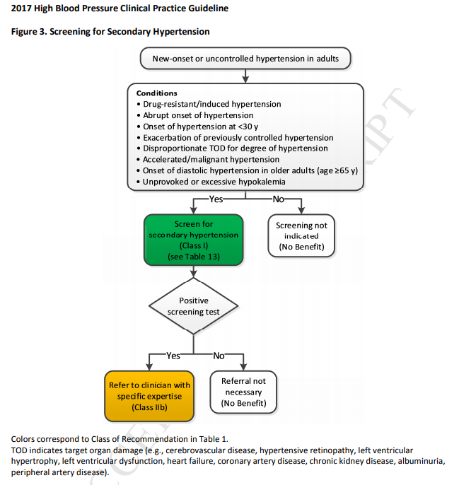

Arterial hypertension
pharmacologic review of therapy

Slide 70
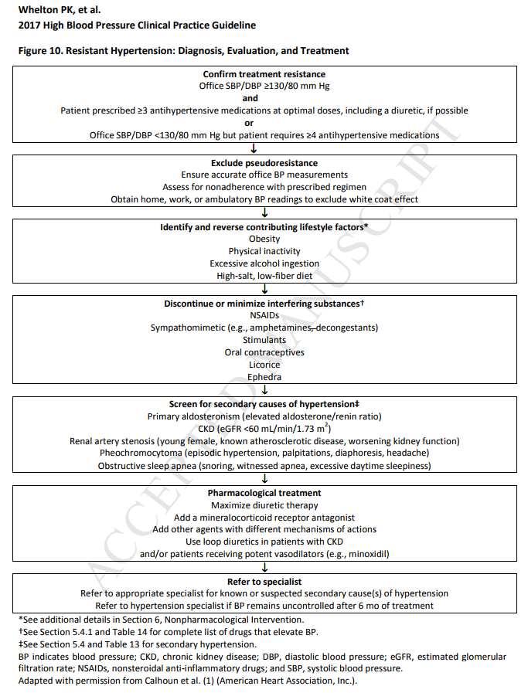
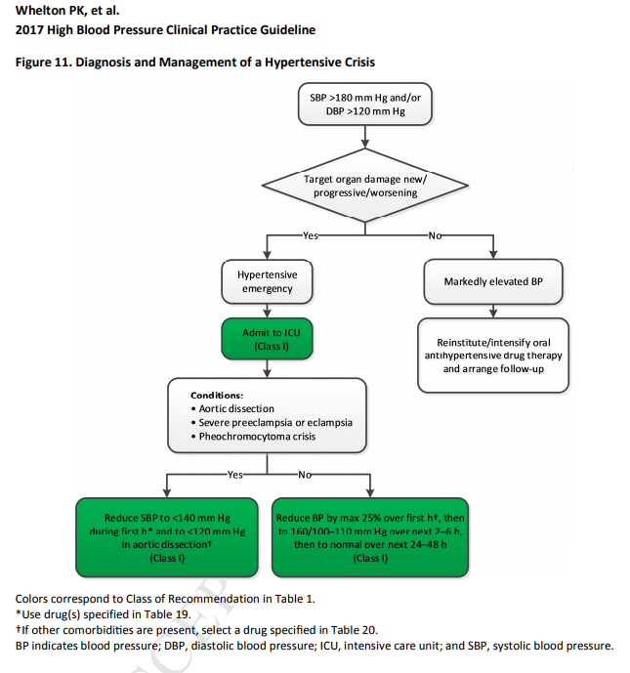

Slide 71
Arterial hypertension pharmacologic review of therapy
Combination therapy — In most cases, single-agent therapy will not adequately control blood pressure, particularly in those whose blood pressure is more than 20/10 mmHg above goal. Combination therapy with drugs from different classes has a substantially greater blood pressure-lowering effect than doubling the dose of a single agent. When more than one agent is needed to control the blood pressure, we recommend therapy with a long-acting ACE inhibitor or ARB in concert with a long-acting dihydropyridine calcium channel blocker. Combination of an ACE inhibitor or ARB with a thiazide diuretic can also be used but may be less beneficial. ACE inhibitors and ARBs should not be used together.
Fixed-dose, single-pill combination medications should be used whenever feasible to reduce the burden on patients and improve medication adherence.
Up to Date

Slide 72
FDA LINKS FOR INFORMATION/RESOURCES
Diabetes mellitus
https://google2.fda.gov/search?q=Diabetes+mellitus&client=FDAgov&site=FDAgov&lr=&proxystylesheet=FDAgov&requiredfields=-archive%3AYes&output=xml_no_dtd&getfields=*

Slide 73
DIABETES THERAPEUTIC REVIEW
In selecting initial therapy, we consider patient presentation (eg, presence or absence of symptoms of hyperglycemia and comorbidities, baseline A1C level), individualized treatment goal, and the glucose-lowering efficacy of individual drugs. Metformin was chosen for initial therapy because of glycemic efficacy, absence of weight gain and hypoglycemia, general tolerability, and favorable cost. Although virtually all recommendations for initial pharmacologic therapy (outside of China, where alpha-glucosidase inhibitors are used frequently) endorse use of metformin, there are, in fact, relatively few relevant direct comparative effectiveness data available.
Up to Date

Slide 74
DIABETES THERAPEUTIC REVIEW
Postmarketing cases of metformin-associated lactic acidosis have resulted in death, hypothermia, hypotension, and resistant Brady arrhythmias. The onset of metformin-associated lactic acidosis is often subtle, accompanied only by nonspecific symptoms such as malaise, myalgia's, respiratory distress, somnolence, and abdominal pain. Metformin-associated lactic acidosis was characterized by elevated blood lactate levels (>5 mmol/L), anion gap acidosis (without evidence of ketonuria or ketonemia), and increased lactate/pyruvate ratio; and metformin plasma levels generally >5 mcg/ml.
Risk factors for metformin-associated lactic acidosis include renal impairment, concomitant use of certain drugs (eg, carbonic anhydrase inhibitors such as topiramate), ≥65 years, having a radiological study with contrast, surgery and other procedures, hypoxic states (eg, acute congestive heart failure), excessive alcohol intake, and hepatic impairment.
Up to Date

Slide 75
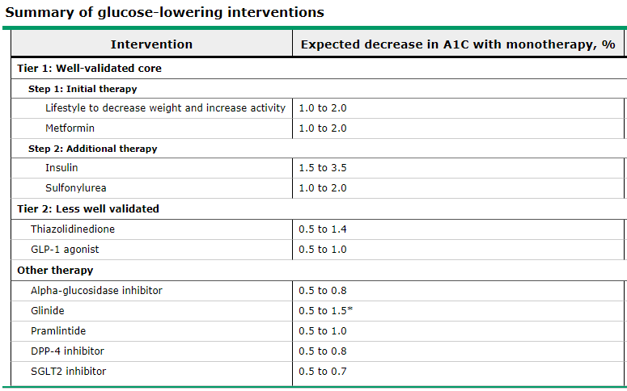
Up to Date
DIABETES THERAPEUTIC REVIEW

Slide 76
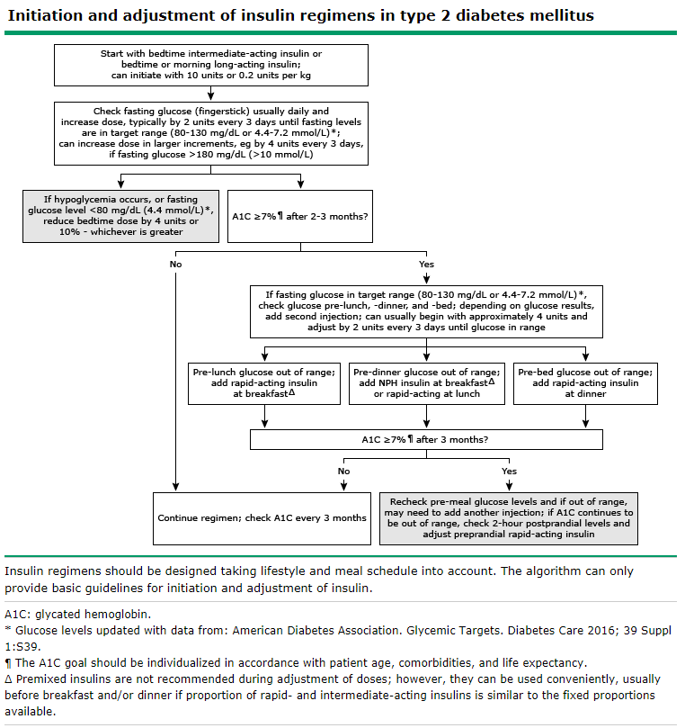

Slide 77
FDA LINKS FOR INFORMATION/RESOURCES
Infectious disease
https://google2.fda.gov/search?q=Infectious+disease&client=FDAgov&site=FDAgov&lr=&proxystylesheet=FDAgov&requiredfields=-archive%3AYes&output=xml_no_dtd&getfields=*

Slide 78
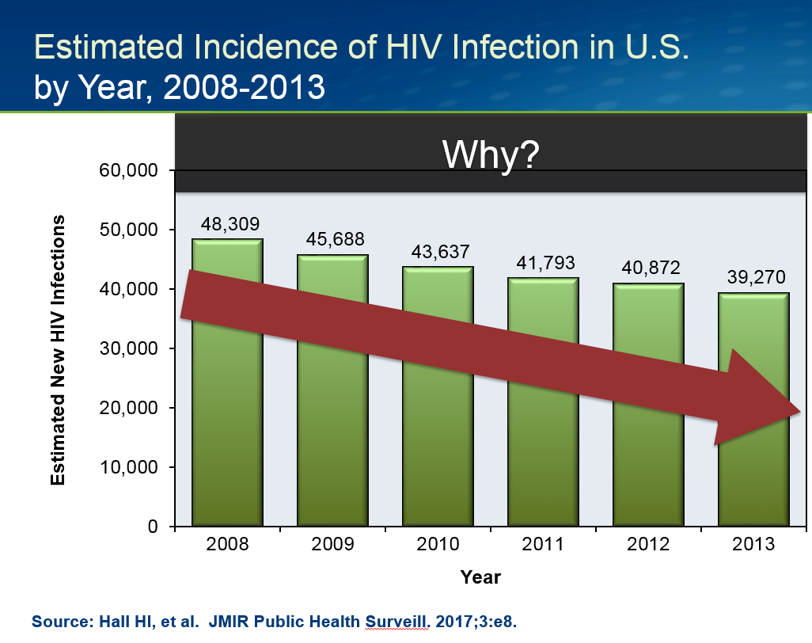
Infectious disease hiv infection improving each year why?????

Slide 79
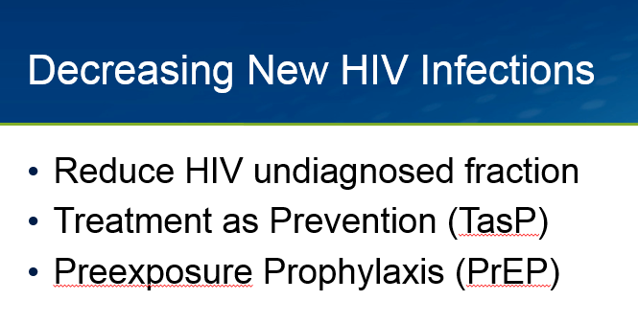
Infectious disease hiv infection improving each year why?????

Slide 80
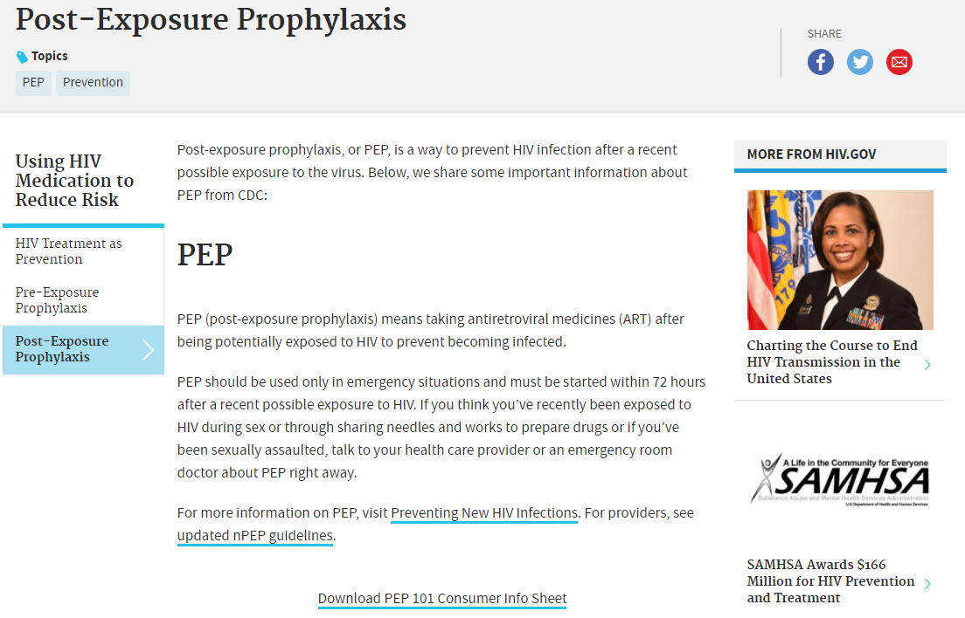
Infectious disease hiv infection improving each year

Slide 81
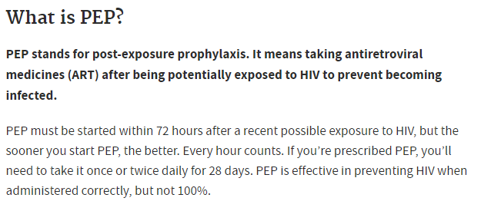
Infectious disease hiv infection improving each year

Slide 82
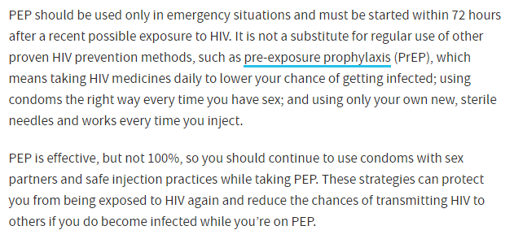
Infectious disease hiv infection improving each year

Slide 83
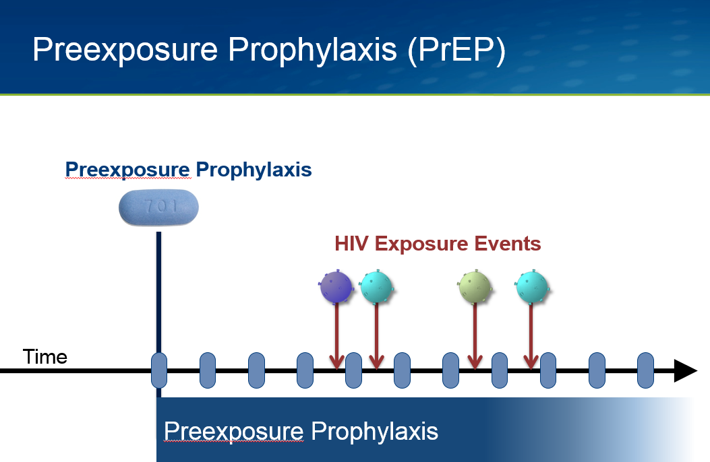
Infectious disease hiv infection improving each year

Slide 84
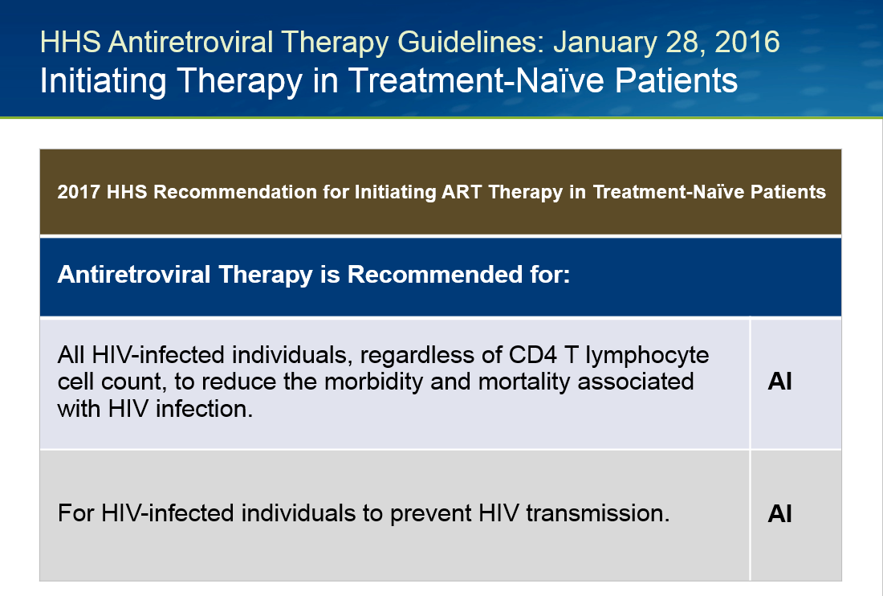
Infectious disease hiv infection treatment review

Slide 85
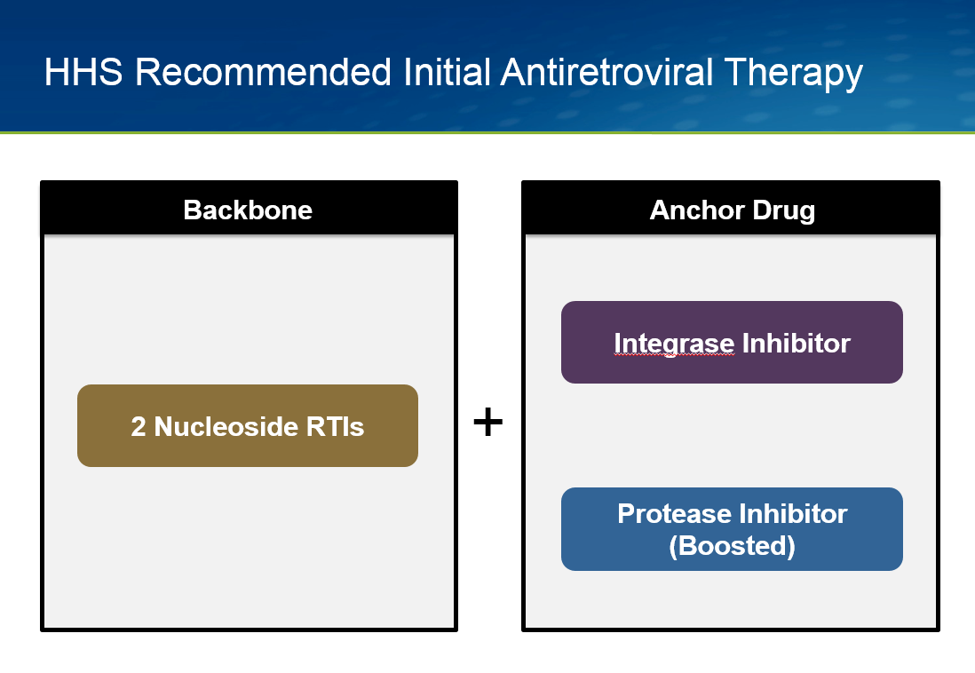
Infectious disease hiv infection treatment review

Slide 86
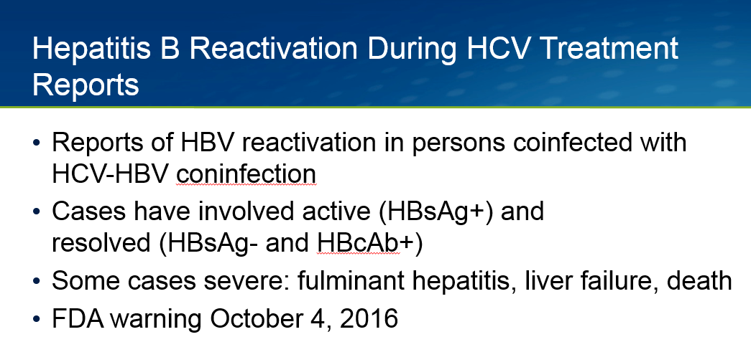
Infectious disease hepatitis b/C infection treatment review

Slide 87
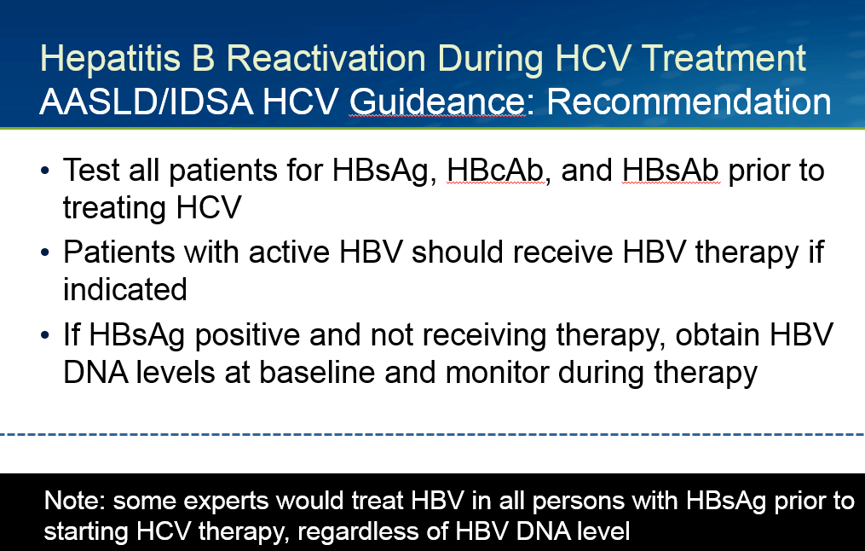
Infectious disease hepatitis b/c infection treatment review

Slide 88
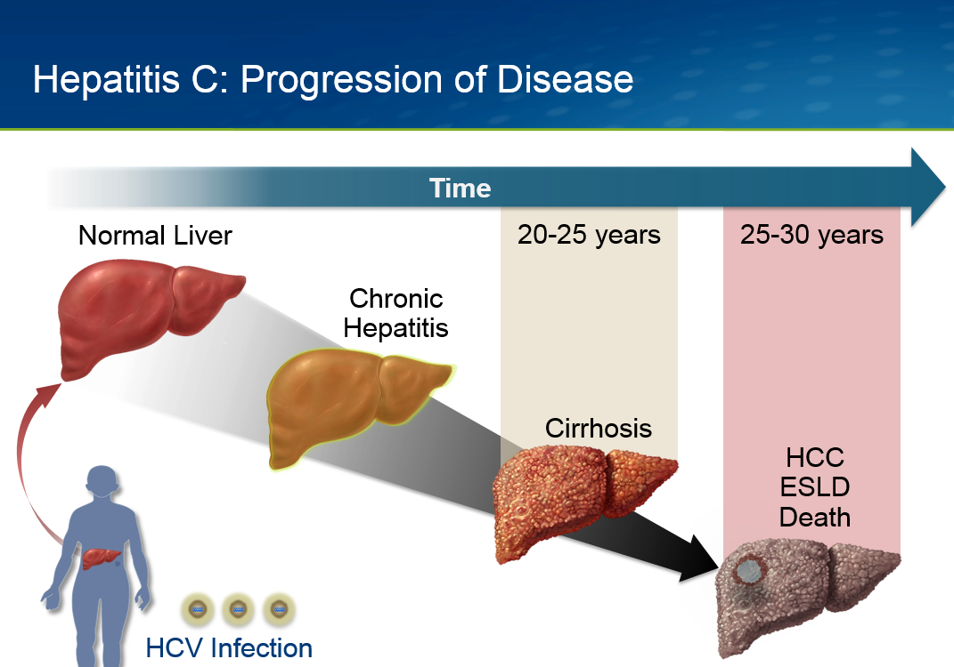
Infectious disease hepatitis c progression of disease

Slide 89
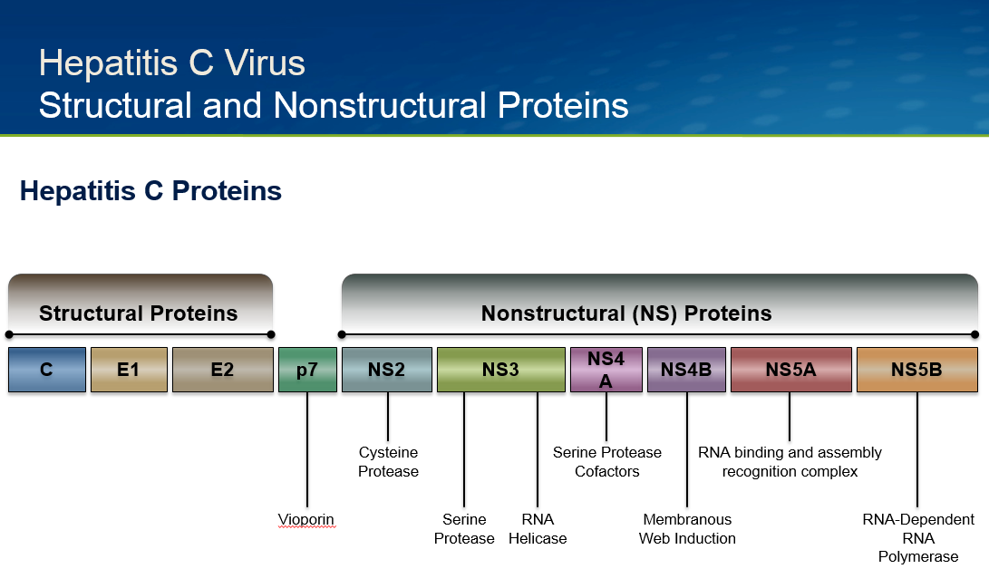
Infectious disease hepatitis c progression of disease

Slide 90
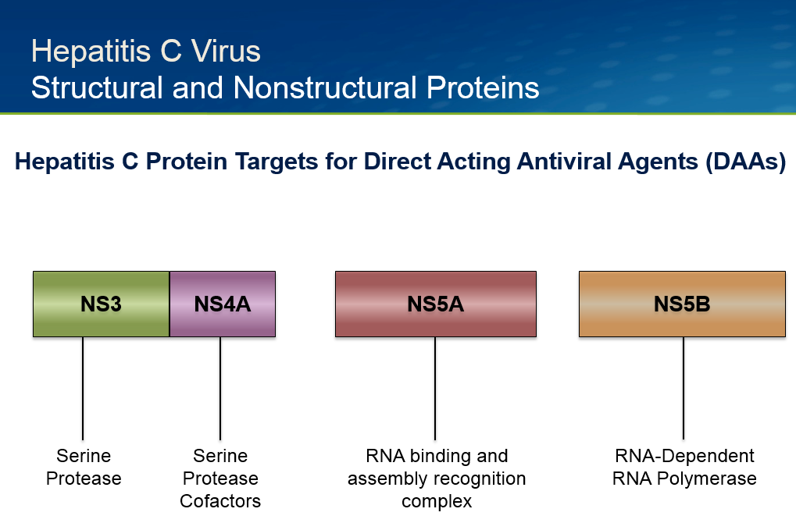
Infectious disease hepatitis c treatment of disease

Slide 91
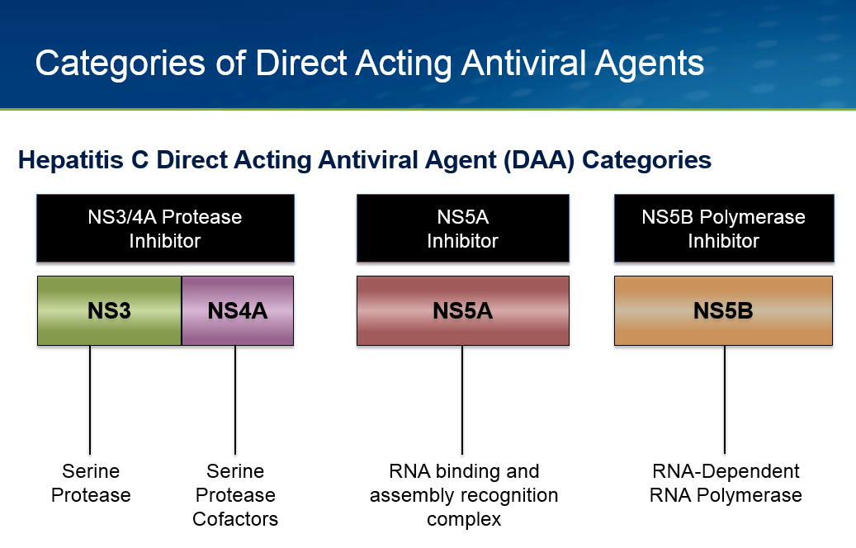
Infectious disease hepatitis c treatment of disease

Slide 92
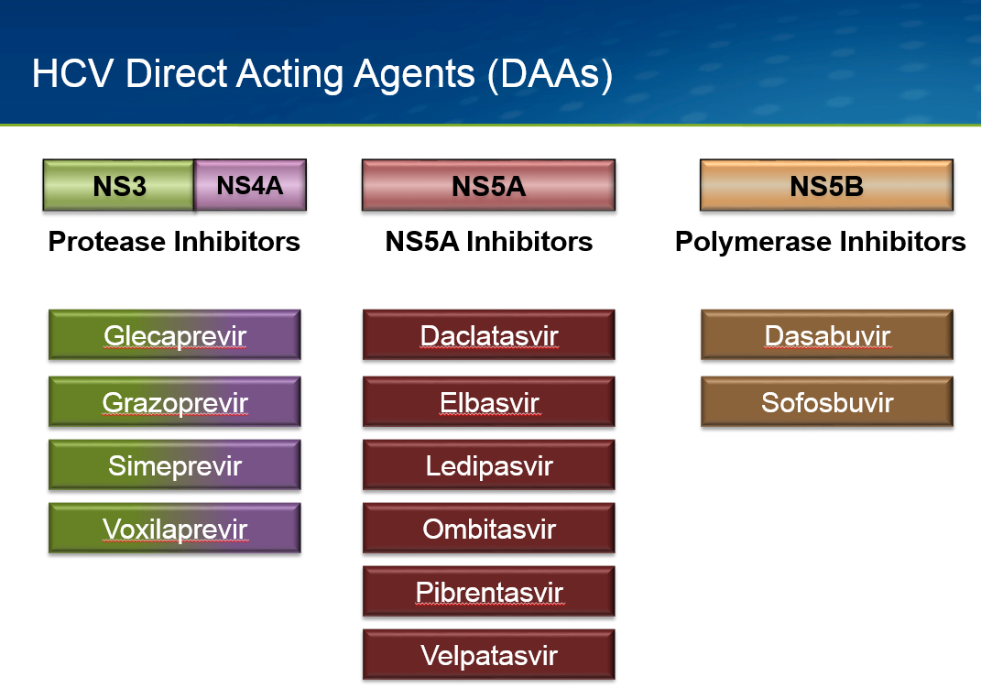
Infectious disease hepatitis c treatment of disease

Slide 93
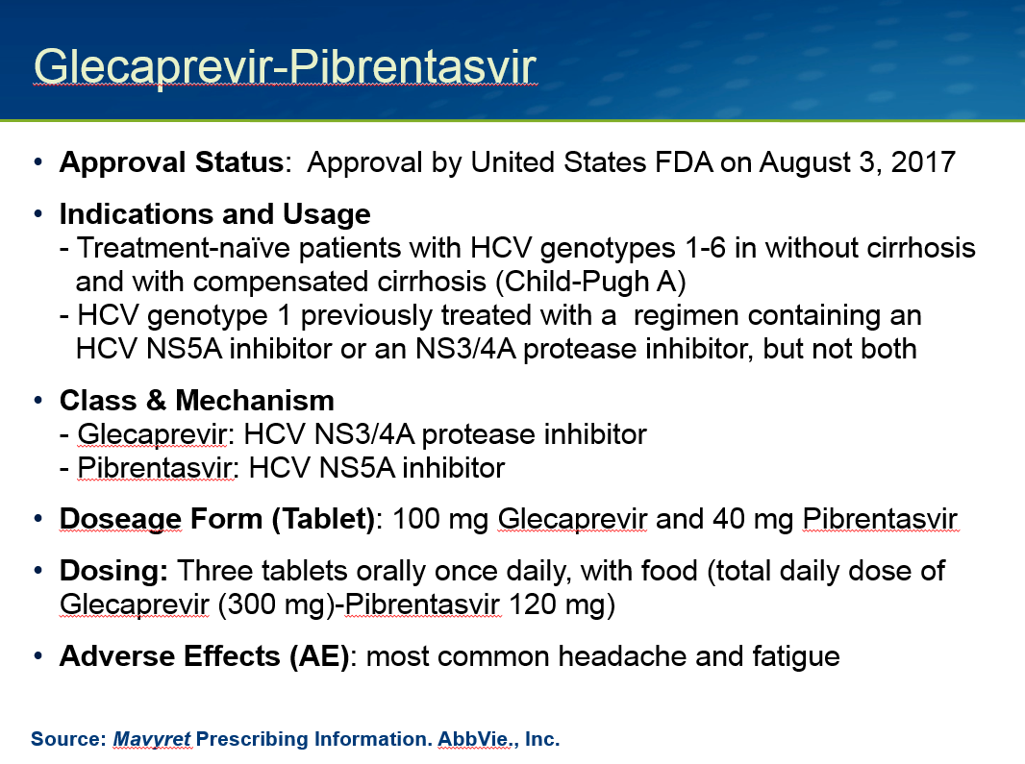
Infectious disease hepatitis c treatment of disease

Slide 94
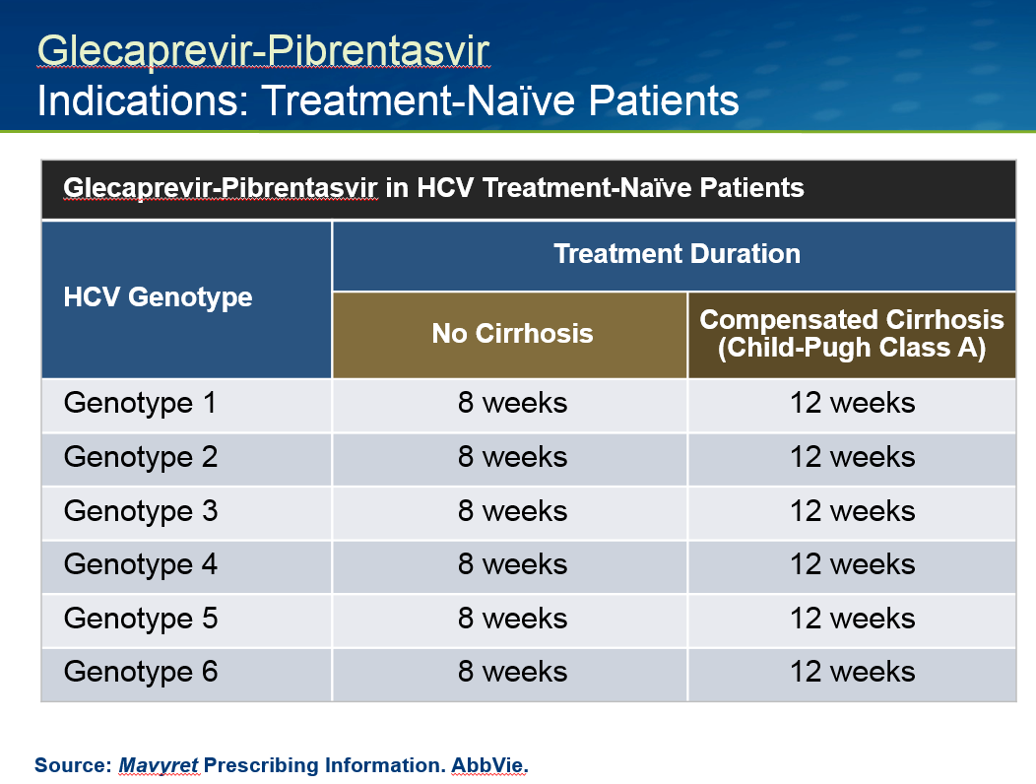
Infectious disease hepatitis c treatment of disease

Slide 95
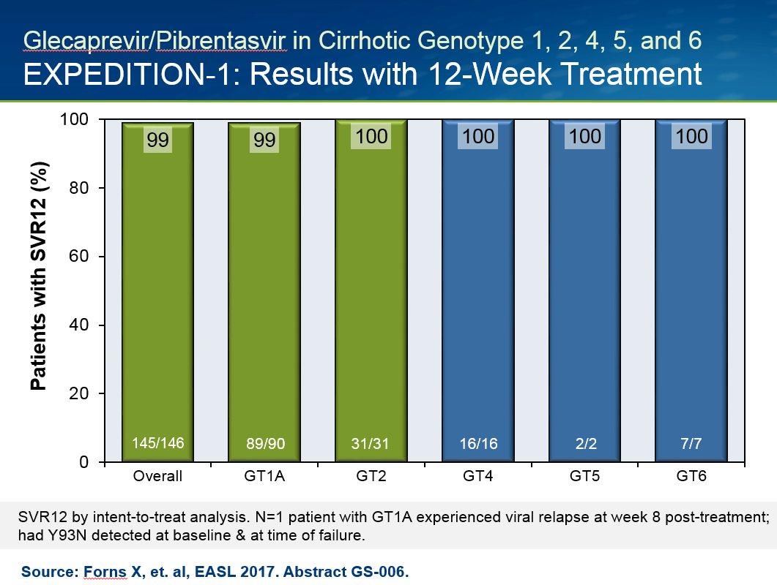
Infectious disease hepatitis c treatment of disease

Slide 96

Infectious diseasehepatitis c treatment of disease

Slide 97

Infectious diseasehepatitis c treatment of disease

Slide 98

Infectious disease hepatitis c treatment of disease

Slide 99

Infectious disease hepatitis c treatment of disease

Slide 100



Slide 101


Slide 102


Slide 103


Slide 104


Slide 105


Slide 106


Slide 107


Slide 108


Slide 109


Slide 110


Slide 111


Slide 112

Infectious disease Learning objectives for vaccination information/advocacy

Slide 113

Infectious disease
Learning objectives for vaccination information/advocacy

Slide 114

Infectious disease Learning objectives for vaccination information/advocacy

Slide 115

ORIGINAL EVIDENCE FLAWED

Slide 116

Infectious disease Learning objectives for vaccination information/advocacy

Slide 117

Infectious disease Learning objectives for vaccination information/advocacy

Slide 118

CALIFORNIA IN THE 90 – 95%
CATEGORY Infectious disease
Learning objectives for vaccination information/advocacy

Slide 119

Infectious disease Learning objectives for vaccination information/advocacy

Slide 120

Infectious disease Learning objectives for vaccination information/advocacy

Slide 121

Infectious disease Learning objectives for vaccination information/advocacy

Slide 122

Infectious disease Learning objectives for vaccination information/advocacy

Slide 123

Infectious disease Learning objectives for vaccination information/advocacy

Slide 124

Infectious disease Learning objectives for vaccination information/advocacy

Slide 125

Infectious disease Learning objectives for pneumococcal vaccine information/advocacy

Slide 126

Infectious disease Learning objectives for pneumococcal vaccine information/advocacy

Slide 127

Infectious disease Learning objectives for pneumococcal vaccine information/advocacy

Slide 128

Infectious disease Learning objectives for pneumococcal vaccine information/advocacy

Slide 129

Infectious disease Learning objectives for pneumococcal vaccine information/advocacy

Slide 130

Infectious disease Learning objectives for pneumococcal vaccine information/advocacy

Slide 131

Infectious disease Learning objectives for pneumococcal vaccine information/advocacy

Slide 132
1. A 65 year old man presents to the clinic for routine care. He has not been vaccinated against for pneumonia. Which of the following is most accurate?
He does not need vaccination unless he has other risk factors
He needs a PCV13 alone
He needs a PCV13 followed 1 year later by a PPSV23
He needs a PPSV23 alone

Slide 133
1. A 65 year old man presents to the clinic for routine care. He has not been vaccinated against for pneumonia. Which of the following is most accurate?
He does not need vaccination unless he has other risk factors
He needs a PCV13 alone
He needs a PCV13 followed 1 year later by a PPSV23
He needs a PPSV23 alone

Slide 134

Infectious disease Learning objectives for herpes zoster vaccine information/advocacy

Slide 135

Infectious disease Learning objectives for herpes zoster vaccine information/advocacy

Slide 136

Infectious disease Learning objectives for herpes zoster vaccine information/advocacy

Slide 137

Infectious disease
Learning objectives for herpes zoster vaccine information/advocacy

Slide 138

Infectious disease Learning objectives for herpes zoster vaccine information/advocacy

Slide 139
PRECAUTION TO ZOSTER VACCINE
Moderate or severe acute illness with or without feverreceipt of specific antiviral drugs (acyclovir, famciclovir, or valacyclovir) 24 hours before vaccination (avoid use of these antiviral drugs for 14 days after vaccination)
CONTRAINDICATIONS TO ZOSTER VACCINE
Severe allergic reaction (e.g., anaphylaxis) after a previous dose or to a vaccine component known severe immunodeficiency (e.g., from hematologic and solid tumors, receipt of chemotherapy, congenital immunodeficiency, long-term immunosuppressive therapy, medical treatment with “biologics” or patients with HIV infection who are severely immunocompromised)
Pregnancy
Infectious disease Learning objectives for
herpes zoster vaccine information/advocacy

Slide 140


A “BIOLOGIC” IS A
CONTRAINDICATION
TO ZOSTER VACCINE
Infectious disease Learning objectives for
herpes zoster vaccine information/advocacy

Slide 141
PRECAUTION TO ZOSTER VACCINE
Moderate or severe acute illness with or without feverreceipt of specific antiviral drugs (acyclovir, famciclovir, or valacyclovir) 24 hours before vaccination (avoid use of these antiviral drugs for 14 days after vaccination)
CONTRAINDICATIONS TO ZOSTER VACCINE
Severe allergic reaction (e.g., anaphylaxis) after a previous dose or to a vaccine component known severe immunodeficiency (e.g., from hematologic and solid tumors, receipt of chemotherapy, congenital immunodeficiency, long-term immunosuppressive therapy, medical treatment with “biologics” or patients with HIV infection who are severely immunocompromised)
Pregnancy
Infectious disease Learning objectives for
herpes zoster vaccine information/advocacy

Slide 142


Infectious disease
Learning objectives for herpes zoster vaccine information/advocacy

Slide 143

Infectious disease Learning objectives for herpes zoster vaccine information/advocacy

Slide 144

Infectious disease Learning objectives for herpes zoster vaccine information/advocacy

Slide 145

Infectious disease Learning objectives for herpes zoster vaccine information/advocacy

Slide 146
2. A 64 year old woman with self-reported history of shingles 2 years ago type II diabetes presents to clinic. What do you recommend regarding the zoster vaccine?
Vaccine is contraindicated given her history of diabetes
Vaccine not indicated
Check VZV titer to confirm history. If negative, proceed with vaccination
Recommend zoster vaccine

Slide 147
2. A 64 year old woman with self-reported history of shingles 2 years ago type II diabetes presents to clinic. What do you recommend regarding the zoster vaccine?
Vaccine is contraindicated given her history of diabetes
Vaccine not indicated
Check VZV titer to confirm history. If negative, proceed with vaccination
Recommend zoster vaccine

Slide 148
3. A 64 year old woman with rheumatoid arthritis on steroids and a biologic asks if she may receive the zoster vaccine. What do you recommend?
Vaccine is contraindicated given she is immunosuppressed
Recommend zoster vaccine
Wait for something else

Slide 149
3. A 64 year old woman with rheumatoid arthritis on steroids and a biologic asks if she may receive the zoster vaccine. What do you recommend?
Vaccine is contraindicated given she is immunosuppressed
Recommend zoster vaccine
Wait for something else

Slide 150

Infectious disease Learning objectives for meningococcal vaccine information/advocacy

Slide 151

Infectious disease Learning objectives for meningococcal vaccine information/advocacy

Slide 152

Infectious disease Learning objectives for meningococcal vaccine information/advocacy

Slide 153

Infectious disease Learning objectives for meningococcal vaccine information/advocacy

Slide 154

Infectious disease Learning objectives for meningococcal vaccine information/advocacy

Slide 155

Infectious disease Learning objectives for meningococcal vaccine information/advocacy

Slide 156
4. A 11 year old otherwise healthy child presents for routine vaccinations. Which of the following is the most accurate regarding meningococcal vaccination?
Not needed at this age
Give meningococcal conjugate vaccine (MCV4)
Give meningococcal polysaccharide vaccine (MPSV4)
Give meningococcal B vaccine only
Give both MCV4 and meningococcal B vaccines

Slide 157
4. A 11 year old otherwise healthy child presents for routine vaccinations. Which of the following is the most accurate regarding meningococcal vaccination?
Not needed at this age
Give meningococcal conjugate vaccine (MCV4)
Give meningococcal polysaccharide vaccine (MPSV4)
Give meningococcal B vaccine only
Give both MCV4 and meningococcal B vaccines

Slide 158

Infectious disease Learning objectives for vaccine information/advocacy

Slide 159

Infectious disease Learning objectives for influenza vaccine information/advocacy

Slide 160

Infectious disease Learning objectives for influenza vaccine information/advocacy

Slide 161

Infectious disease Learning objectives for meningococcal vaccine information/advocacy

Slide 162

Infectious disease Learning objectives for influenza vaccine information/advocacy

Slide 163

Infectious disease Learning objectives for influenza vaccine information/advocacy

Slide 164

Infectious disease Learning objectives for influenza vaccine information/advocacy

Slide 165

Infectious disease Learning objectives for influenza vaccine information/advocacy

Slide 166

Infectious disease Learning objectives for influenza vaccine information/advocacy

Slide 167
5. 67 year old man with moderate COPD presents for his routine visit in the fall. Which of the following is most appropriate regarding immunization against influenza?
Live attenuated vaccine should be given as it has been found t be more effective than the inactivated vaccine
High-dose, trivalent, inactivated vaccine should be administered
Standard-dose, trivalent, inactivated vaccine should be administered

Slide 168
5. 67 year old man with moderate COPD presents for his routine visit in the fall. Which of the following is most appropriate regarding immunization against influenza?
Live attenuated vaccine should be given as it has been found t be more effective than the inactivated vaccine
High-dose, trivalent, inactivated vaccine should be administered
Standard-dose, trivalent, inactivated vaccine should be administered

