Slide 1

MODULE six: pharmacology

Slide 2
MODULE six:
SECTION four:
prescriptions in
clinical practice:
the role of the
physician and
the pharmacologist

Slide 3

UNIT OBJECTIVE
To know the regulations for handling drugs and vaccines in clinics and hospitals in the state, and to understand the responsibility of physicians and pharmacologists

Slide 4
prescriptions in clinical practice: the role of the physician and the pharmacologist
General prescribing guidelines
Electronic prescribing
Prescribing roles for health professionals
  physician vs. pharmacologist

Slide 5
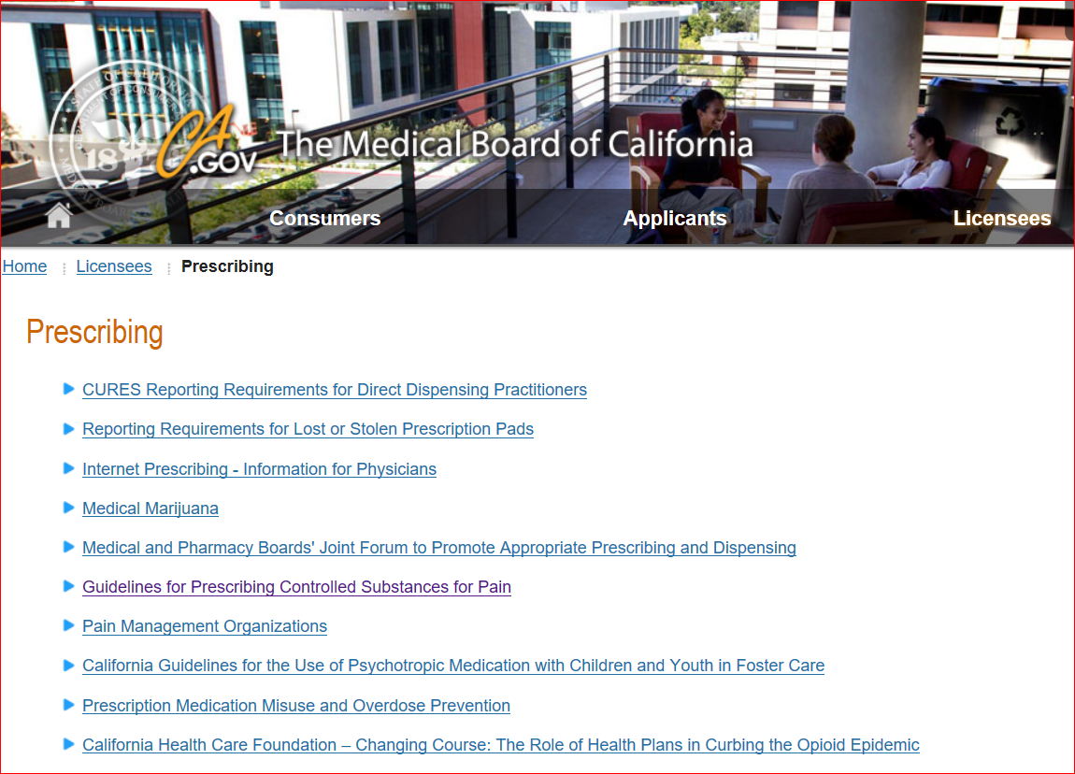
http://www.mbc.ca.gov/licensees/prescribing/
These resources represent links for more details regarding physician prescribing practices and guidelines.

Slide 6

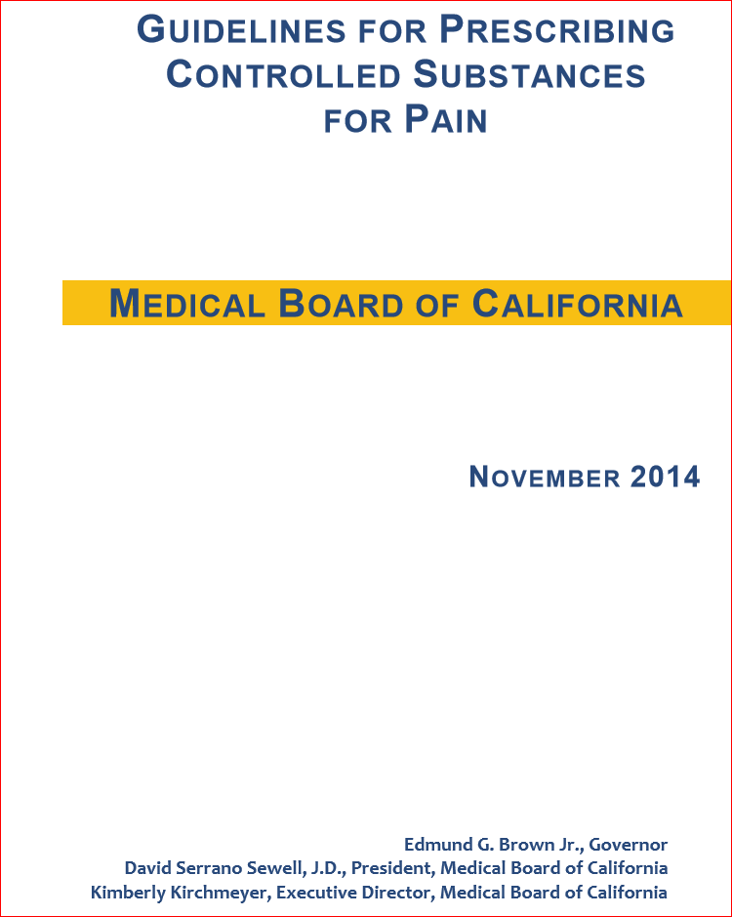
Link to pain guidelines pdf
http://www.mbc.ca.gov/
licensees/prescribing/pain_guidelines.pdf

Slide 7
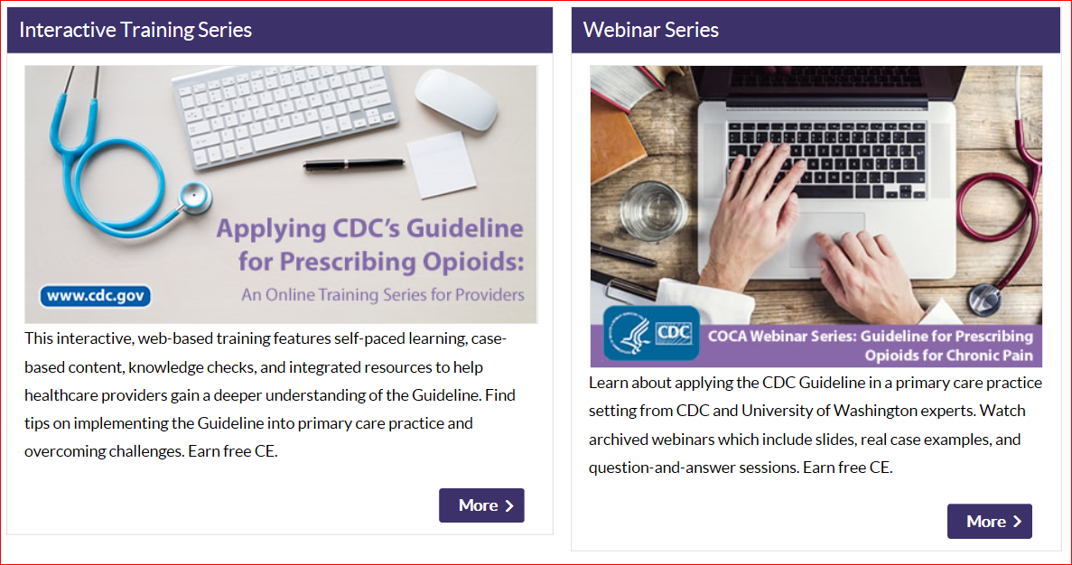
Cdc’s guideline for prescribing opioids

Slide 8
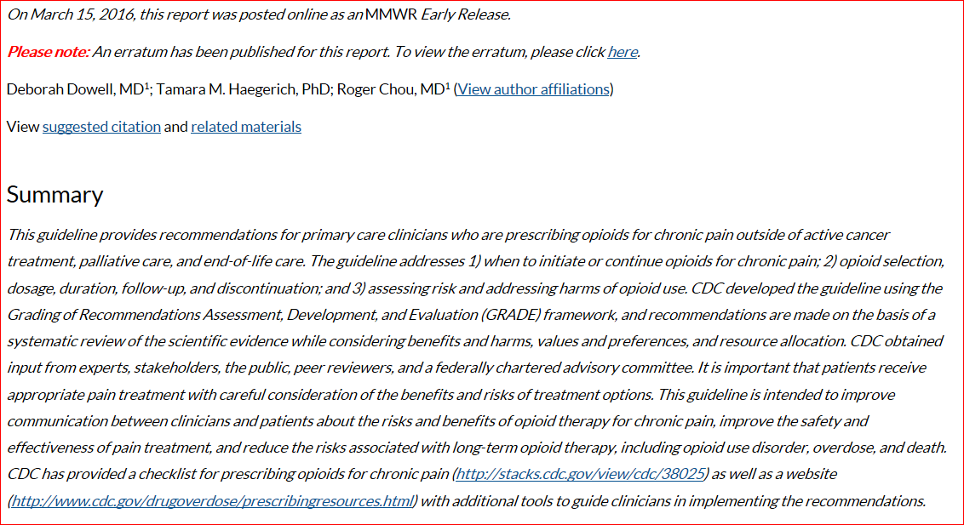

Slide 9
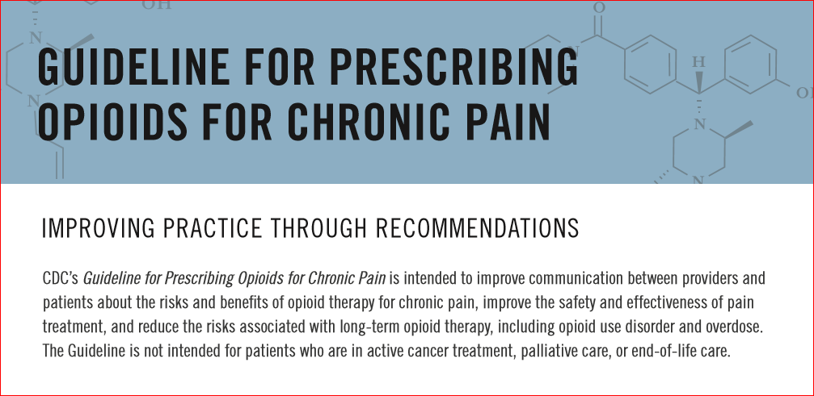


Slide 10
Prescribing practices
1. The Guideline for Prescribing Opioids for Chronic Pain is intended for which category of patients?
Active cancer treatment
Palliative care
End-of-life care
Acute pain prior to starting chronic pain management

Slide 11
Prescribing practices
1. The Guideline for Prescribing Opioids for Chronic Pain is intended for which category of patients?
Active cancer treatment
Palliative care
End-of-life care
Acute pain prior to starting chronic pain management

Slide 12
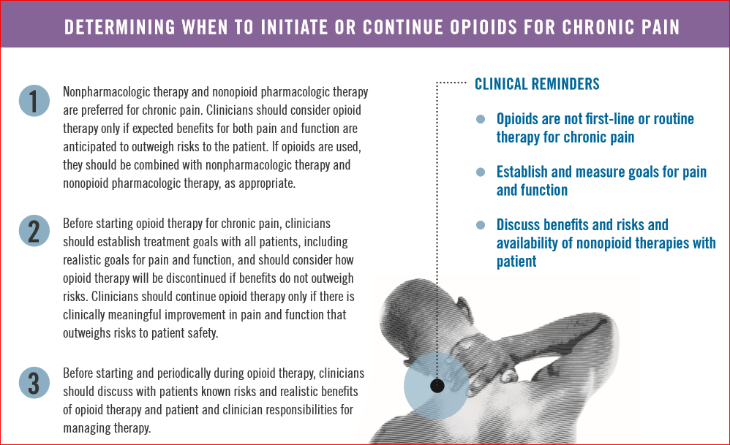


Slide 13
2. Which of the following statement is false?
a) Non-pharmacologic therapy and non-opioid pharmacologic therapy are preferred for chronic pain.
b) Clinicians should consider opioid therapy only if expected benefits for both pain and function are anticipated to outweigh risks to the patient.
c) If opioids are used, they should be combined with non-pharmacologic therapy and non-opioid pharmacologic therapy, as appropriate.
d) Clinicians should tell patients that it is alright to supplement pain treatment with alcohol especially at night.
PRESCRIBING PRACTICES

Slide 14
2. Which of the following statement is false?
a) Non-pharmacologic therapy and non-opioid pharmacologic therapy are preferred for chronic pain.
b) Clinicians should consider opioid therapy only if expected benefits for both pain and function are anticipated to outweigh risks to the patient.
c) If opioids are used, they should be combined with non-pharmacologic therapy and non-opioid pharmacologic therapy, as appropriate.
d) Clinicians should tell patients that it is alright to supplement pain treatment with alcohol especially at night.
PRESCRIBING PRACTICES

Slide 15
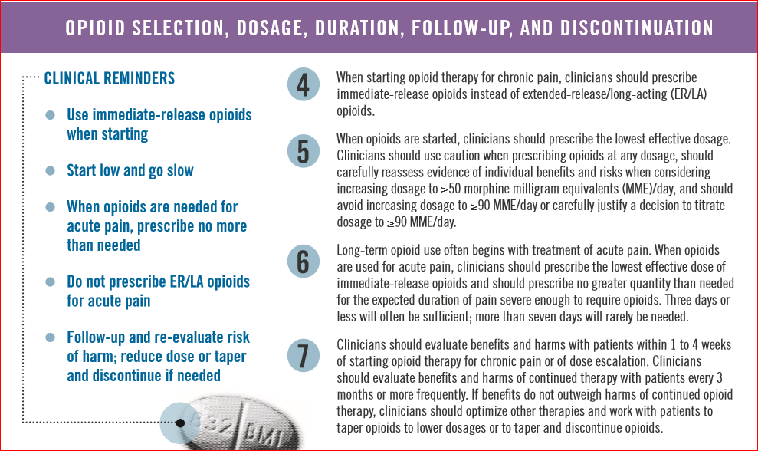


Slide 16
Prescribing practices
3. Which of the following statements are false?
Clinicians should review the patient’s history of controlled substance prescriptions using state prescription drug monitoring program (PDMP) data to determine whether the patient is receiving opioid dosages or dangerous combinations that put him or her at high risk for overdose.
Clinicians should avoid prescribing opioid pain medication and benzodiazepines concurrently whenever possible.
Clinicians should start opioid therapy using long acting agents to optimize smoother more constant pain relief.

Slide 17
Prescribing practices
3. Which of the following statements are false?
Clinicians should review the patient’s history of controlled substance prescriptions using state prescription drug monitoring program (PDMP) data to determine whether the patient is receiving opioid dosages or dangerous combinations that put him or her at high risk for overdose.
Clinicians should avoid prescribing opioid pain medication and benzodiazepines concurrently whenever possible.
Clinicians should start opioid therapy using long acting agents to optimize smoother more constant pain relief.

Slide 18
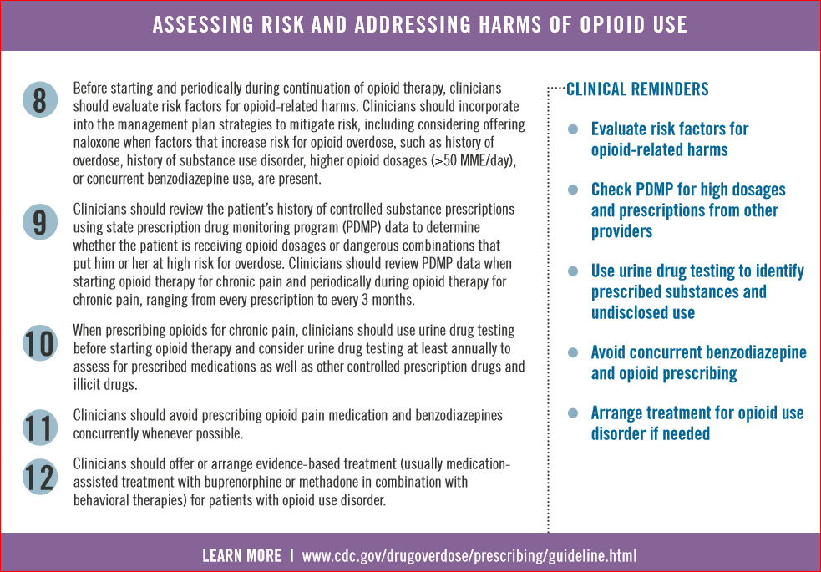

Slide 19
4. Which of the following statements are false?
Use urine drug testing to identify prescribed substances and undisclosed use.
Opioids are not first-line or routine therapy for chronic pain
Short term usage of opioids does not significantly increase the risk of later heroin addiction.

Slide 20
4. Which of the following statements are false?
Use urine drug testing to identify prescribed substances and undisclosed use.
Opioids are not first-line or routine therapy for chronic pain
Short term usage of opioids does not significantly increase the risk of later heroin addiction.

Slide 21
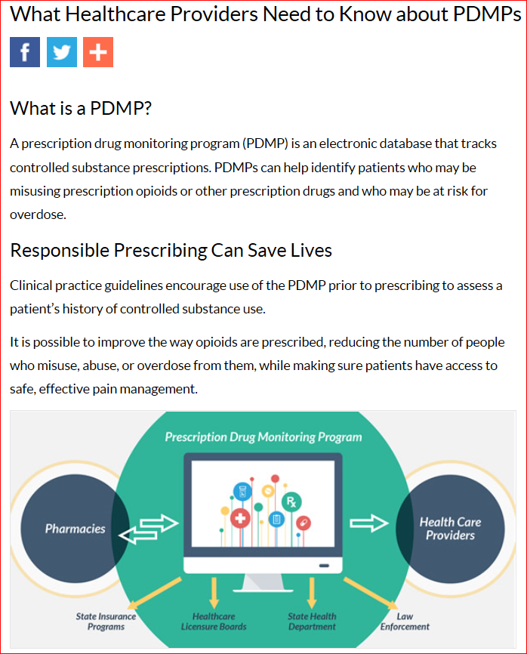
The prescription drug monitoring program provides valuable information even if you are not personally prescribing medication to the patient to optimize their overall care and coordinate care with other medical professionals.

Slide 22
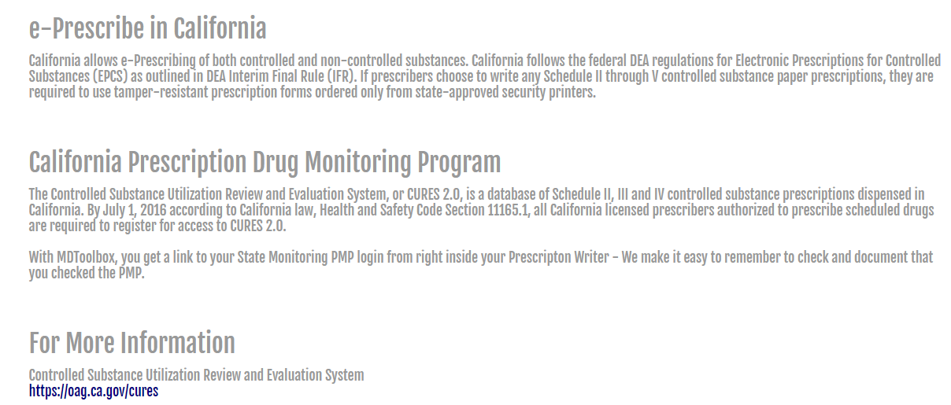
ELECTRONIC PRESCRIBING

Slide 23
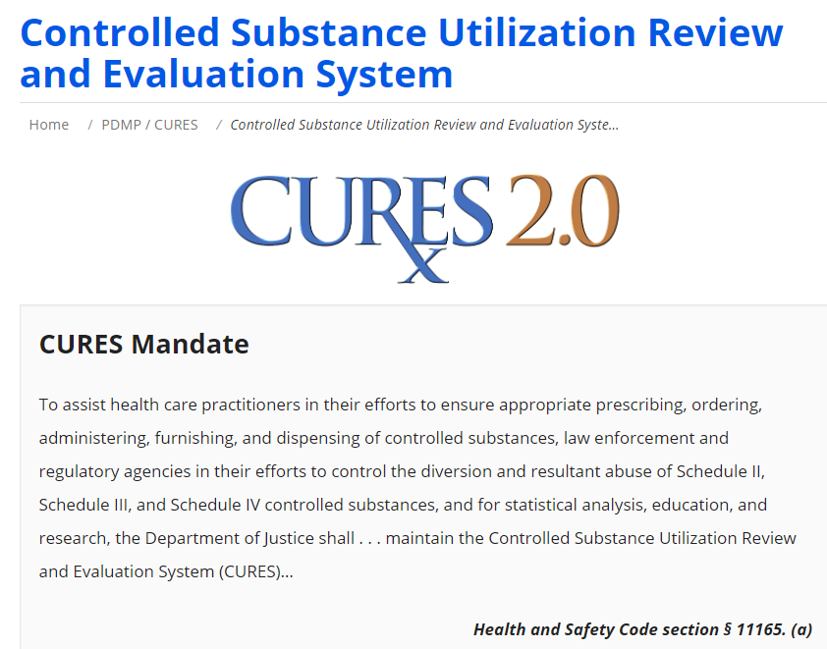
PRESCRIBING

Slide 24
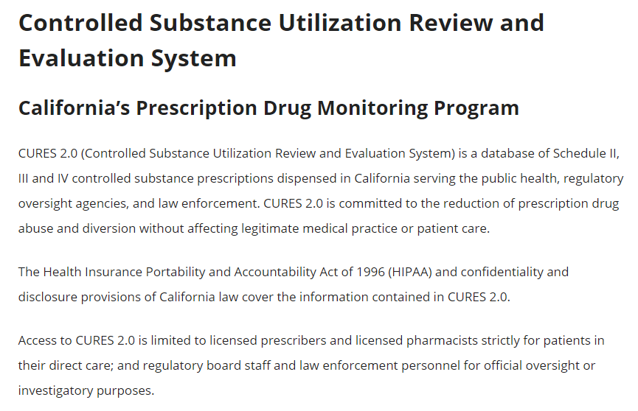
PRESCRIBING

Slide 25
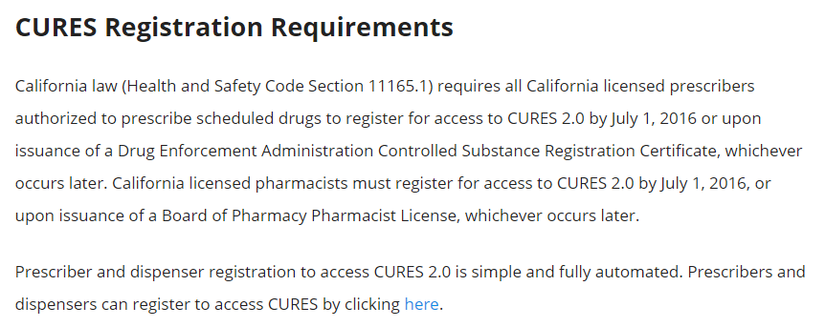
PRESCRIBING

Slide 26
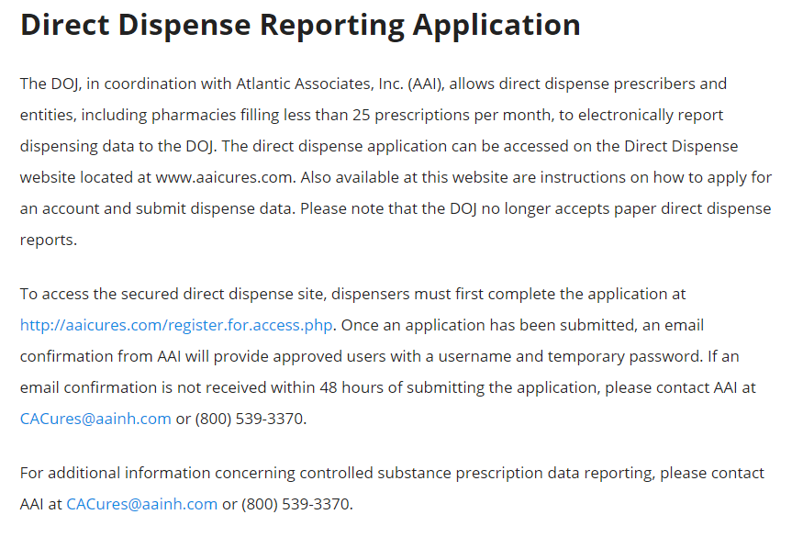
PRESCRIBING

Slide 27
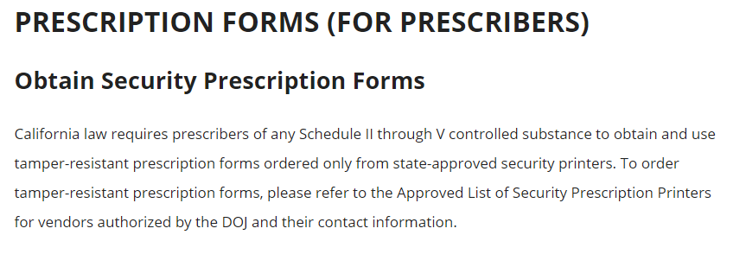
PRESCRIBING

Slide 28
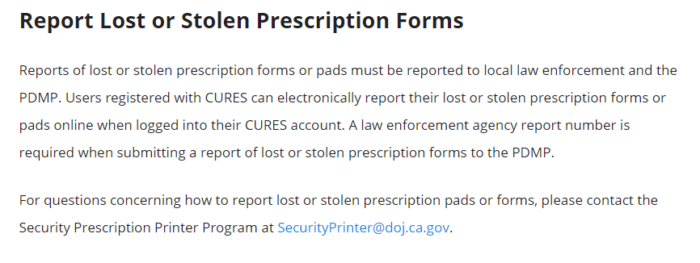
PRESCRIBING

Slide 29
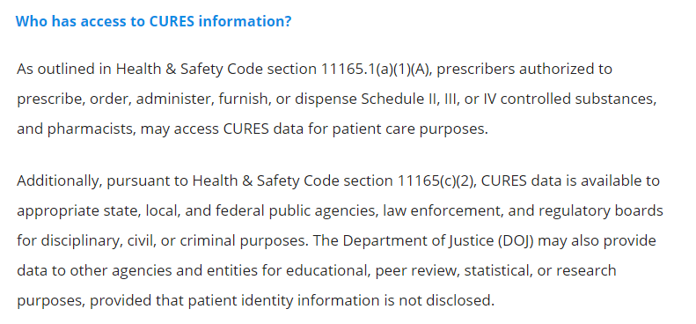
PRESCRIBING

Slide 30


ELECTRONIC PRESCRIBING
NEXTGEN and e-Clinical Works are the electronic medical record systems you will be using for electronic prescribing. A full orientation will be provided prior to seeing patients.

Slide 31
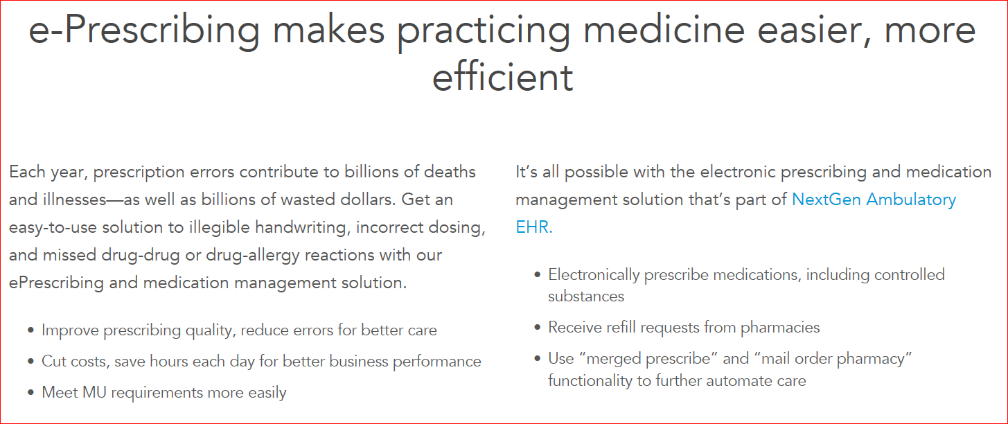
e-Prescribing assistance with EMR

Slide 32
5. Which of the following do not represent advantages of electronic medical prescribing or is false?
Illegible handwriting problems eliminated
Incorrect dosing minimized
Missed drug-drug or drug-allergy reactions minimized
Easier for misuse by patient

Slide 33
5. Which of the following do not represent advantages of electronic medical prescribing or is false?
Illegible handwriting problems eliminated
Incorrect dosing minimized
Missed drug-drug or drug-allergy reactions minimized
Easier for misuse by patient

Slide 34
Physicians/pharmacists and the patient-centered medical home
The patient-centered medical home (PCMH) has been characterized as a model of health care delivery that facilitates comprehensive and coordinated care. PCMH services are intended to be continuous, team-based, and actively involve patients and their caregivers.
The contributions of pharmacists to the team in areas such as: collaborative drug therapy management; health information technology; personalized medicine; and the integration of advocacy and community-engagement learning activities are essential toward improving the quality of care, cost-effectiveness, and the patient experience.
Relationships established between community pharmacists and community health center physicians is a professional partnership that supports and strengthens the PCMH model to optimize patient care.

Slide 35
Physicians/pharmacists and the patient-centered medical home
One of the underpinnings of a patient-centered medical home is the interprofessional team’s effectiveness in providing coordinated and integrated care.
Collaborative drug therapy agreements protocols help facilitate achievement of this goal.
Greater involvement of community health center physicians with pharmacists can assist in achieving quality improvement in many areas such as diabetes and smoking cessation therapy and or counseling.

Slide 36
FDA LINKS FOR INFORMATION/RESOURCES
General prescribing guidelines
https://google2.fda.gov/search?q=General+prescribing+guidelines&client=FDAgov&site=FDAgov&lr=&proxystylesheet=FDAgov&requiredfields=-archive%3AYes&output=xml_no_dtd&getfields=*
Electronic prescribing
https://google2.fda.gov/search?q=Electronic+prescribing&client=FDAgov&site=FDAgov&lr=&proxystylesheet=FDAgov&requiredfields=-archive%3AYes&output=xml_no_dtd&getfields=*

Slide 37
FDA LINKS FOR INFORMATION/RESOURCES
Prescribing roles for physician
https://google2.fda.gov/search?q=Prescribing+roles+for+physcian&client=FDAgov&site=FDAgov&lr=&proxystylesheet=FDAgov&requiredfields=-archive%3AYes&output=xml_no_dtd&getfields=*
Pharmacologist role in physician prescribing
https://google2.fda.gov/search?q=Pharmacologist+role+in+physician+prescribing&client=FDAgov&site=FDAgov&lr=&proxystylesheet=FDAgov&requiredfields=-archive%3AYes&output=xml_no_dtd&getfields=*

