Slide 1

MODULE six: pharmacology

Slide 2
MODULE six:
SECTION five:
Alternative medication
practices

Slide 3

UNIT OBJECTIVE
To learn about alternative medical practices that may be used to support treatment

Slide 4
Alternative medication practices
Review of Alternative Medicine including Traditional Chinese medicine (e.g. acupuncture, herbs and supplements)

Slide 5
ALTERNATIVE MEDICINE
Alternative medicine is defined loosely as a set of products, practices, and theories that are believed or perceived by their users to have the healing effects of medicine, but whose effectiveness has not been clearly established using scientific methods, or whose theory and practice is not part of biomedicine, or whose theories or practices are directly contradicted by scientific evidence or scientific principles used in biomedicine. "Biomedicine" or "medicine" is that part of medical science that applies principles of biology, physiology, molecular biology, biophysics, and other natural sciences to clinical practice, using scientific methods to establish the effectiveness of that practice. Unlike medicine, an alternative product or practice does not originate from using scientific methodology, but may instead be based on testimonials, religion, tradition, superstition, belief in supernatural energies, pseudoscience, errors in reasoning, propaganda, fraud, or other unscientific sources.

Slide 6
In General Guidelines for Methodologies on Research and Evaluation of Traditional Medicine, published in 2000 by the World Health Organization (WHO), complementary and alternative medicine were defined as a broad set of health care practices that are not part of that country's own tradition and are not integrated into the dominant health care system.
The expression also refers to a diverse range of related and unrelated products, practices, and theories ranging from biologically plausible practices and products and practices with some evidence, to practices and theories that are directly contradicted by basic science or clear evidence, and products that have been conclusively proven to be ineffective or even toxic and harmful.
The terms-Alternative medicine, complementary medicine, integrative medicine, holistic medicine, natural medicine, unorthodox medicine, fringe medicine, unconventional medicine, and new age medicine are used interchangeably as having the same meaning and are almost synonymous in some contexts, but may have different meanings in some rare cases.
ALTERNATIVE
MEDICINE

Slide 7
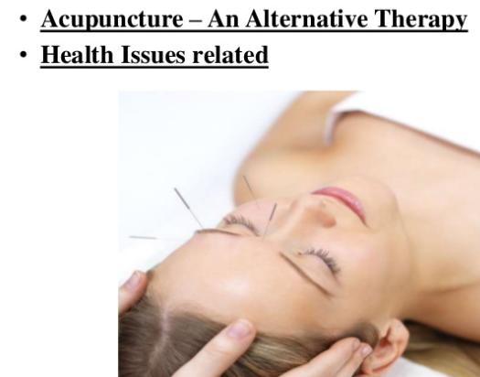

Slide 8
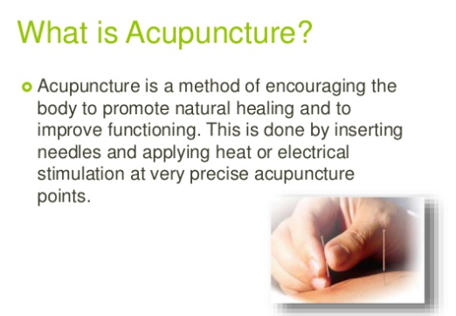

Slide 9
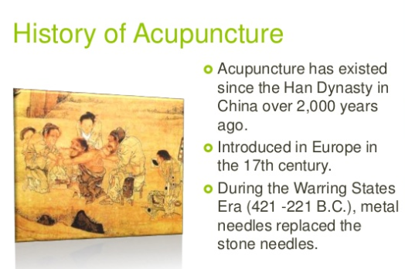

Slide 10
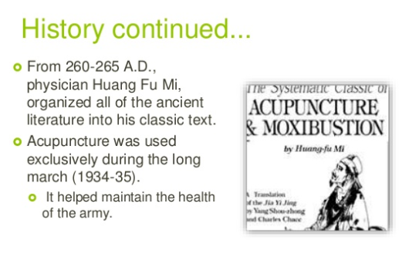

Slide 11
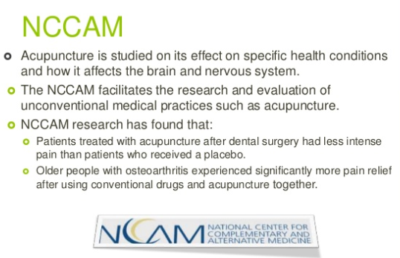

Slide 12
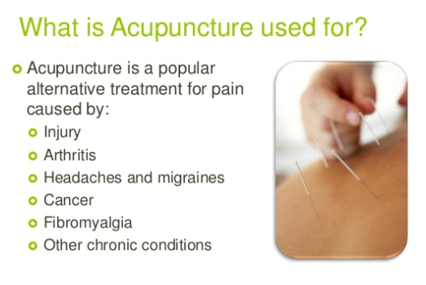

Slide 13
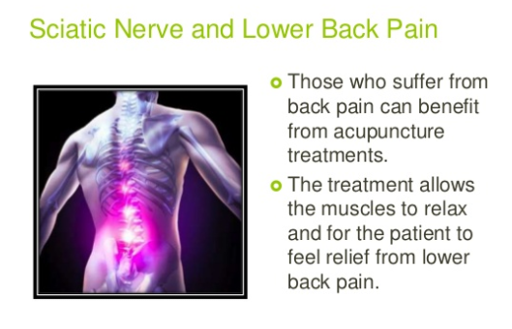

Slide 14
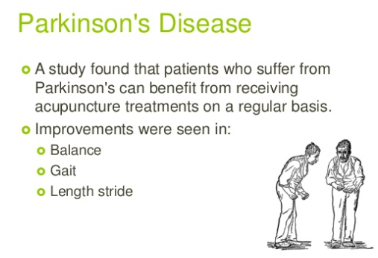

Slide 15
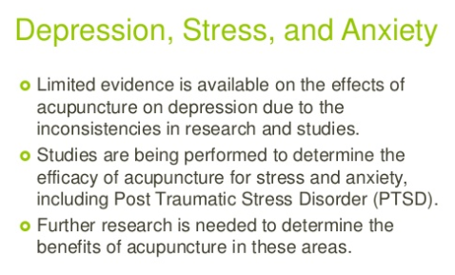

Slide 16
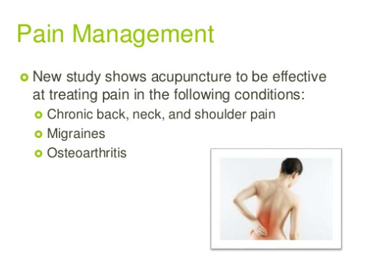

Slide 17
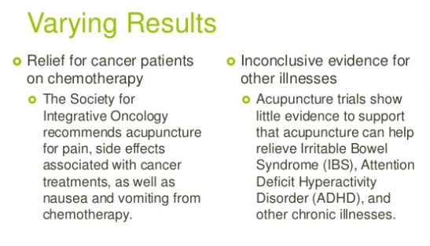

Slide 18
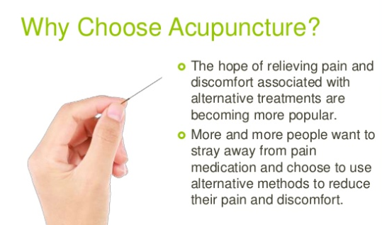

Slide 19
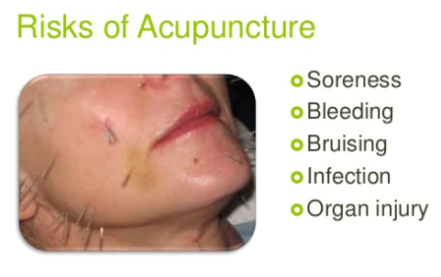

Slide 20
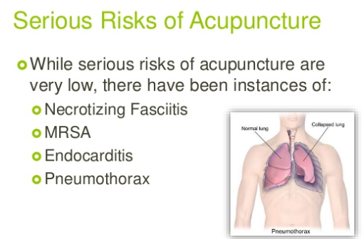

Slide 21
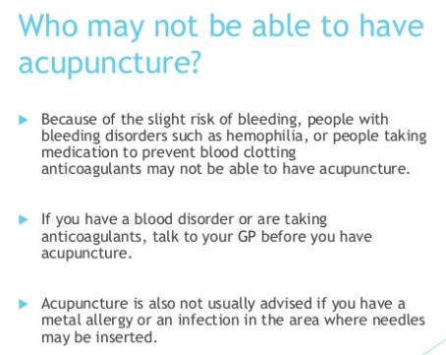

Slide 22
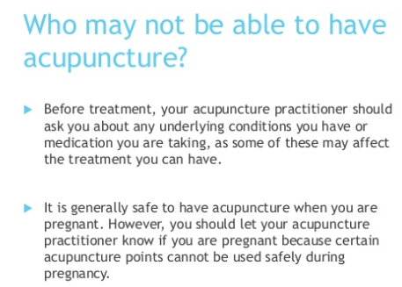

Slide 23
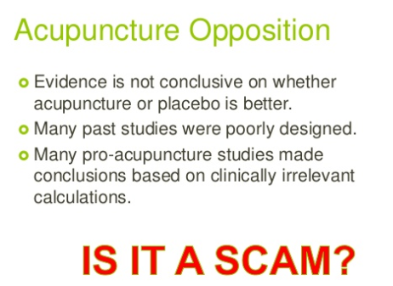

Slide 24
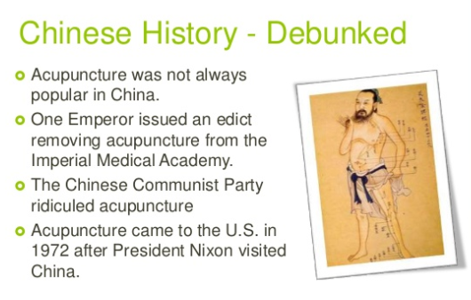

Slide 25
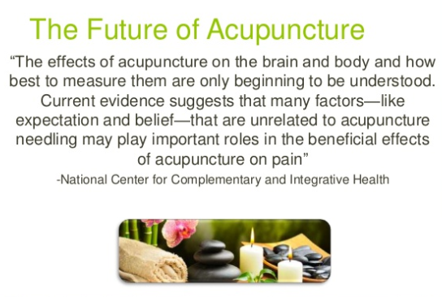

Slide 26
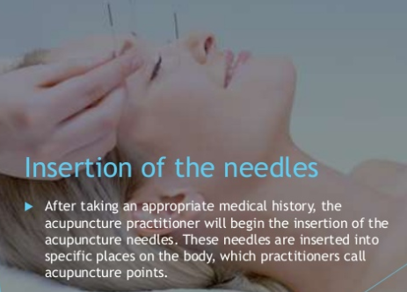

Slide 27
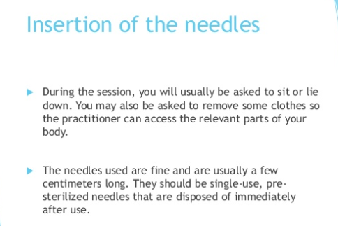

Slide 28
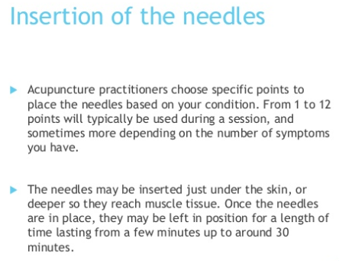

Slide 29
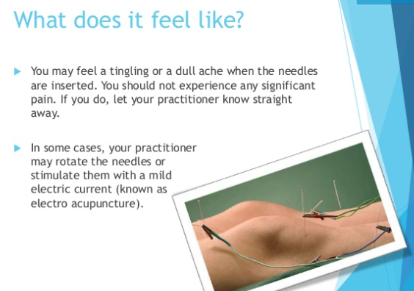

Slide 30
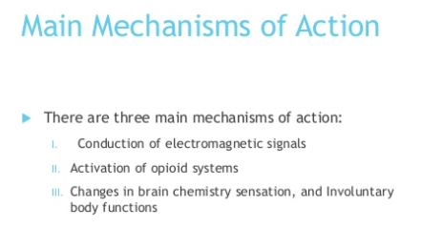
THEORY OF ACTION

Slide 31
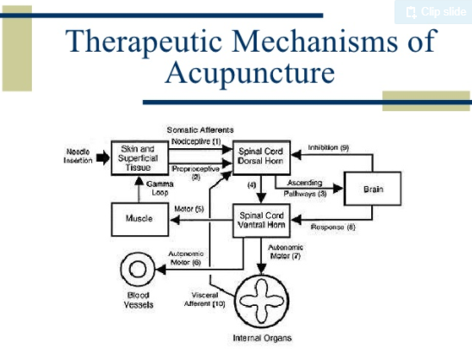

Slide 32
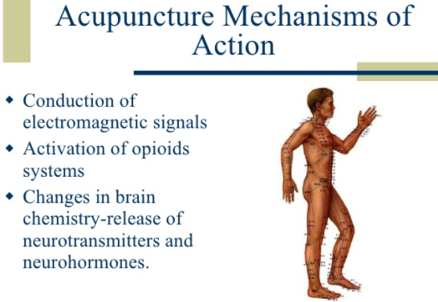

Slide 33
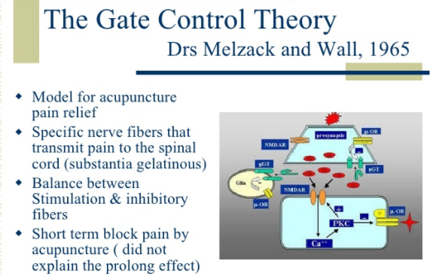

Slide 34
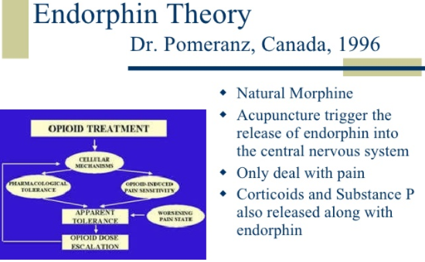

Slide 35
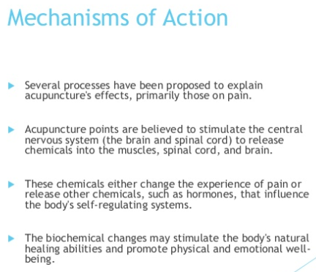

Slide 36
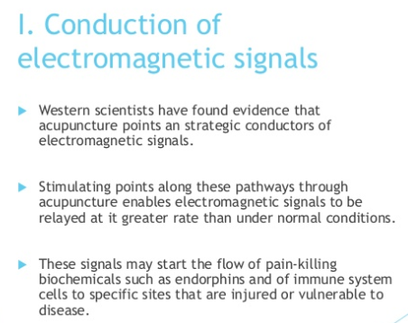

Slide 37
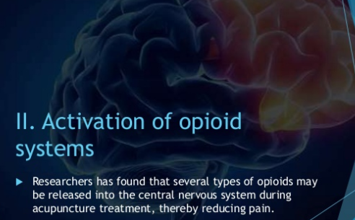

Slide 38
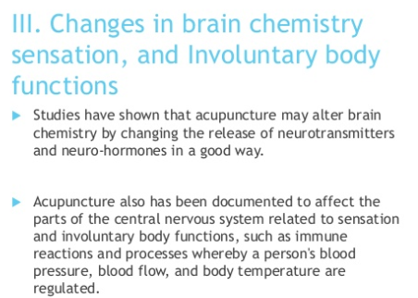

Slide 39
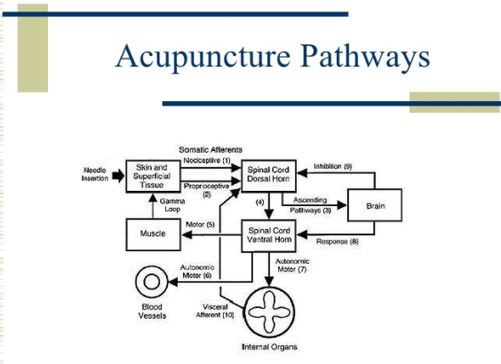

Slide 40
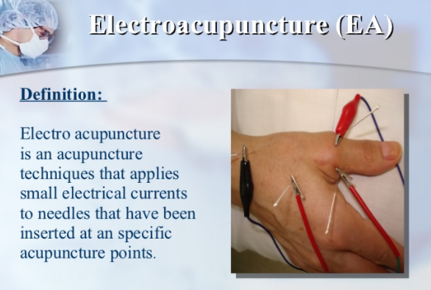

Slide 41
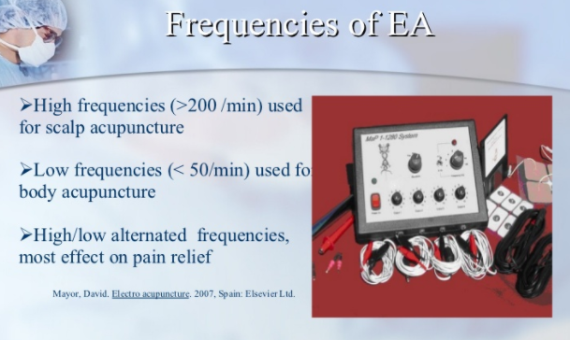

Slide 42
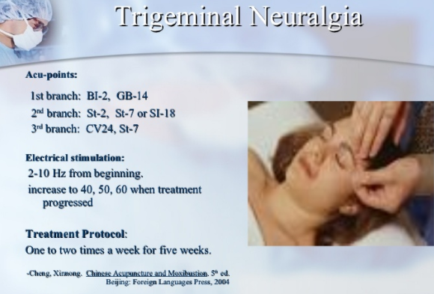

Slide 43
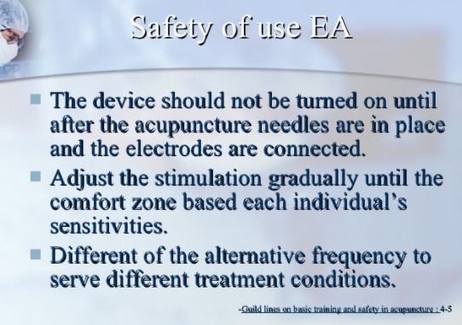

Slide 44
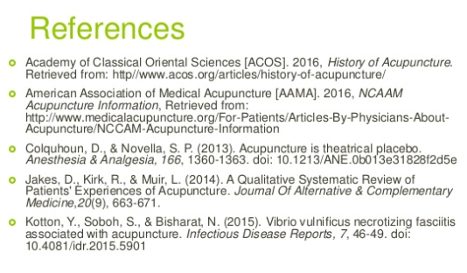

Slide 45
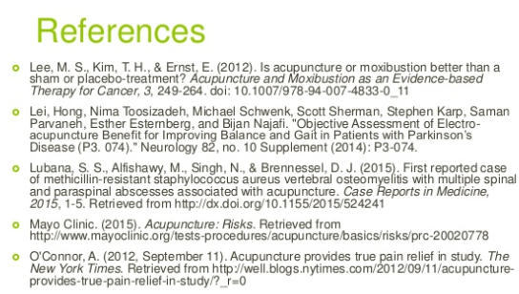

Slide 46
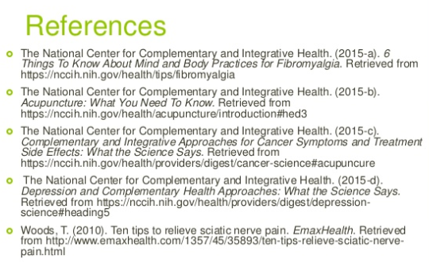

Slide 47
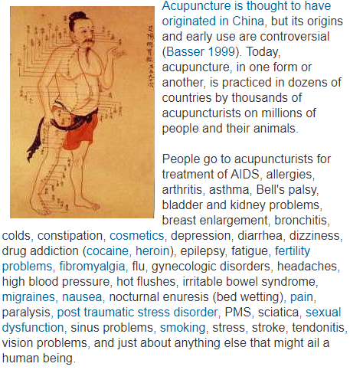
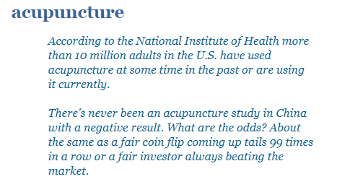

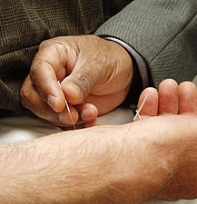
QUESTIONS TO FOLLOW

Slide 48
ALTERNATIVE MEDICINE review
ACCUPUNCTURE
1. According to the National Institute of Health the number of adults in the U.S. that have used acupuncture at some time in the past or are using it currently is which of the following?
10,000 people
100,000 people
1,000,000 people
10,000,000 people

Slide 49
ALTERNATIVE MEDICINE review
ACCUPUNCTURE
1. According to the National Institute of Health the number of adults in the U.S. that have used acupuncture at some time in the past or are using it currently is which of the following?
10,000 people
100,000 people
1,000,000 people
10,000,000 people

Slide 50
ALTERNATIVE MEDICINE review
ACCUPUNCTURE
Question: What is the name of the agency that facilitates the research and evaluation of unconventional medical practices such as acupuncture?
ANSWER: National Center for Complimentary and Alternative Medicine

Slide 51
ALTERNATIVE MEDICINE review
ACCUPUNCTURE
Question: The National Center for Complimentary and Alternative Medicine has found that which of the following is true?
a. Patients treated with acupuncture after dental surgery had less intense pain than patients who received a placebo.
b. Older people with osteoarthritis experienced significantly more pain relief after using conventional drugs and acupuncture together.
c. Acupuncture was shown to cure cancer in long term studies
d. Acupuncture was shown to cure Irritable Bowel Syndrome
ANSWER: a and b are true, c and d are false

Slide 52
ALTERNATIVE MEDICINE review
ACCUPUNCTURE
Question: Name at least recognized risks of acupuncture.
ANSWER: Necrotizing Fasciitis, MRSA Skin Infections, Endocarditis, and Pneumothorax

Slide 53
ALTERNATIVE MEDICINE review
ACCUPUNCTURE
Question: The Society for Integrative Oncology recommends acupuncture for which of the following indications?
a. Pain associated with cancer
b. Side effects associated with cancer treatments
c. Nausea and vomiting from chemotherapy
d. All of the above
ANSWER: d. All of the above

Slide 54
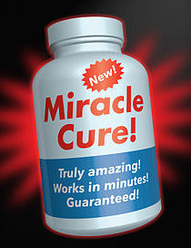

ALTERNATIVE MEDICINE PRACTICES

Slide 55


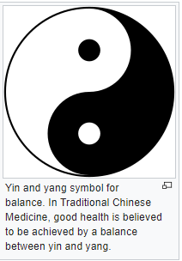
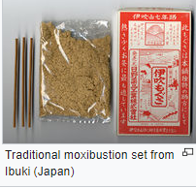
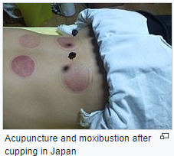
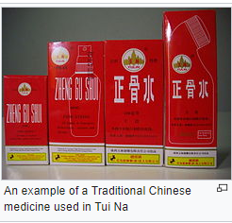



Slide 56




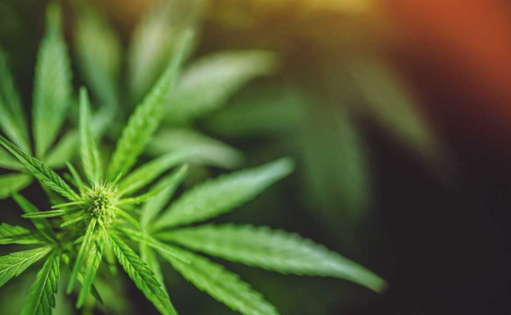
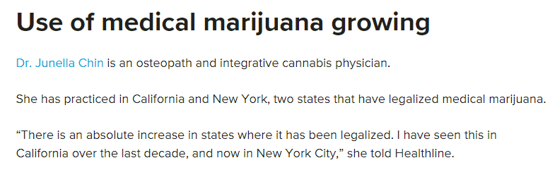

Slide 57








Slide 58


Slide 59

JOHNS HOPKINS MEDICINE, 2017
MULTIPLE LINKS RELATED TO COMPLEMENTARY AND ALTERNATIVE MEDICINE
MAIN LINK FOR THIS AREA https://www.hopkinsmedicine.org/healthlibrary/conditions/adult/complementary_and_alternative_medicine/home_page_-_complementary_and_alternative_medicine_85,p00185

Slide 60
Alternative medicine
WHAT TRADITIONAL MEDICAL ORGANIZATIONS HAVE RESOURCES TO FIND OUT INFORMATION ABOUT ALTERNATIVE MEDICINE?
ANSWER: JOHN HOPKINS UNIVERSITY (SEE LINK TO WEBSITE)

Slide 61
FDA LINKS FOR INFORMATION/RESOURCES traditional Chinese medicine
Traditional Chinese medicine
https://google2.fda.gov/search?q=Traditional+Chinese+medicine&client=FDAgov&site=FDAgov&lr=&proxystylesheet=FDAgov&requiredfields=-archive%3AYes&output=xml_no_dtd&getfields=*
QUESTION TO FOLLOW

Slide 62
2. All of the following are serious risks of acupuncture that have been described, except for the following:
a) Bowel obstruction
b) Necrotizing fasciitis
c) MRSA skin infection
d) Endocarditis
e) Pneumothorax

Slide 63
2. All of the following are serious risks of acupuncture that have been described, except for the following:
a) Bowel obstruction
b) Necrotizing fasciitis
c) MRSA skin infection
d) Endocarditis
e) Pneumothorax

Slide 64
3. The following represent possible contra indications to acupuncture therapy except for which of the following:
Arthritis
Hemophilia
Taking anticoagulants
Metal allergy

Slide 65
3. The following represent possible contra indications to acupuncture therapy except for which of the following:
Arthritis
Hemophilia
Taking anticoagulants
Metal allergy

Slide 66
4. What medication is used for First line medication therapy for acute angina symptoms and prophylaxis later?
Nitrates
Ibuprofen
Calcium Channel Blockers
Angiotensin Enzyme Converters

Slide 67
4. What medication is used for First line medication therapy for acute angina symptoms and prophylaxis later?
Nitrates
Ibuprofen
Calcium Channel Blockers
Angiotensin Enzyme Converters

Slide 68
5. What type of medication therapy is recommended by a consensus of cardiology organizations to reduce angina episodes and improve exercise tolerance?
Beta Blockers
Thiazide Diuretics
Anticoagulants

Slide 69
5. What type of medication therapy is recommended by a consensus of cardiology organizations to reduce angina episodes and improve exercise tolerance?
Beta Blockers
Thiazide Diuretics
Anticoagulants

