Slide 1

MODULE seven:
MEDICAL REVIEW
(CASE STUDIES AND
RESOURCES)

Slide 2
MODULE seven:
SECTION one:
Abbreviations
commonly used
in medicine

Slide 3
Unit objective
To learn and feel comfortable using common medical abbreviations if needed

Slide 4
Abbreviations commonly used in medicine
List of common abbreviations
Exercise (self review)

Slide 5
MEDICAL ABBREVIATION REVIEW
You will not be formally tested on this section although self testing could be utilized if desired.
In general, the Joint Commission on Accreditation of Ambulatory Health Centers discourages the use of abbreviations.
This section is considered low priority for memorization purposes.
If you encounter abbreviations they hopefully will be on the lists provided and this information can be used as a resource.

Slide 6
MEDICAL ABBREVIATION REVIEW
The following list of abbreviations is an example from one of the community health centers that you will be working at in the future.

Slide 7
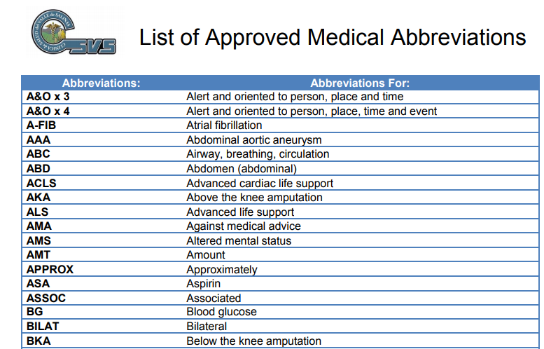

Slide 8
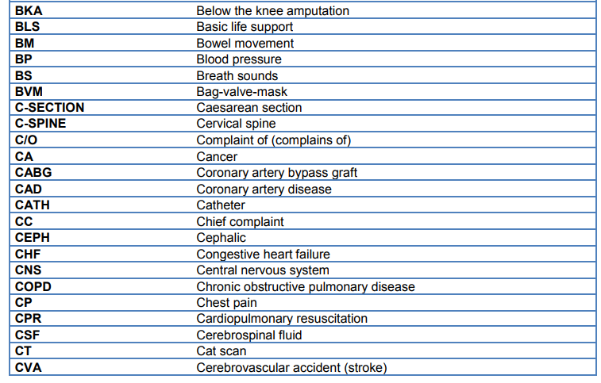
List of Approved Medical
Abbreviations continued

Slide 9
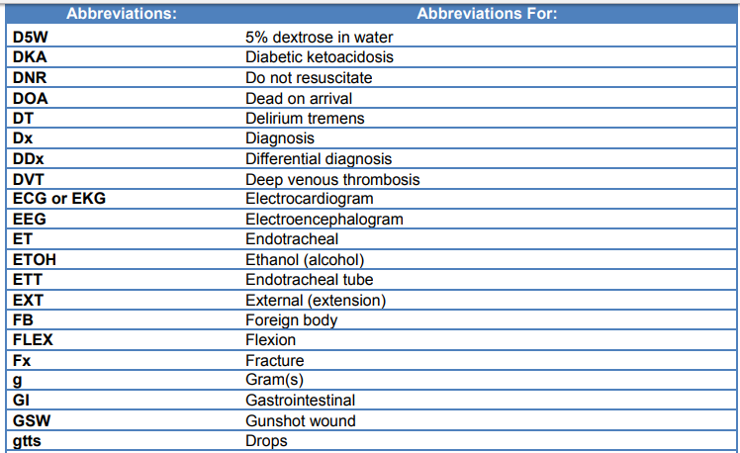
List of Approved Medical
Abbreviations continued

Slide 10
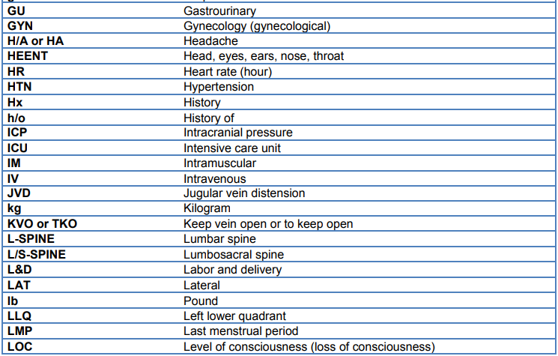
List of Approved Medical
Abbreviations continued

Slide 11
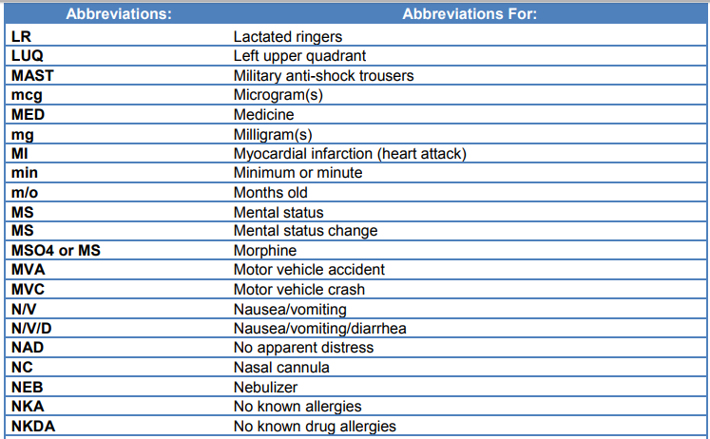
List of Approved Medical
Abbreviations continued

Slide 12
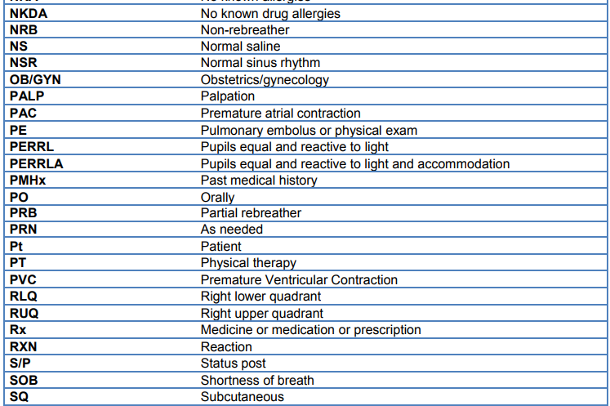
List of Approved Medical
Abbreviations continued

Slide 13
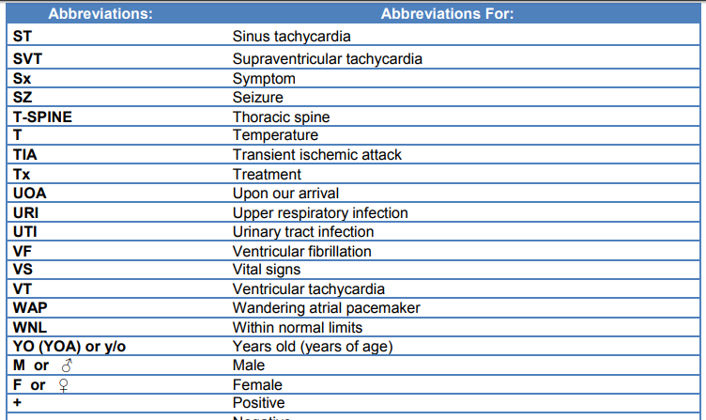
List of Approved Medical
Abbreviations continued

Slide 14
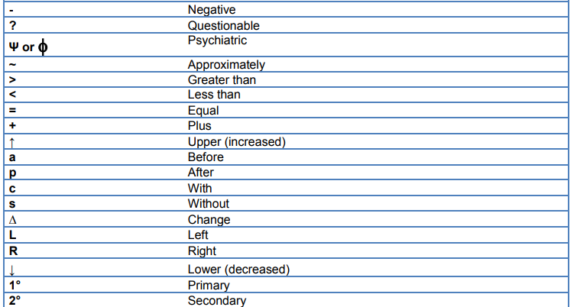
List of Approved Medical
Abbreviations continued

Slide 15
California Department of Health Care Services Abbreviations and Acronyms
This section is to be used only for reference purposes and not to be memorized (review is optional) You will not be tested on this information.
http://www.dhcs.ca.gov/services/HCPCFC/Documents/Section8.pdf
This section provides commonly used abbreviations and acronyms used by the California Department of Health Services and the California Department of Social Services. (When there have been duplications of abbreviations and acronyms, they may only show different meanings in different sections.)

Slide 16
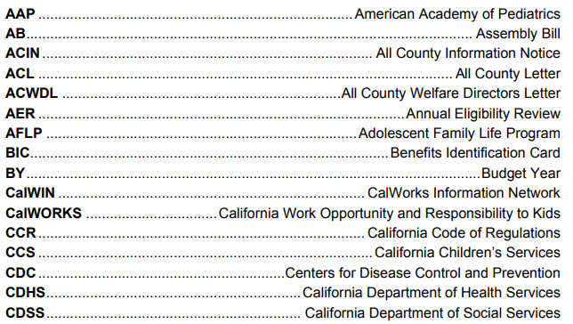
California Department of Health Care Services Abbreviations and Acronyms

Slide 17
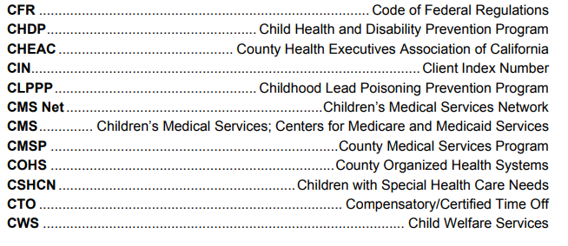
California Department of Health Care Services Abbreviations and Acronyms

Slide 18
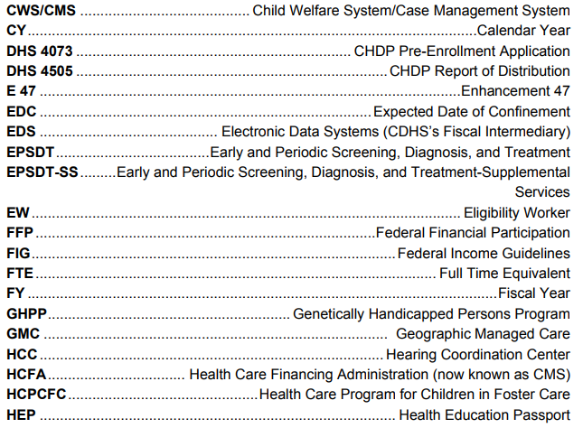
California Department of Health Care Services Abbreviations and Acronyms

Slide 19
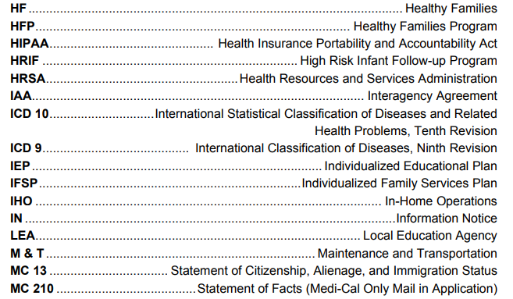
California Department of Health Care Services Abbreviations and Acronyms

Slide 20
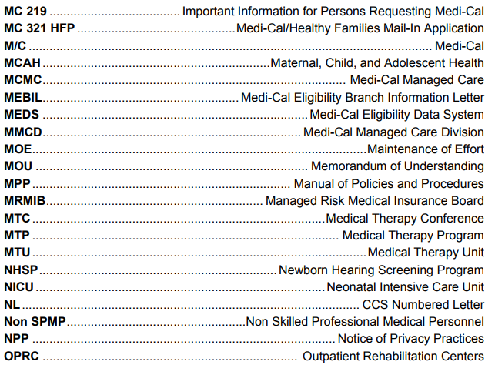
California Department of Health Care Services Abbreviations and Acronyms

Slide 21
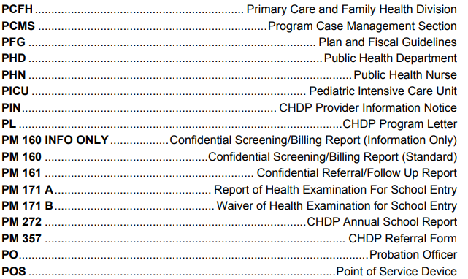
California Department of Health Care Services Abbreviations and Acronyms

Slide 22
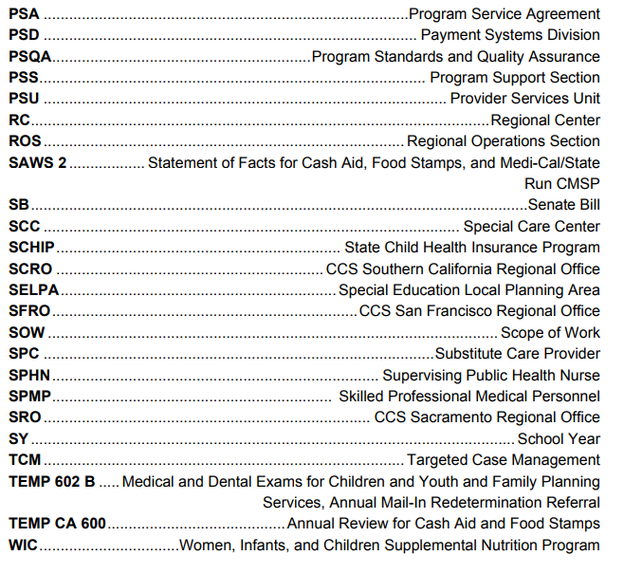
California Department of Health Care
Services Abbreviations and Acronyms

Slide 23
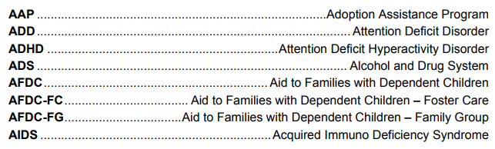
California Department of Social Services Abbreviations and Acronyms

Slide 24
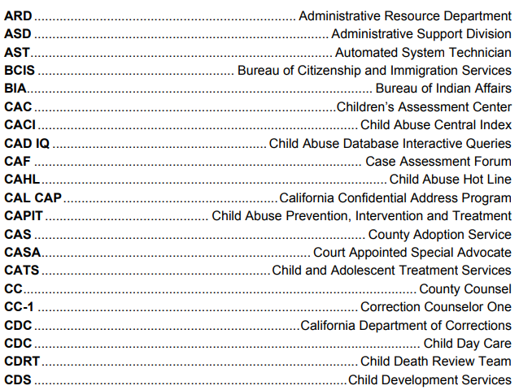
California Department of Social Services Abbreviations and Acronyms

Slide 25
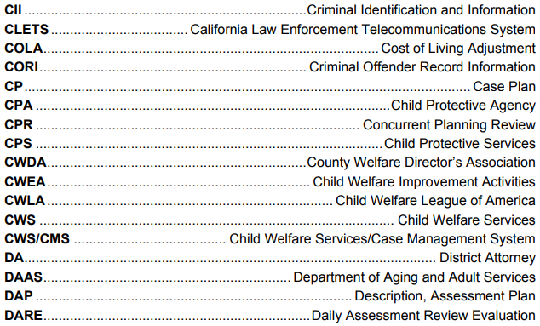
California Department of Social Services Abbreviations and Acronyms

Slide 26
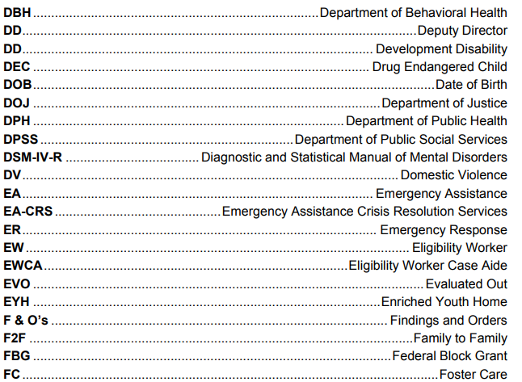
California Department of Social Services Abbreviations and Acronyms

Slide 27
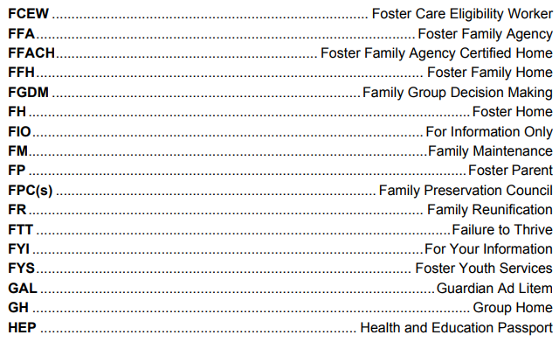
California Department of Social Services Abbreviations and Acronyms

Slide 28
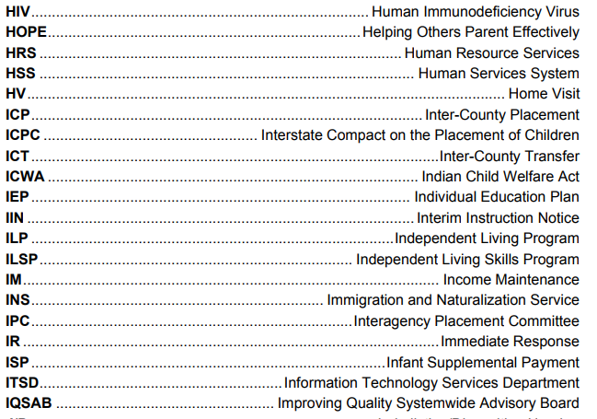
California Department of Social Services Abbreviations and Acronyms

Slide 29
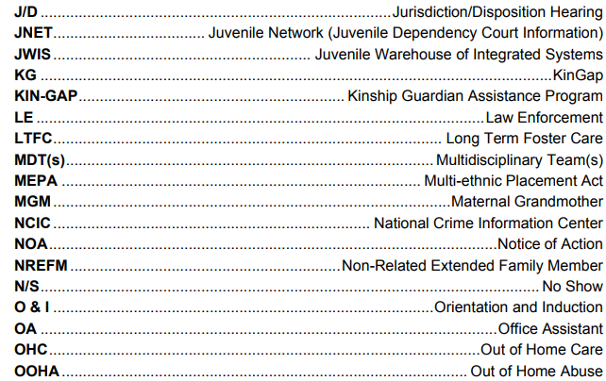
California Department of Social Services Abbreviations and Acronyms

Slide 30
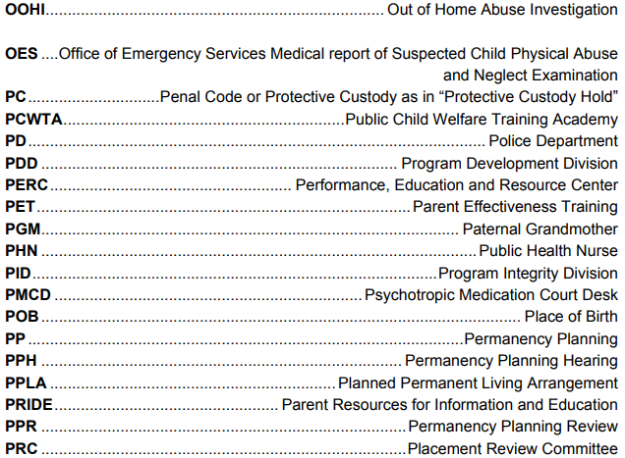
California Department of Social Services Abbreviations and Acronyms

Slide 31
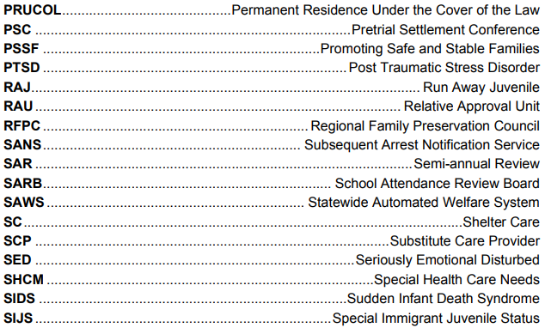
California Department of Social Services Abbreviations and Acronyms

Slide 32
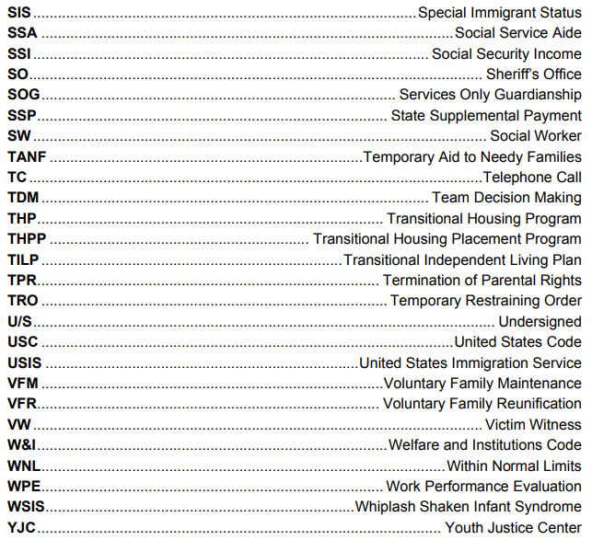
California Department of Social Services Abbreviations and Acronyms

Slide 33
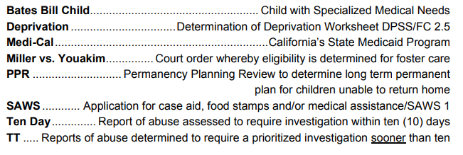

Definitions (Related to Social Services)

Slide 34
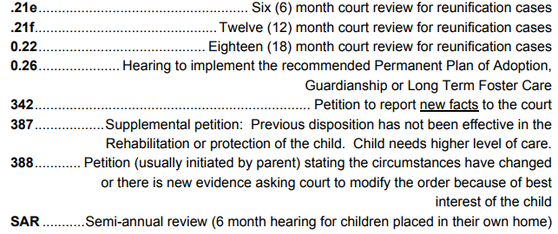
Definitions
(Related to Social Services)

Slide 35
For reference use only
UNITED SPINAL ASSOCIATION – ALPHABETICAL LISTING OF MEDICAL ABBREVIATIONS
THERE ARE A NUMBER OF ABBREVIATIONS THAT CAN MEAN TWO DIFFERENT THINGS WHICH CAUSES CONFUSION AT TIMES
THE FOLLOWING IS A LINK THAT GIVES A MORE EXHAUSTIVE LIST OF ABBREVIATIONS THAT IS 24 PAGES LONG
PREVIOUSLY PROVIDED WAS A LIST OF APPROVED ABBREVIATIONS FROM CLINICA DE SALUD DEL VALLE SALINAS
ALSO PREVIOUSLY PROVIDED WAS A LIST OF APPROVED ABBREVIATIONS FROM THE CALIFORNIA DEPARTMENT OF HEALTH CARE SERVICES AND SOCIAL SERVICES ABBREVIATIONS AND ACRONYMS
UNITED SPINAL ASSOCIATION ABBREVIATIONS https://www.unitedspinal.org/resource-center/askus/?pg=kb.page&id=1413

