Slide 1

MODULE seven: medical review (case studies and resources)

Slide 2
MODULE seven:
SECTION two:
clinical case studies

Slide 3
Unit objective
To learn about and review typical patient scenarios to recognize the value of access to primary care services and to feel more comfortable with the practical aspects of medical practice in this clinical setting.

Slide 4
Clinical case studies
Information regarding basis for clinical case studies
Examples of clinical case studies

Slide 5
Case studies for demonstration of the value of access to quality primary care and associated improved outcomes and improved resource management
The learning objective for these case scenarios is not for the purpose of illustrating the details of any specific medical care, but to merely show how simple access to primary care can have the following benefits to the individual patient and society in general.
1. Reduce morbidity and mortality by either preventive services, early intervention, or continuity of care services.
2. Improve the quality of care outcomes.
3. Improve resource management.
4. Reduce inappropriate utilization of emergency rooms.
5. Improve opportunity of attaining the goal of eliminating health care disparities in an affordable fashion.

Slide 6
CASE STUDY; IMPROVEMENT OPPORTUNITY FOR Access TO CARE AND ELIMINATE HEALTH CARE DISPARITY
CASE PRESENTATION: 30 year old Latina female had a long standing history of psoriasis had noticed what she thought was a flare-up of her psoriasis, but was unable to get into her primary physician after trying for a week to get an appointment. The family was concerned but just thought it was a flare up of her psoriasis and did not take her to the emergency room.
The above patient then collapsed and 911 was called and the patient was taken to the hospital where there was a presumptive diagnosis of septic shock after she was noted to be hypotensive and thought to have a cellulitis. The patient later that day coded and was unable to be resuscitated.
DISCUSSION: This is an example of a health care disparity created by a shortage of primary care or some other health care related assess to care that can be prevented by reducing the shortage of primary health care providers including physicians.
CONCLUSION: This is just one example, but there are many others involving such conditions such as diabetes where easily accessible primary care would for very little resources prevent a catastrophic disaster from occurring.

Slide 7
CASE STUDY; IMPROVEMENT OPPORTUNITIES FOR QUALITY, Access TO CARE AND ELIMINATE HEALTH CARE DISPARITY
CASE PRESENTATION: 46 year old Latina female had a long standing history of a seizure disorder had ran out her anticonvulsant medication. She was unable to find a new reliable primary care physician as her physician had recently retired. After trying for a week to get an appointment in a clinic the patient finally obtained an appointment one week out. The family was concerned but did not insist to take the patient to the emergency room for the refill because in the past they had merely been told they needed to find a new primary care provider and refused to refill the medication.
The above patient, then at home, began convulsing and 911 was called and the patient was taken to the hospital. In the ER the patient was given a diagnosis of status epilepticus complicated by aspiration pneumonia. The patient’s condition subsequently deteriorated and she was coded, but was unable to be resuscitated.
DISCUSSION: This is an example of a health care disparity created by a shortage of primary care provider or some other health care related assess to care problem that could have been prevented by reducing the shortage of primary health care providers including physicians including access to care.
CONCLUSION: This is yet another example where easily accessible primary care would for very little resources prevent a catastrophic disaster from occurring.

Slide 8
CASE STUDY; IMPROVEMENT OPPORTUNITIES FOR RESOURCE MANAGEMENT, QUALITY AND ACCESS TO CARE ISSUES
CASE PRESENTATION: 20 year old Hispanic male that had been working lifting hay bails noted the sudden onset of a sharp severe pain in the area of his umbilicus. The patient was very concerned, but was not able to get in to see his regular primary care physician. Therefore he went to the emergency room for evaluation. In the emergency room it was very busy and the ER physician obtained a very brief history and did a very limited exam. Subsequently abd-xrays, blood tests and eventually a CT scan was ordered. The results did not clearly identify the problem and the patient was given omeprazole and was referred to a gastroenterologist.
The patient was still having problems with discomfort and after pleading with reception was able to get in with their primary care physician. Their primary care physician spent much more time with the patient and obtained a much more detailed history and performed a much more comprehensive physical examination than the ER physician. The primary care physician was able to determine the diagnosis and administer immediate low cost treatment and quality care. They removed the “sharp seed or burr from apparently from the hay” that was hidden from easy identification and was lodged in their umbilicus which was deeper than most. There was instant relief in the pain after the “sharp seed or burr” was easily removed.
DISCUSSION: This is an example of how improved access to primary physician care would improve quality care and greatly improve resource management or lower health care costs.

Slide 9
CASE STUDY; IMPROVEMENT OPPORTUNITIES FOR Access, QUALITY AND RESULTANT RESOURCE MANAGEMENT
CASE PRESENTATION: 43 year old Hispanic male that has a long standing history of diabetes complicated by neuropathy and has been compliant with his long list of medications for diabetes, hypertension, and hyperlipidemia. The patient developed a foot ulcer but had no significant pain and did not notice it was red. The primary care physician was on vacation when the patient noticed the change in appearance. The patient wanted to see their primary care physician group covering physician until their physician returned from vacation, but they were unable to accommodate him until one week from then. While the patient was waiting for care his whole leg became red and swollen with red streaks up to his groin. The patient then went to the emergency room and was admitted to the hospital where he was thought to have a severe cellulitis complicated by osteomyelitis requiring subsequent amputation of his foot and prolonged intravenous antibiotic therapy.
DISCUSSION: This unfortunate complication could have been prevented with easier access to primary care as there was insufficient primary care physicians or other providers to cover for the physician on vacation; resulting in a delay of a timely recognition of an early mild cellulitis which could have prevented the loss of the foot and tremendous expenses related to these complications.

Slide 10

CASE STUDY; IMPROVEMENT OPPORTUNITIES FOR Access, QUALITY AND RESULTANT RESOURCE MANAGEMENT
CASE PRESENTATION: 20 year old Hispanic female that was a prim gravida and had been obtaining obstetrical care elsewhere but the patient had moved recently. The local physician was always short staffed down at least two physicians, but she prided herself in not turning away patients. However, finally she took a much needed vacation and the locum tenens coverage that had been arranged was not able to cover after all. The patient is this small community did not have many options for care coverage. However, the patient developed some back pain and feverishness. The patient did not initially go to the hospital due to the distance from the town in which she lived trying to wait for access to prenatal care in the town where she lived. The patient’s symptoms worsened and so the patient sought care for at the hospital almost an hour away ultimately requiring an emergency C-section complicated by chorioamnionitis resulting in a premature infant and also required prolonged intravenous antibiotic therapy. The infant also needed special care at great expense.
DISCUSSION: This unfortunate complication perhaps could have been prevented with easier access to obstetrical prenatal primary care as there was insufficient primary care physicians or other providers to cover for the physician on vacation. The premature birth and premature obstetrical admission and tremendous expenses related to these complications for mother and infant potentially could have been prevented (by early intervention and treatment of a urinary tract infection).

Slide 11
CASE STUDIES ARE ILLUSTRATIVE OF
OPPORTUNITIES FOR IMPROVEMENT
IN BOTH Access, quality AND RESOURCE MANAGEMENT
Thanks to the combined efforts of the following health care advocates including the community health centers, the California Legislature and especially the Medical Board of California for recognizing the need and to use every reasonable method possible to provide a pathway of increasing the availability of qualified physicians to further address this health care shortage as well as recognizing the need to do so in a manner that will prevent catastrophes, improve quality of care, as well as, optimize resource management.

Slide 12
IMPROVEMENT in timely access to care saves lives, reduces morbidity, and reduces costs
TAKE HOME MESSAGE
Question:
What are the benefits to society of timely easy access to care for patients in a primary care setting?
Answer:
By having medical problems either prevented by primary care services or problems identified early in the clinical course so they can be taken care easily or dealt with providing a much lower mortality and or morbidity and with much less expense or resource utilization.

Slide 13
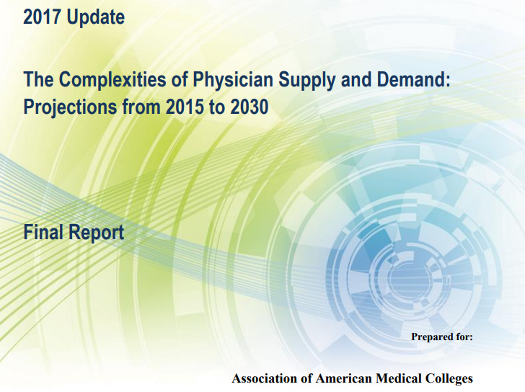
LOOKING TO THE FUTURE OF ACCESS TO CARE

Slide 14
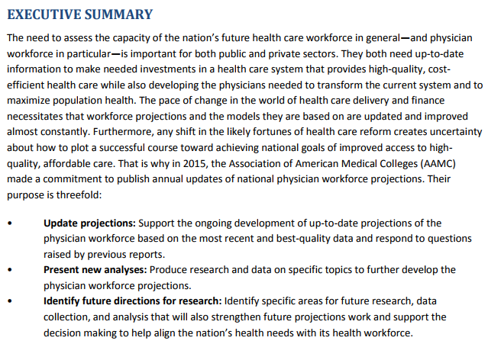
PHYSICIAN DEMAND IS MUCH GREATER THAN SUPPLY

Slide 15
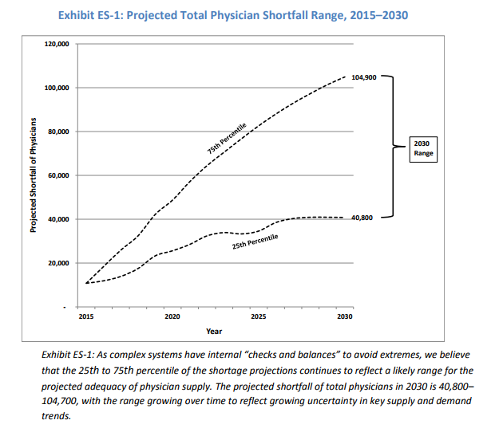
FUTURE PROJECTIONS
PREDICT
A TREMENDOUS SHORTAGE
OF TOTAL PHYSICIANS OF
ALL SPECIALITIES

Slide 16
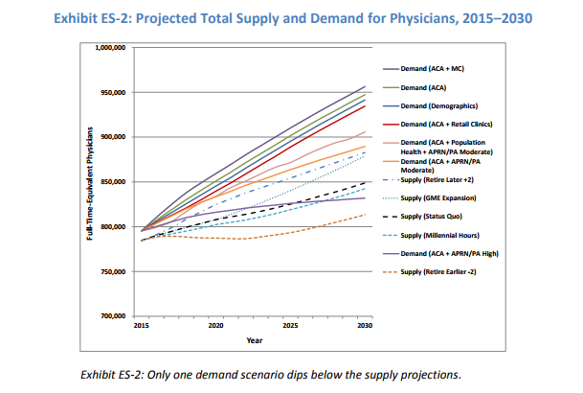
DEMAND FOR
PHYSICIANS
GREATER THAN
SUPPLY PER
PROJECTIONS

Slide 17
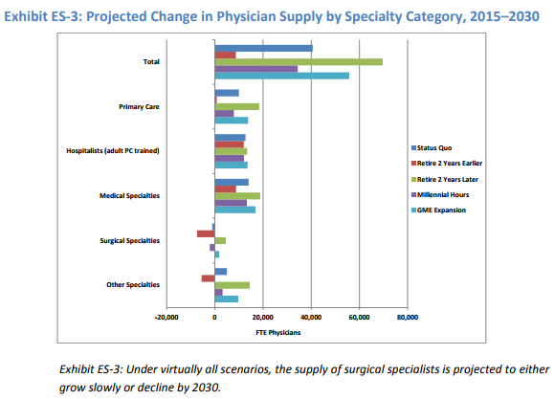
AGAIN PREDICTION
THAT FUTURE SUPPLY
WILL NOT MEET
DEMAND

Slide 18
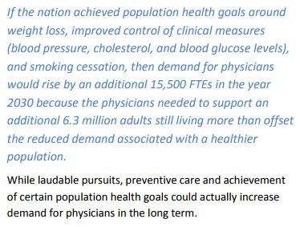
Projection of future physician shortage in the USA to meet goals to reduce health disparity

Slide 19
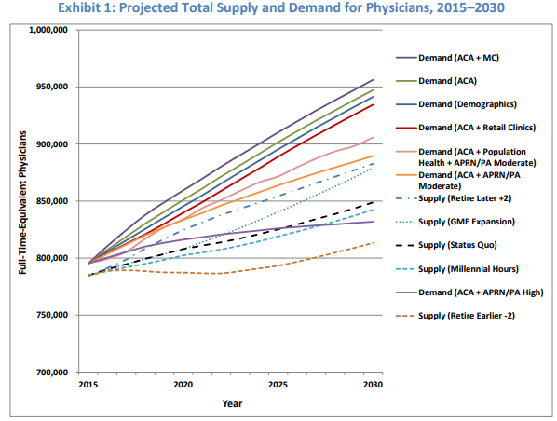
FUTURE DEMAND FOR
PHYSICIANS ANTICIPATED
TO BE MUCH LESS THAN
SUPPLY

Slide 20
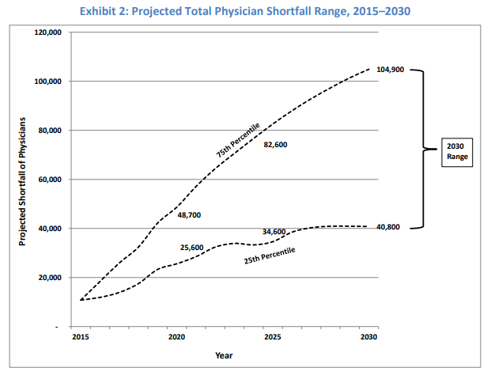
TREMENDOUS SHORTFALL
OF PHYSICIANS ANTICIPATED
BY 2030
AGAIN DEMAND
EXCEEDS SUPPLY

Slide 21
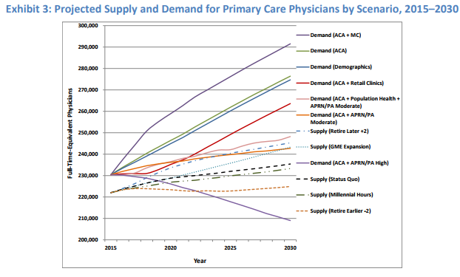
DEMAND OF FURTURE PHYSICIANS CLEARLY EXCEEDS SUPPLY

Slide 22
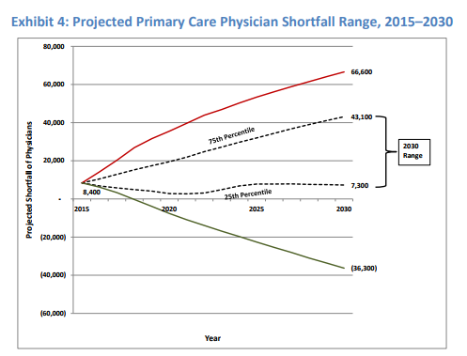
DEMAND MUCH
GREATER THAN SUPPLY
PROJECTED OVER THE
NEXT 15 YEARS

Slide 23
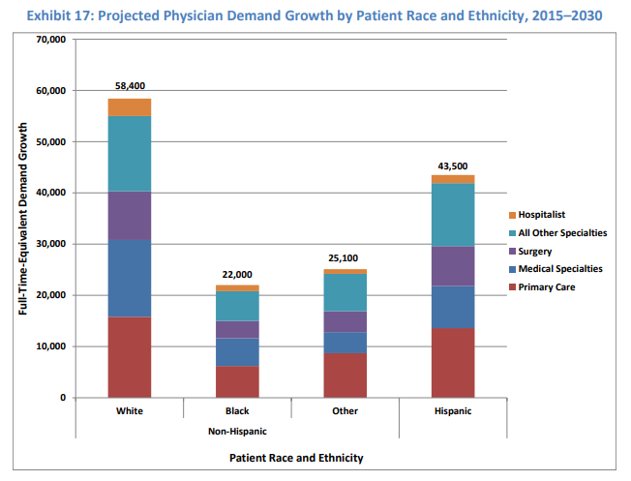
PHYSICIAN DEMAND EXCEEDING SUPPLY IN ALL CATEGORIES

Slide 24
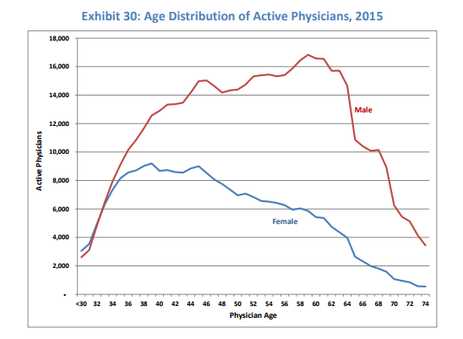
FEMALE PHYSICIANS TEND TO RETIRE AT A MUCH EARLIER AGE THAN THEIR MALE COUNTERPART

Slide 25
TAKE HOME MESSAGE
There is a tremendous shortage of physicians and your presence will improve quality of care, improve access to care, as well as improve resource management. At the same time there should be a reduction in morbidity and mortality.
QUESTIONS TO FOLLOW

Slide 26
1. As a physician working for a community health center please identify the most important entity of the organization.
a) Collection department
b) Board of Directors
c) Patient

Slide 27
1. As a physician working for a community health center please identify the most important entity of the organization.
Collection department
Board of Directors
Patient

Slide 28
2. As a physician working for community health center when you agree to see a patient that otherwise would have been turned away, which of the following is a nominated outcome?
Access to care improved for that patient
Reduce inappropriate utilization in emergency rooms
Improve opportunities for early intervention to optimize health care resources and decrease mortality and morbidity
Nursing staff works an extra thirty minutes

Slide 29
2. As a physician working for community health center when you agree to see a patient that otherwise would have been turned away, which of the following is a nominated outcome?
Access to care improved for that patient
Reduce inappropriate utilization in emergency rooms
Improve opportunities for early intervention to optimize health care resources and decrease mortality and morbidity
Nursing staff works an extra thirty minutes

Slide 30
3. Please select the best answer to the following question. Primary care services that move toward eliminating health disparities benefits include the following:
Problem identified early in clinical course so they can be dealt with more early
By improving access more cost effective health care services allowing more money for the total health care budget
Continuity of care access services can improve health, save lives and save money
All of the above

Slide 31
3. Please select the best answer to the following question. Primary care services that move toward eliminating health disparities benefits include the following:
Problem identified early in clinical course so they can be dealt with more early
By improving access more cost effective health care services allowing more money for the total health care budget
Continuity of care access services can improve health, save lives and save money
All of the above

Slide 32
4. In the year 2030 if the nation achieved population health goals around weight loss improved clinical measures of blood pressure cholesterol and blood glucose levels and smoking cessation then the demand for physicians would rise by and additional 15,500 FTE’s.
True
False

Slide 33
4. In the year 2030 if the nation achieved population health goals around weight loss improved clinical measures of blood pressure cholesterol and blood glucose levels and smoking cessation then the demand for physicians would rise by and additional 15,500 FTE’s.
True
False

Slide 34
5. As a physician working for a community health center you will help to address the physician health care shortage. Women tend to retire at an earlier age than men.
True
False

Slide 35
5. As a physician working for a community health center you will help to address the physician health care shortage. Women tend to retire at an earlier age than men.
True
False

