Slide 1

MODULE seven: medical review
(case studies and resources)

Slide 2
MODULE seven:
SECTION three: tools
and resources

Slide 3
UNIT OBJECTIVE
To learn about and utilize multiple tools and resources available for medical professionals

Slide 4
Tools and resources
American Medical Association
Up to Date
Healthy People 2020
Inspirational Tools

Slide 5

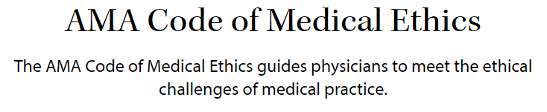


Slide 6

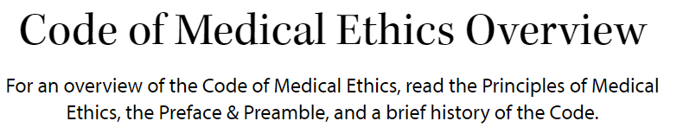
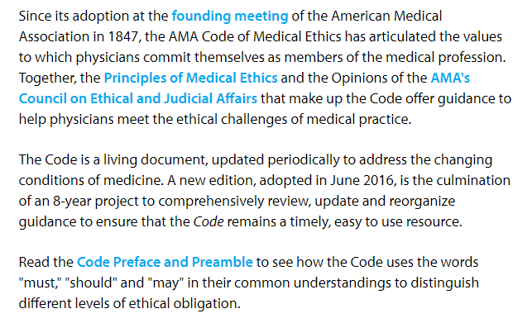



Slide 7
AMA AS A RESOURCE FOR
PROFESSIONAL STANDARDS
Online assess to the AMA resources should be utilized in preparation for your transitionary process.
https://www.ama-assn.org
QUESTION TO FOLLOW

Slide 8
Ama resource review
1. Please identify the three main general areas that the AMA Code of Medical Ethics Overview uses to assist physicians to meet the ethical challenges in the practice of medicine.
a) Genetic ethical principles
b) Treatments and Use of Technologies
c) Professional Relationships and Self-Regulation
d) Patient and Physician Interactions

Slide 9
Ama resource review
1. Please identify the three main general areas that the AMA Code of Medical Ethics Overview uses to assist physicians to meet the ethical challenges in the practice of medicine.
a) Genetic ethical principles
b) Treatments and Use of Technologies
c) Professional Relationships and Self-Regulation
d) Patient and Physician Interactions

Slide 10
Ama resource review
2. AMA Code of Medical Ethics has articulated the values to which physicians commit themselves as members of the medical profession. Please answer true or false.
a) True
b) False

Slide 11
Ama resource review
2. AMA Code of Medical Ethics has articulated the values to which physicians commit themselves as members of the medical profession. Please answer true or false.
a) True
b) False

Slide 12
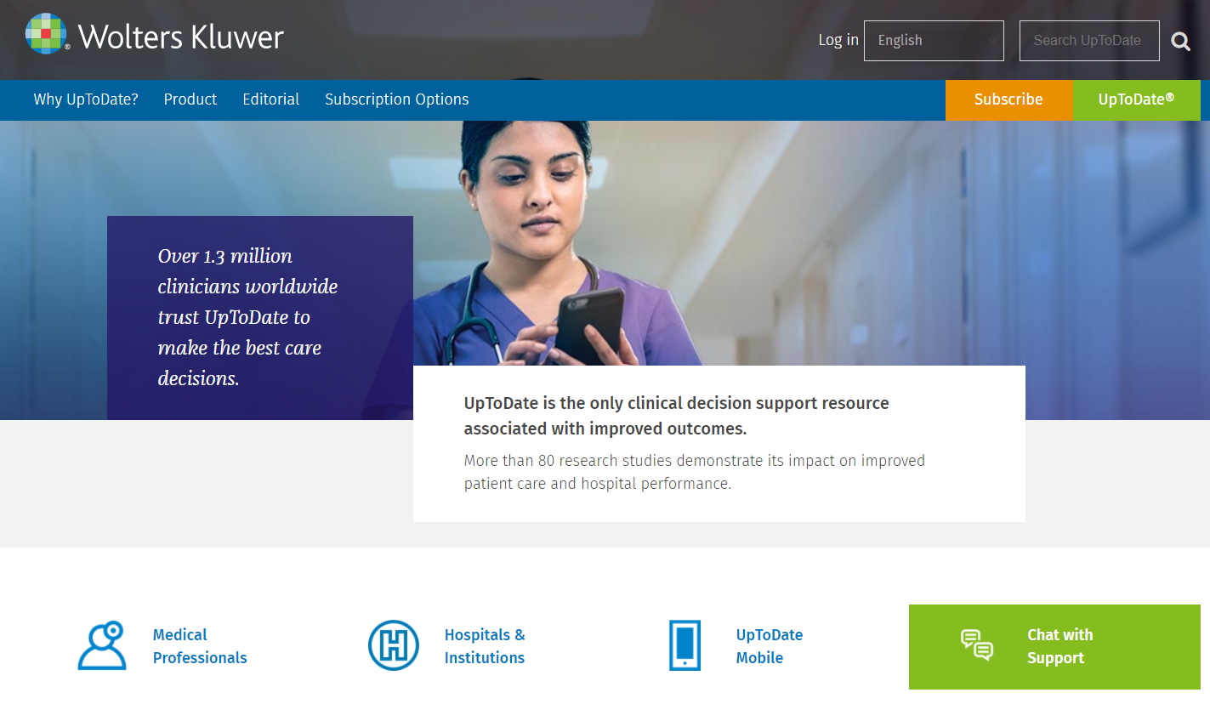
UP TO DATE
EVIDENCED BASED MEDICINE

Slide 13
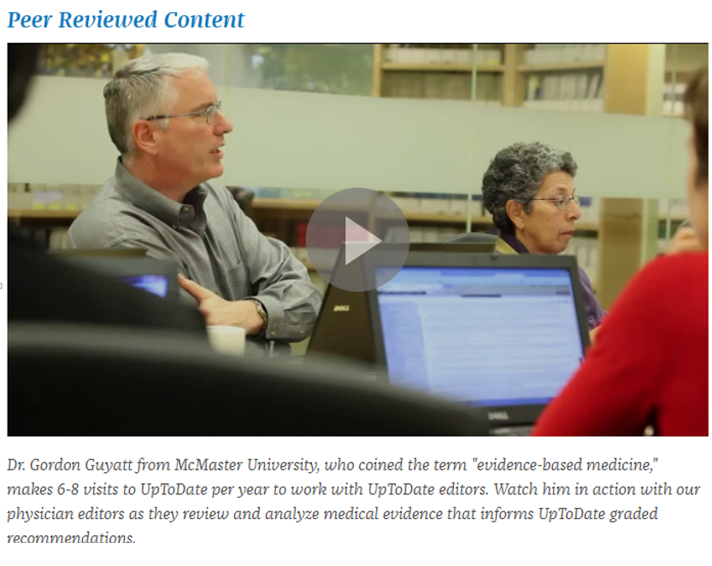

Slide 14
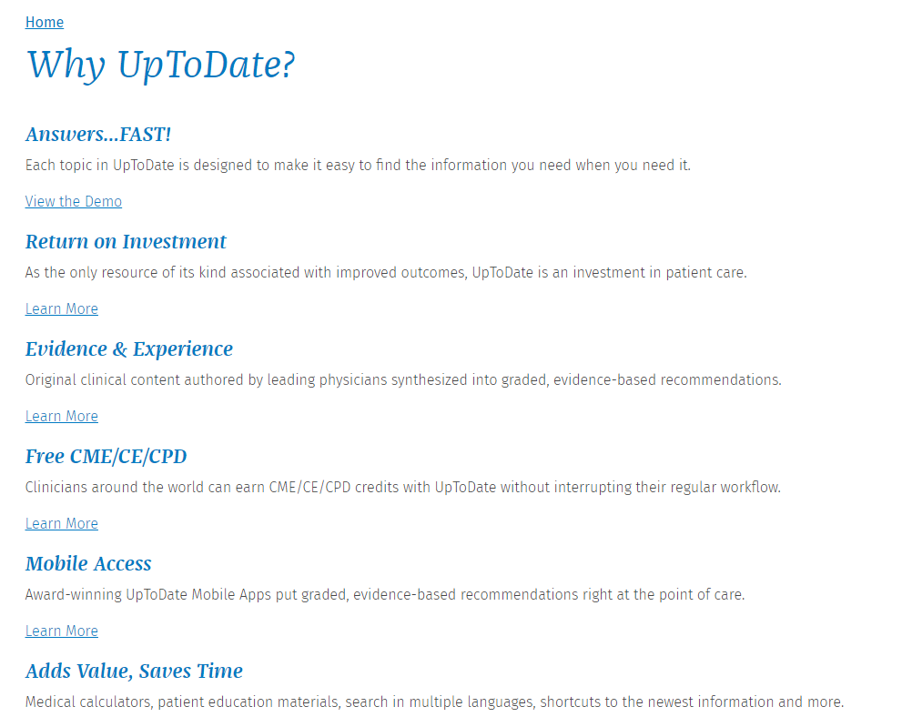
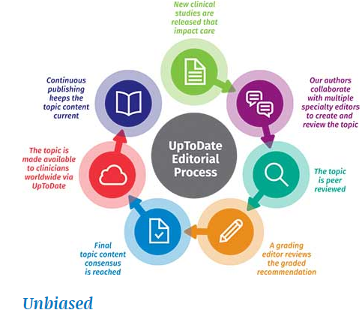


Slide 15
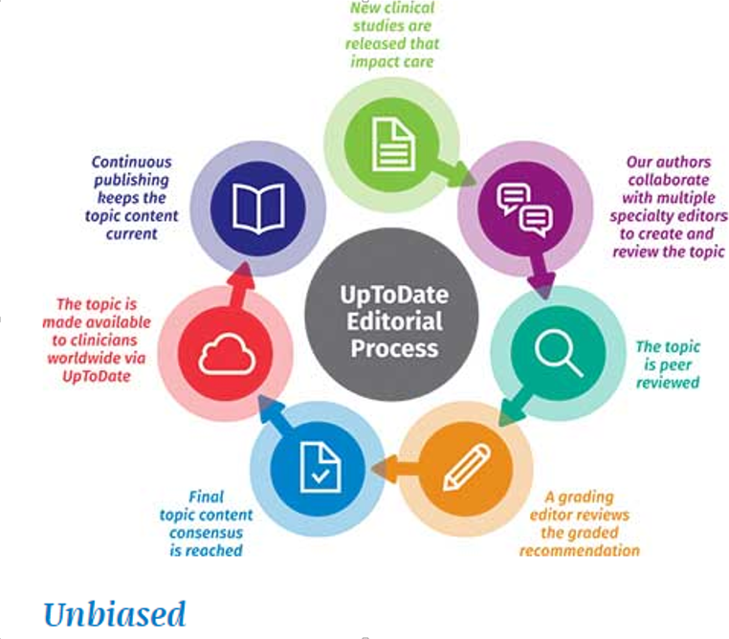

Slide 16
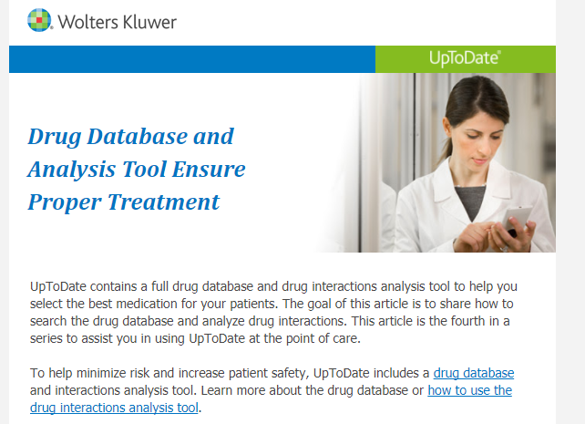

Slide 17
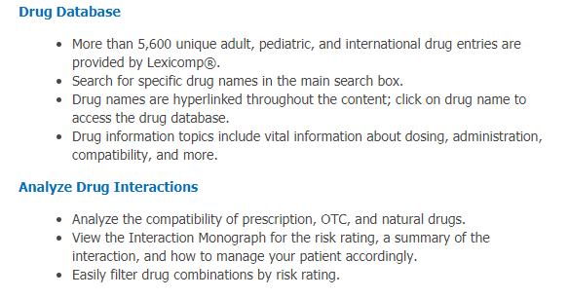


Slide 18
Up to date – Resource
QUESTION TO FOLLOW
Up to Date is considered and recommended by many reputable resources as an outstanding method in providing a quick easy guide if the clinical question you may have is not addressed by other protocols in your particular clinic setting.
This resource is internet based and therefore readily accessible.
This resource will be available to all of you in the clinic setting to use as a resource as you are seeing patients.
In addition this resource will be made available to you during this orientation process.

Slide 19
Up to date; resource review
3. What type of answers does the on-line resource Up to Date profess to provide to practicing physicians? Select all correct options.
a) Current “best practice”
b) Current “evidence-based medicine”
c) Current “antidotal majority viewpoint”
d) Current “well established”

Slide 20
Up to date; resource review
3. What type of answers does the on-line resource Up to Date profess to provide to practicing physicians? Select all correct options.
a) Current “best practice”
b) Current “evidence-based medicine”
c. Current “anecdotal majority viewpoint”
d. Current “well established”

Slide 21


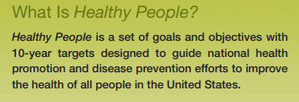
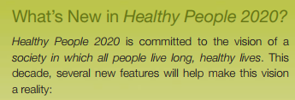


Slide 22
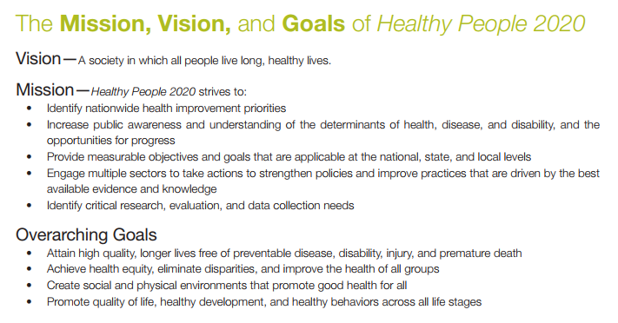

Slide 23
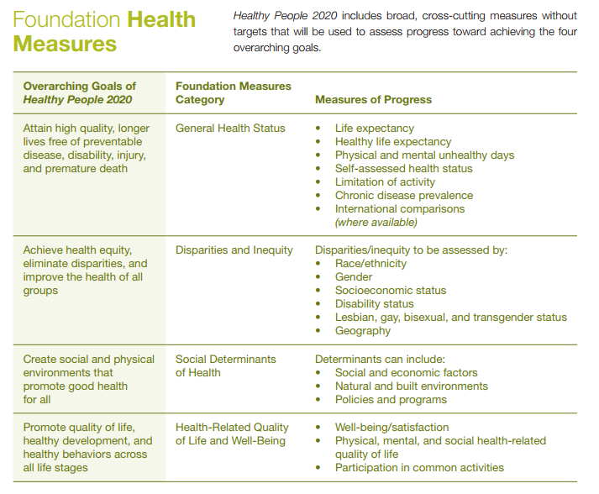




Slide 24
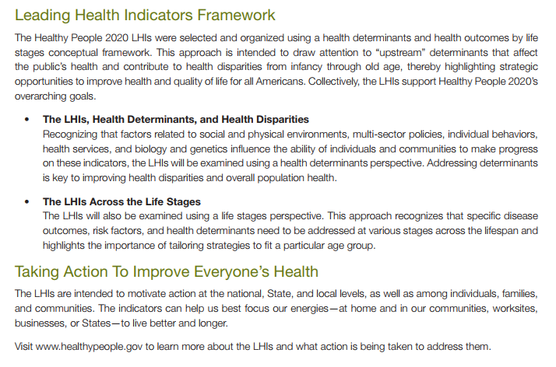






Slide 25


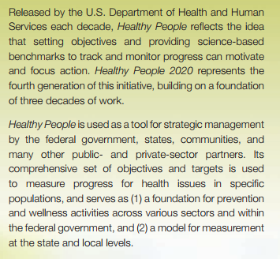

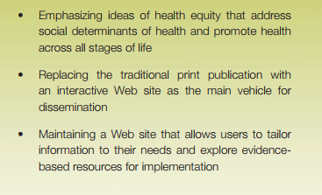




Slide 26
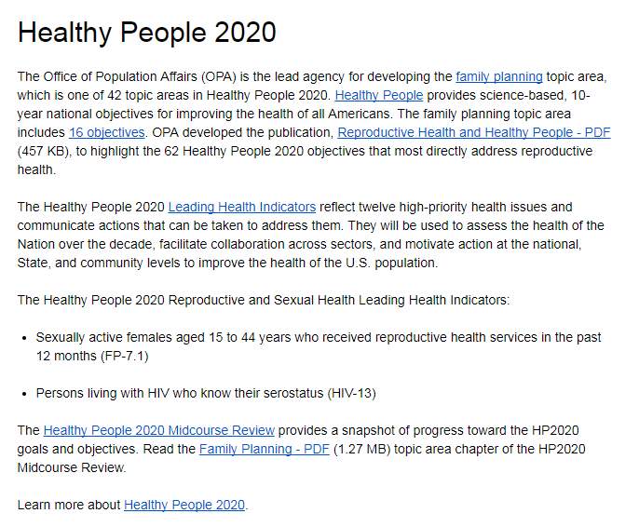

Slide 27


Slide 28
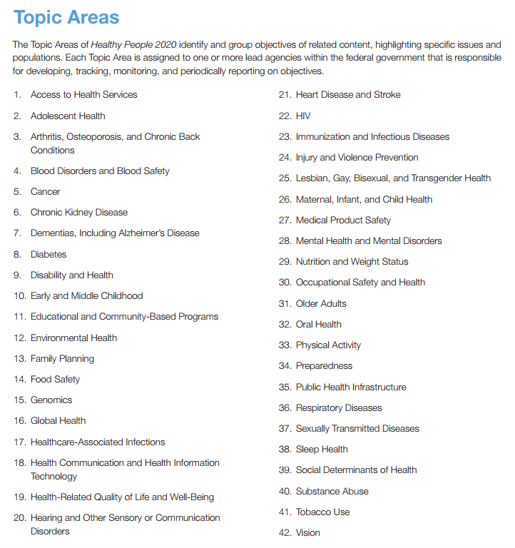







Slide 29
Healthy people 2020 review question to follow
“Healthy People 2020” is important for understanding the long term organizational goals of the Community Health Center you will be working for. This government program is aligned with the vision, mission, and values of all the potential community health centers you would be employed by. You should be aware of the previously stated vision, mission and goals of the Healthy People 2020 Program. Please review them again before preceding with the next slide.
https://www.healthypeople.gov/2020/topics-objectives

Slide 30
Healthy people 2020
Please review the
Mission, Vision, and Goals
of Healthy People 2020
WHAT ARE THEY?????
See next slide for review

Slide 31


Slide 32
Additional inspirational tools to ACHIEVE your GOALS IN YOUR NEW
Position
In your new position as a physician serving the patients at community health centers it is important to emphasize other important goals!
Optimize patient experience with timely quality medical care.
Be a role model to staff and patients.
Be a leader to staff and patients.
Be a motivator to staff and patients.
Be a problem solver to staff and patients.

Slide 33
optimize patient experience with timely quality medical care b) be a role model to staff and patients. c) be a leader to staff and patients. d) be able to lift up small buildings and walk underneath them
4. In your new position as a physician serving the patients at community health centers it is important to emphasize other important goals except for one of the following. Please identify the goal that would not be an expectation.

Slide 34
optimize patient experience with timely quality medical care b) be a role model to staff and patients. c) be a leader to staff and patients. d) be able to lift up small buildings and walk underneath them
4. In your new position as a physician serving the patients at community health centers it is important to emphasize other important goals except for one of the following. Please identify the goal that would not be an expectation.

Slide 35
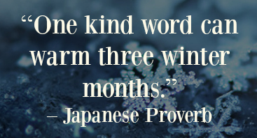
Being kind is a foundational expectation
In a world where you can be anything, be kind.
The patient experience refers to the quality and value of all the interactions, direct and indirect clinical and nonclinical spanning the entire duration of the patient/provider relationship.
BENEFITS:
Fundamentally Correct
Quality Measure
Reimbursement Metric
Culture of respect and compassion
Positive patient care environment

Slide 36
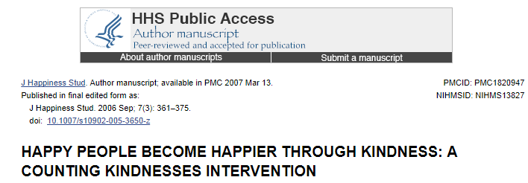
In a world where you can be anything, be kind

Slide 37
5. As a health care physician working for a community health center please identify types of functions you are able to engage in on day one without any orientation other than this course.
a) Teach another provider how to use the NextGen electronic medical record
b) Exhibit kindness and have excellent attitude when interacting with patients and staff
c) Teach another provider all for formulary medications allowed to prescribe
d) Assist the billing department with ICD-10 coding rules

Slide 38
5. As a health care physician working for a community health center please identify types of functions you are able to engage in on day one without any orientation other than this course.
a) Teach another provider how to use the NextGen electronic medical record
b) Exhibit kindness and have excellent attitude when interacting with patients and staff
c) Teach another provider all for formulary medications allowed to prescribe
d) Assist the billing department with ICD-10 coding rules

Slide 39


An expectation of your work will be to be inspired and inspire others consider the following
We are all inspired by greatness, accomplishment, wisdom, science, valid information, and an opportunity to help others as a physician. However your career has plenty of challenges that you will face and that you can overcome with the right attitude, assistance and preparation from the community health center where you will be working. Remember your success is measured by the degree you are able to prevent problems whenever possible and overcoming any other problems that may arise in the most functional and ethical manner possible. Ultimately the quality of your professional life primarily depends on your attitude, how you react to your circumstances and interactions with your patients and co-workers and or colleagues.

Slide 40
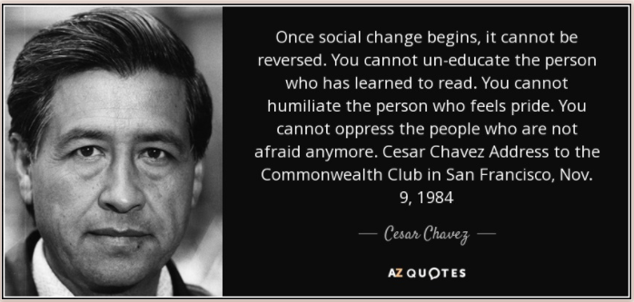


Slide 41
Cesar Chavez civil rights activist
After working as a community and labor organizer in the 1950s, Chavez founded the National Farm Workers Association in 1962. This union joined with the Agricultural Workers Organizing Committee in its first strike against grape growers in California in 1965. A year later, the two unions merged, and the resulting union was renamed the United Farm Workers in 1972. In early 1968, Chavez called for a national boycott of California table grape growers. Chavez's battle with the grape growers for improved compensation and labor conditions would last for years. At the end, Chavez and his union won several victories for the workers when many growers signed contracts with the union. He faced more challenges through the years from other growers and the Teamsters Union. All the while, he continued to oversee the union and work to advance his cause. As a labor leader, Chavez employed nonviolent means to bring attention to the plight of farm workers. He led marches, called for boycotts and went on several hunger strikes. He also brought the national awareness to the dangers of pesticides to workers' health. His dedication to his work earned him numerous friends and supporters, including Robert Kennedy and Jesse Jackson.
It is believed that Chavez's hunger strikes contributed to his death: He died on April 23, 1993, in San Luis, Arizona.

Slide 42
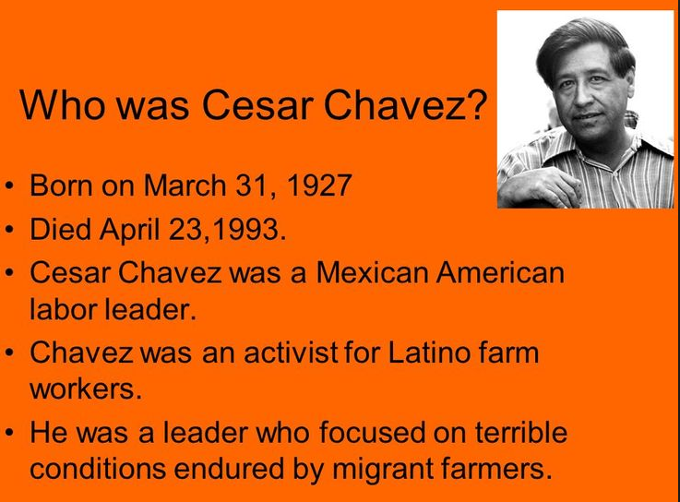
Cesar Chavez Latino farm worker activist

Slide 43
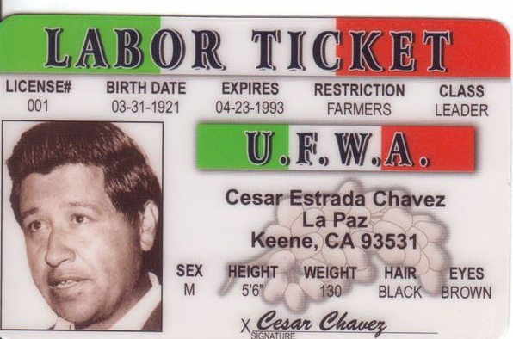

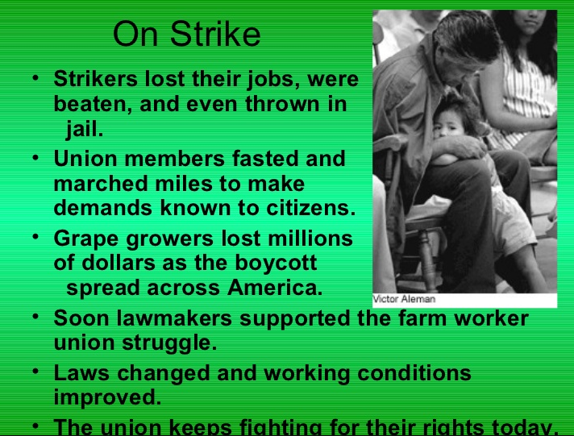
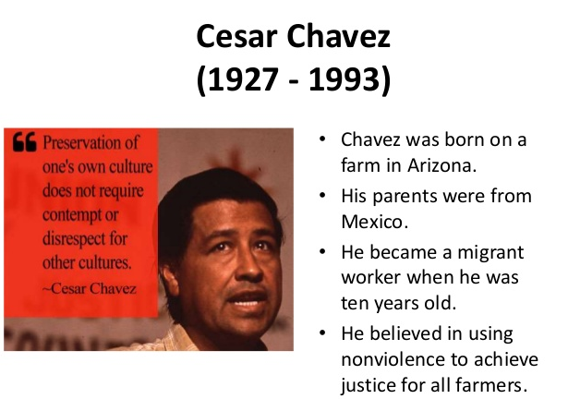
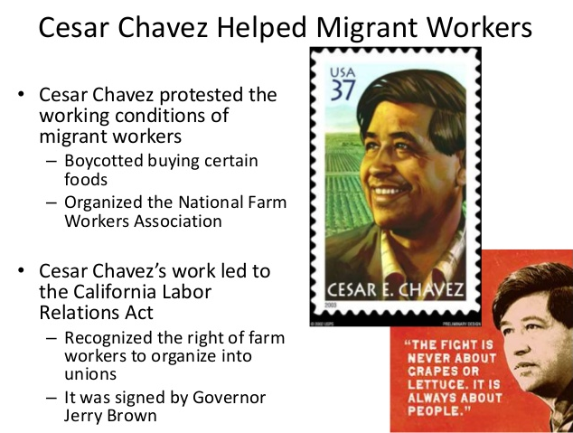
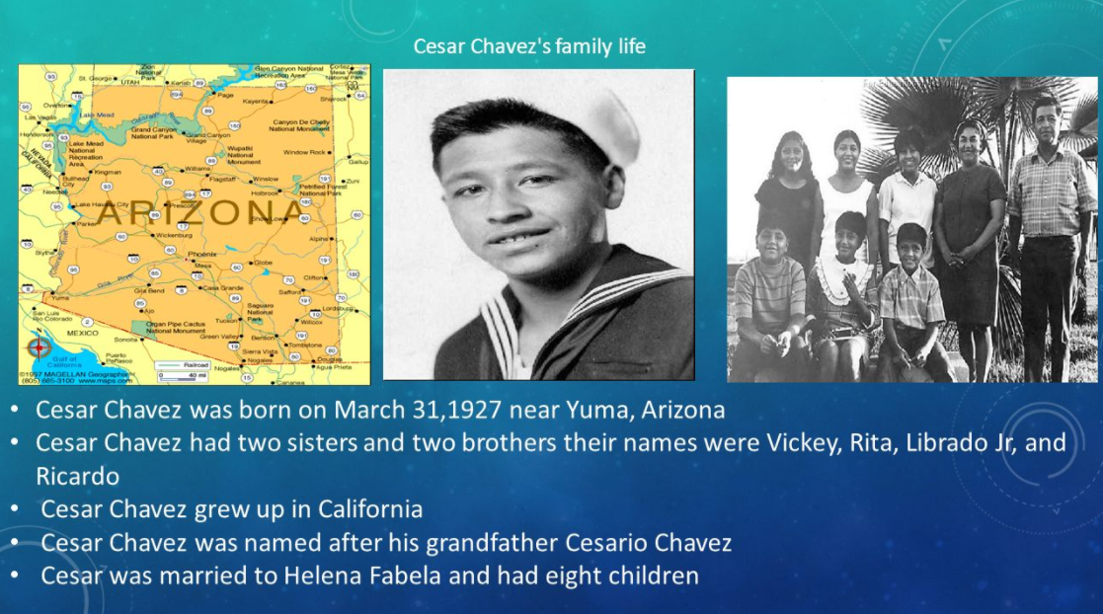


Slide 44
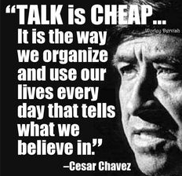
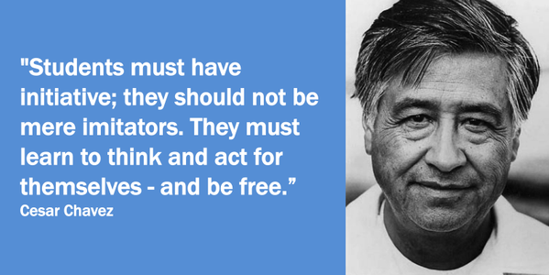
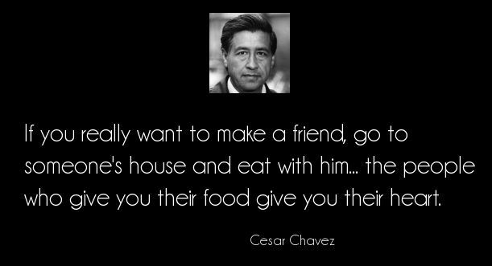
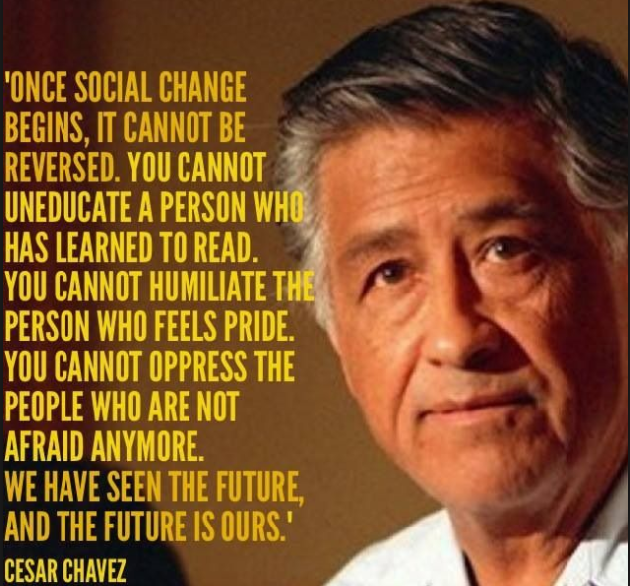
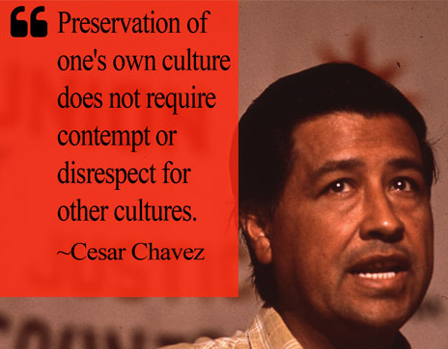
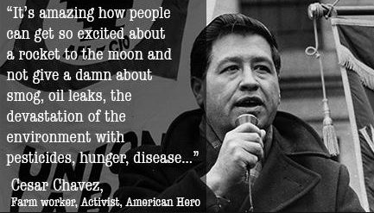

Slide 45
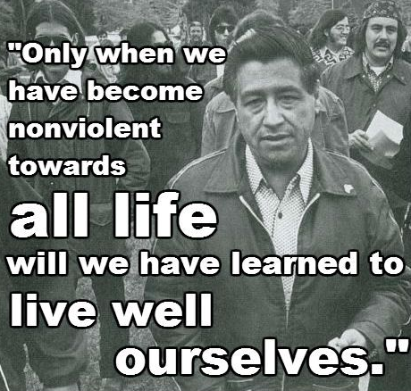
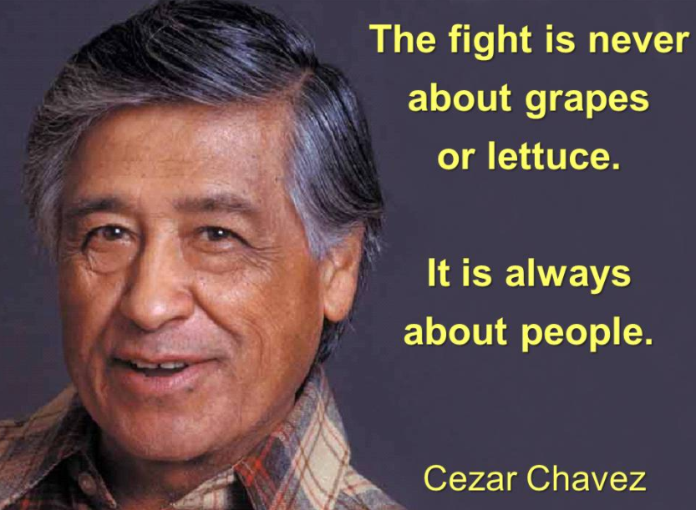
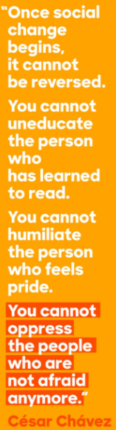
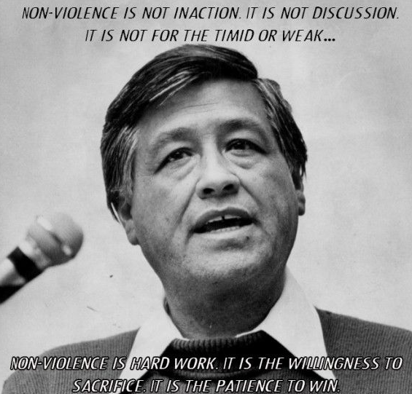

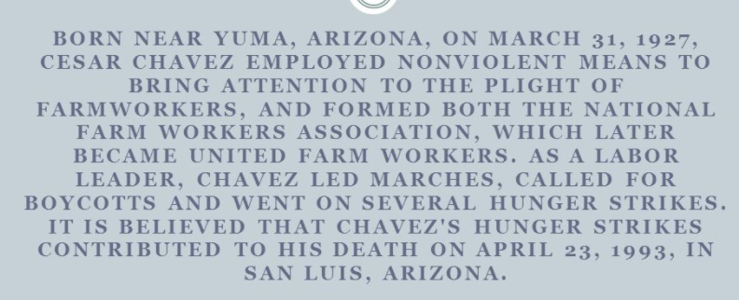

Slide 46
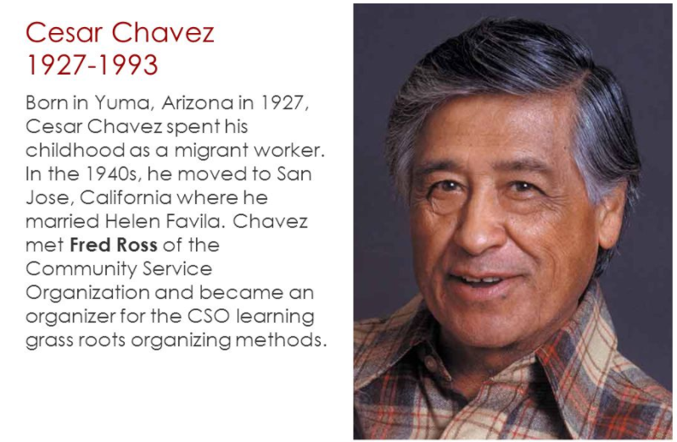
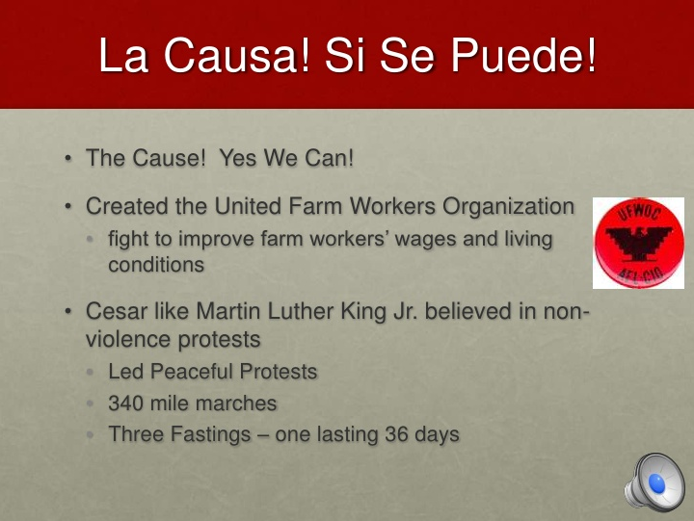
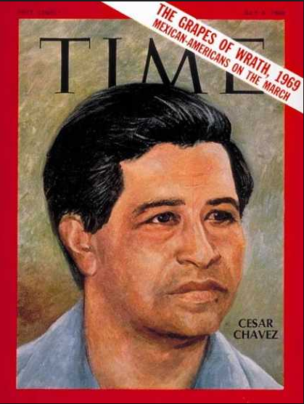

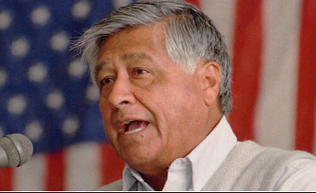

Slide 47


Slide 48

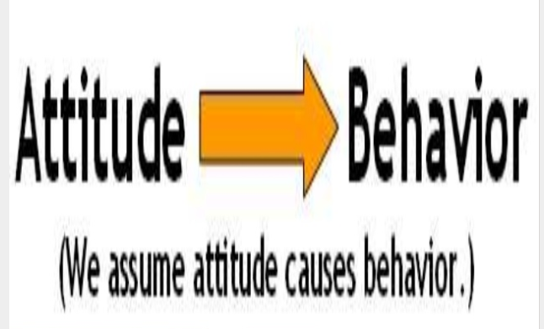
Good attitude >>>>> good behavior

Slide 49
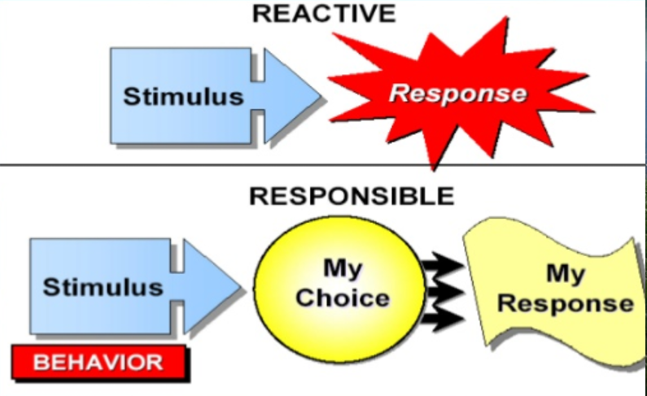
TAKE OWNERSHIP OF YOUR ATTITUDE
I AM RESPONSIBLE FOR WHO I AM,
FOR WHAT I HAVE DONE,
AND WHAT I DO
AND WHAT I WILL DO

Slide 50
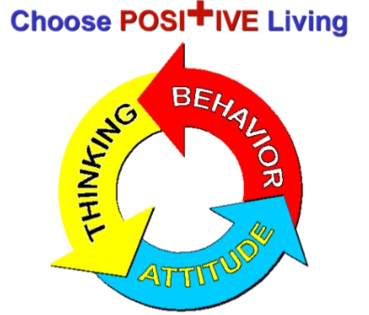
HOW YOU REACT TO YOUR PROFESSIONAL CIRCUMSTANCES IS WHAT DETERMINES THE QUALITY OF YOUR PROFESSIONAL LIFE

Slide 51
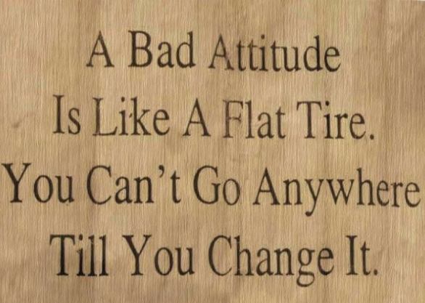

RECOGNIZING THE RISK OF HAVING A BAD ATTITUDE AND AVOIDING THAT CIRCUMSTANCE IS LIKE AVOIDING A ROAD HAZARD AND PREVENTING A FLAT TIRE

Slide 52

A negative attitude should be prevented and is like poison and then IT CAN CREATE a self fulfilling prophecy WHICH can take over YOUR BEHAVIOR
To improve behavior it
takes self assessment,
determination and discipline.

Slide 53

A negative attitude should be prevented and is like poison and then it can create a self fulfilling prophecy which can take over your behavior
If you are mainly positive, you will be focused on good
things, happy thoughts, and successful outcomes.
Otherwise-if you are mainly focused on bad things,
sad thoughts , unsuccessful outcomes and then very likely act and behave negatively too.

Slide 54


Inspired Positive constructive, creative thinking with optimism, and with motivation to accomplish your goals
Can achieve success

Slide 55




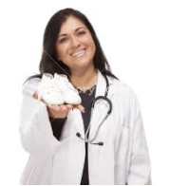


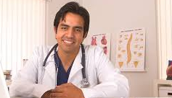
Environment and culture of success with expectations of the best due a positive state of mind

Slide 56

Choose your attitude
Your choice of attitude can decide the out come of your life. Negative thoughts have no power unless you empower them.

Slide 57

If you think you can achieve those quality measures, you’re right. If you think you can’t, you’re right again.
Yes it is all a matter of attitude.
QUALITY MEASURES SUCCESS

Slide 58


Say please and thank you.
Practice empathy.
Evaluate your own behavior in ongoing fashion.
Never miss an opportunity to complement others for their successes.
See criticism as an opportunity to improve.
Keep open minded to changes.
Have a forgiving view of people.
Respect the opinion of others.

Slide 59

Positive attitude and positive thinking
Positive attitude helps one to cope more easily with the daily affairs of life.
It brings optimism into your life, and makes it easier to avoid worry and
negative thinking.

Slide 60

Attitude is a mental position relative to a way of thinking or being.
Barbara o. Lawrence author

Slide 61
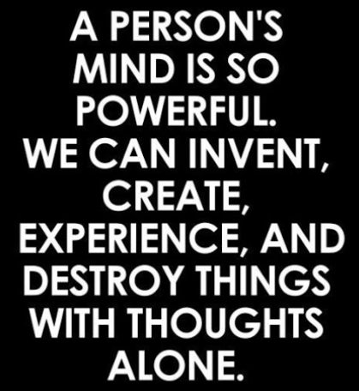









Slide 62











Slide 63





Slide 64






Slide 65


“Attitude is a little thing that makes a big difference!”
British statesman, army officer, and writer, who served as Prime Minister of the United Kingdom

Slide 66


Believe that you can and you’re halfway there.” Theodore Roosevelt
American statesman, author, explorer, soldier, and naturalist, who served as the 26th President of the United States from 1901 to 1909.

Slide 67


“if you want to lift yourself up, lift someone else.” booker t. Washington
American educator, author, orator, and advisor to presidents of the United States originally born into slavery and became the leading voice of the former slaves and their descendants.

Slide 68

“one of the deep secrets of life is that all that is really worth doing is what we do for others.” Lewis carol
English writer, mathematician, logician, Anglican deacon, and photographer. His most famous writings are Alice's Adventures in Wonderland, its sequel Through the Looking-Glass

Slide 69


American philosopher and psychologist who was also trained as a physician.

Slide 70


“In an emergency, what treatment is given by ear? Words of comfort.”
Abraham Verghese, MD
As physician, teacher and
author
his emphasis on empathy and healing is the focus of his talks, nationally and internationally, as he stresses the importance of the patient-physician relationship in an era of advances in medical technology that often tend to de-personalize medical care.

Slide 71

“You treat a disease, you win, you lose. You treat a person, I guarantee you, you’ll win, no matter what the outcome.”
Patch Adams
American physician, comedian, social activist, clown, and author. He founded the Gesundheit!

Slide 72

It doesn’t take an instant more, or cost a penny more, to be empathetic than it does to be indifferent.”
Brian Lee
CEO
CUSTOM LEARNING SYSTEMS

Slide 73

“the greatest of all mistakes is to do nothing because you think you can only do a little.” “People often say motivation doesn’t last. Neither does bathing—that’s why we recommend it daily.” zig ziglar
America's most influential and beloved encourager and believer that everyone could be, do and have more, founded the Zig Ziglar Corporation in 1977. He influenced an estimated quarter of a billion individuals through his 33 books, including the bestseller See You at the Top, which has sold almost two million ...

Slide 74


“Kind words can be short and easy to speak, but their echoes are truly endless.” mother Teresa
Mother Teresa, known in the Catholic Church as Saint Teresa of Calcutta and in 1979 won the Nobel Peace Prize. She was canonized (recognized by the church as a saint) on 4 September 2016.

Slide 75

“a healthy attitude is contagious but don’t wait to catch it from others. Be a carrier.” tom stoppard
Refugee fleeing Nazi occupation only to become
Theatre’s philosopher king
Knighted by England in 1977

Slide 76

“Your most unhappy customers are your greatest source of learning.” Bill Gates
American business magnate, investor, author, philanthropist, and co-founder of the Microsoft Corporation along with Paul Allen.

Slide 77


“if it doesn’t challenge you, it doesn’t change you.” FRED DEVITO
AUTHOR OF BARRE FITNESS AND EXECUTIVE OF
MOVEMENT CLASSES AND TRAINING FOR EXHALE

Slide 78

“Being
good
is good
business”
Famous
Successful
Businesswoman

Slide 79

YOUR NEXT
JOURNEY BEGINS

