Slide 1

MODULE five: professionalism, ethics, and bioethics

Slide 2
MODULE five:
SECTION seven: patient
rights and responsibilities

Slide 3

UNIT OBJECTIVE
To learn about patient rights and responsibilities guaranteed by federal law within the US and California

Slide 4
rights and responsibilities
Patient rights under HIPPA
Health coverage rights and protections
Informed consent
Privacy for sensitive diseases
Ombudsman services

Slide 5
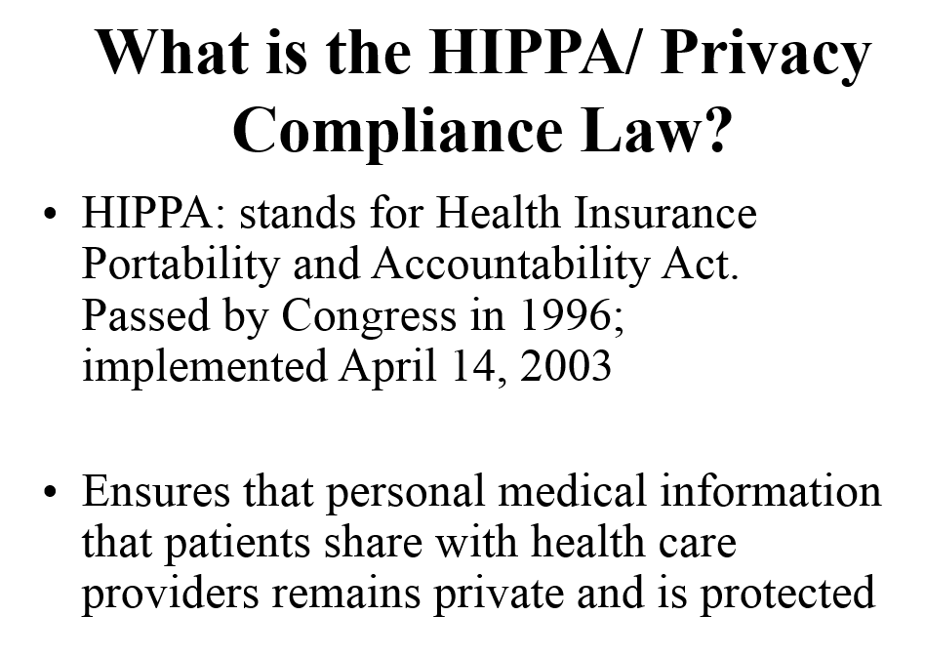


Slide 6
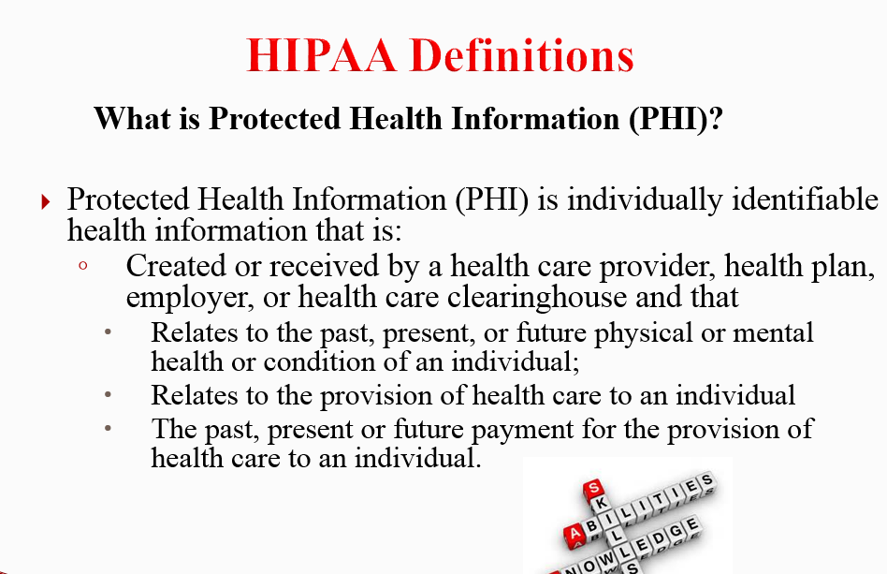

Slide 7
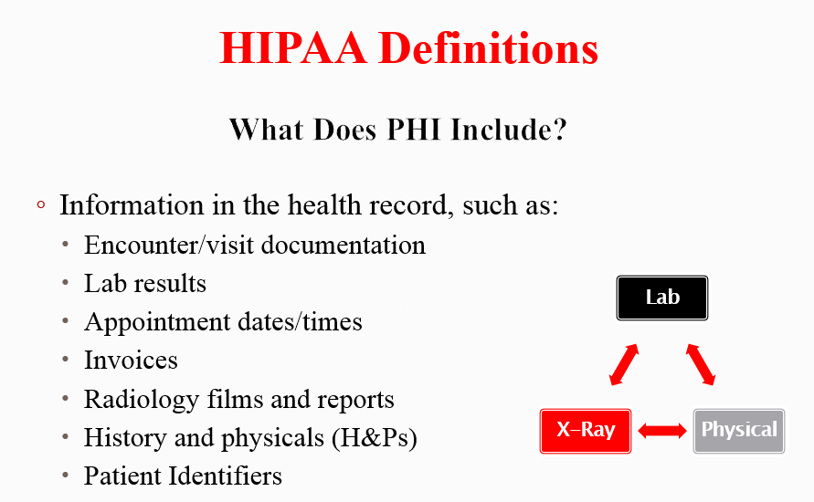

Slide 8
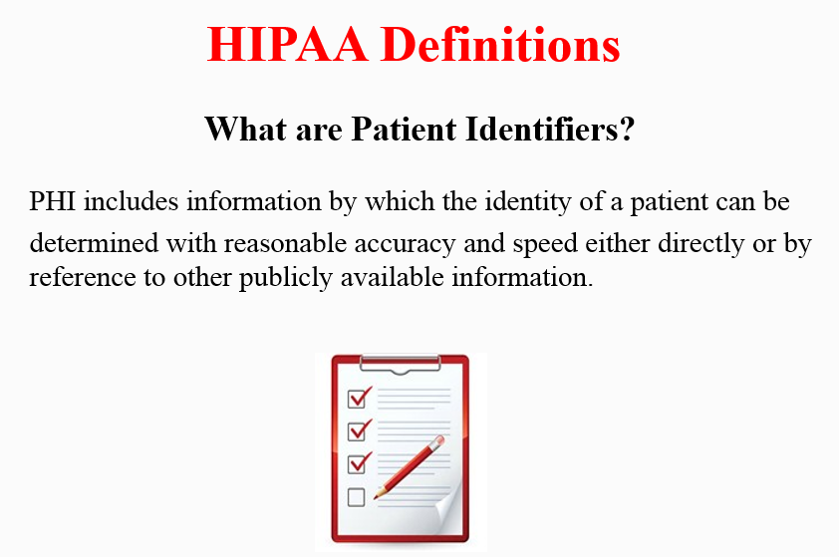

Slide 9
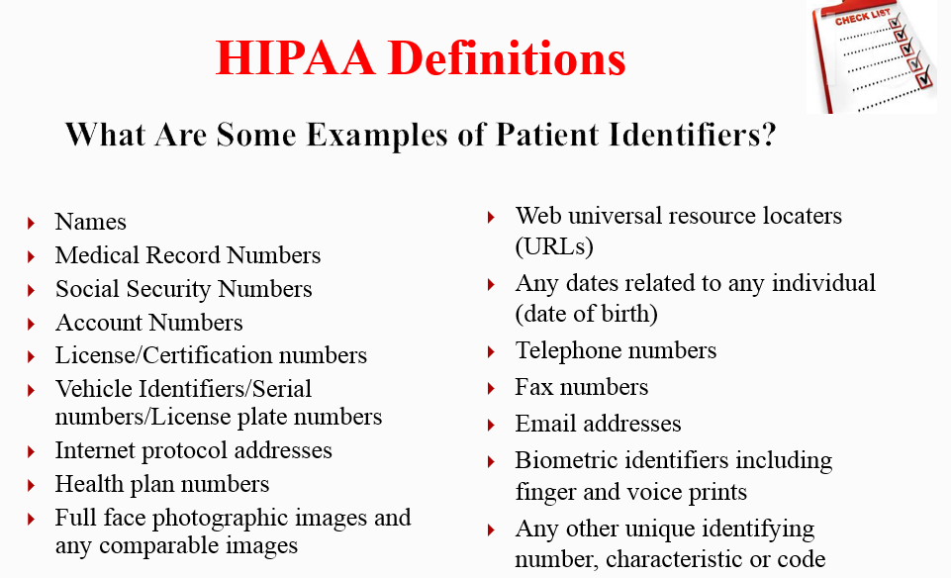

Slide 10
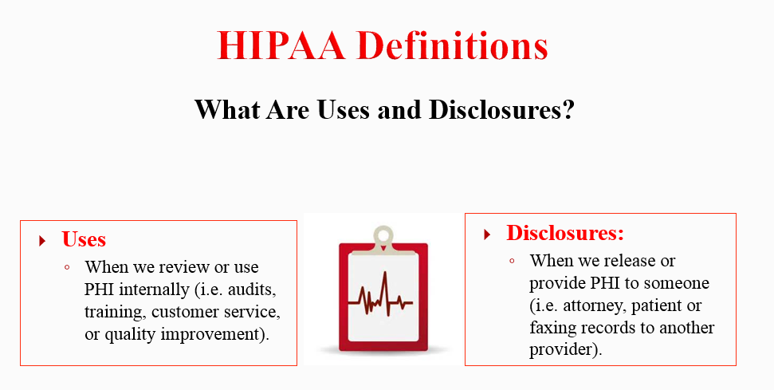

Slide 11
Understand basic principles of the Privacy Rule
Understand your role in protecting patient information
Know where to go for help if you have a question or have incidentally violated rules
HIPPA Training:
Goal is Privacy Protection for Patients

Slide 12
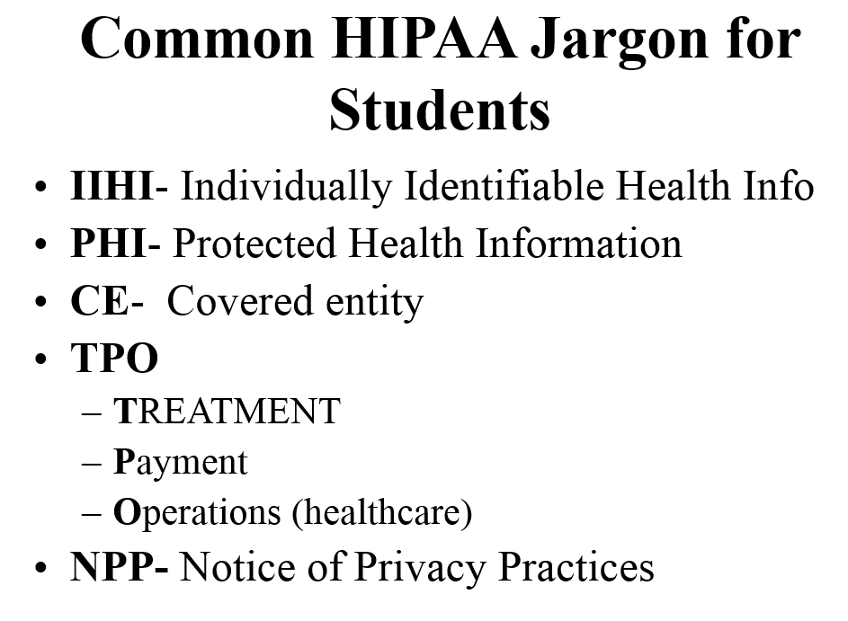


Slide 13
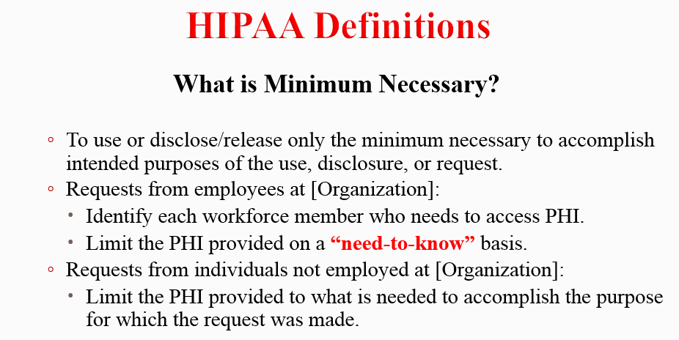

Slide 14
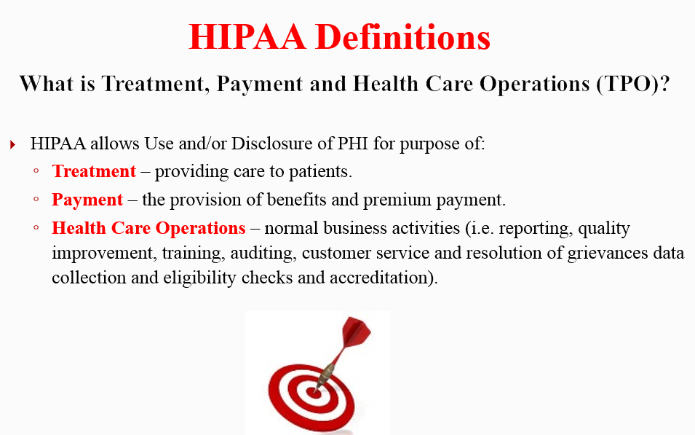

Slide 15
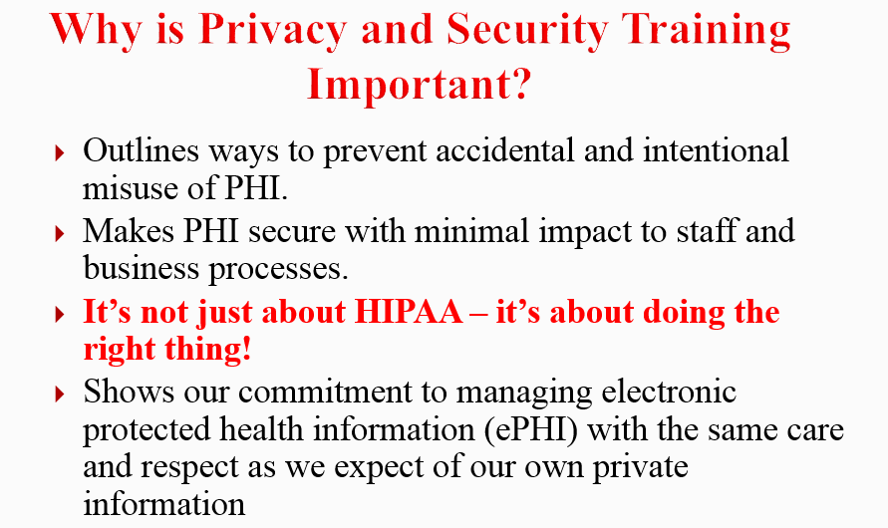

Slide 16
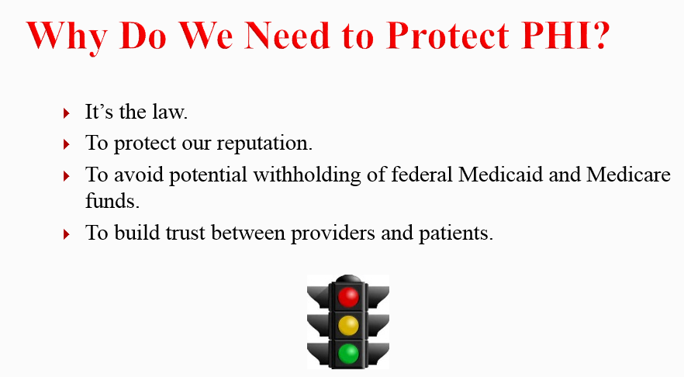

Slide 17
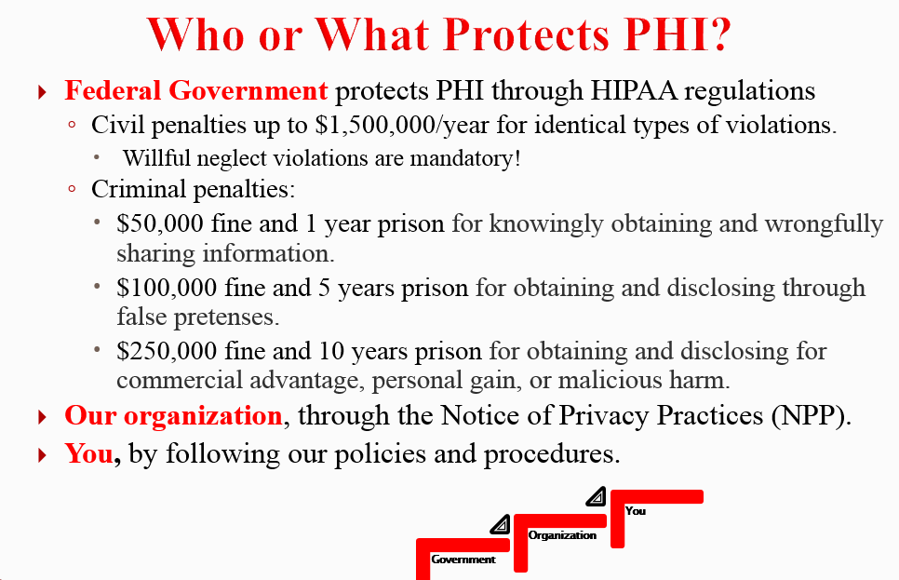

Slide 18


Slide 19
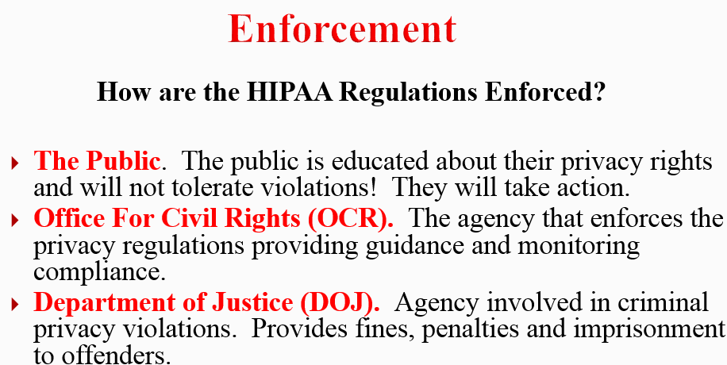

Slide 20
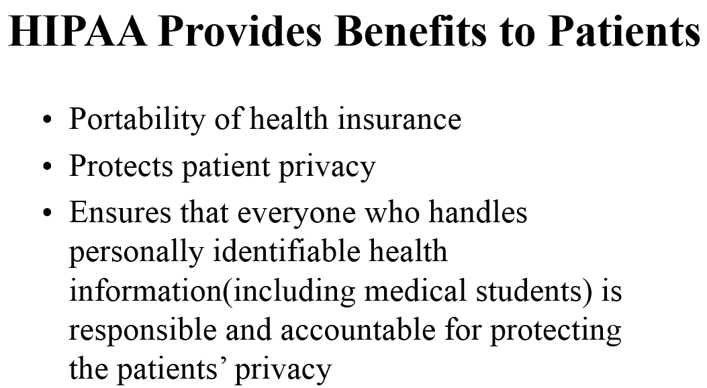

Slide 21
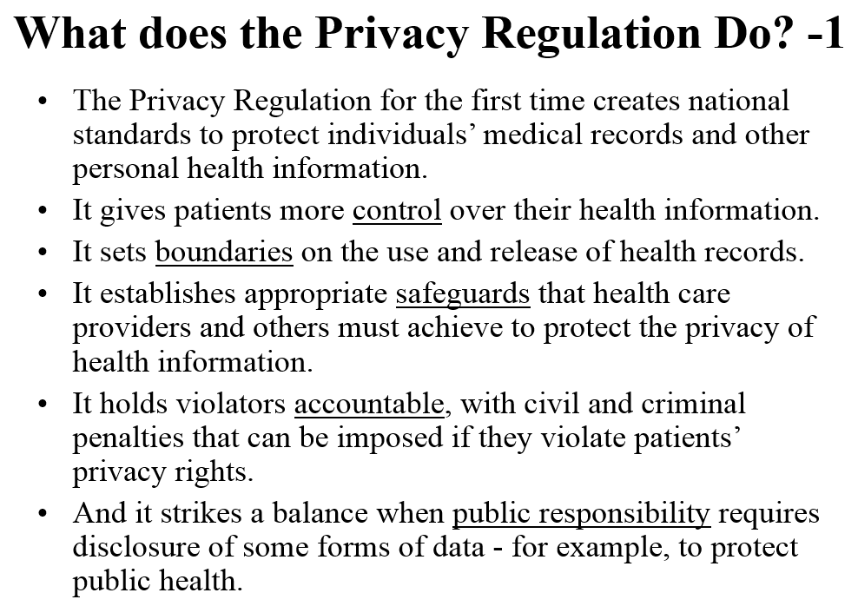

Slide 22
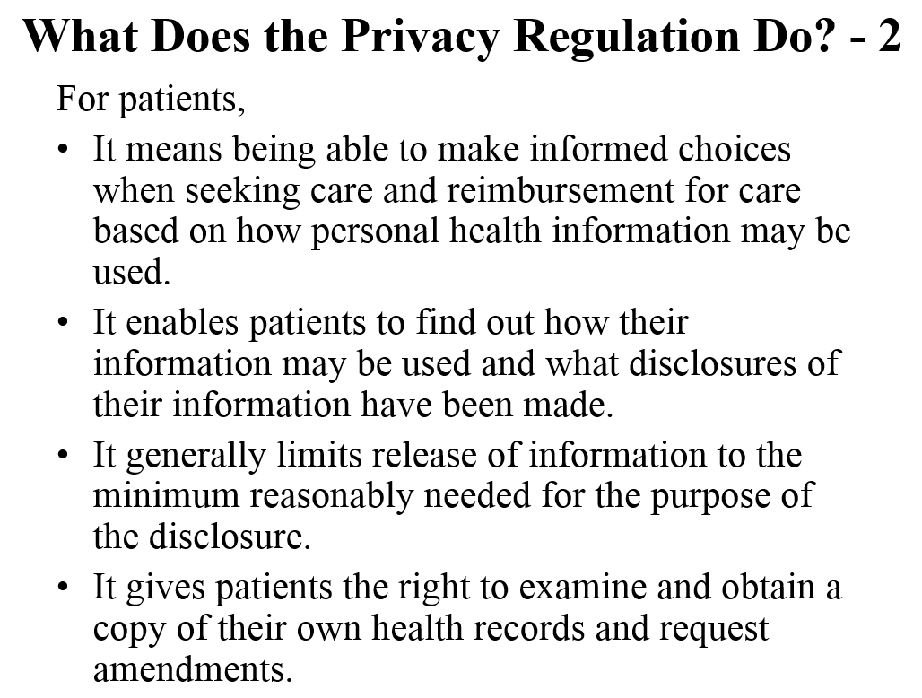

Slide 23
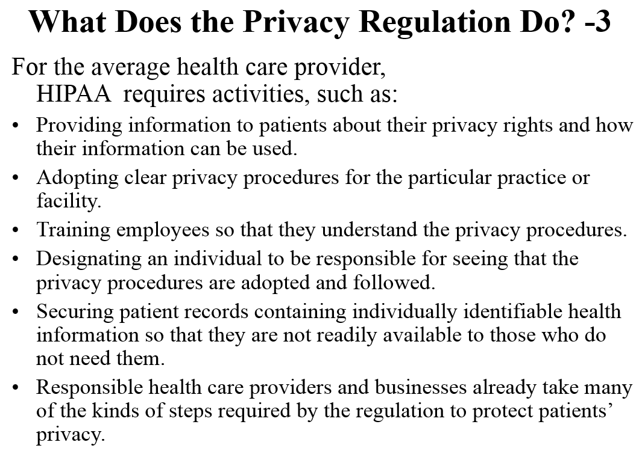

Slide 24
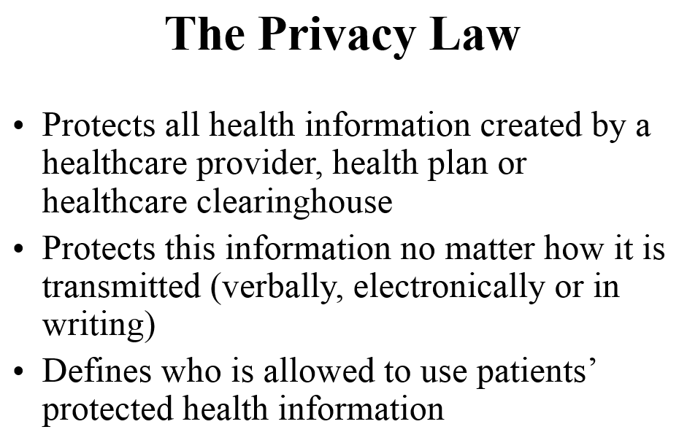

Slide 25
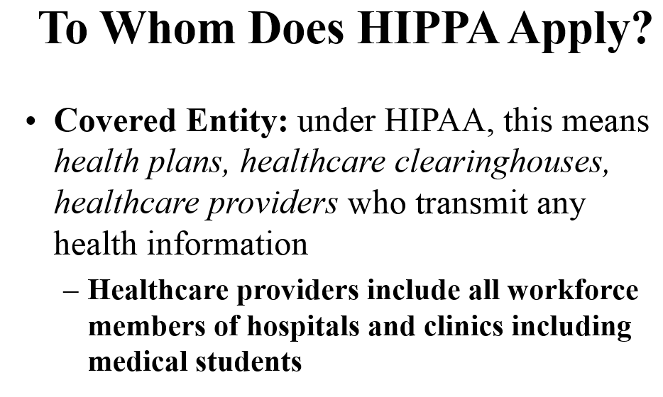

Slide 26
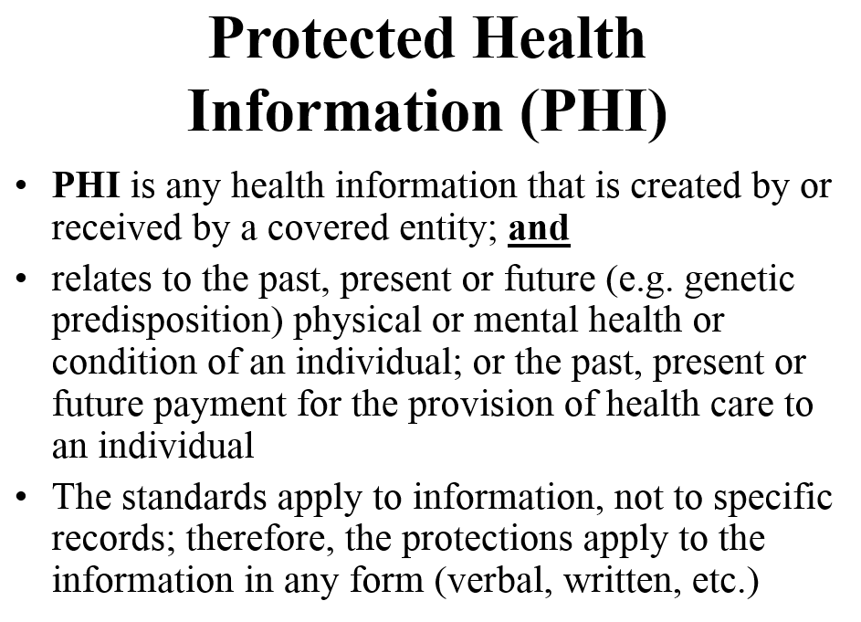

Slide 27
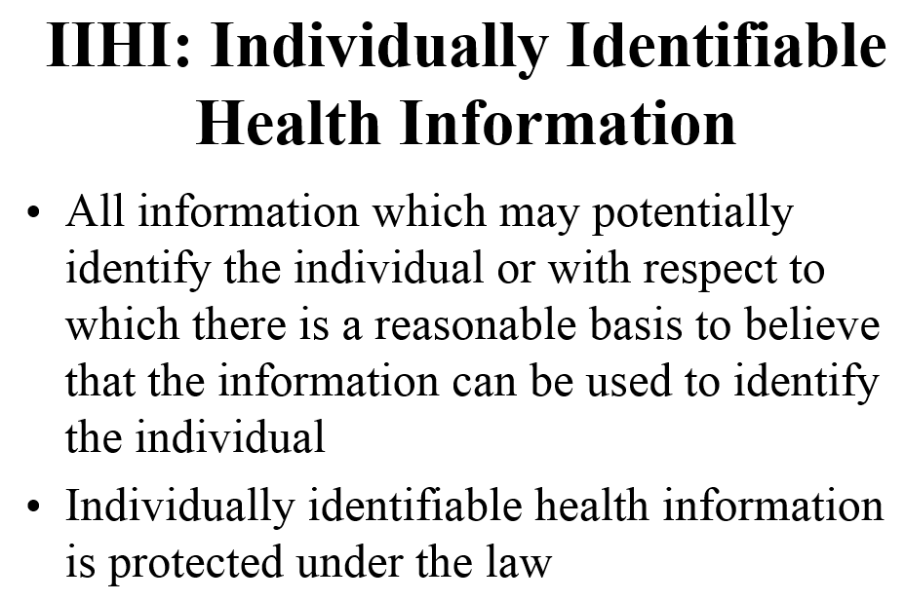

Slide 28
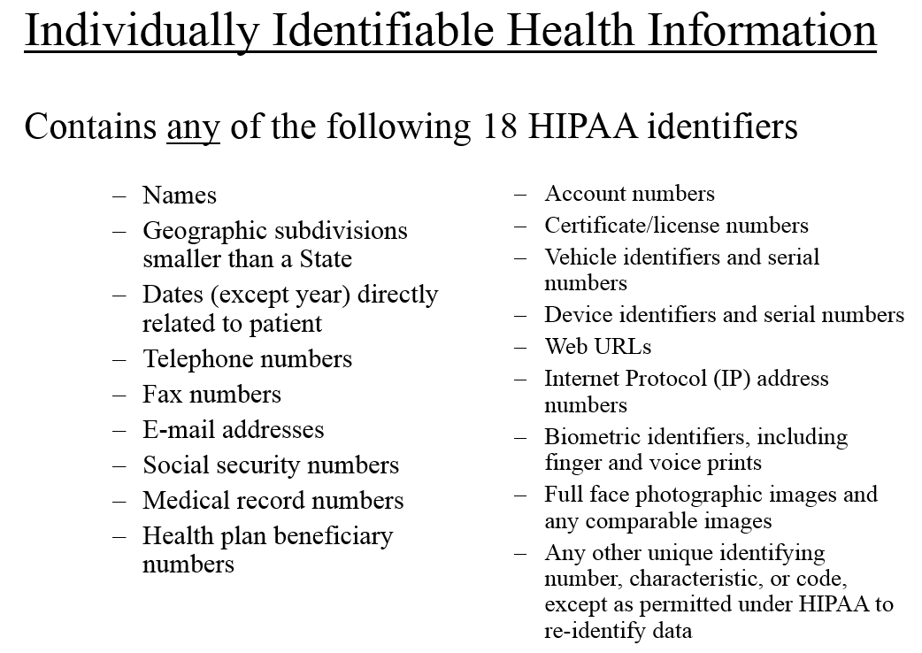

Slide 29
Patient Rights
To have their privacy protected and respected.
To receive a notice of our privacy practices at first contact and acknowledge receiving that notice
To request/authorize disclosure of their PHI, although some disclosures do not require that patient’s authorization.
To receive a copy of their records, within a specified time frame, if they ask.
To request their records be amended ( we do not have to comply, but we must respond in a specified time frame).
To request that PHI be communicated to the patient at alternative locations or by alternative means if possible (e.g., different address).

Slide 30
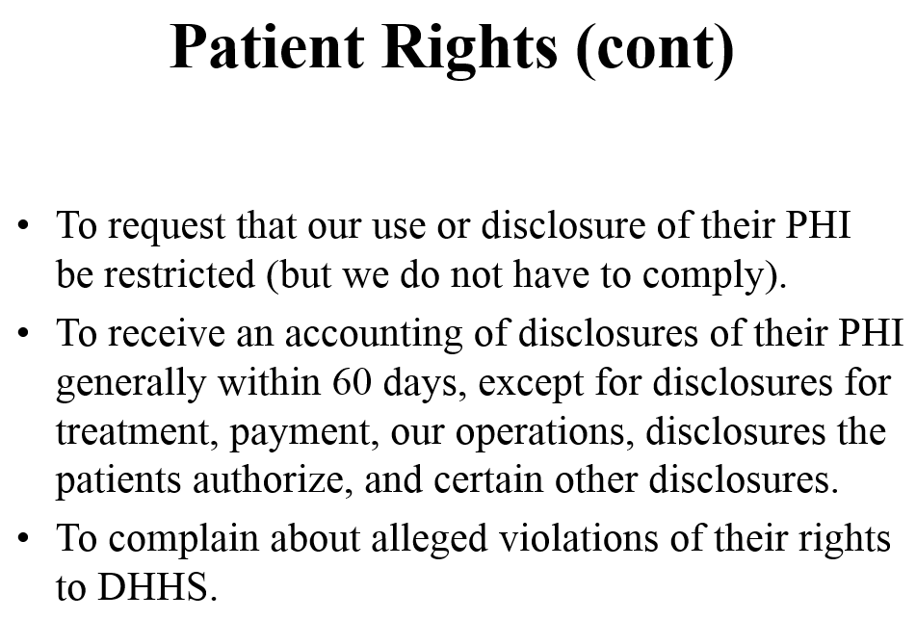

Slide 31
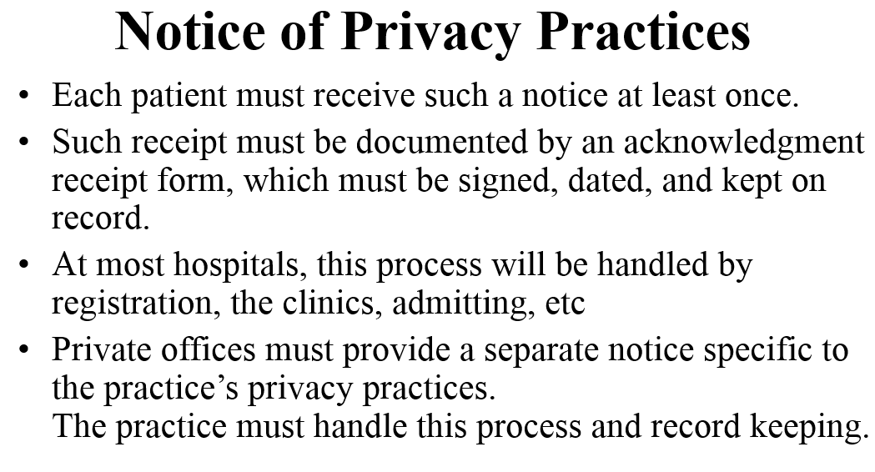

Slide 32
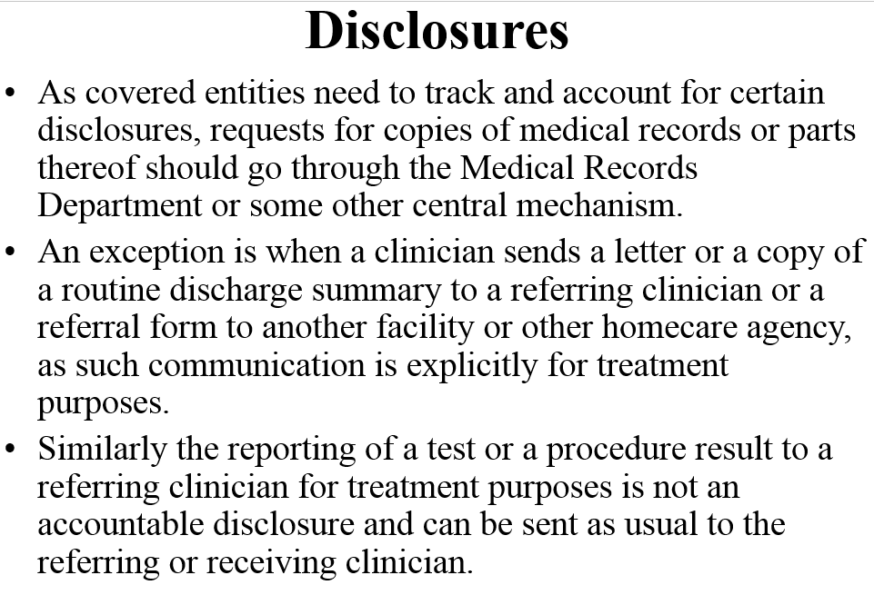

Slide 33
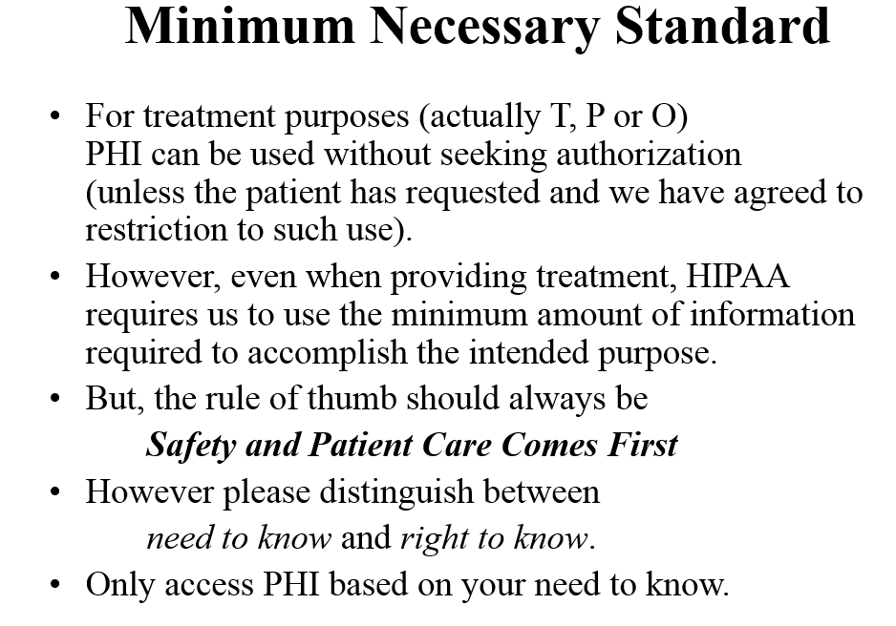

Slide 34
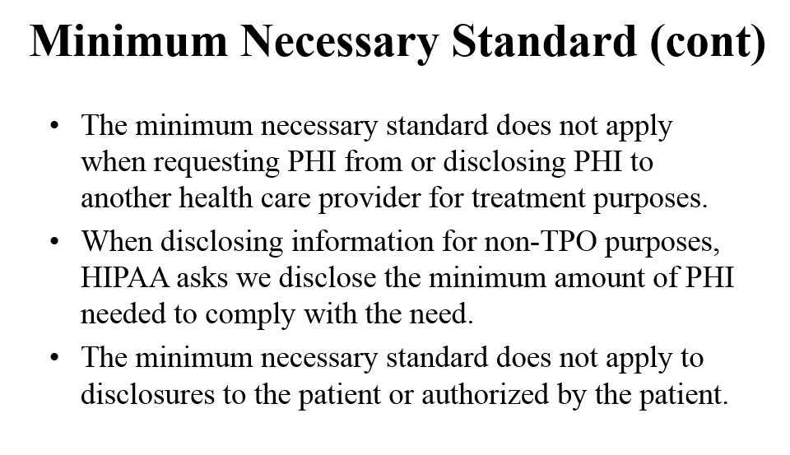

Slide 35
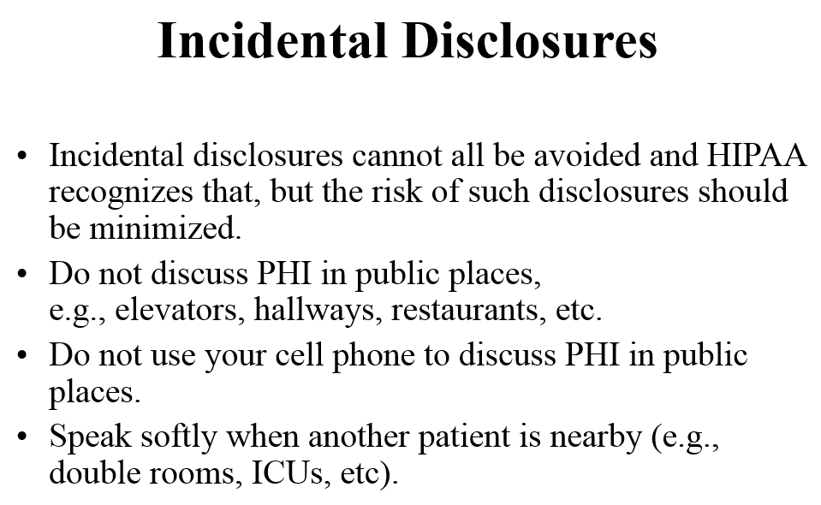

Slide 36
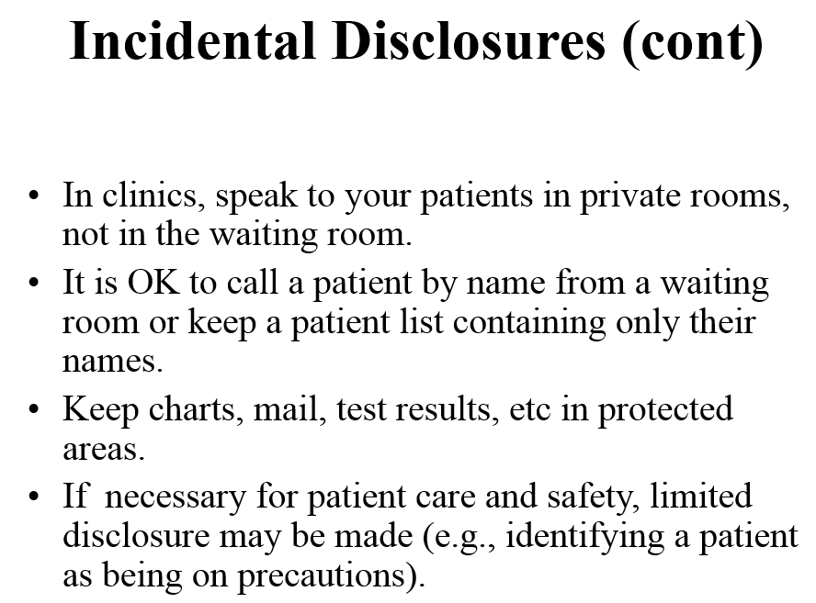

Slide 37
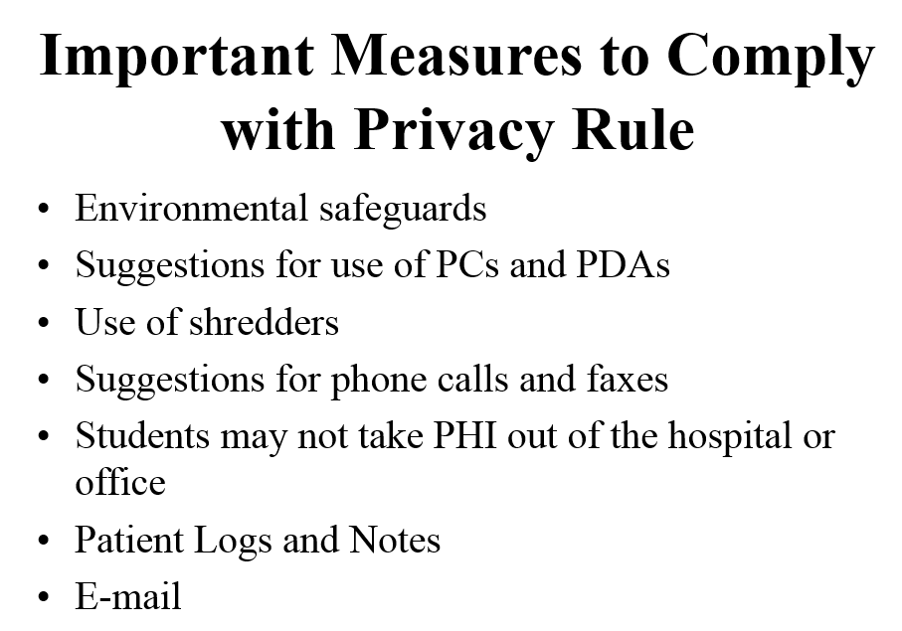

Slide 38
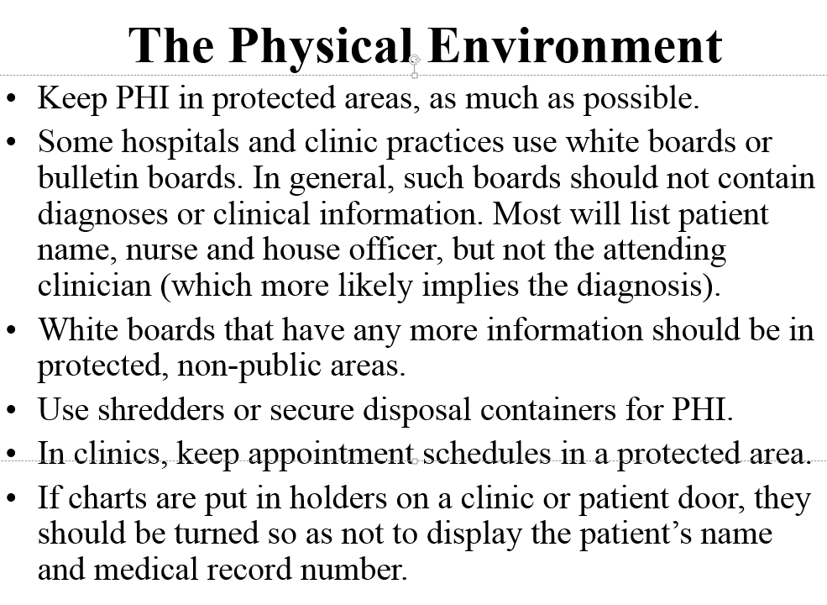

Slide 39
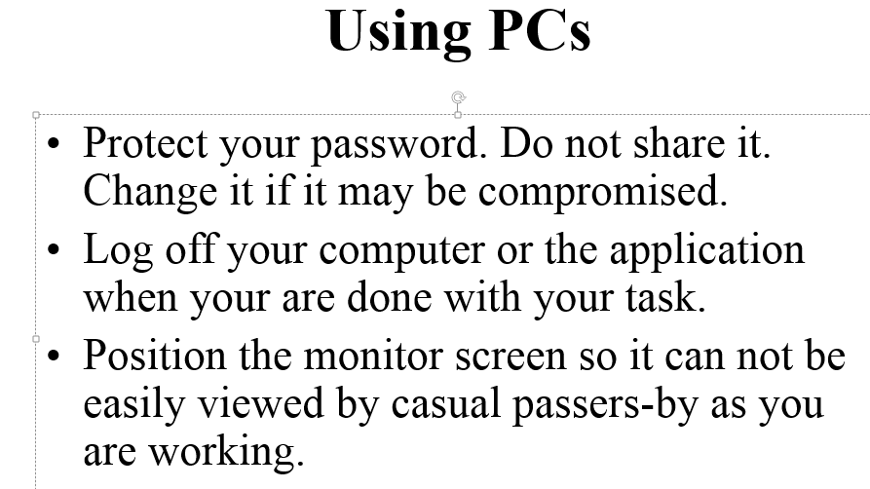

Slide 40
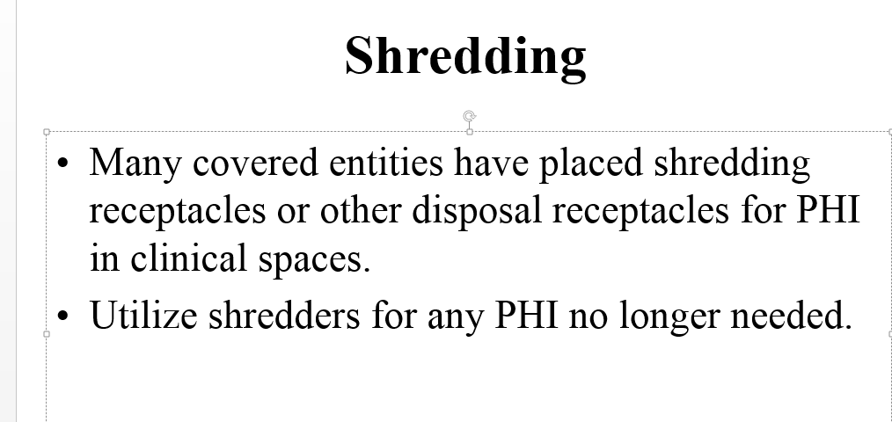

Slide 41
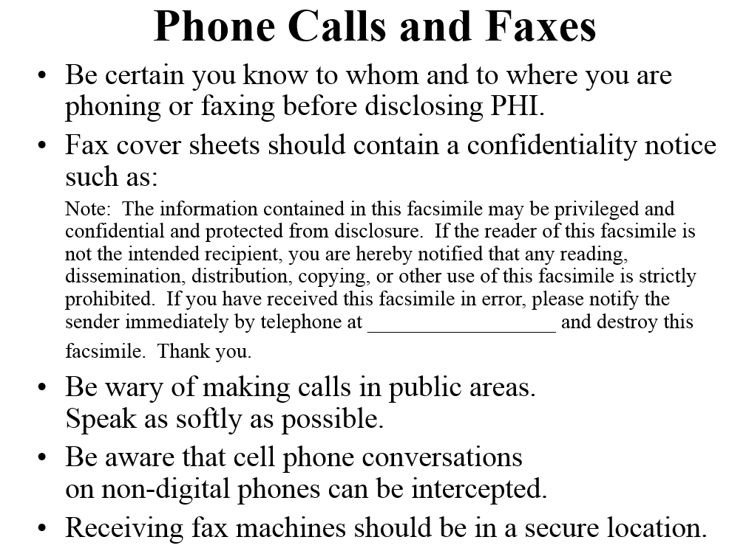

Slide 42
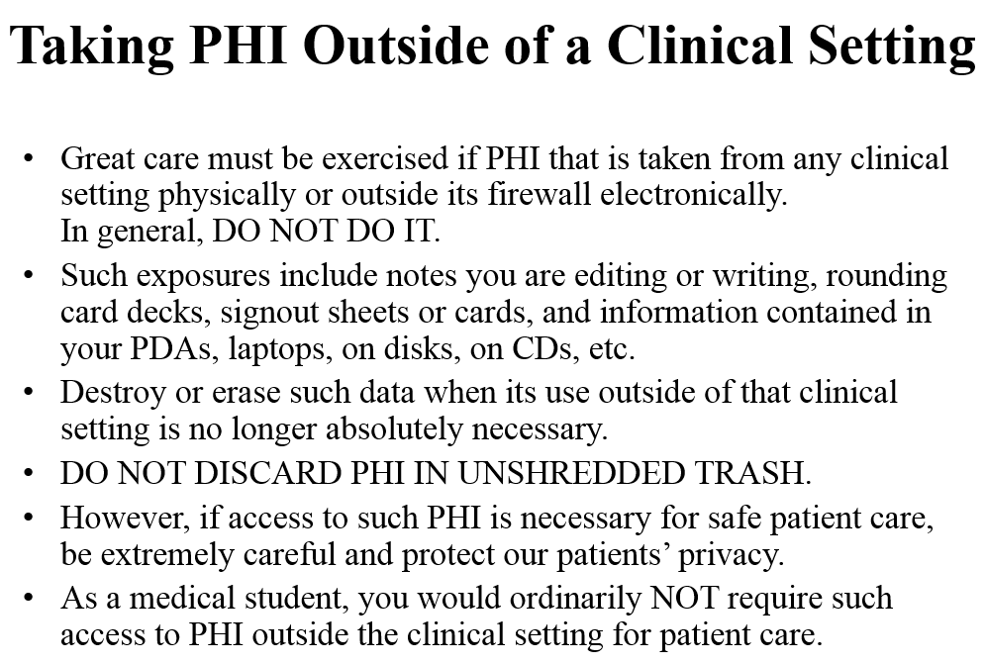

Slide 43
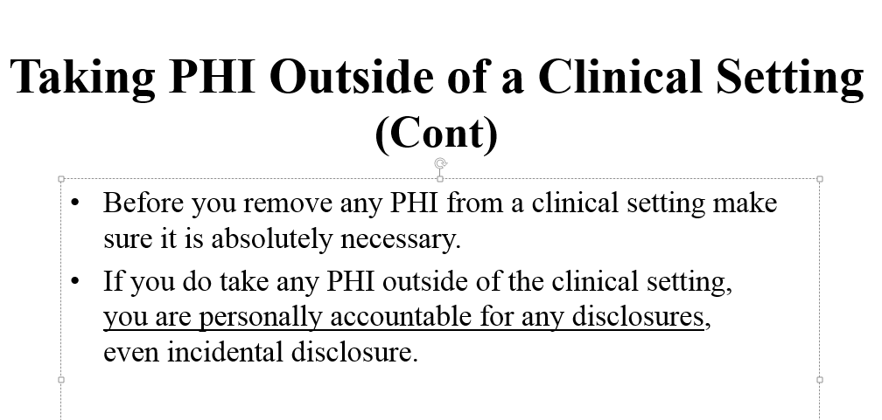


Slide 44
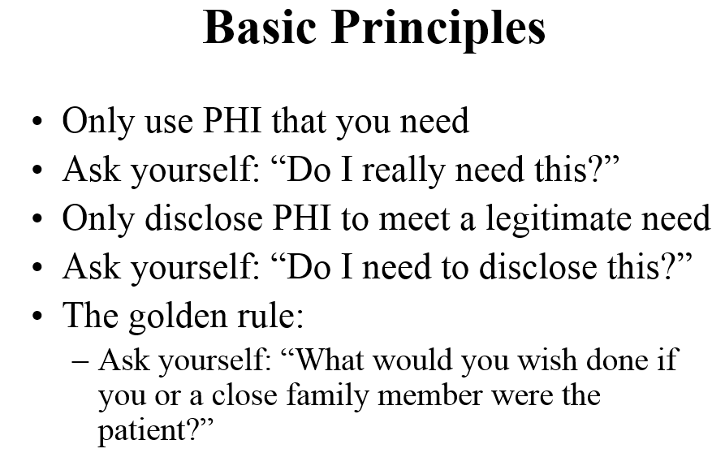

Slide 45
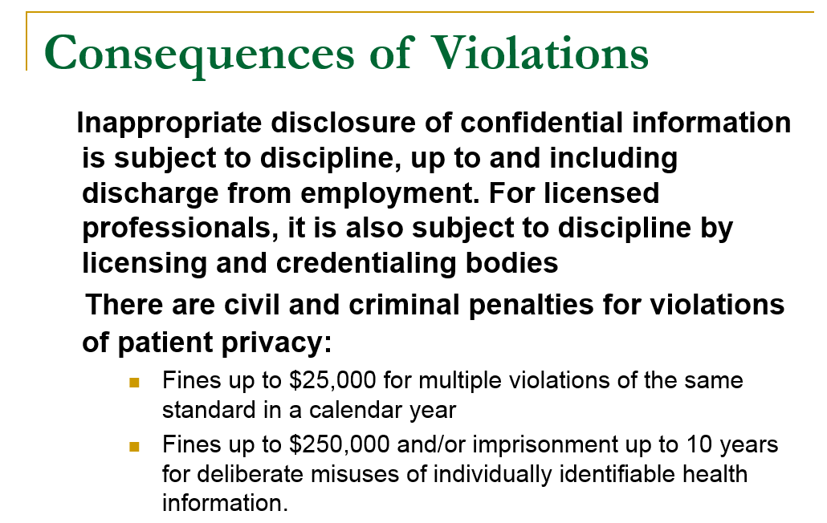

Slide 46
HIPAA REVIEW---- specific instructions
The following represents a review in different words of the same material already presented as you will be expected to understand this information and be a resource to the other staff.
However, each clinic organization will have specific rules and guidelines in addition the these general rules regarding patient confidentiality that are site-specific HIPAA policies.
Please ask questions to clarify any information regarding the following any HIPAA related question. Even though you are viewed as a leader with your organization – you will be a new leader initially --- just find out who the most reliable resource is at your orientation and utilize them appropriately.

Slide 47
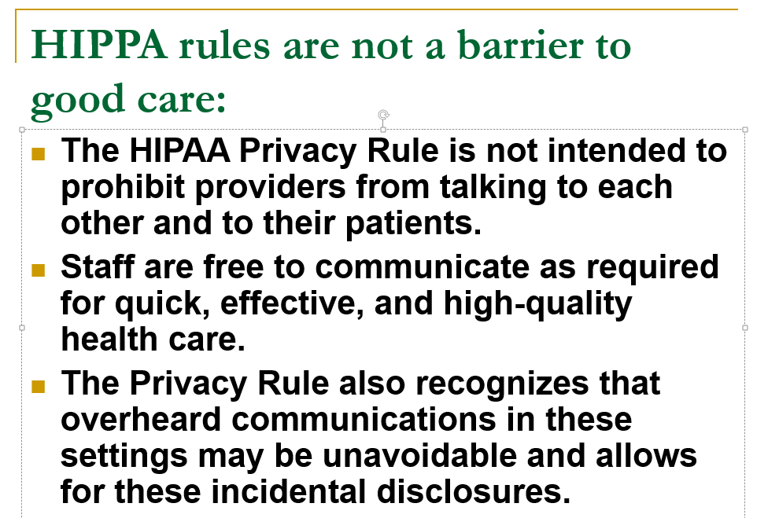

Slide 48
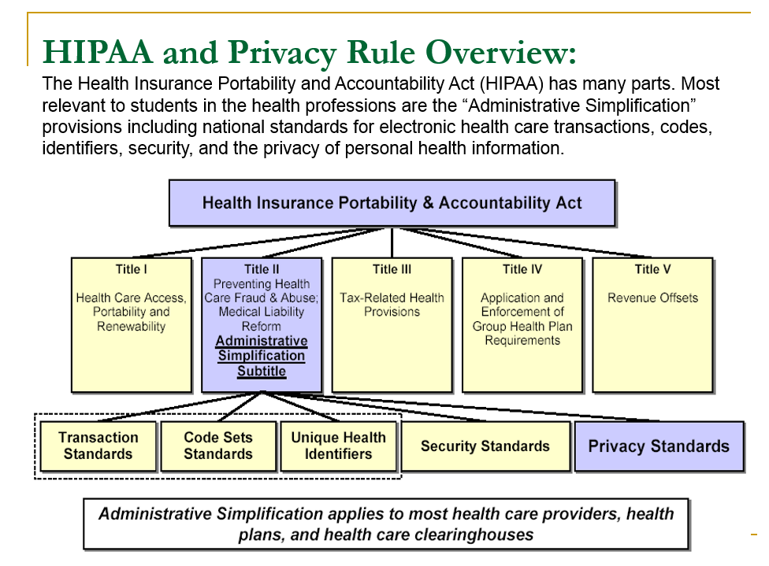

Slide 49
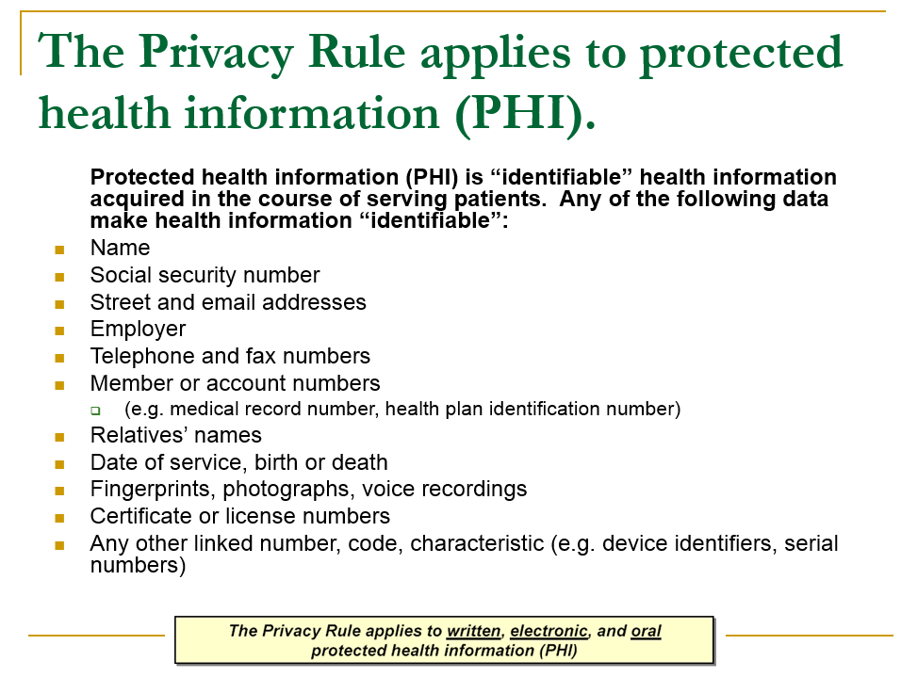

Slide 50
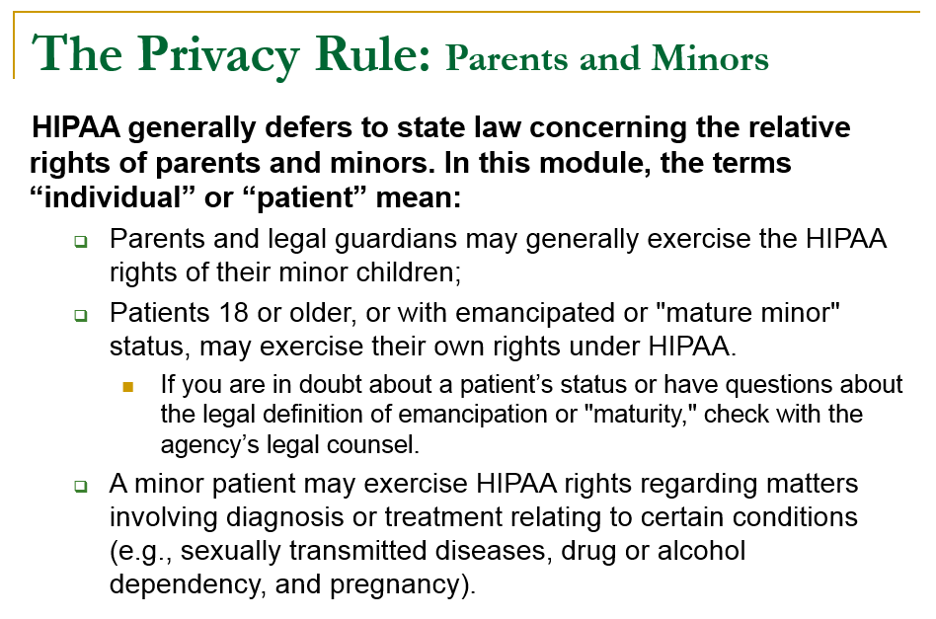

Slide 51
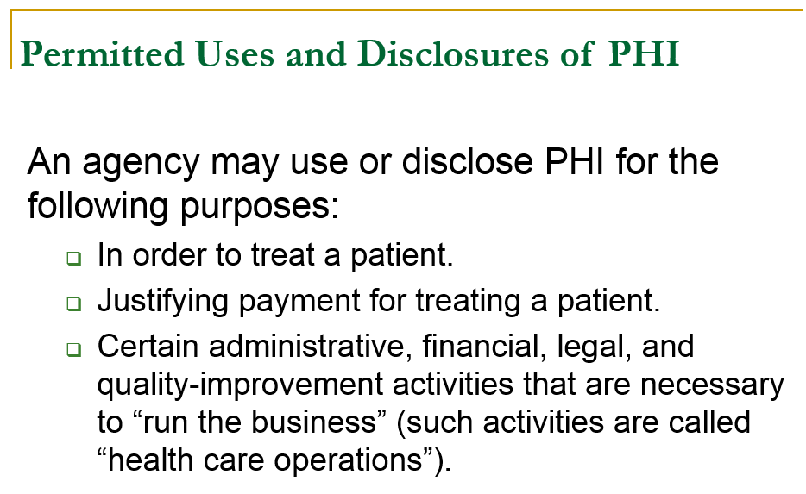

Slide 52
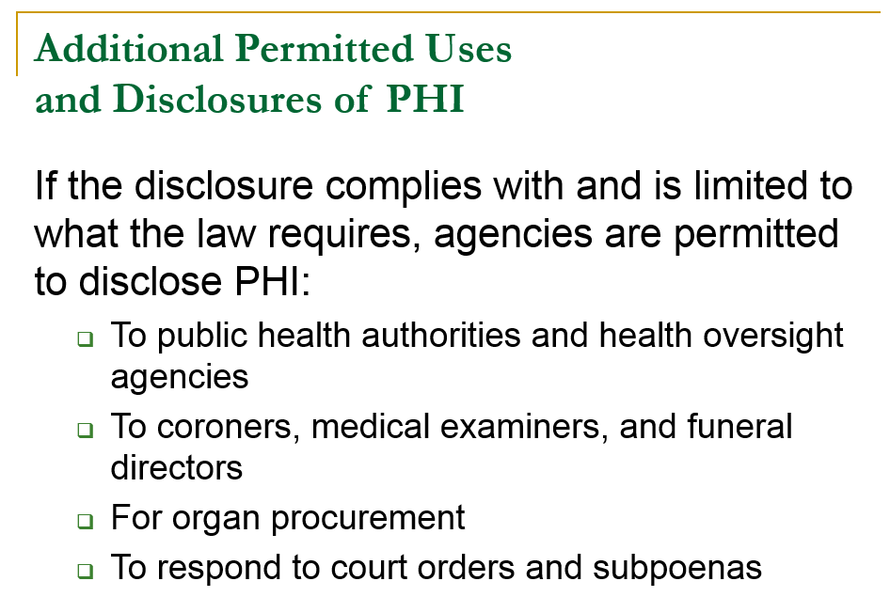

Slide 53
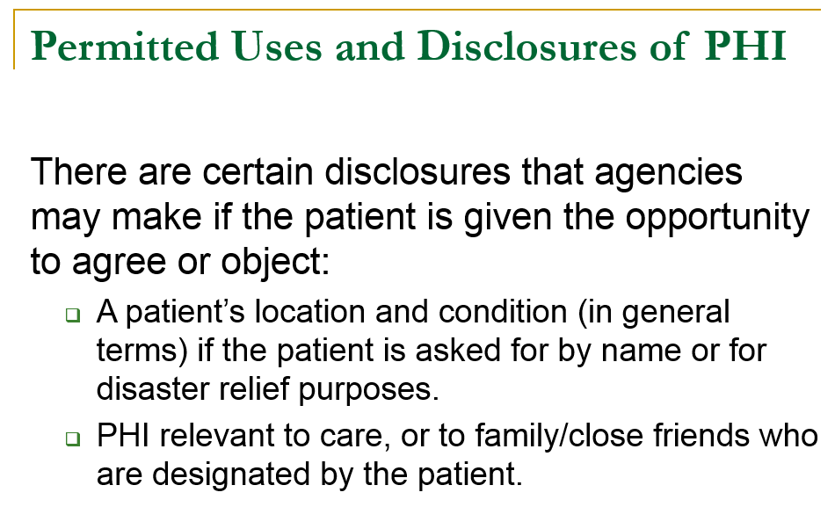

Slide 54
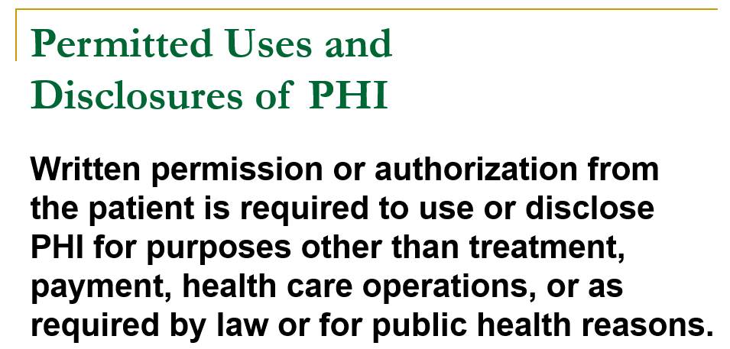

Slide 55
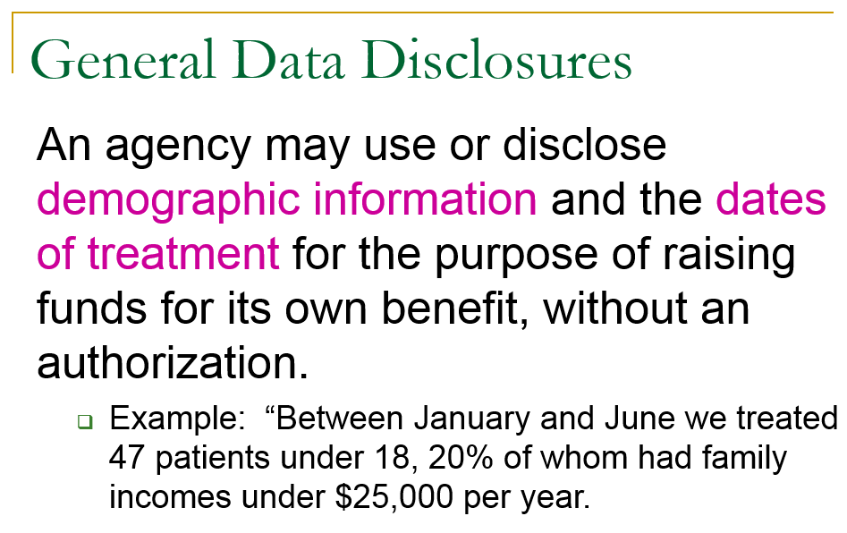

Slide 56
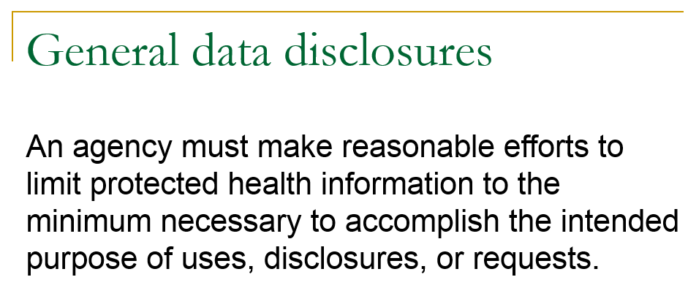

Slide 57
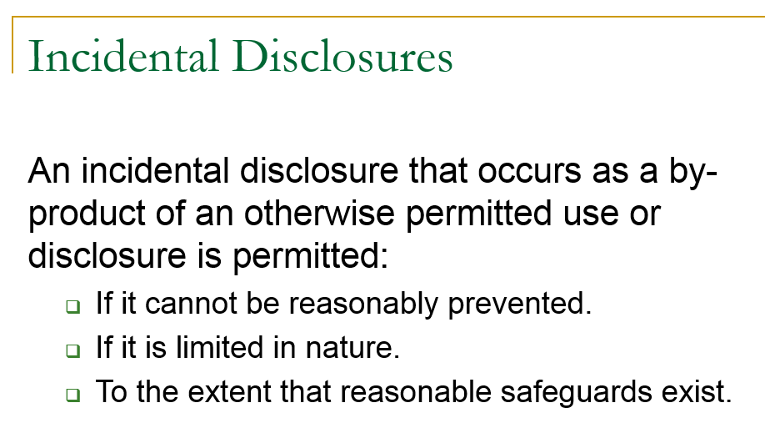

Slide 58
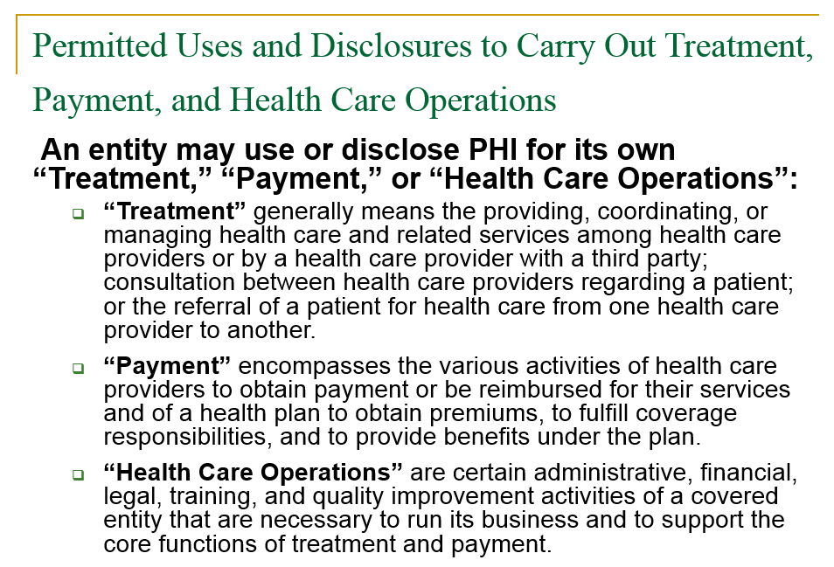

Slide 59


Slide 60


Slide 61


Slide 62


Slide 63


Slide 64


Slide 65


Slide 66


Slide 67


Slide 68


Slide 69


Slide 70


Slide 71


Slide 72


Slide 73
TRUE OR FALSE
One provider cannot send medical records of a patient to another provider without that patient's consent.

Slide 74
FALSE - No consent is necessary for one provider to transfer a patient's medical records to another provider's office for treatment purposes. The Privacy Regulation specifically states that a provider “is permitted to use or disclose protected health information” for “treatment, payment, or health care operations,” without patient consent.

Slide 75
TRUE OR FALSE
A provider is prohibited from sharing information with the patient’s family without the patient’s express consent.

Slide 76
FALSE - Under the Privacy Rule, a provider may “disclose to a family member, other relative, or a close personal friend of the individual, or any other person identified by the individual,” the medical information directly relevant to such person's involvement with the patient's care or payment related to the patient's care. If the patient is present, the provider may disclose medical information to such people if the patient does not object.

Slide 77
TRUE OR FALSE
A provider is prohibited from sharing information with the patient’s family without the patient’s express consent.

Slide 78
FALSE - Under the Privacy Rule, a provider may “disclose to a family member, other relative, or a close personal friend of the individual, or any other person identified by the individual,” the medical information directly relevant to such person's involvement with the patient's care or payment related to the patient's care. If the patient is present, the provider may disclose medical information to such people if the patient does not object.

Slide 79
TRUE OR FALSE
A patient's family member can no longer pick up supplies from an HME (HOME MEDICAL EQUIPMENT)provider or prescriptions from a pharmacy for the patient.

Slide 80
FALSE - Under the Regulation, a family member or other individual may act on the patient's behalf “to pick up filled prescriptions, medical supplies, X-rays, or other similar forms of protected health information.” The Regulation permits the provider to reasonably infer that doing so is in the patient's best interest and in accordance with professional judgment and common practice.

Slide 81
TRUE OR FALSE
Patients will sue health care providers for not complying with the HIPAA Privacy Regulation.

Slide 82
FALSE - Even if a person is the victim of an egregious violation of the HIPAA Privacy Regulation, the law does not give people the right to sue. An individual's only federal recourse is to file a written complaint with the Office of Civil Rights, and it is then within the Secretary's discretion to investigate the complaint.
And, According to the final rule, HHS “intends to seek and promote voluntary compliance” and “will seek to resolve matters by informal means.” Therefore enforcement “will be primarily complaint driven,” and civil penalties will only be imposed if the violation was willful, with the standard being even higher for imposing criminal penalties, so there is not a likelihood of strict enforcement or severe penalties.

Slide 83
TRUE OR FALSE
Patients' medical records can no longer be used for marketing.

Slide 84
FALSE - Use or disclosure of medical information continues to be permitted for health related marketing. The 2000 version of the Privacy Rule required that patients be notified if the health care provider was paid to communicate about a health related product, be given the opportunity to opt out of future communications, and be informed of the identity of the source of the communication. The Bush Administration eliminated all of these requirements from the Regulation.

Slide 85
Marketing, continued
Currently, the only disclosure of medical information for marketing that requires prior authorization by the patient under the Privacy Rule is that in which the provider paid to recommend a product or service that is not related to health.
The Privacy Regulation prohibits “marketing,” however marketing is narrowly defined so that any communication about health related products or treatment is permitted even if the health care provider is paid to encourage the patient to use the product or service.

Slide 86




Slide 87


Slide 88
“The provision, coordination, or management of health care and related services by one or more health care providers, including the coordination or management of health care by a health care provider with a third party; consultation between health care providers relating to a patient; or the referral of a patient for health care from one health care provider to another."
DIRECT TREATMENT AND
COORDINATION OF CARE

Slide 89
For health plans, to obtain premiums or to provide reimbursement to providers of health care services
For health care providers, to obtain reimbursement for such services.
Includes billing, claims management, collection activities, review of health care services with respect to medical necessity, coverage under a health plan, appropriateness of care, or justification of charges; utilization review activities, including precertification and reauthorization of services, concurrent and retrospective review of services; and disclosure to consumer reporting agencies of any of the following protected health information relating to collection of premiums or reimbursement: name and address, date of birth, social security number, payment history, account number(s), and name(s) and address(s) of health care provider(s) and/or health plan(s).
PAYMENT

Slide 90

HIPAA bundles a large number of functions into the term “Health Care Operations." This expansive list is important for many reasons, most notably because HIPAA requires no permission from patients. HIPAA bundles a large number of functions into the term "health care operations." This expansive list is important for many reasons, most notably because HIPAA requires no permission from patients for uses or uses contacting of health care providers or patients with information about treatment alternatives.
Case Management and Care Coordination
Conducting quality assessment and improvement activities, including outcomes evaluation and development of clinical guidelines or protocols (but NOT general research).
Activities relating to improving public health or reducing health care costs.

Slide 91

Reviewing the competence or qualifications of health care professionals.
Evaluating practitioner and provider performance.
Evaluating health plan performance.
Conducting training programs for students, trainees, or practitioners (health or non-health).
Accreditation, certification, licensing, or credentialing activities.

Slide 92


Conducting or arranging for medical review, legal services, auditing functions or other compliance programs.
Business planning and development, cost-management and planning-related analyses.
Development or improvement of methods of payment or coverage policies.
Business management and general administrative activities of the entity.
Business activities relating to compliance with HIPAA.

Slide 93

It sure does! So, you see that in most cases in dealing with your patients you do NOT need to worry about obtaining any consent.
But…… Information uses and disclosures not falling within the TPO trio, and not otherwise exempted by other parts of the privacy regulations, require a supplemental authorization.

Slide 94

For some "extra" activities, the patient must provide an authorization. There are four areas where authorizations are likely to come into use.
The first is for psychotherapy or drug addiction treatment!
The second important area is research. HIPAA defines research as any "systematic investigation, including research development, testing, and evaluation, designed to develop or contribute to generalizable knowledge."

Slide 95

The third major area for authorizations is a marketing activity that fails to meet certain criteria for exception.
Under HIPAA regulations, marketing is defined as "making a communication about a product or service that encourages the recipients of the communication to purchase or use the product or service."
The fourth area is in general requests for, and release of, protected health information, such as information required as part of an insurance coverage application.
For physicians this area is the most likely in which you will need to obtain the authorization.

Slide 96
The final Privacy Rule eliminates the requirements to have separate and different authorization forms. A single authorization form is to be used for all authorization purposes.
The single model form will be available at your clinic site.

Slide 97

Must be presented at “time of first service” (usually for treatment)
This does NOT mean providers have to mail the NPP to their entire patient data base (more discussion will follow…)
Model Forms are readily available for specific HME, Home Care & Hospice applications!

Slide 98

NPP- NOTICE OF PRIVACY PRACTICES
Use dual “layered” Notices (post a shorter version that briefly summarizes the individual's rights, as well as other information)
“Revised” Notices must be redistributed to patients (Web site posting is OK!)
Direct treatment providers must still hand out the full notice-with or without a summary-and obtain an acknowledgement of receipt in writing or make a good faith effort to obtain one.

Slide 99

NPP – NOTICE OF PRIVACY PRACTICES
HIPAA does NOT specify a format nor content to the Acknowledgement of the NPP, except that the document is "a written acknowledgement of receipt" or "documentation of good faith efforts to obtain such written acknowledgment".

Slide 100
If the good faith effort fails to obtain an acknowledgment (e.g., the patient refuses to sign), the reason(s) why should also be documented in writing.
A health care provider whose first treatment encounter with a patient is over the phone satisfies the requirements by mailing the notice to the individual no later than the day of that service delivery.
Providers may include a tear-off sheet or other document with the notice that requests the acknowledgment be mailed back to the provider.
In some cases, “electronic” (e.g. email) delivery is OK.
Questions about the NPP?

Slide 101

(Remember…. optional)
Providers may obtain patient consent prior to use or disclose PHI for treatment, payment or healthcare operations

Slide 102

DHHS provides model business associate contract provisions designed to make it easier and less costly for providers to implement the requirements.
Who needs them? Individuals and entities that receive PHI to perform or assist the performance of a function or activity on behalf of a CE.
Let’s start with the “formal definition”:
"A person who on behalf of a covered entity (or of an organized health care arrangement in which the covered entity participates) performs or assists in the performance of:
….a function of activity involving the use of disclosure of individuality identifiable health information, including
Claims processing or administration, data analysis, processing or administration, utilization review, quality assurance, billing, benefit management, practice management and repricing; or

Slide 103

A person who provides legal, actuarial, accounting, consulting, data aggregation, management, administrative, accreditation or financial services to or for such CE (or to or for an organized health care arrangement in which the CE participates) where the provision of service includes the disclosure of individuality identifiable health information from such CE (or arrangement) or from another business associate of such CE (or arrangement) to the person."

Slide 104

Are they performing a service or activity on our behalf?
Does the service or activity involve the use or disclosure of protected health information for purposes other than treatment?

Slide 105

Accountants, lawyers, practice management services, billing and coding services, paper shredding services, health records storage services, telephone answering services, copying services, bookkeeping services, marketing services, outside financial companies, professional liability carriers, clearinghouses, computer hardware vendors, software vendors, computer support companies, web designers and hosting services, electronic attachment services, collection companies, etc.

Slide 106

A business associate agreement should be used only when you intend the other party to have access to patient-identifiable information in order to perform some service for you. This is not what generally occurs when a homecare provider is purchasing inventory or otherwise buying items or accepting samples from a vendor.

Slide 107

Another health care provider for treatment of an individual
A health plan that is a public benefits program, e.g., Medicare, and an agency other than the agency administering the health plan, such as the Social Security Administration
With persons or services, e.g., janitorial service or electrician, whose functions or services do not involve the use or disclosure of PHI and where any access to PHI would be incidental, if at all.

Slide 108


Slide 109

Do providers need a business associate agreement with manufacturers/vendors for treatment consultations?
No.
The Privacy Rule specifically states that such agreements are not required for disclosures by a Covered Entity to another entity involved in treating a specific patient, and HHS has determined that a manufacturer’s services in supporting appropriate use of its product for a patient are part of the patient’s treatment.

Slide 110



Slide 111
Business Associate Contracts should be avoided if possible
Many reasons….Remember it is a CONTRACT!
Some situational examples:
Although a HIPAA BA Contract does not require you to monitor the BA, it would require action if you become aware of a breach on the BA's part.
Amongst other action, you would have to cancel the primary contract if the BA failed to cure the breach. The BA could fail to cure the breach if they disagree that there is a breach. Do you really need these kind of headaches?
If the other entities are covered entities, let the Office of Civil Rights deal directly with them in any dispute over ambiguity in compliance.

Slide 112

Many providers don’t realize there is much more to the Privacy Rule than the NPP and Business Associate regulations. You should be aware of (at least) these issues. Let’s review some of them!
Right to request restrictions on certain uses and disclosures
Right to receive confidential communications of PHI
Right to review and copy PHI
Right to amend and correct PHI
Right to receive an accounting of how PHI has been used or disclosed
Right to receive written notice of how PHI will be used and disclosed

Slide 113

The regulations require that you “provide training to members of the work force”
In many cases, the training can be simply having your staff read the appropriate sections of your compliance materials, and sign that they understand your policies and procedures (!)

Slide 114



Slide 115

Patient Medical Record: We have a patient's medical record that contains older portions of a medical record that were created by another/previous provider (such as a physician). Will the HIPAA Privacy Rule permit us to disclose a complete medical record even though portions of the record were created by other providers?
Yes, the Privacy Rule permits a provider who to disclose a complete medical record including portions that were created by another provider, assuming that the disclosure is for a purpose permitted by the Privacy Rule, such as treatment.

Slide 116

Would an authorization be necessary for a patient to take records, for treatment reasons, to another provider? And/or, can a family member pick-up records for the patient for the same reason?
Authorization is not be required under HIPAA but it is a good idea.
Consider obtaining an authorization from the patient even if your state law does not require it. It is your proof that you allowed access to those records and your proof that you verified the identity of the person making the request for copies of the record. You could document all that information, which is time consuming, or you could have the patient complete an authorization and use that for your documentation.

Slide 117

If my patient suggests that I am not complying with the Use and Disclosure regulations, and/or that his privacy rights have been violated, where would he submit a complaint?
The Office of Civil Rights. A person who believes a Covered Entity is not complying with a requirement of the Privacy Rule may file with the Office for Civil Rights a written complaint, either on paper or electronically. This complaint must be filed within 180 days of when the complainant knew or should have known that the act had occurred.

Slide 118

If patients request copies of their medical records as permitted by the Privacy Rule, are they required to pay for the copies?
The Privacy Rule permits you to charge reasonable, cost-based fees. The fee may include only the cost of copying (including supplies and labor) and postage, if the patient requests that the copy be mailed. If the patient has agreed to receive a summary or explanation of his or her PHI, the you may also charge a fee for preparation of the summary or explanation. The fee may not include costs associated with searching for and retrieving the requested information.

Slide 119

or Specialist

Slide 120
Yes.
Providers can disclose PHI to another health care provider for treatment purposes. This can be done by fax or by other means. You must have in place reasonable and appropriate administrative, technical, and physical safeguards to protect the privacy of PHI that is disclosed using a fax machine.
Examples of measures that could be reasonable and appropriate in such a situation include the sender confirming that the fax number to be used is in fact the correct one for the other provider’s office, and placing the fax machine in a secure location to prevent unauthorized access to the information

Slide 121

The section concerning "Amendment of Health Information" gives no examples of what types of information a patient may want to amend in his/her PHI.
What is this all about?
I can see someone needing to change insurance information or similar items, but surely the actual medical condition or circumstances of the event cannot be changed!

Slide 122

The government's intent with the Amendment rule is to make sure the record is complete and accurate. The Amendment rule limits those items to be amended to those in the designated record set, which is determined by the provider, usually the medical and billing record.
It is not, however, meant for any correction to be made as medical records are legal documents. It is also not meant to be an administrative burden on the provider. So by checking and making sure records are complete and accurate, a provider can minimize the amount of "amending" needed to be done.
The provider is also not responsible for records not originating within his office. The patient should be directed to the source of the record for those amendments.

Slide 123

I read that “incidental” use and disclosure is OK. I presume that means things like if I’m overheard discussing patient treatment with another therapist. What’s the actual definition?
Customary communications and practices play an important and essential role in ensuring that patients receive prompt and effective health care. Due to the nature of the communications and the various environments, the potential exists for a patient’s PHI to be disclosed incidentally. HIPAA does not intend to impede these communications and practices and does not require that all risk of incidental use or disclosure be eliminated to satisfy the standards.
Incidental uses and disclosures are permitted if they occur as a by-product of another permissible use or disclosure, as long as the CE has applied reasonable safeguards and implemented the minimum necessary standard.

Slide 124

Establish and document policies and procedures relating to information security
Establish physical safeguards of computer systems, equipment and buildings
Technical security to protect the confidentiality and integrity of information and control and monitor access
Safeguard systems against external threats

Slide 125


Slide 126


Slide 127


Slide 128


Slide 129


Slide 130


Slide 131


Slide 132



Slide 133



Slide 134


Slide 135


Slide 136


Slide 137


Slide 138


Slide 139


Slide 140


Slide 141


Slide 142


Slide 143


Slide 144


Slide 145


Slide 146


Slide 147


Slide 148


Slide 149


Slide 150


Slide 151



Slide 152


Slide 153
TRUE OR FALSE
Patient perspective: The privacy rule will create a government database with all of my personal health information (including data from my health care providers).

Slide 154
Patient: The privacy rule will create a government database with all of my personal health information (including data from my health care providers).
False! The rule does not require a provider or any other Covered Entity to send medical information to the government for a government database or similar operation.

Slide 155


Slide 156


Slide 157


Slide 158


Slide 159


Slide 160


Slide 161


Slide 162


Slide 163


Slide 164


Slide 165


Slide 166


Slide 167


Slide 168


Slide 169


Slide 170


Slide 171


Slide 172


Slide 173


Slide 174


Slide 175


Slide 176


Slide 177


Slide 178


Slide 179


Slide 180


Slide 181


Slide 182


Slide 183


Slide 184


Slide 185


Slide 186


Slide 187


Slide 188


Slide 189


Slide 190


Slide 191

Community Health Center Physician

Slide 192


Slide 193


Slide 194


Slide 195


Slide 196


Slide 197


Slide 198


Slide 199


Slide 200
YES

Slide 201


Slide 202


Slide 203
TRUE OR FALSE
All Providers: The privacy rule allows health care therapists, physicians and other health care practitioners to review a patient’s entire medical record if they think they need it to do their jobs.

Slide 204
TRUE OR FALSE
True! The Privacy Rule does not prohibit use or disclosure of, or requests for an entire medical record. The Covered Entity must document in its policies and procedures that the entire medical record is the amount reasonably necessary for certain identified purposes.

Slide 205
TRUE OR FALSE
Billing Service, Clearinghouse or Payer: How are we supposed to do business under this Rule? It would prohibit providers from faxing information to us, or to each other, or to their patients.

Slide 206
TRUE OR FALSE
False! The Rule does not prohibit faxing of individually identifiable health information. Covered entities must have in place appropriate administrative, technical, and physical safeguards to protect the privacy of PHI.

Slide 207
TRUE OR FALSE
Patient: When my family member comes to pick me up from my health care facility, they will still be able to explain my condition and tell him what to expect when I return home. Right?

Slide 208
TRUE OR FALSE
True! The Rule permits providers to discuss a patient’s condition with family or friends involved in the person’s care, unless the patient objects.

Slide 209


FTC stands for Federal Trade Commission

Slide 210



HIPPA Training:
Goal is Privacy Protection for Patients

Slide 211
Principles of Patients rights’ and Responsibilities
PATIENT RIGHTS
1. All patients have the right to informed consent in treatment decisions, timely access to specialty care, and confidentiality protections.
2. All patients have the right to concise and easily understood information about their coverage.
3. All patients have the right to know how coverage payment decisions are made and how they can be fairly and openly appealed.
4. All patients have the right to complete and easily understood information about the costs of their coverage and care.
5. All patients have the right to a reasonable choice of providers and useful information about provider options.
6. All patients have the right to know what provider incentive or restrictions might influence practice patterns.
Developed and approved by the National Health Council Board of Directors, January 1995

Slide 212
Principles of Patients rights’ and Responsibilities
PATIENT RESPONSIBILITIES
1. Pursue healthy lifestyles.
2. Become knowledgeable about their health plans.
3. Actively participate in decisions about their health care.
4. Cooperate on mutually accepted courses of treatment.
Developed and approved by the National Health Council Board of Directors, January 1995

Slide 213


Slide 214


Slide 215


Slide 216



Slide 217
Health coverage rights and protections
The following information regarding Medicare information is not intended to be memorized, but to give you a flavor of the different issues affecting patients with a concentration on health coverage rights and protections. These issues and rules can vary but the themes are very common. Patients on occasion will turn to you for advise and you will need to work with your staff to determine the best resource for the patient’s special question or circumstance.

Slide 218



HEALTH Care COVERAGE RIGHTS
AND PROTECTIONS PATIENT PERSPECTIVE

Slide 219


Slide 220


DIGNITY
RESPECT
PROTECTIONS FROM DISCRIMINATION

Slide 221


Slide 222


Slide 224


Slide 225


Slide 226


Slide 227


Slide 228


Slide 229


Slide 230

DON’T WORRY ABOUT THE FINE PRINT

Slide 231

CIRCUMSTANCES WHERE MEDICAL CARE MAYNOT BE COVERED OR PAID BY MEDICARE

Slide 232


Slide 233


Slide 234



Slide 235


Slide 236

DON’T WORRY ABOUT THE FINE PRINT

Slide 237

QUESTION TO FOLLOW

Slide 238


Slide 239


Slide 240


Slide 241


Slide 242


Slide 243


Slide 244


Slide 245

DON’T WORRY ABOUT THE FINE PRINT

Slide 246
DON’T WORRY ABOUT THE FINE PRINT

Slide 247


Slide 248


Slide 249

QUESTION TO FOLLOW

Slide 250
1. To lower the plan’s cost Medicare Prescription Drug Plans may decide to cover or exclude coverage on its formulary for all antidepressants.
True
False

Slide 251
1. To lower the plan’s cost Medicare Prescription Drug Plans may decide to cover or exclude coverage on its formulary for all antidepressants.
True
False

Slide 252


Slide 253


Slide 254


Slide 255


Slide 256


Slide 257


Slide 258


Slide 259

QUESTION TO FOLLOW

Slide 260
2. When admitted to the hospital in an “inpatient” status, all people with Medicare must receive the “Important Medicare About Your Rights” notice.
True
False

Slide 261
2. When admitted to the hospital in an “inpatient” status, all people with Medicare must receive the “Important Medicare About Your Rights” notice.
True
False

Slide 262


Slide 263


Slide 264


Slide 265


Slide 266


Slide 267


Slide 268

QUESTION TO FOLLOW

Slide 269
3. Medicare must disclose your medical information to all except
You the patient
To a healthy quality survey company
Someone with the legal right to act for you
The Secretary of U.S. Department of Health and Human Services

Slide 270
3. Medicare must disclose your medical information to all except
You the patient
To a healthy quality survey company
Someone with the legal right to act for you
The Secretary of U.S. Department of Health and Human Services

Slide 271


Slide 272


Slide 273

QUESTION TO FOLLOW

Slide 274
4. The Medicare Beneficiary Ombudsman reports to contracted Medicare health plans to help them design better benefit packages.
True
False

Slide 275
4. The Medicare Beneficiary Ombudsman reports to contracted Medicare health plans to help them design better benefit packages.
True
False

Slide 276


Slide 277


Slide 278

HEALTH CARE COVERAGE RIGHTS AND PROTECTIONS --- PATIENT PERSPECTIVE --- MEDICARE ADVANTAGE PLAN (This is just one example)

Slide 279


Slide 280


Slide 281


Slide 282


Slide 283


Slide 284


Slide 285


Slide 286


Slide 287


Slide 288


Slide 289


Slide 290


Slide 291


Slide 292


Slide 293


Slide 294


Slide 295


Slide 297


Slide 298


Slide 299


Slide 300

QUESTIONS TO FOLLOW

Slide 301
5. Medicare Advantage (MA) Plans are sometimes called
Part A
Part B
Part C
Part D

Slide 302
5. Medicare Advantage (MA) Plans are sometimes called
Part A
Part B
Part C
Part D

Slide 303


Slide 304


Slide 305


Slide 306


Slide 307

QUESTION TO FOLLOW

Slide 308


Slide 309


Slide 310


Slide 311


Slide 312

DON’T WORRY ABOUT THE FINEPRINT

Slide 313


Slide 314


Slide 315


Slide 316


Slide 317


Slide 318


Slide 319


Slide 320


Slide 321


Slide 322


Slide 323


Slide 324


Slide 325


Slide 326


Slide 327


Slide 328


Slide 329


Slide 330


Slide 331


Slide 332


Slide 333

THIS PROCESS WILL BE ENLARGED INSUBSEQUENT SLIDES

Slide 334


Slide 335


Slide 336


Slide 337


